Slide 1


Slide 2

Making SOAR Work for Your Community:
Collaboration is Key!
Christine Laguna, Practice Manager
Lauren Dreyer, Program Manager
Suzie Brady, SOAR Team Lead
Healthy Community Collaborative Program
Austin, Texas

Slide 3
What do YOU need from this session?
Where do you work?
Are you familiar with the SOAR process?
Do you use the SOAR process or do you have people in your agency that do?
What questions do you want answered?
Notes:
SUZIE introductions, acknowledge that we are the last session of the day and you may already be familiar with SOAR… Ask who is in the room – ask if they do SOAR themselves or are familiar and have people completing SOAR apps for agencies, ask what things they would like for us to address at the outset

Slide 4
Learning Objectives:
Recognize effective utilization of a dedicated SOAR Specialist within a larger team serving individuals experiencing homelessness
Understand the basic tenets of the SOAR model and how a larger team improves the quality of the application
Learn how to establish a supportive and collaborative SOAR community in your local area
Notes:
SUZIE

Slide 5
Who Is Integral Care?
1967: 50 years of proud service in Travis County
Established as local authority for mental health, substance use and intellectual and developmental disabilities as designated by state law
1 of 39 Community Mental Health Centers in Texas
Governed by a Board of Trustees appointed by Central Health, City of Austin and Travis County
Notes:
CHRIS

Slide 6
Overview
Integral Care helps provide a strong foundation for well-being.
24,581
30+
528,527
40+
Travis County
residents served
last year
Programs and services offered
Services provided
last year
Locations with
direct services and
mobile teams

Slide 7
Why Our Work Is Important
Mental illness, substance use disorder and intellectual and developmental disabilities don’t discriminate. They affect people of all walks of life.
Individuals, families, neighbors, community
Cost
  Co-occurrence with mental illness and chronic disease
  High rates of injury
  Services/systems
Suicide and early death from disease
  On average, people with mental illness die 25 years earlier from
  unaddressed risk factors and chronic disease such as smoking,
  obesity, inactivity, diet, diabetes and high cholesterol
Notes:
CHRIS Cost
SMI $200 billion in lost earnings nationally per year
Mood disorders such as depression or 3rd most common cause for hospitalization for 18-44
Suicide is 10th leading cause of death in US and the most preventable public health problem

Slide 8
What We Do
Individuals
Navigation
24 Hour Crisis Response
Integrated Behavioral
Health Care
Residential Treatment
Prevention & Wellness
Housing & Supports
System
Create a Network
Fill Gaps
Collaborative Planning
Improve and Connect Systems
Technical Assistance & Training
Community
Raise Awareness
Training
Advocacy
Jail Diversion
Substance Use Treatment

Slide 9
Our Care Approach
Person-Centered
Trauma-Informed
Culturally Competent
Integrated Care
Collaborative
Community Partnerships
Notes:
CHRIS
Person centered care – serve the person in a way that fits his/her needs
Integrated care is a model and more than primary and mental, includes sud and idd too. Started offering integrated care in 2009.
Strong community partnerships to extend care

Slide 10
Integral Care and Housing Services
For more than 30 years, Integral Care has worked to address the intersection of homelessness and behavioral health issues.
We provide permanent supportive housing to approximately 400 people, in 200 housing units that we own and another 200 secured from landlords across the community.
Using a Housing First approach, we engage people in services, place them in housing, and offer rehabilitation supports to move them from chronic homelessness to recovery and housing stability.
Notes:
CHRIS What is HCC (part of community collaborative)
Chris will also discuss background of funding/timeline for dedicated SOAR Specialist –see later slides

Slide 11
Where We Provide Services
Over the phone
On a street corner
In schools
In clinics and residential facilities
In jails
In emergency rooms
At home
We go anywhere a person needs help.
46 FACILITIES SPREAD OVER
16 CAMPUSES
Notes:
When we first started, we focused on bricks and mortar facilities.
Now, we’re everywhere. We offer community-based services and are the largest provider of community behavioral health services in Travis County.

Slide 12
What is HCC?
Collaboration between Integral Care and other community organizations
Unique opportunity to restructure the way in which services are provided to the homeless community
Focus on individuals who are homeless AND have a severe and persistent mental illness
Looked beyond the reach of Integral Care to shift the entire system of service delivery
Notes:
CHRIS - overview

Slide 13
HCC Team within Integral Care
Community based services
Mobile intake for entry into services
Intensive Case Management (on at least a weekly basis)
Permanent Supportive Housing and Rapid Rehousing
Landlord Outreach support
Counseling
Peer Support
Criminal Justice Liaison
Supported Employment
And of course…SOAR

Slide 14
Why SOAR?
SOAR is a specialized model of completing SSI/SSDI claims for individuals experiencing or at risk of homelessness that have a mental illness, medical impairment, and/or a co-occurring substance use disorder
SOAR Works! for our population
Provides assistance to individuals to help get basic needs met
  Income
  Access to health care through Medicaid
Overall ability to increase agency PSH capacity
Notes:
LAUREN (ALSO INCLUDE HISTORY OF SOAR IN TEXAS/AREA) If people have income and can pay something toward their rent, as an agency, our financial responsibility toward each voucher is decreased and we can reallocate those dollars elsewhere, thus allowing us to serve more individuals
Nationally, only about 28 percent of individuals who apply for SSI/SSDI are approved on initial application. For people who are homeless and have no one to assist them, that percentage is cut by more than one half. When applications are denied, appeals can take an average of one year to complete, and in that time applicants often give up hope. There are now 50 states implementing SOAR. These states report average approval rates of 67% in an average of 101 days on initial SSI/SSDI applications using the SOAR model.

Slide 15
SOAR Key Components
SOAR key components helps the disability determination process move more smoothly and quickly by providing assistance to SSA and DDS
  SOAR Specialist is liaison between client, DDS, and SSA
  SOAR Specialist requests and collects medical records
  SOAR Specialist writes and submits a Medical Summary Report
  SOAR Specialist maintains contact throughout with client throughout the process and assists with medical appointments, referrals, and follow-up paperwork
Notes:
LAUREN
Emphasize the need to be trained in the model
Can really stress why SOAR is a best practice – talk about how many of our clients could complete an app on their own
MSR – paints a picture and makes a connection to functioning

Slide 16
The Dedicated SOAR Specialist
A novel concept at the time (early 2015)
SOAR had not taken off in any other capacity at the agency
Feedback from other agencies was that doing SOAR as part of case management wasn’t working (it’s hard to become an expert in something you do just every once in awhile)
Investment up front in position with expectations it would pay dividends for clients (and the agency)
Helps with collaboration between DDS/SSA
Notes:
LAUREN
Can take 2-3 years to see return on investment (not everyone bills Medicaid) – it also keeps people engaged in services

Slide 17
SOAR Referral Process
Referrals completed collaboratively by case manager and client
Submitted to SOAR Specialist and included on wait list
SOAR Specialist staffs list when openings become available
SOAR Specialist coordinates intake meeting with case manager and client
SOAR goal/objectives are added into client’s Treatment Plan at that time
Notes:
LAUREN/SUZIE

Slide 18
To Assess for SOAR Eligibility:
What are we looking for?
The presence of medical and/or psychiatric conditions or symptoms which would fit an SSA listing
Current treatment, or a history of treatment for conditions
Inability to work and earn SGA ($1170/month in 2017) due to medical and/or psychiatric conditions (not because he/she cannot find work or was laid off)
Impairments in functioning due to medical and/or psychiatric conditions
Notes:
SUZIE

Slide 19
Role of SOAR Specialist within Team
Job responsibilities focus on helping clients apply for SSI/SSDI using the SOAR model
Team subject matter expert for SSI/SSDI issues or questions for all clients
Assists with case management to support the SOAR application
Coordination of medical/psychiatric appointments, consultative exams (if needed), and SSA appointments
Notes:
Talk about how you serve as the liaison to SSA/DDS to streamline questions – for clients and for staff
Support throughout the claims process, navigating the system – payee services, insurance questions, ticket to work
Talk about what case management could look like – helping get to doc appointments

Slide 20
Role of Team Members in SOAR Process
Jail Liaison
Peer Specialist
Supported Employment Specialist
Intake/Counselor
RN/APN/MD
RN
Case Managers
Notes:
Talk about how each of this positions plays a role in the process – how they help
Specific examples of how each has done something to help a claim (Maggie for CC, RN line to be able to ask questions, more notes for the medical record, peers keeping clients engaged, 3rd party function reports)

Slide 21
Case Study in Collaboration: Lynn
Lynn is a 55 year-old female that was housed at Community First! Village with Rapid Rehousing funds in April, 2017.
Lynn has a history of chronic homelessness since she first ran away from home in her early teens. She has a variety of chronic health issues that contribute to her inability to obtain and maintain employment (hepatitis C, chronic pain from fibromyalgia and bone fractures, glaucoma, gastro-esophageal reflux disease, and a history of traumatic brain injury from domestic violence). Lynn states that she was first diagnosed with major depressive disorder and post-traumatic stress disorder after her ex-boyfriend broke into her trailer and attempted to kill her in Bryan, Texas in 2007. Lynn was connected to HCC by mobile intake at the Austin Resource Center for the Homeless in October, 2015. She was then connected to a case manager, and her SOAR referral was completed in December, 2015. Her SOAR intake appointment took place approximately 6 months later. Lynn’s initial SOAR claim was filed on November 28, 2016. Her initial claim was denied and her Request for Reconsideration was filed on May 1, 2017. She received her first monthly SSI check in July, 2017. She is currently set to start paying her entire rent and utility bills as of December, 2017!
Notes:
Talk from slide – updates on current progress (counseling)

Slide 22
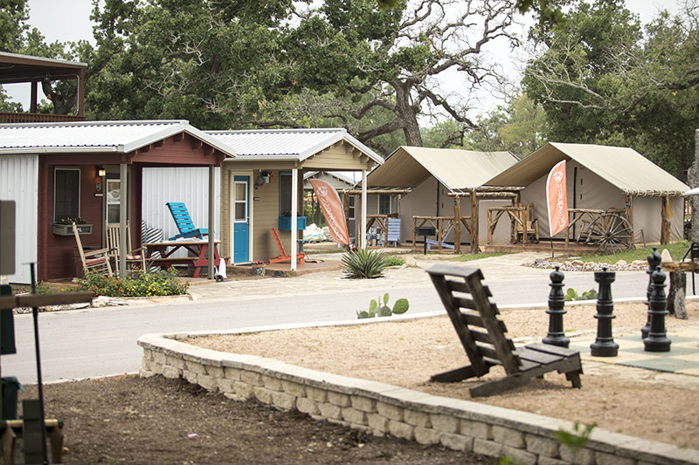
Case Study in Collaboration: Lynn
Community First! Village is where Lynn was housed with Rapid Rehousing funding. Community First! Village is an innovative community of tiny homes, RV’s and canvas-sided cottages run by the faith-based organization Mobile Loaves & Fishes. HCC has partnered with them to provide onsite mental health services and coordinate primary care in partnership with CommUnity Care.
Notes:
When HCC clients are housed at CF! Village they are transition to the HCC CF! Team

Slide 23
Case Study in Collaboration: Lynn
2 Case Managers (Community Team – CF! Village Team)
Jail Liaison
Supported Employment Specialist
Peer Specialist
RN/APN/MD
Medical clinic at Community First! Village
Community First! Village – work supervisor
Notes:
SUZIE

Slide 24
Successes
Last fiscal year (September, 2016 – August, 2017) – 20 approvals using the SOAR model
Medicaid reimbursement over $86,000
Fast Approvals! From date of submission to date of award letter:
  Several claims in a month and a half
  One claim in a week and a half!
  Average of 5 months from date of intake with SOAR Specialist to medical decision
Notes:
SUZIE

Slide 25
Growth of SOAR Agency-Wide
Demonstrated success with dedicated SOAR Specialist encouraged ACT team to follow the same model
Partnership with University of Texas School of Social Work placed two interns with Integral Care to increase SOAR capacity
Revenue recouped by the agency got attention of the business office and top administration
Successes highlighted in newsletters to keep momentum going strong
Created SOAR team within agency – new lead position and additional specialist
Notes:
JUMP OFF EACH OTHER Acknowledge that financial impact speaks volumes in our large agency and has allowed us to continue to grow
Explain more about what the new SOAR team looks like

Slide 26
SOAR Collaboration in Larger Community
Success with dedicated SOAR Specialist was catalyst for more agencies to look for funding sources
Monthly SOAR Support Meetings
More agencies interested in having staff trained
Collaboration with Ending Community Homeless Coalition (ECHO)
Implementation of SOAR referral in Coordinated Entry process
Collaboration with criminal justice systems
Collaboration with THN and State Lead for hybrid training
Notes:
SUZIE Talk about how many new agencies have had staff trained (in any capacity but how many have committed to dedicated SOAR?) – MHPD, VA
SSVF programs will have dedicated SOAR specialists in 2018
Creation of SOAR Workgroup

Slide 27
Challenges
SOAR capacity within the community
Different views on the process and fidelity to the process (within agency and across the community)
Communication with SSA/DDS
Follow through after being SOAR-trained
Notes:
EVERYONE CAN TALK
Talk about limitations of only being able to serve Integral Care clients when need in the community is so great – how to expand on this

Slide 28
Questions?
Christine.Laguna@integralcare.org
Lauren.Dreyer@integralcare.org
Suzie.Brady@integralcare.org

