Slide 1
SOARing The Way Home:
Coordinating Access to Housing and Disability Benefits
Gary Grier
Senior Project Manager
Coalition for the Homeless of Houston/Harris County
Alexis Loving
Director of Program
SEARCH Homeless Services

Slide 2

Today’s Conversation
Simultaneous System Transformation
What is Income Now?
What will it take to create a dedicated SOAR system?
How does Coordinated Access to SOAR work?
What is our community goal for SOAR?
What are the challenges and lessons learned ?

Slide 3


Building a System Response to Ending Homelessness

Slide 5
5 Elements of
Collective Impact
1. Common Agenda
2. Shared Measurement
3. Mutually Reinforcing Activities
4. Continuous Communication
5. Backbone Organization

Slide 6
Simultaneous System Transformation
Simultaneous System Transformation
RRH Expansion
PSH Pipeline
PSH Service Model
Downtown System Redesign
Coordinated Access
System Performance
HMIS
CoC Coordination
Media/PR
Change Manage-ment
System Coordination
Barrier
Buster
Fund
Income Now
Youth/ Young Adults LGBTQ and all
Notes:
Eva

Slide 7
Agreements for Effective System Planning
Remove agency hat and commit to system thinking
View solutions from a client perspective
Focus on how it should be, not how it is
Suspend current barriers, think possibilities
Agree to put outlier issues in the parking lot

Slide 8
Coordinated Access to Housing and Income
Simultaneous System Transformation
VA
Targeted Hubs
Outreach Teams
Hospital
HC Jail
Call In
Center
Housing and Income Assessment
Housing and Income Program Matching
Housing and Income Program Referral
Housing and Income Navigation

Slide 9

Building System Capacity: Next Steps
SOAR Forum May 2016 “Houston, we have a problem”
Identify existing staff resources - how can we reallocate time to work on SSI/SSDI applications?
  Highlight cost savings and incentives to organizations
  Carve out dedicated staff time and identify key staff to train – start small and work up
Create quality review mechanisms to ensure high-quality applications
Local Leads facilitate the free SOAR Online Training
Start with a strong system before scaling up
Notes:
Medicaid reimbursements for providers. Hospitals can reduce costs of high utilizers. Jails can reduce recidivism.
Income stability leads to housing stability – if our common goal is to end homelessness, everyone has a stake in making this happen
Local PATH providers
If having trouble identifying any existing resources, go back to planning stage with CoC. There are creative ways to find resources that don’t have to involve new money.
Quality review examples: Michigan, DC, etc. – implement a quality review process from the start and set expectations for providers.

Slide 10
System Components
Simultaneous System Transformation
Coordinated Access to
Housing and Income
PSH
RRH
Income Now
SOAR
Public Workforce System
Supported Employment

Slide 11
What is Income Now
Simultaneous System Transformation
SOAR
Disability
No regular income
Supported Employment
Disability
Looking to work
Workforce Solutions
No disability
Looking to work
Assistance with the SSA/VA Benefits application process
Intensive workforce development supports
Traditional workforce development supports/embedded staff with Workforce Solutions/Building capacity
Work Incentives Counseling
Medicaid/Medicare/VA

Slide 12
Income Now Workgroups
Simultaneous System Transformation
Income Now
Leadership Team
Central Houston, Inc.
Avenue 360
SOAR Workgroup
Coalition for the Homeless
HGAC/WIB/Workforce Solutions
City of Houston Mayor’s Office
Coalition for the Homeless
SEARCH Homeless Services
Career and Recovery Resources
CSH
SER Jobs for Progress
SEARCH Homeless Services –SOAR provider
Career and Recovery Resources
Ave 360-- FQHC and SOAR provider
Healthcare for the Homeless Houston
CSH
BEACON Law—SOAR provider and appeals legal provider
Social Security Administration-Dedicated Contact
Lone Star Legal Aid
AIDS Foundation Houston
Harris Center for Mental Health and IDD
Department of Disability Determinations Services (DDS)
Houston Center For Independent Living-CWIC
SOAR Works National TA
Income Now Design Team
This workgroup is called upon when system design is necessary. Depending on the design necessary, participating agencies can include; CA, income service providers, homeless service providers, social security, TWC-VRS, employers and other appropriate agencies.

Slide 13
Progress Updates - Coordinated Access
Simultaneous System Transformation
Matching
Referral
Assessment
Income assessment is built into HMIS and incorporated into the housing assessment
RRH= Workforce Solutions (Public Workforce System
PSH= Supported Employment or SOAR
Public Workforce System =to a hub Location
Supported Employment=Nothing
SOAR Started October 24, 2016
Notes:
Implementation Team Chart
Communicate communicate communicate
Allows for group trouble shooting and power leveraging

Slide 14
Progress Update - SOAR
Simultaneous System Transformation
Analysis-Gaps/Resources
Capacity Building and Design
Implementation
Report is completed
Add 3-6 Dedicated SOAR Staff
Limited service delivery as a Community
SOAR Forum and TA
We need 6-10 dedicated SOAR staff
350-700 need SOAR services
Referral process built into HMIS
Added 4 dedicated SOAR staff
HMIS assessment and referral system
Weekly transition team Meeting
Outcomes reports

Slide 16
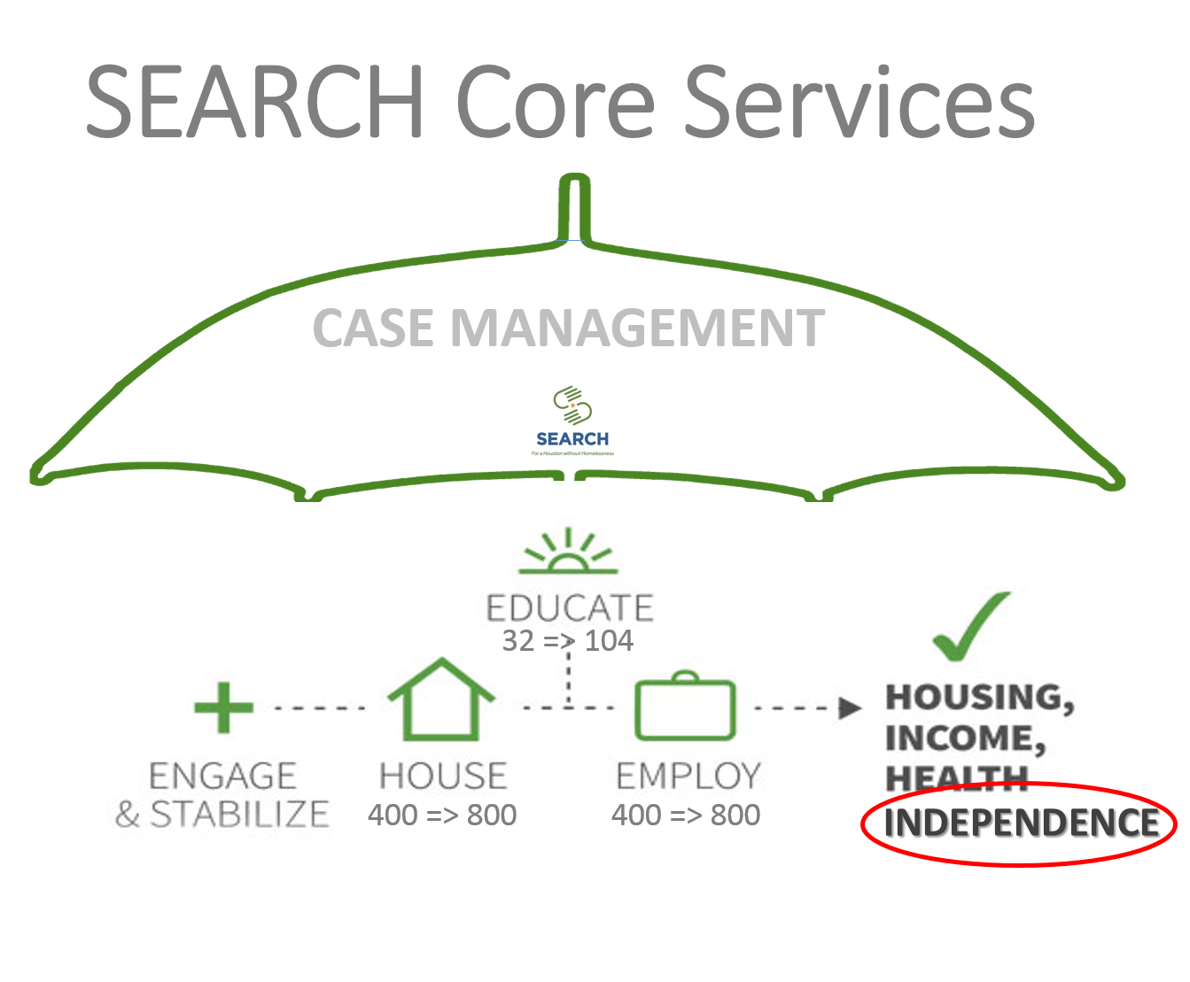


Slide 17
Front Door
Day & Night Shelters
Street Outreach
Hospitals/Jail/ Sobering Center
Coordinated Access
Assessment
Navigation
Back Door
Mainstream Competitive Employment
Rapid Rehousing
Permanent Supportive Housing
Mainstream Competitive Employment
SOAR & T2W
Customized Employment

Slide 18
System Integration
Dedicating staff to the system
Individual Identity and System Integration
Development and Funding

Slide 19
Engage & Stabilize
Associate Program Manager
Welcome Center
Intake
Engagement Specialists
Navigators
CA Navigation
Assessors
PATH
Outreach
Street Outreach (MOP)
DMD
Disability
SOAR

Slide 20
Maintaining Agency Identity and Achieving System Integration
Agency
Culture
Branding
System
Vision/
Mission
Culture
Branding
Vision/
Mission

Slide 21
Development and Funding
Agency Outcomes
Agency Mission
System Outcomes
Community Vision
THE FUNDING PITCH

Slide 22
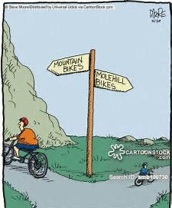

Slide 23
Challenges and Opportunities
Simultaneous System Transformation
System to Silo & Navigation Challenges
VI → ?
Taking to scale—499 referrals/wait list
Next step for assessment and referral
Use Coordinated Access
Wait times = more sifting
PSH Tool Development
Access to Vehicles & Workflows
Red, Yellow, Green Status
Agency Shift & Frustration
Homeless at Referral

Slide 24
Challenges and Opportunities
Partnership with Medical & Mental Health Providers
Consulting MD for MSRs
Treatment Records
Notes:
-Importance of the Medical Records and MSRs- weight of MD signature
-Houston’s Medical System
-HHH part of Workgroup and Transition Team
-Partnership with MD who comes to meet clients and sign off on MSR- CEO helped
-

Slide 25
Challenges and Opportunities
Different Goals & Objectives
SSA and DDS tracking
Legal Partnership for Appeals
Outcomes tracking OAT/HMIS
Building & Maintaining relationships
Need organization, not people
System for coding our app
Single contact for status update
ALJ Process
Shared Outcomes
Entire System or Dedicated only
Accidental Side Doors
Training
Be careful not to throw it in reverse
Built in services into HMIS to mark milestones

Slide 26
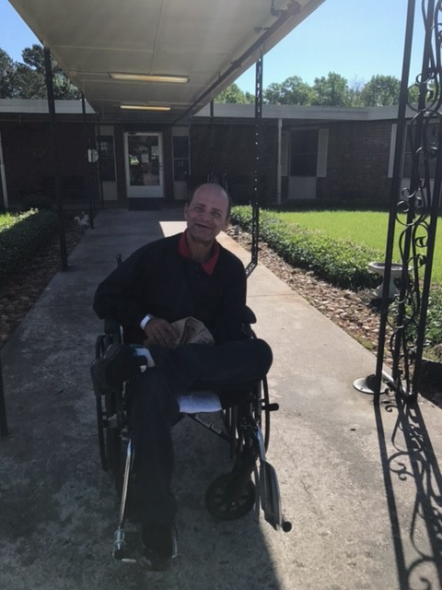
Success
SOAR Blog Success Story https://soarworks.prainc.com/sites/soarworks.prainc.com/files/2017.05eNewsletter.pdf
Chronic at risk living under a bridge
Collaboration between SEARCH, HOT, APS and SOAR system
Used Medicaid to gain housing for skilled nursing
Application approved in less than 4 weeks

Slide 27
Simultaneous System Transformation
Gary Grier
Senior Project Manager
Coalition for the Homeless
ggrier@homelesshouston.org
832-531-6006
Alexis Loving
Director of Programs
SEARCH Homeless Services
aloving@searchhomeless.org
713-276-3007
Notes:
Implementation Team Chart
Communicate communicate communicate
Allows for group trouble shooting and power leveraging

