Slide 1
A Year in the Life of an HMIS User

Slide 2
Spread the word!
Website www.thn.org
Facebook https://www.facebook.com/TexasHomelessNetwork/
Instagram https://www.instagram.com/txhomenet/
Texas Homeless Network @TXHomeNet
Conference Hashtag #EndTXHomelessness

Slide 3
HMIS REPORT TIMELINE
Point-In-Time & Housing Inventory Count
System Performance Measures
1
2
Dates: Count on January 25th HIC surveys due to THN, January 29th.
Date: HMIS report will be reviewed in May.
All data quality issues must be fixed before May.
Annual Homeless Assessment Report
Date: HMIS staff will review report and conduct data quality checks Oct-Nov.
3

Slide 4
Point-In-Time Count
Kristin Zakoor

Slide 5
What is a Point-In-Time Count (PIT)?
A count of all sheltered and unsheltered homeless people in your community on a single night.
Useful for:
Planning and program development
Measuring progress
Raising public awareness
Maintaining/improving HMIS data quality + completeness

Slide 6
Who needs to conduct a PIT Count?
ALL agencies that receive federal funding (HUD requirement)
Any organization that wants to better understand homelessness in their community

Slide 7
Why do we conduct a PIT?
Point-in-time counts are important because they establish the dimensions of the problem of homelessness and help policymakers and program administrators track progress toward the goal of ending homelessness.
Collecting data on homelessness and tracking progress can inform public opinion, increase public awareness, and attract resources that will lead to the eradication of the problem.

Slide 8
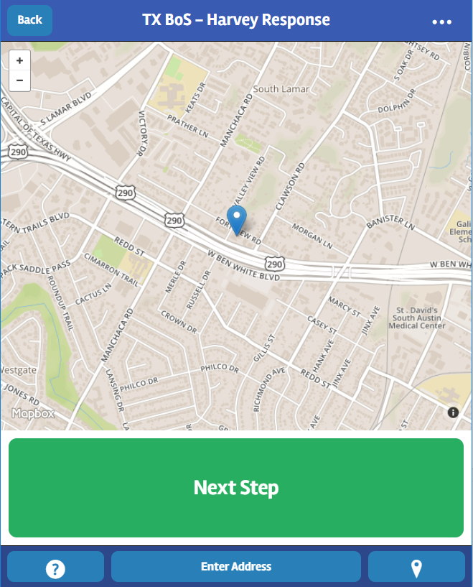
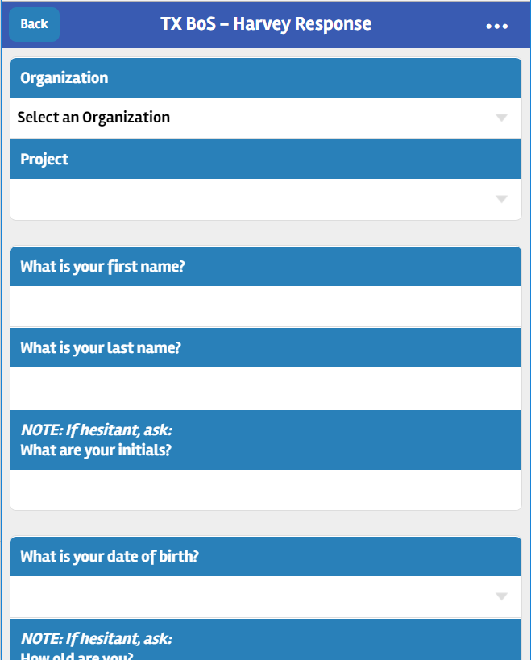
Counting Us App

Slide 9
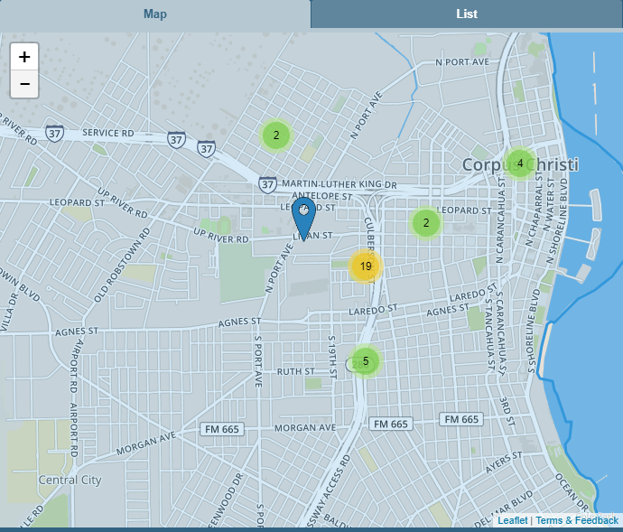
Counting Us Command Center

Slide 10
PIT and HMIS
For HMIS shelters- run a report that, for the night of the PIT, shows all active homeless clients for the specific agency
Compare HMIS report to report generated by “Counting Us” app to verify all in shelter where surveyed
PIT numbers are taken into consideration when running other reports in HMIS

Slide 11
When is the PIT conducted?
2018 PIT Count
TX BoS CoC will conduct the count on January 25th.
Alternate date January 29th

Slide 12
Housing Inventory Count
Kristin Zakoor

Slide 13
What is the Housing Inventory Count (HIC)?
The Housing Inventory Count (HIC) is a point-in-time inventory of provider programs within a Continuum of Care that provide beds and units dedicated to serve persons who are homeless, regardless of funding source.

Slide 14
Who needs to conduct a HIC?
All projects that have beds and units dedicated to serve homeless persons and/or families.
Program Type:
Emergency Shelter
Transitional Housing
Rapid Re-housing
Safe Haven (NOT in TX BoS CoC)
Permanent Supportive Housing

Slide 15
Why do we conduct a HIC?
HUD requirement- still want all to provide nfo
Completed in conjunction with Point-In-Time Count
This informs utilization rates
Contributes to the Annual Homeless Assessment Report (AHAR) and other important reports
Contributes to the CoC application

Slide 16
HIC and HMIS
For all agencies, THN will send a HIC survey to be completed on the night of the PIT count
A separate survey must be completed for each applicable project within the agency
For all HMIS participating agencies, THN will confirm that the information submitted via the survey is what is found within HMIS
It is important that the HMIS information is accurate and up-to-date since the HIC data is used when running other reports

Slide 17
When is the HIC conducted?
2018 HIC
TX BoS CoC will conduct the HIC on the night of the PIT count, January 25th.

Slide 18
A message from Ben Mahoney
Video

Slide 19
System Performance Measures
Victoria Lopez

Slide 20
HMIS REPORT TIMELINE
Point-In-Time & Housing Inventory Count
System Performance Measures
1
2
Dates: Count on January 25th HIC surveys due to THN, January 29th.
Date: HMIS report will be reviewed in May.
All data quality issues must be fixed before May.
Annual Homeless Assessment Report
Date: HMIS staff will review report and conduct data quality checks Oct-Nov.
3

Slide 21
What are SPMs?
1. Length of time persons remain homeless
2. The extent to which persons who exit homelessness to permanent housing destinations return to homelessness
3. Number of homeless persons
4. Jobs and income growth for homeless persons in CoC Program-funded projects
5. Number of persons who become homeless for the first time
6. Homelessness prevention and housing placement of persons defined by Category 3 of HUD’s homeless definition in CoC Program-funded projects
7. Successful housing placement

Slide 22
What elements are considered for SPMs?
2017 Data Standards Element Number | Element Name
2.4 | Project Type
2.5 | Method for Tracking Emergency Shelter Utilization
2.6 | Federal Partner Programs and Components
3.3 | Date of Birth
3.10 | Project Start Date
3.11 | Project Exit Date
3.12 | Destination
3.917 A | Living Situation
3.20 (formerly 4.17) | Housing Move-In Date (formerly Residential Move-In Date)
4.2 | Income and Sources

Slide 23
What programs are considered for SPMs?
Emergency Shelter
Safe Haven
Street Outreach
Permanent Supportive Housing
Rapid
Re-Housing
Transitional Housing

Slide 24
When are SPMs run?
HUD has established the reporting period for system performance measures to be consistent with the federal fiscal year (October 1 through September 30), with the exception of PIT count data collected according to HUD specifications during the fiscal year.
2017 SPMs
TX BoS CoC will run the report in May.
Submit to HUD mid-June.

Slide 25
How does this tie back to HMIS?
Notes:
Assessment real talk
-Many reports that we deal with drawn from data entered into HMIS. This is especially true for System Performance Measures.
-Update data on a regular basis.
-Hard for SPMs to measure change if there is data missing from Year 1, 2, 3, etc.
-One of the biggest hurdles we faced the last time we submitted the SPMs was missing Annual Assessments.

Slide 26
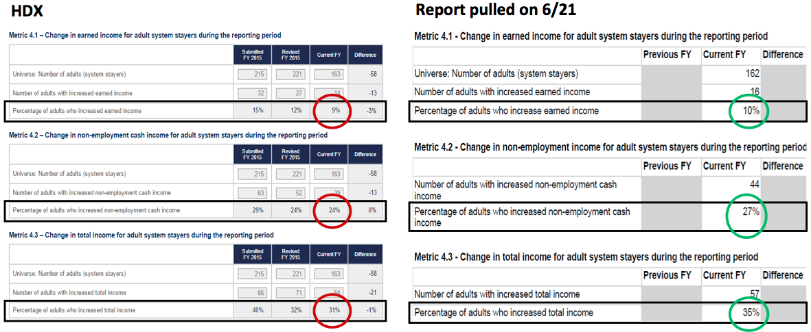
SPMs: Measure 4
Notes:
Left hand side is what was sent to HUD
Right side is after corrections were made; we didn’t submit the right hand numbers to HUD
Numbers dealing with Stayers; easier to get in touch
Might think it’s small, but it’s a significant difference
We want to submit the highest quality data to HUD

Slide 27
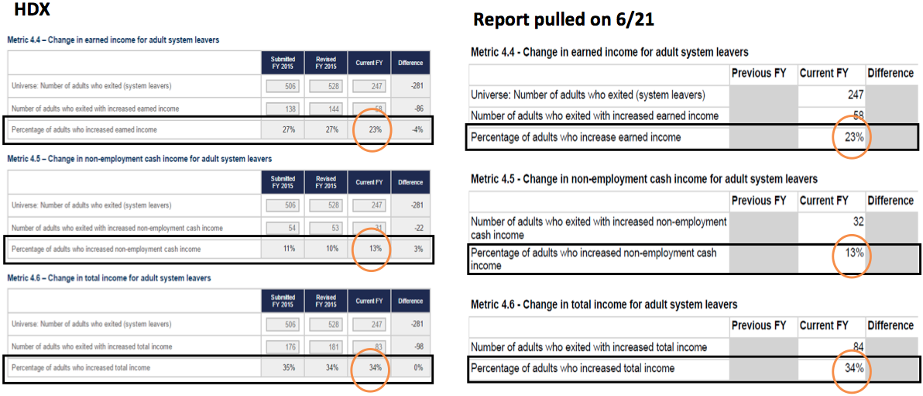
SPMs: Measure 4 (cont.)
Notes:
-Continuation of previous slide.
-Deals with Leavers; no change
-Harder to get in touch with clients that are already gone
-Demonstrates importance of getting data in on time

Slide 28
What can you do to prepare?
Measures 1, 2, 4, & 7
Measures 3 & 5
APR
Entry/Exit Dates
UDQ
Timeliness
Income
Annual Assessments
Annual Assessments
PIT
Number of Homeless (Annual Count)
CE
1st contact with homeless assistance network
(Trickiest one for CoC)

Slide 29
The purpose of the following slides is to give a measure by measure breakdown of what reports you can run in order to get prepared for the SPMs.
There is a caveat here, though. At the time of this presentation, individual agencies and communities are not able to run SPMs on their own. The Texas BoS CoC runs the SPMs for the CoC as a whole. The SPM report was not designed to be run on a small scale.
That being said, the Texas Balance of State CoC will get in touch with individual agencies in order to correct data prior to submitting the SPMs to HUD. With that in mind, the upcoming slides are a way for you to check and prepare your data ahead of time…before we come knockin’ on your door.

Slide 30
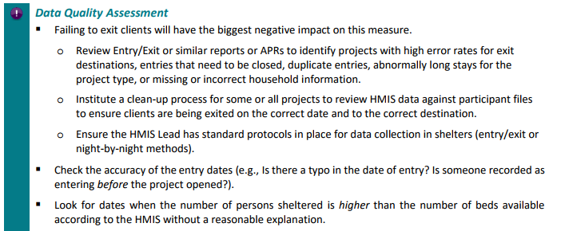
Measure 1: Length of Time Persons Remain Homeless
What to Look For
Clients with incorrect Entry/Exit dates
Clients that need to be exited
Duplicate entries/clients
More people in facilities than beds without a reasonable explanation
Reports to Try
APR
Clients in Programs
Housing and Shelter Utilization
Notes:
Start with the easy things first. This will give you time to work on the harder things later on.
You can set the APR to run, and while you’re waiting for that to export, run the easier reports.
For example, it’s easier to run the Clients in Programs report to spot check things like clients with incorrect dates or who need to be exited or who have duplicate entries.

Slide 31
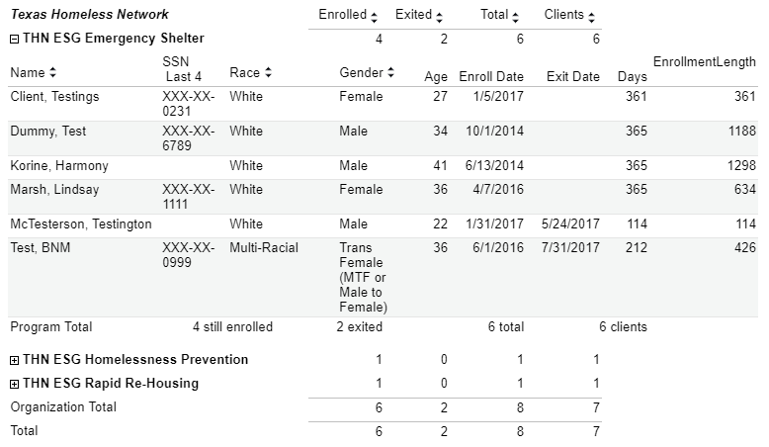
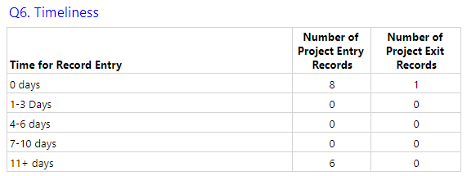
Measure 2: Return to Homelessness
What to Look For
Clients with incorrect Entry/Exit dates
Timeliness
Reports to Try
Clients in Programs
Universal Data Quality (UDQ)

Slide 32
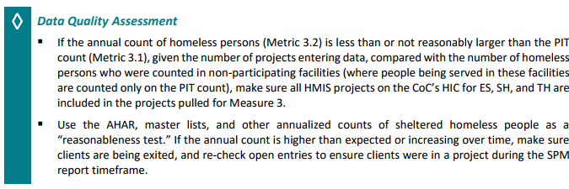
Measure 3: Number of People Experiencing Homelessness
What to Look For
If annual count is higher than expected…
Clients with incorrect Entry/Exit dates
Clients that need to be exited
If annual count is lower than expected…
Clients with incorrect Entry/Exit dates
Reports to Try
AHAR
Clients in Programs
PIT Reports

Slide 33
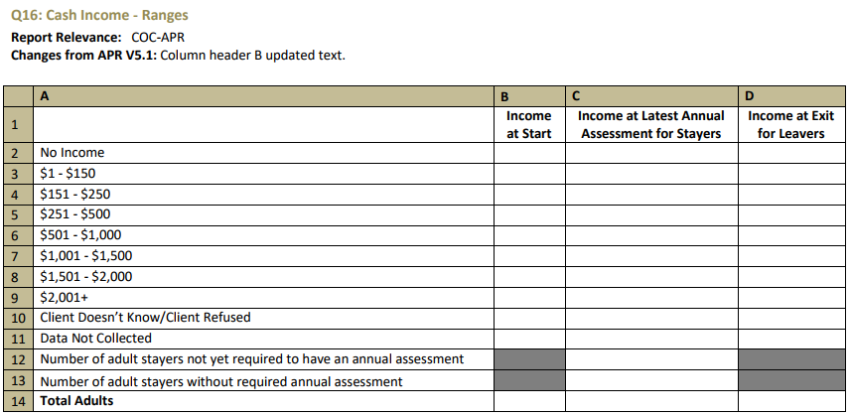
Measure 4: Employment and Income Growth
What to Look For
Annual Assessments entered correctly
Reports to Try
APR
Universal Data Quality (UDQ)
Open Enrollments w/Most Recent Assessment

Slide 34
Measure 5: Number of People Experiencing Homelessness for the First Time
This one is going to be the trickiest one for us, because at this point, we don’t really have a robust Coordinated Entry System working through all major areas of our CoC.
Reports to Try
Data Explorer (ClientTrack only)
Housing Priority List(s)

Slide 35
Measure 7: Successful Placements at System Exit
What to Look For
Clients that need to be exited
Destination (APR Q23)
Reports to Try
APR
Clients in Programs

Slide 36
A message from Ben Mahoney
Video

Slide 37
Annual Homeless Assessment Report
Jesús DeLeón-Serratos

Slide 38
HMIS REPORT TIMELINE
Point-In-Time & Housing Inventory Count
System Performance Measures
1
2
Dates: Count on January 25th HIC surveys due to THN, January 29th.
Date: HMIS report will be reviewed in May.
All data quality issues must be fixed before May.
Annual Homeless Assessment Report
Date: HMIS staff will review report and conduct data quality checks Oct-Nov.
3

Slide 39
How…?
—Estimating the number of people experiencing homelessness
—Counting the number of people receiving assistance in PSH
—Creating a descriptive profile of people in those circumstances
—Producing a greater understanding of service use patterns
—Estimating the capacity to house people in homeless situations

Slide 40
Who…?
Emergency Shelter for Families | ES-FAM
Emergency Shelter for Individuals | ES-IND
Transitional Housing for Families | TH-FAM
Transitional Families for Individuals | TH-IND
Permanent Supportive Housing for Families | PSH-FAM
Permanent Supportive Housing for Individuals | PSH-IND
Notes:
+ Veterans
+ Summary
+ Rapid Rehousing

Slide 41
What…?
UNDUPLICATED list of participants
HIC
PIT
AGE
GENDER
ETHNICITY
RACE
PERSONS by Household Size
PERSONS by Household Type
VETERAN Status
NUMBER of Disabled Participants
LIVING Situation [Prior]
HOW long were they in said situation
TOTAL nights in ES/TH/PSH for adults
TOTAL nights in ES/TH/PSH for children/unaccompanied youth

Slide 42
What else…?
Notes:
Utilization Rates
Utilization rates—or bed occupancy rates—represent the percentage of beds or units that are occupied on a given night or on an average night over a period of time. To calculate the overall bed utilization rate for a community on a given night, take the number of people served on that night and divide it by the number of beds available on that night. The average daily utilization rate is calculated by taking the average number of people served over a given time period divided by the total number of beds.
For the purposes of the report, your utilization rates should never be below 65% or above 105%. Any data that falls outside of those rates is considered poor data and it ends up being rejected and we look bad.
Bed utilization rates below 65 percent are usually attributed to two issues:
The project did not enter all their clients into the HMIS and thus the project appears to be underutilized; or
The project was genuinely under-utilized. Add a note to clarify any reasons why a project was under-utilized (weather, small families in large units, etc.)
Bed utilization rates above 105 are often explained by:
The project did not capture exit dates for all their clients;
The project offered overflow beds—e.g., cots or mattresses—sporadically throughout the year to accommodate high-demand nights, which results in a larger count of persons but the same number of year-round beds.
Seasonal beds, overflow beds, or vouchers were used on the night of the count and the clients were counted as served, but the beds were not added to the bed count.

Slide 43
When…?
This report is usually our Christmas present. It’s the one we complete just before the year ends. Usually, it’s around November, although sometimes it can also go into December. Since we all are ready to pack and leave and enjoy the Christmas break at easy, we would prefer to have this done as soon as possible. Early November.
This year, we will start working on it this Month .

Slide 44
HMIS REPORT TIMELINE
Point-In-Time & Housing Inventory Count
System Performance Measures
1
2
Dates: Count on January 25th HIC surveys due to THN, January 29th.
Date: HMIS report will be reviewed in May.
All data quality issues must be fixed before May.
Annual Homeless Assessment Report
Date: HMIS staff will review report and conduct data quality checks Oct-Nov.
3

Slide 45
Questions?

Slide 46
Resources
“System Performance Measures in Context,” July 2014, HUD
“System Performance Improvement Briefs,” July 2017, HUD
“System Performance Measures Introductory Guide,” May 2015, HUD

