Slide 1
How to Help Homeless Women Veterans and
Homeless Women Veterans with Children
Cassandra Lott
Case Manager/Housing Specialist, Veteran Supportive Services, Family Endeavors, Inc.
Tiffany Price, LCSW
Social Worker, Healthcare for Homeless Veterans Programs, VA North Texas Health Care System

Slide 2
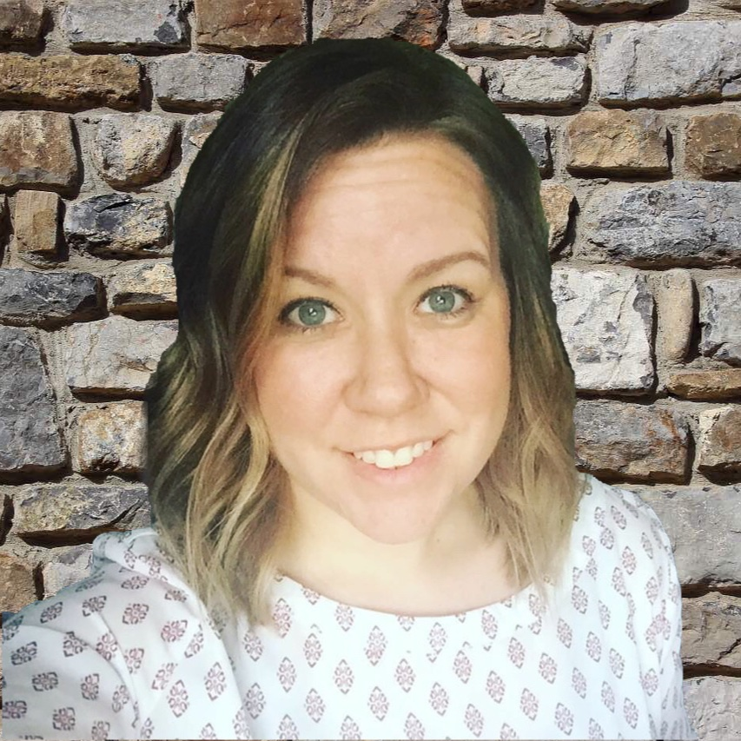


Introductions
Cassandra Lott
clott@familyendeavors.org
214. 932.6276
Tiffany Price, LCSW
Tiffany.price@va.gov
214.857.4675
Notes:
My name is Cassandra Lott with Family Endeavors.
Family Endeavors runs a host of programs such as:
Veteran Services:
That offers Homelessness Prevention & Stabilization Services to Veterans and their families in Texas, Alabama, Florida and North Carolina.
Fairweather Program
The Fairweather Family Lodge (FFL) provides case management, life skills training, employment assistance, educational guidance and other supportive services for women with mental illness and their children in an apartment style campus. Provides services such as…………..
Group and individual counseling
•An individualized assessment of the mother and children’s needs (FFL only) and Parenting training (FFL only)
Children and Youth Services
Family Endeavors has been operating child and youth programs for 25 years, providing after school programs, summer camps, and a Learning & Childcare center to thousands of children a year.
Disaster Relief/Emergency Services
Since 2011, our Disaster Relief/ES program provides client-focused, temporary staff to support emergency staffing needs due to disasters or other unforeseen events.
We have and are providing support for four federally declared Texas disasters. We are serving 60 counties across Texas with our Disaster Case Management (DCM) services operating in five DCM offices in Texas covering 35 counties.
We have assisted in four major surge staffing events that include providing case managers, clinicians, teachers, logistical support, and direct care staff for over 20,000 undocumented youth.
Community Based Services
Provides case managements and support for over 2,500 abused and/or neglected children across Texas each year
Provides essential supportive services to over 150 low-income seniors, shut-ins, and adults with disabilities each year through regularly scheduled in home visits.
Endeavors Unlimited is a division of Family Endeavors that provides employment to those with significant disabilities through developed contracts such custodial services and commercial grounds maintenance and landscaping.
My position with the organization is centralized around Case Management and as the Housing Specialist for the Dallas, Fort Worth, and Waco region of North Texas. In the roles, I act as a liaison for the organization in the development of housing resources with apartment complexes and landlord both private and public sector and provide CM related support to Veterans to aid in housing stabilization etc. I am also a Certified Ready to Rent Facilitator for the organization.
PAUSE FOR TIFFANY
In light of the recent devastation caused by Hurricane Harvey, Family Endeavors and the VA of North Texas proactively stepped up to assist Veterans in need. Through the partnership we’ve been able to access those in need to provide resources, financial assistance, and support to Veterans displaced from 80 Texas Counties from A to Z. It is because of the relationship that we both stand here today as we know if takes more than one entity to complete a mission. We have been able to maximize outreach efforts, provide supportive services to Veteran families to include Emergency Housing, Community Referrals, Temporary Financial Assistance, and Case Management/Lite-Touch Services.

Slide 3


To all Military Personnel would you please stand……
We would like to take a moment to recognize and thank each of you for your service and sacrifice for our freedom!
Notes:
Cassandra

Slide 4
Training Objectives
To identify challenges/barriers when working with homeless women Veterans/homeless women Veterans with children
To identify successful interventions/best practices when working with homeless female Veterans
To identify services/resources homeless female Veterans commonly utilize
Notes:
Cassandra

Slide 5
Quick Facts
It is estimated that approximately 11% of the homeless population are Veterans (National Coalition for Homeless Veterans)
While overall population of Veterans is on the decline, the number of women Veterans is increasing
  Until 1980: 2% of uniformed personnel were women
  2020: It is estimated that 18% of the Veteran population will be comprised of women (Levander & Overland)
Women Veterans are up to 3 times more likely to be homeless than non-Veteran women (Rosenheck and Kane)
Notes:
Tiffany

Slide 6
Homeless Veterans, by Gender
http://vaww.nepec.mentalhealth.med.va.gov/PHV/HCHV/outreachqtr.htm
Notes:
Texas has the most Women Veterans, at 180,286
Tiffany

Slide 7
Homeless Women Veterans with Children
http://vaww.nepec.mentalhealth.med.va.gov/PHV/HCHV/outreachqtr.htm
Notes:
Statewide about 54% of Women Veterans have children, with Amarillo and North Texas having the highest percentage at 67% and 58%
Nationally, 45%
Nationally, the number of male Veterans with children is just under 25%
Statewide, the number of male Veterans with children is just under 27%
If you look at the number of Women Veterans with children whose children live with them, about 23% of Women Veterans in Texas do not live with their children
Tiffany

Slide 8
Demographics Served
HMIS-Homeless Management Information Systems Data 2015-2016 and 2016-2017-Dallas County
ETO HMIS system Tarrant County Homeless Coalition 2015-2016 and 2016-2017
Notes:
Cassandra
HMIS data 2015, 2016 Dallas County
ETO data system

Slide 9
Characteristics of Women Veterans
(In comparison to Men Veterans)
Younger
Less likely to be married, more likely to be divorced
More ethnically diverse
Have a lower median household income
More likely to receive a service connected disability, have no personal income, are in poverty
https://www.va.gov/vetdata/docs/SpecialReports/Women_Veterans_Profile_12_22_2016.pdf
Notes:
Younger
---Men: 65 Women: 50
Less likely to be married, more likely to be divorced
---65% Men married 50% Women married
---15% Men divorced/separated 23% Women
More ethnically diverse
---79% Men White 66% of Women
---19% AA, 10% Hispanic
Have a lower median household income
---6% males use SNAP 10% of Women
More likely to receive a service connected disability, have no personal income, are in poverty
---6% Men in poverty 10% Women

Slide 10
Characteristics of Women Veterans
(In comparison to Non-Veteran Women)
More likely to be African American
More likely to be divorced
Have a higher median household income
More likely to have higher education
Less likely to be uninsured, have no personal income, or be in poverty
https://www.va.gov/vetdata/docs/SpecialReports/Women_Veterans_Profile_12_22_2016.pdf
Notes:
More likely to be African American
---12% of non-Veteran women 19% Veteran women
More likely to be divorced
---13% non Veteran women 23% Veteran women
Have a higher median household income
---47,000 non-Veteran women 55,000 Veteran women
More likely to have higher education
---31% with some college non Veteran women 44% Veteran women
Less likely to be uninsured, have no personal income, or be in poverty
---15% non Veteran women no income 7% Veteran women
---15% non Veteran women in poverty 10% Veteran women

Slide 11
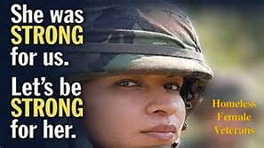
Homeless Women Vets Struggle for Aid
https://www.youtube.com/watch?v=lD0v21jj2HA&t=43s
Notes:
https://www.youtube.com/watch?v=lD0v21jj2HA&t=43s

Slide 12

Discussion:
Challenges and Barriers
REAL WOMEN, REAL PROBLEMS, REAL NEEDS
Notes:
Factors of unemployment, disability, poor health and lack of treatment, PTSD and or anxiety problems are driving forces that keep female Veterans that we service day to day.

Slide 13
Challenges and Barriers
Approximately 54% of Women Veterans in Texas have children
Only 24% of Women Veterans utilize the VA Health Care System (Levander & Overland)
History of trauma
  More likely to experience trauma prior to entering the military (Burkhart & Hogan)
  Military trauma, including military sexual trauma (Levander & Overland)
Notes:
Bullet 1: Source: HOMES data
Bullet 2: Creates a need for non-VA service providers to have an awareness of military culture and the need for partnerships between VA and community orgs
Bullet 3:
Estimated that 33% of Women Veterans had a history of adult sexual abuse prior to entering military and 35% experienced childhood physical or emotional abuse
Estimated that approximately 32% of female Veterans experienced MST (5% of male Veterans)
MST is more predictive of developing PTSD than other types of military trauma, with estimates as high as 40-60% of women Veterans who experienced MST during service developing PTSD.

Slide 14

About Military Sexual Trauma
https://www.youtube.com/watch?v=b9snig5gZfk

Slide 15
Challenges and Barriers
from a Service Providers Lens
In working daily with Veterans as services providers we see a more male dominated presence of those who present for assistance.
Many female Veterans suffer from trouble re-integrating into communities as Veterans and as a result the number of homeless female Veterans is steadily rising according to reports from the National Coalition for Homeless Veterans.
Notes:
VA.gov, 2011

Slide 16
Current HUD Income Limits
ELI-30% and 50% VLI Area Median Income
FY2017 HUD Income Limits Test – FOR STAFF USE
Household Size | Household Income |  | Extremely Low Income Eligibility Test 30% AMI |  | Very Low Income Eligibility Test 50% AMI |  | Does Household Pass? | Staff Initials
 | Monthly | Yearly | Monthly | Yearly | Monthly | Yearly
1 | $ .00 | $ . 00 | $1,283 | $15,400 | $2,141 | $25,700 | ☐Yes ☐No
2 | $ .00 | $ .00 | $1,466 | $17,600 | $2,450 | $29,400 | ☐Yes ☐No
3 | $ .00 | $ .00 | $1,701 | $20,420 | $2,754 | $33,050 | ☐Yes ☐No
4 | $ .00 | $ .00 | $2,050 | $24,600 | $3,058 | $36,700 | ☐Yes ☐No
5 | $ .00 | $ .00 | $2,398 | $28,780 | $3,304 | $39,650 | ☐Yes ☐No
6 | $ .00 | $ .00 | $2,746 | $32,960 | $3,550 | $42,600 | ☐Yes ☐No
7 | $ .00 | $ .00 | $3,095 | $37,140 | $3,795 | $45,550 | ☐Yes ☐No
8 | $ .00 | $ .00 | $3,443 | $41,320 | $4,037 | $48,450 | ☐Yes ☐No
https://www.hud.gov/.../affordablehousing/programs/home/limits/income
Notes:
The above chart represents the current income limits that are reviewed for various programs to include SSVF that work to serve the most critical populations. (Women Veterans with children during the 2016-2017 grant year were 75% more likely to be at 30% ELI rating vs single female Veterans. (HMIS collected data, Dallas County, Family Endeavors)

Slide 17
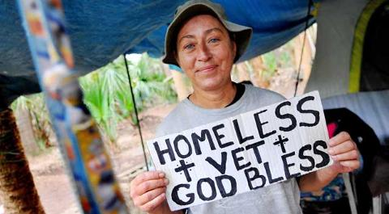
Discussion:
Interventions and Best Practices
Notes:
Factors of unemployment, disability, poor health and lack of treatment, PTSD and or anxiety problems are driving forces that keep female Veterans that we service day to day.

Slide 18
Interventions/Best Practices….as services providers what do you see? (interactive)
(Intervention/Best Practices Ideas)
1.
2.
3.
4.
5.
Notes:
Quick reminder to share interventions, not stories so that we have enough time to share successful interventions with others
Housing First
Advocacy
Utilizing Continuum of Care – warm handoffs
Being culturally competent

Slide 19

What is the
HOUSING FIRST MODEL???
Housing First is an approach used for both homeless families and individuals and for people who are chronically homeless. Program models vary depending on the client population, availability of affordable rental housing and/or housing subsidies and services that can be provided.
(National Alliance to End Homelessness)
Notes:
Cassandra
Discussion: Can anyone share with us what this picture represents to them?
For me, the picture represent just as you’ve mentioned in addition to the struggle that our clients face. Women tend to see a home a structure where as men see providing for the home as structure….but what happens when it all falls apart? What do we do?

Slide 20
HOUSING FIRST PROGRAM MODELS cont….
Two common program models follow the Housing First approach but differ in implementation. Permanent supportive housing (PSH) is targeted to individuals and families with chronic illnesses, disabilities, mental health issues, or substance use disorders who have experienced long-term or repeated homelessness. It provides long-term rental assistance and supportive services.
A second program model, rapid re-housing, is employed for a wide variety of individuals and families. It provides short-term rental assistance and services. The goals are to help people obtain housing quickly, increase self-sufficiency, and remain housed. The Core Components of rapid re-housing—housing identification, rent and move-in assistance, and case management and services—operationalize Housing First principles.
https://endhomelessness.org/resource/housing-first
Notes:
Cassandra
It is incumbent upon each service provider to determine what model best fits into their female Veterans situation. Collectively as service providers
understanding both models can prove beneficial for the outcomes to be attained by the client.
What services are available?

Slide 21
SSVF
Supportive Services for Veteran Families
What is SSVF?
  Supportive Services for Veteran Families is a nationwide homelessness prevention and rapid-rehousing program that focuses primarily on those in a crisis of homelessness.
  A 90 day program and our goal is to have our Veterans housed in 30 days. In some instances, Veteran can be eligible for an extended period of service on a case by case basis.
Program Goal
  Promote housing stability among very low-income Veteran families who reside in or are transitioning to permanent housing.
Eligibility for SSVF services is based upon numerous factors (i.e. annual income, characterization of discharge, homelessness status/risk, household characteristics, and funding availability to name a few.) As service providers it is incumbent upon each organization whether connected to SSVF or not, to provided “resource referrals” to assist Veterans as often as possible.
https://www.va.gov/HOMELESS/ssvf/docs/SSVFUniversity/SSVF_Program
Notes:
Cassandra

Slide 22
Discussion:
What resources do you use when working with Women Veteran clients?
Notes:
Tiffany

Slide 23
Commonly Utilized Resources When Working with Homeless Women Veteran Clients (interactive)
(Resources)
1.
2.
3.
4.
5.
Notes:
Quick reminder to share interventions, not stories so that we have enough time to share successful interventions with others

Slide 24
Resources/Services for Homeless
Women Veterans
Family Endeavors: Supportive Services for Veteran Families: https://www.familyendeavors.org/programs/veteran-services/
VA Center for Women Veterans: https://www.va.gov/womenvet/
Local Homeless Women Veterans Program Coordinator
Local Veteran Women Program Coordinator
VA Women Veterans Call Center: 1-800-VA-Women
VA Homeless Veterans Call Center: 1-877-4AID-VET
Notes:
Homeless Women Veterans Program Coordinator: Michelle King-Thompson, LMSW
Women Veterans Program Manager: Leslie Snowden-Crawford RN

Slide 25
Resources/Services for Homeless
Women Veterans
Attitudes and Attire: Boots to Heels Program: https://www.attitudesandattire.org/boots-to-heels/
Grace After Fire: http://www.graceafterfire.org/
Service Women's Action Network: http://www.servicewomen.org/
Texas Women’s Vets
Lifeline for VETS (offers Vet to Vet assistance)
  Call, text, or online 1-888-777-4443
Notes:
SWAN supports, defends, and empowers today’s servicewomen and women Veterans of all eras, through groundbreaking advocacy initiatives and innovative, healing community programs
Texas Women’s Vets
Offers programs such as Social Entrepreneurship, Mentorship, Rapid Rehabilitative Therapy, and Art Therapy and Services of Counseling, Job Prep, Employment, and Re-entry services

Slide 26
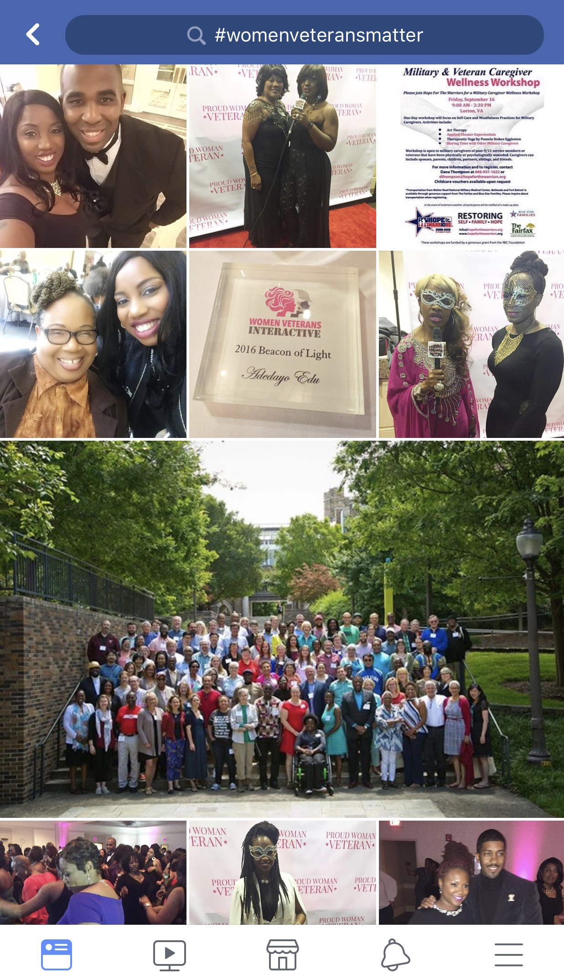
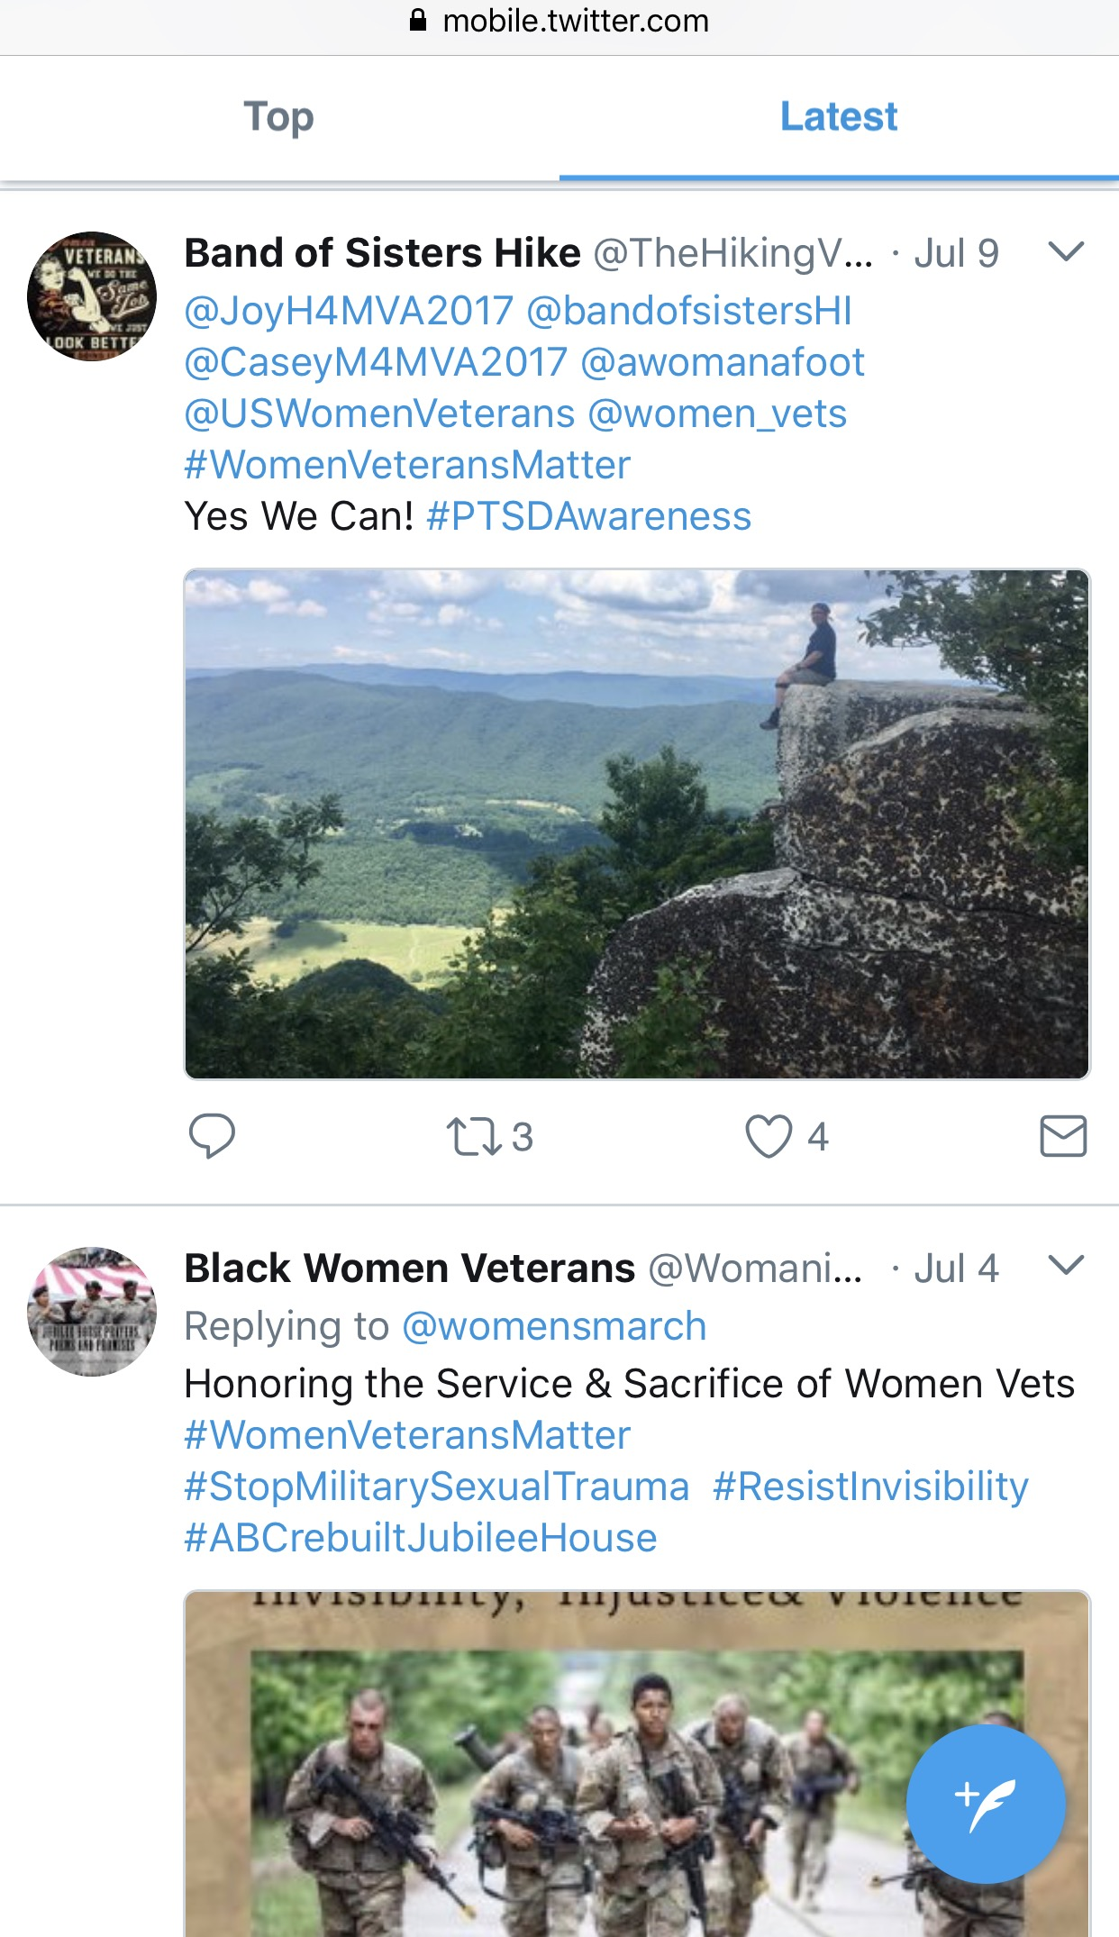
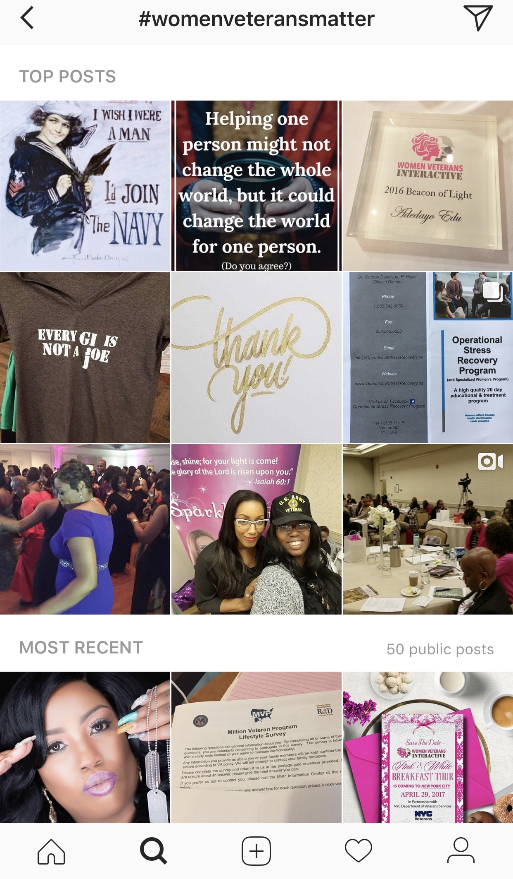
Often Times People Forget…
#WomenVeteransMatter
Let’s continue to share resources using #WomenVeteransMatter on social media and show that we do not forget.
Notes:
Cassandra

Slide 27
Questions?

Slide 28
Thank you
Cassandra Lott
Case Manager/Housing Specialist
clott@familyendeavors.org
214. 932.6276
Tiffany Price, LCSW
Social Worker
Tiffany.price@va.gov
214.857.4675

