Slide 1
Transtheoretical Model and Motivational Interviewing: A Very Brief Introduction
Cathy Crouch, LCSW
Trainer, MI Network of Trainers
Executive Vice-President
SEARCH Homeless Services - Houston
ccrouch@searchhomeless.org
Notes:
Introduce myself. What the next 90 minutes will look like and ground rules re cell phones and asking questions [5 minutes]
How long have they been doing this work?
What are their biggest challenges? NEED FLIP CHART AND MARKERS

Slide 2
Case manager, social worker, or I&R
Help
Help those in difficult situations with advice
Figure out
Figure out what kind of help they need
Help
Help them find the services they need
Create
Create plans for treatment or recovery
Work
Work with other providers
Keep
Keep tabs on client’s progress with treatment plans
Notes:
WHAT ELSE? How else do you see as your job?
I want to propose something else. These tasks are more helpful if the person is ready to change. Ready for your help, your advice.
Your job ACTUALLY is to help people with change – changing their minds then changing their behavior. Now the challenge here is many of the people you are helping are not ready to change. And, most of you have not been trained in or developed skill in helping people move from not wanting to change to actually changing and maintaining those changes. And in order to be successful, you have to understand how people change and know how to do that. And, the bad news is: it isn’t about what you think it is.
Good news is: with effort, you can learn and develop these skills which will make your job easier (NOT EASY), will help your clients be more successful and have a better relationship with you, and you can apply this in your own life. Oh, and it will make you more marketable.

Slide 3
Personal Change Exercise
What change did you make?
How did you decide to make this change?
What people or events influenced your decision?
What steps did you take to make the change?
How long was it from the first time you became aware of that issue to the time you began to try to change it?
How long was it between the time you first began trying to change and when you finally completed and felt it was all behind you?

Slide 4
Successful Behavior Change
Takes time
Often requires multiple attempts and treatments
Consists of self-change and/or treatment
Length of treatment does not correspond to duration of recovery
Involves changes in other areas of a person’s life
DiClemente
Notes:
Might do Personal Change exercise here.
Think about a personal change they have made in their lives; and
Write down everything they can remember about the process, using the questions on the overhead as a guide
No one will see their notes
They are free to share or NOT to share anything they write (it’s up to them, it’s their choice)
Allow 10 minutes for the exercise

Slide 5
TTM – Stages of Change

Slide 6
Assessing Stage of Change
Focus on area of concern that is most important to the client
Identify specific target behavior
Assess stage of change
URICA, SOCRATES or other standardized instruments
Readiness Ruler
Language, emotion and behavior
Indicator that you may have misread stage is “resistance” – arguing, interrupting, denying, or ignoring

Slide 7
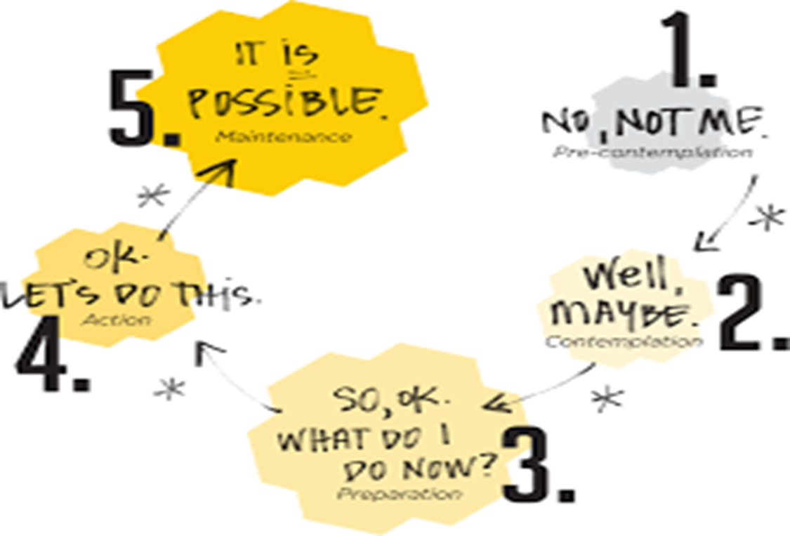
Notes:
ASK THEM TO GIVE ME SOME EXAMPLES OF A TARGET BEHAVIOR FOR ONE OF THEIR CLIENTS AND WHAT THE CLIENT IS SAYING, WHAT SOC THEY IMAGINE THEM TO BE IN

Slide 8
TTM – Well Maintained Behavior
Notes:
Herculaneum in Ercolano
Gulf of Naples

Slide 9
ADBS SUBSCALE SCORES by STAGES OF CHANGE PROFILE
53
52
51
50
49
48
47
46
45
44
PC
AMB
C
PA
CONS
PROS
PC = PRECONTEMPLATION AMB = AMBIVALANT C = CONTEMPLATION
PA = PREPARATION
Notes:
Aggressive Driving Behavior Scale

Slide 10
Transtheoretical Model
A comprehensive model of change
Provides an integrative framework for
understanding behavior change
assessing/measuring
intervening in client’s behavior
Clinicians assess clients’ readiness to change their behavior and design appropriate interventions based upon the clients stage of readiness
DiClemente (modified)

Slide 11
The Transtheoretical Model of Intentional Behavior Change
STAGES OF CHANGE
PRECONTEMPLATION → CONTEMPLATION → PREPARATION →
ACTION → MAINTENANCE
PROCESSES OF CHANGE
COGNITIVE/EXPERIENTIAL BEHAVIORAL
Consciousness Raising Self-Liberation
Self-Revaluation Counter-conditioning
Environmental Reevaluation Stimulus Control
Emotional Arousal/Dramatic Relief Reinforcement Management
Social Liberation Helping Relationships
Social Liberation
CONTEXT OF CHANGE
1. Current Life Situation
2. Beliefs and Attitudes
3. Interpersonal Relationships
4. Social Systems
5. Enduring Personal Characteristics
MARKERS OF CHANGE
Decisional Balance Self-Efficacy/Temptation
Notes:
SOCIAL LIBERATION: Changing societal norms and options
The context of change helps us to identify factors that complement or complicate the process of change.
If issues in one or more of these areas of functioning are complementing or complicating the process of change, they may have to be addressed, augmented, neutralized, or modified in order to facilitate movement.

Slide 12
What is Motivational Interviewing?
Developed by Bill Miller and Steven Rollnick in early ‘80s
Based on non-directive, client-centered therapy of Carl Rogers
MI adds a guiding component – guiding in the direction of change or resolution
Notes:
WHAT DOES NON-DIRECTIVE MEAN?

Slide 13
A Continuum of Communication Styles
Listen
Ask
Follow
Guide
Direct
Inform

Slide 14
Definition of MI
Layperson’s Definition:
Motivational interviewing is a collaborative conversation style for strengthening a person’s own motivation and commitment to change.
Miller and Rollnick, 2012

Slide 15
Four Processes in MI
Planning
Evoking
Focusing
Engaging

Slide 16
Engaging
What promotes engagement?
Desires or goals
Importance
Positivity
Expectations
Hope
What early traps promote client disengagement?
Assessment Trap
Expert Trap
Premature Focus Trap
Labeling Trap
Blaming Trap
Chat Trap

Slide 17
Spirit of MI
Underlying spirit(PACE):
Partnership
Acceptance
Compassion
Evocation
Notes:
Also, when you understand how people change behavior and what behavior change looks like, entails – you begin to have more sympathy for the change process and the ambivalence
Ambivalence as a normal human condition
Helper’s righting reflex

Slide 18
MI Spirit: Partnership
Collaborative – Extent to which the clinician behaves as if the interview is occurring between two equal partners, both of whom have knowledge that might be useful in the problem under consideration (MITI 3.1)
Resist the “righting reflex”
Client talks more than the clinician
Tempers advice giving, suggestions, feedback and asks permission before giving

Slide 19
MI Spirit: Acceptance
Person-centered conditions:
Inherent worth and potential, what Carl Rogers called unconditional positive regard
Accurate empathy
Autonomy/support
Affirmation
Notes:
HAVE MY EMPATHY AND OLD AUTONOMY SUPPORT SLIDES PRINTED OUT FOR MY USE

Slide 20
MI Spirit: Autonomy/Support
Autonomy/Support – extent to which the clinician supports and actively fosters client perception of choice as opposed to attempting to control the client’s behavior or choices.
Explores clients options genuinely
Acknowledges client option not to change without sarcasm, that it’s their choice
Gives credence to client’s ideas about change and motivation (MITI 3.1)

Slide 21
Empathy & Compassion
Empathy – degree to which the clinician understands or makes an effort to grasp the client’s perspective and feelings.
Empathy should not be confused with warmth, acceptance, genuineness, or client advocacy; these are independent of empathy.
Reflective listening is an important part of this characteristic, but empathy captures all effort that the clinician makes to understand the client’s perspective and convey that understanding to the client. (MITI 3.1)
Goes beyond collecting facts, history, and asking information-seeking questions.
Requires more than a shallow attempt to understand the client
Conveys interest in the client’s perspective and effectively communicates this viewpoint.
Often encourages the client to elaborate, say more
Notes:
Still in the most recent version of the MITI that was just released. Will be one of the features that I’ll be evaluating them on in terms of overall MIness.

Slide 22
MI Spirit: Evocation
Evocation – extent to which the clinician conveys an understanding that motivation for change, and the ability to move toward that change, reside mostly within the client and therefore focuses efforts to elicit and expand it within the therapeutic interaction (MITI 3.1)
Elicit – to draw forth or bring out (latent or potential)
Requires you to use the core skills (OARS)
The counselor’s main task is to elicit change talk and commitment talk

Slide 23
Partnership
MI
Spirit
Compassion
Acceptance
Evocation

Slide 24
Definition of MI
Layperson’s Definition: Motivational interviewing is a collaborative conversation style for strengthening a person’s own motivation and commitment to change.
Practitioner’s Definition: Motivational interviewing is a person-centered counseling style for addressing the common problem of ambivalence about change.
Miller and Rollnick, 2012

Slide 25
MI Inconsistent
Unsolicited Advice, Persuading, Sermonizing, Directions & Feedback
Emphasize Abstinence
Direct Confrontation
Powerlessness, Loss of Control
Asserting Authority
Close-Ended Questions
MIA-STEP
Notes:
A Taste of MI – Comparison Exercise {15}
Thumbs Up, Thumbs Down {probably 15 minutes at the most}
Definitely do: A Difficult Client {10 minutes for exercise and 5 minutes to debrief = 15 minutes}
HBC video 2 & 4

Slide 26
Four Processes in MI
Planning
Evoking
Focusing
Engaging
Notes:
Not rapport building

Slide 27
Core Counseling Skills: OARS
Open-Ended Questions
Affirming
Reflections
Summarizing
Notes:
Relational vs Technical Aspects
Acronym

Slide 28
Open-Ended Questions
Helps engage the client and encourages them to talk about their concerns and what’s important to them
Sets the stage for more than just a brief, one-word response
Examples of ways to begin an open-ended question:
What would you like to talk about today?
Tell me a little more about that.
How do you think drinking alcohol is related to your being homeless?
What ideas have you had about how you might begin to include exercise in your schedule?
What bothers you about your use of cocaine?
Notes:
Examples of closed-ended questions not appropriate for collaboration and inconsistent with MI – use Jeff and Jackie’s slides 46-49
Don’t you think your wife and kids have been hurt enough by your using?
Isn’t your friend’s idea that you should quit using really a good one?
Have you ever thought about joining a 12-Step group?
Often we get into this pattern of close-ended question, short response, repeat, repeat. We’re doing most of the talking and the client is relegated to a more passive role.

Slide 29
Open-ended Questions
Disadvantages of the Status Quo
How do you feel about your drinking (or drug use)?
What worries do you have about your health right now?
Advantages of Change
What benefits might you see if you were to change?
How would you feel if you were to lose weight?
Optimism for Change
What makes you feel that now is a good time to try something different?
Intention to Change
What would you like to do about this?
Hecht & Breckon, June 2009

Slide 30
Affirming
When we affirm, it is genuine
Judicious, not promiscuous
Shows that we notice the effort the client has made
Usually directed toward something specific that the client has done and that has furthered movement toward change
Affirm specific behaviors, values that support change
Affirmations consistently evoke change talk, much more consistently than reflections or open questions (Apodaca)
Notes:
Try to leave the I out

Slide 31
Affirmations
In Latin it means “to make firm”
In MI you want to strategically anchor (make firm, drive home, reinforce) internal strengths, values, beliefs, thoughts or behaviours.
An affirmation is an anchoring to support self-efficacy
It is not about the clinician agreeing, praising or approving but rather seeing the client’s strengths, skills, and insights and reinforcing them.
Hecht & Breckon, June 2009
Notes:
ASK THEM FOR EXAMPLES OF AFFIRMATIONS?
HOW DO THEY DIFFER FROM PRAISE OR COMPLIMENTS?

Slide 32
Reflections
Primary way to show empathy
Shows that you are listening to the client
Form a hypothesis, a guess, as to what the client means
Requires using statements instead of questions
Can be used strategically to emphasize certain aspects of the client’s view, emotion, ambivalence, and change talk
Notes:
Give some examples

Slide 33
Guiding
Guiding – the degree to which clinicians maintain appropriate focus on a specific target behavior or concerns directly tied to it.
Can exert guiding by selectively reinforcing client discussion toward the possibility of concern or change with regard to the target behavior.
Returns to the target behavior when the conversation wanders.
Does not lack structure or have an aimless quality to the session (MITI 3.1)

Slide 34
Discord
Trying to convince a client that a problem exists or that change in needed can precipitate even more discord
If you try to prove a point, the client predictably takes the opposite side
Discord is predictive of poor treatment outcomes and lack of involvement in the therapeutic process
More constructive viewpoint is that the client views the situation differently than you do
Discord is a signal to change direction or listen more carefully
TIPS 35
Notes:
Refer to PAGE 47 IN TIPS 35 BOOK.

Slide 35
12 Tasks in Learning MI
The ‘spirit’ of motivational interviewing
OARS: Client-centered counseling skills
Identifying change goals (target behavior) toward which to move
Exchanging information and providing advice
Recognizing change talk and sustain talk
Evoking change talk
Responding to change talk in a way that strengthens it
Responding to sustain talk and discord in a way that does not amplify it
Developing hope and confidence
Timing and negotiating a change plan
Strengthening commitment
Flexibly integrating MI with other clinical skills and practices
Notes:
Acronym

Slide 36
Learning and Developing Skill in MI
Workshop alone seldom sufficient
Training plans should include:
Deliberate, concentrated practice
Continuing coaching
Feedback
Supervision
Additional ways to learn can include:
Peer learning groups
Video trainings
Reading books
Book discussion groups
Notes:
Practice can be:
Role plays
Audiotaped sessions with clients
Standardized patients

Slide 37
Recommended Readings
Transtheoretical Model
Prochaska: Changing for Good
Motivational Interviewing
Miller & Rollnick: Motivational Interviewing, Helping People Change (3rd edition)
Notes:
For coaching, all staff will have recorders and upload sessions to a web-site that only I will have access to. Will have to get clients to sign off for the recording. Should keep in client files. Typically we don’t have a problem with client saying no.

Slide 38
Contact Information
Cathy Crouch, LCSW,
Executive Vice-President
SEARCH Homeless Services
2015 Congress Street
Houston, TX 77002
ccrouch@searchhomeless.org
713.276.3077 (direct)

