Slide 1
Tuberculosis (TB) in Texas’ Homeless Population TB and Hansen’s Disease Branch
Texas Conference on Ending Homelessness
October 6, 2017

Slide 2
Objectives
Provide an overview of TB
Discuss risk factors for TB
Discuss trends in TB transmission
Discuss TB transmission among homeless populations
Identify measures for TB control in shelter settings

Slide 3
Overview of TB

Slide 4
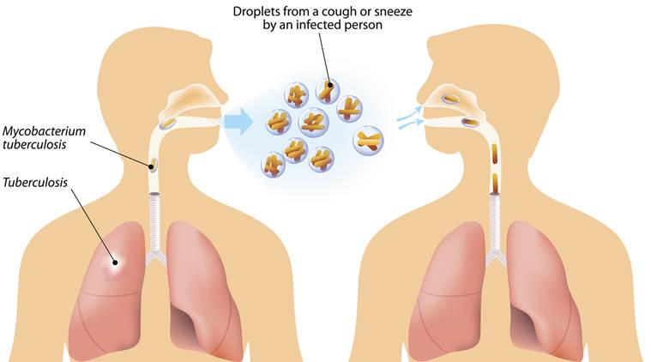
Overview of TB
Caused by a bacterium called Mycobacterium tuberculosis (M. tuberculosis)
Transmitted when the bacteria spread through the air from person to person
Usually attacks the lungs, but can also attack other parts of the body (e.g., kidney, brain, spine)
(Centers for Disease Control [CDC], 2016)
Notes:
TB bacteria are spread through the air from one person to another. The TB bacteria are put into the air when a person with TB disease of the lungs or throat coughs, speaks, or sings. People nearby may breathe in these bacteria and become infected.
TB is NOT spread by:
shaking someone's hand
sharing food or drink
touching bed linens or toilet seats
sharing toothbrushes
kissing

Slide 5
Overview of TB
TB Infection
TB Disease
No symptoms
Does not feel sick
Positive skin/blood test
Normal CXR
Negative sputum smear
Cannot spread TB to others
Treat for TB infection to prevent TB disease
Symptoms are present
Usually feels sick
Positive skin/blood test
Abnormal CXR
Positive sputum smear
May spread TB to others
Treat for TB disease
(CDC, 2016)
Notes:
TB bacteria can live in the body without making you sick. This is called latent TB infection. In most people who breathe in TB bacteria and become infected, the body is able to fight the bacteria to stop them from growing.
TB bacteria become active if the immune system can’t stop them from growing. When TB bacteria are active (multiplying in your body), this is called TB disease. People with TB disease are sick. They may also be able to spread the bacteria to people they spend time with every day.
Many people who have latent TB infection never develop TB disease. Some people develop TB disease soon after becoming infected (within weeks) before their immune system can fight the TB bacteria. Other people may get sick years later when their immune system becomes weak for another reason.
For people whose immune systems are weak, especially those with HIV infection, the risk of developing TB disease is much higher than for people with normal immune systems.
Symptoms vary depending on part of body affected.

Slide 6
TB Risk Factors
Recently Infected
Immunocompromised
Close contact
Immigrants from high risk countries
Children <5 years of age
Homeless persons
IV drug users
HIV infected person
Congregate settings
HIV infection
Substance abuse
Diabetes
Severe kidney disease
Organ transplants
Cancer
Corticosteroids treatment
Low body weight
(CDC, 2016)
Notes:
Overall, about 5 to 10% of infected persons who do not receive treatment for latent TB infection will develop TB disease at some time in their lives. For persons whose immune systems are weak, especially those with HIV infection, the risk of developing TB disease is much higher than for persons with normal immune systems.
Generally, persons at high risk for developing TB disease fall into two categories:
Persons who have been recently infected with TB bacteria
Persons with medical conditions that weaken the immune system

Slide 7
TB Treatment
TB infection and TB disease can be treated
Treatment takes much longer than other types of bacterial infections
6 – 9 months daily medications; longer with drug resistant strains
Shorter course treatment regimen available
Inadequate or lack of treatment for TB infection can lead to TB disease
Inadequate or lack of treatment for TB disease can be fatal
(CDC, 2016)
Notes:
Although TB can be treated,

Slide 8
Survivor’s Story
Notes:
Click image for video (3 ½ minutes long).

Slide 9
TB Trends

Slide 10
TB Trends
Global Statistics (2015)
TB is one of the world’s deadliest diseases
An estimated 2 billion people are infected with TB
10.4 million people get sick with TB disease each year
1.8 million TB-related deaths occur each year
TB is the leading cause of death for people with HIV infection
(CDC, 2017)

Slide 11
TB Trends
Reported TB Cases, United States (1995- 2015)
(CDC, 2017)
Notes:
Steady decline in cases since 1995. A total of 9,563 cases were reported in 2015.

Slide 12
TB Trends
Reported TB Cases, TX (2001-2015)
(Wu, 2016)
Notes:
The number of cases have declined since 2001; 1,334 cases reported in 2015.

Slide 13
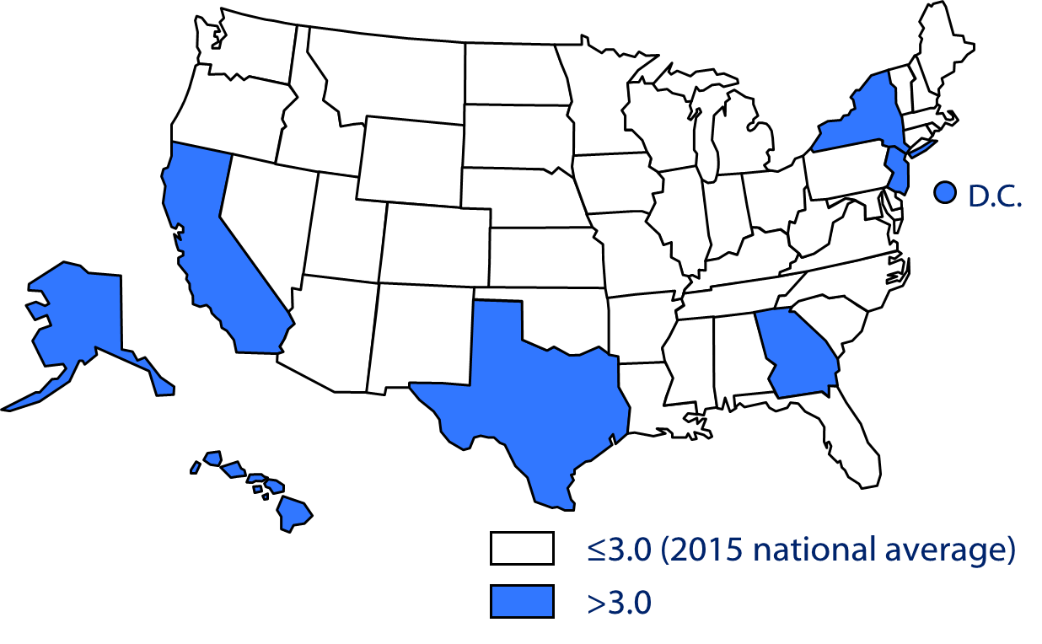
TB Trends
TB Case Rates*, United States 2015
*Cases per 100,000 population
(CDC, 2017)
Notes:
Texas case rate = 4.9 per 100,000

Slide 14
Texas TB Cases by County (2015)
County | Cases
Harris | 327
Dallas | 189
Bexar | 83
Cameron | 73
Hidalgo | 72
Tarrant | 67
Travis | 59
Webb | 44
El Paso | 38
Fort Bend | 27
(Wu, 2016)

Slide 15
TB Texas Homeless Populations

Slide 16
TB and Homelessness
TB has been recognized as a disease associated with homeless since 1914
270,948 cases of TB reported in U.S. from 1994 -2010
16,257 homeless (6%) – disproportionate number of cases
Approximately 1% of the population experience homelessness in any given year
TB incidence ranged from 36 – 47 cases per 100,000 population from 2006 – 2010
Not surprising!
High occurrence of TB risk factors
Lack of access to medical care for early diagnosis and treatment
(CDC, 2013; Bamrah, 2013)

Slide 17
TB and Homelessness
TX TB Case Count/Homeless Proportion, 2001 - 2015
(Wu, 2016)

Slide 18
TB and Homelessness
TX TB Case Count by Homeless/Geographic Area, 2015
(Wu, 2016)

Slide 19
TB and Homelessness
TX Proportion of Homeless Cases by Race, 2001- 2015
(Wu, 2016)

Slide 20
TB Outbreaks and Homelessness
Homelessness linked to 72% of U.S. outbreaks investigated by CDC (2002 – 2010)
Common themes
U.S. born
Males
Substance abuse
Prolonged infectious period
Difficulty identifying/locating contacts
Sites of drug use/jails frequent sites of transmission
Delayed diagnosis and treatment of TB infection
(Bamrah, 2013)
Notes:
Outbreaks include large numbers of cases who share a common link (DNA fingerprint, resided in same shelter, shared acquaintances.

Slide 21
TB Outbreaks and Homelessness
Outbreaks demonstrate the vulnerability of homeless persons to TB and highlight the need for aggressive TB control measures.
Notes:
Addressing TB among homeless population is challenging due to many financial, logistical, and clinical barriers. Never the less, it remains critically important for public health.

Slide 22
TB Control Measures
Public Health Recommendations

Slide 23
TB Control Measures
Effective TB control measures reduce the spread of TB among the homeless and those who provide services (i.e. staff, volunteers)
Strategic plans to improve TB control measures require partnerships between:
National public health organizations (e.g., CDC, Advisory Council for the Elimination of TB)
State TB controllers
Local/regional public health departments
Homeless shelter providers and other homeless agencies
Local healthcare systems
(CDC, 2013)

Slide 24
TB Control Measures
Successful strategic plan outcomes in the past have included:
Comprehensive onsite healthcare services
Supportive housing during TB treatment
Incentives to encourage completion of evaluation and treatment
Standardized shelter TB control plans
(CDC, 2013)

Slide 25
Shelter TB Control Plans
The CDC recommends TB control plans for high risk environments (e.g., nursing homes, correctional facilities, shelters)
Plans should be periodically reviewed and evaluated to determine effectiveness
Key components of a TB control plan include
Administrative controls
Most important level of control
Management activities which reduce risk of exposure to infectious person
Environmental controls
Secondary level of control
Reduce the spread of infectious bacteria
(CDC, 2013)
Notes:
Outbreaks include large numbers of cases who share a common link (DNA fingerprint, resided in same shelter, shared acquaintances.

Slide 26
Key Components of a TB Control Plan
Administrative Controls
Environmental Controls
Develop a written TB control plan
Assess facility’s TB risk
Provide TB education to staff, volunteers, and clients
Establish TB screening policy for staff, volunteers, and clients
Promote cough etiquette
Maintain bed maps and searchable rosters
Head-to-toe arrangement of beds
Assess ventilation, airflow, and lighting
Offer tissues/surgical masks to cover coughs
Designate separate sleeping area for clients with a cough
(CDC, 2016)

Slide 27
Additional Recommendations
Assign a facility/shelter healthcare liaison
Identify TB Program contacts within designated jurisdictions
31 contracted local health departments
8 DSHS health service regions
(CDC, 2013)
Notes:
Click link

Slide 29
Homelessness and TB Toolkit
Developed by CDC, National Health Care for Homeless Council, and other health/social services agencies
Includes guidelines, forms, educational materials, and other resources
Forms can be modified to meet individual shelter needs
(CDC, 213)
Notes:
Developed in collaboration with CDC, National Health Care for the Homeless Council, US Interagency Council on Homelessness, and many other health and social service organizations, the Homelessness and TB Toolkit contains guidelines, forms, signs, educational materials, and other resources collected from many sources in the United States and Canada. The forms are presented as templates that can be modified or edited for a given site’s needs.
Click image for link to TB Toolkit

Slide 30
Summary
TB is a disease caused by Mycobacterium tuberculosis
Persons can develop TB infection (noncontagious) or TB disease (contagious)
Homeless persons have a disproportionate risk for TB
Homelessness has been linked to the majority of TB outbreaks in the U.S.
Effective TB control among homeless populations require partnerships between among federal, state, and local agencies
Written TB shelter control plans can limit the spread of TB among clients, staff, and volunteers
Notes:
Developed in collaboration with CDC, National Health Care for the Homeless Council, US Interagency Council on Homelessness, and many other health and social service organizations, the Homelessness and TB Toolkit contains guidelines, forms, signs, educational materials, and other resources collected from many sources in the United States and Canada. The forms are presented as templates that can be modified or edited for a given site’s needs.
Click image for link to TB Toolkit

Slide 31
Summary
Questions?
Tomas Rodriguez
CDC Senior Public Health Advisor
Tomas.Rodriguez@dshs.texas.gov
(512) 533-3074
Dr. Tonya Conley
CDC Public Health Advisor
Tonya.Conley@dshs.texas.gov
(512) 533-3156
Notes:
Developed in collaboration with CDC, National Health Care for the Homeless Council, US Interagency Council on Homelessness, and many other health and social service organizations, the Homelessness and TB Toolkit contains guidelines, forms, signs, educational materials, and other resources collected from many sources in the United States and Canada. The forms are presented as templates that can be modified or edited for a given site’s needs.
Click image for link to TB Toolkit

Slide 32
Thank you

Slide 33
References
Bamrah, S., Woodruff, R., Powell, K., Ghosh, S., Kammerer, J., & Haddad, M. (2013). Tuberculosis among the homeless, United States, 1994 – 2010. International Journal of Tuberculosis and Lung Disease, (17)11, 1414-9.
Centers for Disease Control and Prevention. (2013). TB in homeless populations. Tuberculosis.
Centers for Disease Control and Prevention. (2016). Basic TB facts. Tuberculosis.
Centers for Disease Control and Prevention. (2017). Data and statistics. Tuberculosis.
Morris, S. (2013). Management of TB in the homeless: CDC’s experience with outbreaks. International Union Against Tuberculosis and Other Lung Diseases – North American Regional Meeting.
Wu, M. (2016). Tuberculosis in Texas.

