Slide 1
LHCs’ Role in Ending Homelessness in Texas

Slide 2
Welcome and Introductions
THN staff and VISTA Summer Associate
Attendees
Name
Agency
One interesting fact about your community
Your favorite candy bar

Slide 3
Spread the word!
Texas Homeless Network @TXHomeNet
Caitlin Bayer @caitbayer
Conference Hashtag #EndTXHomelessness
Website www.thn.org
Facebook https://www.facebook.com/TexasHomelessNetwork/
Instagram https://www.instagram.com/txhomenet/

Slide 4
THN, LHCs, and the TX BoS CoC Oct. 2017

Slide 5
Texas Homeless Network (THN)

Slide 6
THN
Incorporated in 1991 to help the Texas Interagency Council for the Homeless (TICH) carry out its legislatively mandated activities
Mission: Texas Homeless Network (THN) provides support to agencies and communities that are building systems to end homelessness in Texas through education, resources, and advocacy.
Funding from TDHCA, DSHS, HUD CoC Program

Slide 7
Objectives
Understand the role that LHCs play in carrying out the work of a large CoC
Gain strategies to work as part of the CoC to end homelessness
Learn about LHC Requirements in order to be recognized by the TX BoS CoC

Slide 8
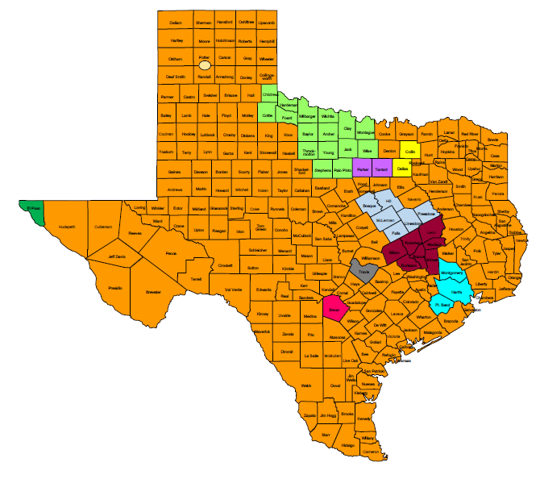
Are you in the right room?
Notes:
This presentation is tailored specifically for people who live and work in the TX BoS CoC (the area shown in orange). People who live and work in other areas may not find this presentation to be applicable.

Slide 9
Continuum of Care (CoC)

Slide 10
What is a CoC?
A CoC, as defined by HUD in the CoC Program Interim Rule at 24 CFR Part 578.3, is the group organized to carry out the responsibilities required under the CoC Program for a defined geographic area.
A community-based planning network for homelessness assistance.
The geographic area covered by the community-based planning network.
A program operated by the Dept. of Housing & Urban Dev.
(HUD)
Notes:
Operate the CoC (including governance, coordination, collaboration, performance evaluation, and standards)
Designate and operate a Homeless Management Information System (HMIS)
Conduct CoC planning (assessing needs, identifying resources, developing and operating a housing and service system)
Collaboratively develop and submit applications for funding

Slide 11
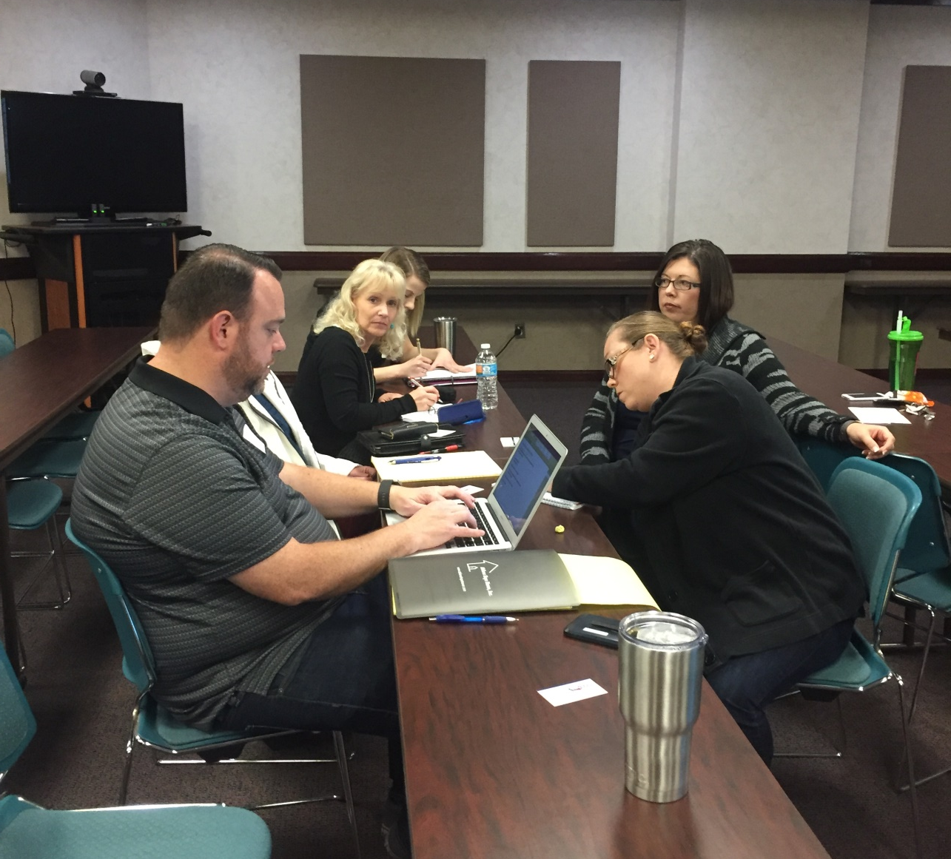
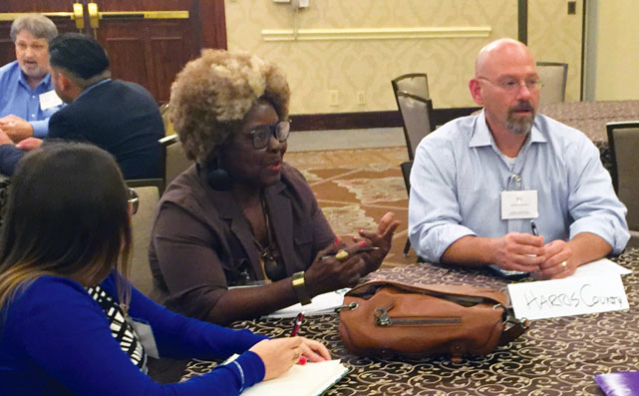
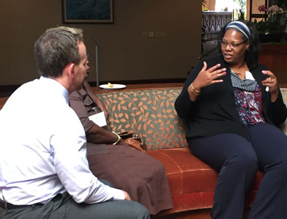
A Community-Based Planning Network

Slide 12
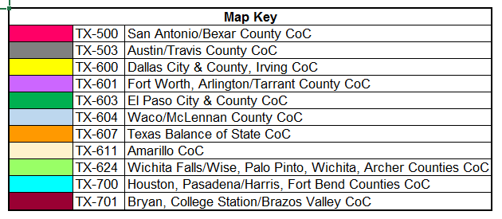
CoCs in Texas

Slide 13
HUD CoC Program’s Purpose

Slide 14
CoC Responsibilities
Establish a CoC and a CoC Board
Conduct CoC Planning and Operations
Administer and Operate HMIS
Facilitate Application for Funds

Slide 15
THN and the TX BoS CoC
THN is the Lead Agency for the TX BoS CoC
THN is the HMIS Lead Agency for the TX BoS CoC
TX BoS CoC covers 215 of Texas’ 254 counties (87% of Texas’s land mass)

Slide 16
CoC Planning across the TX BoS
THN conducts CoC Planning activities with the entire TX BoS CoC, even in communities that do not have CoC Program-funded or ESG Program-funded projects.
Implementing best practices in housing interventions and service delivery
Collecting, analyzing, and reporting data, and making decisions using that data
Partnering with Local Homeless Coalitions (LHCs)
Maximizing available resources and community strengths
Tailoring processes and activities to local needs

Slide 17
What’s unique about the TX BoS CoC?
Mix of Geography
Rural
Urban
Balance of State
Initial jurisdiction decided by HUD
Mergers
Structure
CoC Board/General Membership
Local Homeless Coalitions
Everything in between

Slide 18
Everything’s bigger in Texas…

Slide 19
CoC Governance

Slide 20
Governance Structure
TX BoS CoC General Membership
Local Homeless Coalitions (LHCs)
HMIS Lead Agency
CoC Board
Collaborative Applicant/CoC Lead Agency/CoC Staff
CoC Committees
Notes:
This governance structure is not typical of most CoCs. We have adapted our structure to serve a large geographic area and to allow for as much participation as possible.

Slide 21
CoC Board
Is the primary decision-making body for the TX BoS CoC
Determines the policy direction of the CoC
Ensures that the CoC fulfills its responsibilities assigned by HUD
Oversees and approves the work of the other entities in the CoC governance structure

Slide 22
LHCs
LHCs are groups that plan, deliver, and evaluate homeless services, housing, and supportive services in communities
LHCs have broad membership that includes a variety of stakeholders
LHCs’ goals align with the CoC’s goals and revolve around preventing and ending homelessness
LHC Chairpersons serve as liaisons to the CoC
LHCs cover portions of the CoC geography

Slide 23
LHC Membership
Persons with lived experience of homelessness
Homeless services providers
Housing providers
Homeless Education Liaisons in schools
Public Housing Authorities (PHAs)
Health care providers
Local Mental Health Authorities (LMHAs)
Aging and Disability Resource Centers (ADRCs)
Local governments, Councils of Govts. (COGs)
Community Action Agencies (CAAs)
And more!

Slide 24
LHCs Are Important!
Local Expertise
Resource Gathering
Social Services Landscape
On-the-Ground Leaders
LHC President/Chair
Community Leaders
Community
Buy-In
Coalition Building
Local Initiatives

Slide 25
LHCs, You Are the Reason Anything Gets Done

Slide 26
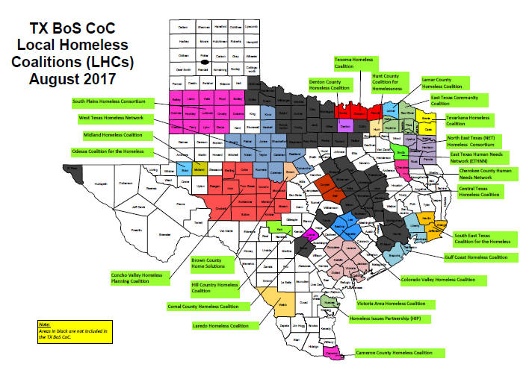
Notes:
LHCs are the means by which priority projects are done. LHCs do the all-important work of actually ending homelessness.

Slide 27
Did you know?
Only 30% of counties in the TX BoS CoC represented by an LHC.

Slide 28
CoC Priority Projects
What can an LHC accomplish?

Slide 29
Data
Point-in-Time (PIT) Count
How many people experiencing homelessness (i.e., needing housing & services) are counted on one night?
Housing Inventory Count (HIC)
How many beds are available for the people counted?
Gaps analyses
Difference between the need and the inventory
System Performance Measures
Jan. 25, 2018

Slide 30
Data (cont.)
System Performance Measures
1: Length of time persons remain homeless
2: Extent to which persons who exit homelessness to permanent housing destinations return to homelessness
3: Number of homeless persons
4: Employment and income growth for homeless persons
5: Number of persons who become homeless for the first time
6: Homelessness prevention and housing placement of
persons defined by Category 3 of HUD’s homeless definition
7: Successful placement into permanent housing

Slide 31
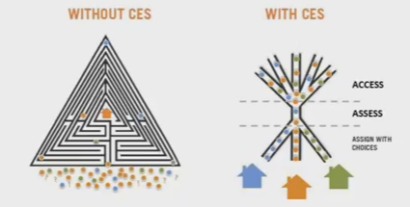
Coordinated Entry
Systematic, streamlined way for persons experiencing homelessness to quickly access housing and services that meet their needs
Uses a common assessment tool
Involves systems change and agency coordination
Incorporates prioritization of persons based on vulnerability

Slide 32
Coordinated Entry (cont.)
The CE Written Standards describe the framework for the TX BoS CoC’s CE process. They inform how local CE processes must be implemented in order to be recognized by the TX BoS CoC.
TX BoS CoC CE Google Drive -- https://goo.gl/efEQAz
TX BoS CoC Systems Change Toolkit -- https://goo.gl/hYQxmI
HUD Requirements for CE -- Notice CPD-17-01, webinar
HUD Coordinated Entry Guidebook

Slide 33
Ending Homelessness
Veteran Homelessness
Youth Homelessness
Family Homelessness
Chronic Homelessness
Opening Doors Federal Strategic Plan to Prevent and End Homelessness
www.usich.gov

Slide 34
Supporting Local Efforts to House People Experiencing Homelessness
Fundraising
Landlord Outreach
And more!
Creating a Systemic Response to Housing Crises

Slide 35
LHC Requirements
There’s a lot LHCs can do, but there are a few things they must do…

Slide 36
LHC Requirements
The CoC Board approved requirements related to:
Meetings
Planning
Data and Performance
Point-in-Time (PIT) Count and Housing Inventory Count (HIC)
Coordinated Entry (CE)
http://thn.org/wp-content/uploads/2017/07/LHC-Requirements-approved-by-CoC-Board-5-24-2017.pdf

Slide 37
THN Website – www.thn.org

Slide 38
TX BoS CoC Section

Slide 39
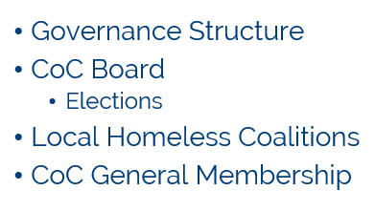

Slide 43
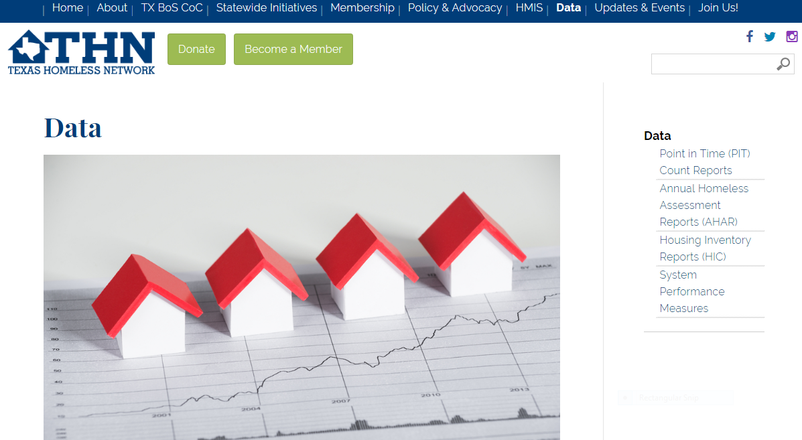
Data Section

Slide 44
THN Staff for the TX BoS

Slide 45
THN Staff for the CoC
www.thn.org/about/staff/
Eric Samuels, President/CEO
Kameron Fowler, CoC Director
Sophia Checa, Assistant CoC Director
Mary Rychlik, CoC Manager
Jesús DeLeón-Serratos, HMIS Project Manager
Kristin Zakoor, Data Coordinator

Slide 46
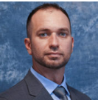
THN Staff for the CoC (cont.)
Caitlin Bayer, CoC Programs Coordinator
Victoria Lopez, HMIS Support Specialist
Benjamin Mahoney, HMIS Support Specialist
Jim Ward, CoC Technical Assistance and Performance Coord.
Tiffany Hart, Systems Change Coordinator
Kraig Blaize-Fiero, CoC Program Assistant

Slide 47
Get Involved!
Join your Local Homeless Coalition (LHC)
Contact list available at http://thn.org/wp-content/uploads/2017/07/LHC-contacts-8-18-2017.pdf
Attend monthly TX BoS CoC General Meetings
Second Wed. of the month at 2:00 via webinar
Meeting schedule: http://thn.org/wp-content/uploads/2017/07/CoC-General-Meeting-schedule-2016-17-rev-7-28-2017.pdf
Contact mary@thn.org to receive meeting invitations via the CoC’s email list

Slide 48
Contact Information
Mary Rychlik, LMSW
CoC Manager
Mary@thn.org
512-861-2180
Caitlin Bayer
CoC Programs Coordinator
Caitlin@thn.org
512-861-2192
Alexa Timmreck
VISTA Summer Associate
www.thn.org

Slide 49
If you liked this presentation, you’ll also like…

Slide 50
TX BoS CoC Conference Track
Thursday, Oct. 5
Friday, Oct. 6
5.2: T-Minus 111 Days: Coordinated Entry in the TX BoS CoC (1:45 PM)
6.2: Goal Setting Using Your Data/Data Driven Strategies (3:30 PM)
7.3: A Year in the Life of an HMIS User (10:30 AM)

