Slide 1
Housing Houston’s Heroes
How Communities have prioritized Homeless Veterans through Coordinated Access
October 5, 2017

Slide 2
Goals for Today’s Meeting
Understand how using CA system can help end veteran homelessness
Understand the new Federal Criteria and Benchmarks
It’s all about the DATA!
Identify new and ongoing challenges and solutions
Resources, HUDVASH/SSVF Referral package, Landlords, Outreach
Set targets for improving the system

Slide 3
Ending Veteran Homelessness
An end to homelessness does not mean that no one will ever experience a housing crisis again. An end to homelessness means that every community will have a systematic response in place that ensures homelessness is prevented whenever possible or is otherwise a rare, brief, and non-recurring experience.

Slide 4
Street Outreach
Drop-in Centers
Meal programs
Healthcare &
mental health providers
Faith-based programs and ministries
211 United Way Helpline referrals
Walk-ins
&
Direct phone inquiries
DV/Sexual Assault Crisis Centers
and Shelters
Criminal Justice
System
Emergency Shelter
Transitional Housing
Safe Havens
Permanent Supportive
Housing
Affordable/Fair Market Housing

Slide 5
Paradigm Shift
Programs
From
Homeless Response System
To

Slide 6
Coordinated Access to Housing and Income
Simultaneous System Transformation
VA
Targeted Hubs
Outreach Teams
Hospital
HC Jail
Call In
Center
Housing and Income Assessment
Housing and Income Program Matching
Housing and Income Program Referral
Housing and Income Navigation

Slide 7
The right people in the room
Different environment
Important & Urgent
Set a Goal
Notes:
Over the next 15 minutes, I’m going to discuss what worked in Houston. Please keep in mind that this has been and is an ongoing process and evolution. The process was driven by need and changes were not planned but evolved. You won’t know what works best for your community until you do it. We agreed as a community to be nimble, flexible, and responsive. To that end, there are a number of strategies and changes which we’ve made throughout our system to ACHIEVE THE GOAL OF ENDING VETERAN HOMELESSNESS
This slide shows what we think is our formula for success here in Houston. (next slide) Getting the right people in the room is vitally important, (next slide) changing the location of where we meet as a collective is also important, (next slide) and deciding that this issue is both Important AND Urgent. We’ll talk more about importance and urgency in an upcoming slide. (next slide) We then set a goal just slightly out of what we thought was possible. Our community goal was to house 100 chronically homeless veterans in 100 days. (next slide)

Slide 8
Notes:
TSA Houston is one of 5 agencies who are grateful to receive SSVF funding this year. These agencies include Goodwill, US Vets, Neighborhood Centers, and Career and Recovery. Any one of these agencies could be on this call today sharing some of the changes we have worked through as a collective over the past year. (next slide)

Slide 10
Community
Setting goals slightly out of reach
Housing First
Commitment to principles
100 in 100
Next new goal?
Always stay in urgency
sobriety not required
no bio-psychosocial assessments
medication compliance not required
no income required
Strategy/Data
SSVF Weekly meeting
tracking different points of lease up process
SSVF Providers HMIS Agreement
SSVF Providers integrated into Coordinated Access at VA Drop-In Centers
Housing Authority Gaining access to HMIS through User Agreement
Notes:
These are some of the examples of the changes that we’ve made Operationally. These are community goals, not agency goals. We keep those goals slightly outside of our reach. No one agency can independently achieve this collective goal. (read the rest)
In order to continue to streamline the process of accessing housing, we had to have full commitment to housing first principles.
Some specific strategic changes which were implemented include:
HA gaining access to HMIS through a USER agreement. They can now track their lease up process. This not only allows the HA to see services but also other CoC providers to see different points of the lease up process.
SSVF providers are working as a collective to end veteran homelessness. Towards this collaboration, we meet on a weekly basis to coordinate service delivery and review data. Additionally, SSVF providers are taking an active role in the coordinated access system through our VA drop in center. All SSVF providers are accepting program participants through coordinated access system. SSVF providers have made a full commitment to operate in a client centered manner vs. agency centered manner. (next slide)

Slide 11
VA programs
Monthly VASH mass briefings: (Housing Events)
Coordinated Access System
At Stand Down
At Drop In Center
Assessment and match for best resource
HUD VASH, SSVF, GPD, CoC Funded Housing
Pulling together all service providers in one single location.
SSVF
Employment
Fair Market property owners
Housing Authorities
VA
Notes:
Again, these are just some of the changes we’ve made to service delivery. We think two are vitally important: the mass briefing is a “one stop shop” for veterans to access housing. These mass briefings have become so streamlined that Outreach teams are now able to bring veterans directly from the street to the mass briefing location. This allows veterans to be issued a VASH voucher often times in the same day.
Just as an aside, many of these changes have resulted in service delivery changes within my agency. We now hold Housing Events for other housing programs and streamlined our own processes from screen to lease up. (next slide)
The second is the Coordinated Access System. Here are a couple of examples of how we’ve integrated into the coordinated access system. We brought Coordinated Access assessors to the Houston Stand Down to assess veterans for housing and begin the housing referral process onsite. We’ve also integrated SSVF providers and Coordinated Access housing assessors into the VA’s drop in center so that the assessors can match veterans that are looking for housing to best resource for them whether in the VA system or the CoC system. (next slide)

Slide 12
Effective End of Veteran Homelessness
Steady State
describes a system that maintains equilibrium, even through changes
=
Number of veterans
who will face
homelessness
each year
Number of available housing units based on
historical turnover of VASH, SSVF, and CoC

Slide 13
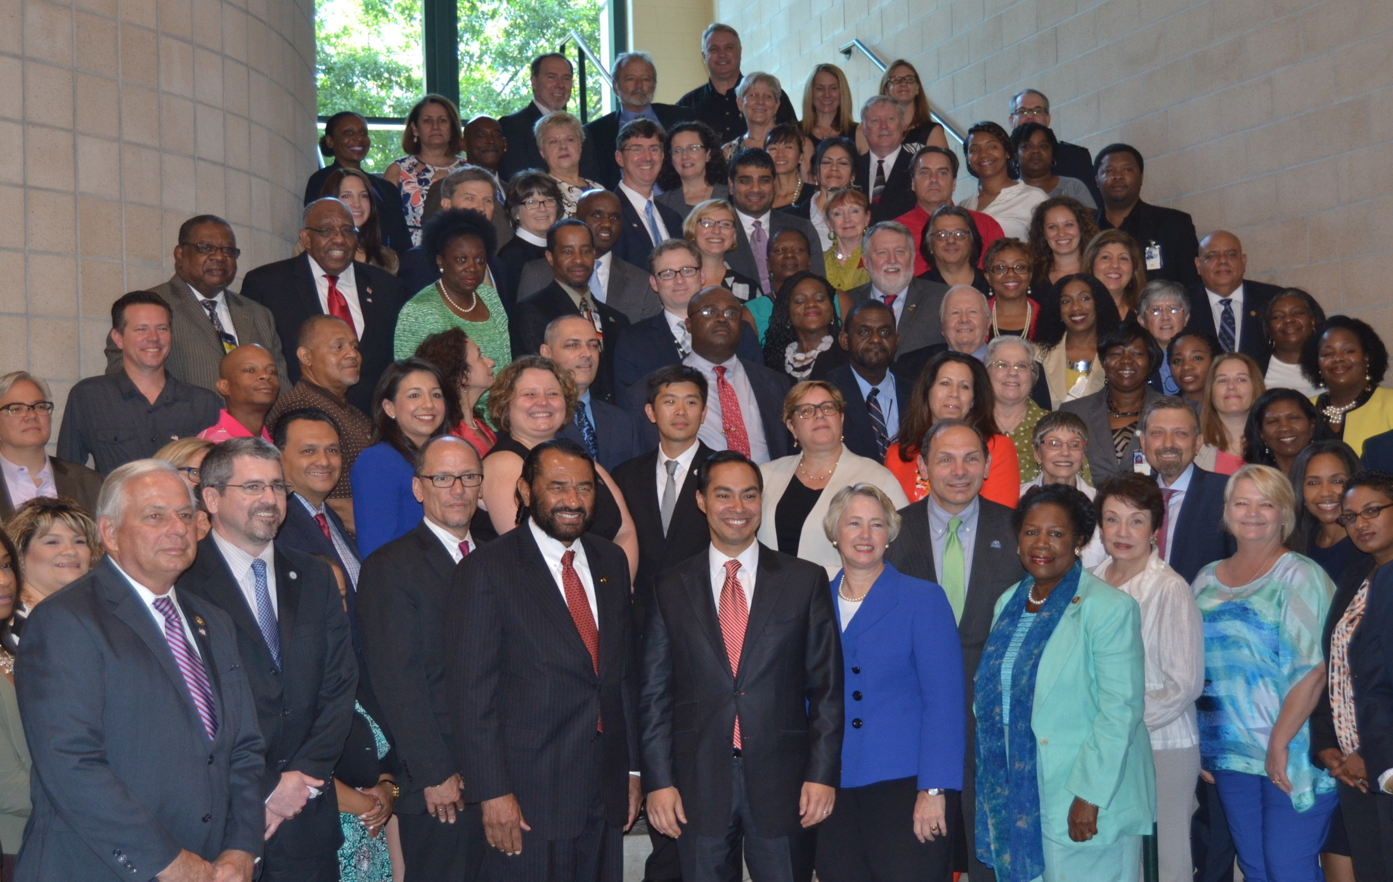

Slide 14
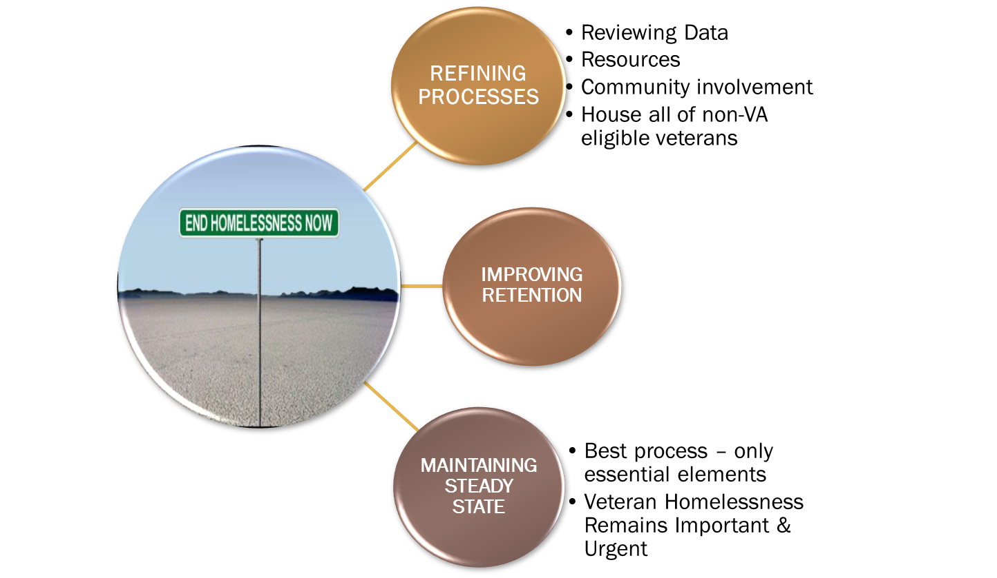
What’s Next?

Slide 15
Our Process: Landlord Recruitment and Engagement
Marketing
Barrier Buster
Funds
Navigation Services

Slide 16
Veterans Experiencing Homelessness
Point-in-Time Counts, 2012-2017

Slide 17
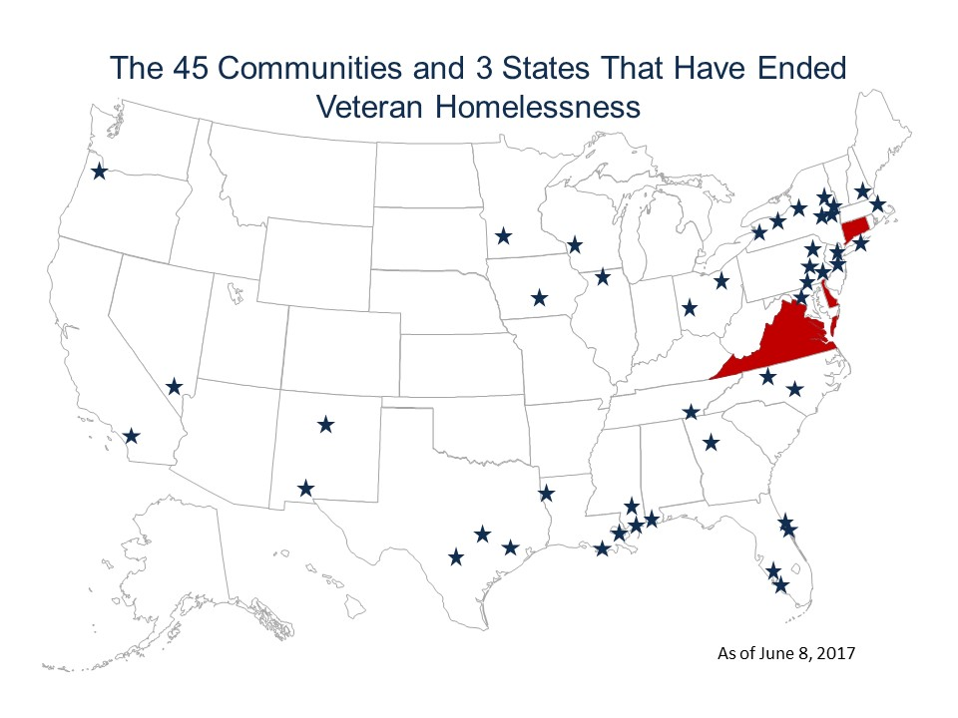
Communities Have ENDED Veteran Homelessness
Notes:
Of the 100 largest metropolitan areas in the United States, at least 14 reduced homelessness among veterans by one-half or more over three years and some reduced veteran homelessness by over two-thirds.
Those metropolitan areas include:
• Anchorage, Alaska
• Mesa, Arizona
• Phoenix, Arizona
• Anaheim, California
• Fresno, California
• Riverside, California
• Santa Ana, California
• Denver, Colorado
• Orlando, Florida
• Tampa, Florida
• Baton Rouge, Louisiana
• New Orleans, Louisiana
• New York, New York and
• Austin, Texas
The largest metropolitan area in the U.S., New York City, reduced veteran homelessness by almost 65 percent. California, the state with the most homeless veterans, was also the state with the most cities showing decreases of half or more. The largest percentage decrease outside of California was in New Orleans, LA, with a decrease of 76.5 percent. Cities with decreases of more than half were from all parts of the country, from Anchorage, AK to Tampa, FL. There has already been a great deal of progress, but more needs to be done.

Slide 18
Federal Criteria for Ending Veteran Homelessness
The community has identified all veterans experiencing homelessness.
The community provides shelter immediately to any veteran experiencing unsheltered homelessness who wants it.
The community provides service-intensive transitional housing only in limited instances.
The community has capacity to assist veterans to swiftly move into permanent housing.
The community has resources, plans, and system capacity in place should any veteran become homeless or be at risk of homelessness in the future.

Slide 19
Federal Benchmarks for Ending Veteran Homelessness
Chronic and long-term homelessness among veterans has been ended (with few exceptions, including those who choose GPD to address clinical need)
Veterans have quick access to permanent housing (90 days or less on average, with few exemptions including those who choose Transitional Housing/GPD after declining PH)
The community has sufficient permanent housing capacity
The community is committed to housing first and provides service-intensive transitional housing to veterans experiencing homelessness only in limited instances.

Slide 20
Long-Term Homeless New Definition
Long-Term Homeless: Veterans who meet length of homeless requirement to qualify as chronically homeless, but:
The Veteran does not have a qualifying disability
The calculation of 12 months of homelessness includes time spent in Transitional Housing. This means Veteran can become long-term homeless while in TH

Slide 21
Are We Meeting the Updated Federal Benchmarks and Criteria?

Slide 22
Benchmark A: Has community ended chronic homelessness among veterans?
As of August 2017
Number of chronically homeless Veterans who are not in permanent housing: 67
Exempted Group 1: Number of chronically homeless Veterans who have been offered a permanent housing intervention at least once every two weeks, but who have either not yet accepted or not yet entered housing : 4
Exempted Group 2: Number of chronically homeless Veterans who have been offered a permanent housing intervention, but have chosen to enter service-intensive transitional housing prior to entering a permanent housing destination 63
Number needed to end chronic homelessness among veterans:
67 – 4 – 63 = 0

Slide 23
Benchmark A - continued
Average: 21/month

Slide 24
Benchmark B: Do Veterans have quick access to permanent housing? (<= 90 days)
Veterans housed from August 2016 to July 2017
Total number of days | Number of days from Coordinated Access assessment to PH placement (PSH & RRH programs in HMIS; no VASH) | 17,529
Total number of veterans | Number of veterans who had been assessed by Coordinated Access and permanently housed | 139
Average number of days needed to permanently house a homeless veteran |  | Mean: 126 Median: 63

Slide 25
Benchmark C. Does the community have sufficient permanent housing capacity? Data from August 2016 to July 2017 (number of exits to PH equal to or greater than those entering homelessness)
Number of exits to permanent housing | Veterans exiting HMIS programs to PH options | 878
Number of veterans entering homelessness | Veterans newly entered in HMIS programs (SO, ES, TH, PSH, RRH) | 847

Slide 26
Benchmark D. The community is committed to housing first and provides service -intensive transitional housing to veterans experiencing homelessness only in limited instances
Data from August 2016 to July 2017
Number veterans entering TH | Veterans entering service-intensive transitional housing (VA GPD) | 272
Number of veterans entering homelessness | Veterans newly entered in HMIS programs (SO, ES, TH, PSH, RRH) | 847

Slide 27
Overall veteran PH placements
Data from January 2016 to May 2017
Includes all HMIS projects and HUD-VASH (deduplication required)
Average: 73/month

Slide 28
SSVF Enrollment Summary
New enrollments from August 2016 to July 2017

Slide 29
SSVF Exit Destinations
Exits from August 2016 to July 2017

Slide 30
SSVF Returns to Homelessness
Exits from August 2015 to July 2016
Returns to ES or TH within the next 12 months
SSVF Type | Exits | Returns | %
HP | 618 | 37 | 6%
RRH | 799 | 66 | 8%

Slide 31
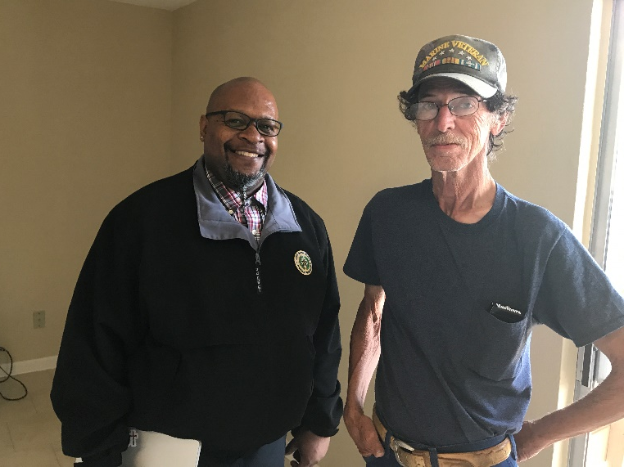
Finding a Way Home in Fort Bend: A Community Responds
Sometimes there’s a light at the end of even the darkest tunnels. After 30 years of instability, Joseph, a Vietnam Veteran, is no longer homeless. During seemingly endless decades, Joseph worked various jobs — that's until he became disabled. Though he had disability benefits, the support wasn't enough. His challenges made finding a home unfeasible.
Things changed for Joseph when he met Richmond Police Officer Emanuel Vasquez. Officer Vasquez sought the help of Coalition Fort Bend Project Manager Amber Paaso in March. Amber and The Way Home partners in Fort Bend responded to the call.
Amber and Michael Brooks, an Outreach Case Manager with the Supportive Services for Veteran Families (SSVF) program, met with Joseph when he was living in front of a vacant building on FM 1650 in Richmond. Because he did not have a stable address or access to transportation, Joseph was not receiving the health care and medications he needed from the Veteran's Administration. Within a few days, Michael was able to help Joseph secure a studio apartment in Richmond. After a few visits to collect documents, Joseph moved into his new home this month.
Thanks to several The Way Home partner organizations working
together, Joseph finally found his way home.

