Slide 1
Leading the Conversation
A New Narrative For Health & Human Services
P: 512.782.4355
F: 877.585.6513
3710 Cedar #228,
Austin, TX 78705
|
www.healthstartfoundation.org

Slide 2
Table of Contents
Section | Section Name
1. | Introductions
2. | National Human Services Assembly (NSHA)
3. | What We Say – What They Hear: The Human Services Gap
4. | Framing the Story
5. | Examples From the Field
6. | Questions
Notes:
We’re here to build Public Support for the important work we do through more effective and rigorously researched and tested communications models

Slide 3
Introductions
Robin Herskowitz, Founder & Executive Director, HealthStart Foundation
Jo Kathryn Quinn, Executive Director, Caritas
Members One Voice Central Texas
A coalition of nonprofit health and human service organizations unified by the common value that People Come First
Notes:
HealthStart’s mission is to help children build strong brains and bodies through early health education so that they can reach their potential and help set the foundation for healthy communities.
Caritas’ mission is to prevent and end homelessness for people in Greater Austin.
OVCT is a 100 member strong coalition of health and human services organizations working to make sure that everyone can contribute to our communities and thrive. Together we connect people of all ages and circumstances to social resources, opportunities, and support so everyone we serve can reach their full potential.

Slide 4
National Human Services Assembly
DC-based association of the largest national human service federated organizations in the U.S., reach and support nearly every household in America.
Notes:
TALKING POINTS
Walk through new communications research with 2 key goals
Review what the sector currently does/says that undermines our work and limits public support
Share the new frame for human services which is proven build public support and engage audiences to action

Slide 5
One Voice & The National Human Services Assembly
1999 - NHSA established the FrameWorks
Communications research to effectively reframe social issues because….
Notes:
How human services experts and advocates view the health and human services sector looked very different from the way the public views the human services sector. NHSA brought in multi-disciplinary team of social scientists, cultural linguists, and anthropologists to determine where the disconnect was and how to address it.

Slide 6
What is Human Services?
Notes:
TALKING POINTS
Ask for Audience Feedback FIRST: what surprised them? Concerns them? What did they hear?
Explain that in this short video is representative of what we heard in our research.
Make sure to note:
The impluse to blame individuals for their problems
Focus on money as solving problems
Narrow view of human services – food/clothing/shelter
Charity/compassion model devalues work of the sector

Slide 7
Mapping the Gaps
Experts
Public
Services Advocacy
Prevention
Scope of human services
Direct services
Systemic
Causes
Individual
Civic
Responsibility
Individual
Direct
Recipients
Everyone
Beneficiaries
Source: FrameWorks Institute, Handed to them on a Plate: Map the Gaps Report, 2013.
Notes:
TALKING POINTS
First phase of our research: conducted focus groups and surveys to learn what the public understands about human services and compared to what the experts know to be true.
These are the top answers.
Be sure to note at the end:
Beneficiaries: Aligned with the current frame of Makers vs Takers in public discourse.
TRANSITION:
How does this play out in our communications
FOR MORE INFO:
Source: http://www.frameworksinstitute.org/assets/files/humanservices/NHSAMaptheGaps-Final7-31-13.pdf

Slide 8
You Say…They Think
In tough economic times, people who get those programs have a better quality of life than the rest of us! Must be nice to have someone else pick up the tab...
In these tough times people need more support, not less! This is no time to cut funding to human service issues.
Source: FrameWorks Institute, You Say They Think, 2014.
Notes:
Tip: Have them read the slide first
TALKING POINTS
We typically create messages in an echo chamber
Key point: YOU ARE NOT YOUR AUDIENCE
You are experts and understand industry short-hand and jargon and why people need human services and how they work.
Highight in the second example:
Zero sum thinking
Makers vs Takers
Othering
Transition:
Why does that happen –that you say one thing and your audience thinks another?
FOR MORE INFO and additional options:
http://www.frameworksinstitute.org/toolkits/humanservices/elements/pdfs/nhsa-yousaytheythink2015.pdf

Slide 9
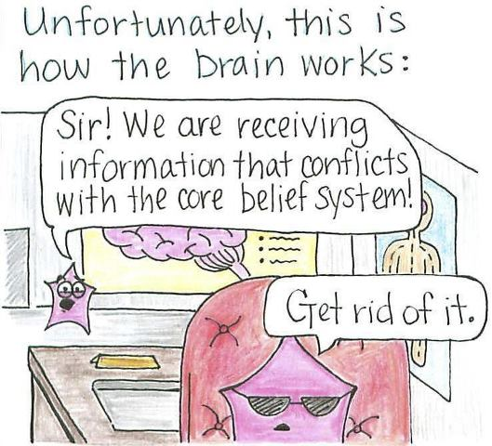
Notes:
TALKING POINTS
Key point: PEOPLE AREN’T BLANK SLATES
Last few decades of neuroscience research on how we our brains process information.
1. Brains have evolved to be efficient and fast and a lot of our thinking is unconscious.
Existing beliefs are formed at a young age and become ingrained and hard to dislodge ➔Confirmation Bias
More on Confirmation Bias:
https://en.wikipedia.org/wiki/Confirmation_bias
Transition:
What can we do about this?

Slide 10
Cultural Models
Notes:
Note:
Brain research – individual scale
Cultural models--large scale
TALKING POINTS:
We employ something called cultural models in the stories we tell.
Cultural models are deeply and widely held cognitive shortcuts used to make sense of new information. They motivate thought and behavior unconsciously. Baked into culture through books over generations.
Very powerful. So we need to be aware of when we are invoking them and if they build support for our work.
This one goes to the heart of What it means to be American.
Rugged Individualism
Bootstraps
Grit/Willpower
American Dream – from nothing to Oprah
Connect back to what they heard in the video
Transition:
Share one other cultural model. My personal fave.
FOR MORE INFO: Source: http://www.frameworksinstitute.org/pubs/mm/talkinghumanservices/page2.html

Slide 11
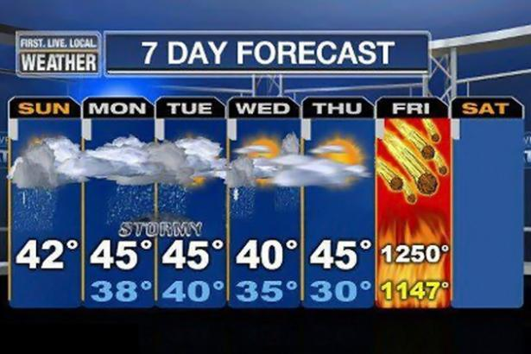
Fatalism
Fatigue
Skepticism
Notes:
TALKING POINTS
There are several cultural models implicated in our communications. More details in a workshop.
Fatalism Model = the problem feels too big to solve/sky-is-falling language
Crisis tone disengages people from the issue and solutions.
Leads to Fatigue - Everything matters so nothing matters
Invokes Skepticism – claims are exaggerated. Immediate impacts aren’t felt. Allows people to retreat to ideological corners.
Urgency Disengages.
KEY POINT: Explanatory tone will help jolt people out of partisan bickering and you can reach the persuadable middle
BE THE VOICE OF REASON

Slide 12
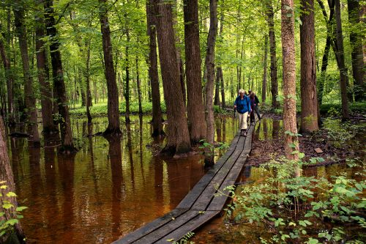
What Is
Well-Being?
What Threatens
Well-Being?
Lack of Willpower
Family Bubble
Communities are Unsafe
Financial Health
Physical Health
How Do We Improve
Well-Being?
What are Human Services and
How do they Work?
• Individuals are Responsible
• Government is Inept and Corrupt
• Informal Networks
Cognitive Hole
Direct Aid to Needy
Charity and Compassion
Kids are sponges
Notes:
How do we do circumvent these mental shortcuts and cultural models to really connect with our audience?
Worked with the FrameWorks Institute in DC. They idenitified what they call the Swamp of HS
Swamp: ecosystem of cultural models people use to understand human services/well-being
“Well Being” is how we describe the ultimate goal of human services but for our participants.
What’s missing in the definition of Well Being? Mental, what else? It’s basically just things like job training and unemployment assistance but nothing broader – afterschool programs, independent living for people with disabilities, activities for seniors
What threatens wellbeing?
Individual choices
Bad parents and not poor school system, lack of good nutrition, opportunities to succeed
What are Human Services?
Can’t leave the cognitive hole empty bc they will fill with ideas that don’t nec align with your interest but when push comes to shove, “direct services” and those services are then framed as kindness and charity NOT framed as a sector that we as a society need.
Also makes it more of a private choice not a public concern. Only temporary –best program gets people OFF the program as soon as poss. Dire need, emergency, very narrow view of sector.
Where did “building well-being” come from? It was tested against others. Came through process of developing metaphors. Well-Being container is large enough to hold the wide range of sectors.
well-being is the thing we’re trying to achieve: it’s an umbrella term for the outcomes you’re trying to achieve. fully realized human capacity was not a term we could use. NOT wellness.
It’s a pretty broad term which is like human services. The best word we could come up with and when testing it it only produced good things and did nothing bad. “human development” people don’t know what it is, it’s a black box. Doesn’t’ seem like something we could “build” just happens. No process there. Needed something we could “do” or “effect”.
We had a whole group of people working on this and testing it. Might not be perfect. But no slippage to an individual character trait—your motivation, decisions. Its something we can construct as a society. Even “thrive” is about you and what you do.
Well-being is the social good that the human service sector provides/builds. And human potential fosters that. We’re trying to make well-being.
ASK: WHAT ARE YOUR GATORS

Slide 13
What cultural models might “eat” this message?
Growing up in poverty increases the chances that an American will continue to live in poverty as an adult. That's of course bad for the people directly affected and also bad for the economy. Furthermore, it casts a long shadow on The American Dream.
The real tragedy here is that we know what programs work to combat intergenerational poverty. We simply fail to support them.
A common response to intergenerational poverty is to scale back forms of direct aid to families — welfare, food stamps, etc. — that are frequently labeled as creating dependency. This position flies in opposition to the facts. Research shows that giving aid to a family increases the chances that a child will not continue to live in poverty as an adult. If we want to end intergenerational poverty in America, we should be giving families more aid — not less.
To state the obvious, money is a big deal. Having more money makes all sorts of things possible — a healthier diet, higher quality child care, a move to a safer environment, a trip to a museum or other experiences that expand a child's world. Kids with access to any of these things are more likely to thrive.
Notes:
American dream, focus on the individual—healthier diet (choice), having more money (choice) access to healthy food instead, early learning are available to all and are affordable (instead of higher quality child care)
Intergenerational poverty (fatalism—nothing will work), welfare, food stamps
Myth/fact structure in 3rd para
Refers to “government” programs which cues up the govt is inefficient.
Use the word “aid” a lot and plays into “temporary” and “charity”
Beneficiaries are only children “the most worthy” and not adults (like “the dreamers” immigration). Can’t keep playing into the “worthiness game” zero sum (if you get more, I get less)

Slide 14
The Solution: Framing
Notes:
TALKING POINTS
So what can we do instead, what stories can we tell to connect with our audience and shift public beliefs?
Frames are choices about how to tell a story: What to leave out, What to leave in, and What to emphasize.
Framing helps people think more productively. Vs. Imposing an idea (messaging) onto someone. Remember: it’s nearly impossible to dislodge and existing belief.
Neuroscience shows that helping people think about a problem is more persuasive than trying to disprove or counter existing beliefs.
When communication is effective, people can see an issue from a different perspective

Slide 15
Research-based Communications
Sample
Treatment Groups
Analysis
Diffs btwn treatment and control groups (controlling for demographic variability)
Frame A
Frame B
Frame C
Control (No Prime)
Outcome
Measures
4000+ online participants - nationally representative sample
Random assignment to a
treatment group
Attitudes
Knowledge
Policy Support
Notes:
TALKING POINTS
How did we do this, 2nd phase of reserach
5000 surveyed to test potential frame elements for productivity and to ensure their stickiness
National sample representative of the voting population.
Across geography (if calif is pulling up a message they toss it out), race, gender, education, income, religion
In the research we looked regionally (works in the south and north east) but not a city or local level. but these differences are not as big as you’d think). Fundamental machinery in the brain is surprisingly similar. So we have a strategy that works for folks broadly.
But you’re style and what’s special about your place is also important to know and integrate to make it work in your community.
The research shows that this story will work, with conservatives and dems. It’s effective across ideology.
Explain Persistence Trials (like telephone game): Tells us whether the integrity of the frames hold up. Is it staying to the concepts we’re trying to convey to the public?

Slide 16
A Well-Framed Story Arc:
Answering the public’s big questions about social issues
What’s this about?
How does this work?
If it’s not working, why not?
Why does this matter?
What can we do about it?
METAPHORS
EXAMPLES
EXPLANATIONS
PRINCIPLES
EFFICACY
SOLUTIONS
VALUES
Notes:
A well-framed story answers the public’s big questions about social issues.
An effective narrative on any given social issue has its own structure that builds understanding, shifts opinions, and generates supports by answering the following questions.
Values to show what’s at stake and provide “big picture” context
Principles to explain the fix, efficacy to empower the public, and solutions to show how the problem can be addressed.

Slide 17
A Well-Framed Story Arc:
Answering the public’s big questions about social issues
What’s this about?
How does this work?
If it’s not working, why not?
Why does this matter?
What can we do about it?
Human Potential: Human services help everyone to reach our potential, so we can all contribute fully to our communities
Notes:
Values orient decision making.

Slide 18
Which Value works? That’s an empirical question.
Prevention
Remediation
Planning and Research
Importance & Efficacy
*
*
*
Percentage point increase in policy support vs. control
*
VALUE:
Autonomy
VALUE:
Opportunity for All
VALUE:
Compassion
VALUE:
Human Potential
* = Statistically Significant
p < .10
Messages
Notes:
FrameWorks tested every element and the entire frame together.
First two taken from the field: autonomy and compassion”. Other two FW recommended: opp for all, human potential
Still work to be done because human potential only moves the needles a bit on importance and efficacy so need to use the full frame.

Slide 19
Human Potential
Redirect public perceptions from:
Individuals are Responsible
Well-Being = Financial Self-Sufficiency
Well-Being = Physical Health
Conveys human services as:
Applicable to everyone
When people reach their full potential, everyone benefits
Your issue matters because...
“When we support well-being, we make sure that everyone can reach their potential and fully contribute to our communities.”
Notes:
The value does a lot of work for you with little explanation.
Public intuitively understands:
--the intrinsic value of everyone reaching their potential
--that you can’t meet your full potential on your own (innoculates against the “rugged individualism” model)
--that everyone’s potential does and should look different
Important to couple the value with the concept that it then allows people to contribute to their community in a meaningful way. This allows the public to understand the impact of human services beyond just the direct recipient.
Lots of different ways for people to contribute across lifespan and circumstances.

Slide 20
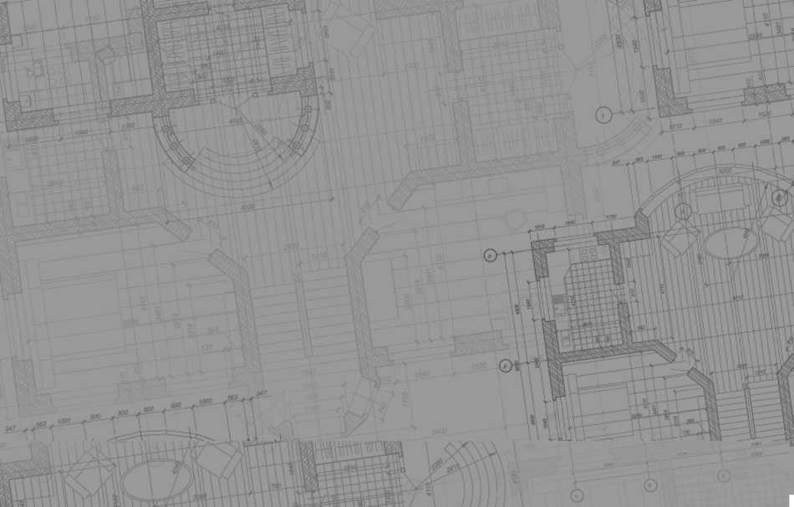
Leading the Conversation (1)
Reframed with Building Well-Being
Framed with Crisis and Fatalism
As our policymakers use our most important civic tool for peering into the future - our public budget - we must make it a priority to attend to our nation’s most important asset - our human potential. When we support well-being, we ensure that everyone can contribute to our communities.
A good budget meets our needs today and plans for the future - so let’s keep in mind that we need everyone’s potential for the civic, social, and economic well-being of our communities.
As lawmakers wrestle with the budget, funding for vital services are at risk of being gutted. The cuts proposed would shut the door to critical services for hundreds of thousands of families across the state. But then what? Families in need are not going away. Our elected officials need to do their jobs.
We need a budget that is prudent, reasonable and doesn’t end up costing more than it saves. Cutting in the dark is never a good idea.
Notes:
TALKING POINTS
Here is one short example of how the frame is different from our current communications.
On the left: fatalism, snipes at lawmakers, our partners. Have to be careful not to cue up the Government is Ineffective model. Not productive.
On the right. Note the difference in tone. Tone and order are very important to holding your audience’s attention.
Lose the Lecturing. Focus on Solutions.
Examples in our toolkit. Can be plagiarized.
http://www.frameworksinstitute.org/toolkits/humanservices/

Slide 21
A Well-Framed Story Arc:
Answering the public’s big questions about social issues
What’s this about?
How does this work?
If it’s not working, why not?
Why does this matter?
What can we do about it?
Construction: Well-being is built, by a team, over time
Construction:
Shaky foundations, missing materials, life’s storms can all negatively impact wellbeing
Human Potential: Human services help everyone to reach our potential, so we can all contribute fully to our communities

Slide 22
Building Well-Being
Emphasizes the need for support and reinforcement throughout a lifetime
Describes well-being as supports and foundation, not bootstraps
Implies a sense of communal responsibility (can’t build a house by yourself!)
Source: FrameWorks Institute, Talking Human Services MessageMemo, 2015
Notes:
4 things this metaphor does well:
Big enough to include more than just money…. able to have a broader discussion about what constitutes well-being
You can’t build a house by yourself. Inoculating against individual responsibility/will power. While invoking all the people involved in the construction of the house. These are specialists. They have specialized knowledge. They do research. They know what works.
Construction is an ongoing process. It’s not a singular event. Maintenance. Things you do to keep up the stability of the house. Gets away from “temporary and gotta move on”
The metaphor is not the message. It’s the thing you hang the message on.
Metaphor promotes the idea that human services are accessed across the lifespan
More than direct services
Interconnected systems
Supports and foundation, not bootsrtaps
Well-being is the social good that the human service sector provides/builds. And human potential fosters that. We’re trying to make well-being.

Slide 23
Leading the Conversation (2)
Reframed with Construction/Life’s Storms
Framed with Vulnerable Populations
Our nonprofit organization believes everyone should have the opportunity to reach their full potential and contribute to their community. We provide the bricks and mortar of sturdy well-being: social relationships, opportunities to maintain physical fitness, access to counseling or other supports for mental health. When these materials aren’t available, people may have difficulty weathering the life storms that can affect all of us - a layoff, the loss of a loved one, a lingering health concern. Since 1899, we have helped to shore up the foundations of well-being, through advocacy, research, and direct services.
Our nonprofit organization is dedicated to helping those in need live healthy, productive lives. Since 1899, we have supported and empowered America’s most vulnerable groups, including veterans, seniors, people with disabilities, the homeless, those recovering from addictions, and other at-risk individuals. In collaboration with other nonprofits, we are able to advocate for the most vulnerable among us.
Notes:
TALKING POINTS
Here is one short example of how the frame is different from our current communications.
On the left: Using the theme of “vulnerability” which we know tends to cue up our audience’s unproductive beliefs and allows them to “blame” people for their problems. Lists “groups” of people (eg the homeless) suggesting that they are homogenous characteristics and therefore homogenous solutions.
On the right. Note the difference in tone. More positive. Makes more clear they types of things the organization does and who they work with. Anyone can seem themselves in this description.
Examples in our toolkit. Can be plagiarized.

Slide 24
A Well-Framed Story Arc:
Answering the public’s big questions about social issues
What’s this about?
How does this work?
If it’s not working, why not?
Why does this matter?
What can we do about it?
Construction: Well-being is built, by a team, over time
Construction: Shaky foundations, missing materials, life’s storms can all negatively impact wellbeing
Construction: Well-being is about planning and maintenance
Human Potential: Human services help everyone to reach our potential, so we can all contribute to our communities
Life Cycle Examples Demonstrate how programs support well-being throughout life, show the scope of human services, and highlight prevention.
Notes:
TALKING POINTS
Stories help us make sense of the world, our place in it, why things happen the way they do
When we frame, we tell stories in a particular order and answer particular questions that are organized to build support and understanding.
Instead of leading our stories (first few sentences are prime real estate!) with crisis language, or the problem, or data – lead with a value. We make big and small decisions based on our values.
Explain the complex work we do with metaphors (feeling blue/pushing a rock up a hill). Metaphors are used by people to spread ideas. Turns your audience into ambassadors.
What are the solutions we recommend? Examples of how our programs work throughout life.
THIS IS IT. This order, these questions, this value and metaphors. We tested all of this. The results were off the charts. We know it works.

Slide 25
Austin Mayor Steve Adler on
National Mayor’s Mental Health Day of Action
“Our community is so much stronger when everyone has access to the tools and the support that they need, so that everybody can contribute to their fullest potential to our city and to our community,” Adler said.
Notes:
Austin Mayor Steve Adler on National Mayors' Mental Health Day of Action. He called on Congress to protect mental health services in the American Health Care Act, which, if passed in its current state, would leave many people without access to mental health care in Travis County
http://kut.org/post/vulnerable-texans-could-lose-access-mental-health-care-under-gop-bill

Slide 26
To Change the World, Change your Frame
You are not your audience.
Be the voice of reason.
Lead with the value of human potential.
Notes:
Tip: Always highlight key points at the end.

Slide 27
Before Reframing
We design fun, science-based programs to help children adopt healthy habits younger.
Why is younger better?
By five years old, our food and fitness preferences are often set. Which makes the link between our childhood and adult health strong. It’s also easier to learn a good habit than break a bad one! Roughly one-third of Texas children are overweight or obese. HealthStart fills the urgent need for early health education today so our children and communities can thrive tomorrow.
How do we do it?
HealthStart delivers on its mission with key programs like
our curriculum, Health Education for Youngsters (HEY!), which uses a whole-child approach to build on the natural curiosity of our youngest about how their bodies work with ways to be healthier,
our cafeteria nutrition education, What are YOU Feeding?
our CHEWs (Children’s Health Education Workshops),
our digital game, Monstralia: A Healthy Life for Your Little Monster, and
our parent-child cooking classes/kid cooking classes
As a result, our students become health “change agents,” sharing what they learn with their families and influencing the community at large by changing how we eat, move and live together.
Where are we going?
Since our first year, HealthStart has grown the number of schools it reaches by 566%. We plan to keep expanding our educational outreach regionally to eventually help children across America live healthier lives.
After Reframing
Health Start helps children to build strong brains and bodies so they can reach their full potential and contribute to our communities. We do this by working with childcare centers, schools, and health care clinics so children can establish good health habits early in life. Roughly one-third of Texas children are overweight or obese, which can lead to significant health problems later in life.
By five years old, our food and fitness preferences are often set. Which makes the link between our childhood and adult health strong. It’s also easier to learn a good habit than break a bad one!
As a result of HealthStart’s programs, our students become health “change agents,” sharing what they learn with their families and influencing the community at large by changing how we eat, move, and live together.
How We Do It We design fun, science-based programs to help children adopt healthy habits younger. HealthStart delivers on its mission with key programs like:
Our early pre - and elementary school curriculum, Health Education for Youngsters (HEY!), which includes tools to build a sturdier foundation for nutritional, physical, social and emotional wellbeing for life.
Our cafeteria nutrition education initiative, What are YOU Feeding? delivers the materials to construct good nutrition decisions. Children can see the connection between what they eat at school and their health.
Our CHEWs (Children’s Health Education Workshops)
Parent-Child Cooking Classes/Kid Cooking Classes
With the HealthStart’s tools children build healthy habits, a strong foundation for lifelong well-being.

Slide 28
Learn More
info@onevoicecentraltx.org
robin@healthstartfoundation.org
www.nassembly.org
www.frameworksinstitute.org
Notes:
Include your contact information
TALKING POINTS
Take advantage of free online resources
Sign up for reframing network.

Slide 29
Thank you
3710 Cedar Streeet #227
Austin, TX 78705
|
www.healthstartfoundation.org

