Slide 1
Final PIT Session

Slide 2
Housekeeping
Everyone will stay muted during the webinar
Please type all questions into the Q&A box
We will answer questions at the end of the presentation
If need more detailed help, please email kristin@thn.org to set up a phone call.

Slide 3
Agenda
Reminders
Counting Us App
Sheltered Count Review
Unsheltered Count Review
Housing Inventory Count
Questions

Slide 4
PIT Count Date:
1/25/18
Inclement weather date:
1/29/18
Notes:
If conditions are not safe for you to conduct the count on 1/25 please inform THN and make arrangements to conduct the count on 1/29/18

Slide 5
Deadlines
All Saved Drafts need to be submitted at the end of each count shift
No surveys should remain on a volunteer’s device
All paper surveys must be entered in the app by 1/27/18
Scan and email (or mail) to THN by 2/2/18
All Housing Inventory Count worksheets must be submitted by 1/31/18
HIC worksheets will be submitted via Google Forms
Volunteer Hour Tracker must be sent to THN by 2/1/18
Scan and email or mail

Slide 6
Volunteer Hour Tracker
MAKE SURE TO HAVE ALL YOUR VOLUNTEERS FILL OUT FORM!
*Please scan and email to kristin@thn.org by COB Thursday, February 1st*

Slide 7
Volunteers
Emphasize to volunteers the importance of complete surveys
Missing data and incomplete surveys negatively impacts your final reports
Make an effort to collect:
First and Last name (initials if hesitant)
DOB (age range if hesitant)
Demographic information
Provide Volunteer Interview Guide to help them become comfortable with the PIT process

Slide 8
Day of Count Took Kit
Notes:
On the site now- purpose is to help you have all important docs handy for the day of the count to answer any questions and ensure smooth process

Slide 9
Counting Us App

Slide 10
Survey UPDATE!
THN has added new questions to the survey
Purpose of adding new questions is to ensure that we are collecting valuable longitudinal and sub-population data
Questions added:
Youth
Veteran
Education
Reasons for becoming homeless
Update is complete for both Sheltered and Unsheltered surveys

Slide 11
Day of Count Set-Up Key
MAKE SURE ON THE DAY OF THE COUNT ALL SURVEYS ARE COLLECTED UNDER SET-UP KEY…
TXBOS18

Slide 12
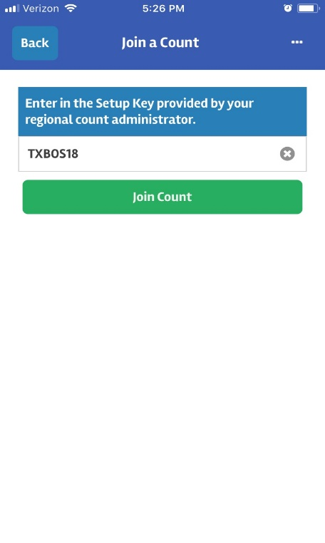
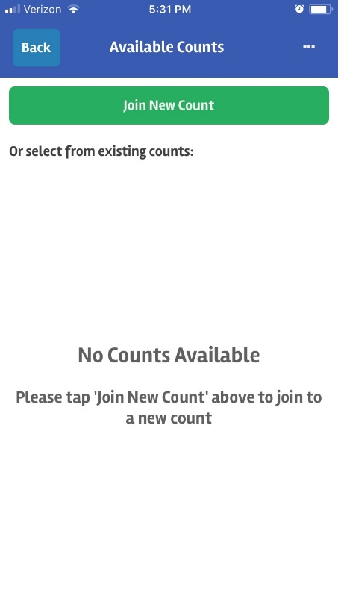
How to Change Set-up Key
If already using TXBOSTest set-up key:
If have not selected a set-up key:

Slide 13
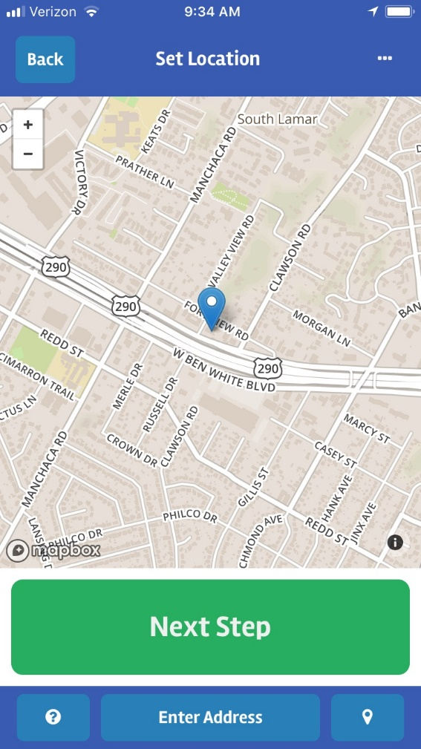
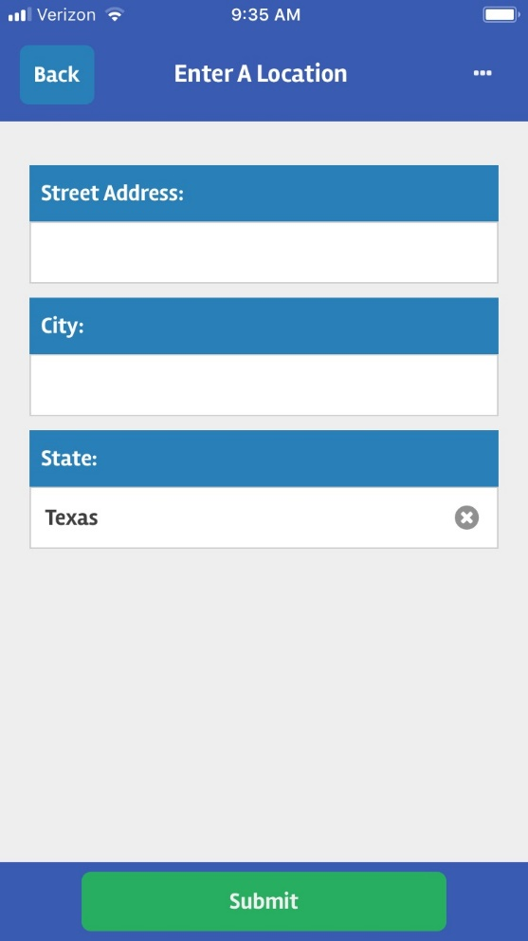
Domestic Violence and Surveys
Use Counting Us App
On geo-location screen, click “Enter Address” button and ONLY enter in City and State information
DO NOT enter in first or last name
For date of birth information ONLY enter in age range

Slide 14
Sheltered Count

Slide 15
Sheltered Count
You should count:
Emergency Shelters:
Domestic violence shelters
Hotel, motel, or apartment vouchers paid for by a public or private agency because the individual or family is homeless
Transitional Housing
You should NOT count:
Persons living doubled up in conventional housing;
Formerly homeless persons living in Section 8 SRO, Shelter Plus Care, Supportive Housing Program permanent housing or other permanent housing units;
Persons living in conventional housing and receiving temporary assistance (Rapid Rehousing or Homelessness Prevention) from a program funded by the Homelessness Prevention and Rapid Re-housing Program (HPRP);
Children or youth, who because of their own or a parent’s homelessness or abandonment now reside temporarily or for a short anticipated duration in hospitals, residential treatment facilities, emergency foster care, or detention facilities;
Adults in mental health facilities, chemical dependency facilities, or criminal justice facilities.

Slide 16
Shelter Survey
Shelter count should include anyone staying in Emergency Shelter or Transitional Housing
THN sent a list of ES and TH to PIT Leads to verify which programs are still active or new in their community
It is of utmost importance that THN has an updated list of ES and TH so that those programs can be entered into the system and selected on the day of the count

Slide 17
Sheltered Count and HMIS
NO surveys will be collected via HMIS
All surveys should be conducted via Counting Us App
If given permission, paper surveys and uploaded into Counting Us App
HMIS users MUST enter a “PIT Count 2018” Service
Learn how to enter a service in HMIS here

Slide 18
Unsheltered Count

Slide 19
Unsheltered Count
A count of people who are homeless but not in a shelter or transitional housing program is referred to as an unsheltered count.
The unsheltered count requires identification of homeless people that are living on the street, in abandoned buildings, in their vehicles, tents, shanties, parks, woods, transportation stations, or other places not meant for human habitation on January 25th.
Coordinated Entry

Slide 20
Sample Script
Hello, my name is ___________________, and I am helping ________________conduct a short survey of our community. We would like to learn more about people experiencing homelessness, what kinds of problems they face, and whether or not their needs are being met.
Your participation is strictly voluntary, and all of your responses are confidential. Your privacy will be protected and respected. If questions make you uncomfortable you do not have to answer them. Would you be willing to take a few minutes to answer some questions?

Slide 21
Safety
Do
Don’t
Ask a person to participate if you think they are homeless
Introduce yourself and explain what you are doing
Be sincere and caring
Remain calm
Know how to de-escalate
Know emergency numbers
Know appropriate distance
Honor requests to not participate
Provide shelter information if possible
Dress appropriately
Leave valuables behind
Wake up someone
record as observation survey
Approach if you don’t feel comfortable
record as observation survey
Mandate participation
Invade personal space
Cross barriers
Promise anything you can’t deliver
Be judgmental
Give money or offer rides
Share any confidential info or photos of participants
Panic
Put anyone in danger
Deviate from the survey

Slide 22
Tips
Be aware of your surroundings
Always travel in pairs
Be respectful and understanding
Make sure to get consent before starting the survey
Remember survey information is confidential
Contact PIT lead immediately if:
Someone is in danger/hurt
Made a mistake with the app
Lost or unable to locate team
Need any other type of help

Slide 23
Housing Inventory Count

Slide 24
PIT & HIC, what is the difference?
Point-in-Time Count (PIT)
Housing Inventory Count (HIC)
Number & characteristics of person experiencing homelessness
Count of sheltered and unsheltered homeless persons on January 25th, 2018.
Surveys will be conducted via the Counting Us App
Completed in conjunction with the PIT
A count of all beds and units available on 1/25/18 dedicated to individuals experiencing homelessness
HIC worksheets must be filled via Google Forms to reflect bed and unit availability on 1/25/18

Slide 25
HIC Details
The Project Types included in the HIC are:
Emergency Shelter (ES)
Transitional Housing (TH)
Permanent Housing (PH)
Permanent Supportive Housing (PSH)
Rapid Re-housing (RRH)
Other PH (OPH) – consists of PH – Housing with Services (no disability required for entry) and PH – Housing Only, as identified in the 2014 HMIS Data Standards)
Beds and units in the HIC must be dedicated to serving homeless persons, or for permanent housing projects, dedicated for persons who were homeless at entry.
To be completed on night of PIT Count, 1/25/18
THN will send out HIC worksheets along with instructions to be completed by responsible party

Slide 26
Not included in the HIC
The project types not included in the HIC are: Beds in institutional settings not specifically dedicated for persons experiencing homelessness, for example:
Detox facilities
Emergency rooms
Jails
Acute crisis or treatment centers
Children in foster care or wards of the state

Slide 27
Example of HIC Worksheet

Slide 28
PIT Leads and HIC
Some PIT Leads to complete HIC worksheets for your community
If you are not going to complete HIC worksheets-please assist THN in connecting with point-person who can complete the worksheet
THN sent out first round of HIC emails and thank you to those who responded!
THN will send out follow-up emails to make sure we have contact information for each ES, TH, RRH, and PSH program in our BoS
Please inform us if there are any new or existing programs that are not on the list

Slide 29
THN Staff Support
Each community will be assigned a staff member for the day of the count
Help PIT Lead answer any questions about the app
Fix any survey errors
Answer any general PIT questions
Support by THN staff will be available during normal business hours
KZ will be providing support throughout the day of the count
Office # 512-354-2033
Cell # 734-992-7179

Slide 30
Social Media
Find us on FaceBook with @TexasHomelessNetwork
Follow us on Twitter @TXHomeNet#TXBOSPIT2018
Notes:
If you participate on SM please make sure to tag us
Be respectful and do not post picture without asking permission
Many ppl post volunteer pictures to highlight efforts

Slide 31
Concerns for Day of Count
This is the time to address any questions or concerns about the app, training materials, support, etc.
THN wants to make sure you are prepared for a successful count.
Questions?

Slide 32
Thank you!

