Slide 1
PIT Q&A Session

Slide 2
Housekeeping
Everyone will stay muted during the webinar
Please type all questions into the Q&A box
  We will answer questions after THN updates
If need more detailed help, please email kristin@thn.org to set up a phone call.
Poll

Slide 3
Agenda
Reminders
Counting Us Updates
Domestic Violence Info
Specific Populations
Housing Inventory Count
Day of Count Took Kit
Q&A

Slide 4
PIT Count Date
1/25/18

Slide 5
Changes to This Year's PIT Requirements
U.S. Department of Housing and Urban Development (HUD) has made the following changes to the 2018 PIT Count.
Consistent with the updated 2017 HMIS Data Dictionary, HUD changed the “Don’t identify as male, female, or transgender” gender response option to “Gender Non-Conforming (i.e. not exclusively male or female).”
HUD is requiring that data reported on survivors of domestic violence should be limited to reporting on those who are currently experiencing homelessness because they are fleeing domestic violence, dating violence, sexual assault, or stalking, as opposed to reporting on survivors who have ever experienced these circumstances.
CoCs are now required to report the number of children of parenting youth families where the parent is under 18 separate from the children of parenting youth families where the parent is aged 18 to 24.

Slide 6
Volunteer Hour Tracker
MAKE SURE TO HAVE ALL YOUR VOLUNTEERS FILL OUT FORM!
*Please scan and email to kristin@thn.org by COB Thursday, February 1st*

Slide 7
Volunteer Training
Emphasize to volunteers the importance of complete surveys
Missing data and incomplete surveys negatively impacts your final reports
Make an effort to collect:
  First and Last name (initials if hesitant)
  DOB (age range if hesitant)
  Demographic information

Slide 8
Counting Us App

Slide 9
Day of Count Set-Up Key
MAKE SURE ON THE DAY OF THE COUNT ALL SURVEYS ARE COLLECTED UNDER SET-UP KEY…
TXBOS18

Slide 10
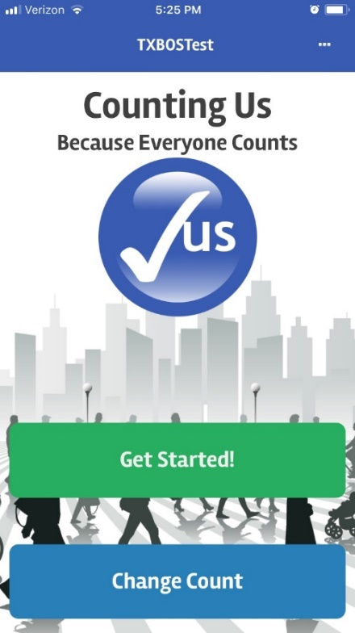
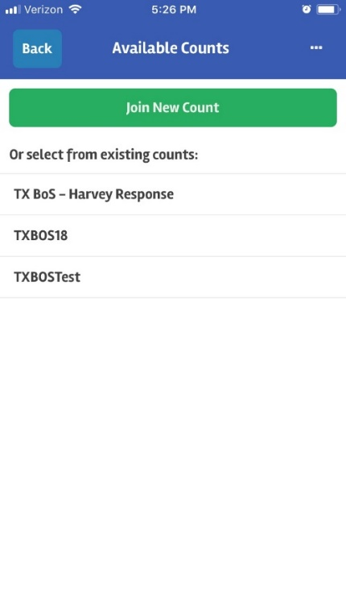
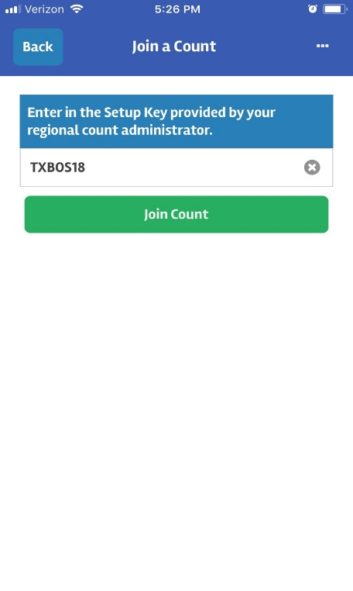

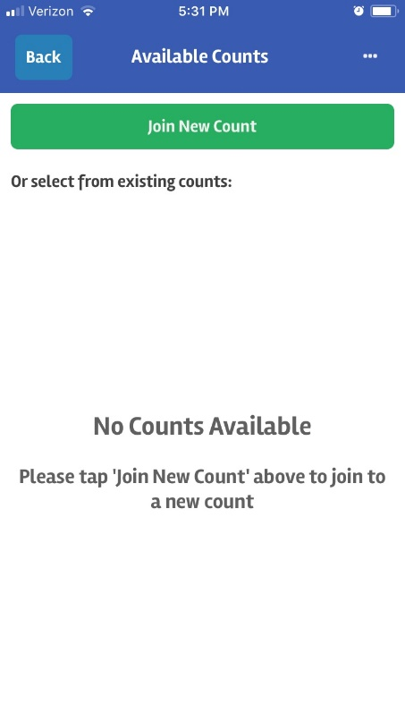

How to Change Set-up Key
If already using TXBOSTest set-up key:
If have not selected a set-up key:

Slide 11
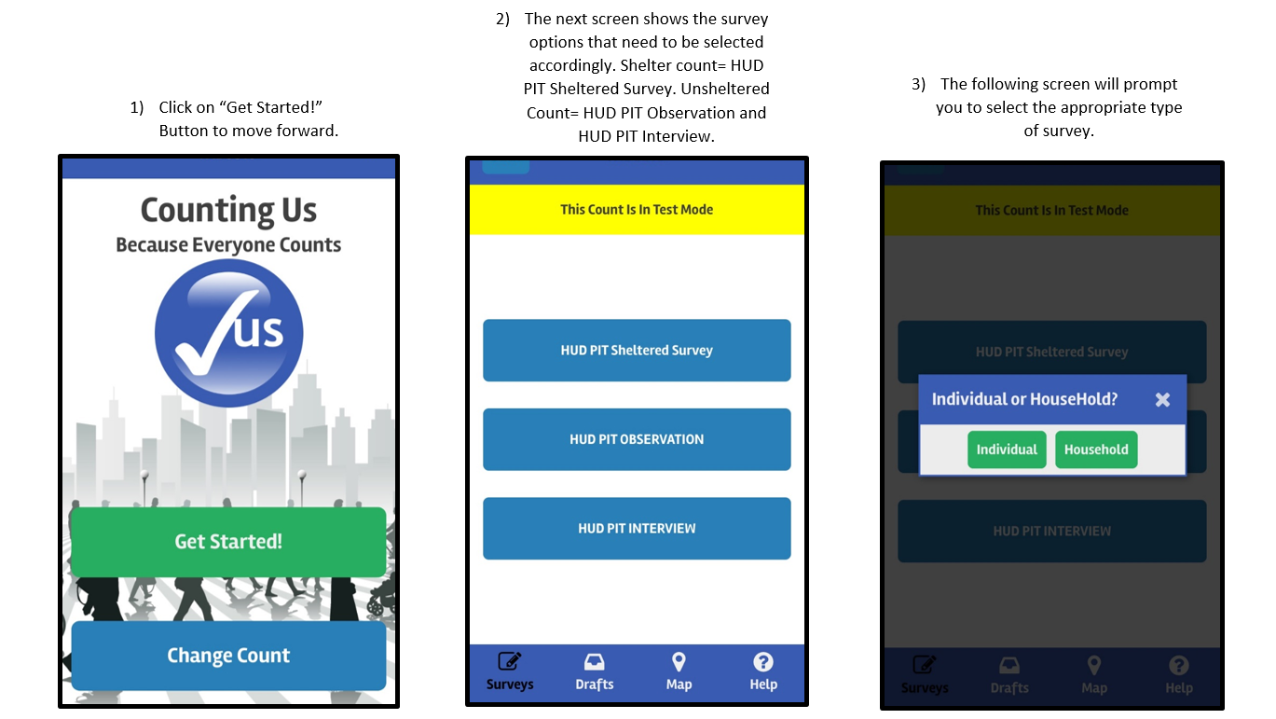
New Counting Us Layout

Slide 12
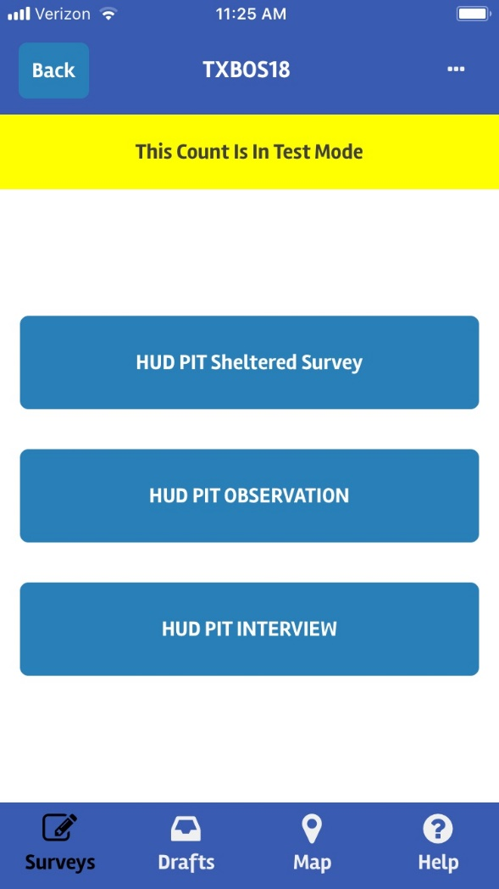
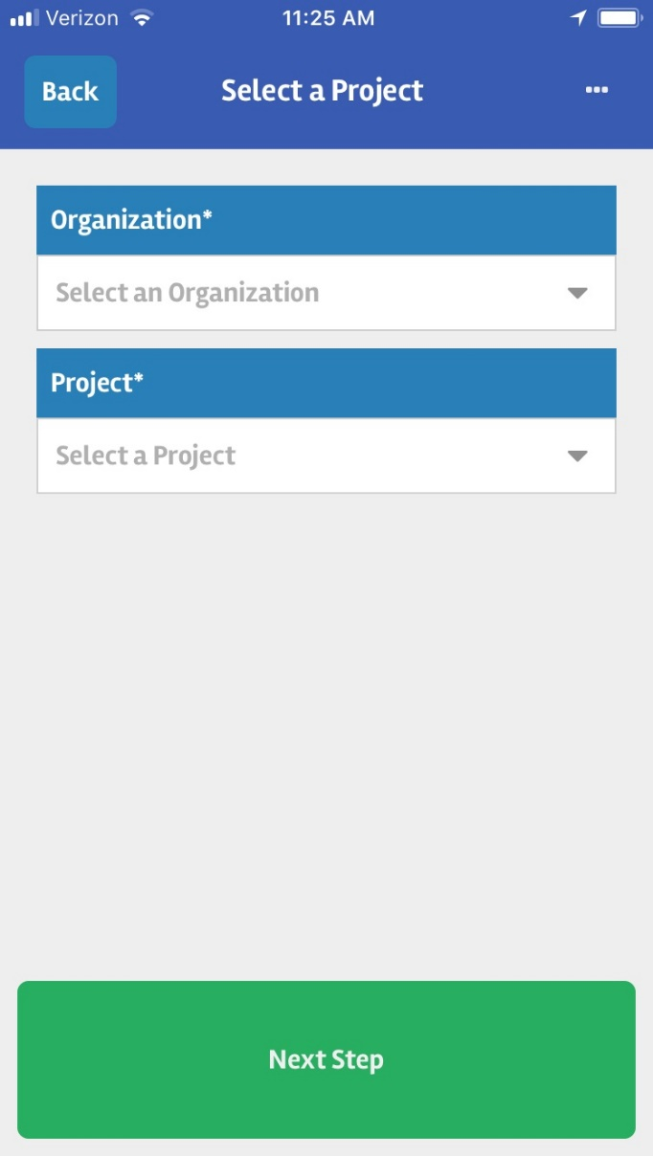
New Shelter Layout
Notes:
Note for them to check out website for video

Slide 13
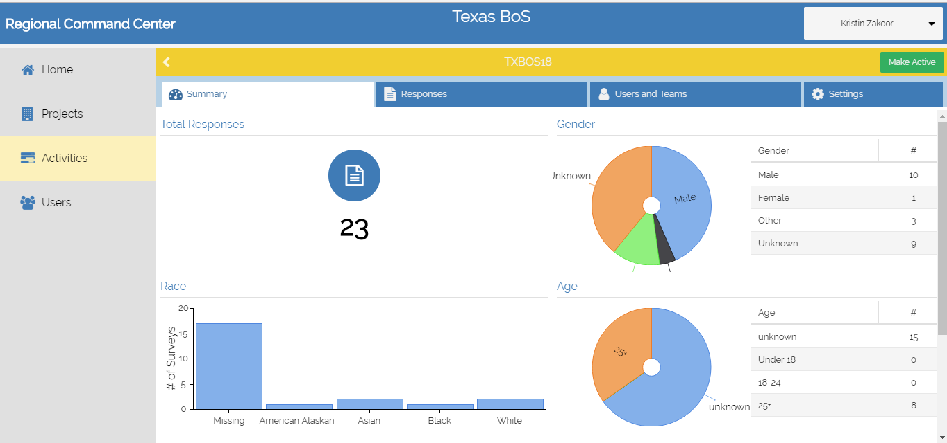
Regional Command Center (RCC)
NOTE: Please DO NOT share any of the preliminary reports until THN has given approval to do so. It is necessary for THN to further analyze each community’s data before it can be shared with local agencies and the public.

Slide 14
Surveys
If volunteers have technical issues, make sure they contact PIT Lead first to triage
  Contact THN staff if need further help addressing issue
  You will be assigned a THN staff member to contact
Make sure all volunteers submit “Saved Draft” surveys once they have internet access and need to do so within 24 hrs of count.
  NO surveys should stay on any device
Decide how you want to check-in with volunteers at end of count
  Make sure are safe and count was completed successfully

Slide 15
Domestic Violence Update
Notice CPD 17-08:
HUD is requiring that data reported on survivors of domestic violence should be limited to reporting on those who are currently experiencing homelessness because they are fleeing domestic violence, dating violence, sexual assault, or stalking, as opposed to reporting on survivors who have ever experienced these circumstances.

Slide 16
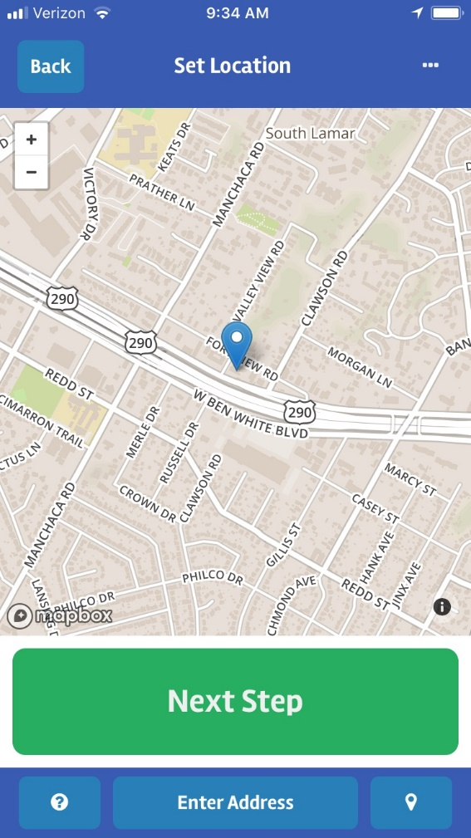
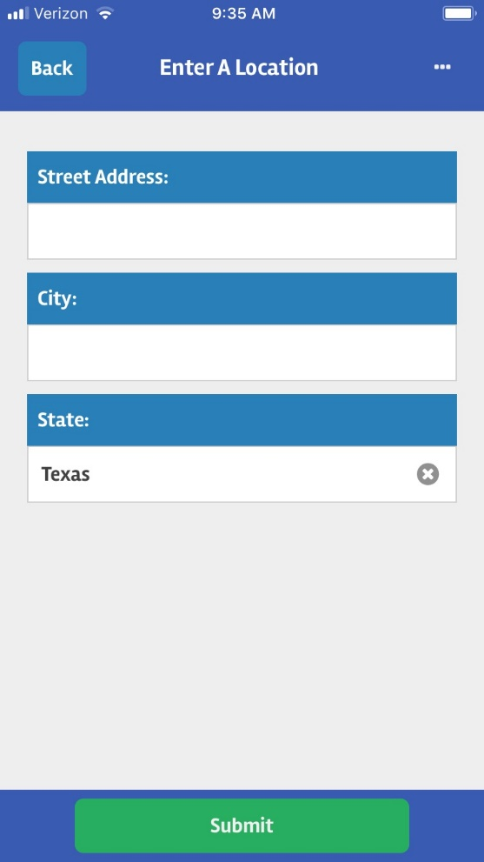
Domestic Violence and Surveys
Use Counting Us App
On geo-location screen, click “Enter Address” button and ONLY enter in City and State information
DO NOT enter in first or last name
For date of birth information ONLY enter in age range

Slide 17
Specific Populations
https://www.hudexchange.info/programs/hdx/guides/pit-hic/#resources-for-counting-specific-populations

Slide 18
Youth
Resources:
Youth Count! Process Study by the Urban Institute
We Count, California!: Lessons Learned from Efforts to Improve Youth Inclusion in California’s 2015 Point-in-Time Counts by the California Homeless Youth Project
Voices of Youth Count Toolkit by Chapin Hall
Stand Up and Be Counted: Better Data Collection on Youth Experiencing Homelessness by the U.S. Interagency Council on Homelessness
Youth Count Toolkit by the True Colors Fund
HUD Point-in-Time Count Collaboration in North Carolina by National Center for Homeless Education

Slide 19
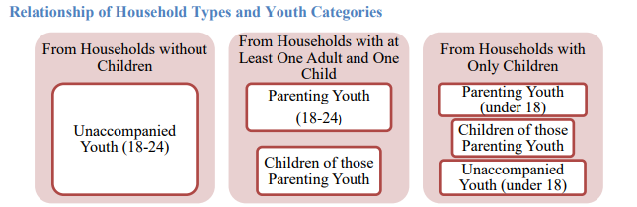
Youth (cont.)
Collect data on parenting youth and unaccompanied youth
  Parenting Youth: Parenting youth are youth who identify as the parent or legal guardian of one or more children who are present with or sleeping in the same place as that youth parent, where there is no person over age 24 in the household. Parenting youth are either a subset of households with at least one adult and one child if the parenting youth is between 18 and 24, or households with only children if the parenting youth is under 18.
    Beginning in 2018, CoCs should report the numbers of children in parenting youth households separately for households with parenting youth under 18 and households with parenting youth who are 18 to 24.
  Unaccompanied Youth: Unaccompanied youth are persons under age 25 who are not presenting or sleeping in the same place as their parent or legal guardian or their own children. Unaccompanied youth are either a subset of households without children, if they are 18 to 24, or households with only children, if they are under 18.

Slide 20
Veterans
A “veteran household” includes households with one or more veterans who might be presenting with other persons.
Coordinate with the Department of Veteran Affairs
  Establishing coordination between local VA Medical Center (VAMC), other VA staff (e.g., Vet Center staff), and stakeholders involved in your local leadership group addressing veteran homelessness is critical to ensuring a successful PIT count in your area.
  Collaborate with VAMC and VA Vet Center staffs to participate in unsheltered count planning activities, help with the identification of unsheltered veteran hotspots, and assist community efforts to broaden PIT count participation among veteran organizations.
  HCHV staff may be particularly key in assisting a community to have a comprehensive PIT count that includes every homeless veteran, including those who are unsheltered and only being engaged by HCHV staff or who are known to VAMC staff.
  https://www.hudexchange.info/resources/documents/Veterans-HIC-PIT-Count-Data-Guidance-Tool.pdf

Slide 21
Families
When families become homeless, the experience itself is traumatizing, especially for children. Children in families experiencing homelessness have high rates of acute and chronic health problems, and the majority of them have been exposed to violence.
Coordinate with local agencies
  Local Intermediate School District
    Local Homeless Education Liaison
  Shelter providers
  Domestic Violence providers
  Child Welfare services
  Local street outreach teams

Slide 22
Housing Inventory Count (HIC)
The Project Types included in the HIC are:
Emergency Shelter (ES)
Transitional Housing (TH)
Safe Haven (SH) (NOT in TX BoS)
Permanent Housing (PH)
  Permanent Supportive Housing (PSH)
  Rapid Re-housing (RRH)
  Other PH (OPH) – consists of PH – Housing with Services (no disability required for entry) and PH – Housing Only, as identified in the 2014 HMIS Data Standards)
Beds and units in the HIC must be dedicated to serving homeless persons, or for permanent housing projects, dedicated for persons who were homeless at entry.
To be completed on night of PIT Count, 1/25/18
THN will send out HIC worksheets along with instructions to be completed by responsible party

Slide 23
Day of Count Took Kit

Slide 24
Questions?

Slide 25
Thank you!

