Slide 1
2018 HUD Start Up 2 CFR 200

Slide 2
Financial Grant management
Super Circular
Policies/ Internal Controls
Common Financial Findings

Slide 3
Super-Circular
Super Circular
2 CFR Part 200
Uniform Administrative Requirements, Cost Principles, and Audit Requirements for Federal Awards
Stuff Formerly found in……
A-21, 87, 89, 102, 110, 122 and 133

Slide 4
Super-Circular
Super Circular Background
12/26/13 – OMB published final guidance on this endeavor
12/26/14 – OMB and Federal Awardmaking Agencies publish joint interim final rule
HUD adopted this guidance at 2 CFR Part 2400
HUD amended 24 CFR Parts 84 and 85

Slide 5
Super-Circular
Super Circular Purpose
Streamline:
Administrative Requirements
Cost Principles
Audit Requirements

Slide 6
Super-Circular
Super Circular Purpose
Outcomes Anticipated:
Improved Performance and Outcomes
Ensure Financial Integrity of Taxpayer Dollars when Partnering with non-Federal Stakeholders

Slide 7
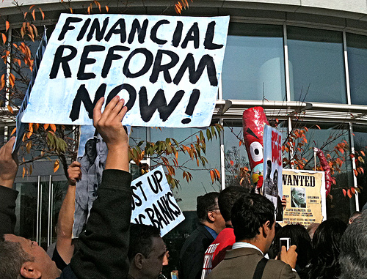
Super-Circular
Super Circular Reforms
Eliminate Duplicative/Conflicting Guidance
Focus on Performance
Consistent Treatment of Costs
Limit Allowable Costs
Strengthen Oversight
Single Audit Threshold Raised from $500,000 to $750,000

Slide 8
Super-Circular
Super Circular
Let’s Take a Walk
2 CFR Part 200
Subpart A – Acronyms and Definitions
Subpart B – General Provisions
Subpart C – Pre-Federal Award Requirements and Contents of Federal Awards

Slide 9
Super-Circular
Super Circular
Let’s Take a Walk
2 CFR Part 200
Subpart D – Post-Federal Award Requirements
Subpart E – Cost Principles
Subpart F – Audit Requirements

Slide 10
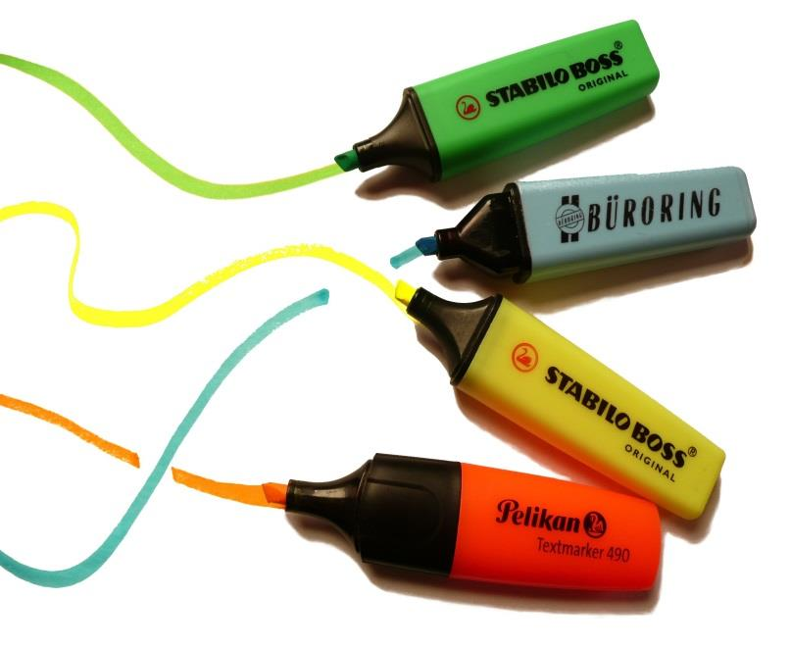
Super-Circular
Super Circular
Highlights of Subpart A
Definitions including such things as….
Non-Federal Entity
Pass-Through Entity
Cognizant Agency for Audit
Supplies
Allocation
Real Property

Slide 11
Super-Circular
Super Circular
Highlights of Subpart B
General provisions
Basic Purpose of 2 CFR 200
Applicability to Federal Awards (Chart)
Conflict of Interest

Slide 12
Super-Circular
Super Circular
Highlights of Subpart C
Prescribes the instructions and other pre-award information to be used in the funding announcement and application process
Don’t be Naughty – Section 200.207 authorizes Federal Agencies to impose additional conditions on recipients with poor performance

Slide 13
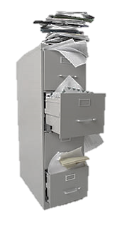
Super-Circular
Super Circular
Highlights of Subpart D
**This subpart packed with info for you**
Performance Measurement
Financial Management
Internal Controls – including protecting Personally Identifiable Information (PII)
Payment
Cost Sharing or Matching

Slide 14
Super-Circular
Super Circular
More Highlights of Subpart D
Property Standards
Equipment
Supplies
Procurement Standards
Monitoring – including subrecipient monitoring
Record Retention

Slide 15
Super-Circular
Super Circular
Highlights of Subpart E
**Read this Subpart**
Key Point – This subpart covers the allowability of costs
Good News – Most of this info is unchanged
Bad News – If you don’t have a handle on this the consequences are painful

Slide 16
Super-Circular
Super Circular
Highlights of Subpart E
Direct Costs
Indirect Costs – includes a new
de minimis rate
Details on more than 50 specific costs from Advertising to Travel Costs

Slide 17
Super-Circular
Super Circular
Highlights of Subpart E
Key Costs that may affect You
Audit Services
Compensation – Personal Services & Fringe Benefits
Contributions and Donations
Entertainment Costs

Slide 18
Super-Circular
Super Circular
Highlights of Subpart E
Equipment
Lobbying
Materials and Supplies
Professional Service Costs
Publication and Printing Costs
Travel Costs

Slide 19
Super-Circular
Super Circular
Highlights of Subpart F
The End is Near….
Audit Stuff
Increased Single Audit Threshold –
up to $750,000
Responsibilities, etc.

Slide 20
Internal Controls and Compliant Policies
Establishing Internal Controls
COSO Internal Control Framework
Establish the Control Environment
Conduct Risk Assessment
Implement Control Activities
Implement Information and Communication Systems
Monitor Internal Controls
Procurement
Cost Allocations
Documenting Allowable Costs/Match
Personnel Activity Reports
Conflict of Interest

Slide 21
Financial Grant management
Super Circular
You Want More?
Read Notice SD-2015-01
See HUD Integrity Bulletins
Click on the Council of Financial Assistance Reform Page at https://cfo.gov/cofar/
Read the entire 100 pages of 2 CFR 200

Slide 22
Common Findings
Common Findings – Recordkeeping
2 CFR 200.403(g)
Costs must be adequately documented in order to be allowable under Federal awards

