Slide 1
A Systematic Approach to Landlord Recruitment
Texas Conference on Ending Homelessness, September 28, 2018
Notes:
SM

Slide 2
Your Presenters
Samantha Maggiani
Program Manager
Samantha.Maggiani@csh.org
Adrian Hudspeth
LEAP Landlord Liaison
ahudspeth@housingforhouston.com
Notes:
SM

Slide 3
CSH Mission
Improve lives of vulnerable people
Maximize public resources
Build strong, healthy communities
Notes:
SM

Slide 4
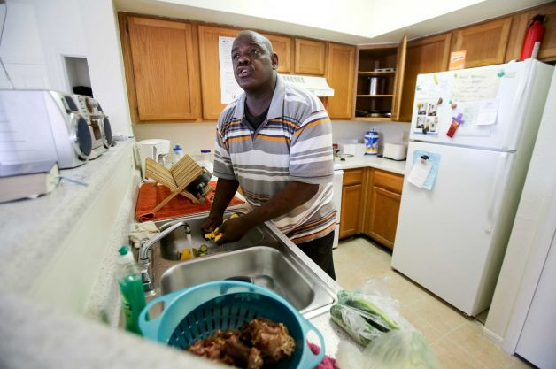
Houston Housing Authority
Our Mission
To improve lives by providing quality, affordable housing options and promoting education and economic self-sufficiency.
Notes:
AH

Slide 5
Agenda
Overview and Background
Target
Engage
Retain
Sustain
LEAP
Notes:
SM

Slide 6
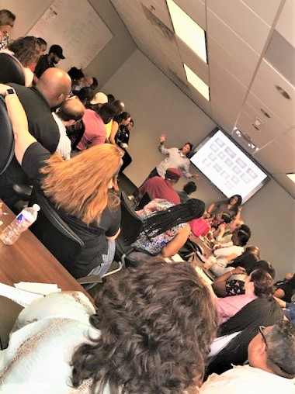
Overview
Notes:
SM

Slide 7
System Transformation
Programs,
Providers,
Funders
Homeless Response System
A diverse collection of independent stakeholders employing lots of methods seeking various goals
An integrated network of stakeholders coordinating efforts to achieve maximum impact
Notes:
SM

Slide 8
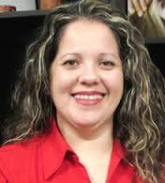
Project Mangers- Dedicated Implementation Team
Eva Thibaudeau
Coalition for the Homeless
CoC Policy/Funding Coordination, Change Management, Youth, Performance
Mandy Chapman Semple
City Mayor’s Office/CSH
Mayor’s Leadership Team, Vets, Project Management, PSH Service Model
Jessica Preheim
Houston Housing Authority
Veterans, PSH Pipeline, RRH
March Eichenbaum
City Mayor’s Office
Downtown System Redesign, Media/PR
Weekly 30 Min. Project Management Check-Ins via Phone
Weekly 1.5 Hour Coordination Meeting
Ana Rausch
Coalition for the Homeless
Coordinated Access
Heather Muller
CSH
Coordinated Access, Vets, SSVF/RRH, PSH Pipeline
Sara Brown
Coalition for the Homeless
Media/PR, Change Management
Mark Thiele
Houston Housing Authority
Veterans, PSH Pipeline, RRH
Gary Grier
Coalition for the Homeless
PIT, SSVF/RRH, CoC, Youth
Samantha Maggiani
CSH
PSH/RRH Implementation, Landlord Recruitment and Management
Takeshia Richardson
Coalition for the Homeless
HMIS
Concetta Scerbo
Coalition for the Homeless
Performance, CoC, RRH
Notes:
SM

Slide 9
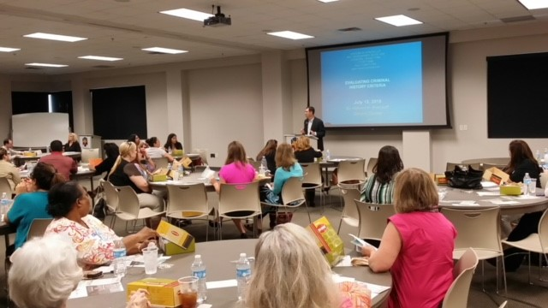
Landlord Engagement Infrastructure
Goal: Develop and implement engagement and recruitment strategies to increase Landlord partnerships with The Way Home housing programs
Members: CoC Lead Agency (Lead), CSH (Lead), Houston Housing Authority, Houston Apartment Association, Harris County Community Services Dept.,CORT Furniture, Various Service Provider Agencies

Slide 10
Targeting Landlords

Slide 11
Identifying Landlords
Assess the rental market
Identify pain point
Set realistic expectations
Affordability
Connection to neighborhoods / communities
Musts vs. Wants
11

Slide 12
Intentional Targeting
Mom & Pop
<10 units
Pros:
Flexible on background
More invested in property
Decision Maker
Cons:
Risk adverse due to cost restraints
Smaller portfolio means less choice
Professionally Managed
Pros:
Respond to vacancy and turnover
Staff/infrastructure
Cons:
Less flexibility on screening
Bigger complex= more opportunities for issues

Slide 13
Targeting Landlords
DATA,
DATA,
DATA!!,

Slide 14
Targeting Landlords: Examples
The Way Home partnered with Houston Apartment Association to identify multi-family properties in the Houston area that would be a good fit for PSH and RRH.
HAA generated a list of all multi-family property in Harris County:
-Occupancy rate of 89% or below
-Classified as C or D class property
-More than 275 units on property
TWH did further analysis of rental prices to identify which properties already participate in subsidized programs.
The properties that were identified from targeted search were seen as priority to engage for PSH and RRH conversion of unit.

Slide 15
Impact
New Hope Housing
BNC Equites
Kayra Mngmt
Nova Asset Mngmt
Villa Serena
= Approximately 3000- 3500 units

Slide 16
Engaging Landlords

Slide 17
Engagement
Maximize Return on Investment
Reduce
Risk/Liability

Slide 18
Recruitment
Actual vs Perceived Risk
Speak Their Language!
Match Making
Incentivize

Slide 19
Incentives
Financial
Non-Financial
Master Leasing
Leasing bonus
Increased deposits
Increased capacity
Risk/Insurance funds
Notes:
SM

Slide 20
Engagement is more than outreach!
“Outreach is something we do TO people, while engagement is something we do WITH them…”

Slide 21
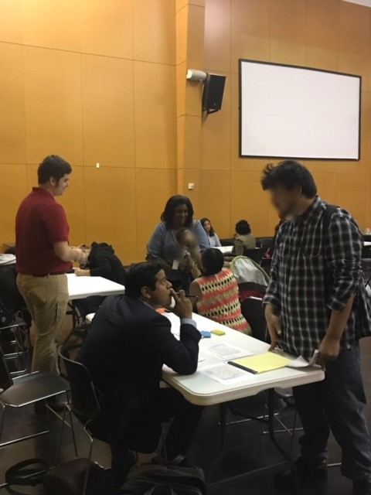
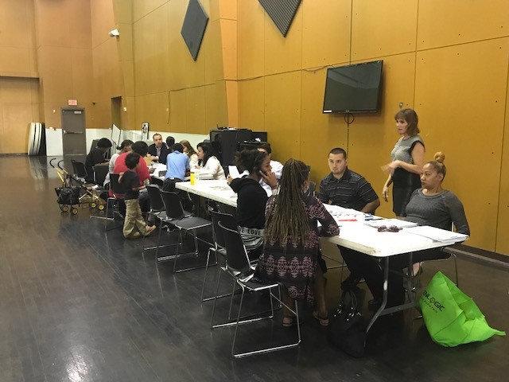
Rapid Re-Housing Leasing Event
Notes:
SM

Slide 22
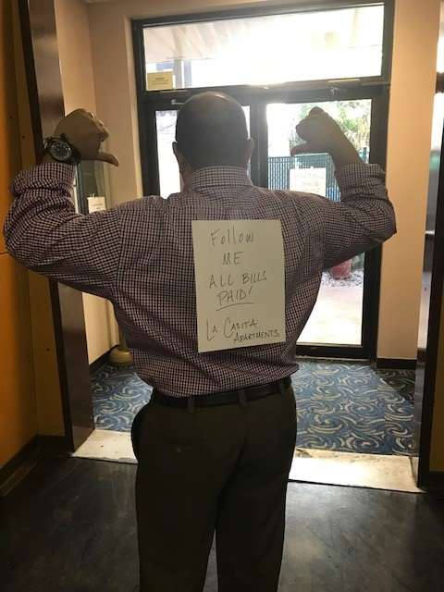
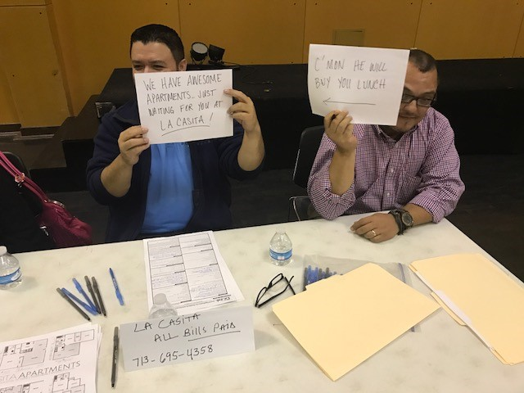
Notes:
SM

Slide 23
Retaining Landlords

Slide 24
Maintaining Landlord Partners
Communication. Collaboration. Coordination.

Slide 25
Supporting your landlord partner
“We have lowered vacancy rates, reduced turnover and reduced marketing costs. This program has been a success for us.”
-Jeannie Werthman, Marketing Director and Operations Manager of Villa Serena Communities

Slide 26
Making the LEAP to ending homelessness

Slide 27
Landlord Engagement and Assistance Program (LEAP)
Recruitment and Housing Search Assistance
Engagement
Education, Training, and TA
System navigation support
Increase utilization of HRC location tool
One stop shop for landlords
Marketing
One-on-one TA
Increased capacity

Slide 28
Recruitment and Navigation
Recruitment of new property managers and private landlords is key to increasing availability to individual experiencing homelessness.
Engaging current property managers and landlords
Identifying new property on our housing location tool
Referrals from navigators, property managers and clients
Creating landlord recruiting events
Providing Navigation Group new available rental units

Slide 29
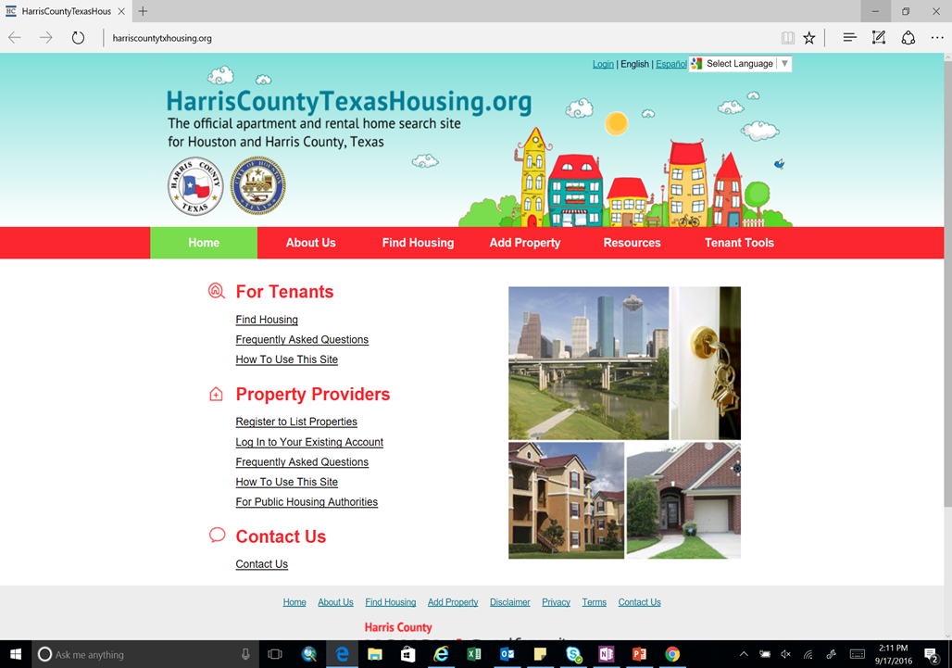
Housing Location Tool Houston/Harris Co.

Slide 30
Engagement
On-going outreach to property management staff and owners is key in accessing any problems being experienced.
In-person property visits
Phones calls
Emails

Slide 31
Education and TA
Providing property managers and private landlords education and technical assistance can reduce barriers on working with various subsidy programs aimed at helping the homeless.
Monthly newsletter
Property management staff training
Educational seminars and events
Subsidy training seminars
Visiting properties with recent failed inspections

Slide 32
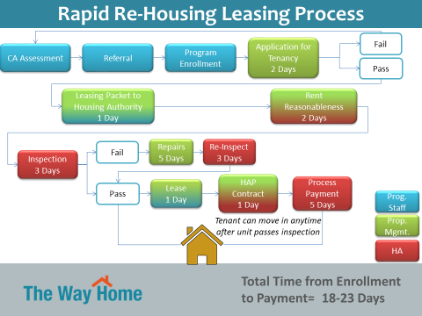

Slide 33
Working through it all..
Transitions and challenges are normal
Immediate response
Have a plan
Be results and solutions oriented
Be a (neutral) mediator and advocate
Avoid eviction at all costs!

Slide 34
LEAP Add On’s
Financial coaching
Match savings program
Tenant Education Curriculum

Slide 35
Q&A

Slide 37
Your Presenters
Samantha Maggiani
Program Manager
Samantha.Maggiani@csh.org
Adrian Hudspeth
LEAP Landlord Liaison
ahudspeth@housingforhouston.com
Notes:
SM

