Slide 1
Holistic Care: Combining Housing with Healthcare
Amber Maul, FNP, Clinic Director
Katherine Hennecke, LMSW, Housing Director

Slide 2
4 Training Objectives
Compare practice frameworks for healthcare practitioners operating within a housing program
Analyze the differences between preventative healthcare versus reactive crisis interventions
Examine an interdisciplinary relationship between permanent supportive housing case management and healthcare clinicians
Demonstrate the ability to identify client-directed healthcare goals

Slide 3
Fast Facts
Due to the complex health needs of the homeless population, the average life expectancy is estimated between 42 and 52 years, compared to 78 years in the general population.
The National Health Care for the Homeless Council (2008) estimates that 70% of Health Care for the Homeless (HCH) clients do not have health insurance.
Individuals experiencing homelessness with six or more emergency room visits accounted for 73% of all emergency room visits in a cohort of nearly 6500 total homeless patients. National Health Care for the Homeless Council

Slide 4
Healthcare Frameworks
Public Health Framework
Equity of Access to Medical Care Framework
A patient-center, multisector service delivery model for homeless populations
Designed to capture the dimensions of prevention, treatment, and continuity of care
Core Functions:
1. Assessment
2. Policy Development
3. Assurance
Evaluating the effect of health care policies and programs
Developing, implementing, and evaluation “homeless-sensitive” care training programs
Core Functions & Beliefs:
1. Health care is a human right
2. Health care resources are limited
3. Health care policy must allocate resources equitably

Slide 5
Preventative vs Reactive Healthcare
Los Angeles County health department has made it’s mission to end homelessness and provide access to healthcare.
Participants needed:
Fewer mental-health check-ups
Fewer crisis interventions
Fewer months of county general-relief financial support
Participants made nearly 70% fewer visits to the ER in the year after moving into supportive housing
AND spent 75% less time in the hospital

Slide 6
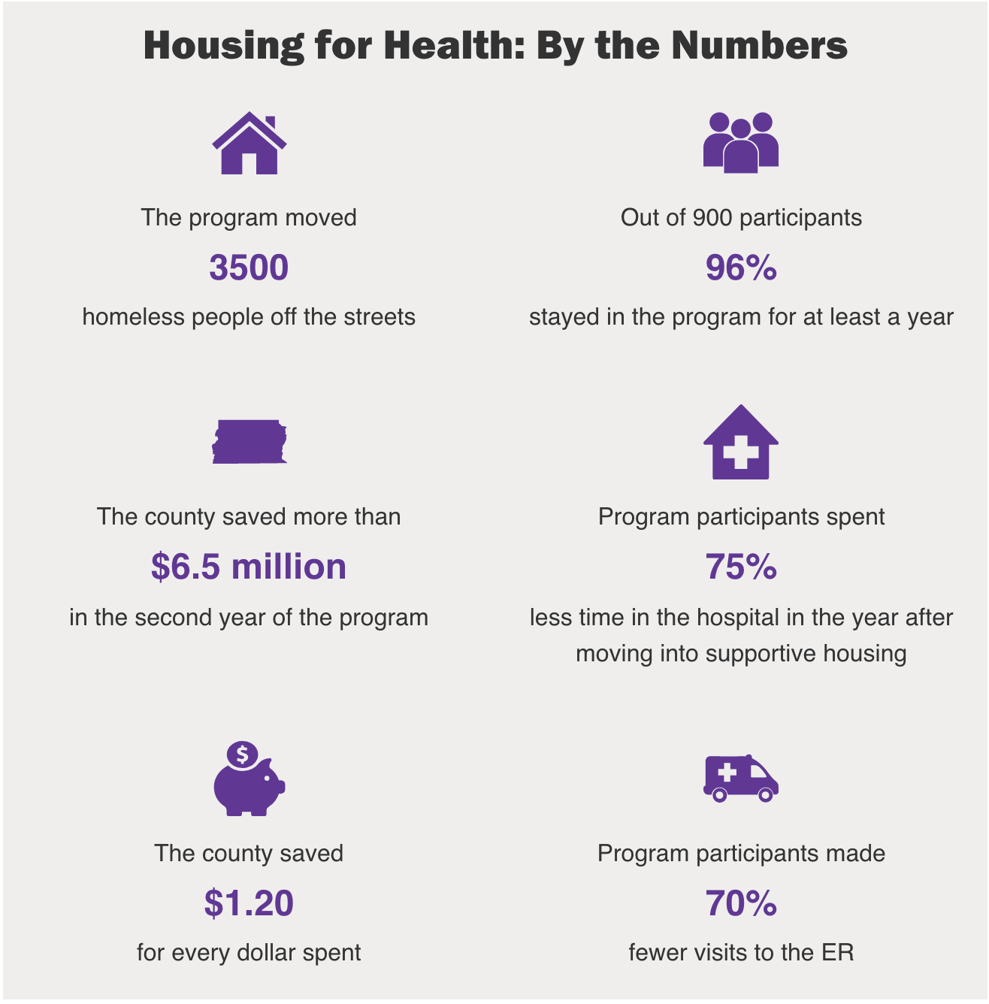

Slide 7
Interdisciplinary team approach
Step 2: Identify client-direct healthcare goals
2
Step 1: Identifying Social Determinants of Health
1
Step 3: Collaborating on the key clinical components
3

Slide 8
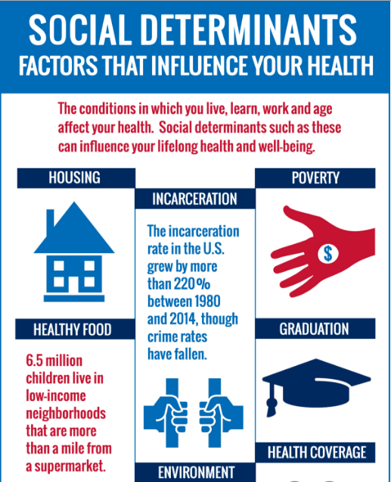
Interdisciplinary team approach
Step 1: Identifying Social Determinants of Health

Slide 9
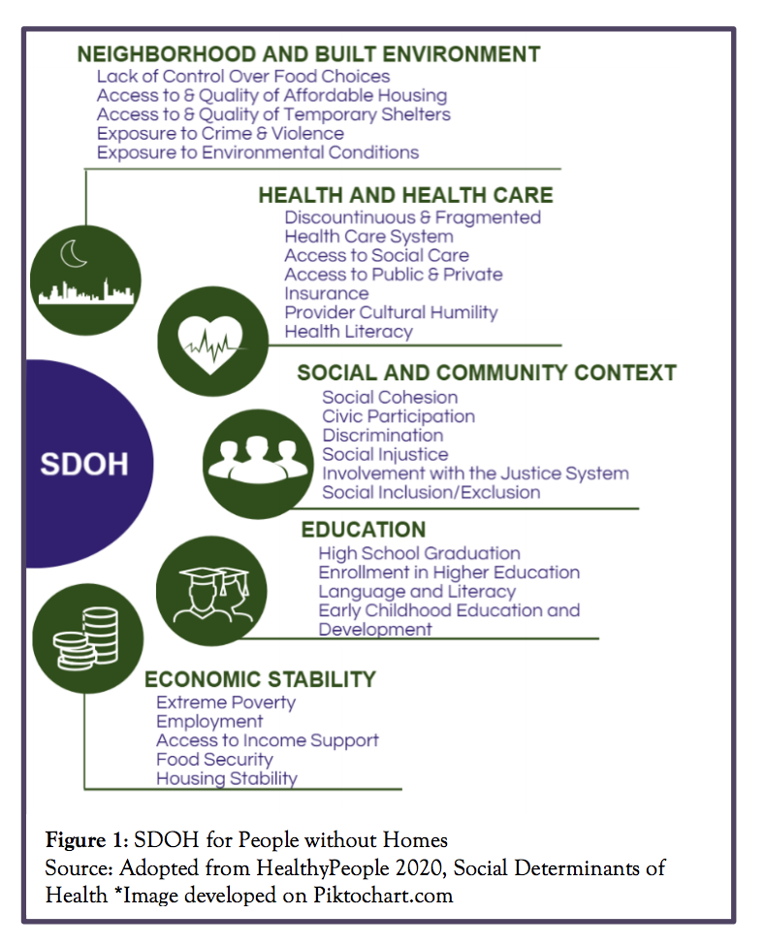
Interdisciplinary team approach
Step 1: Identifying Social Determinants of Health

Slide 10
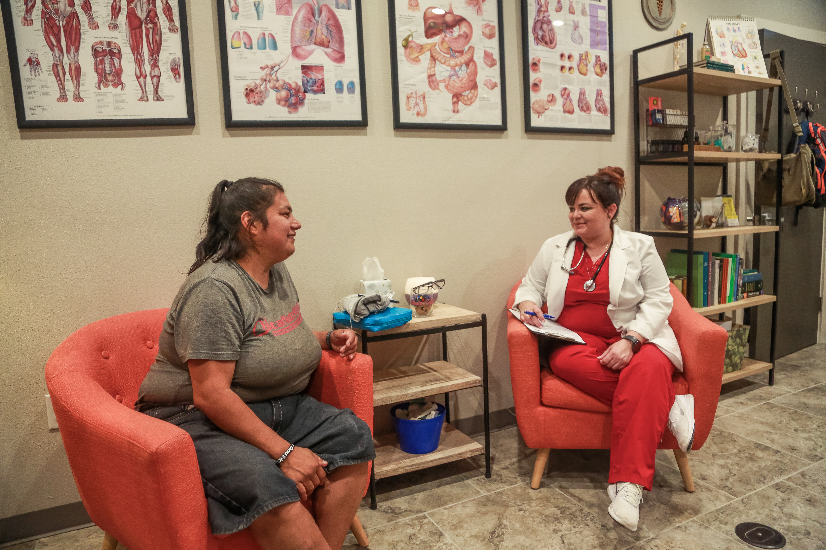
Interdisciplinary team approach
Allow the housing participant to identify his/her first healthcare goal
Healthcare is based on establishing a trusting relationship with each person
Care is provided in the environment that the participant choses
The housing participant is the source of control for their care
Step 2: Creating Client-Directed Healthcare Goals

Slide 11
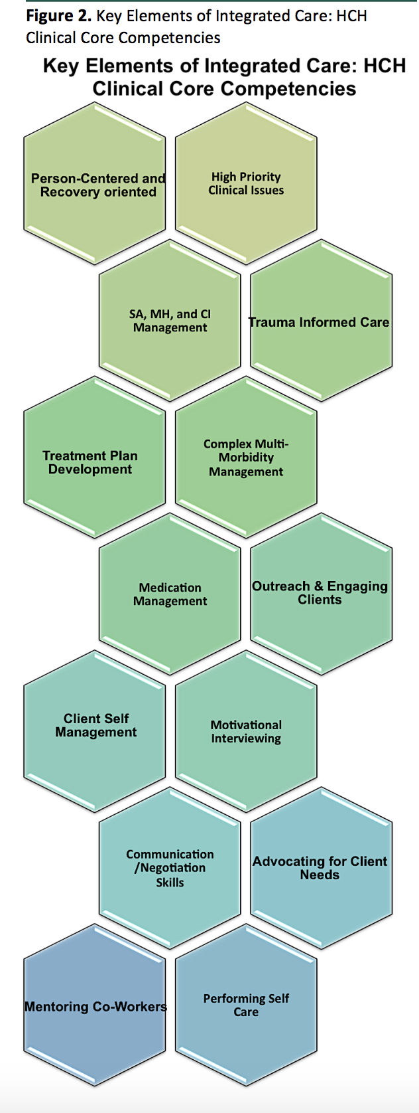
Interdisciplinary team approach
Step 3: Collaborating on the key clinical components

Slide 12
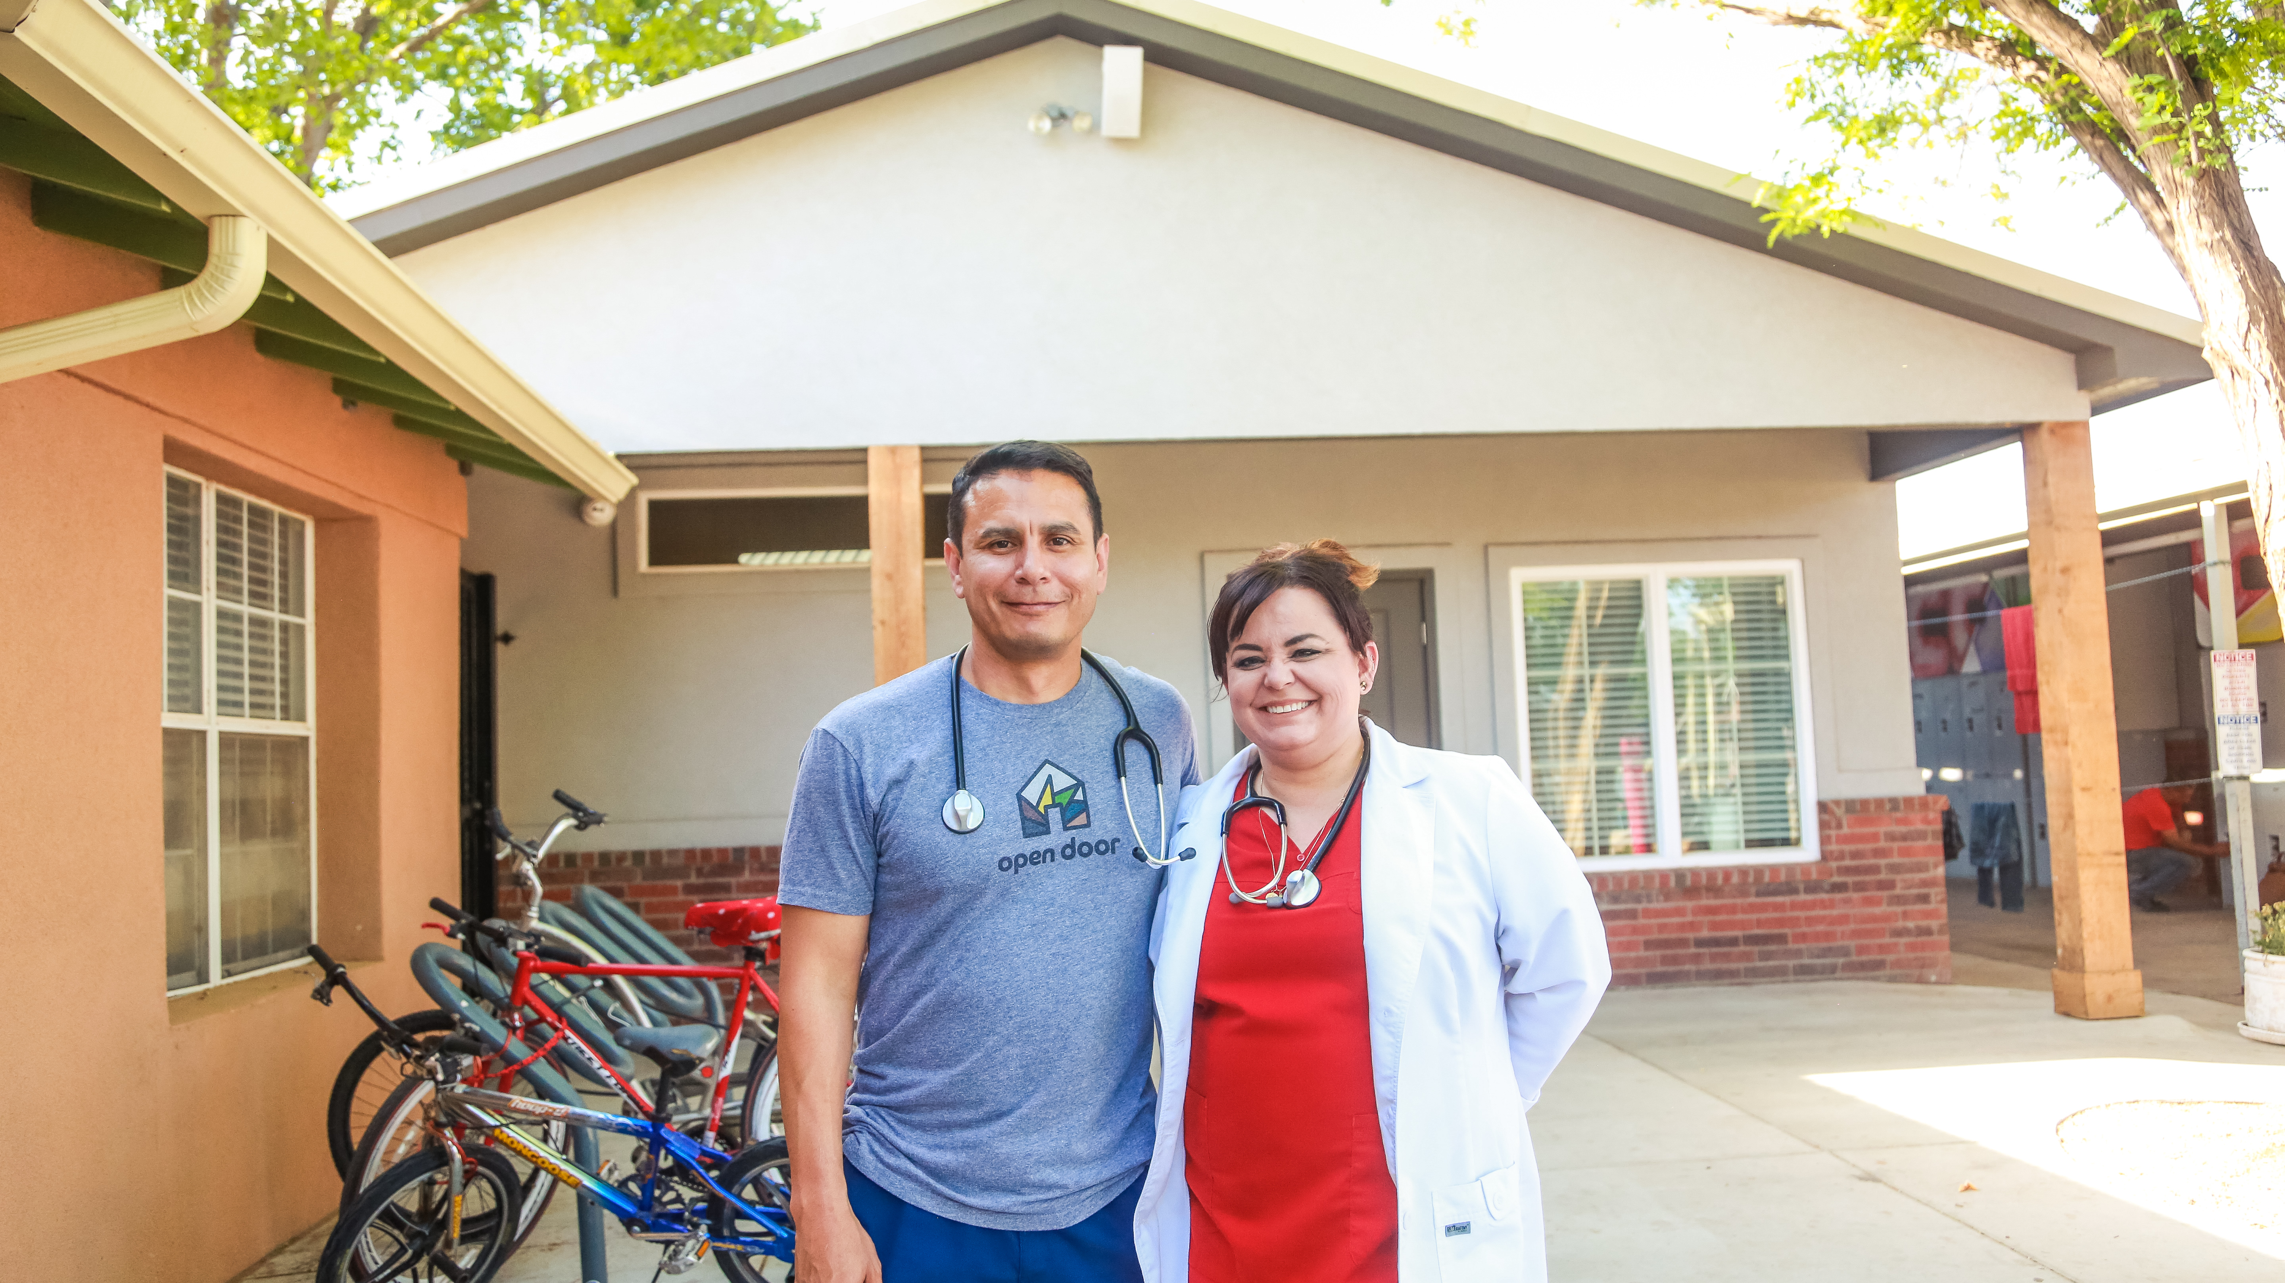
APA Citation
Hunter, S., Harvey, M., Briscombe, B., Cefalu, M., (2017). Evaluation of housing for health permanent supportive housing program. Rand Corperation. www.rand.org
Irving, Doug. (2018, June 17). Supportive housing reduces homelessness and lowers health care costs by millions. Rand Review. Retrieved from: https://www.rand.org/blog/rand review/2018/06/supportive-housing-reduces-homelessness-and-lowers.html
Lozier, John. (n.d.). Housing is health care. National Health Care for the Homeless Council. www.nhchc.org
National Health Care for the Homeless Council. (August 2017). Demonstrating value: Measuring the value and impact of the health care for the homeless grantees. Retrieved from https://www.nhchc.org/resources/general-information/fact-sheets/
National Health Care for the Homeless Council. (October 2016). Social determinants of health: Predictors of health among people without homes. Retrieved from https://www.nhchc.org/resources/general-information/fact-sheets/
O’Connell, J. J., Oppenheimer, S. C., Judge, C. M., Taube, R. L., Blanchfield, B. B., Swain, S. E., & Koh, H. K. (2010). The Boston Health Care for the Homeless Program: A Public Health Framework. American Journal of Public Health, 100(8), 1400–1408. http://doi.org/10.2105/AJPH.2009.173609
White, B. M., Newman, S. D. (2014). Access to primary care services among the homeless: A synthesis of the literature using the equity of access to medical care framework. Journal of Primary Care & Community Health, 6(2), 77-87. http://journals.sagepub.com/doi/pdf/10.1177/2150131914556122

