Slide 1
Outreach and Engagement with Veterans Experiencing Homelessness: Clinical Approaches and Ethical Considerations
Presented by:
Molly Batschelet, LCSW-S, LCDC
Central Texas Veterans health care system
Safe haven program coordinator/
outreach social worker
&
David Gomez
Austin Travis County Integral Care
PATH & Safe haven program manager

Slide 2
Presentation Objectives
Understand effective clinical approaches when working with Veterans experiencing homelessness.
Learn about the use of the Housing First model as a way to effectively house the most vulnerable Veterans and those who are chronically homeless.
Recognize potential ethical dilemmas a clinician may face while working in outreach and engagement services.

Slide 3
National Homeless Veteran Data
Proportion of Adults Experiencing Homelessness Who Are Veterans
Sheltered Status, 2017
Sheltered Status | # of Veterans Experiencing Homelessness | # of Adults Experiencing Homelessness | % of Adults Experiencing Homelessness Who are Veterans
Total | 40,056 | 438,913 | 9.1
Sheltered | 24,690 | 257,578 | 9.6
Unsheltered | 15,366 | 181,335 | 8.5
https://www.hudexchange.info/resources/documents/2017-AHAR-Part-1.pdf

Slide 4
National Homeless Veteran Demographic Characteristics
Gender
90.6% were male
8.9% were female
0.3% were transgender
0.1% do not identify as male, female, or transgender
Race
56.8% were white
33.1% were African American
1.1% Asian
3.3 % Native American
0.9% Pacific Islander
4.8% Multiple Races
Ethnicity
10.3% Hispanic
89.7% Non-Hispanic
https://www.hudexchange.info/resources/documents/2017-AHAR-Part-1.pdf

Slide 5
National/State Data
The estimated number of Veterans experiencing homelessness in the United States has declined by nearly 50% since 2010
Between 2016 and 2017, there was a 1.5 % increase in Veterans experiencing homelessness nationally
The estimated number of Veterans experiencing homeless in Texas:
2010- 5,133
2016- 1,768
2017- 2,200
https://www.va.gov/HOMELESS/pit_count.asp
https://www.hudexchange.info/resources/documents/2017-AHAR-Part-1.pdf
https://www.hudexchange.info/resources/documents/2017-AHAR-Part-1.pdf

Slide 6
Homeless Veterans vs. Non-Veterans
Research has found that Veterans are at an increased risk of homelessness compared to the general population. This is especially true for those who served in the all-volunteer force (after 1975).
A 12 month study of chronically homeless individuals found that Veterans tended to be older, more likely to be male and more likely to have completed high school.
There were no significant differences in mental health diagnoses, housing, clinical status or health service use.
Once admitted to supported housing programs, Veterans were not at an increased risk for adverse outcomes.
(Tsai, Mares, and Rosenheck, 2012)

Slide 7
Why are Veterans Homeless?
A complex set of factors which may include PTSD, lack of social support, and/or substance abuse issues
Lack of affordable housing
Social isolation after discharge
Difficulty readjusting to civilian life
Family background and various personal characteristics are also strong indicators of risk of homelessness
May have difficultly asking for help or may feel help is not available

Slide 8
What is Outreach and Engagement?
Outreach – going out into community settings to meet Veterans and help them access various support services.
Engagement – building a trusting and therapeutic relationship with Veterans to enhance comfort, motivation and willingness to participate in various support services.
Engagement often involves creatively applying therapeutic techniques in ways that may not be traditional but are tailored to the experience and needs of the Veteran you’re working with.
(Fisk et al, 2009)

Slide 9
What is Outreach & Engagement?

Slide 10
Recommendations for Outreach Providers
Assess your own level of ability and comfort working with untreated serious mental illness, substance use, and serious medical issues.
Outreach efforts must remain non-judgmental and non-coercive.
Understand and accept that engagement may take years before there is detectible momentum and celebrate small successes.
Redefine “success” as this may not always be an outcome of housing.
Practice good self-care, some situations you encounter in outreach may be very intense and disturbing.

Slide 11
Recommendations for Outreach Providers
Have an open and trusting relationship with your team where you can obtain feedback and support. Be able to have non-judgement communication about ethical dilemmas and boundary issues.
Create your own support system! This may include professionals in other agencies or other disciplines.

Slide 12
The Process of Engagement
Assess for possible mental health symptoms, substance use, medical, and/or behavioral issues. Evaluate for immediate safety concerns and proceed accordingly.
Bring tangible items such as coffee, bus passes, socks, etc. to start the relationship to demonstrate the intent to help.
Develop mutually agreed upon terms for ongoing contact.
Be a consistent and reliable provider, producing deliverable outcomes, while maintaining flexibility with the Veteran.
Possess up-to-date knowledge on resources to minimize misguided referrals and reduce frustration for the Veteran.
Help the Veteran identify their current support system as this can help decrease feelings of helplessness and isolation.

Slide 13
The Process of Engagement
Be prepared to encounter a variety of clinical presentations, including:
Distrustful/Fearful Client
Angry Client
Disorganized Client
Overly Compliant/Passive Client
Others?

Slide 14
Exploring Housing in Outreach
Is the Veteran current open to permanent housing?
Explore what other goals may the Veteran have, despite whether they are currently open to housing or not.
Specialized treatment, i.e. medical procedures, drug/alcohol treatment or psychosocial rehabilitation?
Increasing income, i.e. filing for Social Security or VA Disability?
Reconnecting with family?
Getting identification?
Working on smaller goals (or a current crisis) can help to build rapport, establish trust, and increase confidence. This has the potential to increase the Veterans willingness to consider housing if they are ambivalent.

Slide 15
The Housing First Model
http://100khomesbtv.weebly.com/housing-first.html

Slide 16
Key Principles of Housing First
All people can achieve housing stability in permanent housing.
Everyone is “housing ready.”
Improved quality of life, health, mental health, and employment can be achieved through housing.
There is a focus on the right to self-determination, dignity and respect.
Configuration of housing and services is based on the needs and preferences of the participant.
https://www.usich.gov/resources/uploads/asset_library/PRS_Housing_First_and_RRH_Webinar_07_22_14.pdf

Slide 17
Does Housing First Work?
Consumers in a Housing First model access housing faster and are more likely to remain stably housed.
Permanent supportive housing (PSH) has a long-term housing retention rate of up to 98 percent.
A variety of studies have shown that between 75 percent and 91 percent of households remain housed a year after being rapidly re-housed.
A majority of clients are found to participate in the optional supportive services provided, often resulting in greater housing stability.
PSH has been found to be cost efficient, resulting in savings for communities because housed people are less likely to use emergency services, including hospitals, jails, and emergency shelter, than those who are homeless.
https://endhomelessness.org/resource/housing-first/

Slide 18
Clinical Approaches
Utilize a harm-reduction approach:
Use as an alternative to abstinence-focused interventions.
Identify target behaviors/risk factors and work to minimize consequences of such behavior.
Relate behavior to Veteran goals.
Support Veteran in self-defining recovery.
Additional clinical approaches may include:
Crisis Intervention
Acceptance and Commitment Therapy
Cognitive Behavioral Therapy
Motivational Interviewing
Group therapy (various modalities)

Slide 19
Clinical Approaches: Motivational Interviewing
Motivational Interviewing (MI) is an “empathic, person-centered counseling approach that prepares people for change by helping them resolve ambivalence, enhance intrinsic motivation, and build confidence to change.” (Kraybill and Morrison, 2007)
Spirit of MI is described as:
Partnership – Work collaboratively and avoid the “expert” role.
Acceptance – Respect the client’s autonomy, potential, strengths and perspective.
Compassion – Keep the client’s best interests in mind.
Evocation – The best ideas come from the client.
http://homelesshub.ca/resource/motivational-interviewing-open-questions-affirmation-reflective-listening-and-summary

Slide 20
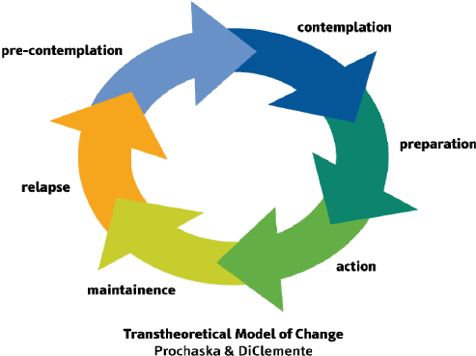
Clinical Approaches: Motivational Interviewing
Recognize the signs of each stage of change. A person’s stage informs what strategies you will choose to use.
Change is a process and it may not be linear.

Slide 21
Clinical Approaches: Motivational Interviewing
MI Self Check for Clinicians:
Veterans I meet with would say that I…
Believe that they know what’s best for themselves
Help them to recognize their own strengths
Am interested in helping them solve their problems in their own way
Am curious about their thoughts and feelings
Help guide them to make good decisions for themselves
Help them look at both sides of a problem
Help them feel empowered by my interactions with them
Adapted from Hohman. & Matulich. Motivational Interviewing Measure of Staff Interaction, 2008
http://go9host.com/thn/images/THN_MI_Handouts.pdf

Slide 22
Clinical Approaches: The Group Process
In the group environment, others serve as mirrors that reflect aspects of yourself that you can recognize and explicitly choose if you want to modify or change.
Finding common ground can be normalizing.
A natural process of enhanced acceptance of self and others occurs as one learns to relate more honestly and directly with others in the group.
Veterans can benefit from the group even during sessions when they may just listen.
The group can increase accountability and serve as a ‘safety net’ for the Veteran.
A group/group facilitator can remain a point of consistency as the Veteran moves through phases of engagement through housing.

Slide 23
Clinical Approaches: The Group Process
Considerations for group therapy in a homeless setting:
Tailor exercises and handouts so they are applicable to individuals experiencing homelessness.
Drop-in & community-based groups will be more accessible for individuals.
Having an informational/psychoeducational component reduce resistance to those who are not comfortable in a therapy setting.
Encourage word-of-mouth referrals.
Welcome Veterans in all phases of engagement and/or housing to attend to provide diversity in experiences.
Consider having light refreshments/snacks.

Slide 24
Ethical Considerations: Safety
Safety considerations for Outreach:
Prioritize YOUR safety. You can’t help anyone if you are hurt or incapacitated.
Address safety issues first before attending to any other business. This keeps you and Veterans safe and can reinforce appropriate boundaries.
If you don’t feel safe meeting with a Veteran or going to a location alone, go in teams or ask to meet the Veteran somewhere nearby.
Always make sure someone knows where you are and when you’re expecting to be done.
Process with colleagues to maintain perspective on safety issues.

Slide 25
Ethical Considerations: Boundaries
Outreach activities may not appear to be therapeutic from the outside , i.e. helping a Veteran move or cleaning an apartment, but offer unique opportunities to build rapport/trust and demonstrate life skills.
The responsibility lies with the provider to ensure professional boundaries are clear to everyone and that appropriate limits are set and maintained.
Boundaries in outreach are going to look differently than they do in an office setting. You may have limited control over physical and personal boundaries when meeting in a Veteran’s home space.

Slide 26
Ethical Considerations: Boundaries
The disturbing nature of witnessing homelessness may tempt workers to cross boundaries with Veterans by:
Providing personal assistance outside of that offered by your agency.
Putting yourself in more risky or unsafe situations for Veterans you are working with.
Tolerating inappropriate language and behavior.
Others?
(Fisk et al, 2009)

Slide 27
Ethical Considerations: Right to Self- Determination v. Lacking Decision Making Capacity
Definitions:
Capacity describes a person’s ability to a make a decision. In a medical context, capacity refers to the ability to utilize information about an illness and proposed treatment options to make a choice that is congruent with one’s own values and preferences.
Informed consent is the process by which competent adults make voluntary decisions following adequate disclosure of the relevant information.
Self-determination can be defined as the process by which a person controls their own life.
https://www.uptodate.com/contents/assessment-of-decision-making-capacity-in-adults

Slide 28
Ethical Considerations: Right to Self- Determination v. Lacking Decision Making Capacity
General principles to consider:
Any illness or treatment that compromises cognition may be associated with reduced capacity.
Diagnostic labels such as Alzheimer disease or mental illness cannot substitute for an assessment of capacity. However, be aware of groups that are higher risk such as neurodegenerative disease, TBI, etc.
Decision-making capacity is not static.
The law and ethics have settled on four decision-making abilities that constitute capacity: understanding, expressing a choice, appreciation, and reasoning.
A formal assessment of an individual’s decision-making abilities in the context of a medical decision constitutes an assessment of capacity
https://www.uptodate.com/contents/assessment-of-decision-making-capacity-in-adults

Slide 29
Ethical Considerations: Right to Self- Determination v. Lacking Decision Making Capacity
Considerations when faced with this concern:
Involve other parties as appropriate, i.e. APS or community health programs. This provides additional support but also creates a trail of documentation which may be needed in the future to illustrate deterioration.
Be aware that there may not be sufficient resources to assess the Veteran. Advocate and find creative ways to increase accessibility if there is a lack of resources.
Understand the Veteran may refuse to be assessed for capacity.
Seek consultation with other professionals, including an Ethics Consultation team if one is available to you.
Accept that Veterans who have decision-making capacity may choose to make decisions that a clinician may not agree with. Continue working with the Veteran from a harm-reduction approach.

Slide 30
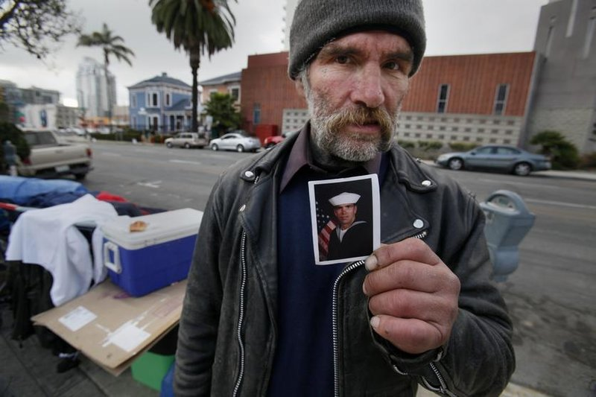
Conclusion
Thank you!
Questions or Comments?
molly.batschelet@va.gov
david.gomez@integralcare.org
Notes:
Video if time allows:
https://www.cbsnews.com/video/homeless-veteran-reunited-with-family-after-32-years/

Slide 31
References
Ackerman, C. (2017, March). 25 CBT Techniques and Worksheets for Cognitive Behavioral Therapy. Retrieved from Positive Psychology Program:
https://positivepsychologyprogram.com/cbt-cognitive-behavioral-therapy-techniques-worksheets/#cbt-tools
Ann Oliva, R. C. (2014, July). USICH Resources. Retrieved from HUD and USICH: Core Principles of Housing First and Rapid Re-Housing Webinar:
https://www.usich.gov/resources/uploads/asset_library/PRS_Housing_First_and_RRH_Webinar_07_22_14.pdf
Centers for Disease Control and Prevention. (2017, December 14). National Homeless Person's Memorial Day. Retrieved from CDC Features:
https://www.cdc.gov/features/homelessness/index.html
Claudia Dewane, L. (2008, September/October). The ABCs of ACT - Acceptance and Commitment Therapy. Retrieved from Social Work Today:
http://www.socialworktoday.com/archive/090208p36.shtml
Deborah Fisk, M. J. (1999). Outreach workers' experiences in a homeless outreach project: Issues of boundaries, ethics, and staff safety. .
Psychiatric Quarterly, 231-246.
Ending Community Homelessness Coalition (ECHO). (2017, April 20). Results of 2017 Austin/Travis county annual count of people experiencing
homelessness. Retrieved from Austinecho.org:
http://www.austinecho.org/wp-content/uploads/2017/04/170420-ECHO-2017-Homeless-Count-Final-Results.pdf
Grace College Online. (2018). Responding to trauma: Crisis intervention models. Retrieved from Human Services News: h
ttps://online.grace.edu/news/human-services/crisis-intervention-models/
Homelessness Resource Center (HRC). (2007). Motivational Interviewing: Open Questions, Affirmation, Reflective Listening, and Summary Reflections
(OARS). Retrieved from Homeless Hub: motivational-interviewing-open-questions-affirmation-reflective-listening-and-summary

Slide 32
References (continued)
Jack Tsai, P. A. (2012). Do homeless veterans have the same needs and outcomes as non-veterans? Military Medicine, 27-31.
Jason Karlawish, M. (2017, September 20). Assessment of decision-making capacity in adults. Retrieved from Up To Date: https://www.uptodate.com/contents/assessment-of-decision-making-capacity-in-adults
Matulich, H. a. (2008). Motivational Interviewing Measure of Staff Interaction. Retrieved from Texas Homeless Network: http://go9host.com/thn/images/THN_MI_Handouts.pdf
Meghan Henry, R. W. (2017, December). The 2017 annual homeless assessment report (AHAR) to Congress. Retrieved from hudexchange.info: https://www.hudexchange.info/resources/documents/2017-AHAR-Part-1.pdf
Michael Rowe, T. S. (2015). Mental health outreach to persons who are homeless: Implications for practice from a statewide study. Community Mental Health, 56-65.
National Alliance to End Homelessness. (2016, April 20). Resources: Housing First. Retrieved from National Alliance to End Homelessness: https://endhomelessness.org/resource/housing-first/
National Coalition for the Homeless. (2009, July). Healthcare and Homelessness. Retrieved from National Coalition for the Homeless: www.nationalhomeless.org/factsheets/health.html
Sandra K Schwarcz, L. C. (2009). Impact of housing on the survival of persons with AIDS. BMC Public Health.
Stephen Metraux, P. (2018). Homelessness among recent U.S. Veterans in 10 questions. VA National Center on Homelessness Among Veterans.

