Slide 1
Increasing access to housing

Slide 2
Increasing access to existing housing
Most communities have an existing inventory of housing units that could be used to serve people who are most in need, such as people exiting homelessness, people with disabilities, or people with barriers to housing.
This might include private property controlled by landlords or property management companies and subsidized housing such as HUD housing for people who are elderly or rural housing created with USDA funds. It also includes housing units created/controlled by behavioral health systems or local Continuum of Care providers focused on people who are homeless.

Slide 3
Working with landlords

Slide 4
Outreach to landlords
Conduct outreach to landlords.
Look for small property owners/independent rental owners.
Provide free events to share information, including how to participate in any community programs such as the housing choice voucher program (HCV).
Offer resources such as landlord and tenant education programs; checklists; fact sheets and flyers on topics of interest.
Celebrate success; if you have worked successfully with a landlord, ask her or him to speak to other landlords about your efforts. Hold an annual awards ceremony.

Slide 5
Support for landlords
Support for landlords includes providing tools to facilitate the relationships among landlords/property management, tenants and service providers.
This can include:
Sample MOUs that can spell out how each party will behave in efforts to house people with significant barriers to housing.
Provide a venue for problem-solving: the case managers cell phone; a centralized hotline; a pipeline to service provider agency leadership; free neutral mediation.

Slide 6
Incentives for landlords
Meaningful incentives might include:
Access to a risk mitigation fund that can pay for emergency repairs.
Have the capacity to make small emergency repairs with no fuss for the landlord.
Provide make-ready services if tenant leaves prior to lease.
Train staff to conduct inspections (see next slide)
Provide funds for tenant start-up including deposits; have some funds available to hold a unit while arrangements are finalized.

Slide 7
Make it simple and easy
At the system level, there are things you can work towards that will simplify landlord involvement. For example, you can work with your housing authority to set up user-friendly, step-by-step support for participation in the HCV program. This might include having the MH system pay for part time staff at the PHA that assist participating landlords in accessing the system and trouble-shooting.
Help the PHA with inspections of units. With PHA agreement, oversight and training, housing quality inspections can be conducted by non-PHA staff.
Make it easy for people to do the right thing!

Slide 8
Master leasing

Slide 9
Master Leasing
Master leasing is a strategy in which a governmental entity, a lead CoC agency or other community level organization enters into an arrangement with one or more landlords. That arrangement provides streamlined access to some number of units, and may allow the lease holder to control tenant selection.
This helps address access to housing for people with housing barriers such as criminal convictions.

Slide 10
Master Leasing
Benefits for the landlord can include:
Guaranteed rent
Access to risk mitigation funds
Access to mediation services, avoiding eviction court costs
Centralized ‘hotline’ for complaints or concerns

Slide 11
Master Leasing
Benefits for the system can include:
Access to housing for people with significant housing barriers
System level coordination of landlord outreach can reduce interagency competition for friendly landlords and streamline administrative procedures

Slide 12
Improve housing search capacity

Slide 13
Improve Housing search capacity
Provide user-friendly information on subsidized housing resources developed for low-income households, including PHA resources, Continuum of Care resources, HUD Multi-family Housing Inventory and the USDA inventory for rural areas.
Include any local apartment search engines.

Slide 14
Improve housing search capacity
Provide routine training for new staff who will have responsibility for assisting people to find housing.
Convene routine meetings across the community among social service agencies working on housing issues.
At the management/leadership level, have an organized approach and senior staff responsible for actively scanning the market for changes, new opportunities, attend relevant community meetings.

Slide 15
Housing search
Provide information to behavioral health system and homelessness assistance staff to ensure that they are seeking access to the full range of subsidized housing in the community.
At the system level, organize outreach to property managers and owners of subsidized properties.

Slide 16
Resources for Affordable Housing
There are multiple sources of funding for affordable housing.
Federal resources include dollars from HUD, the Veteran’s Administration, the Department of Agriculture and the Treasury Department.
Quasi-federal resources include the Federal Home Loan Bank system, Fannie Mae and Freddie Mac.

Slide 17
Resources for Affordable Housing
These dollars are delivered to the community in different ways.
Some funding goes directly to programs.
Some funding goes through city or county governments.
Some funding goes through the state housing agency.
Some funding goes to umbrella organizations, which then distribute funding to programs.

Slide 18
Resources for affordable housing
Sources of funding for housing include:
Federal Department of Housing and Urban Development (HUD)
Public housing agencies (PHAs)
Consolidated Plan resources (e.g., Community Development Block Grant and HOME programs)
Multi-family housing developments
Specialized programs such as the Section 811 program
United States Department of Agriculture (USDA)
Units developed using Low-Income Housing Tax Credits

Slide 19
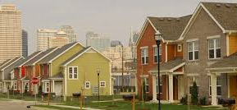
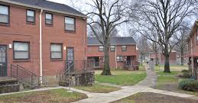
HUD – Public Housing Agencies
Public Housing Agencies (PHAs) operate public housing units and/or the housing choice voucher program. Some PHAs have additional programs, such as the Veteran’s Affairs Supportive Housing (VASH) program, or the Shelter Plus Care program provided through the Continuum of Care planning process.
A good way to find out more information is to contact the PHA directly. AND, review the PHA’s plan – this usually gives information about programs, set-asides, local preferences, eligibility and budget.

Slide 20
HUD – Public Housing Agencies
To find contact information about PHAs in your area: http://portal.hud.gov/hudportal/HUD?src=/program_offices/public_indian_housing/pha/contacts
To find your PHA’s plan you will have to go to your local PHA. For example: Dallas - http://www.dhadal.com/Publications/1/Annual%20Plans
Or, subscribe to Affordable Housing Online:
http://affordablehousingonline.com/

Slide 21
HUD - Consolidated Plan Resources
Cities above 50,000 in population and counties above 250,000 in population develop a Consolidated Plan that governs the allocation of four types of formula-based resources. The ConPlan describes how the community will spend dollars in these programs:
Community Development Block Grant (CDBG)
HOME
Emergency Solutions Grant (ESG)
Housing Opportunities for People with AIDS (HOPWA)

Slide 22
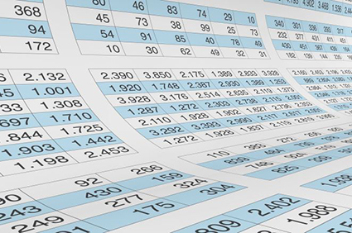
HUD - Consolidated Plan Resources
Not every community receives all four types of funding.
Communities receiving Community Development Block Grants (CDBG) must be cities in excess of 50,000 in population. Urban counties above 250,000 in population also receive these funds.
Cities at or above 75,000 in population and urban counties also receive HOME program funds.
Depending on factors such as need for homelessness services, concentration of poverty or prevalence of AIDS, your community may also receive Emergency Solutions (ESG) funds and/or Housing Opportunities for People with AIDS (HOPWA).

Slide 23
HUD - Consolidated Plan Resources
What can these programs do?
CDBG: Activities that develop viable communities by providing decent housing, a suitable living environment, and opportunities to expand economic opportunities, principally for low- and moderate-income persons.
HOME: Supports a wide range of activities including building, buying, and/or rehabilitating affordable housing for rent or homeownership or providing direct rental assistance to low-income people.

Slide 24
HUD - Consolidated Plan Resources
What can these programs do?
ESG: Funds essential services related to emergency shelter and street outreach, emergency shelter operation and renovation, short-term and medium-term rental assistance, housing relocation/stabilization services (rapid re-housing)for those who are homeless or at risk of homelessness.
HOPWA: Funds services and housing for people with AIDS.

Slide 25
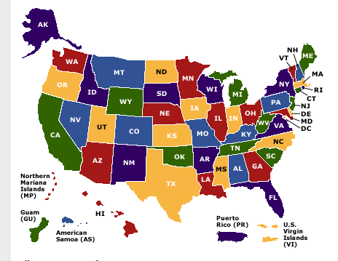
HUD - Consolidated Plan resources
To find out how much money your community received in 2017, go to:
https://www.hud.gov/program_offices/comm_planning/about/budget/budget17
This takes you to a US map
Click on your state.
This brings you to an excel spreadsheet showing how much your community received in 2017
Notes:
List is in the resources

Slide 26
HUD - Consolidated Plan resources Example from Virginia
Notes:
List is in the resources

Slide 27
HUD Multi-family Inventory
HUD has several programs designed to produce affordable housing in communities. A subset of units produced with those programs may be set aside for “elderly or persons with disabilities”. The inventory lists multifamily properties developed using HUD funds for these populations.
https://www.hud.gov/program_offices/housing/mfh/hto/inventorysurvey
HUD also provides a list of assisted properties that are available to any low income family (not just persons who are elderly or have a disability). That inventory is available at: https://apps.hud.gov/apps/section8/
Notes:
2017 list in resources

Slide 28
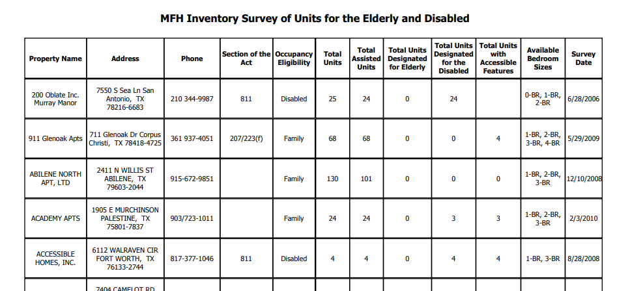
HUD Multi-family Inventory
Example from Texas:
Notes:
2017 list in resources

Slide 29
HUD 811 Program
One of the very few programs targeted to persons with disabilities
Relatively small program compared to the others featured here
Important because of its targeting and new rules that result in the creation of highly affordable, integrated housing units
See http://811resourcecenter.tacinc.org/ or https://www.hud.gov/program_offices/housing/mfh/grants/section811ptl for more information.

Slide 30
HUD Sec. 811 Program
The “OLD” 811 program.
HUD’s Section 811 program is one of the few programs targeted to assist persons with disabilities. Up until 2012, the program funded construction and operations funding (including project based vouchers) for single-site settings for persons with disabilities. Those properties are included in the HUD Multi-family Inventory previously explored.

Slide 31
HUD 811 Program
In 2012, the 811 program was reformed to achieve a different result: integrated housing for people with disabilities. The revised program does this in two ways:
Encouraging and incentivizing development using multiple sources of capital, such as federal Low Income Housing Tax Credits and HUD HOME funds;
Allowing the use of Project Based Rental Assistance to help state and local governments work with developers to create integrated supportive housing units in affordable rental housing developments.

Slide 32
HUD 811 Program – example: texas
Texas Target Populations:
People with disabilities living in institutions. People that wish to transition to the community from nursing facilities and intermediate care facilities for persons with intellectual and developmental disabilities may not have access to affordable housing in their community.
People with serious mental illness. Individuals engaged in services but facing challenges due to housing instability. Stable, integrated, affordable housing would enable these individuals to have the opportunity to fully engage in rehabilitation and treatment, greatly improving their prospects for realizing their full potential in the community.
Youth with disabilities exiting foster care. Youth exiting foster care often become homeless, particularly without the stability of long-term housing and comprehensive support services

Slide 33
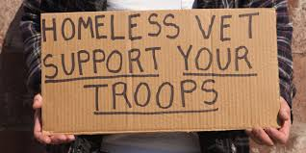
Veteran’s Affairs Supportive Housing
The HUD-Veterans Affairs Supportive Housing (HUD-VASH) program combines Housing Choice Voucher (HCV) rental assistance for homeless Veterans with case management and clinical services provided by the Department of Veterans Affairs (VA). VA provides these services for participating Veterans at VA medical centers (VAMCs) and community-based outreach clinics.

Slide 34
USDA provides millions in housing and community development funding to rural areas.
Units developed with federal support are considered subsidized, and, when available, should be more affordable than unassisted market rate units to people on SSI level incomes.

Slide 35
USDA Housing Resources
More than 440,000 multifamily housing (MFH) rental units in 15,000 complexes provide safe and decent housing for more than 750,000 individuals who otherwise could not afford it.
MFH also provides rental assistance on behalf of 270,000 low and very-low income families that enables those families to live in apartments financed through Rural Development.

Slide 36
USDA
One of the best features of the USDA Rural Development program’s website is immediate and specific access to the addresses and other information for assisted units.
To get specific information for rural communities, click on this link:
http://rdmfhrentals.sc.egov.usda.gov/RDMFHRentals/select_state.jsp

Slide 37
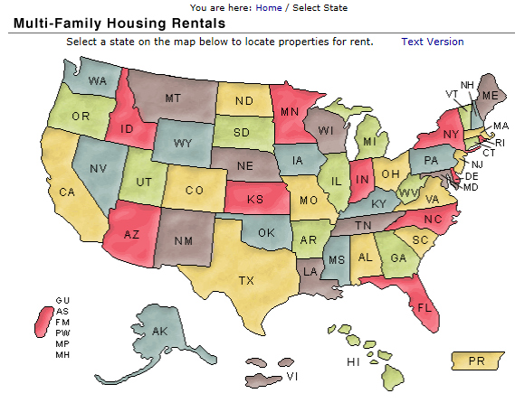
USDA: Find an Assisted Property
How to find a property?
Go to: https://rdmfhrentals.sc.egov.usda.gov/RDMFHRentals/select_state.jsp
Click on Texas, then click on the relevant County.

Slide 38
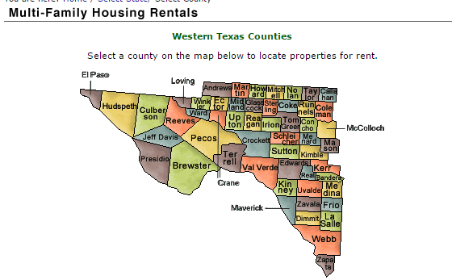
USDA: Find an Assisted Property
Pick an area: North; Western; Eastern. For western Texas, Medina County (selected at random!)

Slide 39
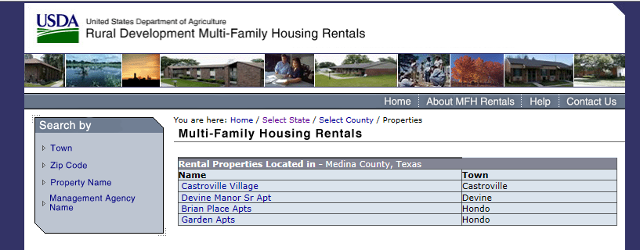
USDA: Find an Assisted Property
Here are subsidized properties in Medina County

Slide 40
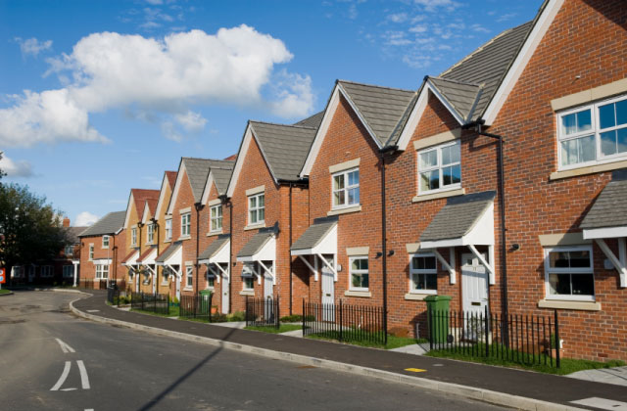
Low Income Housing Tax Credits
Low Income Housing Tax Credits (LIHTC) are used to create a funding stream that supports the development of affordable housing. LIHTC developments are everywhere, and are designed to have units that are affordable for people at very low incomes.
The only problem is that the subsidies don’t often make housing affordable to people on SSI incomes. So, someone on SSI might want to move in, but would have to have a voucher, or be willing to pay a higher percentage of their income towards rent.

Slide 41
Low Income Housing Tax Credits
Some states provide lists of assisted tax credit properties. In Texas, the Texas Department of Housing and Community Affairs operates the tax credit program.
https://tdhca.state.tx.us/multifamily/housing-tax-credits-4pct/index.htm. Go to bottom of page, click on HTC Property Inventory.
Notes:
List in resources

Slide 42
discussion

