Slide 1

SOAR For Children
Presented BY:
SAMHSA SOAR Technical Assistance Center
Policy Research Associates, Inc.
Under Contract TO:
Substance Abuse and Mental Health Services Administration
U.S. Department of Health and Human Services

Slide 2

What is SOAR?
A model for assisting eligible individuals to apply for Supplemental Security Income (SSI) and Social Security Disability Insurance (SSDI)
For individuals who are experiencing or at-risk of homelessness and have a serious mental illness, co-occurring substance use disorder, or other physical disabilities
Sponsored by the Substance Abuse and Mental Health Services Administration (SAMHSA) in collaboration with the Social Security Administration (SSA) since 2005
All 50 states and Washington D.C. currently participate

Slide 3
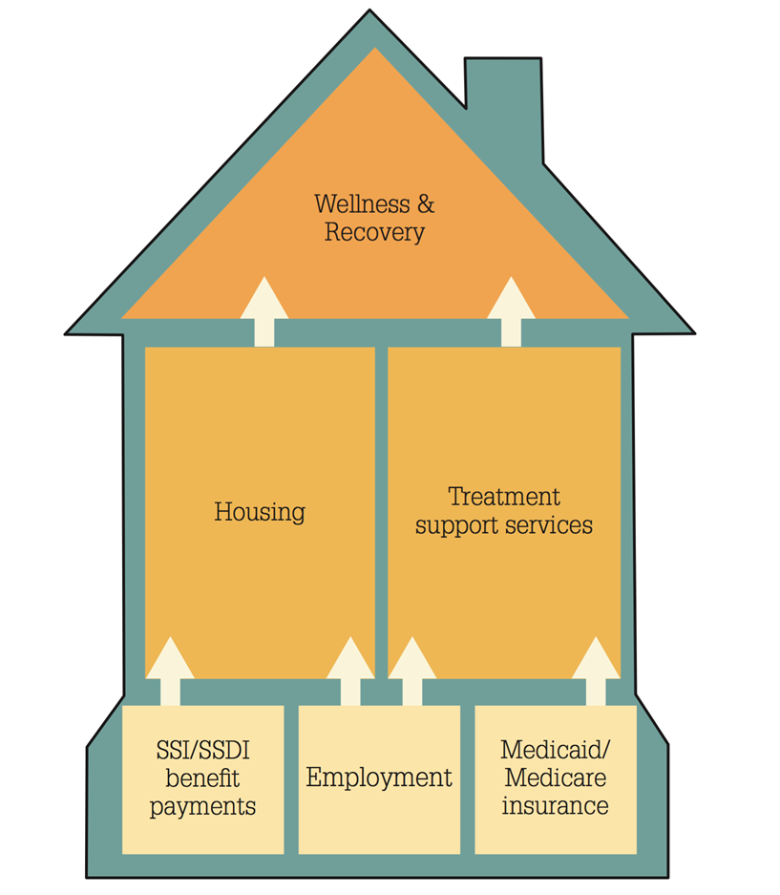

A Foundation for Recovery
SSI/SSDI provides more than income:
Access to health care and housing
Increased employment opportunities
Decrease in incarcerations and hospitalizations

Slide 4

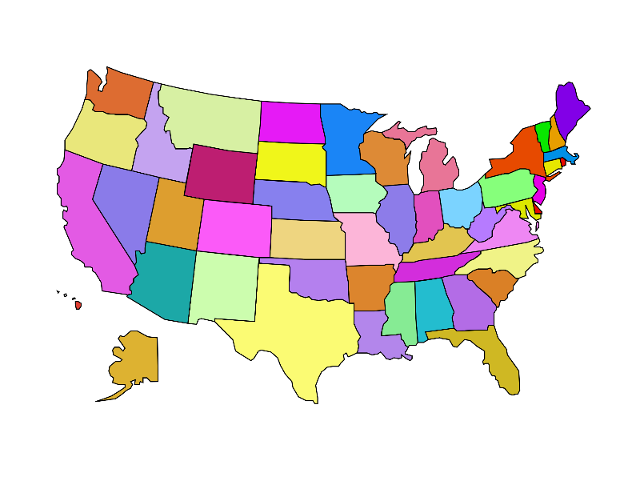

How do States and
Communities Benefit?
SSI/SSDI and Medicaid/Medicare bring federal dollars into states, localities, and community programs:
  Health providers can recoup cost of uncompensated care
  States and localities can recoup the cost of public assistance
  Cash benefits and back payments received by individuals is spent in the local community (2017: $356 million)
Notes:
FBR x 12 mos x 12 mos x cumulative approvals (initial + appeal)
$735 (2017) x 12 mos. x 40,311 approvals = $355,543,020

Slide 5
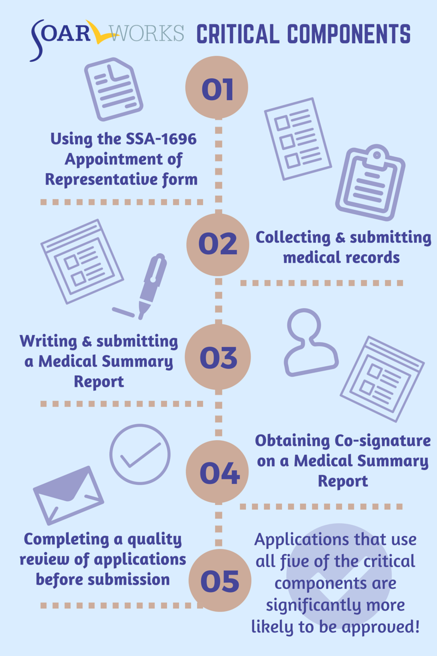
What Makes SOAR Unique?
SOAR-trained case workers are the heroes!

Slide 6
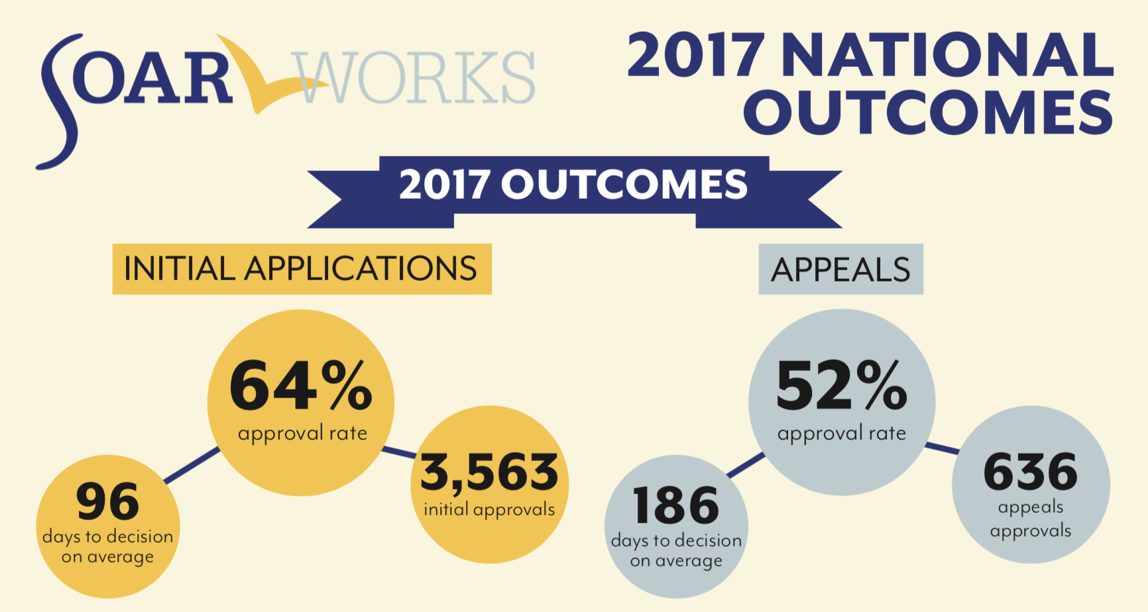
SOAR Works!
Notes:
Compares to 10-15 percent for unassisted applications from people who are homeless and 28.5 percent for all applicants

Slide 7
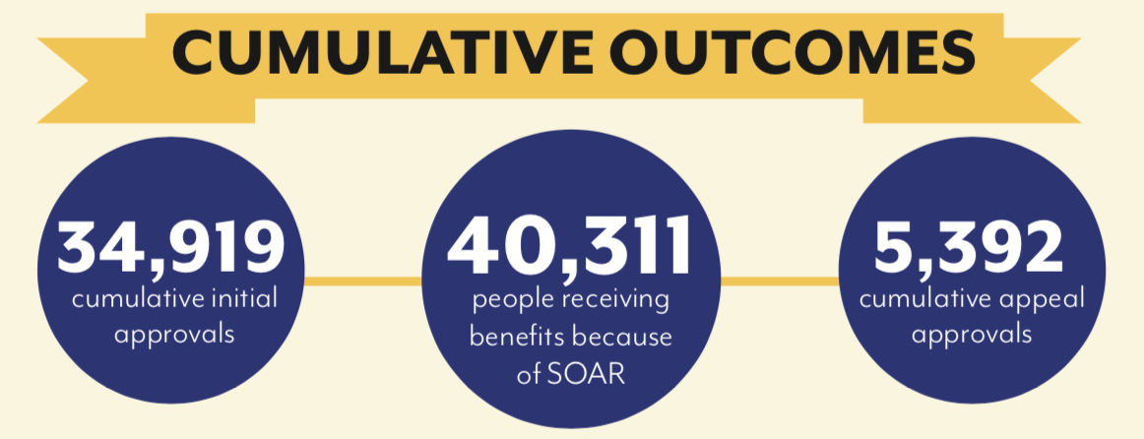
And Works!

Slide 8
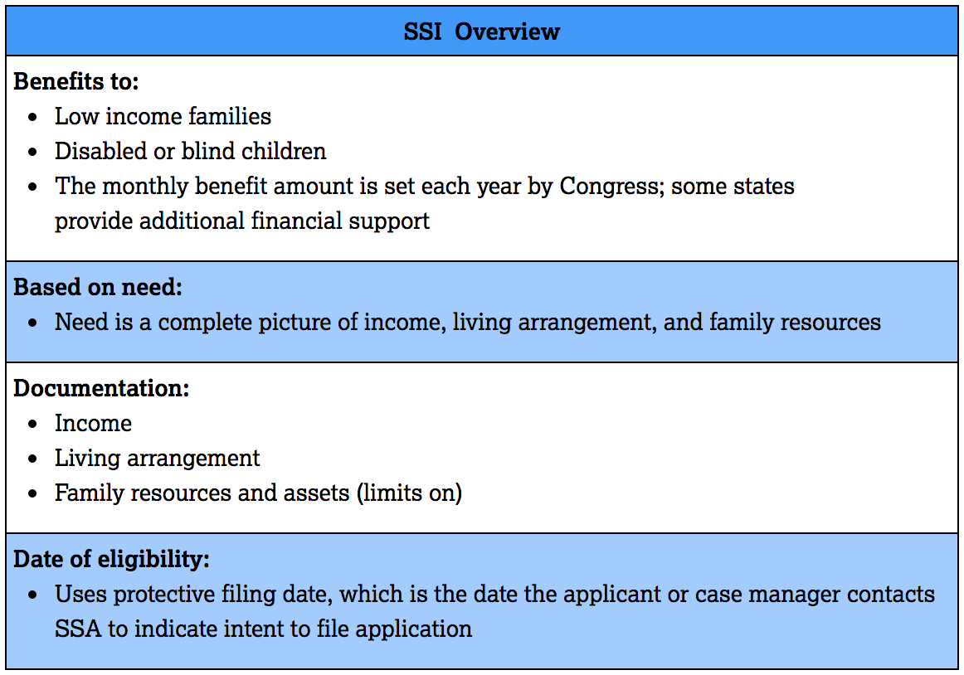
Supplemental Security Income (SSI)
Needs based; federal benefit rate is $750 (2018); provides Medicaid in most states

Slide 9
Definition of Disability for Children
The Social Security Administration SSA defines disability for children as:
A medically determinable physical or mental impairment(s) (including an emotional or learning problem)
Which very seriously limits his or her functioning
That has lasted or is expected to last for a continuous period of at least 12 months OR result in death
SSA will determine how the child’s functional abilities compare to the functional abilities of a child of the same age who does not have the physical and/or mental impairments

Slide 10
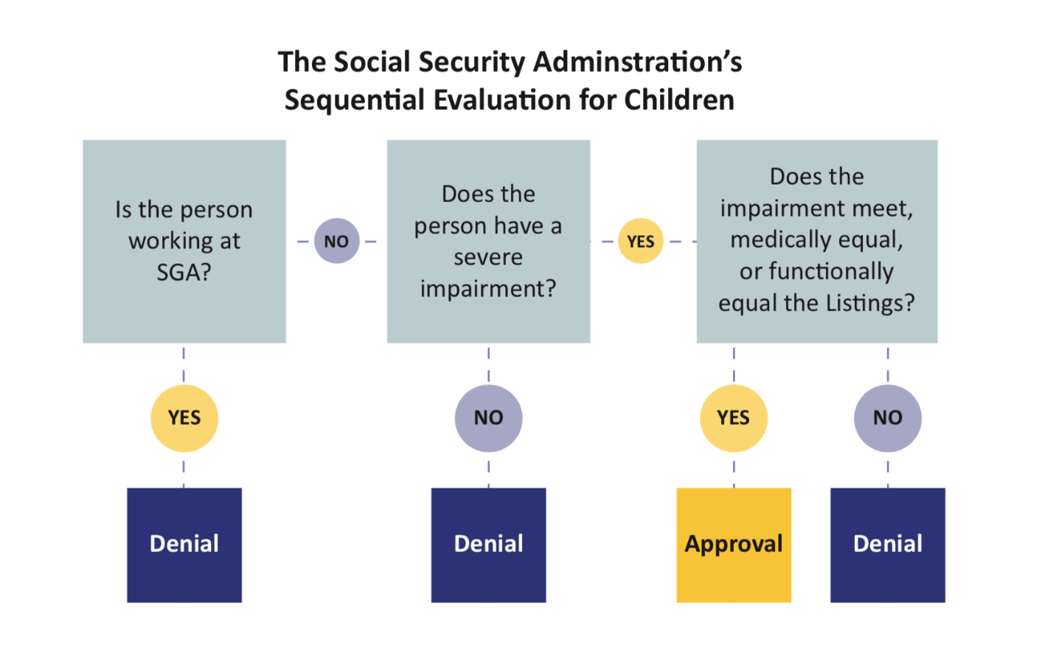
Sequential Evaluation for Children

Slide 11
Overarching Question
How does the child’s functional abilities compare to the functional abilities of a child of the same age who does not have the physical and/or mental impairments?

Slide 12
General Guidelines for Practice
SSA must consider all relevant information- both medical and non-medical
But must have some evidence of a medically determinable impairment

Slide 13
Acceptable Medical Sources
Licensed physicians (medical or osteopathic doctors)
Licensed or certified psychologists (including school psychologists)
Licensed optometrists (for the measurement of visual acuity and visual fields)
Qualified speech-language pathologists (for purposes of establishing speech or language impairment only)
Physical, Occupational, & Rehabilitation therapists
Advanced Nurse Practitioners and DO’s

Slide 14
Does the child need extra help?
More help than a child of the same age without an impairment would need
Nature and extent of any adaptations
(i.e., necessary assistive devices or technology)

Slide 15
Focus on:
Focus on whether there are factors present which mask the functional limitations or which cause or exacerbate the functional limitations.
Focus on the standard of comparison (ex. special education teacher stating that the child is doing well – as compared to what one would expect of this child, as compared to other children in the special education class, or as compared to children who do not have impairments)

Slide 16
Must also consider:
Impact of limitations and/or chronic illness
• Effects of treatment, including medications side effects (eg.: drowsiness, nervousness, pain, nausea, impact on appetite)
Frequency of treatment
How long the child will need treatment
Does treatment interfere with the child’s participation in typical activities

Slide 17
Does the child need a structured or supportive setting?
Structured or Supportive setting as follows:
• the child’s home in which family members or other people (nurses or home health workers) make adjustments to accommodate the child’s impairments
• the child’ classroom in school, whether it is a regular education classroom in which the child is accommodated or a special classroom
• a residential facility or school where the child lives for a period of time

Slide 18
Structured or Supportive Setting cont’d
REMEMBER SUCH STRUCTURED OR SUPPORTIVE SETTINGS MAY MINIMIZE SIGNS AND SYMPTOMS OF CHILD’S IMPAIRMENTS
SSA should assess the child’s need for a structured setting and the degree of limitation in functioning he/she would have outside the structured setting.
Even if child is able to function adequately in the structured or supportive setting, SSA must consider how the child would function in other settings and whether he/she would continue to function at an adequate level without the structured or supportive setting.

Slide 19
Unusual Settings
SSA recognizes that children may behave and perform differently in unusual settings (i.e., testing or one-on-one situations), but that this behavior should not be relied upon in isolation in determining the severity of functional limitations.
Must look to typical behavior

Slide 20
Is the child receiving special education or early intervention services?
Useful School Records:
• Referrals for evaluations
• Evaluations and Reevaluations
• IEPs or IFSPs
• Progress updates
• IEPs are reviewed annually

Slide 21
Requesting school records
Request any, and all, records, including but not limited to:
    Report cards
    Evaluations
    IEPs
    Incident or disciplinary reports
    Progress reports
    Therapy notes
    Attendance records

Slide 22
Special Educ./Early Intervention cont’d:
SSA must consider the info on a child’s:
• IFSP (0-3)
• IEP (3-18, actually can be until 22nd b’day)
An IEP/IFSP has the following purposes:
outline of educational program
guide to teacher
contract between parent and school
measure of progress

Slide 23
Early Intervention
Assesses developmental delay in five functional areas
Areas are different than domains, but can be very useful in a functional equivalence argument
To be eligible for EI services, must have significant delay in at least one of the areas (40-50% delay or 2 or more standard deviations) or moderate delay in at least two of the areas (25% delay or 1.5 standard deviations below average)

Slide 24
Useful components of special education/early intervention records
Classification
• Type of program
• Related services (transportation, speech-language therapy, counseling, occupational therapy, physical therapy)
• Evaluation summaries, present levels of performance, strengths and weaknesses
• Annual goals

Slide 25
Caution about using school and EI Records
IEP/IFSP eligibility does not automatically equal SSA disability
Records may not include diagnosis
Report cards often contain A’s and B’s (need to question basis of comparison)

Slide 26
Functional Equivalence
20 C.F.R. 416.926a - Functional equivalence is shown when an impairment or combination of impairments causes the same disabling functional limitations as those of a listed impairment.
• Do not need to connect the functional limitations to any particular listing.
• Basis for functional comparisons is with the activities of children the same age who do not have impairments.

Slide 27
Looks to answer the following questions:
What activities is the child able to perform?
What activities is the child not able to perform?
Which activities are limited or restricted?
Where does the child have difficulty performing activities?
Does the child have difficulty initiating, sustaining, or completing activities?
6. What kind of help does the child need?

Slide 28
Six Domains
Acquiring and Using Information
Attending and Completing Tasks
Interacting and Relating With Others
Moving About and Manipulating Objects
Caring for Yourself
Health and Physical Well-Being

Slide 29
Domains cont’d
Each of the domains, excluding health and physical well-being contains age-appropriate criteria for the following age groups:
• Newborns and young infants (up to age 1)
• Older infants and toddlers (1 – 3)
• Preschool children (3 – 6)
• School age children (6 – 12)
• Adolescents (12 – 18)

Slide 30

SOAR Online Course
An Overview

Slide 31

Benefits of the SOAR Online Course
Standardized training across all geographic areas
Allows SOAR Leaders to coordinate follow-up training and support
20 NASW CEUs
FREE, web-based, self-guided

Slide 32
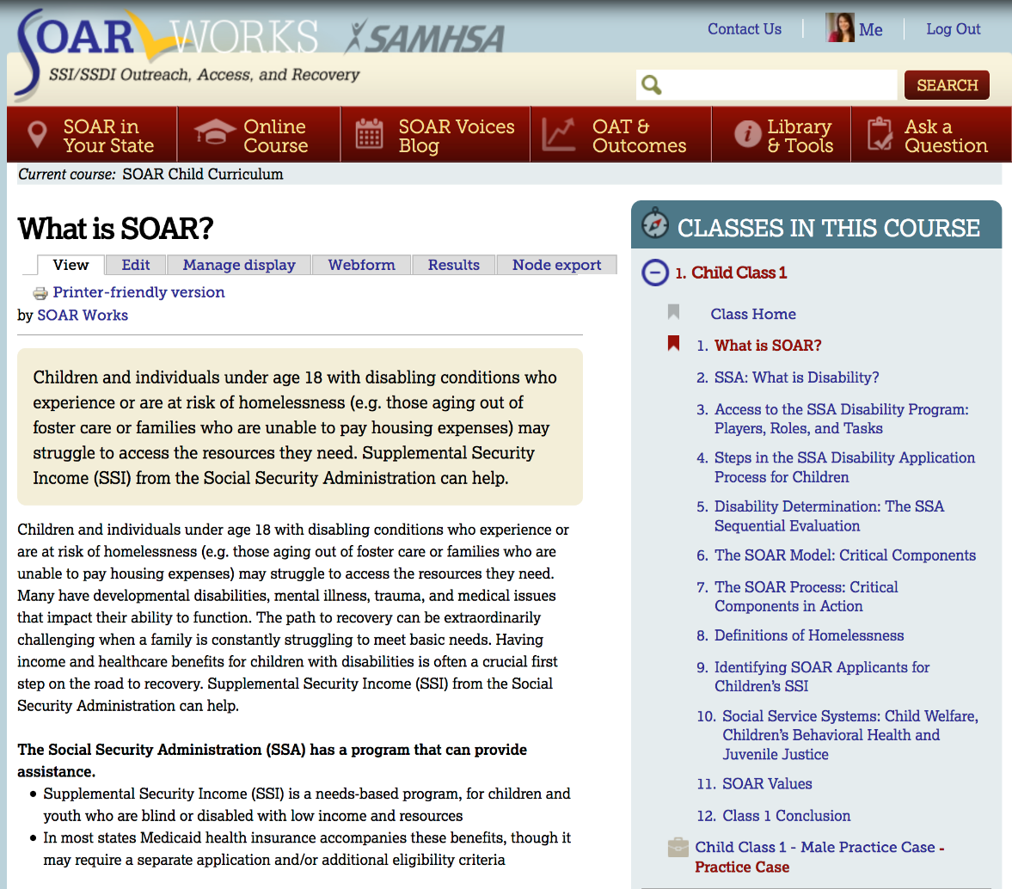
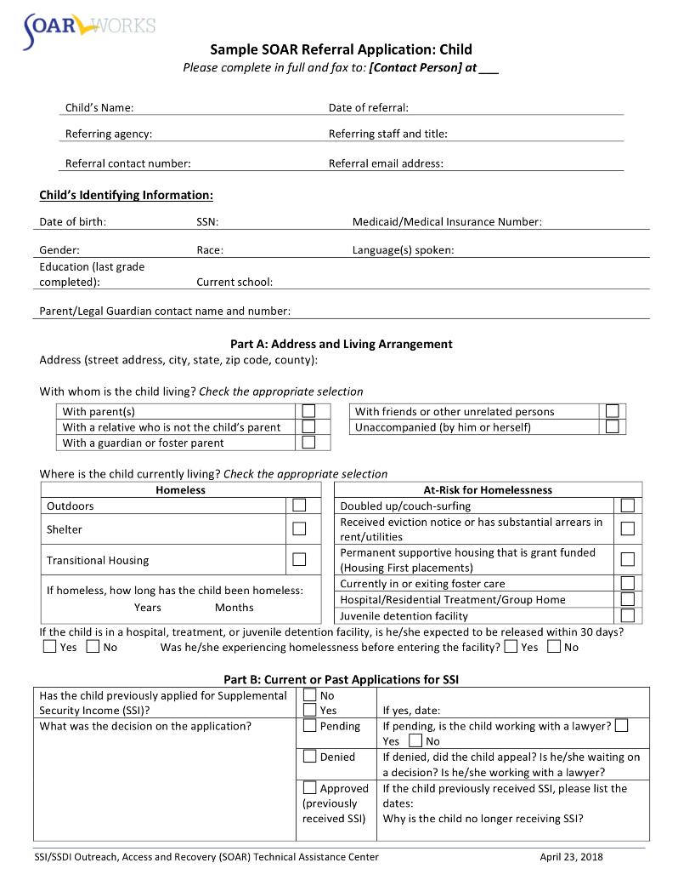
SOAR Child Curriculum Updates

Slide 33
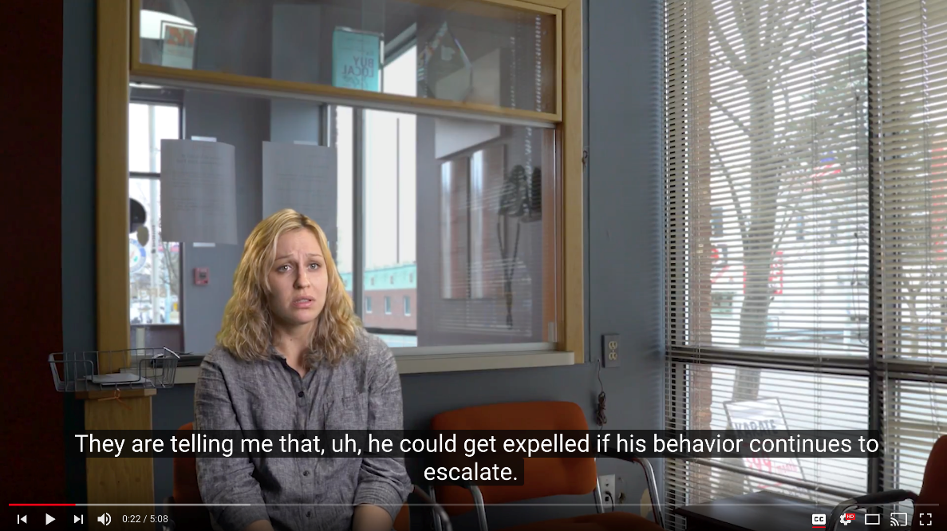
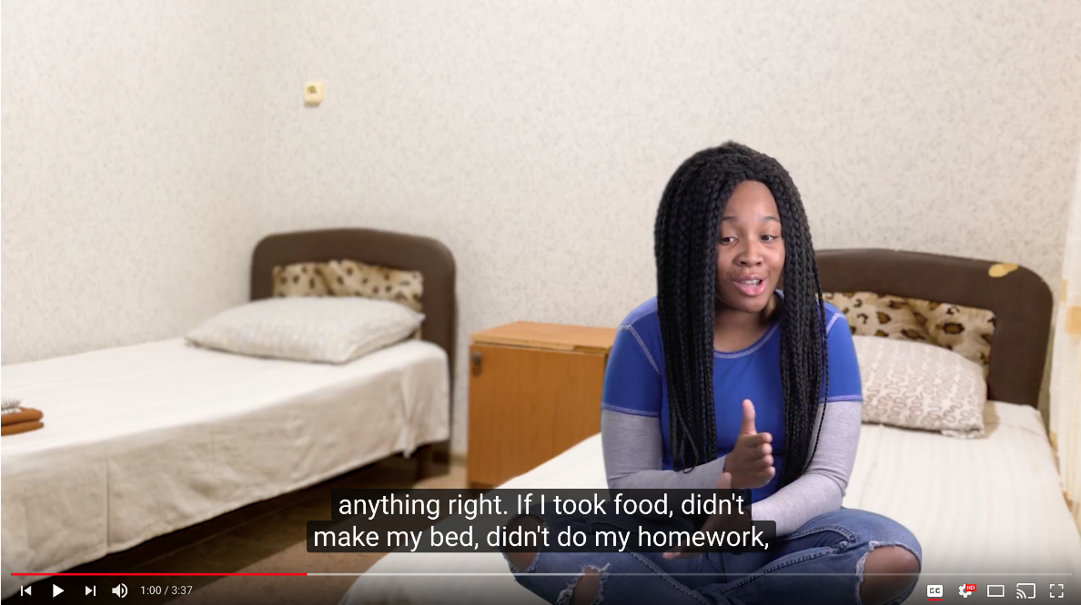
Practice Cases: Videos and Records

Slide 34
Projected Timeline
SOAR Online Course: Child Curriculum Beta Testing
  October 2018
SOAR Leadership Academy for Child Providers
  January 2019

Slide 35
Next Steps
Learn more about SOAR
Get in touch with your SOAR TA Center liaison
Reach out to your local or state SOAR leads
Register for the SOAR Online Course

Slide 36
Questions and Answers
How can we help?

Slide 37


Connect With Us!
https://soarworks.prainc.com
SAMHSA SOAR TA Center
Policy Research Associates, Inc.
Kristin Lupfer, Project Director
(518) 439-7415 x5262
klupfer@prainc.com

