Slide 1
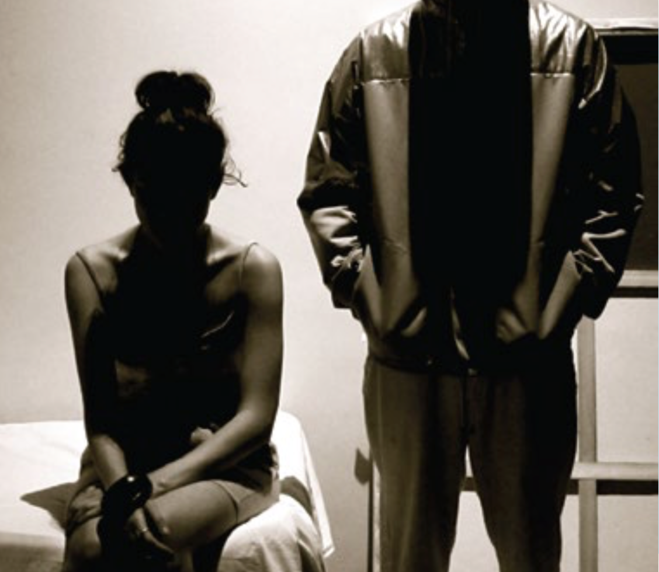
How to recognize the signs, incorporate information into trainings and help victims Kathy Wigtil, Baylor University School of Education Jessica Sykora, UnBound Waco,
Unaccompanied Youth and Human Trafficking:

Slide 2
Why We’re Concerned…
Youth homelessness is reaching crisis levels
On any night – approximately 37,000 unaccompanied youth in the U. S.

Slide 3
Unaccompanied homeless youth, the most at risk:

Slide 4
Youth are groomed and lured…

Slide 5
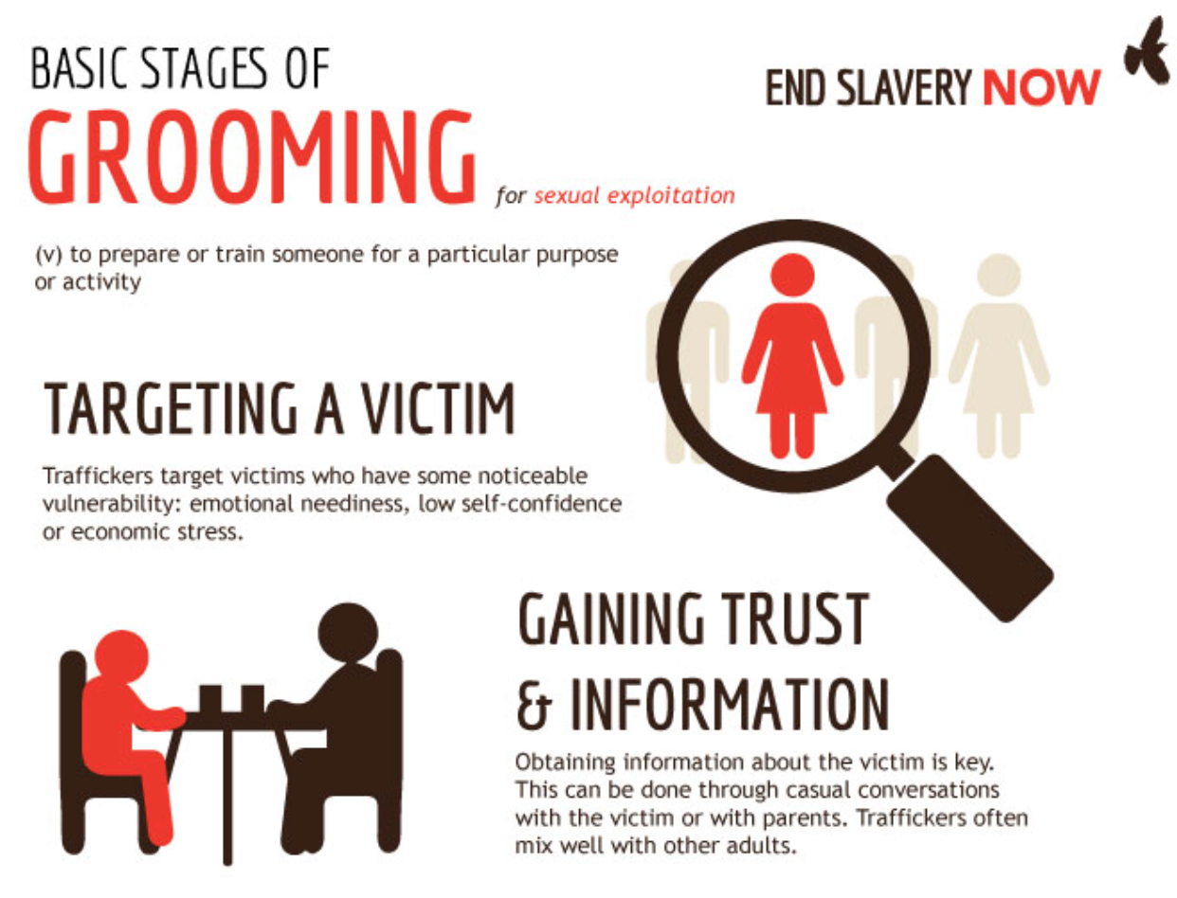

Slide 6
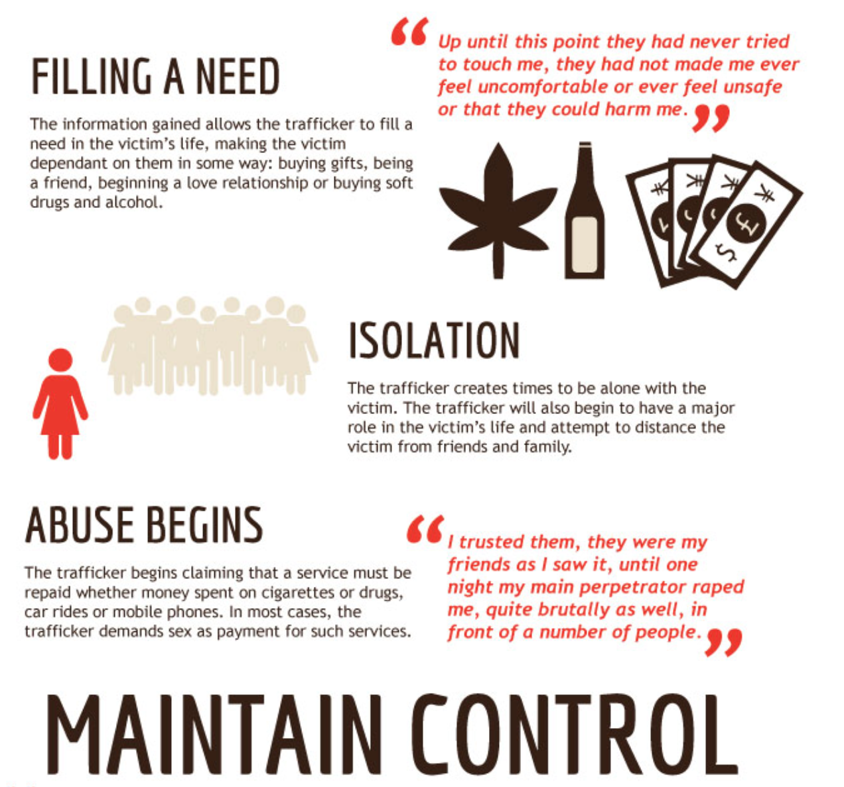

Slide 7
Where Human Trafficking Happens
Sex Trafficking
Labor Trafficking
Escort services
Illicit massage parlors
Residential labor
Bars, strip clubs, cantinas
Pornography
Restaurants
Peddling begging
Personal sexual servitude
Construction
Hotels
Landscaping
Commercial cleaning
Factories - manufacturing
Health Care
Recreational facilities

Slide 8
Trafficking in Texas
#2 in the country for calls the to national trafficking hotline
HWY 10 is the #1 corridor for movement of trafficking victims
Texas has several Top Cities for demand
20% of all victims in the US will pass through Texas during
79,000: approximate number of youth in sex trafficking annually
234,000 : approximate number of people in labor trafficking
University Tx Austin 2017, US GPO20 14_DFPS2016 HUman trafficking HOtline 2017

Slide 9
Trafficking Victims Protection Act
Labor trafficking: the recruitment, harboring, transportation, provision, or obtaining of a person for labor or services through the use of force, fraud or coercion for the purpose of insubjection to involuntary servitude, peonage, debt bondage or slavery.

Slide 10
T.V.P.A.
Sex Trafficking: the recruitment, harboring, transportation, provision, or obtaining, soliciting, patronizing of a person in which the commercial sex act is induced by force, fraud or coercion, or in which the person induced to perform such act has not obtained the 18 years of age.

Slide 11
Who are the Traffickers
U.S. citizens of foreign nationals
Male or female
Family member, intimate partners, acquaintances, strangers
Pimps, gangs, business owners, companies, ranches, factories
Polaris Project, 2017

Slide 12
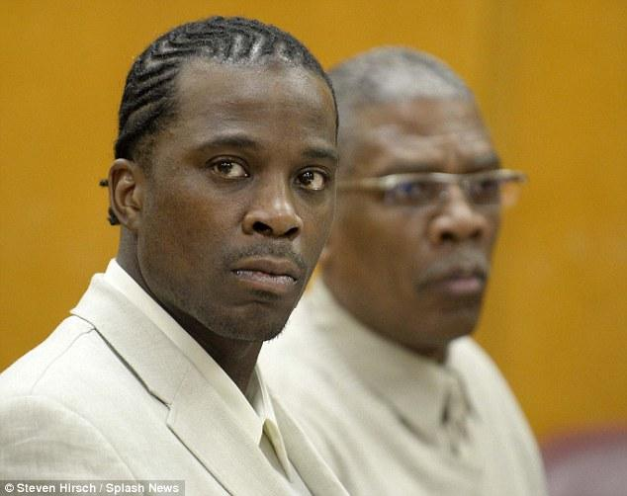
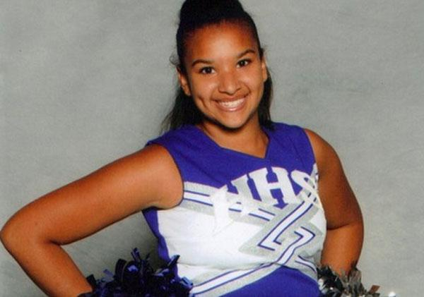
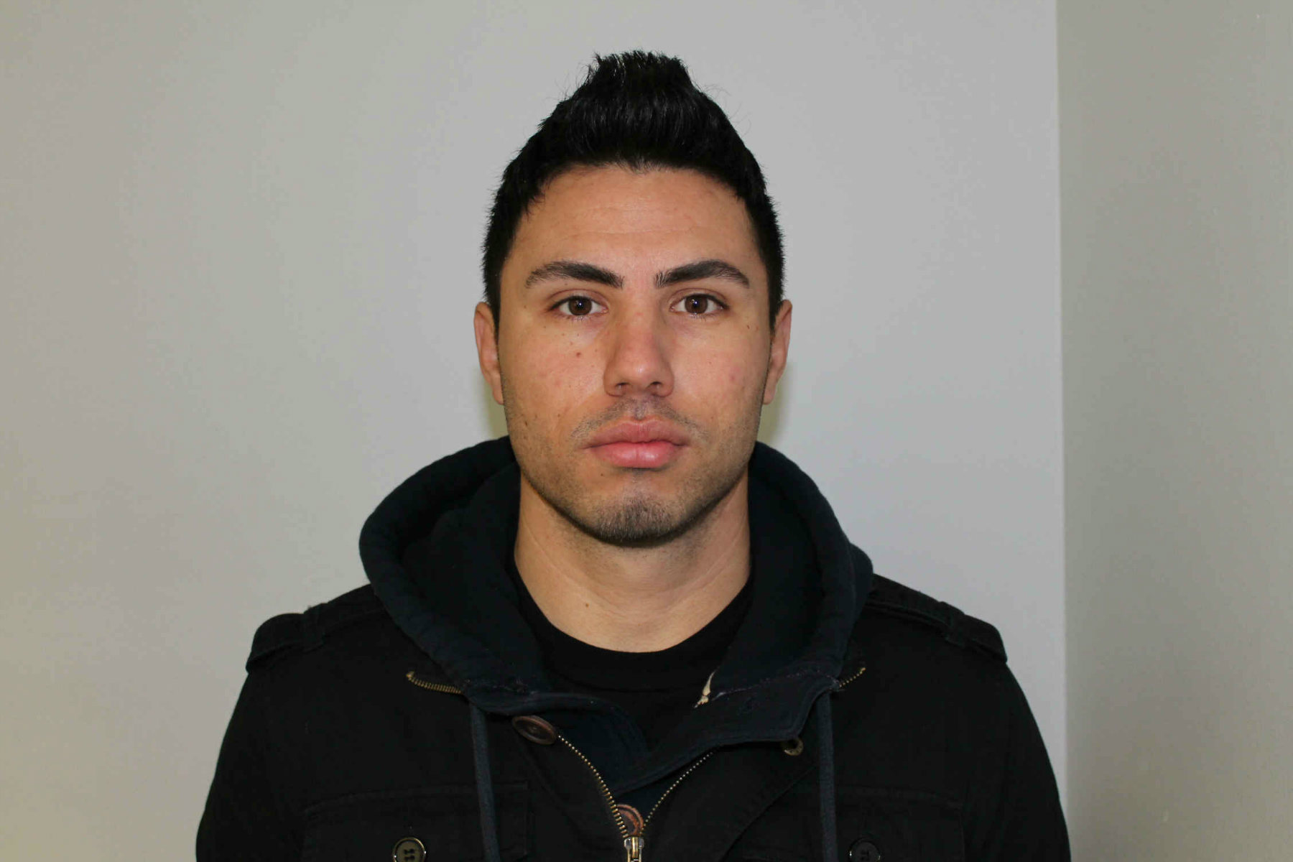
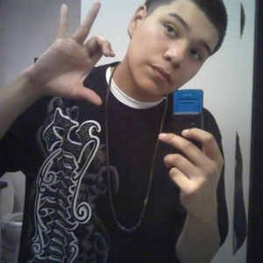
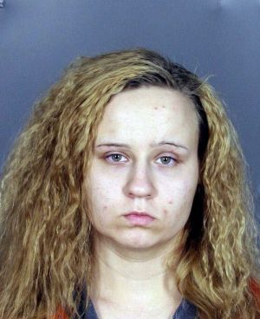
pick the pimp

Slide 13
Tactics of a Trafficker
Befriending Boyfriending
Lies and false promises
Manipulation
Recruiters
Kidnapping
Threats
Violence
Addiction
Hopelessness
Trauma bonding
Polaris Project, 2017
Notes:
AD A few pictures of traffickers

Slide 14
Who are the victims : Anyone
Vulnerabilities
Homelessness
Removal from familiar settings
Economically disadvantaged
Low level of education
Substance use
Involvement with child welfare
Runaway
Trouble connecting with peers

Slide 15
traffickers use victims to recruit their friends or other girls that they meet in foster care or at juvenile detention centers.
she is frequently moved to other places like California and other cities in Texas
Victims say
“receives a lot of messages every week from girls asking her to “go out” with them.”
“They try to get the girls that need stuff and don’t have nowhere to go”.

Slide 16
WHAT PART CAN YOU PLAY?

Slide 17
What to look for
Involvement in commercial sex industry
Tattoos or branding
Frequent movement
sudden truancy or change in academic performance
Gang involvement
new expensive clothes or accessories
dramatic change in language or behavior
Unpaid or paid very little
Not free to come or go
Owes debt
Recruited through false promises
Signs of violence
Few personal possessions
Lacks basic knowledge about whereabouts

Slide 18
What to do
Prioritize student’s safety
National Trafficking Hotline in Texas will send you through to an expedited line with DFPS for reporting Report to law enforcement
Ensure your district has and communicates a Human Trafficking reporting protocol. Go to: https://safesupportivelearning.ed.gov/human-trafficking-americas-schools/sample-protocol-school-districts for information on a school protocol.
Know what local agencies and coalitions provide appropriate services
Every school should have an well communicated protocol for reporting
National Trafficking Hotline in Texas should send you through to an expedited line with DFPS for reporting
Call police

Slide 19
Advocate for Prevention Education
Students grades 6th-12th should be educated on the laws, tactics of trackers, vulnerabilities, and how to keep themselves safe.
School Faculty and Staff should be educated on the laws, reporting protocol, signs of grooming , and how to recognize vulnerable students.
https://commonthread.net/
www.unboundnow.org
Notes:
what other agencies would you like to offer

Slide 20
Educating Our Community

Slide 21
Contact us for more information…
Kathy_Wigtil@baylor.edu
Jessica.sykora@unboundnow.org
www.unboundnow.org
1-888-373-7888 – National Trafficking Resource Center

