Slide 1
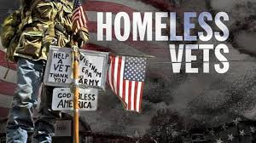
WALK IN MY SHOES:
Journey of the Homeless Veteran
Presented by:
Artie Williams, LCSW, BCD
VA North Texas Medical Center
Fort Worth Homeless Veterans Programs

Slide 2
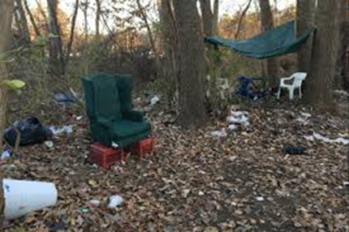
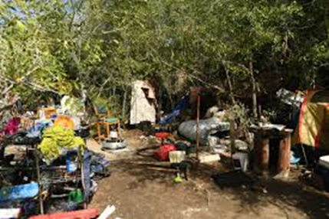
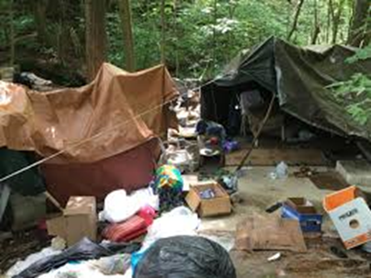
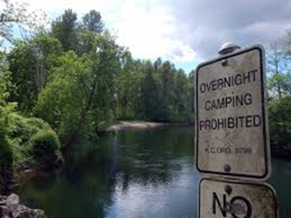

Slide 3
Objectives:
Participants will be able to identify the unique challenges of homeless Veterans from different wartimes.
Participants will learn the prevalence of suicidality among homeless Veterans.
Participants will be able to identify the symptoms of PTSD and discuss available treatment options for homeless Veterans.
Participants will be able to identify challenges facing female homeless Veterans.

Slide 4
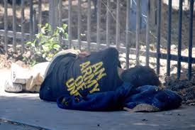

Slide 5
Causes of Veteran Homelessness
Mental health disorders
History and/or current substance abuse
Isolation and poverty
Family conflicts/Domestic Violence
Foreclosure and At-Risk of Foreclosure
Eroding Work Opportunities to match experience
Decline in Public Assistance
Lack of Affordable Housing/Reluctant Landlords
Multiple and extended deployments
Traumatic brain injuries
Post-Traumatic Stress Disorder (PTSD)
Medical and physical disabilities
History of evictions
Legal Issues
Lack of housing and assistance programs for homeless Veterans who are ineligible for VA Healthcare (except emergency care)

Slide 6
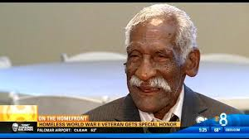
World War II
December 7, 1941 – December 31, 1946
Korean War
June 27, 1950 – January 31, 1955
Former Tuskegee Airman Stephen Lawrence shakes the hand of Veterans Moving Help’s owner Gregory Ledge, who helped move the 92-year-old World War II Veteran from his Gainsville, Florida home to an assisted living facility.

Slide 7
Causes of Homelessness Among World War II Veterans
Age
Health issues
Isolation/loneliness
Lack of family support
Mental illness
Poverty
Loss of caregiver
Post-Traumatic Stress Disorder (sometimes undiagnosed)
Lack of appropriate housing options that provide the appropriate care to the elderly Veteran

Slide 8

World War II

Slide 9
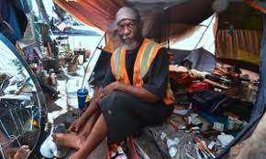
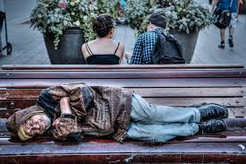
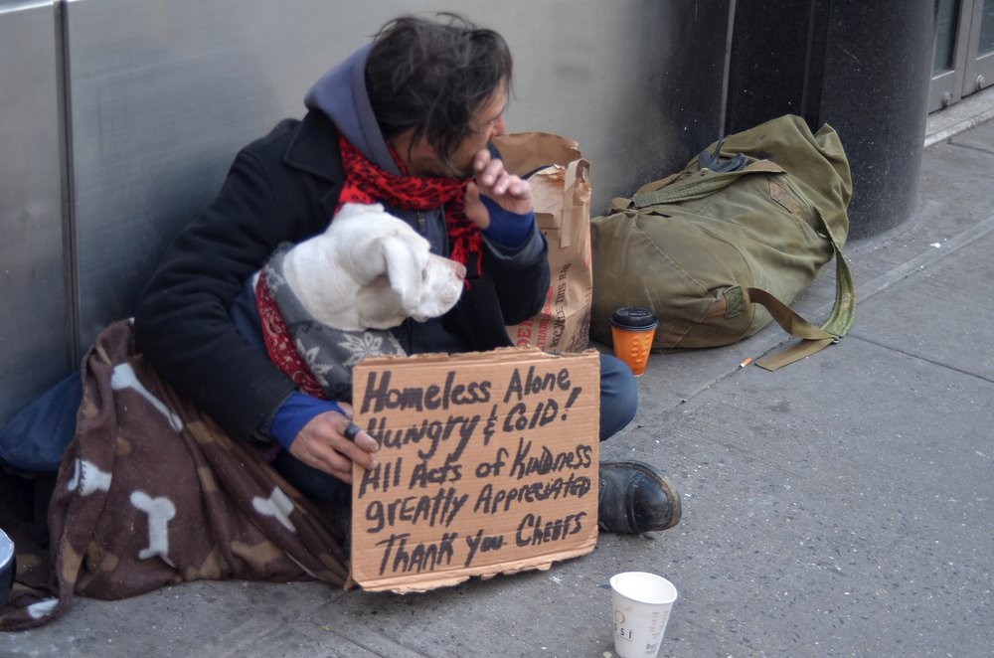
Vietnam War
February 28, 1961-May 7, 1975

Slide 10
Facts about the Vietnam Conflict
Approximately 2.7 million American men and women served in Vietnam
During the way, more than 58,000 servicemen and women lost their lives.
During the war, from 1962 to 1971, the U.S. military sprayed more than 19 million gallons of defoliants and herbicide over rural areas in South Vietnam, Laos and Cambodia in an attempt to deprive the enemy of food and vegetation cover. (known as Agent Orange)
No victory parades or welcome-home rallies upon soldiers return home.
Many returning service men and women felt uncared for or seemed to be viewed with distrust and anger.

Slide 11
Medical Issues Specific to Vietnam Veterans
Al Amyloidosis
Chronic B-cell Leukemias
Chloracne
Diabetes Mellitus Type 2
Hodgkin’s Disease
Ischemic Heart Disease
Multiple Myeloma
Non-Hodgkin’s Lymphoma
Parkinson’s Disease
Peripheral Neuropathy, Early Onset
Porphyria Cutanea Tarda
Prostate Cancer
Respiratory Cancer (including lung cancer)
Soft Tissue Sarcomas

Slide 12
Causes of Homelessness Among Vietnam Veterans
Poverty
Isolation
Mental health issues
History and/or current substance abuse
Survivor’s Guilt
Post-Traumatic Stress Disorder (PTSD)
Distrust of helpers, including shelters, doctors, VA, etc.
Legal Issues including incarceration, parole, probation
Lack of family and social support
Lack of housing, reluctant landlords, misunderstanding of Housing First

Slide 13
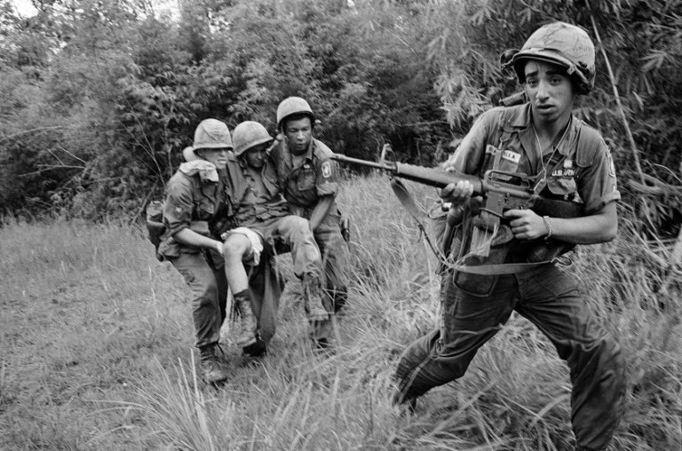
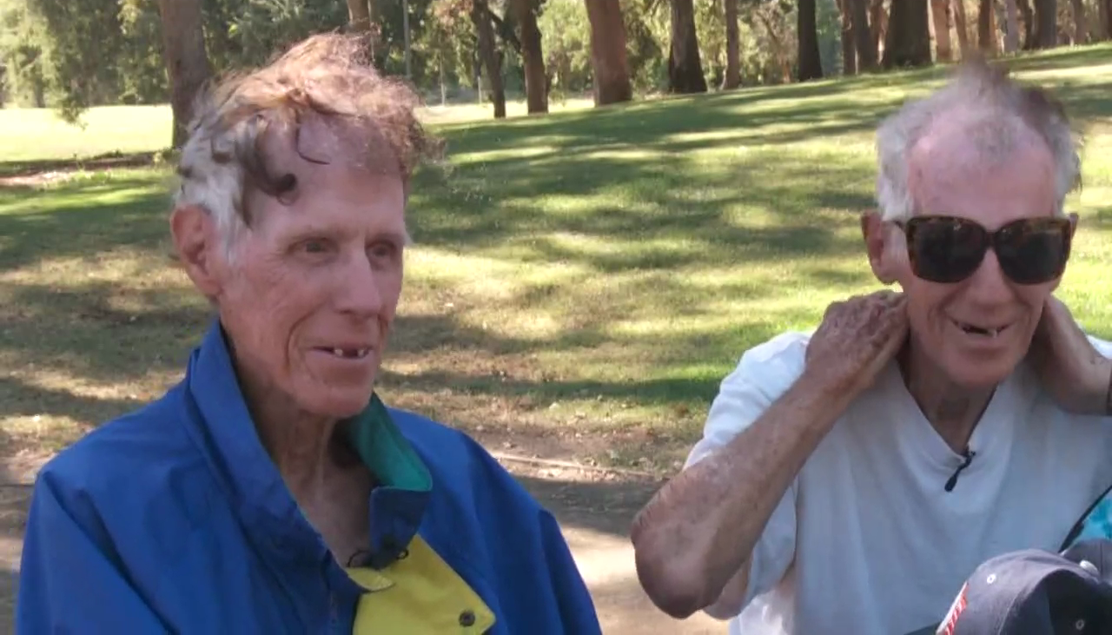
Vietnam War Homeless Veterans
(con’t)

Slide 14
They are 84 years old and twins!! http://video.foxnews.com/v/5513989861001/family-friends-work-to-help-homeless-84-year-old-twins#sp=show-clips

Slide 15
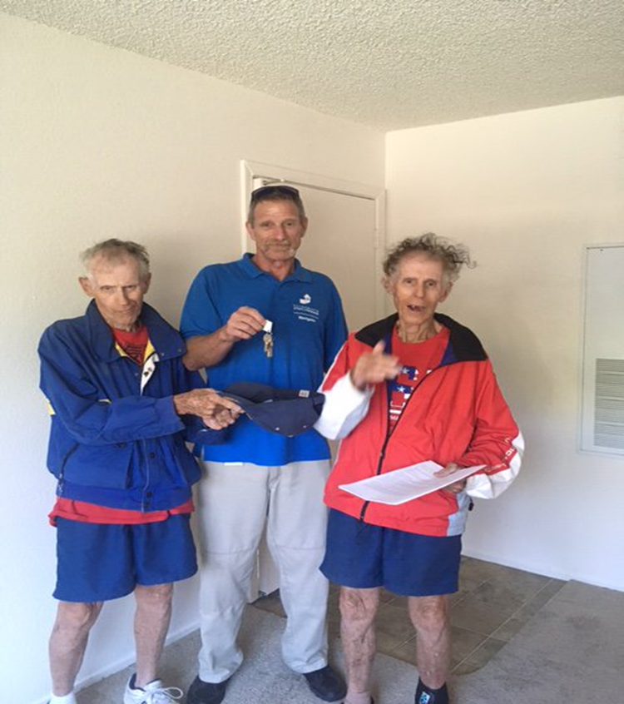
Congratulations!!!

Slide 16
A Word About Survivor’s Guilt
“I watched a man die on a trail near the village of My Khe. I did not kill him. But I was present, you see, and my presence was guilt enough.”
Excerpt from The Things They Carried, written by Tim O’Brien
According to Nancy Sherman, author of Afterwar: Healing the Moral Wounds of Our Soldiers, “they also train with a set of ideals that encourage black-and-white thinking: Never leave a buddy behind, bring everyone home, minimize collateral damage. But as missions get harder and you encounter things like insurgency in civilian populations, you can’t do all those things well. So there are a whole lot of moral compromises that people might not have been prepared to make.”

Slide 17
As these soldiers age, especially those that are homeless, and face the end of their lives, many find themselves receiving palliative or hospice care. Many have never heard kind words about their service and still experience a great amount of guilt and shame.
According to one Veteran, he said that what needs to be said is this:
“We love you, we’re proud of you. You are not going to hell. You are a hero.
Welcome home”.

Slide 18
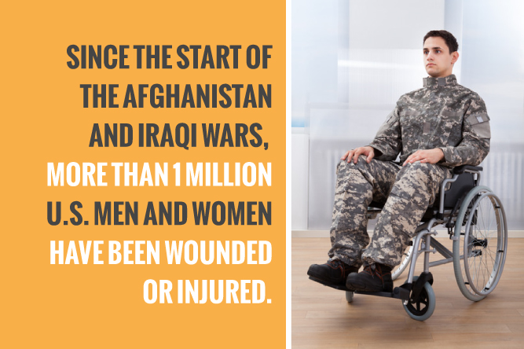
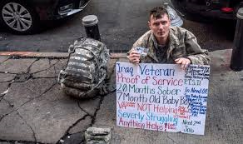
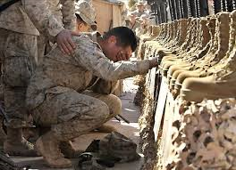
Gulf War, Iraq and Afghanistan
August 2, 1990 - Present

Slide 19
Facts
In 2013, 48,000 Veterans in this era were either literally homeless or in Federal programs designed to keep them off the streets.
Afghanistan and Iraq Veterans experienced traumas during deployment, and disrupted connections with friends and family.

Slide 20
Challenges…
Military As Family
  Caretaker
  Structure
Normal Is Alien
  Disconnection
  Unsupportive Institutions
  Lack of Civilian Structure
  Loss of Purpose

Slide 21
Causes of Homelessness Among Iraqi and Afghanistan Veterans
Post-Traumatic Stress Disorder (PTSD)
Traumatic Brain Injuries
Physical Disabilities
Medical Disabilities
Mental Health Issues
Survivor’s Guilt
History and/or current substance abuse
Legal issues including incarceration, parole and probation
Reluctant landlords
Lack of affordable housing options

Slide 22
Causes of Homelessness Among
Female Veterans
Mental Health Disorders
Post-Traumatic Stress Disorder (PTSD)
Military Sexual Trauma (MST)
*1 in 5 women report experiencing, nearly 19,000 cases in 2011
Not Being Believed
Maintaining Productive Employment
Lack of Child Care
Lack of Adequate Income
Housing Issues including evictions, reluctant landlords, etc.
Privacy and Safety Concerns
Domestic Violence

Slide 23
Causes of Homelessness Among Female Veterans
Female Veterans who experience MST were nine times more at risk for PTSD.
More than 30,000 single mothers have deployed to Iraq and Afghanistan.
Being identified as homeless creates a threat and fear of CPS assessing the situation as dangerous and removing their children.
In FY 2010, 77% of homeless female Veterans were unemployed.
Skills learned in the military do not always translate to employment ready skills or are skills in predominately male positions.

Slide 24
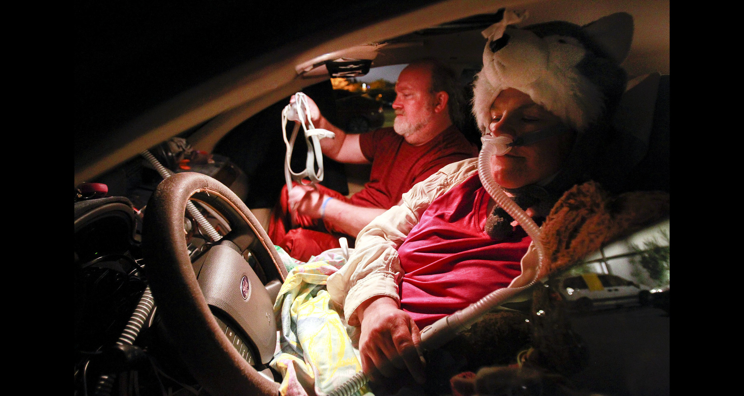
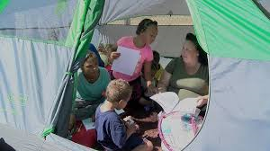
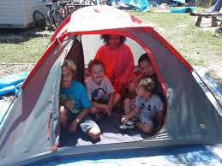
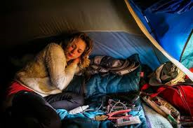

Slide 25
Post-Traumatic Stress Disorder
PTSD

Slide 26
Post-Traumatic Stress Disorder
What is it?
  A mental health problem that some people develop after experiencing or witnessing a life-threatening event, like combat, a natural disaster, a car accident, or sexual assault.
  Combat and other military experiences
  Sexual or physical assault
  Learning about the violent or accidental death or injury of a loved one
  Child sexual or physical abuse
  Serious accidents, like a car wreck
  Natural disasters, like a fire, tornado, hurricane, flood, or earthquake
  Terrorist attacks

Slide 27
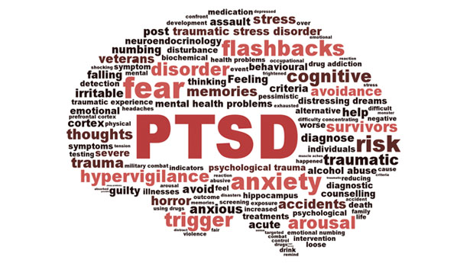

Slide 28
Symptoms of PTSD
Reliving the event
Avoiding things that remind the person of the event
Having more negative thoughts and feelings than before
Feeling on edge

Slide 29
“The emotional numbness… will just tear away all of the relationships in your life, you know, if you don’t learn to unlock them [and] get those emotions out.
--- Sarah C. Humphries
US Army (1994-2012)

Slide 30
“Even just falling asleep was tough. The minute I would start dozing off I would get a surge of adrenaline or anxiety, and would wake up. And even when I did fall asleep, I would wake up with night terrors or sweats.”
-- Stacy L. Pearsall
US Air Force (1998-2008)

Slide 31
PTSD Treatment Modalities
Trauma-focused Psychotherapies
Prolonged Exposure Therapy (PE)
Cognitive Processing Therapy (CPT)
Eye Movement Desensitization and Reprocessing (EMDR)

Slide 32
“When you can walk through it with a trained professional – and that doesn’t mean your buddy or your buddies that went through it with you – they have a way of making you look at it from all the angles, not just the one perception that you have.”
--- Reedy Hopkins
US Air Force (1983 – 2011)

Slide 33
Suicide and Veteran Homelessness

Slide 34
Suicide Among Veterans
20 Veterans commit suicide each day but only six of them have touched the VA health system
65% of Veteran suicides are among people age 50 or older and 67% of Veteran suicides are a result of firearm injury
Only about 30% of all Veterans (6 million) use VA health care
Suicide among Veterans is 22% higher than the general population
The suicide rate among Veterans with homelessness in the past year was 81.0 per 100,000 as compared to Veterans without recent history of homelessness with a rate of 35.8 suicides per 100,000

Slide 35
Suicides Among Homeless Veterans
The suicide rate among Veterans with homelessness in the past year was 81.0 per 100,000 as compared to Veterans without recent history of homelessness with a rate of 35.8 suicides per 100,000.
Nearly a third (29.3%) of Veterans receiving care for suicidality showed evidence of homelessness.
There is sufficient evidence that exists to suggest that homelessness is a risk factor for suicide, suicide attempt, and suicidal ideation.

Slide 36
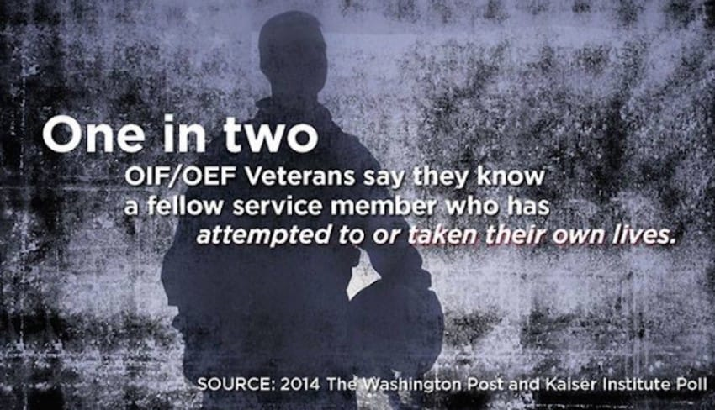

Slide 37
Suicide and Homeless Veterans
Warning Signs
  Hopelessness; feeling like there’s no way out
  Anxiety, agitation, sleeplessness, or mood swings
  Feeling like there is no reason to live
  Rage or anger
  Engaging in risky activities without thinking
  Increasing alcohol or drug misuse
  Withdrawing from family and friends

Slide 38
Simple Intervention to a Not So Simple Problem
These require immediate attention:
Thinking about hurting or killing self
Looking for ways to kill self
Talking about death, dying, or suicide
Self-destructive behavior such as drug misuse, carelessly handling weapons, etc
But above all don’t be afraid to ask THE question:
ARE YOU THINKING ABOUT KILLING YOURSELF?

Slide 39
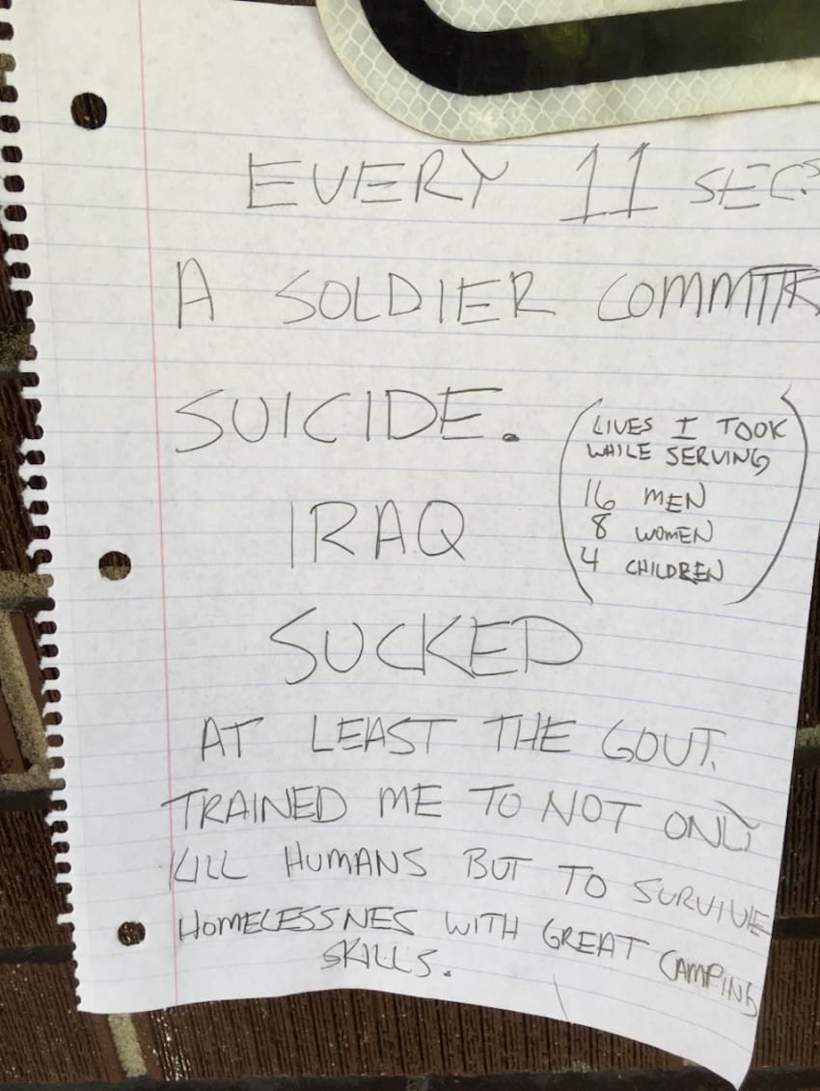

Slide 40
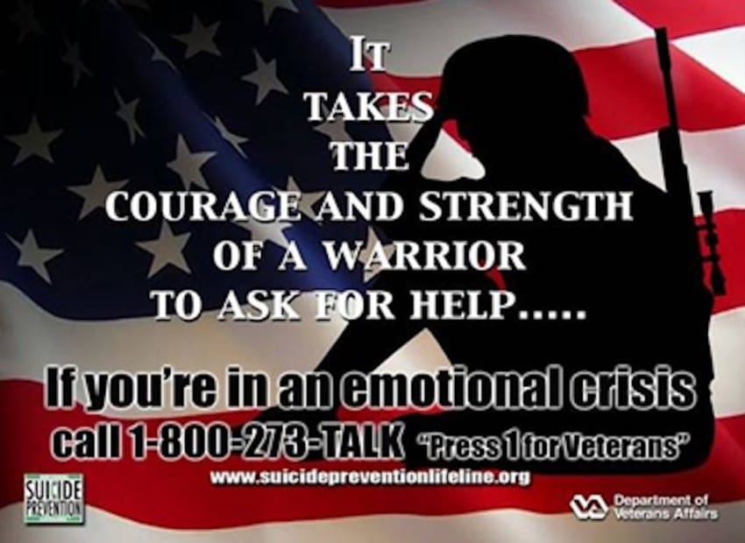

Slide 41




Slide 42
References
Centers for Disease Control and Prevention, National Center for Health Statistics. (2016). Increase in Suicide in the United States, 1999-2014. Retrieved November 9, 2017, from https://www.cdc.gov/nchs/products/databriefs/db241.htm 2.
U.S. Department of Veterans Affairs, Office of Mental Health and Suicide Prevention. (2017). Suicide Among Veterans and Other Americans, 2001-2014. Retrieved January 22, 2018 from https://www.mentalhealth.va.gov/docs/2016suicidedatareport.pdf
Hoffberg, A.S., Spitzer, E., Mackelprang, J.L., Farro, S.M. , & Brenner, L. (2017). Suicidal SelfDirected Violence Among Homeles US Veterans: A Systematic Review. Suicide and LifeThreatening Behavior. (doi:10.1111/sltb.12369).
U.S. Department of Veterans Affairs, Veterans Health Administration, Office of Suicide Prevention. Suicide among Veterans and other Americans 2001-2014. August 2016. Accessed at http://www.mentalhealth.va.gov/docs/data-sheets/VA-Suicide-Data-Report.pdf.
Ahern, J., Worthen, M., Maters, J., Lippman, S.A., Ozer, E., and Moos, R. The Challenges of Afghanistan and Iraq Veterans’ Transition from Military to Civilian Life and Approaches to Reconnection. Published: July 1, 2015. Accessed at https://doi.org/10.1371.journal.pone.0128599.
U.S. Department of Veterans Affairs, Office of Mental Health and Suicide Prevention. (2018). VA National Suicide Data Report 2005-2015.
http://video.foxnews.com/v/5513989861001/family-friends-work-to-help-homeless-84-year-old-twins#sp=show-clips.
National Coalition for the Homeless. “Why Are People Homeless?”, 2009. National Coalition for the Homeless, 2201 P St NW, Washington, D.C., 20036; 202-462-4822.
National Center for PTSD. “Understanding PTSD and PTSD Treatment.” Feb. 2018. Accessed at www.ptsd.va.gov.

