Slide 1



Decriminalizing Homelessness and Same Day ID Recovery
September 2018
Notes:
Recommended Title: “Decriminalizing Homelessness and Same Day ID Recovery”
Working Together to End Homelessness

Slide 2

PRESENTERS:
W. David Row | Coordinated Entry Project Manager | SARAH
Morjoriee White | Homeless Administrator | City of San Antonio (DHS)
Monty McCann | HOPE Team | San Antonio Police Department
Joe Farris | HOPE TEAM | San Antonio Police Department

Slide 3
WHO IS SARAH?
The South Alamo Regional Alliance for the Homeless is charged to create an improved service system that effectively provides support, coordination, and housing to all the homeless populations within San Antonio / Bexar County.
Our mission is to make homelessness rare, brief, & non-recurring.

Slide 4
SYSTEM BUILDING
STRATEGY
Listen
to people with lived experience
Lead
systems change to end homelessness
Engage
with mainstream systems to end homelessness
Educate
service providers because program improvements drive system improvements
Use Data
to make decisions about resource investments
Drive
systems to prioritize vulnerable people experiencing homelessness
Notes:
Listen to people with lived experience
Lead systems change to end homelessness
Engage with mainstream systems to end homelessness
Educate service providers because program improvements drive system improvements
Use data to make decisions about resource investments
Drive systems to prioritize vulnerable people experiencing homelessness
We listen to people with live experience and service providers who are experts in what they do, then we take what the community tells us lead the necessary changes by engaging with other mainstream systems to create a more supportive and coordinated continuum of care.
We also understand the a key component in addressing homelessness in San Antonio / Bexar County is by educating the community about the issue, as well as service providers, because program improvements drive system improvements.
We use data to make informed decisions about resource investments and how to better support those most vulnerable and the people serving them.Finally, we drive systems to prioritize vulnerable people experiencing homelessness, because ultimately our goal is to make homelessness a rare, brief, & nonrecurring event.

Slide 5
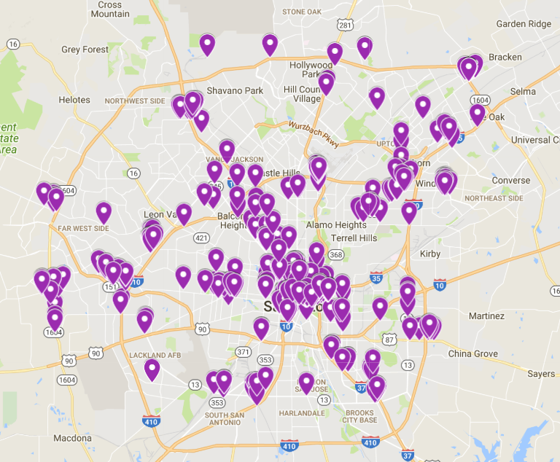
Point-in-Time Count
The Point-In-Time (PIT) Count is a count conducted on one night in January every year. The count captures the number of people in the community who are experiencing homelessness in shelters and on the streets.
Image: 2018 PIT Unsheltered Count Distribution

Slide 6
56 SAPD Officers
356 Volunteers
26 Partner Agencies
Point-in-Time Count

Slide 7
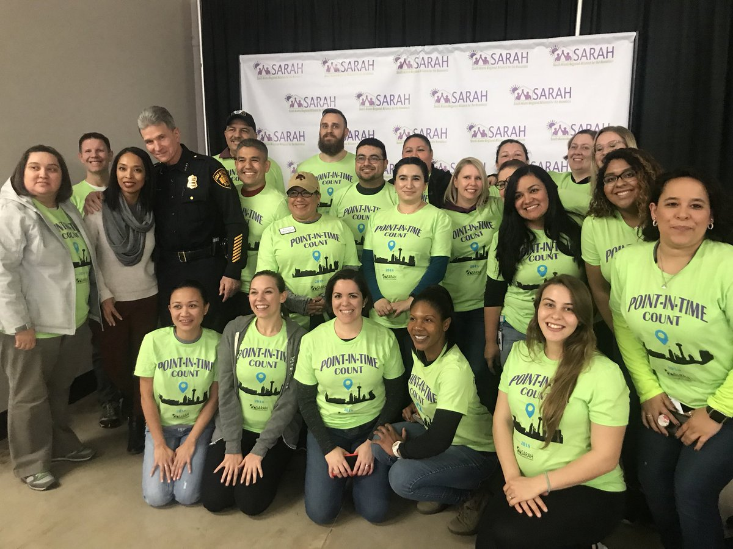
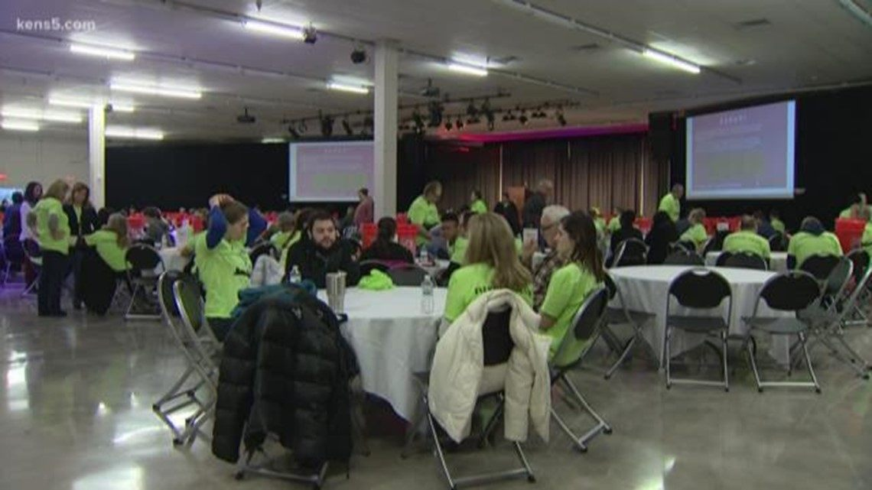

Slide 8

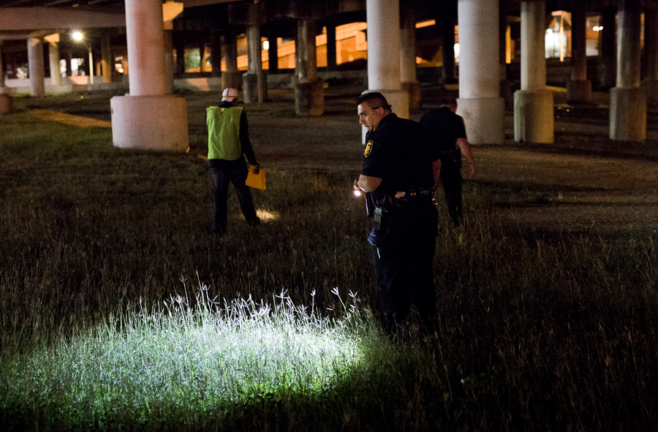

Slide 9


City of San Antonio
Homeless Investments and Partnerships
Homelessness is Rare, Brief, & Non-Recurring

Slide 10



Comprehensive Homeless Plan:
December 2015:
  Department of Human Services (DHS) and the San Antonio Police Department presented the Comprehensive Homeless Plan to City Council.
  Goal: Combine traditional law enforcement and social service strategies to address homelessness.
City of San Antonio’s Role:
Public Safety
Planning and Policy Development
Coordination and Facilitation
Financial Investment
Notes:
Goal: Combines traditional law enforcement and social service strategies to address homelessness.

Slide 11

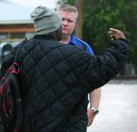
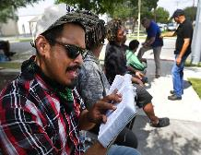
Public Safety
San Antonio Fear Free Environment (SAFFE) Community Outreach
  Provide information on services and resources in coordination with DHS and Haven for Hope
  Focus on neighborhoods and identified areas throughout the city.
Crisis Intervention Training
  Offered to all officers through annual in-service curriculum
  Focus on de-escalation techniques and strategies to engage individuals that are mentally unstable and/or under the influence of drugs
HOPE (Homeless Outreach Positive Encounters) Team – SAPD Downtown Bike Patrol
  The goals of the program are to inform and connect homeless individuals within the downtown area to available resources and provide street outreach to build rapport with them.
  SAPD assisting with ID verification in order to facilitate issuance of valid identification necessary for government services and assistance
IMPACT (Integrated Mobile Partners Action Care Team)
  SAPD MHU
  SAFD Paramedic
  CHCS Clinician
  Haven for Hope Outreach staff

Slide 12

Homeless Investments
Homeless Prevention
Domestic Violence Services
Emergency Shelter
Mental Health and Substance Use Services
Coordinated Homeless Encampment Outreach
Permanent Supportive Housing
Housing Opportunities for People with Aids (HOPWA) Resources
Outreach and Navigators
Total DHS Homeless Investment: $10.2 M
Haven for Hope $4.5 M
Other
Providers
$2.1 M
Dept. of Human Services
$0.4 M
Haven for Hope Partners $3.2 M

Slide 13
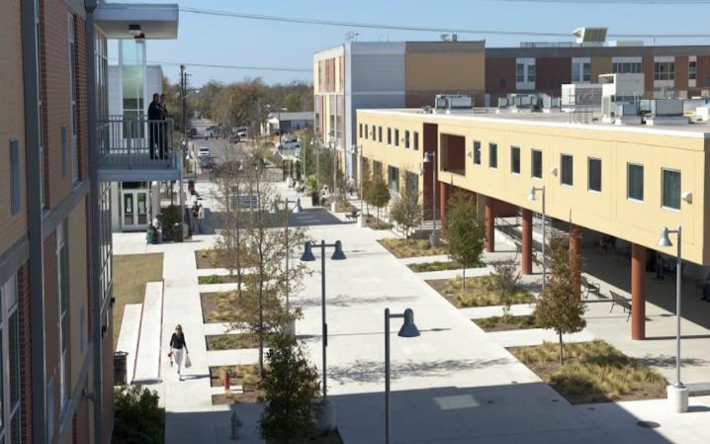

The transformation campus includes several levels of shelter for men, women, and families along with supportive services.
Total 949 Beds
Approximately 143 Community Partners Organizations
The campus includes detox, in-patient rehabilitation, and mental health and substance use residential and out-patient services.
Courtyard - safe-sleeping environment, basic needs, case management, and mental health services.
  Direct Referral Program (DRP) - low barrier emergency shelter beds with supportive services
Haven for Hope
Notes:
The campus also includes detox, in-patient rehabilitation, and mental health and substance use residential and out-patient services.
Support services are provided with the goal of moving individuals and families from shelter to permanent housing.
Residential Services for Single Adults and Families
Healthcare Services Center for Health Care Services
San Antonio Food Bank
Family Violence Prevention Services, Inc.
Education and Job Training
Family Support Food
Services Courtyard

Slide 14
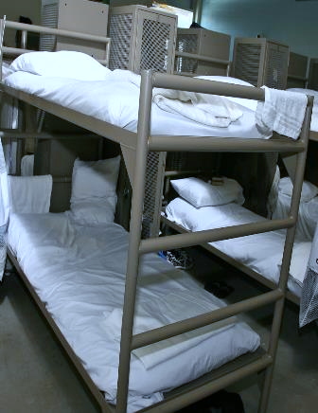



Mental Health and Substance Use Investments
Mental Health and Substance Use Residential Treatment:
  Integrated Treatment Program is located on the Haven for Hope Transformational Campus to provide MH and SUD services to homeless individuals.
Center for Health Care Services Restoration Center:
  Sobering Program- targets Public Intoxicants brought by law enforcement or Haven for Hope Security in an effort to divert entrance to the legal system.
  As of FY18 Q3- 3,497 public intoxicants were diverted from the Magistrate.
SAPD Mental Health Unit Clinician Support
Notes:
Fund 96 out of 238

Slide 15
SAPD and DHS Homeless Chronic Crisis Stabilization Initiative
Improve quality of life.
Reduce the number of interactions between homeless individuals diagnosed with serious and persistent mental illness and the San Antonio Police Department.
Identify unmet needs and barriers in the community that contribute to an individual’s inability to engage and remain in mental health treatment and help prevent chronic homelessness.
Provide Support and education to individuals and family members to encourage compliance with Mental Health Treatment.
Facilitate compliance with recommended mental health treatment to reduce the number of involuntary commitments to behavioral health facilities, negative interactions with SAPD.
Notes:
DHS is collaborating with the SAPD Mental Health Unit and SAPD HOPE team to identify 20 homeless individuals within the downtown area that are mentally decompensating due to untreated mental illness and substance use concerns. The goal of the initiative is to increase outreach and service coordination amongst various partners including health care entities and homeless providers to assist with mental health stabilization, provide intensive case management and accessing social support services.

Slide 16
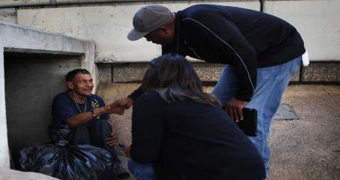
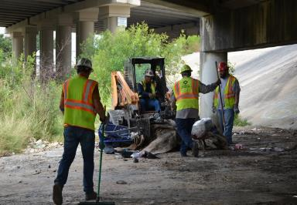
Coordinated Homeless Encampment Outreach
FY 2018 Q3YTD Results
121 Outreach Events
299 Homeless Offered Services
16% Accepted
Collaborating Partners:
8 City Departments and
Haven for Hope
Identify
Outreach
Restore
Maintain
Notes:
Development Services Department, SAPD, Transportation and Capital Improvements, Parks and Recreations, DHS, Office of Risk Management and Solid Waste Management

Slide 17


Coordinated Homeless Encampment Outreach
“I credit DHS Homeless Services, SAPD West SAFFE, and Haven Outreach for helping me have a new outlook on life. “My life has been changed. The In-House Treatment program has given me a chance to live my life in a way I never believed would be possible.
“Thank you from the bottom of my heart. You all saved my life; you all truly did.”
Notes:
In February, Human Services, Haven for Hope, and San Antonio Police Department began making contact with Christianne. At that time, Christianne was living under a drainage culvert near Highway 151 and Potranco Road. Nancy S. Williams, Homeless Services Special Projects Manager, worked with Ron Brown, Haven for Hope Outreach Director, and SAPD West SAFFE Officer Elliott Valdez in reaching out to her and helping her access services.
Last Friday, Christianne joined several other previously homeless individuals in completing the In-House Treatment program at Haven for Hope and participating in a commencement ceremony to mark this achievement. She is shown with Nancy and Ron. Christianne’s next goal is sustainable housing.
“I credit DHS Homeless Services, SAPD West SAFFE, and Haven Outreach for helping me have a new outlook on life,” Christianne said. “My life has been changed. The In-House Treatment program has given me a chance to live my life in a way I never believed would be possible.
“Thank you from the bottom of my heart. You all saved my life; you all truly did.”

Slide 18

  Counseling
  Connection to education and employment
  Trauma-informed approach to reconnect youth to society
Youth Re-engagement Center
  Services Offered:
  Counseling
  Connection to education and employment
  Trauma-informed approach to reconnect youth to society
Goal
Connect
disengaged youth to education and employment
Challenge
35,000
Youth
Ages 16-24
Not in school
Not working
Notes:
$345,000
for Center and
Coordination
plus
$415,000
for Delegate Agency Support
CHRONIC HOMELESSNESS NOTES
Data reported by Capital Healthcare Planning estimates that people experiencing chronic homelessness in San Antonio / Bexar County cost approx. $80 million annually.
ASPE, the principal advisor to HHS, reports that findings from studies on youth who experienced prolonged homelessness are at greater risk of substance use and developing SMI. This parallels research in adults with chronic homelessness.

Slide 19

Mayor’s Housing Taskforce
Strategy Recommendations to Create Opportunities for Vulnerable Populations:
Create more service enriched housing.
Risk Mitigation Fund
  Mitigate the impacts of displacement including relocation assistance for households up to 80 percent AMI, rapid rehousing and housing navigators.
Fund Proactive outreach and counseling to low and moderate income households experiencing housing vulnerability.

Slide 20

HOPE TEAM
Notes:
AID:
Water
Food
Medical
Shelter
Supportive Services / Assistance:
Notes
Notes
HELP:
Notes
Notes
ADDITIONAL NOTES:
Directly engage those experiencing homelessness in the community through outreach to connect individuals to supportive services and resources to succeed in recovery and move on from homelessness to permanent housing.
METHDOLOGY:
Progressive Engagement / Outreach: Meet people where they are at / provide additional methods for people to access the system
Partner Collaboration: Actively working together towards achievable goals
Person-Centered: Treating people as individuals, not a marginalized population

Slide 21
HOPE TEAM
Emergency Aid
Immediate Crisis Intervention
Supportive Services
Recovery Oriented
On-Going Outreach
Progressive Engagement
Trauma Informed
Notes:
AID:
Water
Food
Medical
Shelter
Supportive Services / Assistance:
Notes
Notes
HELP:
Notes
Notes
ADDITIONAL NOTES:
Directly engage those experiencing homelessness in the community through outreach to connect individuals to supportive services and resources to succeed in recovery and move on from homelessness to permanent housing.
METHDOLOGY:
Progressive Engagement / Outreach: Meet people where they are at / provide additional methods for people to access the system
Partner Collaboration: Actively working together towards achievable goals
Person-Centered: Treating people as individuals, not a marginalized population

Slide 22
ID RECOVERY
 | 2017 | 2018 (to date)
Clients Served | 1, 136 | 918
ID Recovery | 247 | 417
Birth Certificates | 146 | 97

Slide 23

Warrants Information
For warrants: contact County Sheriff’s office
For tickets: www.municipalrecordsearch.com

Slide 24
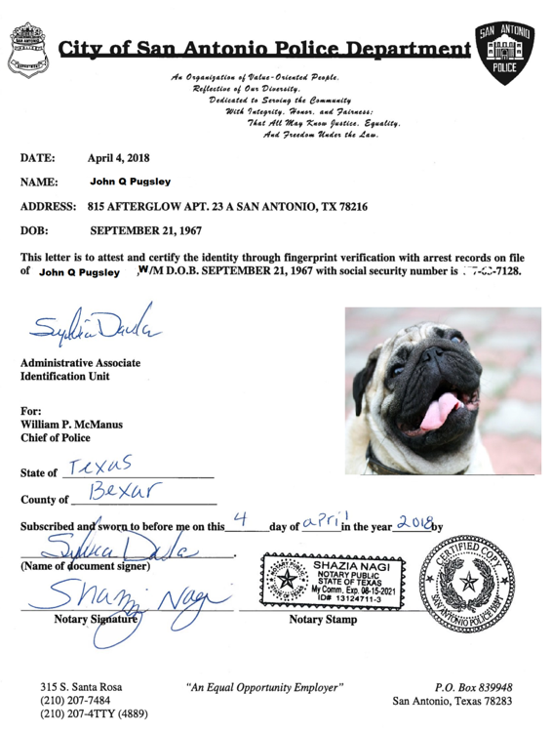

Slide 25
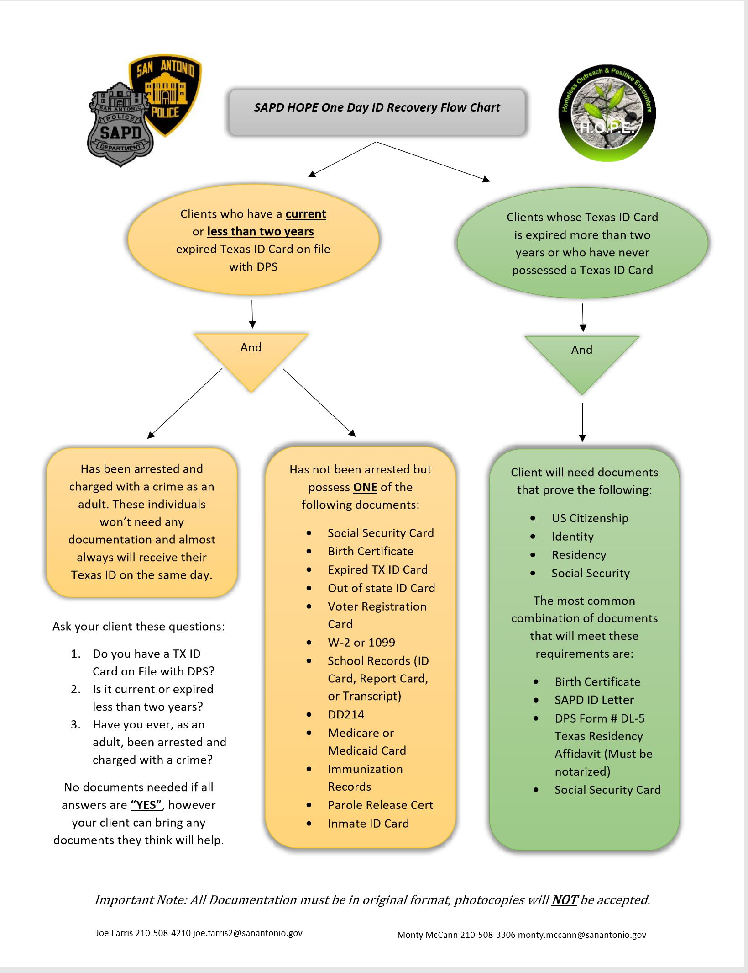

Slide 26
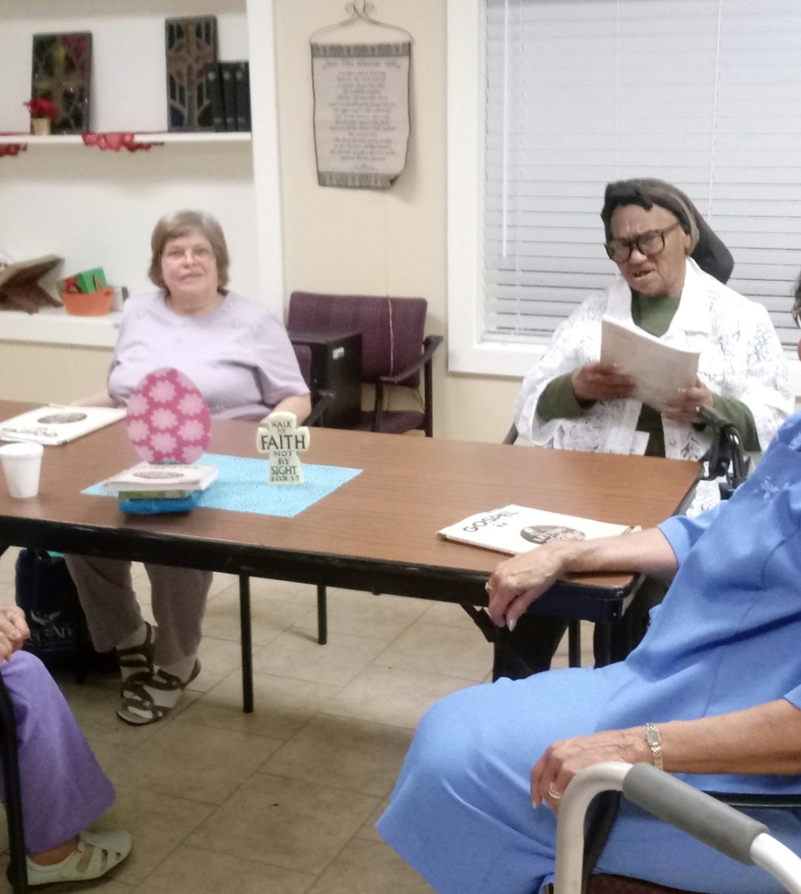

FACES OF SUCCESS
Ms. Virgil
Notes:
Ms. Virgil has lived at H4H since the transition from the SAMM Shelter in 2010. No one knew her real name and info. HOPE Team learned her true name through ID Recovery and has since begun to receive benefits and has been reunited with family who had “lost” her.

Slide 27
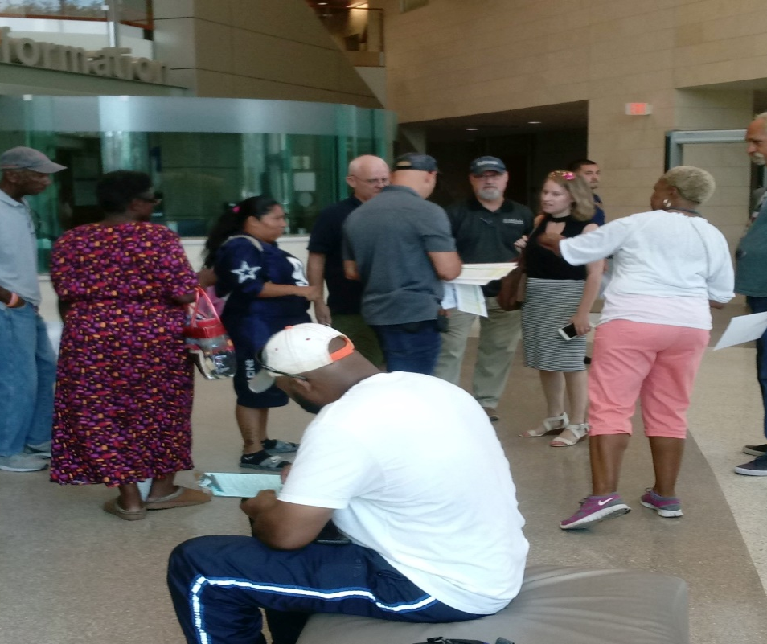
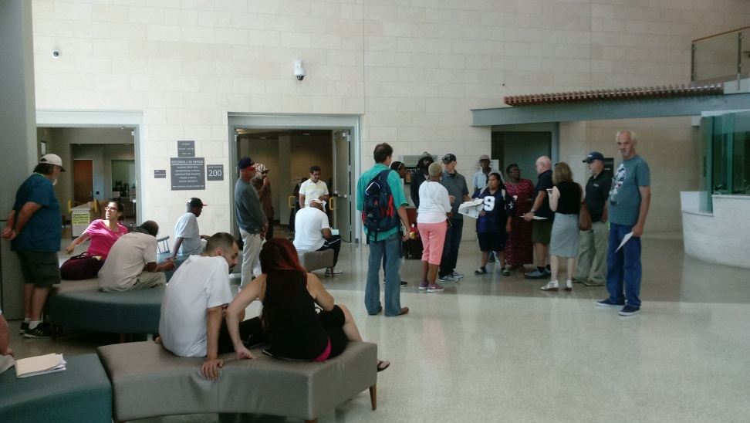
FACES OF SUCCESS

Slide 28
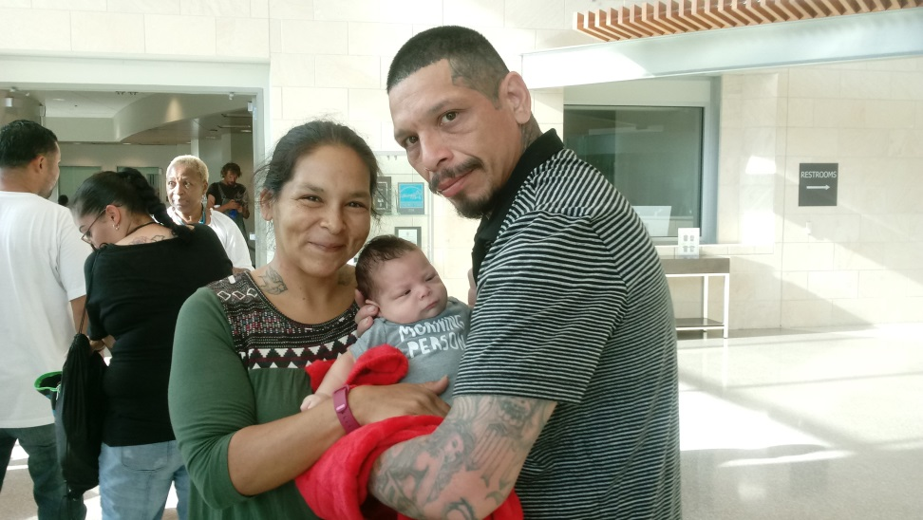
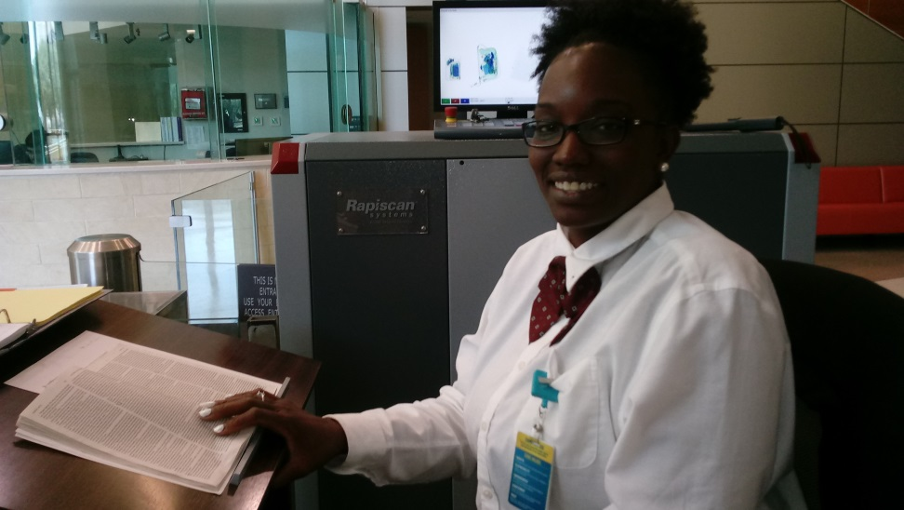
FACES OF SUCCESS

Slide 29
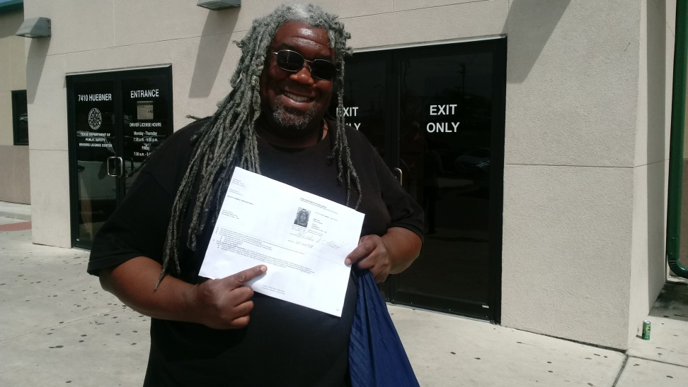
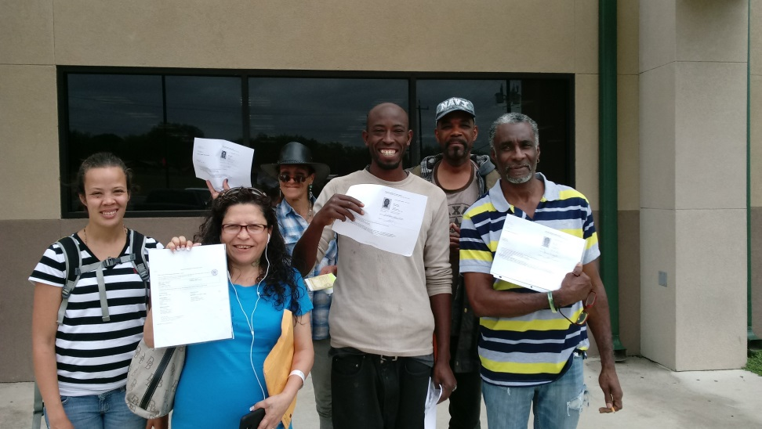
FACES OF SUCCESS

Slide 30
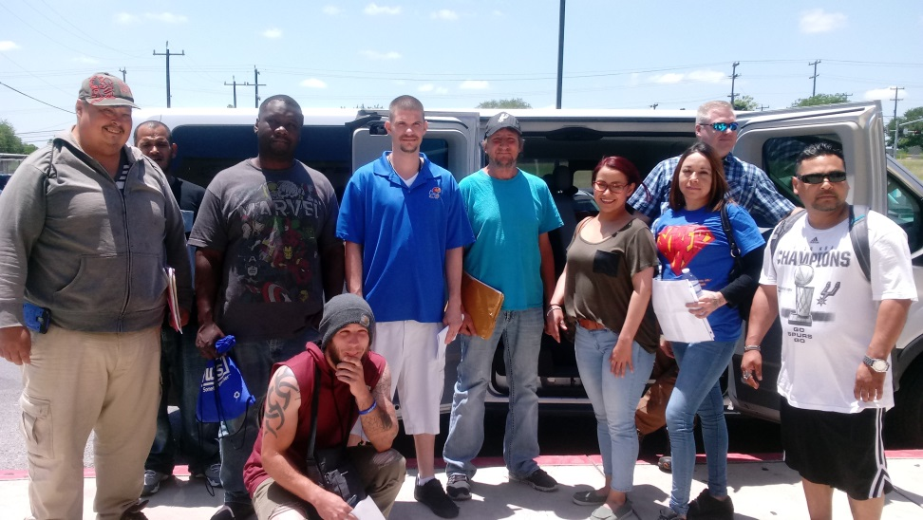
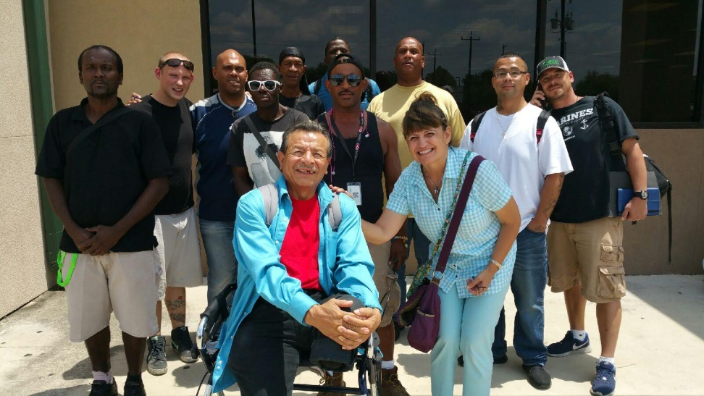
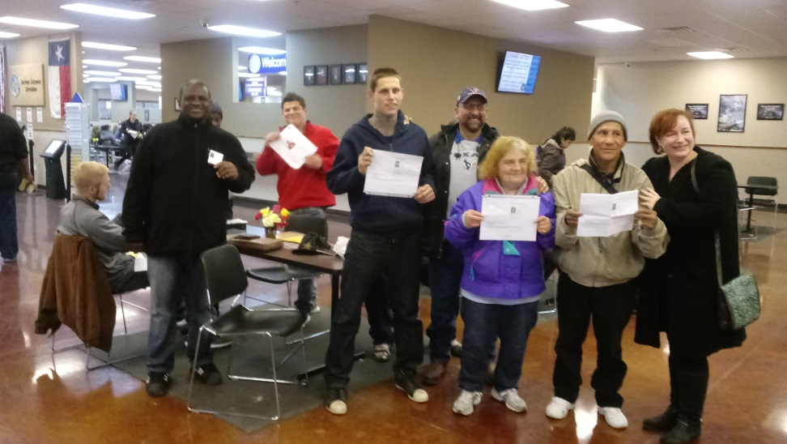
FACES OF SUCCESS

Slide 31
Questions?

