Slide 1

Education Leads Home Texas:
Preventing and Ending Homelessness
Through Education
Texas Conference on Ending Homelessness
Wednesday, September 26, 2018
Notes:
Barbara

Slide 2

Website: http://www.schoolhouseconnection.org
Newsletter
Federal and state policy advocacy
Q&A from our Inbox
Webinars and implementation tools
Youth leadership and scholarships
SchoolHouse Connection works to overcome homelessness through education. We provide strategic advocacy and technical assistance in partnership with schools, early childhood programs, institutions of higher education, service providers, families, and youth.

Slide 3
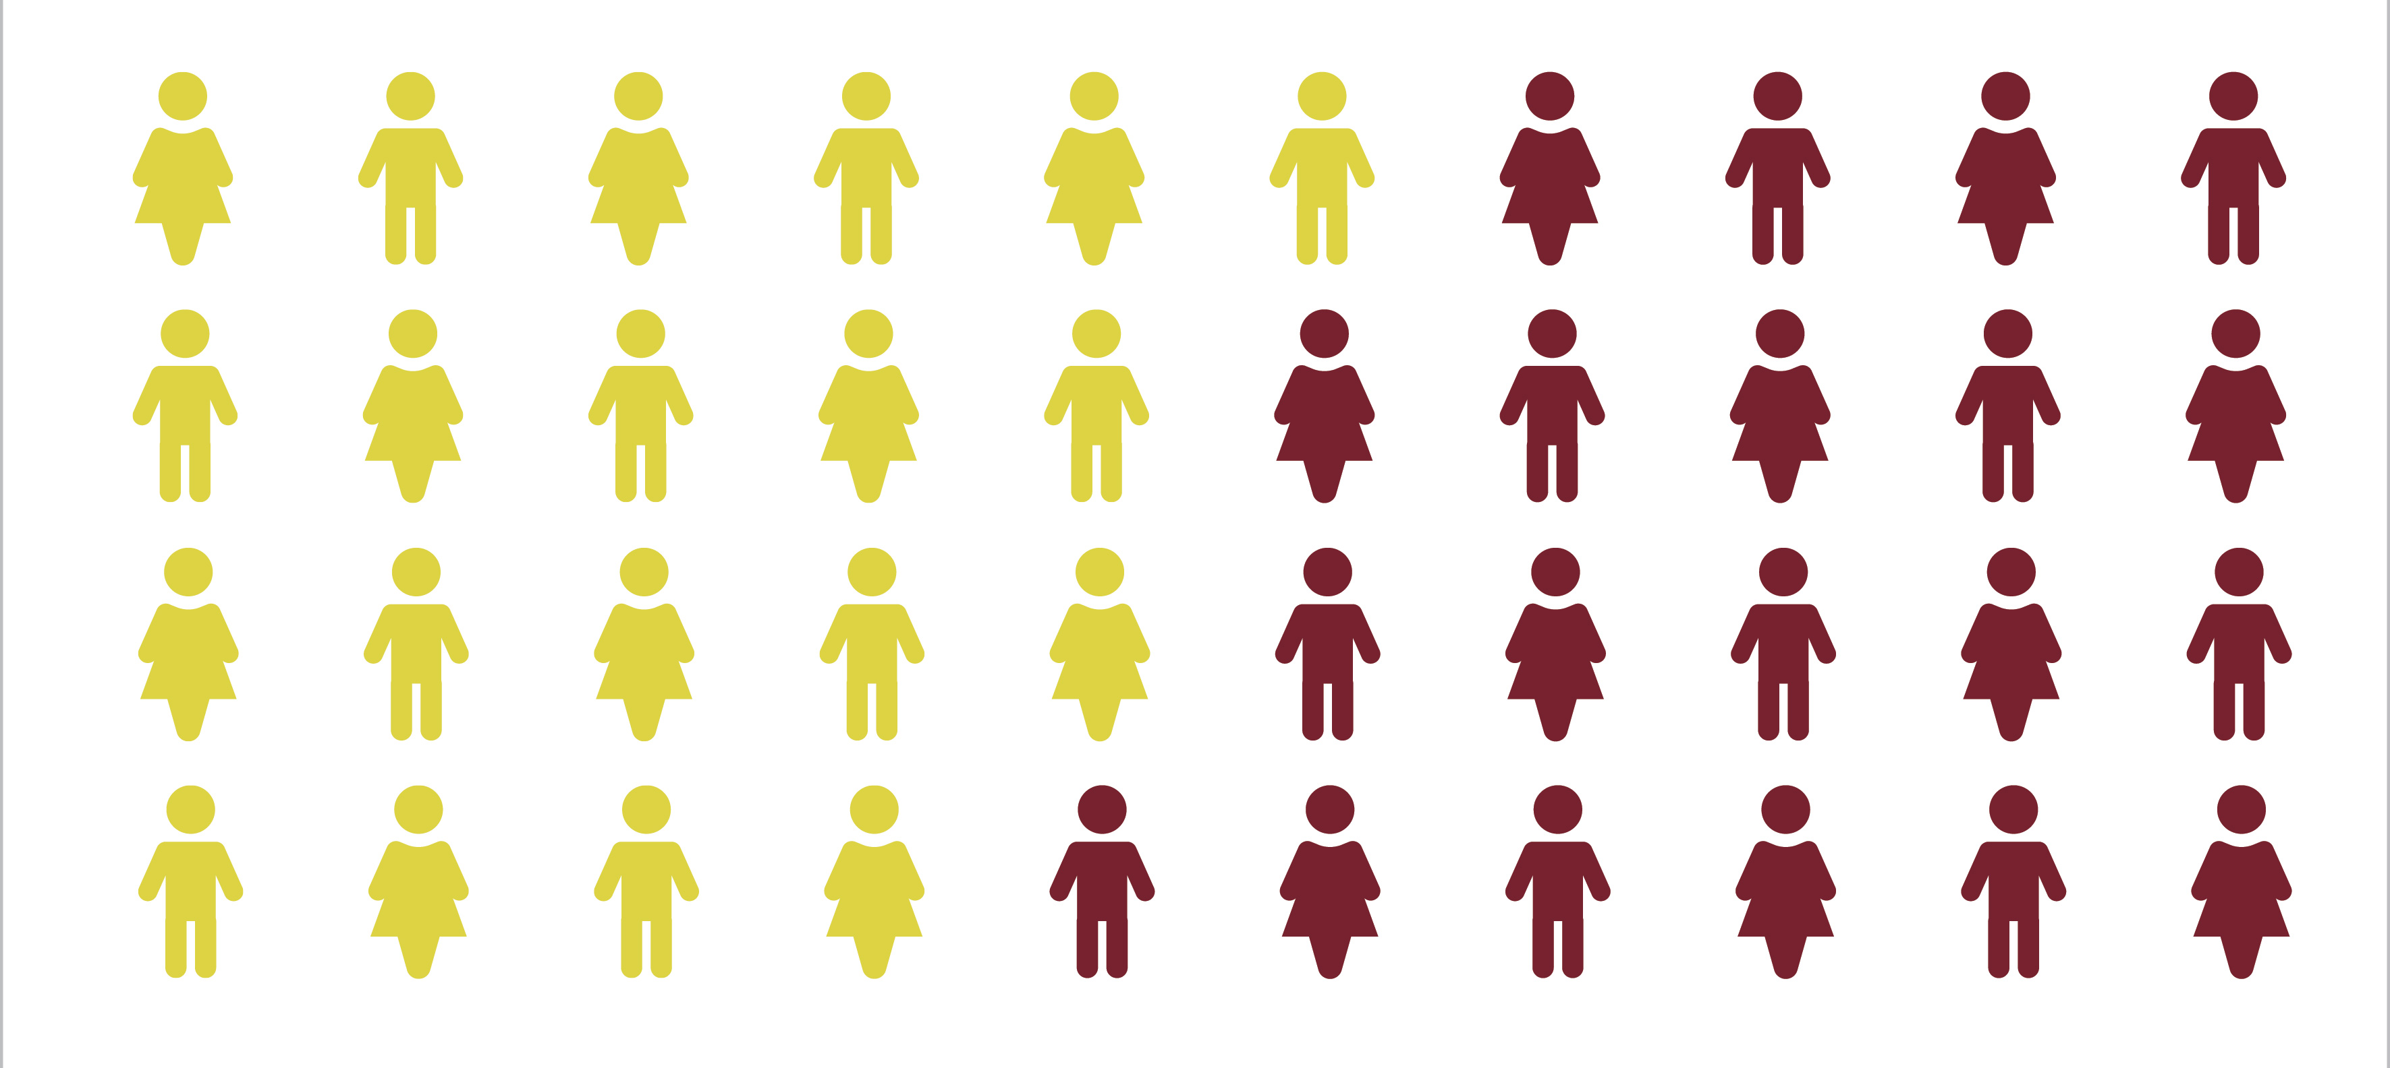
New Youth Experience Homelessness for the First Time Every Day
“Missed Opportunities: Youth Homelessness in America,” Chapin Hall, University of Chicago, Voices of Youth Count

Slide 4
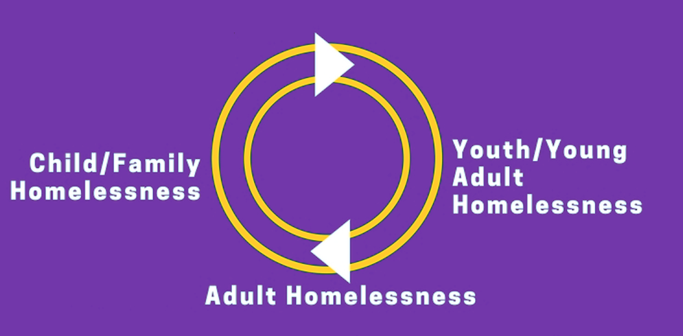

Slide 5
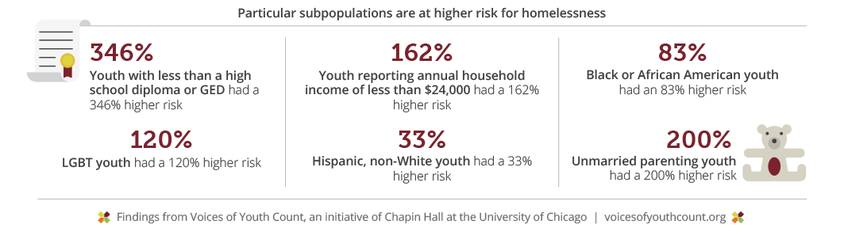
Lack of education is strongly correlated with young adult Homelessness
Source: Chapin Hall, http://voicesofyouthcount.org/wp-content/uploads/2017/11/ChapinHall_VoYC_1-Pager_Final_111517.pdf
Notes:
ERIN – Civic Enterprises

Slide 6
Education Can Protect against Homelessness
Children in quality preschool programs are more likely to graduate from high school and own homes.
99% of the jobs created since the Great Recession have gone to workers with at least some postsecondary education.
High school and college graduation are to linked to other important indicators of health and well-being.
Notes:
ERIN – Civic Enterprises

Slide 7
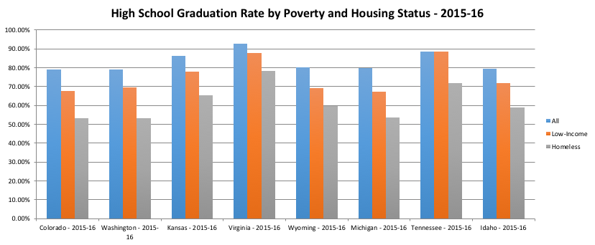
Homelessness has a Harmful Impact on Graduation that is Over and Above the Effects of Poverty
Not connected
with outside services/
program
Not connected with outside services/programs
Connected
with outside services/
program
Notes:
ICPH - ANNA

Slide 8
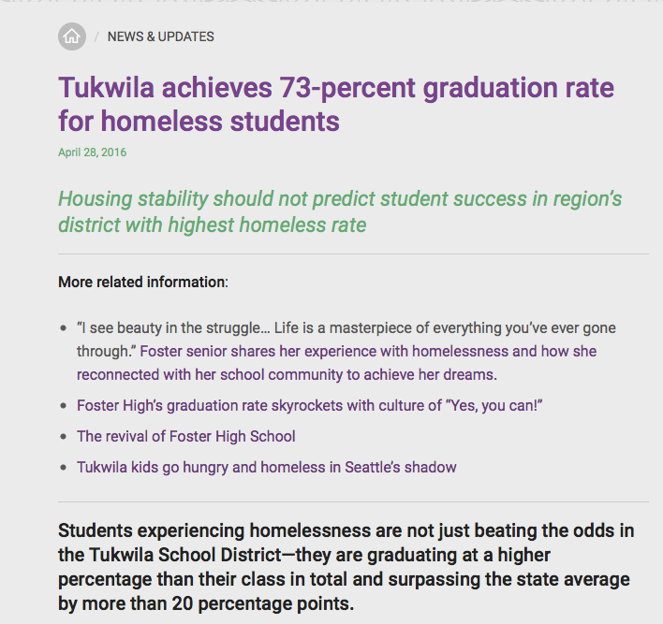
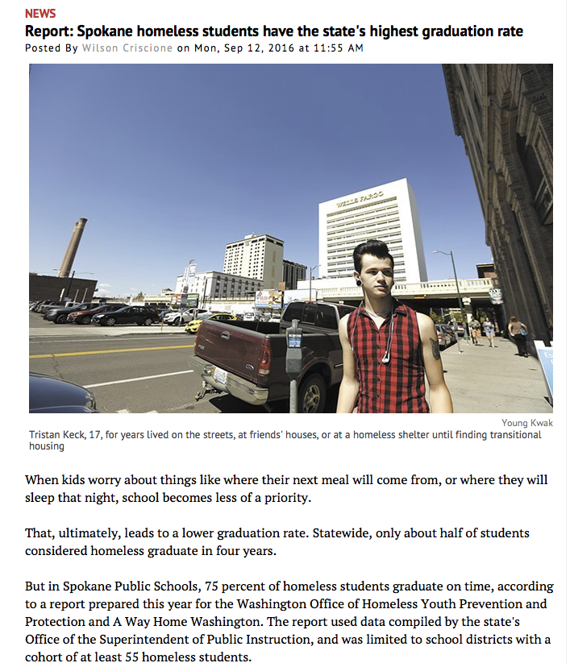
Students Experiencing Homelessness
Can and Do Succeed
Notes:
Talk about Texas and also about Wyoming

Slide 9
Schools as the Hub for
Connection and Success
Schools may be the only service provider in the community (no shelters in most places).
Schools may be the most consistent component of a student’s life, and their best source to connect with caring adults for help and support.
Education is the one of the best interventions to prevent future homelessness.
Notes:
We view schools as having a critical role to play in helping homeless students to access the supports they need to reconnect to housing, stay in school, and break the cycle of poverty.
Schools are often the most consistent source of food, safety, and adults supports that students may have access to. And in many communities, they may be the only service provider in place, especially in rural areas.
Schools can help to identify students more quickly, and to connect them to the other organizations and resources within the community that can help them and their families to re-stabilize.

Slide 10
Education Leads Home: A National Campaign Building Stronger Futures for Homeless Students
Young children will participate in quality early childhood programs at the same rate as their housed peers by 2026.
High school students will reach a 90 percent graduation rate by 2030.
Postsecondary students will reach a 60
percent attainment rate by 2034.
www.educationleadshome.org
Notes:
TONYA – APA
Over eleven million jobs have been created in the United States since 2010. Ninety-five percent of those jobs have gone to workers with at least some college education.
Without the opportunity to achieve a high school diploma, and go on to post-secondary education of some kind, young people will be unable to take advantage of these new jobs, and be unable to achieve stable work.
Increasing high school graduation rates and post-secondary enrollment is how we break cycles of poverty in this nation.
Yet one of America’s most vulnerable student populations has been absent from the conversation for far too long: the 1.3 million students preK-12 who experience homelessness.
Launched in 2018, Education Leads Home is a national campaign focused on closing the high school graduation gap and creating more pathways to postsecondary attainment for homeless students enrolled in America’s public schools. The campaign seeks to raise awareness of key challenges and increase implementation of proven practices and policies that improve educational outcomes, from early childhood through college, for one of the country’s most vulnerable student populations.
It is the only national campaign of its kind focused solely on addressing the educational needs of homeless students.

Slide 11
Federal policy FRAMEWORK: education
The McKinney-Vento Homeless Assistance Act requires state and local educational agencies to:
  Designate state coordinators and local liaisons.
  Remove barriers to identification, enrollment, stability, and success.
  The blueprint for graduation and transition to postsecondary, and the bridge from early childhood education
Early Childhood: Head Start, child care, special education: all have homelessness requirements
Higher Education: financial aid, college access programs have homelessness requirements
Notes:
Katie - SHC

Slide 12
Federal policy FRAMEWORK: housing
Continuum of Care Applicants:
  Collaborate with local educational agencies to assist in identifying, inform youth/families of education protections
  Consider educational needs when placing in shelter, place close to school of origin ”to maximum extent practicable”
Project Applicants:
  Establish policies and practice that do not restrict exercise of educational rights
  Designate a staff person to ensure children are enrolled in school and connected to services, including early childhood programs
Notes:
Katie - SHC

Slide 13
Education leads home: current action items
Youth Risk Behavior Survey data collection:
  https://www.cdc.gov/healthyyouth/data/yrbs/index.htm
State progress reports
  See previous reports here: http://www.americaspromise.org/report/hidden-plain-sight#state-report-cards
State Partnerships Project: educationleadshome.org
Highlighting replicable best practices
Notes:
Katie - SHC
-YRBS is a biennial survey of adolescent health risk and health protective behaviors such as smoking, drinking, drug use, sexual activity, diet, and physical activity conducted by the Centers for Disease Control and Prevention. A record number of states (19!) added questions about homelessness for the 2017 distribution, and we’re working with our partners to summarize the data.
-State progress reports are summaries of existing data for all three campaign goals (EEC, K-12, and higher education); new reports will be released on June 12 in coordination with our young leaders at a Congressional briefing.
-Local convenings – we anticipate holding local, action-oriented convenings to pull together stakeholders around the campaign goals for early childhood education, preK-12, and higher education.
-A big part of our work is highlighting/sharing regional best practices. We’d love to hear from you! In the webinar evaluation, please let us know what you’re doing that’s working for your students!

Slide 14

How can we reach these goals?

Slide 15

cypress-Fairbanks iSD, houston, texas
The district is the third-largest in the state and 22nd-largest in the nation.
Largest school district in Texas to have 100% of its campuses earn “Met Standard” honors with TEA for six straight years.
Enrollment: 115,340 (as of 8/31/18)
  Projected to educate more than 117,000 students this year
Homeless Students: 2,241(at the close of the 2017-18 school year)
91 campuses
  56 elementary schools,
  18 middle schools,
  12 high schools, and
  5 special program facilities
Senior graduation rates:
  2015: All Students – 96% Homeless Students – 91%
  2016: All Students – 96% Homeless Students – 96%
  2017: All Students – 93.4% Homeless Students – 94%

Slide 16
CFISD’s comprehensive McKinney-Vento team
District Homeless Liaison
Director of Student Services/Foster Care Liaison
Director of Guidance and Counseling
91 School Counselors and Campus EASE Counselors
1 Data Management Specialist
1 Data Entry Clerk
14 Youth Service Specialists
10 Itinerant Counselors
    Focus on the student’s social and emotional needs
    Check and monitor grades, attendance, and discipline at progress report and end of grading period.
    Support and collaborate with EASE Counselor and the alpha counselor assigned to that student.
    Provide information and resources to identified students
    Conduct small group sessions when appropriate
    Maintain parent communication
    Follow-up with students regarding college and career readiness - SAT/ACT (individual planning) in the Spring
3 Tutors – staffed at Mission of Yahweh Shelter

Slide 17
school-BASED supports and incentives
Free Tutoring for Dual Credit Students
Tracking absences and grades
Technology support
Fee waivers
Free school supplies
Free summer school tuition
Free PE uniforms at Middle and High School
Free graduation cap/gowns
Assistance with FAFSA
Free admission to T.A.P into Spring Break Camp to assist with EOC/SAT testing

Slide 18
Postsecondary planning and support
Academic Achievement Specialist (at every High School campus)
EASE/Itinerant Counselors (at every High School campus)
College & Career Readiness Program (on many High School campuses)
FAFSA Assistance/Completion
College Day Visits
Military Enrollment Support & Visits
District-wide Military Academy Night
District-wide College & Career Night

Slide 19
credit accrual policies and paving the way
  Partial/full credit accrual policies
    Partial Credit: students can earn ½ credit for the semester in which the student earned 70 or above
    Full Credit: students can earn full credit (1.0) provided the student passes the second semester of a yearlong class with a grade high enough to bring the semester average to 70% or higher.
      Example: a student earns a 65 in English II for the Fall and a 75 in the Spring
  Use online programs for credit recovery with prior instruction
  Self-paced one-on-one programming
  Summer School
  Texas Virtual School Network (TxVSN)
  Distance Learning (Texas Tech and UT)
  Credit by Exam
  College Credit Program

Slide 20
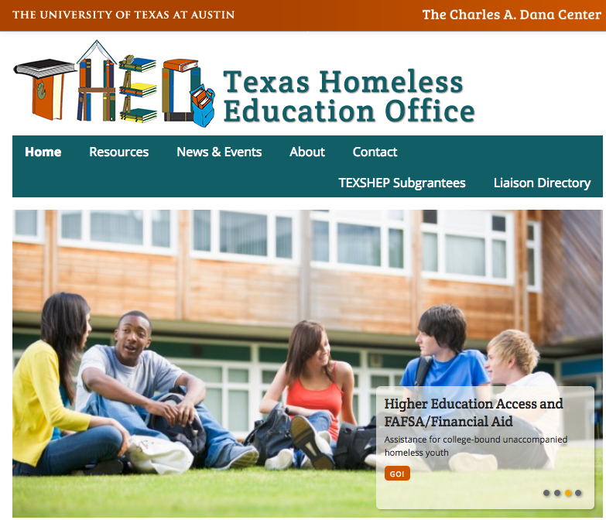
http://www.theotx.org/ 800-446-3142 in Texas

Slide 21
Education = Success
Starting in 2017-2018, per ESSA all states must disaggregate achievement and graduation rates for homeless students.

Slide 22
Success = Early Intervention
Graduation on time begins with pre-school and continues through elementary, middle and high school – instill the vision and goal
Early identification and ongoing support throughout every grade leads to graduation – provide the support at each grade level- whether the student changes schools or not

Slide 23
Best Practices for Graduation

Slide 25
Texas Education Code Supports
If 11th or 12th grade student transfers to a different district and the student is ineligible to graduate from the district to which student transfers, district from which student transferred shall award a diploma at the student’s request, if the student meets the graduation requirements of the district from which the student transferred – 28.025(i)
Ensuring student who is not likely to receive a high school diploma before the 5th school year following the student’s enrollment in 9th grade, has course credit accrual and personal graduation plan reviewed - 25.007(2)(b)(12)

Slide 26
Texas Education Code Supports
Develop procedures for allowing student who was previously enrolled in a course required for graduation the opportunity, to the extent practicable, to complete the course, at no cost to the student, before the beginning of the next school year – 25.007(2)(b)(11)
In recognition of the challenges faced by students who are homeless or in substitute care, the agency shall assist the transition of students who are homeless or in substitute care from one school to another by: 3) developing procedures for awarding credit, including partial credit if appropriate, for course work, including electives, completed by a student who is homeless or in substitute care while enrolled at another school; 25.007(2)(b)(3)

Slide 27
TOP 10 CREDIT ACCRUAL
& RECOVERY STRATEGIES
#10 Conduct Campus-based Academic Monitoring Meetings – periodic review of Individual Graduation Plan
#9 Collaborate with Other Departments
#8 Work with Other Campuses & Districts for Awarding or Verifying Grades & Credits
#7 Create Attendance Contracts---Great for Credit Reinstatement
#6 Credit Recovery
#5 Credit Repair

Slide 28
TOP 10 CREDIT ACCRUAL
& RECOVERY STRATEGIES
#4 Grades & Credits Review
#3 Regular Staff Meetings
#2 Credits Earned Report
And …THE NUMBER 1 STRATEGY:
  HOUSE BILL 5 – Foundation High School Program
  (consider going for recommendations and endorsements, not just lower level plan)

Slide 29
Case Management Creates a Coordinated Approach
Keep the needs of the youth central to the decision-making process!
Develop relationships with staff from dropout prevention programs, housing programs, youth shelters, law enforcement, and community agencies
Create a task force that includes representatives from a wide variety of organizations
  LEA, Social Services, child welfare, juvenile justice, law enforcement, youth shelters, local continuum of care
  Involve youth in awareness trainings and task forces so they can share their experiences

Slide 30
Case Management Addresses Needs
Identify needs and provide supports, access to supports, referral for supports:
Provide access to school shower and laundry facilities
Provide students with a secure place to store personal belongings
Provide flexibility with school assignments, including deadlines and needed supplies
Help students obtain needed supplies
Implement policies to assist with accumulating credits for graduation

Slide 31
Case Management Addresses Needs
Become familiar with State laws related to the reporting of suspected abuse or neglect
Become familiar with State laws about minor medical consent
Reach out to local service and housing providers and learn their criteria for eligibility
Consider alternative education programs that allow flexible school hours (TX VSN or other online program)
Notify school nutrition services and develop other sources of food for evenings

Slide 32
Tools for Credit Recovery
TEA Foundation High School Program (https://tea.texas.gov/communications/brochures.aspx)
Edgenuity (https://www.edgenuity.com/)
SchoolHouse Connection (https://www.schoolhouseconnection.org/what-it-takes-to-graduate-credit-accrual-and-recovery-for-students-experiencing-homelessness/)
Pathways to Prosperity (http://www.jff.org/initiatives/pathways-prosperity-network)
National Center for Homeless Education (https://nche.ed.gov/ibt/credit.php)
  Other useful strategies:
  Chunking credits
  Mastery-based learning

Slide 33

Barbara Wand James
Homeless Student
Support Scholarship
Texas Scholarship
The scholarship was established in honor of Ms. James’ 24 years of service as Director of The Texas Homeless Education Office.
The scholarship is open to Texas students who:
    are homeless or formerly homeless,
    have been accepted into a postsecondary program,
    are outstanding students, and
    demonstrate the resilience and strength needed to succeed in a higher education setting.
2014 - 215
For more information and to donate, visit:
http://www.theotx.org/barbara-wand-james-homeless-student-support-scholarship/

Slide 34
Contact Information
Jeanne Stamp, LCSW, LMFT, LCDC
Director
The Texas Homeless Education Office
The Charles A Dana Center
The University of Texas at Austin
3925 W Braker Ln, Suite 3.801
Austin, Texas 78759
800-446-3142 in Texas
512-475-6898
jeanne.stamp@austin.utexas.edu

Slide 35

SchoolHouse Connection Scholarship Program
Deadline November 9, 2018
Eligible students:
  Born on or after November 9, 1998
  Entering college for the first time during the 2019-2020 school year.
https://www.schoolhouseconnection.org/youth-leadership/scholarship-program/

Slide 36
Resources
SchoolHouse Connection: http://www.schoolhouseconnection.org/
Hidden in Plain Sight: http://www.americaspromise.org/report/hidden-plain-sight
National Center on Homeless Education: https://nche.ed.gov
National Network for Youth: http://www.nn4youth.org
DVDs for awareness-raising: vimeo.com/pjulianelle
  “The McKinney-Vento Act in Our Schools”
  “Education and Homelessness: Young Children to Young Adults”
Title I
  http://center.serve.org/nche/downloads/briefs/titlei.pdf
  http://www2.ed.gov/policy/gen/leg/recovery/guidance/titlei-reform.pdf
  http://www2.ed.gov/programs/homeless/homelesscoord0815.pdf
Early Childhood
  http://www.acf.hhs.gov/programs/ecd/expanding-early-care-and-education-for-homeless-children

