Slide 1
The Practical Application of Harm Reduction in a Housing Setting Jim Ward, TX BOS CoC Performance Coordinator

Slide 2
Social Media
Texas Conference on Ending Homelessness Hashtag: #EndTXHomelessness
Texas Homeless Network Twitter Handle: @TXHomeNet
My Twitter Handle: @THNjim

Slide 3
About the Speaker
Jim serves as the Texas Balance of State, Continuum of Care Technical Assistance & Performance Coordinator. Jim provides distance and onsite monitoring to CoC recipients ensuring compliance with the CoC program interim rule, and the highest quality services for the most vulnerable. Additionally, Jim provides hands-on program level technical assistance to start-up projects and renewals alike.

Slide 4
Learning Objectives
Attendees should understand the guiding principles of Harm Reduction and the Ethical Framework for making programmatic decisions, using a Harm Reduction informed approach.
Attendees will understand the working relationship between Harm Reduction and Housing First.
Attendees will have the opportunity to reflect on organizational policies and practices at their respective Agencies that either embrace or oppose HR as an organizational philosophy.

Slide 5
Caveats
This session is intended for providers of direct service. Frontline staff, administrators, decision makers will get the most out of this session, although all are welcome
My experience is in Housing First CoC Funded Projects. Always defer to the funding guidelines for your project, but be cautious when using those guidelines to justify a lack of person-centeredness

Slide 6
Just a reminder
Morals deal in right and wrong but Ethics deal in degrees of right -Anonymous

Slide 7
What is Harm Reduction?
Here’s where it gets tricky,
According to the U.S. Harm Reduction Coalition,
“Because harm reduction demands that interventions and policies designed to serve drug users reflect specific individual and community needs, there is no universal definition of or formula for implementing harm reduction.”
However, Harm Reduction International broadly describes harm reduction as
“…policies programmes and practices that aim primarily to reduce the adverse health, social and economic consequences of the use of legal and illegal psychoactive drugs without necessarily reducing drug consumption.”
Notes:
Why does this matter? How does it connect to housing.

Slide 8
Harm Reduction Myths
Without an abstinence only policy, we are enabling drug use
Harm Reduction is at it’s core, Anti-abstinence
Harm Reduction encourages anti-social behavior
Harm Reduction is destructive to the community
My Agency receives HUD funding so we must have a zero tolerance policy towards drug use or other “harmful” behaviors

Slide 9
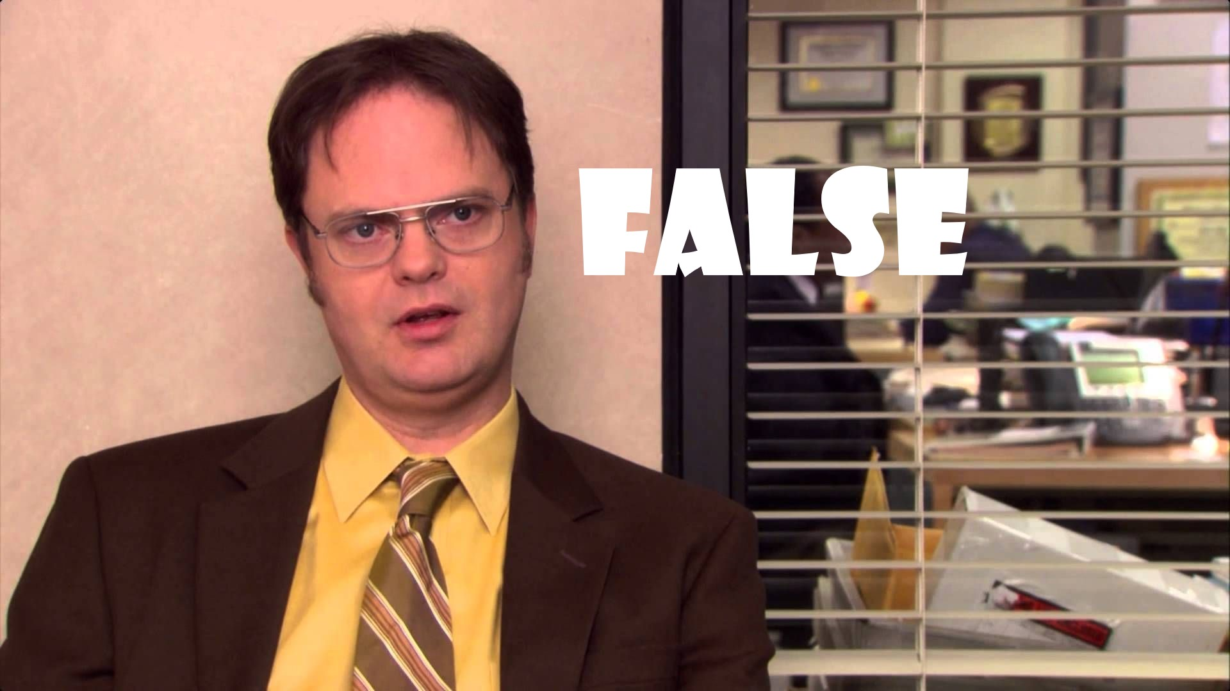

Slide 10
Harm Reduction Facts
Harm reduction policies/practice neither condemns nor condones drug use or other problematic behaviors
Harm reduction is not anti-abstinence. Rather it recognizes recovery as a continuum of choices and neither condemns, nor condones drug use. Harm Reduction honors the autonomy of the individual to make their own decisions about their use, and their lives
Harm reduction interventions reduce risk to the individual and community (Needle-Exchange, Naloxone, Housing First, Purity Strips)
Harm reduction approaches save the community money. (Housing First projects, Treatment Alternatives to Incarceration, Community Court)

Slide 11
Harm Reduction Facts
Harm reduction is actually an integral part of the Housing First Philosophy. Without adherence to Harm Reduction, you are not practicing Housing First.
So… when you signed that contract and started receiving CoC Program funds you assured HUD that Participants will not be terminated for,
“Any other activity not covered in a lease agreement typically found for unassisted persons in the project’s geographic area”

Slide 12
The Components of Harm Reduction
There are essentially five characteristics of harm reduction approaches.
Targeting risk and harms to people who use substances, understanding the roots of these risks, and tailoring interventions to reduce them
Acknowledging the significance of any positive change that people who use substances make in their lives
Accepting people who use drugs as they are and treating them with dignity and compassion
Protecting the human rights of people who use drugs
Maintaining transparency in decisions about interventions as well as their successes and failures

Slide 13
How then?
Looking at Harm Reduction as a means to effect behavior change- lets look at the principles.
Humanism
Pragmatism
Individualism
Autonomy
Incrementalism
Accountability Without Termination*
*There are of course, rare circumstances that would necessitate
termination of assistance.
Hawk, M. et al. Harm Reduction Journal (2017) 14:70

Slide 14
Case Study
SC is a former chronically homeless individual working with your agency in your RRH Program. He says he doesn’t currently use in his place but he has a decades long history with heroin use. Your Agency has been getting complaints from the Property Manager about “Traffic” since the day after he moved in. He was evicted from his last Apartment in 2012 because of repeated complaints of dealers taking over. Neighbors report SC is using his apartment as a source of income and means of fueling his substance use.
SC is reluctant to meet Case Management Staff in his home and has been in the Project for 3 months without much progress on the goals he set for himself. Most recently the police were called to SC’s Apartment because his guests were caught breaking into the laundry machines- which SC does not accept as true. The landlord is willing to give him one more chance.
At his most recent Case Management appointment, SC verbalized some desire to move to a “better area” Meanwhile staff at your Agency are wondering why the Project doesn’t take steps to terminate assistance
How can we apply the principles of Harm Reduction to this situation?
Humanism

Slide 15
Humanism
Concepts | Approaches
Providers value, care for, respect, and dignify participants as individuals, (to the greatest extent possible*) Providers seek to assess the benefit participants gain from behaviors, They acknowledge the benefits and engage in honest conversations about the harm and benefits Providers recognize the cultural values of participants and the need for social connectedness Providers/Organizations implicitly endorse moral judgements constantly through community partnerships, historical context, verbal and non-verbal staff communications etc. | Engaging in ongoing assessment of these biases and honest conversations with participants about their perception of Agency/Services and adjusting accordingly by modifying policies & procedures/case management strategy as needed Services are truly person-centered and non-judgmental. Meeting participants “where they are” both literally and figuratively are important to empowering participants and staff Motivational Interviewing Assertive Engagement

Slide 16
Case Study
SC is a former chronically homeless individual working with your agency in your RRH Program. He says he doesn’t currently use in his place but he has a decades long history with heroin use. Your Agency has been getting complaints from the Property Manager about “Traffic” since the day after he moved In. He was evicted from his last Apartment in 2012 because of repeated complaints of dealers taking over. Neighbors report SC is using his apartment as a source of income and means of fueling his substance use.
SC is reluctant to meet Case Management Staff in his home and has been in the Project for 3 months without much progress on the goals he set for himself. Most recently the police were called to SC’s Apartment because his guests were caught breaking into the laundry machines- which SC does not accept as true. The landlord is willing to give him one more chance.
At his most recent Case Management appointment, SC verbalized some desire to move to a “better area” Meanwhile staff at your Agency are wondering why the Project doesn’t take steps to terminate assistance
How can we apply the principles of Harm Reduction to this situation?
Humanism
Pragmatism

Slide 17
Pragmatism
Concepts | Approaches
Understanding and operationalizing that none of us will ever achieve “perfection” Providers seek to assess the benefit participants gain from behaviors, They acknowledge the benefits and engage in honest conversations about the harm and benefits Providers recognize the cultural values of participants and the need for social connectedness Messaging around behaviors should be about actual immediate harm as opposed to societal or moral standards Concept of “Least Harm” | Setting realistic expectations for staff Creating partnerships that are able to quickly mobilize when participants are ready for change Motivational Interviewing Ecomapping Genograms Assertive Engagement Remember: services are optional for participants, but not for providers Assessing and prioritizing the risk of harm Safety Planning Stages of Change

Slide 18
Case Study
SC is a former chronically homeless individual working with your agency in your RRH Program. He says he doesn’t currently use in his place but he has a decades long history with heroin use. Your Agency has been getting complaints from the Property Manager about “Traffic” since the day after he moved in. He was evicted from his last Apartment in 2012 because of repeated complaints of dealers taking over. Neighbors report SC is using his apartment as a source of income and means of fueling his substance use.
SC is reluctant to meet Case Management Staff in his home and has been in the Project for 3 months without much progress on the goals he set for himself. Most recently the police were called to SC’s Apartment because his guests were caught breaking into the laundry machines- which SC does not accept as true. The landlord is willing to give him one more chance.
At his most recent Case Management appointment, SC verbalized some desire to move to a “better area” Meanwhile staff at your Agency are wondering why the Project doesn’t take steps to terminate assistance
How can we apply the principles of Harm Reduction to this situation?
Humanism
Pragmatism
Individualism

Slide 19
Individualism
Concepts | Approaches
Each person has their own unique strengths and needs. People present with a spectrum of behaviors and receptivity, therefore a spectrum of intervention options are required | Individual participant assessments of strengths and needs No assumptions based on behaviors There is no “One size fits all” Harm Reduction application or messaging that will work for all participants. Instead workers must, Listen Build trust and relationship Minimize Risk Assess Safety Physical Emotional Environmental Providers must remain flexible and maximize the treatment/ intervention options for each participant served, recognizing that repeatability is not guaranteed

Slide 20
Case Study
SC is a former chronically homeless individual working with your agency in your RRH Program. He says he doesn’t currently use in his place but he has a decades long history with heroin use. Your Agency has been getting complaints from the Property Manager about “Traffic” since the day after he moved in. He was evicted from his last Apartment in 2012 because of repeated complaints of dealers taking over. Neighbors report SC is using his apartment as a source of income and means of fueling his substance use.
SC is reluctant to meet Case Management Staff in his home and has been in the Project for 3 months without much progress on the goals he set for himself. Most recently the police were called to SC’s Apartment because his guests were caught breaking into the laundry machines- which SC does not accept as true. The landlord is willing to give him one more chance.
At his most recent Case Management appointment, SC verbalized some desire to move to a “better area” Meanwhile staff at your Agency are wondering why the Project doesn’t take steps to terminate assistance
How can we apply the principles of Harm Reduction to this situation?
Humanism
Pragmatism
Individualism
Autonomy

Slide 21
Autonomy
Concepts | Approaches
Providers value, care for, respect, and dignify participants as individuals, (to the greatest extent possible*) Providers recognize and Agencies recognize participants as experts in their own lives. Coercion is off the table. | Fostering and developing the participant/ provider relationship. Maintaining clear and separate staff roles in the project. Agencies support creative engagement ideas. Agencies actively seek to reduce the power differential that exists between provider and participant by incorporating the voices of participants in all stages of recovery (not just abstinence) Providers listen to what participants tell them they need and collaboratively evaluate outcomes.

Slide 22
Case Study
SC is a former chronically homeless individual working with your agency in your RRH Program. He says he doesn’t currently use in his place but he has a decades long history with heroin use. Your Agency has been getting complaints from the Property Manager about “Traffic” since the day after he moved in. He was evicted from his last Apartment in 2012 because of repeated complaints of dealers taking over. Neighbors report SC is using his apartment as a source of income and means of fueling his substance use.
SC is reluctant to meet Case Management Staff in his home and has been in the Project for 3 months without much progress on the goals he set for himself. Most recently the police were called to SC’s Apartment because his guests were caught breaking into the laundry machines- which SC does not accept as true. The landlord is willing to give him one more chance.
At his most recent Case Management appointment, SC verbalized some desire to move to a “better area” Meanwhile staff at your Agency are wondering why the Project doesn’t take steps to terminate assistance
How can we apply the principles of Harm Reduction to this situation?
Humanism
Pragmatism
Individualism
Autonomy
Incrementalism

Slide 23
Incrementalism
Concepts | Approaches
Any positive change is a step toward improved health and positive outcomes and should be celebrated. Agencies and Providers understand that positive change takes time. Agencies and providers anticipate and plan for backward movement. All people experience plateaus or negative trajectories when engaging in behavior change. | Celebrating any positive movement is critical. Planning with participants for plateaus or negative trajectory. Safety Planning, Relapse Prevention** Cannot over-emphasize the importance of celebrating the “small wins” Getting off probation or parole. (Actually a HUGE win) Passing a UA for a job Celebrating a year in housing! 1 month with no lease violations. 1 week with no negative interactions with neighbors Scheduling a needed Doctor’s appointment The list goes on and on…

Slide 24
Case Study
SC is a former chronically homeless individual working with your agency in your RRH Program. He says he doesn’t currently use in his place but he has a decades long history with heroin use. Your Agency has been getting complaints from the Property Manager about “Traffic” since the day after he moved in. He was evicted from his last Apartment in 2012 because of repeated complaints of dealers taking over. Neighbors report SC is using his apartment as a source of income and means of fueling his substance use.
SC is reluctant to meet Case Management Staff in his home and has been in the Project for 3 months without much progress on the goals he set for himself. Most recently the police were called to SC’s Apartment because his guests were caught breaking into the laundry machines- which SC does not accept as true. The landlord is willing to give him one more chance.
At his most recent Case Management appointment, SC verbalized some desire to move to a “better area” Meanwhile staff at your Agency are wondering why the Project doesn’t take steps to terminate assistance
How can we apply the principles of Harm Reduction to this situation?
Humanism
Pragmatism
Individualism
Autonomy
Incrementalism
Accountability Without Termination*

Slide 25
Accountability without Termination
Concepts | Approaches
Participants are responsible for their own lives. Natural consequences are often significant, and do not need reinforcement from Projects. Termination of assistance is rare and reserved for the most extreme of situations. Participants are not terminated for lack of progress, increased substance use, or other problematic behaviors. Participants have the right to make their own decisions about their lives and be informed about how those decisions may impact their lives, health, choice etc. | Backwards movement is not penalized. Participants are assisted to find new housing when they are not renewed or given a notice to vacate. Providers engage participants in meaningful conversations about natural consequences of behaviors

Slide 26
Examples of Ethical Tensions (that you are likely to encounter in Housing Programs)
Education on safer usage practices | Repeated overdose education & Safety Planning
Money management for Substance Use Budgeting | Staff comfort/competence creating Ideal Use Plans
Balancing the human need for social interaction with the Participants identification of people they acknowledge to be “not healthy” | Repeated training on Activities of Daily Living Bystander to “negative” outcomes
Negative trajectories on the recovery spectrum, (exploitation, self harming behaviors, high-risk use management | Repeated coaching on maintaining a “Low Profile”- to retain housing, What is acceptable outside, may not be acceptable inside
Negative social-network “interference” Continued use despite negative consequences | Lack of measurable progress on a service plan Pressure to terminate assistance

Slide 27
(S0me) Ethical Frameworks
Deontological Ethics
Is the normative ethical theory that the morality of an action should be based on whether that action itself is right or wrong under a series of rules, rather than based on the consequences of the action.
Consequentialism
Holds that the consequences of one's conduct are the ultimate basis for any judgment about the rightness or wrongness of that conduct. Thus, from a consequentialist standpoint, a morally right act (or omission from acting) is one that will produce a good outcome, or consequence.
Ethical Relativism
Ethical relativism teaches that right and wrong, good and bad, are relative to the situation, circumstances, or personal conviction. "Pragmatic" refers to the belief that we should use what works and alter or discard what doesn't. Pragmatic ethics does hold that absolute/universal truth exists, but it also teaches that the imperfect human intellect will never recognize truth; all we can do is endeavor to get as close as possible.

Slide 28
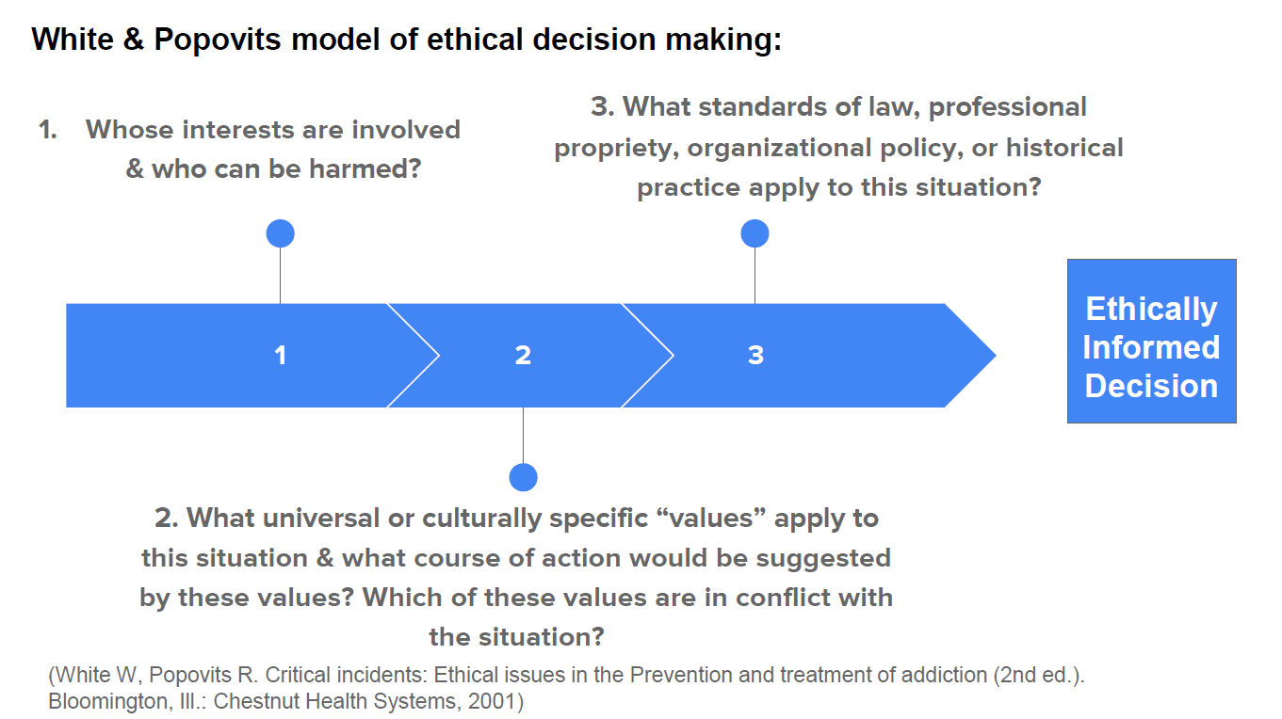

Slide 29
Case Study
SC is a former chronically homeless individual working with your agency in your RRH Program. He says he doesn’t currently use in his place but he has a decades long history with heroin use. Your Agency has been getting complaints from the Property Manager about “Traffic” since the day after he moved in. He was evicted from his last Apartment in 2012 because of repeated complaints of dealers taking over. Neighbors report SC is using his apartment as a source of income and means of fueling his substance use.
SC is reluctant to meet Case Management Staff in his home and has been in the Project for 3 months without much progress on the goals he set for himself. Most recently the police were called to SC’s Apartment because his guests were caught breaking into the laundry machines- which SC does not accept as true. The landlord is willing to give him one more chance.
At his most recent Case Management appointment, SC verbalized some desire to move to a “better area” Meanwhile staff at your Agency are wondering why the Project doesn’t take steps to terminate assistance
How can we apply White & Popovitz Model of Ethical Decision Making to this situation?

Slide 31
Ethical Decision Making Considerations
Who is involved & who’s Interests can be harmed?
SC
Property Manager
Neighbors
Friends
Agency
Case Manager
What cultural or universal values are at play?
The Principles
“Street” culture?
Using Culture?
Helping?
Historical Precedence? Laws in play?
The Lease
Clinical Licenses?
Like Housing First, this list is individualized. Depending on the situation, the considerations may look very different,

Slide 32
Next Steps?

Slide 33
Social Media
Texas Conference on Ending Homelessness Hashtag: #EndTXHomelessness
Texas Homeless Network Twitter Handle: @TXHomeNet
My Twitter Handle: @THNjim

Slide 34
Contact Information
Jim Ward
CoC Technical Assistance & Performance Coordinator
Texas Homeless Network
(512) 861-2165
jim@thn.org

Slide 35
TX BoS CoC Conference Track
Thursday, September 27
8:30 AM – 10:00 AM
3.5 How are we doing and where do we go from here? An interactive look at how to understand data and use it to drive decision making
Thursday, September 27
10:15 AM-11:45 AM
4.4 Adding to Your HMIS Toolbox: Building a set of HMIS Resources and Strategies for Your Data, Troubleshooting, and Training Needs
Thursday, September 27
1:45 PM- 3:15 PM
5.5 TX BoS CoC RRH Learning Collaborative

Slide 36
TX BoS CoC Conference Track
Thursday, September 27
3:30 PM – 5:00 PM
6.5 #SystemsChange: The Only Constant Is Change
Thursday, September 27
5:30 PM -6:30 PM
TX BoS CoC Coordinated Entry Mix & Mingle
Friday, September 28
10:30 AM – 12:00 PM
Homelessness and At-Risk of Homelessness Definitions (TDHCA)

