Slide 1
Creative Solutions to Identifying Affordable Housing for Individuals Exiting Homelessness
Abby tatkOW
COMMUNITY HOUSING PROGRAM MANAGER
ENDING COMMUNITY HOMELESSNESS COALITION
Austin, TX

Slide 2
Who Am i?
Community Housing Program Manager at the Ending Community Homelessness Coalition
Formerly Landlord Outreach Specialist at Caritas of Austin, Supportive Services for Veteran Families
Realtor
Affordable housing enthusiast
Problem solver!
Zoning and Platting Commissioner

Slide 3

Today’s presentation
Austin Housing Market
Housing First and Housing Location
Housing-Related Skill-Building
Developing Robust Partnerships
Alternative Screening Criteria
Risk mitigation
Buydowns/Availability Payments
Building Realtors into your model
Other Strategies!
On the Horizon

Slide 4
Austin Housing market
Austin is one of the fastest growing cities in the country
And is considered the most economically-segregated
Over the past decade, Austin has become home to many multi-million dollar companies, including Oracle, Google, Indeed
Has brought many of the same housing challenges of other cities like San Francisco and Seattle
Average price of a 1brm is $1,168 (Austin-American Statesman)
Leaving people at all levels of income fighting for the remaining “affordable” units
Notes:
-Also most economically segregated city in the country
-About 80% of who we serve are single-headed households
-What does this mean for housing?
--The first component of context I will provide today is regarding the Austin housing market

Slide 5
Implications of the Austin housing market for landlords include:
They do not have to be flexible with rental criteria
They have no interest in completing additional forms
They do not want to wait to get paid or for someone to move into housing
They do not want to deal with passing an inspection
They do not want increased turnover or short-term leases
They do not want to take the time to learn about the nuance of how someone can become homeless or why it is extremely difficult to emerge from the cycle of poverty and homelessness
Third party screening algorithm gives them a black and white answer on whether someone will be a good tenant
Notes:
-Having this type of rental market makes it extremely difficult to advocate and negotiate to get someone experiencing homelessness into housing
-Biggest challenge we face—As I’ll talk about further, when you employ a Housing First methodology in your programming, the folks you’re serving often do not have income, may have criminal history or may have evictions or outstanding rental debt which can preclude them from being approved for rental housing
-And when the housing market is strong, they don’t have to…

Slide 6
Housing first and housing location
Housing First is an approach to quickly and successfully connect individuals and families experiencing homelessness to permanent housing without preconditions and barriers to entry, such as sobriety, treatment or service participation requirements
Both Rapid Rehousing and Permanent Supportive Housing programs can utilize this framework when serving individuals at different levels of vulnerability
Recognizing the challenges of addressing certain barriers to housing stability without having a place to sleep, cook, shower, or store your belongings, we prioritize housing as the first step in an individual’s process and also recognize that there are many implications when working in the normal rental market
Notes:
-The second piece of context is around housing first
-Some more context about the work we’re doing in Austin is that we have almost across the board implemented the Housing First paradigm in our programming
-could be things to keep in mind when determining the right type of housing option for someone
-because the typical leases in Texas prohibit individuals living in a unit who are not on the lease, smoking in a unit, exorbitant maintenance needs and other things, individuals may require more than one housing placement before they understand how to abide by a lease

Slide 7
It starts with skill-building!
Denied.
Lack of confidence in programming
Client blaming
Overcome barriers
Housing Focused
Concise/easy to read
Approved!
What is the first thing a landlord
sees when you request housing?
An application!
Notes:
-First impressions
-Completeness—application, ID, proof of income/program letter; funding letters
-Support documentation
-Because housing is limited, we need to treat every chance at housing like the only chance

Slide 8
Housing Location Process
Program enrollment
Background Check
Housing intake (Barriers/Preferences)
Program Advocacy
Housing Search
Complete Housing Application
Approval
Check Processing
Lease Signing!
Notes:
-very thorough and process oriented
-Came from a time when every housing search was like starting a whole new process—when you are actively trying to reduce the number of days that an individual experiences homelessness, you need a process!
Background check (Criminal history/rental history/credit)-not to screen out, but to ensure a transparent application process for your client and the landlord; will guide the conversation
Housing Intake—could do a whole training on this; with intention of completing an app
Housing search-based on barriers and preferences; if someone has experienced trauma in one area of town, we would try to ensure that they do not return to that part of town
-Complete housing app
-Program advocacy—sometimes it’s not the person they are concerned about, it’s the program—show the landlord that we are different than every other time they’ve worked with a program-we are responsive, get money on time, communicative
-Approval—don’t assume an approval until you have it in writing
-check processing
-lease signing! Often done online now; be prepared to go over this again at a later date

Slide 9
Each move-in will have different successes and challenges, but there are many things that must be addressed at EVERY move-in.
Be calm and organized.
The best way to do this is to have a list!
Notes:
-There are so many unpredictable things that can come up on move-in day
-For a client, there will be many things that they either have not completed in a while (ie turning on utilities) or that are brand new if they’ve never formally rented before
-The checklist is to keep you, the client and the landlord calm—and to ensure that we control the things that are within our control, so there may be outlying things that come up (unauthorized occupants, etc)

Slide 10
More skill-building resources can be found at
www.austinecholistings.org
Notes:
-Build a case for your program, housing intakes, how to communicate with housing providers
-None of the creative housing solutions we’ve developed would be possible without channeling the market-based habits and priorities
-cannot stress the importance of this enough

Slide 11






Community Housing partnerships

Slide 12
The answer to homelessness is housing
The ECHO Community Housing Department focuses on expanding housing options for individuals exiting homelessness, enrolled in RRH & PSH programs
Naturally affordable market-rate providers
Affordable housing
Realtor resources
Notes:
-we build robust partnerships
-leave no rock unturned
-turn one unit into a partnership
-ideally, cap number of units at each property

Slide 13
Historically, housing location has been based on storytelling, advocating, and personal program relationships
The ECHO CH Department has employed a strategy of intention in developing housing partnerships for our clientele
ECHO makes these opportunities widely available to all programs that accept referrals through our Coordinated Entry System
Notes:
-Historically, the relationships have always been based on relationships with certain agencies and programs whose primary focus is housing the individuals enrolled in their program
-We’ve found much greater success at housing more individuals more quickly when these resources are shared at a larger level and when there is capacity to build out the relationships in a more robust way

Slide 14
Alternative screening criteria
Income
Criminal History
Rental History
Credit
Notes:
-screening criteria is a major barrier to quickly getting folks into housing
-As opposed to case by case for every client
-FH implications because we’re talking about protected classes

Slide 15
Housing Austin Fund: Risk mitigation
Funds reserved to provide financial assurances to landlords (typically with properties who have signed an MOU with us)
Typical agreement includes:
  Up to 90 days rental loss (excluding late fees)
  Damages beyond normal wear and tear (up to $500 per unit)
  Eviction court costs (excluded legal fees)
This fund is used to negotiate lower screening criteria
The fund can also be used address certain financial barriers that a RRH or PSH program is unable to address
Notes:
-Barrier busting—HQS issues; deposits;

Slide 16
The Community Housing portfolio
Includes:

Slide 17
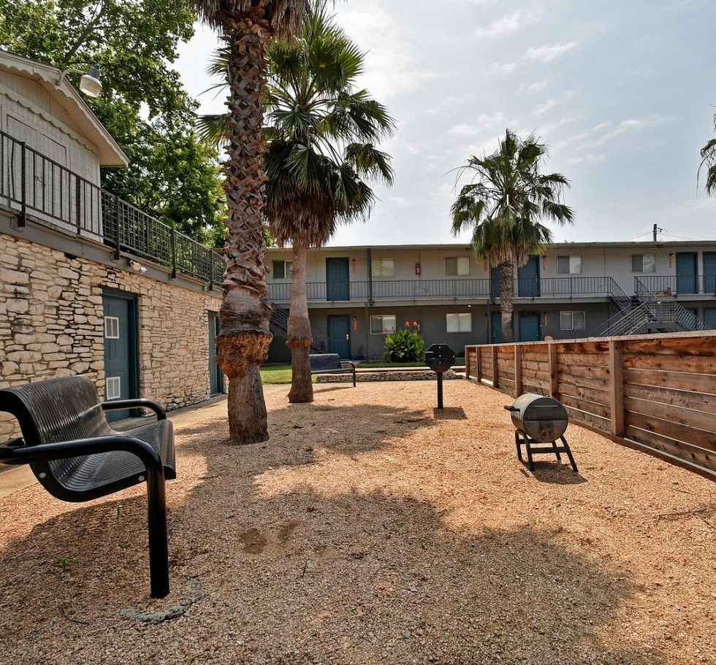
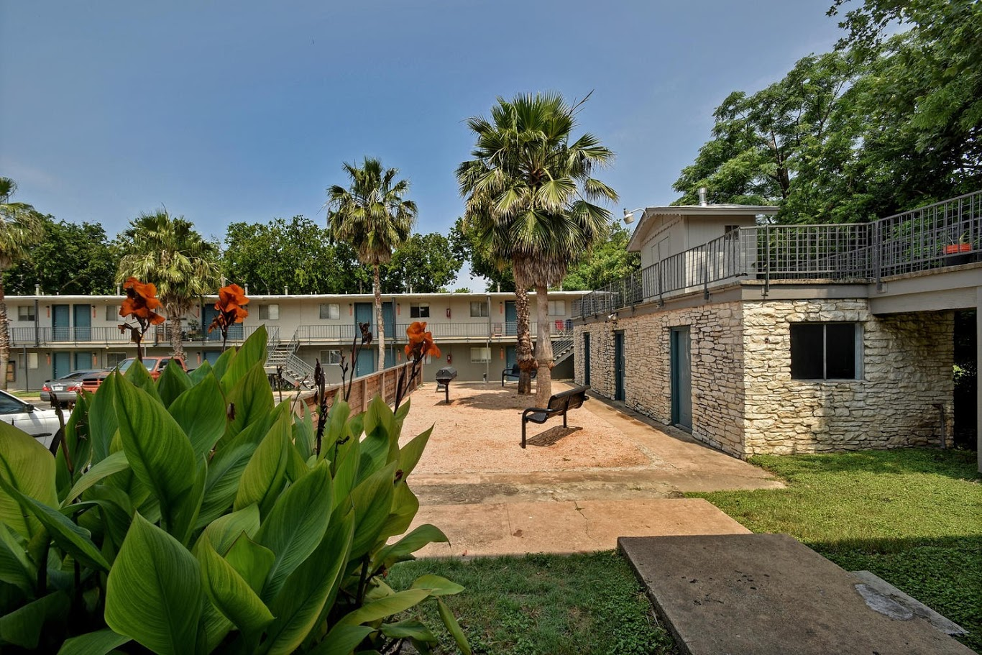
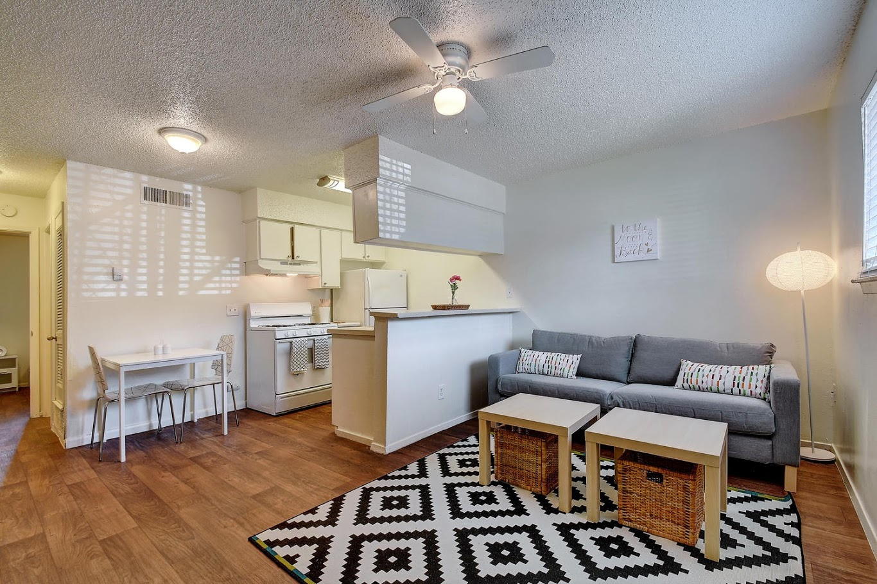
36 Committed Units
1brm units
Affordable market-rate housing
Centrally located
Near bus stop
Courtesy officer on site

Slide 18

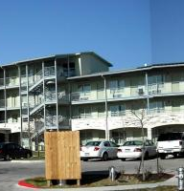

Subsidized affordable housing
Serve low-income individuals and those with developmental disabilities
Prioritized individuals exiting homelessness
Notes:
-No shortage of those needing deeply affordable housing
-Incredible option for those with a fixed income
-Typically have trouble accessing Affordable housing because of screening criteria

Slide 19


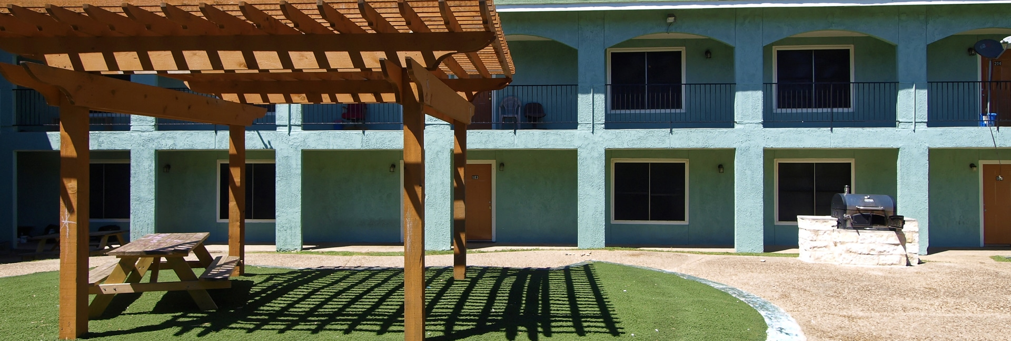
Many amenities
Great customer service
Diverse locations
Market-rate properties with mid
to large sized apartment complexes
Alternative screening
Notes:
Most partnerships are with property management companies with mid to large portfolios, who commit to an alternative criteria for our applicants
Market rate, geographically diverse units; willing to work with paperwork and inspections
Typically fill up to 20% of the units at any particular property that they manage

Slide 20
availability payment (Buydowns)
A one time payment submitted to property management to lower the rental contract rate offered to a household
Allows access to more diverse and expensive rental areas
Lowers contract rate up to $250 dollars per month
Can be used to convince landlords to accept vouchers
Not used to keep households under the cost burdened threshold of 30% of their income
Notes:
A one time payment submitted to property management to lower the rental contract rate offered to a household. They are a mechanism to create deeper affordability in market rate rental housing, one unit at a time.
The availability payment cannot exceed $250 per month for a one year lease term and can be renewed for one subsequent one year lease
This is not to act like a subsidy from the housing authority. With that being said, it is not used to ensure that a client is only paying 30% of their income in rent. Households may still pay more than that in rent.
An availability payment is used when no other affordability units can be quickly identified.

Slide 21
Partnerships benefit clients beyond access to housing
Housing Stability
Provides consequences without immediate return to homelessness
Oftentimes increased access to resources
Avoid Evictions
Allows flexibility with programs to re-house someone who has outstayed their welcome
Risk mitigation allows someone to avoid incurring debt
Helps with Engagement
Sometimes able to utilize landlord notices/maintenance to re-engage a client
Landlords want to see our clients succeed

Slide 22
Other creative tools and methods used to
gain access to housing for
individuals exiting homelessness include:
Utilizing Realtors
Liaising between landlords and the Housing Authority
Involvement in the local affordable housing conversation and building relationships with developers

Slide 23
Building Realtors into your model
There are many similarities between Realtors and homeless service providers!
Case Managers
Assist in identifying housing units
Advocate with and on behalf of clients
Realtors
Have access to most local housing units
Know what landlords are looking for in a tenant, and can help present the information
Notes:
-Another way to diversify housing
-Back to knowing the market and speaking the housing language

Slide 24
Ways to utilize a Realtor
Partner with a local Relator
Have them send you listings
Educate them on how to speak to their “owners”
Employ a Realtor
Get licensed for direct access to units
Utilize commissions for risk mitigation
Understand their incentives
Many are incentivized to lease a certain number of vacant units quickly
Pre-leasing can make their owners happy

Slide 25
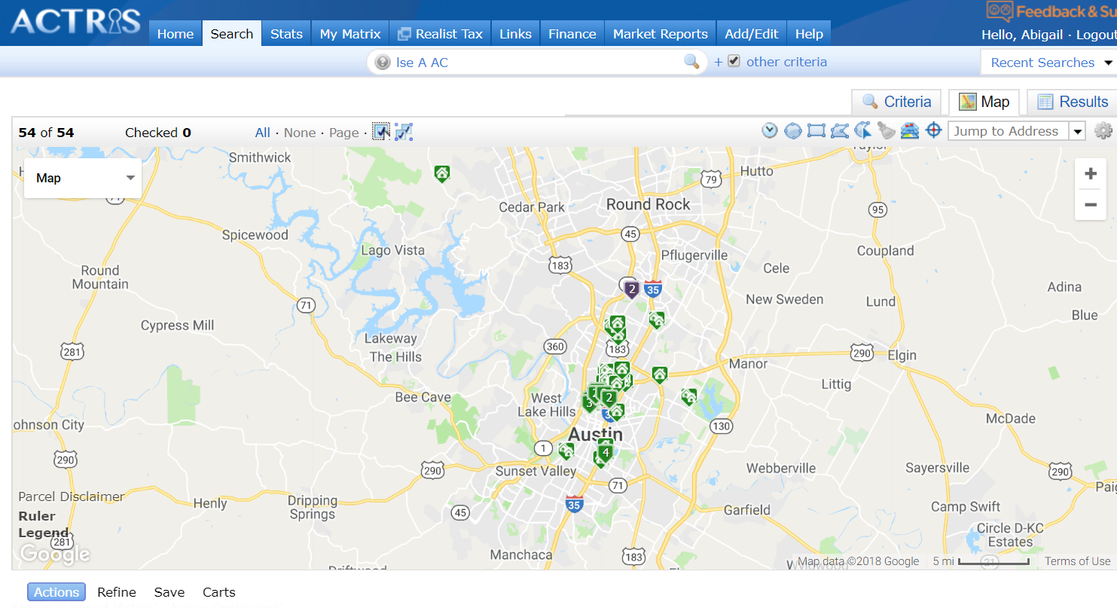
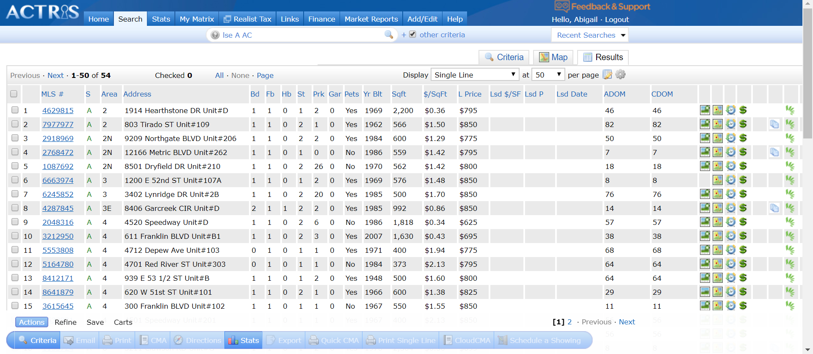
A quick search garnered 54 immediate availabilities in Austin for under $850/mo.
These units are geographically diverse and range
From studios to 2brms.
Notes:
-Really useful for someone who has specific needs, like school district, has utility debt to a certain company, or who has pets

Slide 26
Though being issued a housing choice voucher can be a golden ticket, there are many hoops that landlords may not feel compelled to jump through
We have found creative ways to mitigate some of these disincentives, and it has dramatically increased the pool of landlords open to housing individuals with Housing Choice Vouchers—i.e. HUD-VASH and other Special Programs
Non-Landlord-Centric PHA Policies | Mitigation
Inspections | Pre-Inspections; shared cost
Unfamiliar paperwork | Can complete paperwork with landlord
Delayed move-ins | Can liaise between the landlord and the housing authority to prevent miscommunication/ensure timely process
Notes:
-Carson’s HUD is doing studies on this right now

Slide 27
Challenges abound in developing housing in Texas, so seize the opportunity for partnership!
Memorandum of Understanding with Developer
Developer in pursuit of zoning change to rehab a hotel into an apartment building
Because of complications in this process, the developer needed additional community buy-in
Developer approached ECHO and among other things, committed to reserving a certain number of units for ECHO referred clients once the rehab is complete
Local funding for affordable housing can be tied to the provision of housing to certain populations
There are some funding streams that directly note Housing First as a priority; follow up on this!
If developers and property managers can have a direct link to the tenants, they may be more inclined to pursue the funding stream
Long-term thinking

Slide 28
On the Horizon
Shared Housing System
Shared housing is recognized as one of the
most affordable housing options for our clients
Recent partnership with student housing with infrastructure and relevant services in place
Developing matching process
Income-Restricted Affirmative Marketing
City and state incentives used to develop housing
These units often do not go to individuals who need them most, in part because of lack of regulation on marketing techniques
Working to develop partnerships

Slide 29
In sum…
Leave no stone unturned
Creativity
Covet every opportunity
Skill-Building
Quid pro quo
Partnerships
These interventions work!
Confidence
Notes:
We now have lower barrier, geographically disperse housing options in a city with a tight housing market
We have a diverse stock of housing options to offer clients
Austin Housing Market
Housing First and Housing Location
Housing-Related Skill-Building
Developing Robust Partnerships
Alternative Screening Criteria
Risk mitigation
Buydowns/Availability Payments
Building Realtors into your model
Other Strategies!
On the Horizon

Slide 30

Thank you!
Please feel free to contact me with any questions, comments or to compare notes!
Abby Tatkow
abbytatkow@austinecho.org
512-710-5779

