Slide 1
TDHCA
Emergency Solutions Grant
TX BoS CoC Local Competition
Local Competition for TX-607
The Texas Balance of State Continuum of Care

Slide 2
What is a State ESG Coordinator?
The Texas Department of Housing and Community Affairs (TDHCA) the State ESG Recipient in the State of Texas has designated three Emergency Solutions Grants (ESG) Coordinators for the 2019 ESG Application cycle. The Texas Balance of State Continuum of Care (TX BoS CoC) is one of those three ESG Coordinators.
As the ESG Coordinator for the TX BoS CoC: The Texas Homeless Network (THN) will be running an application process to subgrant ESG funds. While subgranting is not allowed for ESG Subrecipients, the ESG Application process is a subgranting process on behalf of TDHCA by THN,
TDHCA’s ESG funds for competition are made available by Continuum of Care (CoC) region. The TX BoS CoC has $3,332,143 dollars of funding to award agencies working to make homelessness rare, brief and non-recurring in the TX Bos CoC.
Click here to read the official Local Competition notice from TDHCA.

Slide 3
What State ESG looks like in the Balance of State
There are currently 23 TDHCA Subrecipients
serving 35 counties across the 215 counties
in the TX BoS CoC.

Slide 4
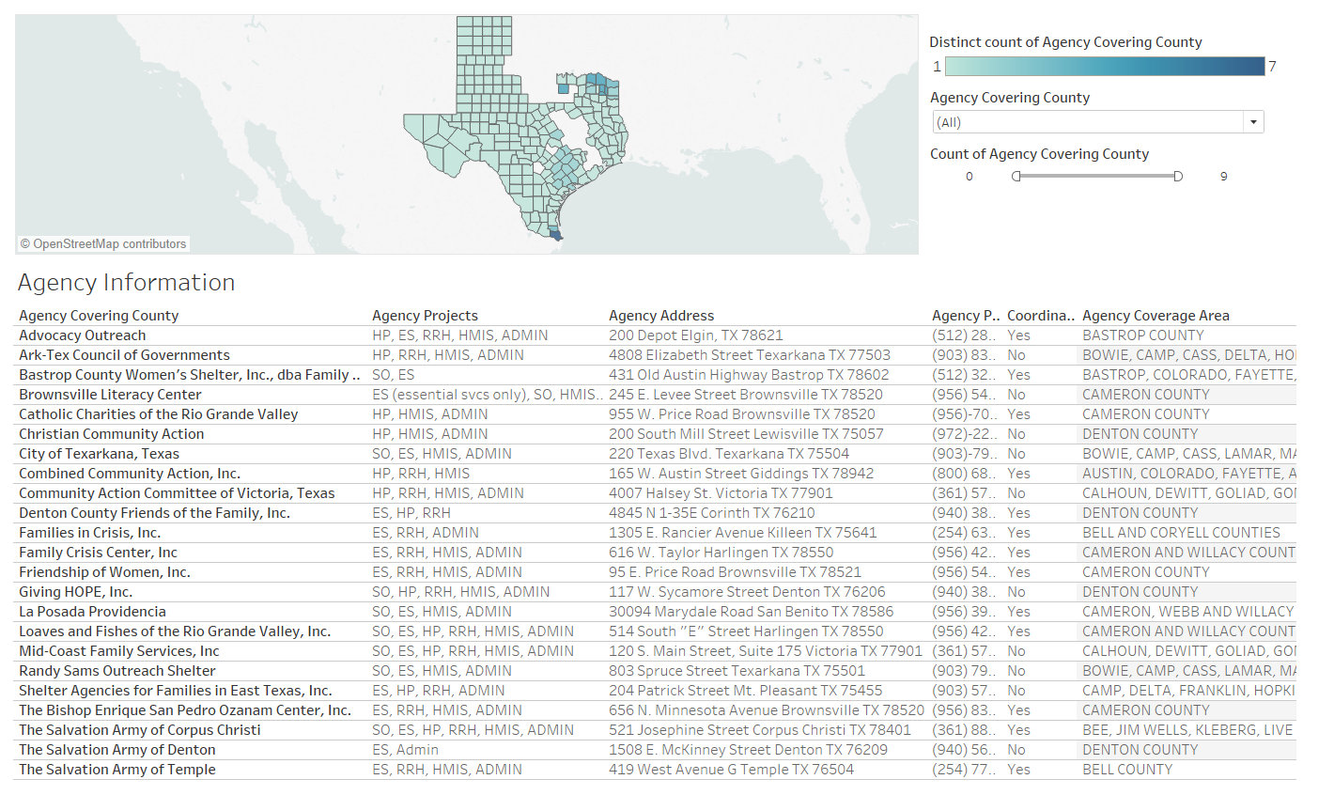
Current State ESG Subrecipients
in The TX BoS CoC
Link to Tableau Map.
Notes:
https://public.tableau.com/profile/mollie.lund#!/vizhome/ESGTDHCASubrecipientsinTXBoSCoC/Dashboard2

Slide 5
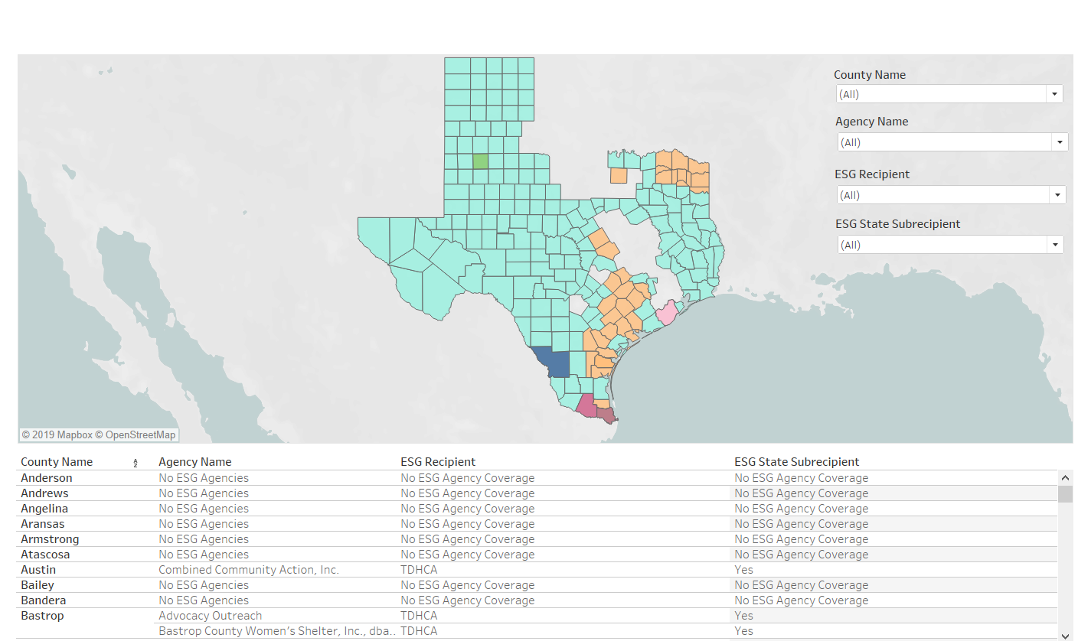
State, County & City ESG Recipients
in the TX BoS CoC
Link to Tableau Map.
Notes:
https://public.tableau.com/profile/mollie.lund#!/vizhome/AllESGRecipientsintheTXBoSCoC/Dashboard1

Slide 6
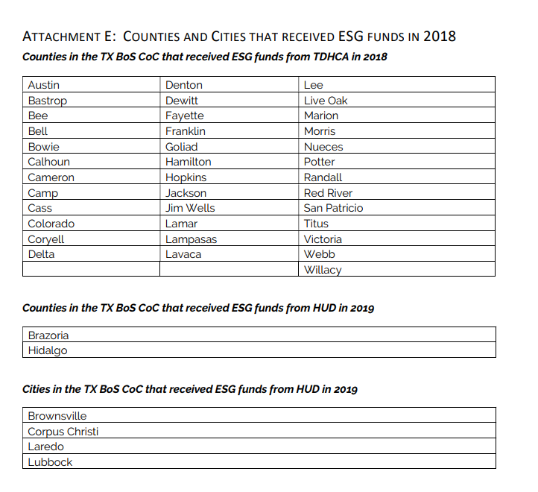
Attachment E: Counties & Cities
with ESG Funds

Slide 7
6 Key Goals of ESG Funding.
The ESG program provides funding to:
Engage homeless individuals and families living on the street;
Improve the number and quality of emergency shelters for homeless individuals and families;
Help operate these shelters;
Provide essential services to shelter residents;
Rapidly re-house homeless individuals and families; and
Prevent families and individuals from becoming homeless.

Slide 8
What ESG Components are there?

Slide 9
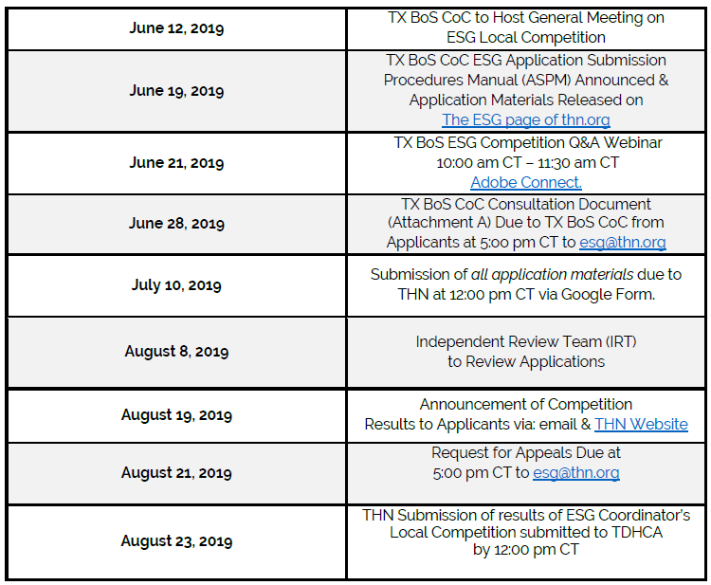
What are the local competition deadlines?

Slide 10
How do I know if I qualify for ESG Funding? Threshold Criteria
Applicants must meet the following Threshold Criteria to be eligible for ESG Funding:
An itemized ESG budget including both the request for ESG funds and the proposed Match for the ESG funds;
A copy of the Applicant’s written standards that comply with the requirements of 24 CFR §576.400 and certification of compliance with these standards. Any occupancy standard set by the Applicant must not conflict with local regulations or Texas Property Code §92.010;
A copy of the Applicant’s policy for termination of assistance that complies with the requirements of 24 CFR §576.402 and certification of compliance with these standards;
Commitment in the Applicant’s budget to the provision of at least 100% Match;
Applicant certification of compliance with State and federal laws, rules and guidance governing the ESG Program published in the TDHCA Emergency Solutions Grant Application;

Slide 11
How do I know if I qualify for ESG Funding? Threshold Criteria (Cont.)
Applicants must meet the following Threshold Criteria to be eligible for ESG Funding:
Evidence of Data Universal Numbering System (DUNS) number for Applicant;
Documentation of existing Section 501(c) tax-exempt status, as applicable;
Completed previous participation review materials published by TDHCA, as outlined in 10 TAC Chapter 1, Subchapter C (relating to Previous Participation) for Applicant;
Local government approval per 24 CFR §576.202(a)(2) for Applicant that will be providing shelter activities with ESG or as ESG Match, as applicable; and
A resolution or other governing body action from the Applicant's direct governing body which includes: Authorization of the submission of the Application; Title of the person authorized to represent the entity and who also has signature authority to execute an agreement ; and Date that the resolution was passed by the governing body, which must be within 12 months preceding the date the Application is submitted.

Slide 12
Where can I find Application Materials?
THN’s ESG Page

Slide 13
Updated Application Materials
Volume 2 – Uniform Scoring Criteria Revised 6/20/2019 at 2:40pm (Excel Sheet)
Tab 3 & 4 were updated as Contracts can no longer be from the second benchmark expenditure and must be from closed contracts.
Volume 7 – TX BoS CoC Narrative Revised 6/19/19 at 2:55 pm (Excel Sheet)
Excel Sheet was updated as it was protected when first posted on THN ESG web page.
Attachment F: Local Government Approval of Shelter Activities Revised 6/20/19 at 7:20 am (PDF)
Attachment F was updated in regards to a form field which was not allowing for typing.
Attachment D: Attachment D: ESG Applicant Certifications (PDF)
Attachment D was updated in regards to a printing error on Page 36.
Notes:
All are available on THN Website: https://www.thn.org/texas-balance-state-continuum-care/esg-program/

Slide 14
What do I do with Excel Documents?
Google Form

Slide 15
What do I do with PDF Documents?
Google Form

Slide 16
Q&A
Please take this time to place questions in the
chat box.

Slide 17
First Applicant Deadline:
June 28, 2019
5:00 pm CT
CoC Consultation Form Due
Email the form to: esg@thn.org
Notes:
There is no longer a letter of intent due, only this consultation form.

Slide 18
Last Applicant Deadline:
July 10, 2019
12:00 pm CT
All Application Materials Due
Via Google Form

Slide 19
Q&A
Please send all ESG questions to esg@thn.org

