Slide 1
INCOME NOW
HOUSTON
Coordinated Access to Housing and Income
Texas Conference on Ending Homelessness
October 9, 2019

Slide 2

Coordinating access to income
What is worker housing?
Notes:
What were three keys to your success? (cont.)
3. Coordinating access to income- Having an Income plan to match a housing plan enhances housing sustainability and creates understanding and expectations for success.

Slide 3


Building a System Response to Ending Homelessness
Engaging Workforce Development Boards In Your System
Notes:
Slide 1

Slide 4

Simultaneous System Transformation
Programs & Services
A diverse collection of independent providers employing lots of methods, targeting various goals.
Homeless Response System
An integrated network of providers coordinating efforts to achieve maximum impact.
Building Systems to get Houston Housed, Healthy, and Hired!

Slide 5
Simultaneous System Transformation
Simultaneous System Transformation
RRH Expansion
PSH Pipeline
PSH Service Model
Downtown System Redesign
Coordinated Access
System Performance
HMIS
CoC Coordination
Media/PR
Change Manage-ment
System Coordination
Barrier
Buster
Fund
Income Now
Youth/ Young Adults LGBTQ and all
Notes:
Eva

Slide 6
Building the System
Simultaneous System Transformation
System to End Homelessness
Coordinated Access
Income Now
New Service Delivery Model
RRH Expansion
2500 Additional PSH Units

Slide 7

A New System of Accountability
The Continuum of Care/The Way Home Steering Committee
(Primary Decision Making Body)
Planning and Implementation Bodies
System
Director of Workforce Board added to CoC Steering Committee Governance
Design
Shared vision in Employment Summit with collaboration across agencies and systems
Implementation
Leadership team
Training
System Navigators
Implementation team
Project Management
Culture shift training
Supported by:
HMIS
PM Team
CoC Lead Agency
Notes:
We created new systems of accountability
Not just to boards and funders

Slide 8
Coordinating Access to Housing and Income
Simultaneous System Transformation
VA
Targeted Hubs
Outreach Teams
Hospital
HC Jail
Call In
Center
Housing and Income Assessment
Housing and Income Program Matching
Housing and Income Program Referral
Housing and Income Navigation

Slide 9
One Income System, Multiple Interventions
Simultaneous System Transformation
SOAR
Supported Employment
Competitive Employment

Slide 10
What is Income Now
Simultaneous System Transformation
SOAR
Disability
No regular income
Supported Employment
Disability
Looking to work
Workforce Solutions
No disability
Looking to work
Assistance with the SSA/VA Benefits application process
Intensive workforce development supports
Traditional workforce development supports/embedded staff with Workforce Solutions/Building capacity
Work Incentives Counseling
Medicaid/Medicare/VA

Slide 11
Coordinated Access Matching
Simultaneous System Transformation
Coordinated Access to
Housing and Income
PSH
RRH
SOAR
Income Now
Workforce Solutions
(Public Workforce System)
Supported Employment

Slide 12
Progress Updates-Coordinated Access
Simultaneous System Transformation
Matching
Referral
Assessment
Income assessment is built into HMIS and incorporated into the housing assessment
RRH=Public Workforce System +
PSH=Supported Employment and/or SOAR
Public Workforce System =to any career office –fully integrated
Supported Employment=ramping
SOAR= Six dedicated staff
Notes:
Implementation Team Chart
Communicate communicate communicate
Allows for group trouble shooting and power leveraging

Slide 13
Progress Update - SOAR
Simultaneous System Transformation
Analysis-Gaps/Resources
Capacity Building and Design
Implementation
Report is completed
Add 3-6 Dedicated SOAR Staff
Limited service delivery as a Community
SOAR Forum and TA
We need 6-10 dedicated SOAR staff
350-700 need SOAR services
Referral process built into HMIS
Added 6 dedicated SOAR staff
HMIS assessment and referral system
Weekly transition team Meeting
Outcomes reports

Slide 14
Progress Update-Public Workforce System
Simultaneous System Transformation
Analysis-Gaps/Resources
Capacity Building and Design
Implementation
Access challenges
Capacity challenges
Culture Shift
Racial Equity
Fully integrated system
Invest in OJT/WE
Navigation maintenance
Data Matching
TWC
Heartland Alliance-Connections Project and PWFC
Notes:
Implementation Team Chart
Communicate communicate communicate
Allows for group trouble shooting and power leveraging

Slide 15
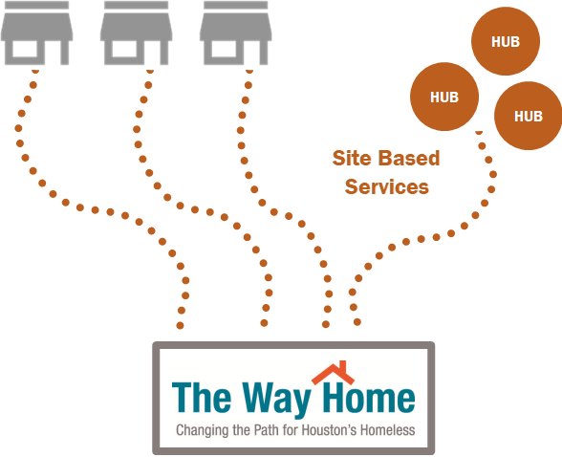

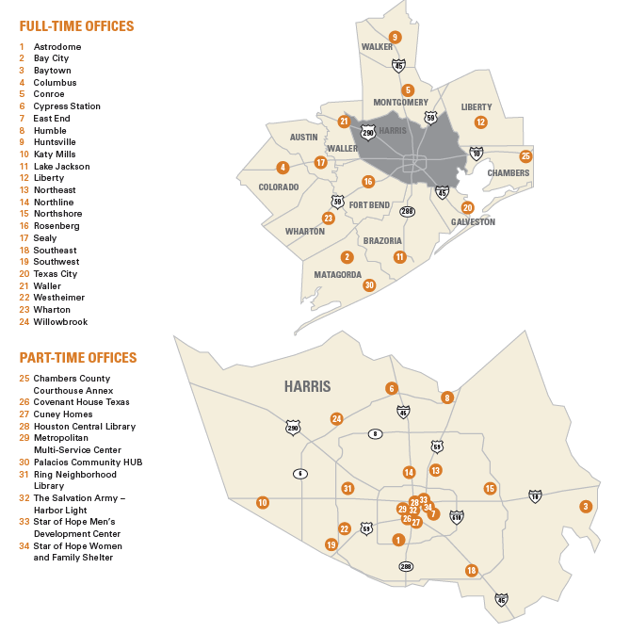
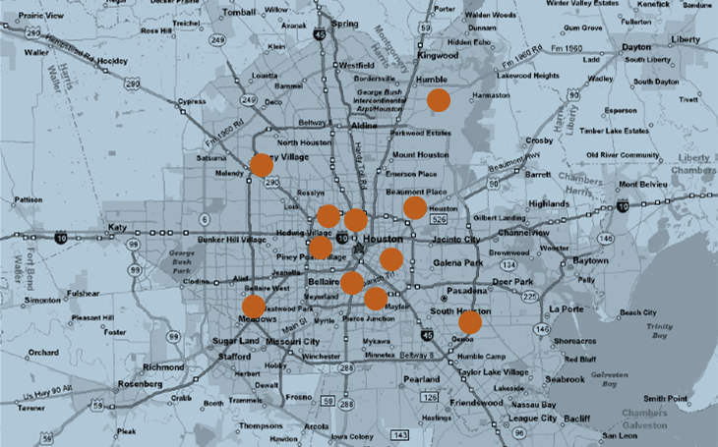
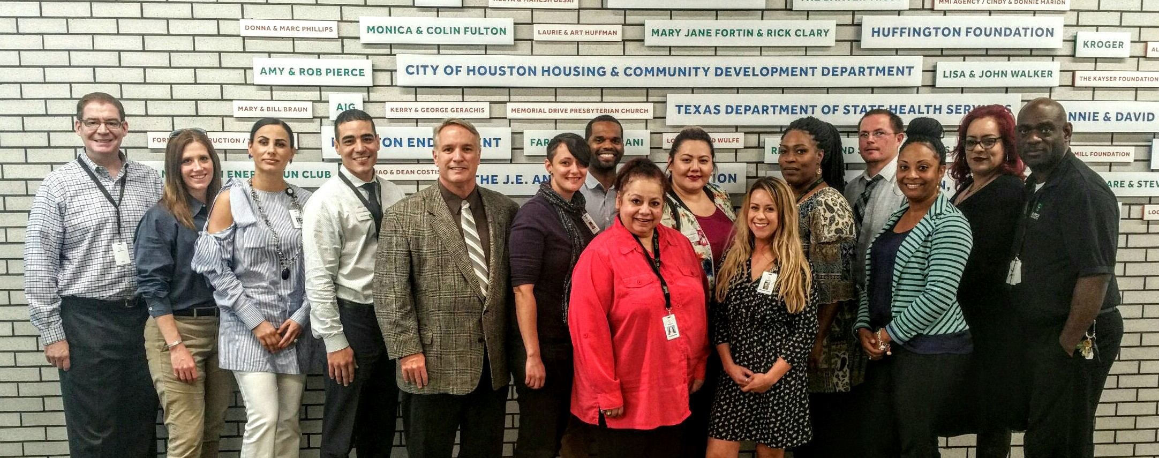

Integration with the public workforce system
Career Offices
Notes:
What is your greatest success so far?
Integration with the public workforce system. Houston’s CoC is integrated with the Workforce system and brought to scale in the Income Now initiative. It’s a two way mutually beneficial relationship which includes data sharing, points of entry for both systems, and accountability.

Slide 16
Income Now Service Locations Today
Simultaneous System Transformation

Slide 17

Workforce Solutions
Who We Are
The Gulf Coast Workforce Board and its operating affiliate Workforce Solutions are the public workforce system in the 13-county greater Houston region.
Workforce Solutions helps employers meet their human resource needs and individuals build careers.
What We Do
Employers - Help filling open jobs; labor market data and employment projections; and talent development
People - Job search assistance; career planning; education and training opportunities; and financial support
Where We Are
Workforce Solutions has 24 local careers offices throughout the region, four information centers, and five special project locations.
Our Employer Service office, centrally located in Houston, works with employers throughout the 13 counties.
www.wrksolutions.com or 1-888-469-5627

Slide 18

Work-Based Learning
Services
On-the-Job Training
Work Experience
Registered Apprenticeships

Slide 19
Staff Development and System Guidance
The Academy (new employee training)
Connecting the Dots (e-learning)
Issuance 17-09 (system policy on serving individuals experiencing homelessness)
Referral Process
System Navigation

Slide 20
Income Now Culture Shift
Baseline Assessment
Train
Re-Assess
Coalition for the Homeless
10 Employment focused sessions through 2016
Targeting 84 provider staff throughout the homeless provider and workforce communities
Social Impact Research Center
@ Heartland Alliance
Administer survey after trainings and quarterly
Analyze data
Determine impact of training on beliefs
Social Impact Research Center
@Heartland Alliance
Design survey
Administer survey
Analyze data

Slide 21
Income Now Implementation Infrastructure
Simultaneous System Transformation
Income Now Design Team
This workgroup is called upon when system design is necessary. Depending on the design necessary, participating agencies can include; income service providers, homeless service providers, social security, DARS, employers and other appropriate agencies.
Income Now
Leadership Workgroup
Align Resources
Income Now
Implementation Workgroup
Direct Service
Influence
Trouble Shooting
Developing P&P’s
Build Coalitions
Staffing
Oversight
System Accountability
System Refinement
Troubleshooting
Data Quality
Sustainability
Elevating Needs and Issues
Rubber-Stamp for System Work
Provide Cover for the Work to Get Done

Slide 22

























Building Income Now
Simultaneous System Transformation

Slide 23
Income Now Implementation Phase I
Simultaneous System Transformation
Hire Project Managers
Complete Gaps Analysis and Right-Sizing Intervention Mix Projections
Complete Existing Services and Resource Crosswalk
Data Collection
  Population
  Market
Action Planning
Build a Design Team
Host a Design Retreat
Build Implementation Workgroup
Build Leadership Workgroup
Engage Potential Partners and Stakeholders
Build Resources/Funding to Execute System Design
Implement!!!

Slide 24
Income Now Implementation Phase I
Simultaneous System Transformation
February, 2015 December, 2015
10
Months
LOI submitted to Heartland Alliance for the Connections Project
_
First services delivered through our newly designed system
$2.3M in Aligned Resources
2 Dedicated Project Managers
Leadership Workgroup
Design Team
Implementation Workgroup of
32 Dedicated Staff

Slide 25

Never underestimate the job seekers
Notes:
What are three lessons you’ve learned so far? (cont.)
2. Never underestimate the job seekers. No doubt people who have survived homelessness are resilient. Don’t hold the client back let them aspire and you will be rewarded.

Slide 26
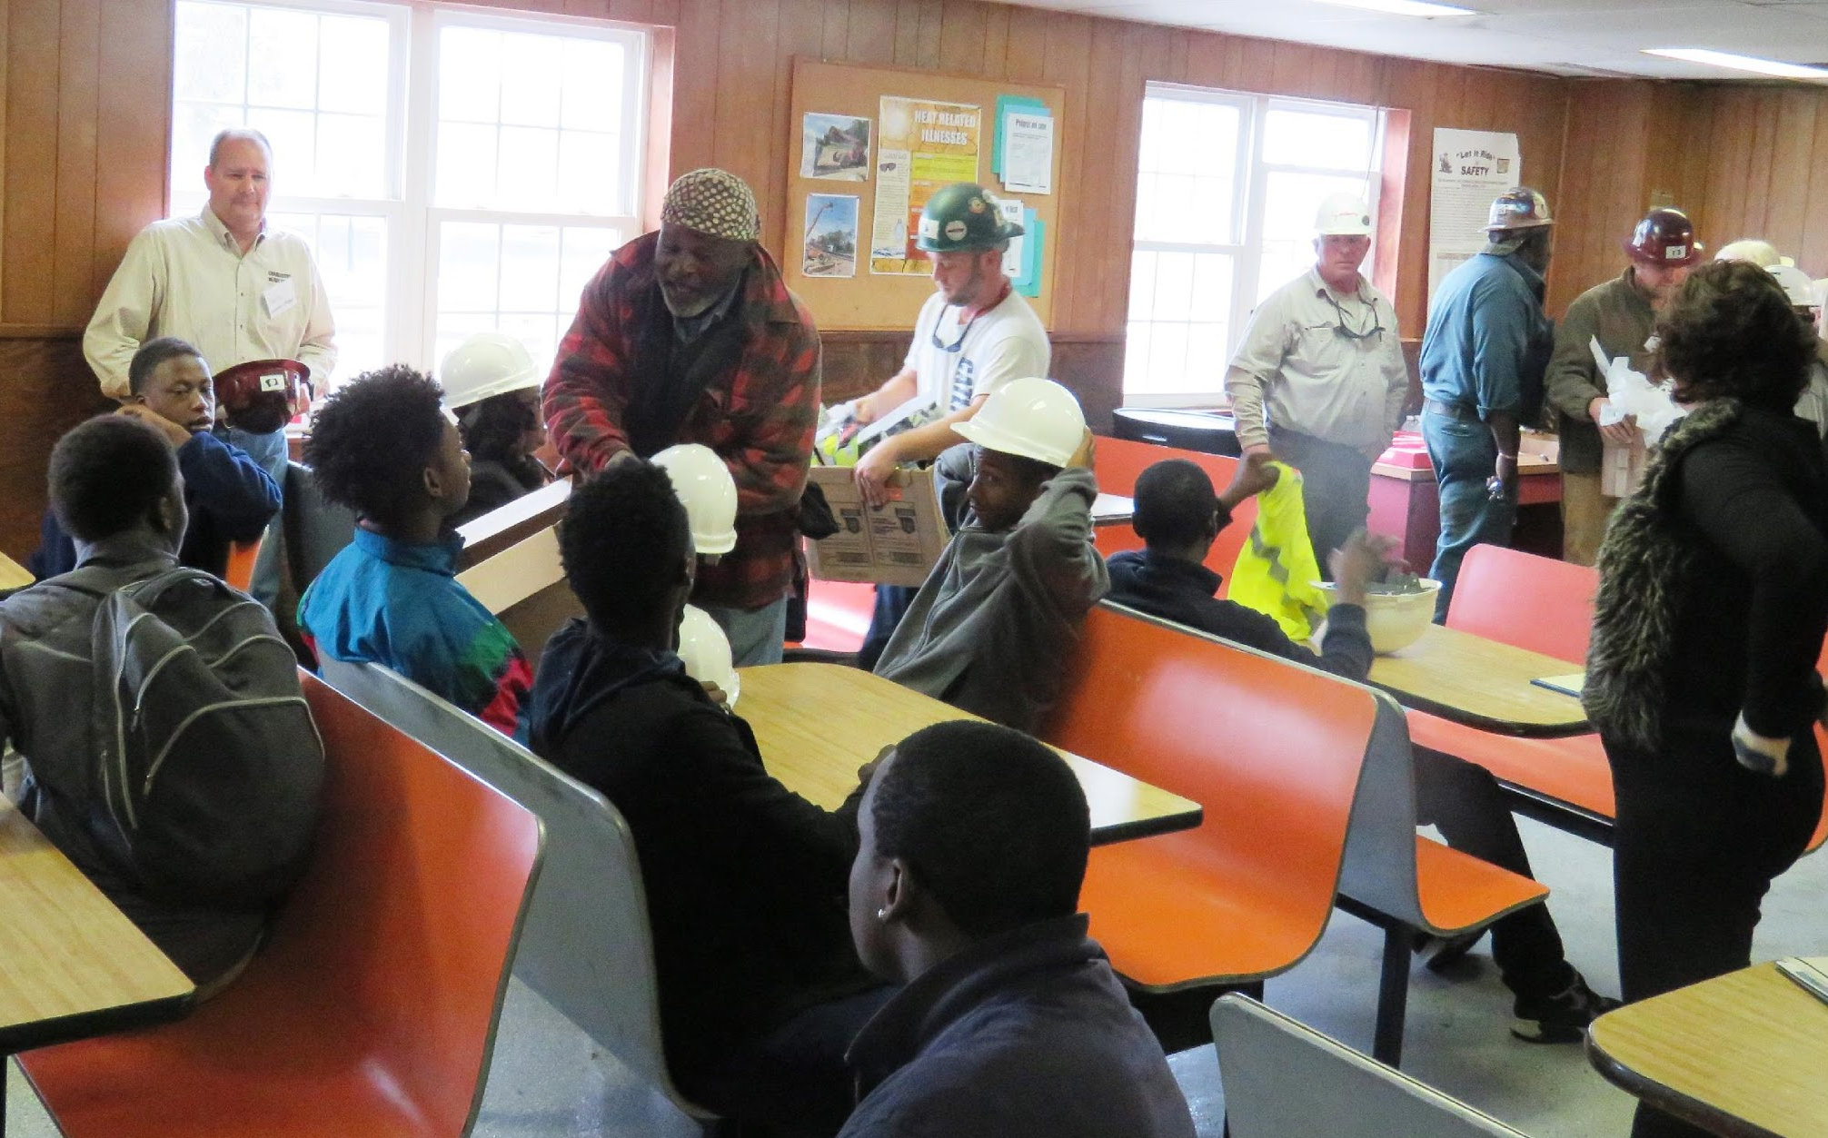
Work based learning Works!
Notes:
What are three lessons you’ve learned so far? (cont.)
3. Work based learning is a useful intervention. Weaving together money management , soft skill training, applied skills training, and work experience…this intervention has large return on investment.

Slide 27
Pathways Forward and Connections Project
Simultaneous System Transformation

Slide 28
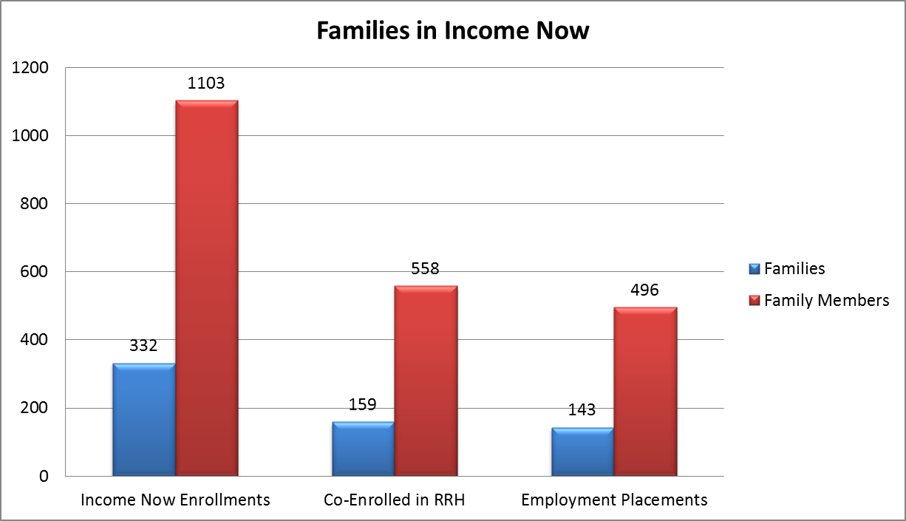
RRH and Income Now Co-enrollment
110 YYA between 18-24
Average wage over $11.50 per hour
Notes:
Community wide goals we set for ourselves

Slide 29
Data Sharing Reports
2705 clients received services as of August 8, 2019
Track movement through the system by demographic and by quarter
Notes:
Community wide goals we set for ourselves

Slide 30
Simultaneous System Transformation
Thank You
Gary Grier
Senior Project Manager
Coalition for the Homeless of Houston Harris County
Ggrier@homelesshouston.org

