Slide 1
Giving voice to students experiencing homelessness: Sharing lessons from students’ stories
Kathy Mustacato Wigtil, Ed.D.
Department of Curriculum & Instruction
Notes:
Introduce self, what I did, what I am doing now and ask who is in the room

Slide 2
Presentation Agenda
Why give students a voice?
What did they say about how homelessness influenced their education?
What did we learn from listening?
Discussion and Questions

Slide 3
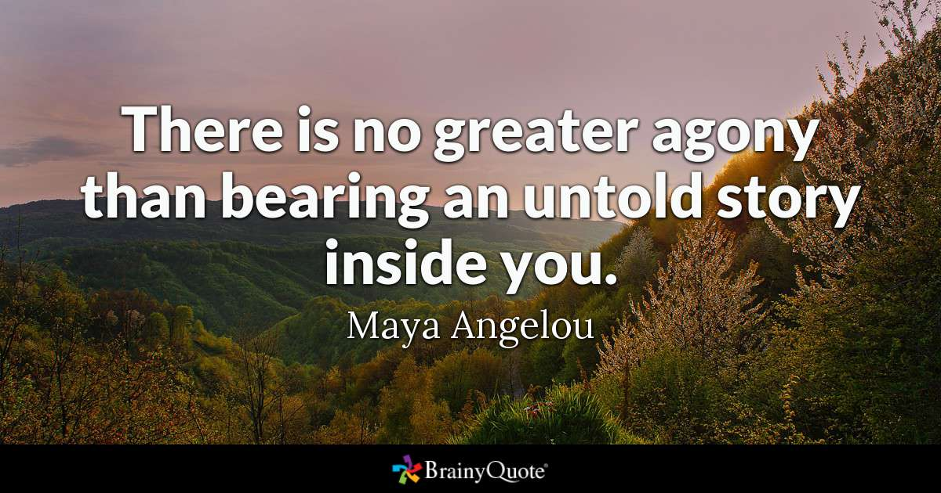
Why give students a voice?
Notes:
I love this quote by MA. Because those of us who work with SEH know that they have powerful stories. And what I know as an educator and researcher is that stories have the power to move things and highlight the need for change in a way that data alone often does not. So we need data, but we also need stories to facilitate real change. Especially in situations where leadership does not get it. I want to pause and ask you to turn to a neighbor and share the first name of a student or young person you know who has a powerful story. (Wait about 2 minutes). Ok – I’ll bet none of us had a hard time thinking of someone. So what would it look like to tell their story to those who make educational decisions?
Take a minute and share with your neighbor - the first name of a student you know who has a powerful story that educators need to hear.
OK, we all probably had someone specific in mind.

Slide 4
What do educational theorists say? Culturally Responsive Teaching (CRT) & Care Ethics
Hiddenness of Student Homelessness
CRT: Knowing students' lived experiences, valuing student voice
CRT: Students' knowledge, skills, resiliency
Importance of Connectedness and Social Supports
Care Ethics: Student connnections to friends, family, school personnel
Care Ethics: Social supports from service providers, community
Positive Adult Interventions
CRT & Care Ethics: Psychosocial factors
CRT & Care Ethics: Strategies and interventions
Notes:
So as a research I wanted to know what information is already out there related to educating at risk students, like SEH so I looked at it through the lens of two different theories that work well in educating at risk students: CRT and Care Ethics. Anyone ever heard of those? I aligned some of the big themes related to student homelessness with these two theories. And this is what I came up with. We know that SH is a hidden and broad problem. CRT could address that by knowing students. We know that connections and social supports are critical, and these students may not have that a home, so Care Ethics can fill that gap. From Nell Noddings’ Care Ethics - Noddings says that educators have a moral obligation to create mutually caring relationships, that is the foundation of education, where we listen to students and respond accordingly . Then the need for positive adult interventions, we provide both the psychosocial supports students needs and the educational supports they need to graduate – we need both.

Slide 5
Notes:
To put it into simple, clear words, I like the way True Colors explains it: Authentic Youth Collaboration, where it isn’t just tokenism. I especially like their motto: Nothing about us without us. And we know that the most students most vulnerable to homelessness are those represented in special populations.

Slide 6
Why do educators need to listen?
Lack of current studies related to achievement and educational outcomes for homeless students (Cowen, 2017; Ingrim et al., 2016)
A need to understand what factors contribute to educational resiliency and academic success (Bryan, 2015; MacDonald, 2013)
Notes:
But in education speak – why do educators need to be concerned about authentic youth collaboration and listening to our students? We can clearly show that research says…

Slide 7
We need data, but…
Notes:
So I’m not saying we don’t need hard data – numbers and charts and graphs – we will always need that, especially to speak to educational leadership. BUT…

Slide 8
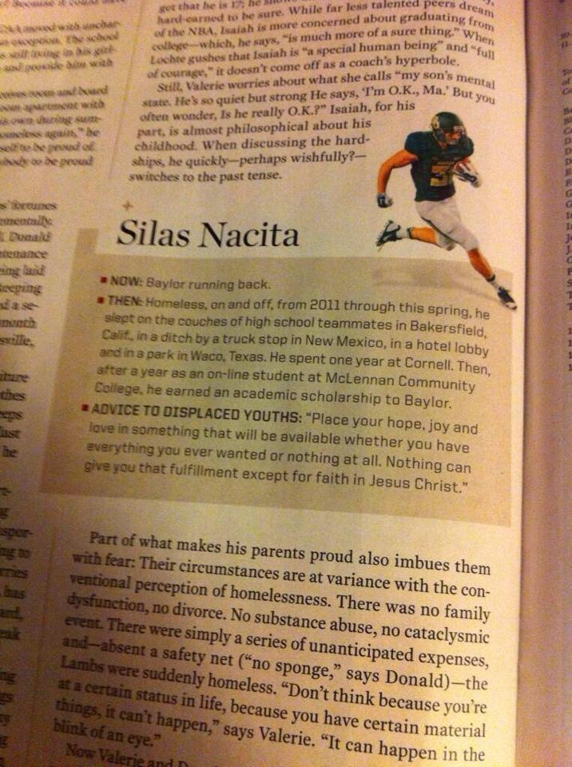
We need stories…
Portraiture: a term described by Lawrence-Lightfoot and Davis (1997) as a “method of inquiry and documentation” (p. 3) to share the students’ voices in a way that develops a rich, complex story of their experiences with homelessness and schooling
Source: Sports Illustrated, October, 2014
Notes:
Story has the power to move things in a way that data alone does not. We need both. So I actually used an unique educational technique to tell the stories of the students in my study in a way that has credibility, called Portraiture – as the slide states: a way to tell students’ stories as a method of inquiry (so it’s not willy-nilly) that provides a rich and complex word picture. Especially if you find students who can articulate in their experiences in a very real way. That was one reason I used a young athlete from Baylor University who had told his story to a reporter from Sports Illustrated and then his story went viral. Anyone here when Ken Rodriguez came to THN and asked us to tell him about homeless athletes? Talk about the power of student voice!?!

Slide 9
Here is what I asked students?
How has homelessness influenced the student’s educational outcome?
What interventions did the student find the most helpful?
What interventions did the student find the least helpful?
Notes:
Here are my questions for the students in my study. The first question was very general on purpose. I did not define it for them, I let them talk about it any way they saw fit. They could talk about their experiences in high school or college or both, and they did. But I also wanted to know what was the most and least helpful. And because I had trusting relationships with these students, I knew they could articulate how homelessness had influenced their education. And I knew their stories were different but each had something important and powerful to share.

Slide 10
Participants
Students | Years Homeless | Homeless Context | Educational Outcome
Silas | 6+ | Homeless and unaccompanied in high school and college | Bachelor’s degree
Mary | 6+ | Homeless and unaccompanied in middle and high school | High school graduate
Destiny | 3 | Homeless and unaccompanied in high school | Bachelor’s degree, Master’s degree
Danny | 2 | Homeless and unaccompanied in high school | Bachelor’s Degree
Notes:
Very quickly – here are the students in my study. Describe relationships. All were at least 18 at the time of the study. Can you guess which student has the most positive outcome to this day? And which one has the least positive? The difference for Destiny, in addition to earning her Masters in SW, is that she always had a loving family even when they were in disarray and lacked the resources to support her. On the other hand, the other students communicated that they were always looking for that love. Mary said she always wondered if she was loved and where she belonged and she made some bad decisions looking for that love.

Slide 11
Here is what they talked about…
Notes:
This is interesting – I created a word cloud from their stories and some of my case notes and look what is in the center: School. I think this is so telling because one of my students shared that often teachers think you don’t care when homelessness interferes with school. But school was a central topic that all the students talked about.

Slide 12
Research Question | Students Answers
How has homelessness influenced the students’ educational outcomes? | Making education difficult School is both stressful and safe Valuing education Determination/desperation Needing to belong
What interventions did the students find the most helpful? | Helpful programs Helpful individuals
What interventions did the students find the least helpful? | Lack of understanding Lack of post-secondary preparation
Notes:
And I want to share in their own words their answers. READ from notes

Slide 13
Here’s what I concluded:
For Educators
Need Social Workers and Counselors who are trauma trained
Need Community Partners
Create opportunities to include students
Post-secondary training
Notes:
So here are my take-aways for educators.

Slide 14
Here’s what we can do:
Programs
On Your Own: Navigating the Road to Independence (Jumper, 2010) – Support groups for students transitioning to post-secondary life
Student Advisory Boards (Aviles de Bradley, 2015; Nieto, 2013) – Seeking student input on programs and initiatives
Florida State University’s Unconquered Scholars Program (Field, 2015; Jackson, 2017).
Community Partnerships
Using Social Work Interns
Food Pantries & Resale Shops/Clothes Closets
SNAP benefits
Notes:
And here are some practical action-oriented steps school personnel can take to help these students stay in school and graduate. Because, after all, isn’t that the point of all this?

Slide 15
Discussion - take a few minutes to share with your neighbor(s): can you think of ways to include students’ stories in your work? What would that look like? Questions? Kathy M. Wigtil, kathy_wigtil@baylor.edu
Notes:
So I want to take a few minutes for you to think back to the student who you named at the beginning - the one(s) with powerful stories. Take a few minutes to talk among yourselves - can you think of ways to include student’s voices? For them to tell their stories? What could that look like at your school or in your organization? Take a few minutes and then I’ll open it up for discussion and questions.

