Slide 1
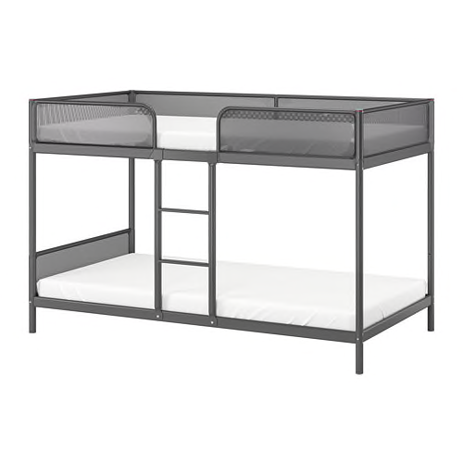
Harmony House, Inc.
Worker Dorm Model
Meg Pohodich

Slide 2
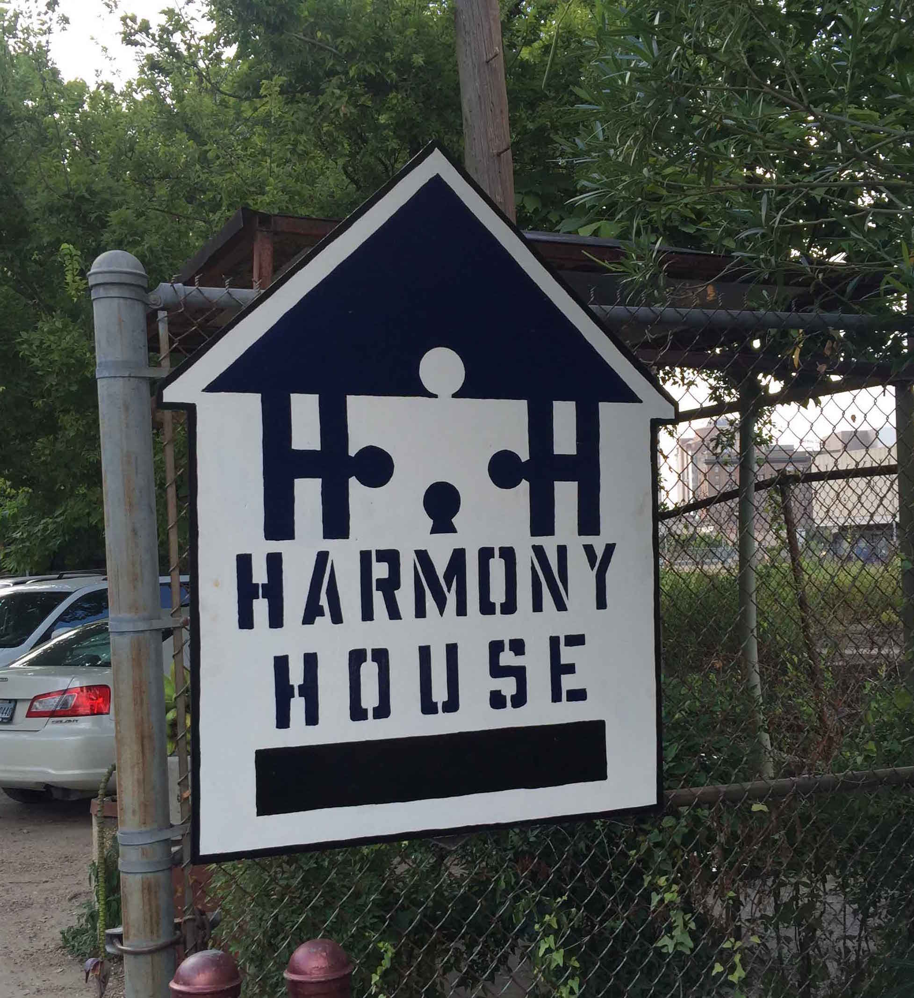
Past and Present
Founded in 1992
Mid-size/34 employees
Bunkhouse in 1993
Harris Health Open Access Clinic
Medical Respite Care
Infectious Tuberculosis Facility
Provide 185 units of PSH across 8 locations

Slide 3

THIS IS NOT A SHELTER!!

Slide 4
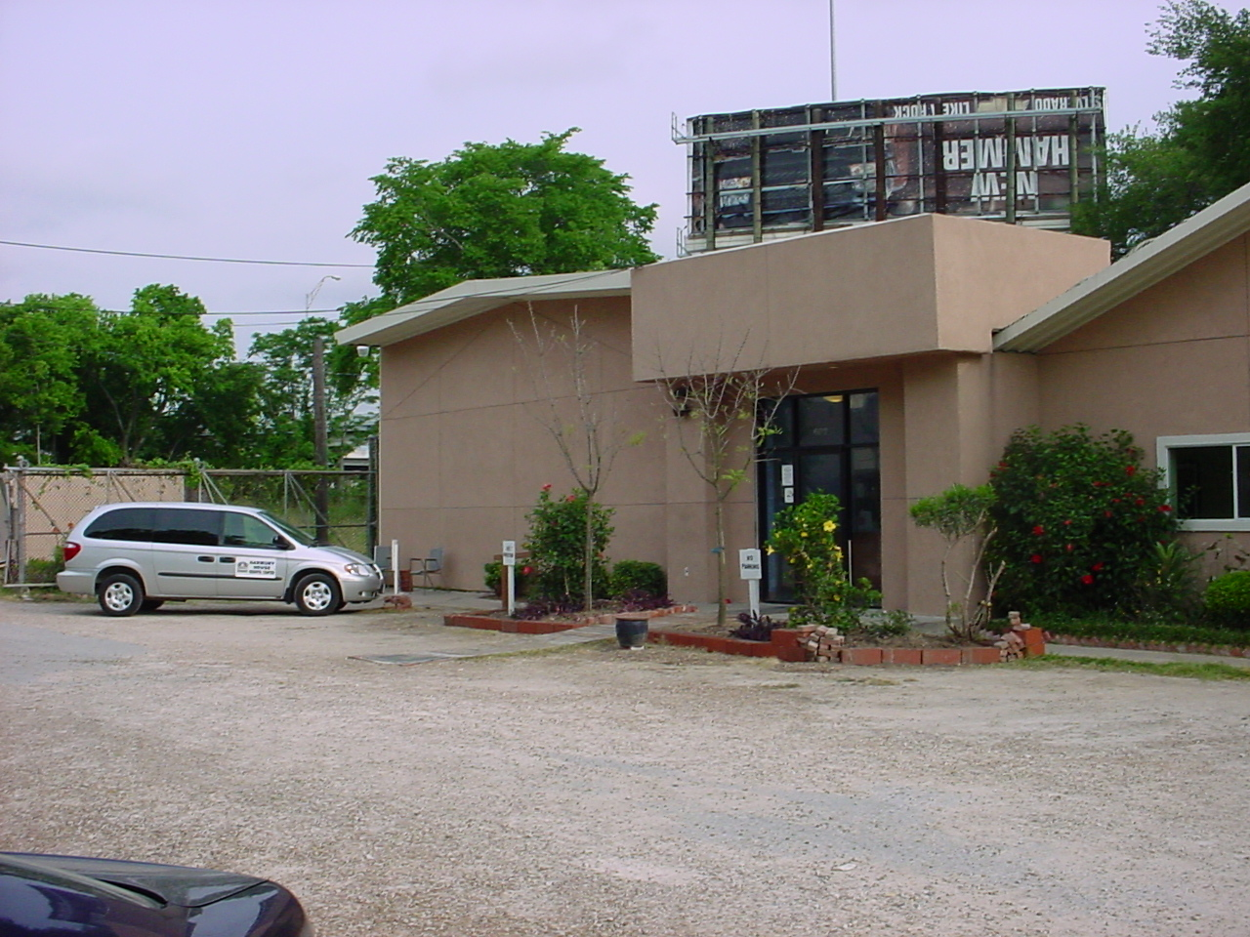
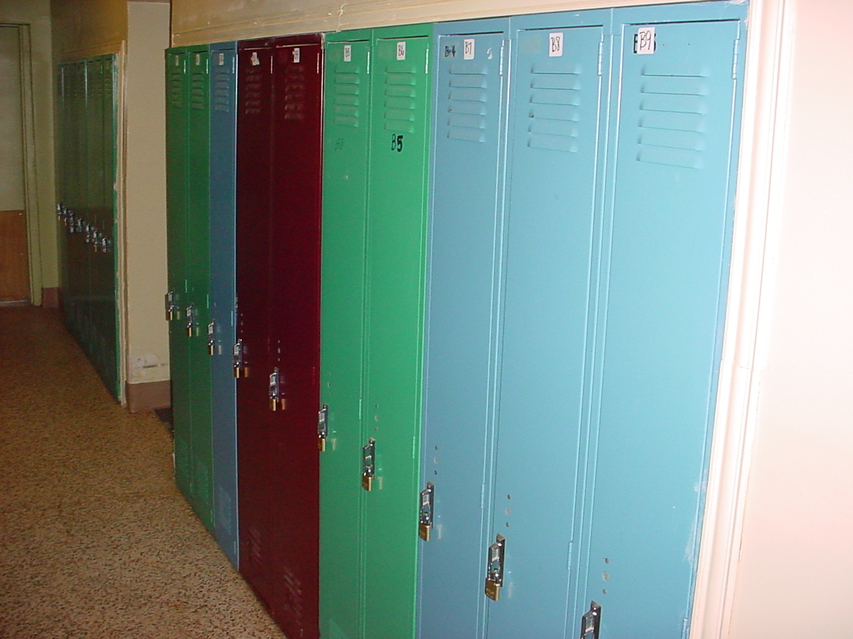
The “Bunkhouse”
Harmony House’s very first program
All male dormitory style facility
Bunk beds
Common bathrooms
Common kitchen and eating spaces
Nightly/weekly/monthly rate options
No leases
No background checks
Approved Alternate Housing Resource for TDCJ
Harris Health Open Access Clinic

Slide 5
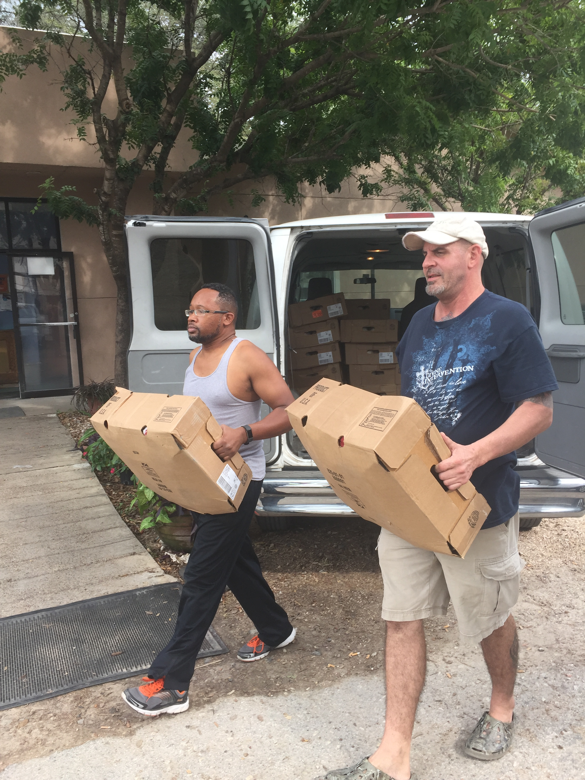
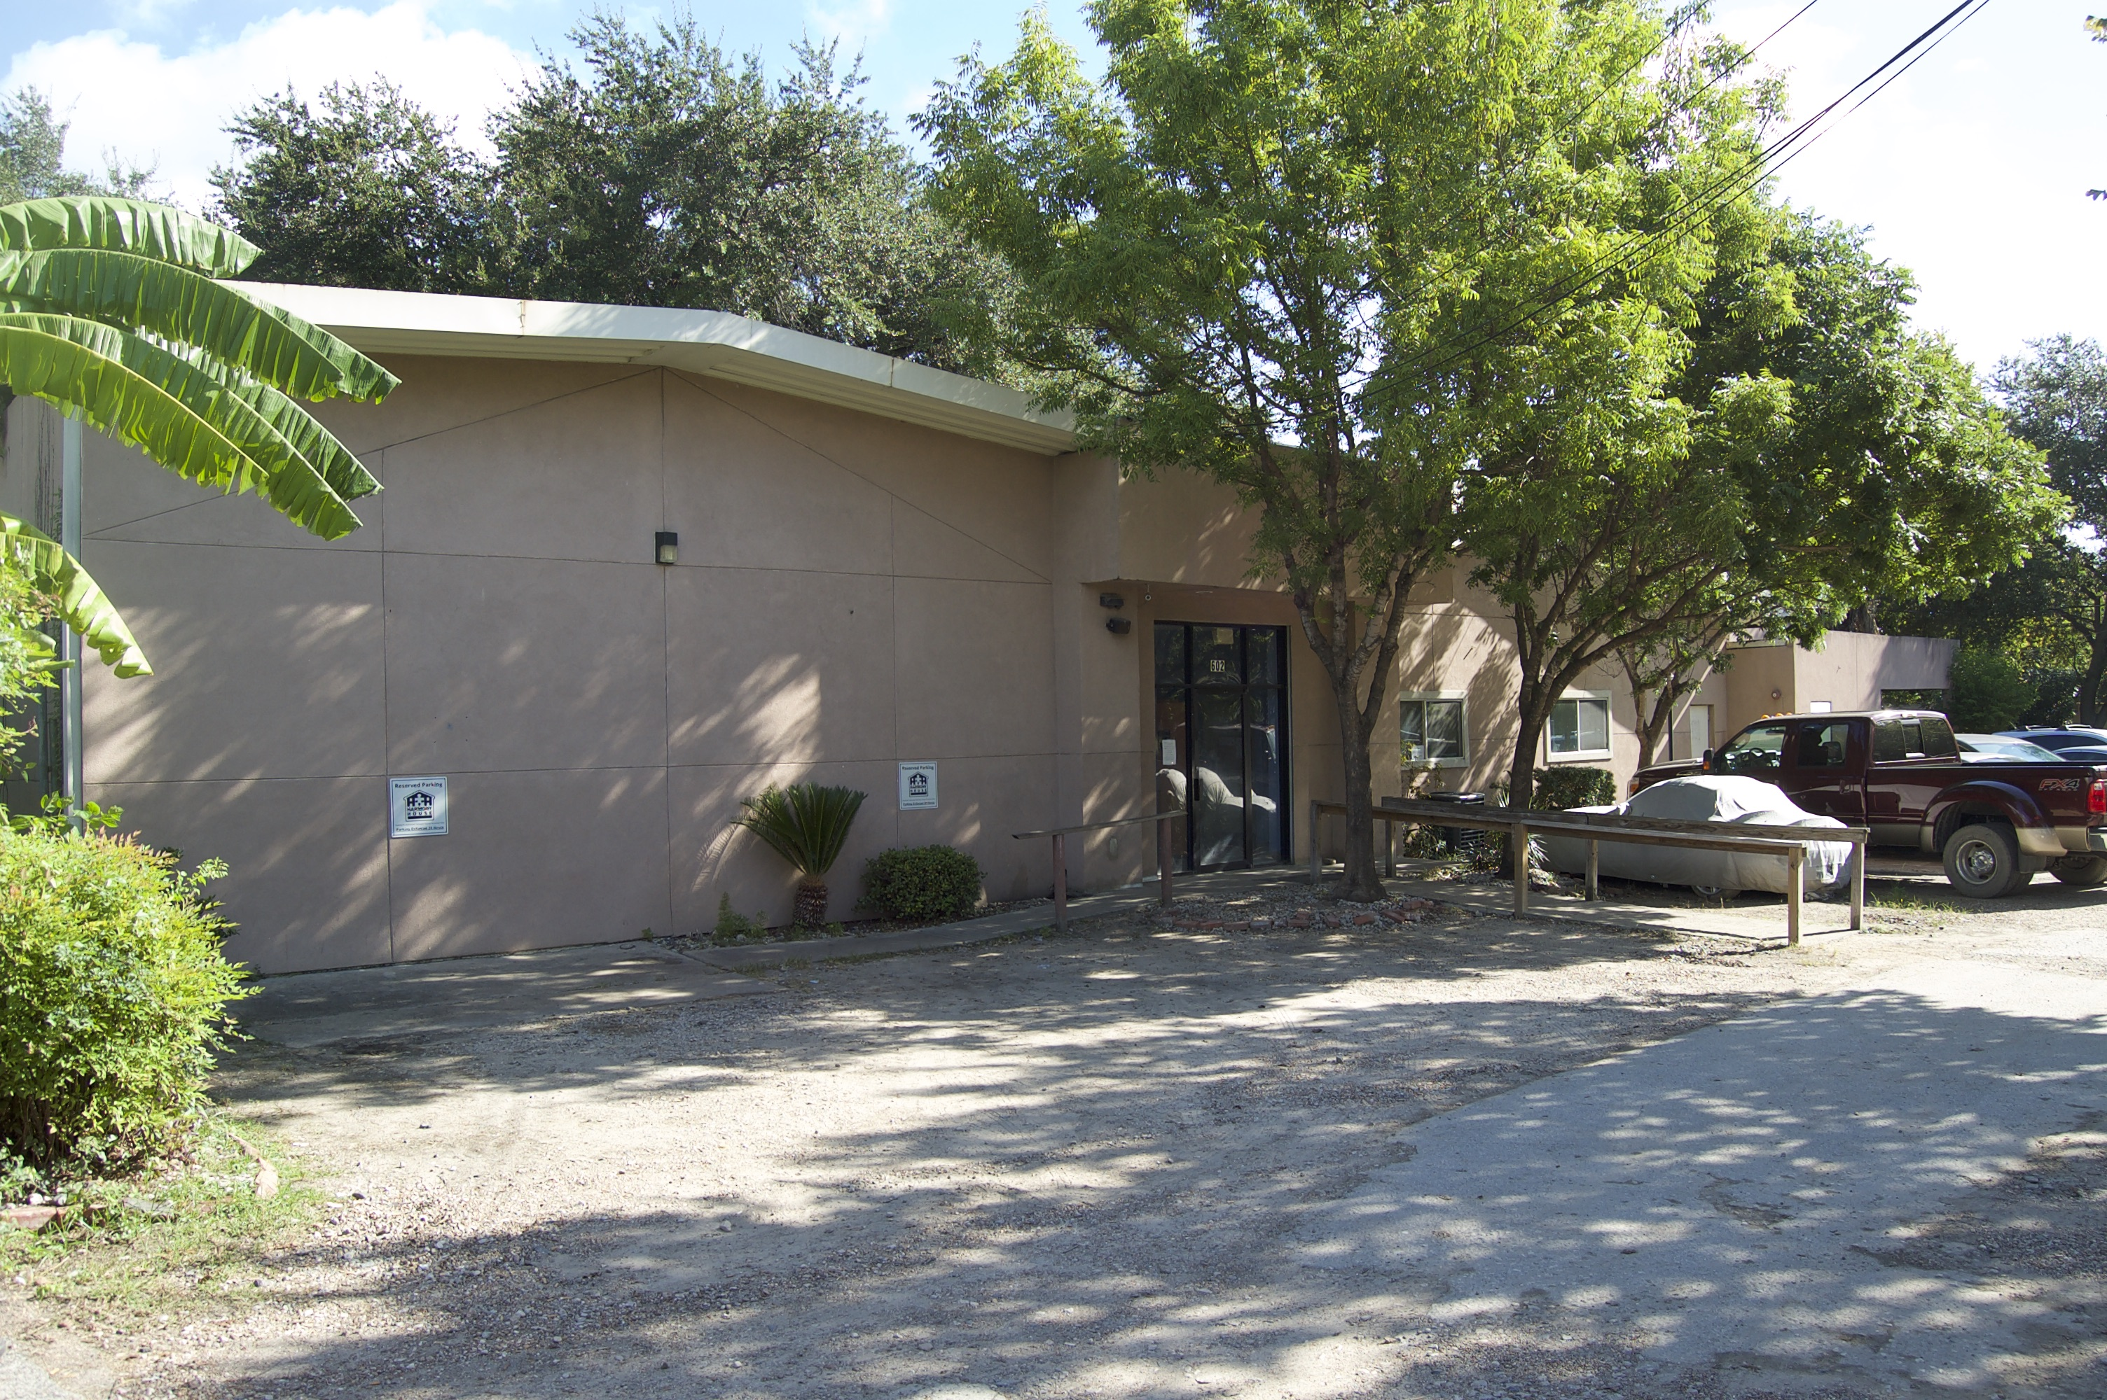
Who can live here???
ID and proof of employment

Slide 6
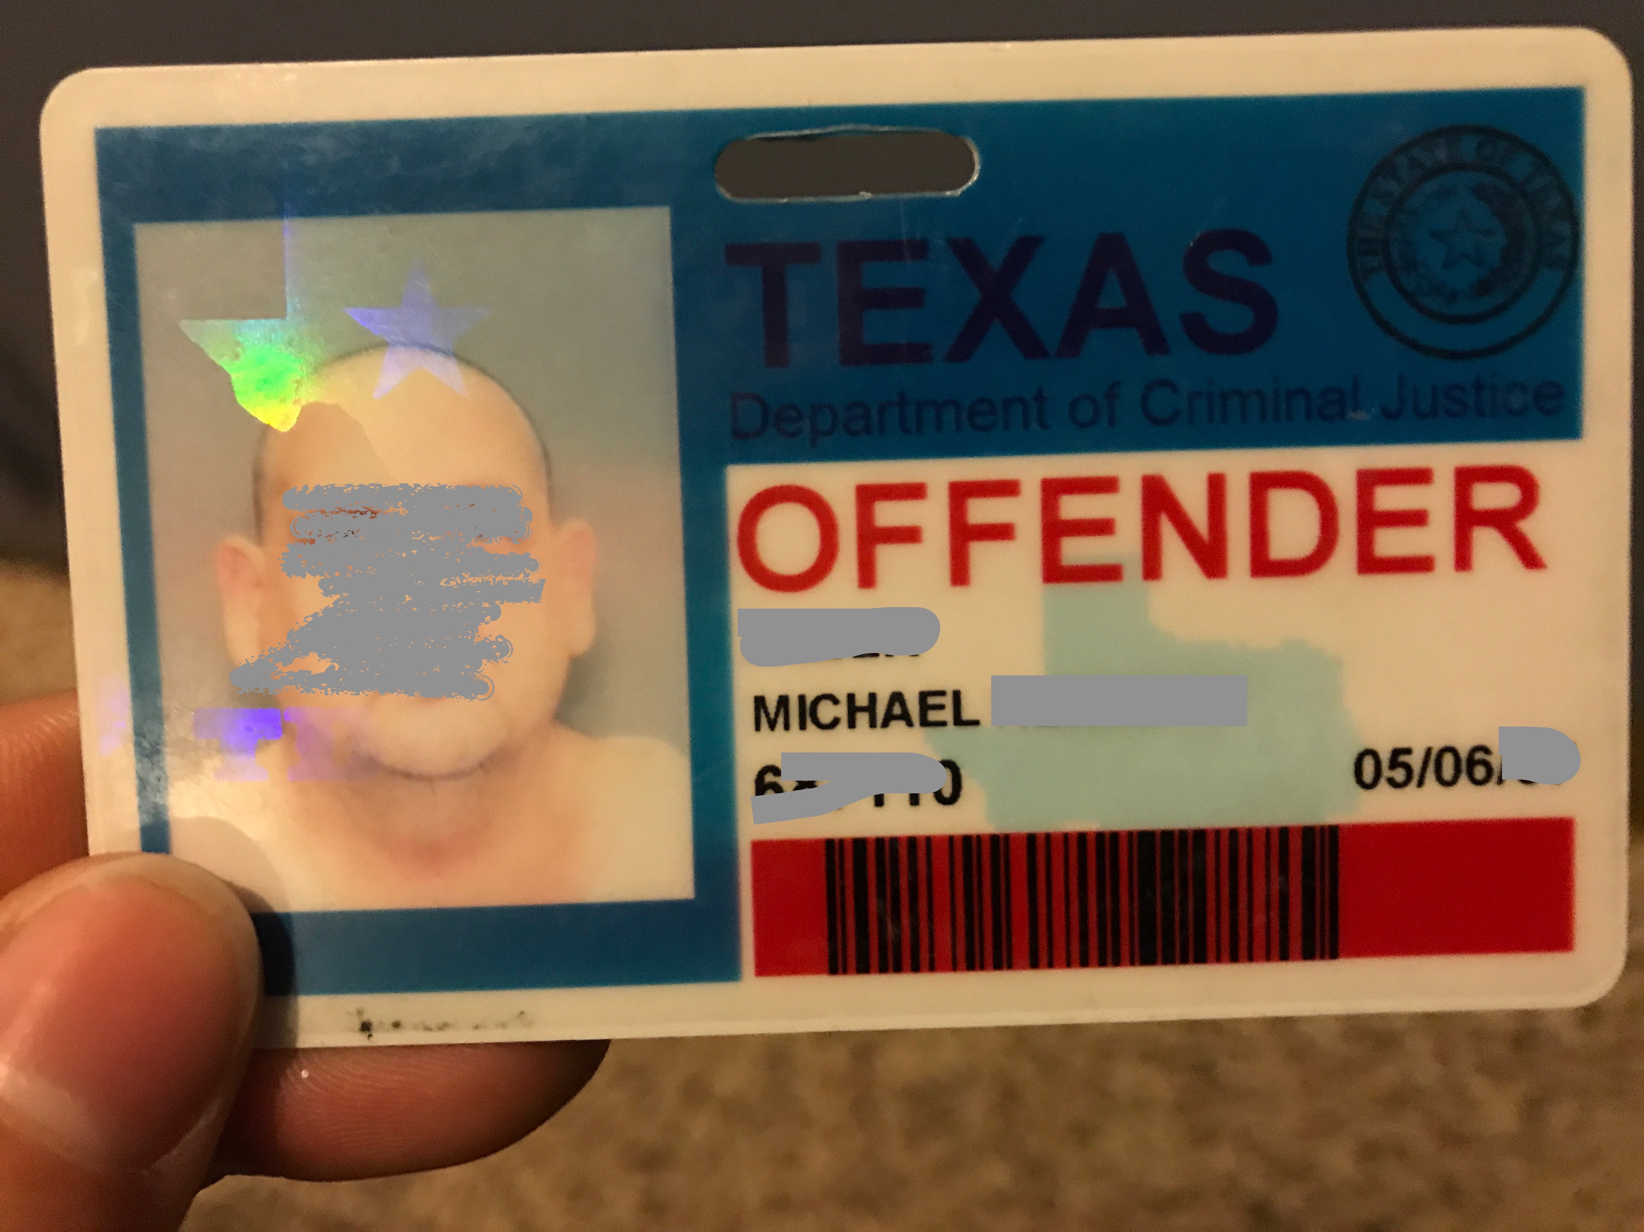
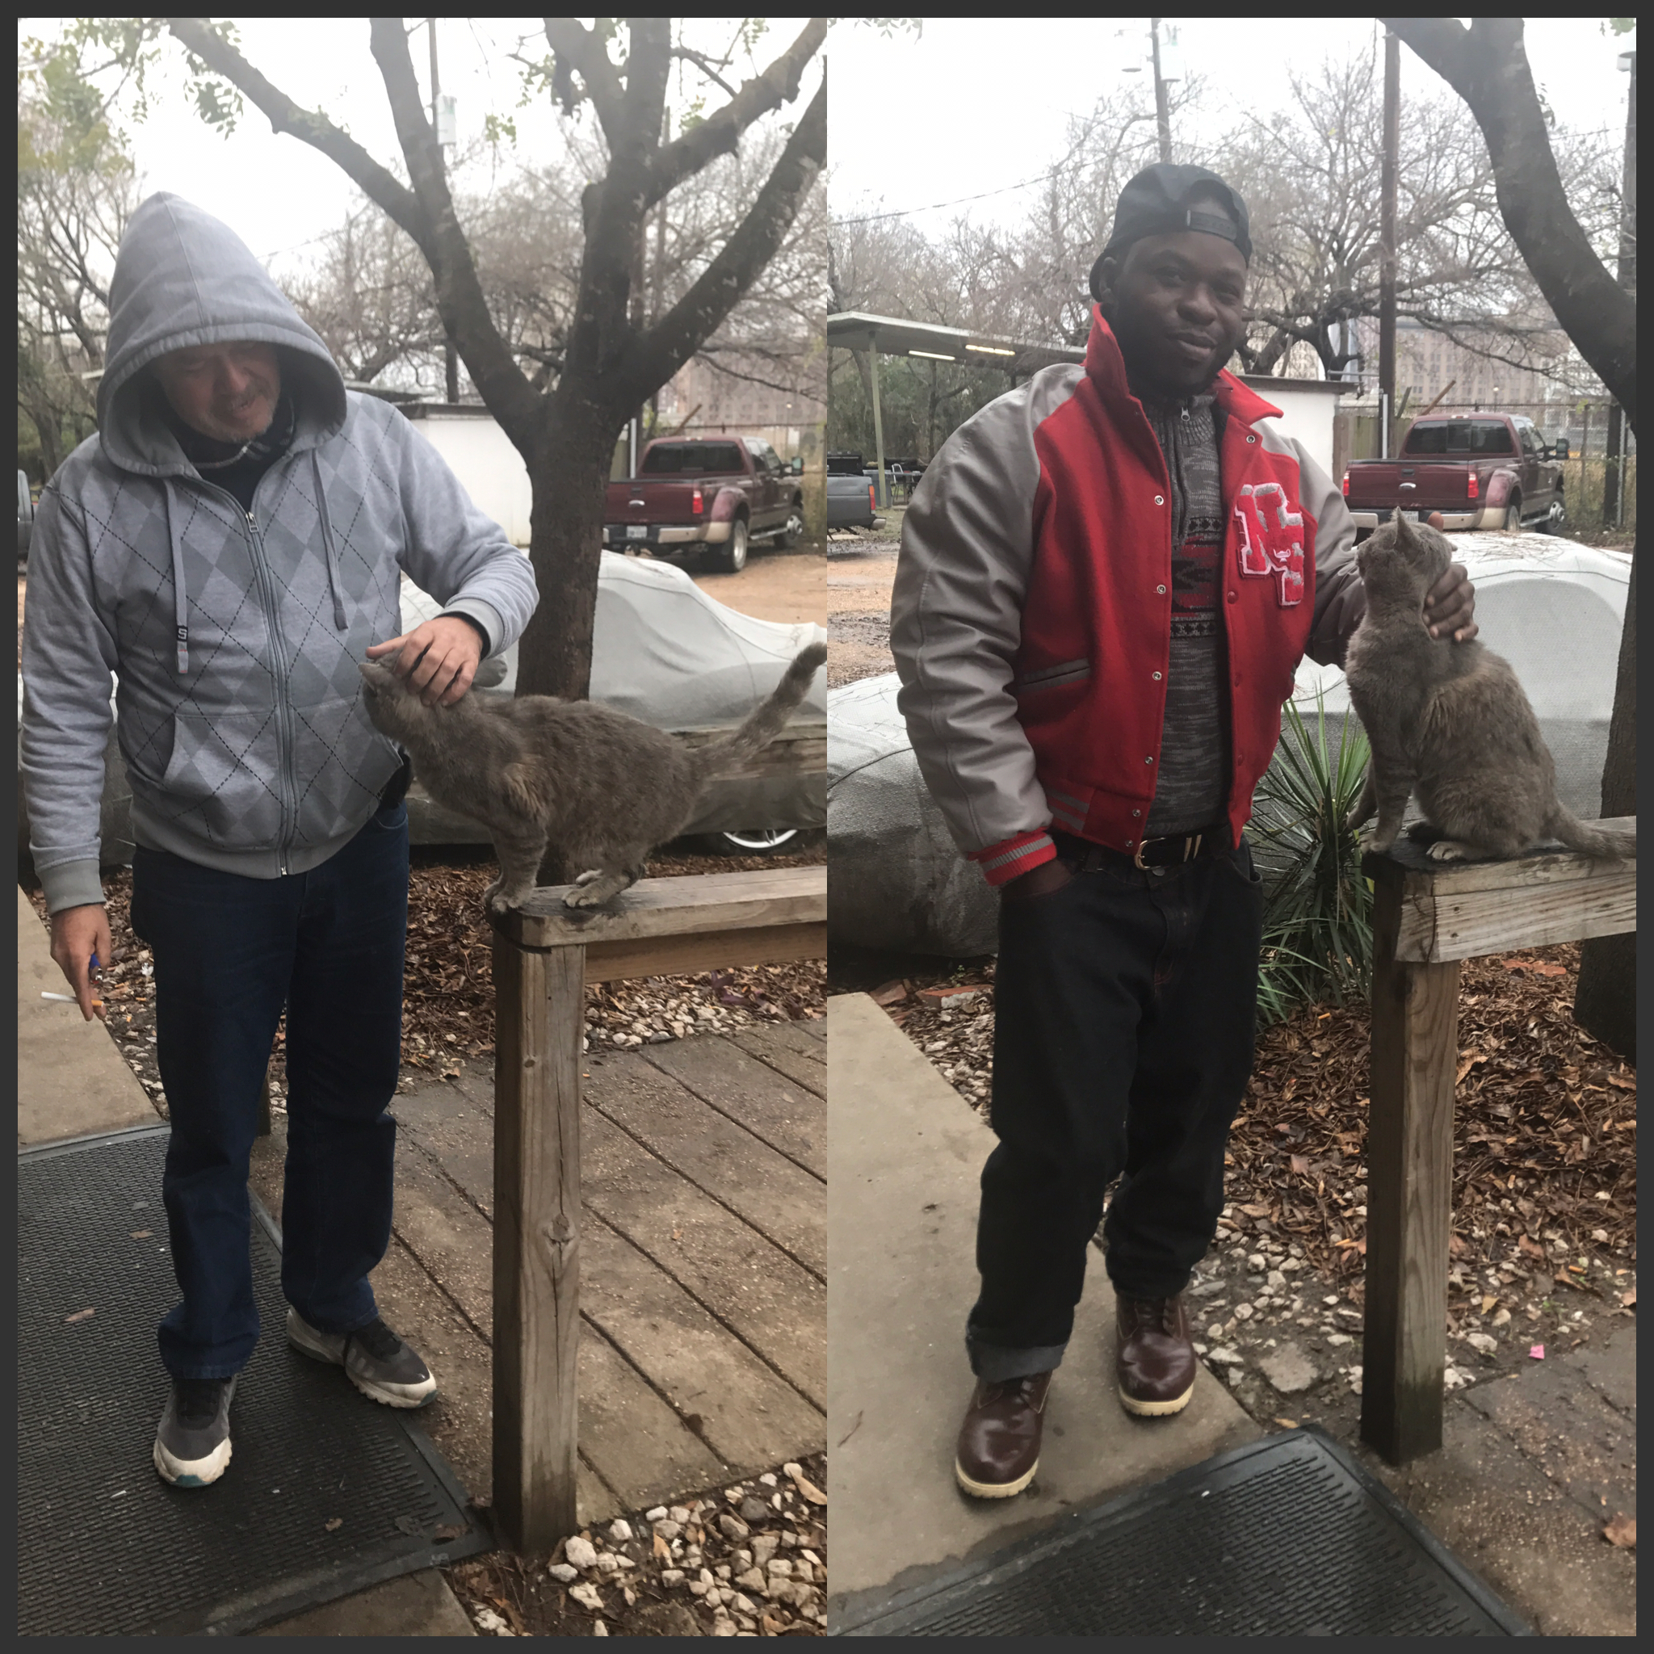
Prison Outreach
*On the Approved Alternative Housing Resource list for the Texas Department of Criminal Justice
*May parole to the Worker Dorm

Slide 7
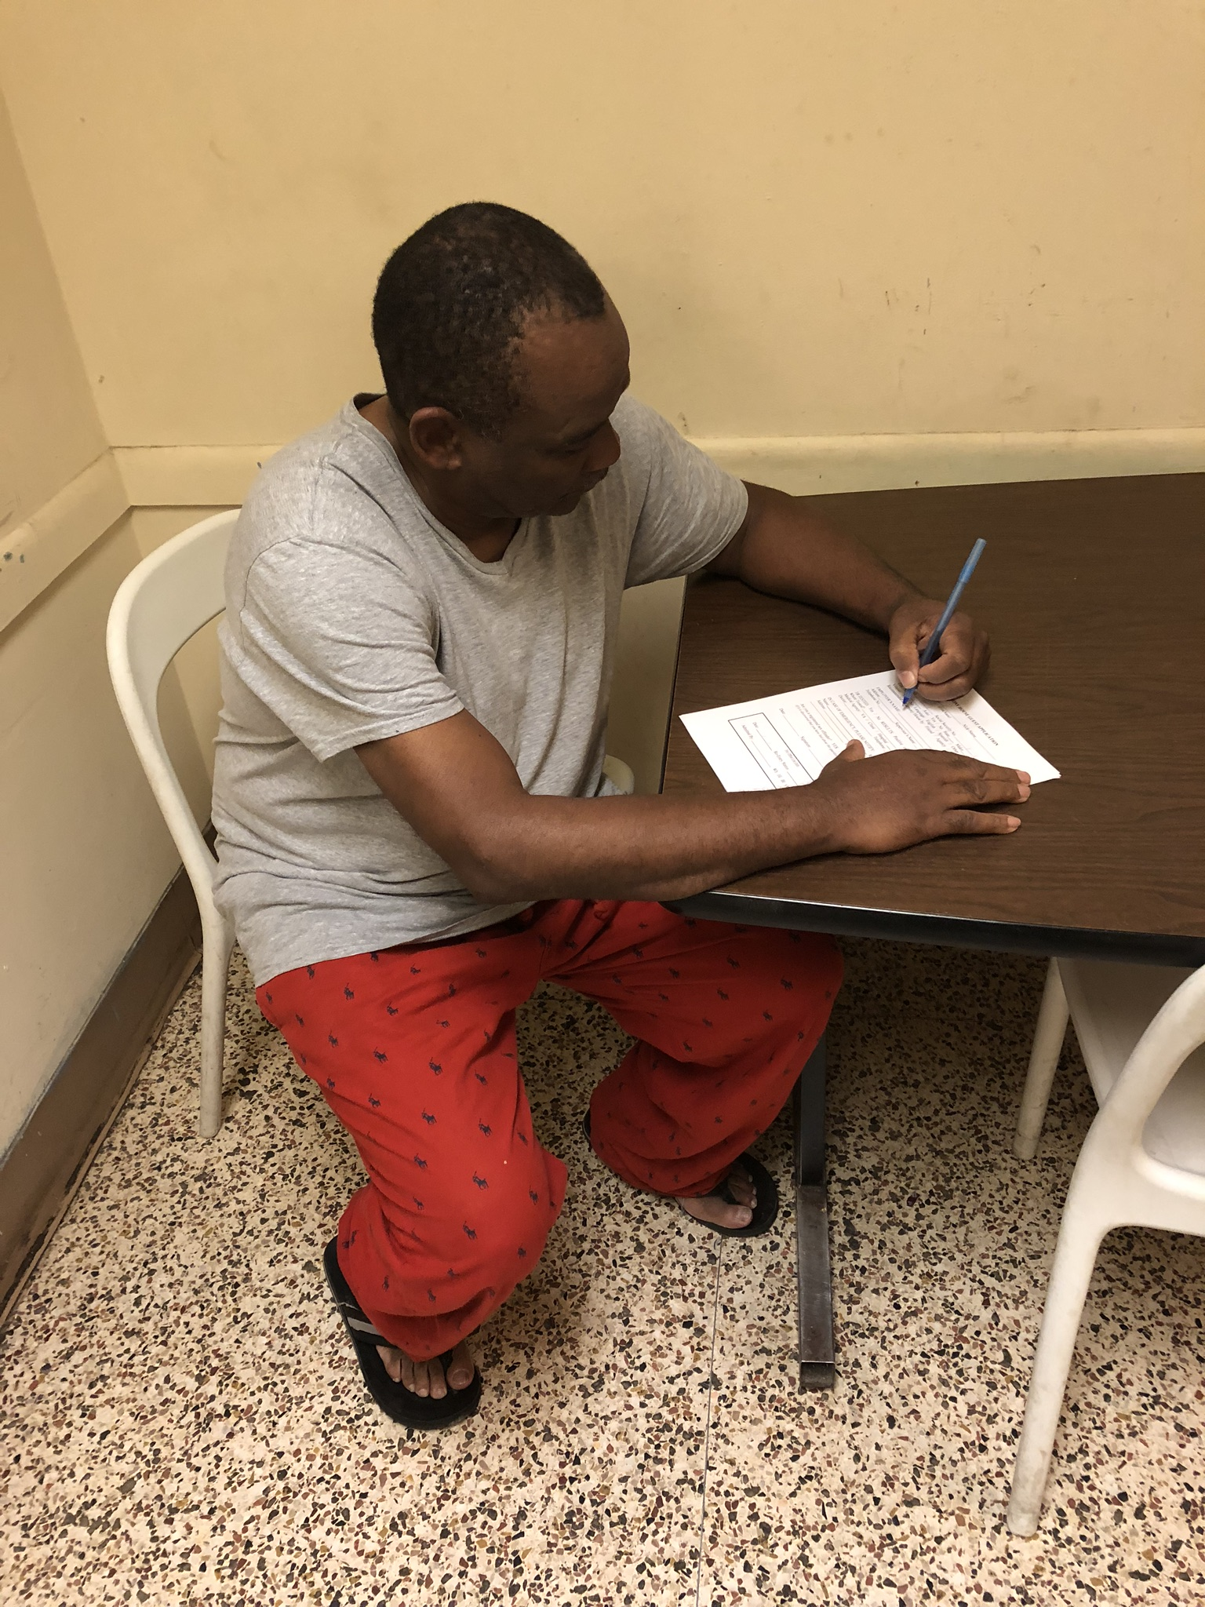
Intake Process
Identification
2 page agreement
Tour
Orientation
Wash and Hot Box
Linens

Slide 8
Staffing and Costs
No Security
Resident Care Assistant
Building Manager
General maintenance
$13/night $65/week $235/month
Self sustainable!!

Slide 9
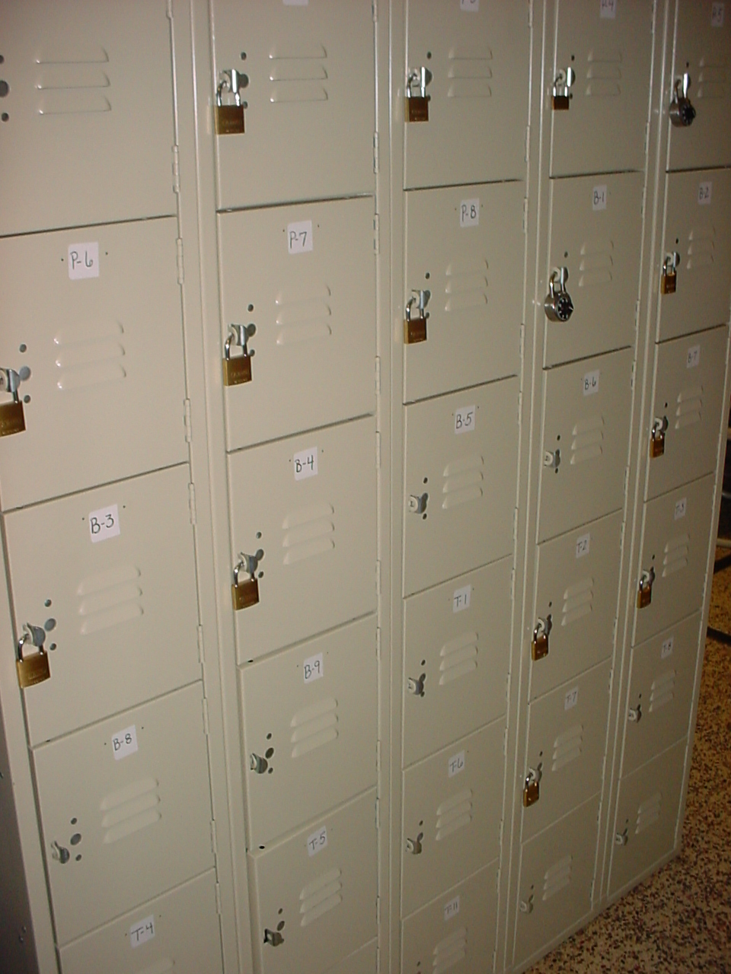
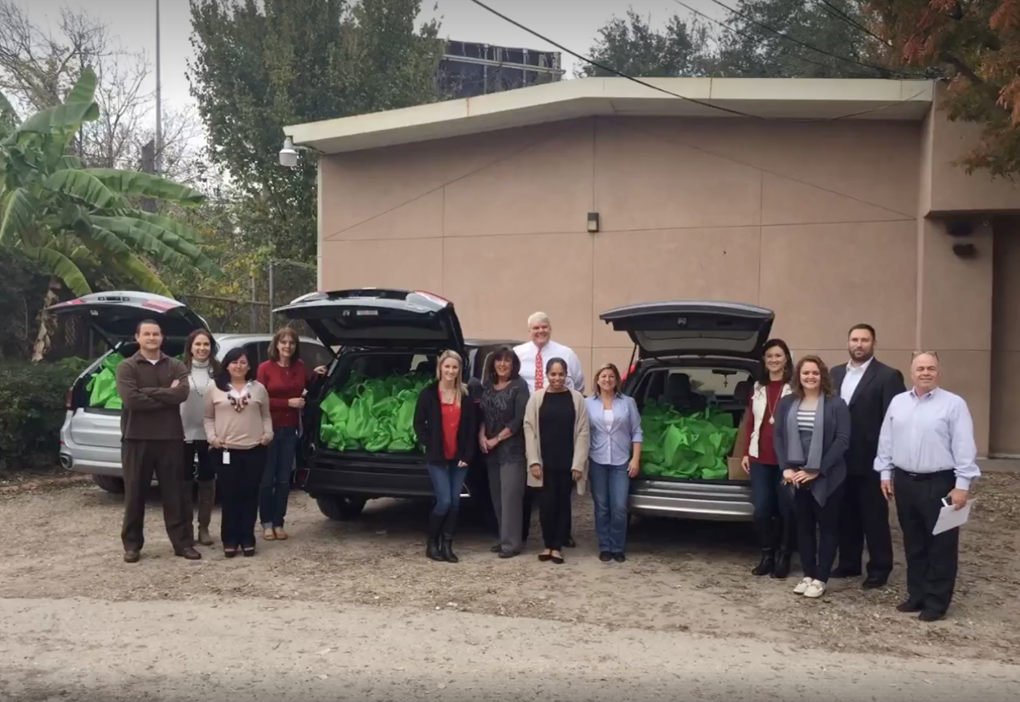
Operational Considerations
NIMBY
Pest Control
Behavioral Issues
On-site store
Security
Ordinances and zoning

Slide 10
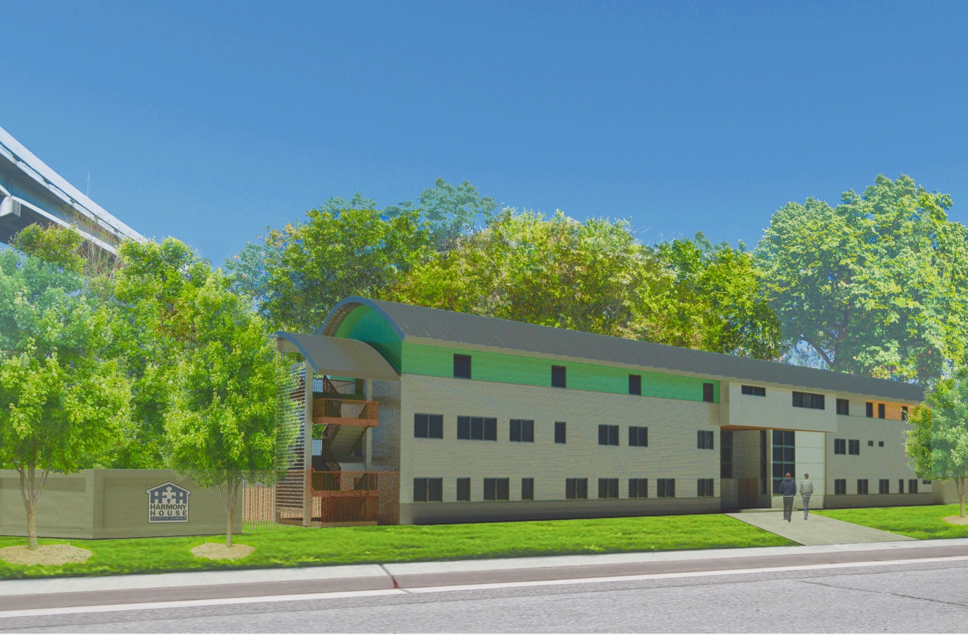
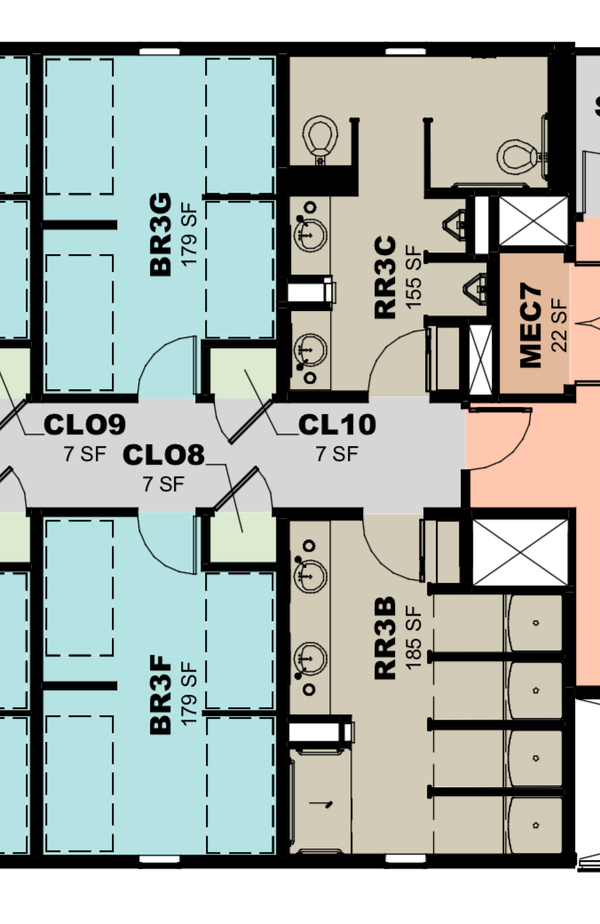
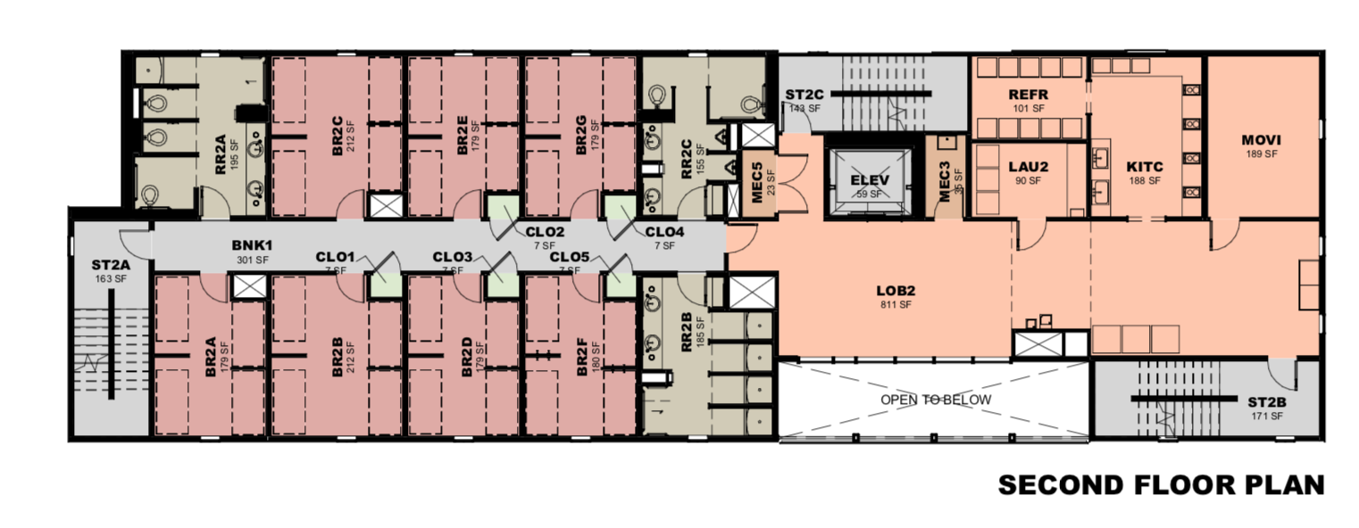
Worker Dorm 2.0
128 beds
Improved amenities
Expanded clinic and services
Life Skills
More collaborations

Slide 11
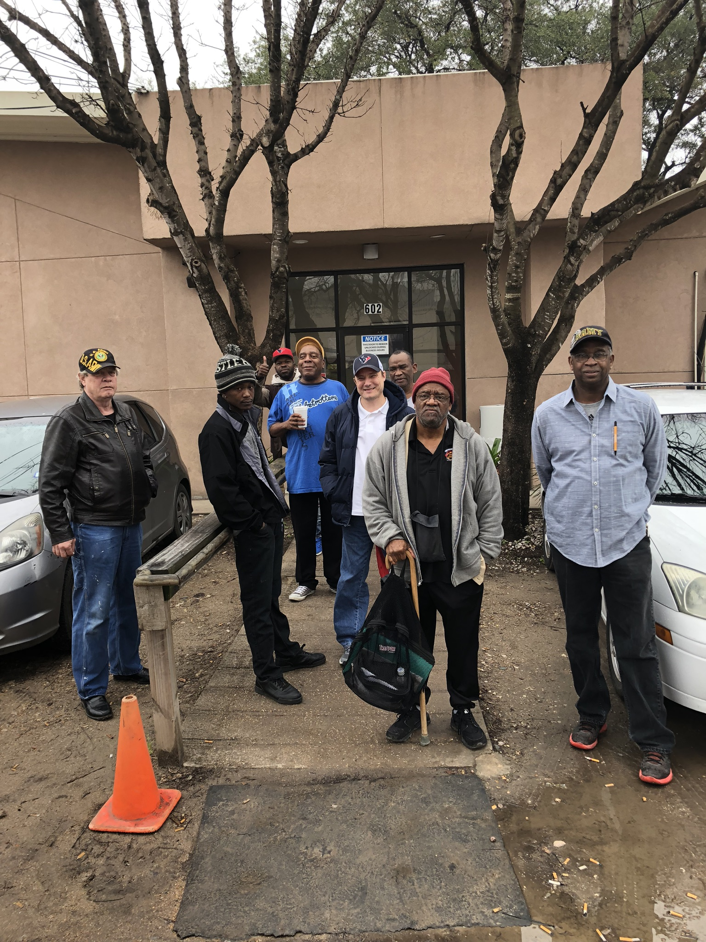
Questions???
meg_pohodich@harmonyhouse.org

