Slide 1

Combating human Trafficking:
How to Join Forces in Your community
Kathy Mustacato Wigtil, Ed.D.
Notes:
I’m here today to talk about how organizations can partner together to start a coalition to combat human trafficking in their community. How many of your already have an organization in your community that works to end human trafficking? Anyone have a coalition
designated for that purpose? Let’s start with the definition of human trafficking so that we are all on the same page.

Slide 2
Human Trafficking
Human trafficking is the fastest growing criminal industry in the world, with more than 40 million victims worldwide.
Simply put, human trafficking is any time a person is forced, tricked, or manipulated into providing labor or sexual service for someone else’s financial gain. Or, anytime a child is involved in a commercial sex act, whether or not there is someone directly forcing them to do so.
Notes:
Here is some information about human trafficking – both labor trafficking and sex trafficking. Coercion is the key element involved in trafficking but notice that for minors, there is not a requirement to prove coercion. We always say that there is no such thing as a 14 year old prostitute – that is sex trafficking!

Slide 3
Not in my city
https://vimeo.com/226361342
Notes:
So our community in the Heart of Texas decided to do something about this problem. I want you to hear about it from the representatives in our community who are partnering to say, “Not In My City.”

Slide 4
Who can help?
Turn to the person/people sitting next to you and discuss:
  Who in your community is already combatting human trafficking?
  If you are unaware of any community efforts to combat trafficking, who should be included in discussions/efforts?
  Can you think of specific people your organization could approach to begin discussions about joining efforts in order to combat human trafficking in your community?
Notes:
Take a few minutes now and turn to your neighbor and discuss the questions on the slide – who is working on this, or who can work together on this in your community? (Read the questions out loud and give everyone about 3-5 minutes to do this)

Slide 5















Participating agencies
Notes:
So here are some of the agencies in the Heart of Texas who are partnering on the coalition. (Read off organizations’ names and briefly explain what a few of them do, like JSL running the Stop the Demand School). These are just a few. but here are the key players you will need: 1. Law Enforcement - local, county, federal, 2. Courts and legal system representatives – criminal justice system, juvenile court system, lawyers and DA 3. Education – Homeless Liaisons and Social workers/counselors, 4. Health care – those who will treat victims, 5. Social service agencies, 6. Faith-based organizations, 7. All organizations that serve victims – advocacy center, crimes against children. Anyone already combating HT. History of how the coalition got started: Unboundnow Waco, approaching different entities in the community to broach the idea. Since Unbound had already been doing the work in our community, they had credibility and knew how to use data and what we had already seen in Waco to inform law enforcement, for example. Today we have 161 members of the Coalition and 113 agencies represented. You can start small but if you get key leaders in your community on board, it can grow quickly. I’ll talk more about this as we go through the slides.

Slide 6
Agencies you need to consider:
Law Enforcement
Judicial System
Education
Health Care
Social Service Organizations
Faith-Based Organizations
Any Organization that Serves Victims
Notes:
But here are the key players you will need: Think about who those contact people are in your community. It is important to seek input and buy-in from these key areas that come into contact with victims of trafficking and traffickers.

Slide 7
Steering committee Members
Community leaders in the sectors represented by the goals:
  Law Enforcement – investigation
  Judicial System – prosecution
  Identification – education, healthcare, service providers, community members
  Trauma-informed Services for Victims – mental health, service providers
Notes:
What really makes the coalition work is its leadership and the fact that each agency has an avenue or means of addressing trafficking and each agency stays in their lane, so to speak. For example, those of us working in education and prevention don’t approach traffickers and step into the role of law enforcement. And because each of these sectors: law enforcement, the judicial system, identifying and serving victims has leaders who are in the work for the long haul there is consistency among the leaders that serve on the steering committee. And that’s important for the coalition’s success. Chief Lanning says, “Check your pride at the door.” It’s what makes the coalition and its leadership work.

Slide 8
Coalition goals
1) Increase community awareness for the prevention and identification of human trafficking victims.
2) Increase investigation and prosecution of human trafficking cases at a local, state and federal level.
3) Provide coordinated, comprehensive, trauma-informed services to the individualized needs of human trafficking victims.
Notes:
So once the coalition was formed, there were three main goals that the group agreed on. You can see how the three areas that the coalition addresses align with the agencies and organizations that participate in the coalition. For example, the first goal focuses on the education and prevention and would involve our education, health care and service providers. The second goal involves all of our law enforcement, prosecution and legal partners and the third goal revolves around the services provided to victims. But it is all intertwined and overlapping so that when arrests are made for prostitution, for example, the law enforcement personnel involved understand that often the women are victims, not criminals. The other thing you will note is that these are achievable goals that get broken down into tasks through the work of the subcommittees. You will see this more on the next slides.

Slide 9
Coalition roundtable & subcommittees
The Coalition meets for quarterly roundtables to share information and increase knowledge of trafficking-related topics.
Bi-monthly subcommittees also meet to accomplish tasks in specific areas.
These subcommittees are:
  Prevention
  Protection & Prosecution (law enforcement personnel)
  Partnership
  Program Evaluation (grant funded personnel)
Notes:
Then within the coalition there are subcommittees that have specific roles and tasks that work together to support the coalition goals. These meet every other month to establish tasks that provide opportunities for all members of the coalition to participate. (Review how participates in each subcommittee and explain about the DOJ grant). And we need that – so that for our educators and health providers, we need them to be on the front lines of identifying potential victims. At the same time, law enforcement may be conducting stings and or following up on a lead (Protection & Pros – only for law enforcement). Another important aspect of the subcommittees’ work is informing our community about the problem of human trafficking and what to do if someone suspects it. The police have gotten calls from someone at a local gas station/truck stop where they witnessed a teenage girl with a trucker and called police. Another woman was at a spa in our community and when she was looking for the bathroom she opened a door and saw sleeping mats on the floor and suspected that the women that worked in the spa, who did not speak English, might be living there. She called the police and she was right and an arrest was made and the business shut down. The Limo story from Baylor student. So the subcommittees provide a way for individuals to get involved in the aspects of the work where they are the experts or the boots on the ground.

Slide 10
Coalition roundtables
Begin the meetings with each attendee sharing their name and organization
Hearing from experts in the field
Sharing evidence of how the coalition’s work is making a difference
Providing time for coalition members to connect and share their organizations’ ideas about the topic presented
These meetings have to communicate a sense of winning: How goals are being achieved
Notes:
The Coalition meets quarterly in what we call a Roundtable.
And that name is intentional because we understand that no one agency or organization has a more important role than any other in the fight against human trafficking. It takes everyone working together and doing what they do best. These meetings help coalition members see that they are making a difference. At these roundtable meetings we hear from experts in the field that are making a difference as well as have time to talk at our tables about what our agencies are doing, or to give input on an issue. We have heard from survivors of trafficking who shared what was the most helpful to them and from the lead detective on investigations about their work to train other law enforcement agencies about this work. The bottom line is that involvement in the coalition has to be a win for everyone, not just one or two lead agencies – we all feel that we have an important part to play in the coalition’s work to combat human trafficking.

Slide 11
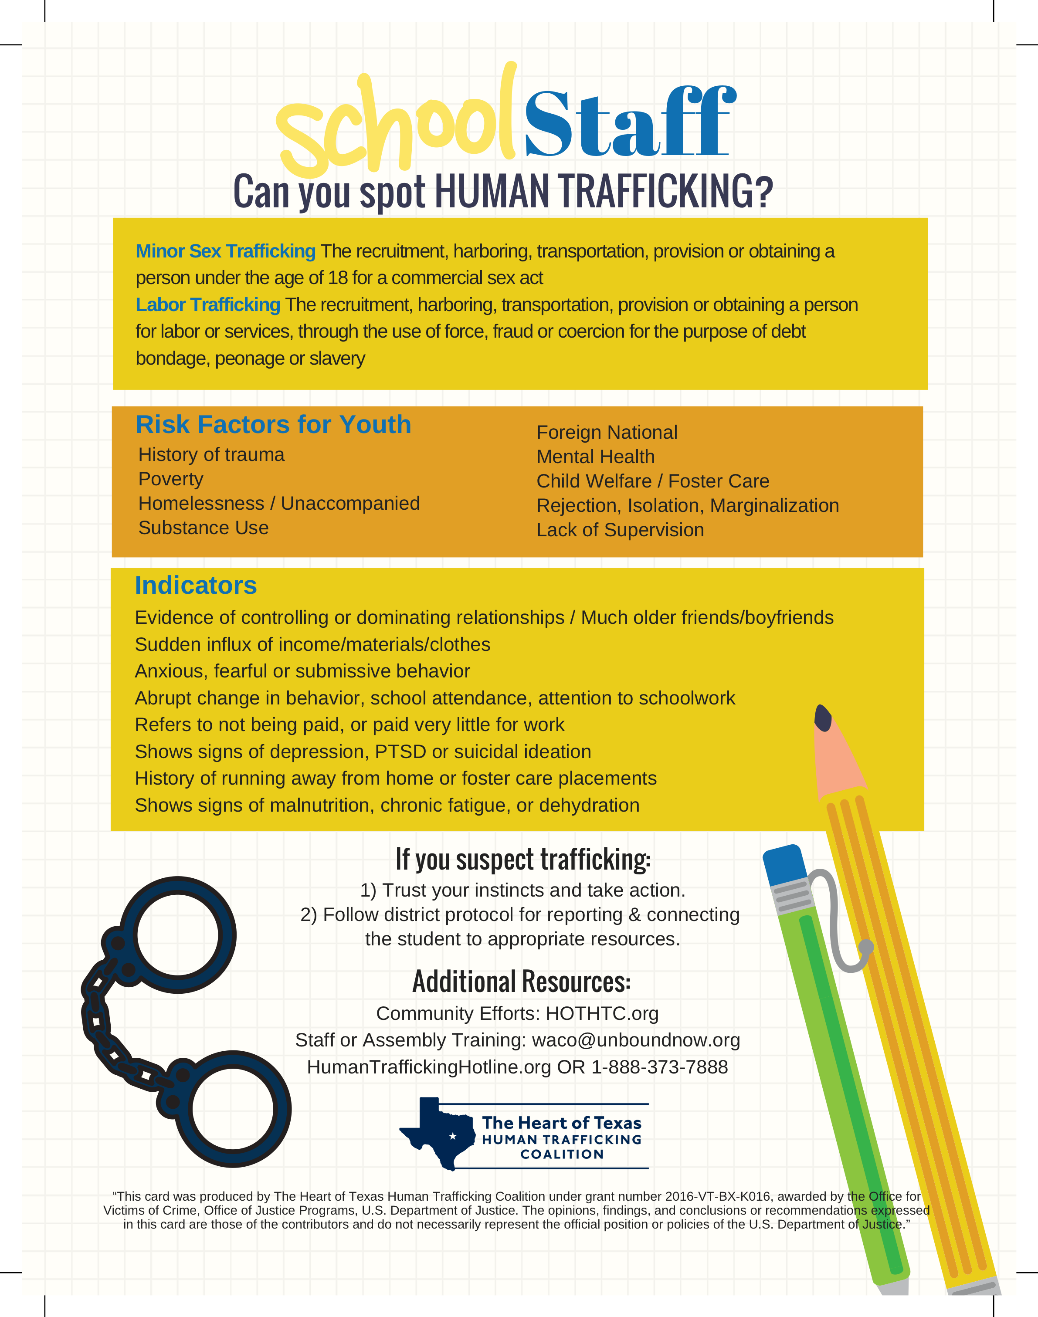
Coalition events and Programs
Notes:
Here are two examples of some of the programs the Coalition sponsors to spread awareness in our community. January – National HT Awareness month – pick a Sat. to meet in the counties represented by the coalition and post flyers in areas like motels, truck stops. Etc. We also have hosted Teacher Nights – dinner and a presentation and presentations on campuses and at the Region 12 Education Service Center as part of educator trainings.

Slide 12
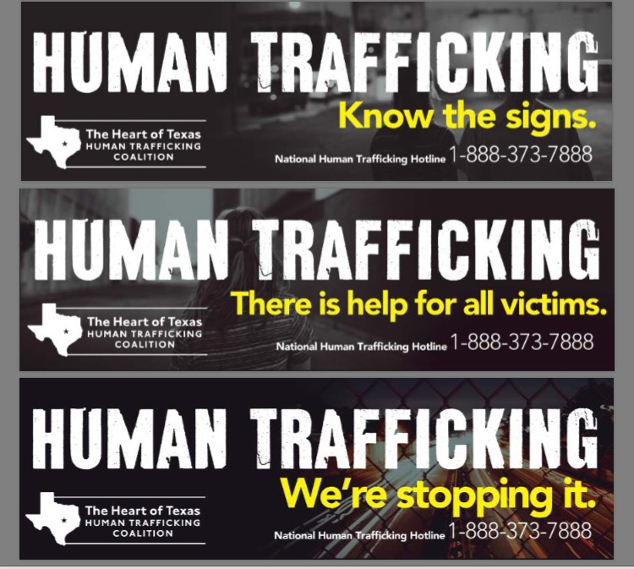
COMMUNITY BILLBOARDS
Notes:
These are three of the billboards the Coalition has in our community – at least one along Interstate 35 through Waco. And the cool thing is that a company donated the space – we don’t pay for it.

Slide 13
Human trafficking arrests
Between 2016 – 2018, 64 arrests including:
  promotion of prostitution
  trafficking of persons
  conspiracy to commit human trafficking
  engaging in organized criminal activity
  online solicitation of a minor
  trafficking of a minor
Results:
  64 years of probation
  61 years of state jail time
  46 months of federal jail time
Notes:
So here is some data to show the results of the coalition members’ work from a law protection and prosecution perspective.

Slide 14
Victims served
FY 2016 – FY 2019 (8/1/19)
2017
70
2018
123
TOTAL
297
(as of 8/1/19)
2019
104 (as of 8/1)
Notes:
And here is a look at the coalition member agencies’ work to serve victims of human trafficking – both labor trafficking and sex trafficking. These services involve crisis intervention, medical care, mental health treatment, financial assistance with housing and food, for example. Legal services, transportation, ongoing case management and social service advocacy.

Slide 15
victim services provided
Services Provided
Emotional/moral support (informal counseling)
Housing/Shelter Advocacy
Financial Assistance
Personal Items
Ongoing Case Management
Crisis Intervention / 24 hour hotline
Notes:
The most utilized services are the ongoing case management, housing and rental assistance, emotional and moral support as well as crisis intervention and mental health treatment. This is why we need all of our community organizations working together – it is not just law enforcement, not just education but all of our service providers are needed to assist victims.

Slide 16
How Can Your Community start a human trafficking coalition?
Engage with others who are passionate about addressing this issue
Identify key “players” in your community: Law Enforcement, Judicial, Education, Faith-based Organizations, Social Service Agencies
Host training opportunities for Educators, Law Enforcement, Medical Staff and Homeless Shelters to become more proficient in understanding and recognizing the signs of human trafficking.
Notes:
So, how can your community begin to address the need to fight human trafficking in your area? The first step may be determining how your organization can partner in your community. So, going back to an earlier question: can you think of key individuals in these areas (law enforcement, the judicial system, education, social service and faith-based agencies and organizations) who you could approach about joining efforts to combat trafficking? STOP RIGHT NOW AND WRITE DOWN SOME NAMES.
Finally, would it be helpful to have someone conduct trainings – with law enforcement, for example? That could be a great first step.

Slide 17
Questions & Contact information:
Unbound – Waco, Houston, Fort Worth, College Station/Bryan
Search internet for Human Trafficking Task Forces or Coalitions in your area.
Kathy M. Wigtil, kathy_wigtil@alumni.baylor.edu
QUESTIONS?

