Slide 3
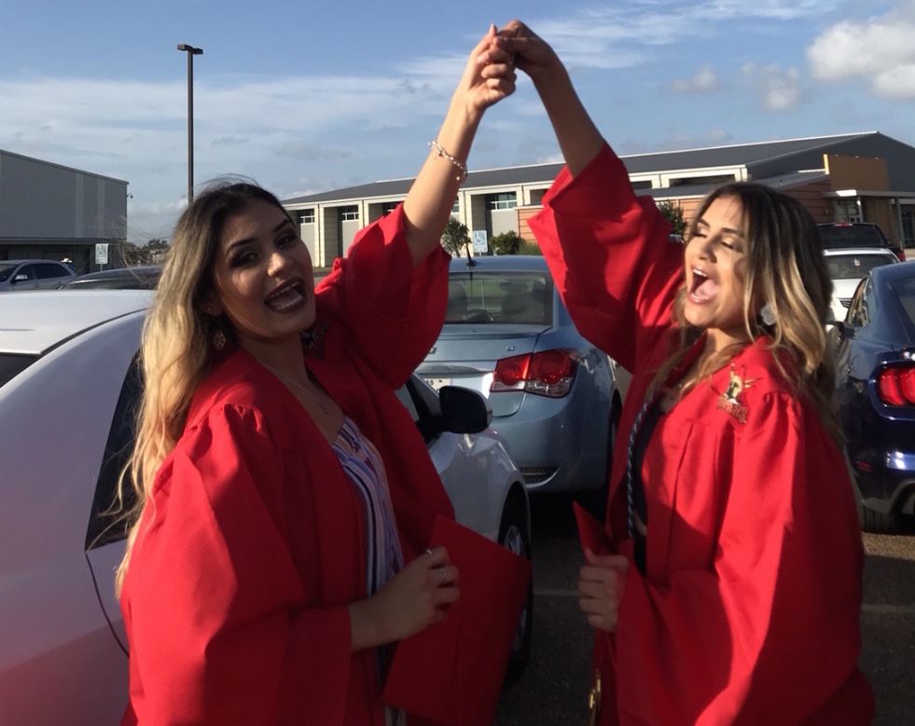
The mission of TNOYS is to strengthen services and support for Texas youth and families to help them overcome challenges and achieve healthy development.

Slide 4
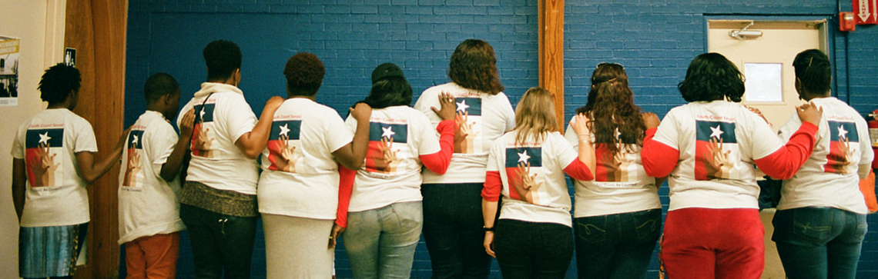
TNOYS members share a vision of Texas where all youth and young adults in Texas are valued, their strengths are recognized, their voices are heard and respected, and they have access to the resources, opportunities, and support they need to meet their goals.

Slide 5
TNOYS APPROACH
Our work is guided by a comprehensive systems change approach:
Policy
Practice
Partnership

Slide 6
TNOYS APPROACH
We provide an array of services:
Across youth-focused systems:
Focused on four priority areas:
Membership Program
Youth Engagement Program
Public Policy Advocacy
Training and Program Development
Leadership and Organizational Development
Experiential Learning Camps
Equity and Inclusion
Youth Voice and Youth/Adult Partnership
Research & Performance-Driven Policy and Practice
Cross-Systems Collaboration

Slide 7
What Is a Host Home?

Slide 8
What Are Host Homes?
“Host homes are an intervention for youth who are currently experiencing homelessness for a variety of reasons, including family conflict, poverty, gender identity and sexual orientation.” – Point Source Youth Host Home Handbook

Slide 9
Lived Experience
Charles Batiste

Slide 10
Host Homes in Texas

Slide 11
Giving youth experiencing homelessness a safe place to thrive.
Kathy Mustacato Wigtil
kathyw@thecovewaco.org

Slide 12
Bridge2Home A Host Home Model Program Carol Dunlap cdunlap@valleyyouthhouse.org

Slide 14
SIX ELEMENTS OF SUCCESS:

Slide 15
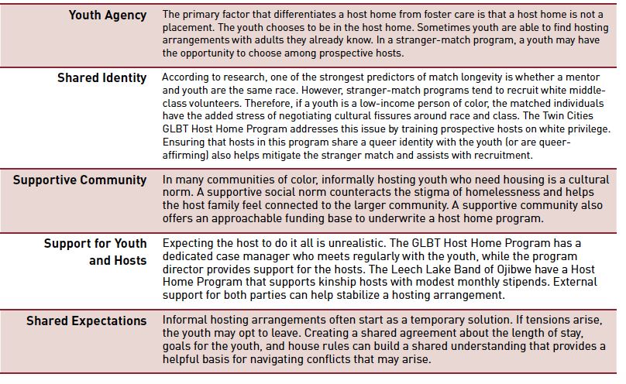
Minnesota Host Home Network (CloseKnit): www.Mnhosthome.net 6 Best Practices

Slide 16
AVENUES FOR HOMELESS YOUTH

Slide 17
Notes:
To put it into simple, clear words, I like the way True Colors explains it: Authentic Youth Collaboration, where it isn’t just tokenism. I especially like their motto: Nothing about us without us. And we know that the most students most vulnerable to homelessness are those represented in special populations.

Slide 34
CONTACT US OR JOIN OUR MAILING LIST!
rbrownlie@tnoys.org
www.tnoys.org/subscribe

