Slide 1
Creative Case management with homeless clients with chronic & persistent mental illness
Karen Hunt, BS
512-854-3031
karen.hunt@traviscountytx.gov
Becca Hyatt, LMSW
512-854-4103
rebecca.hyatt@traviscountytx.gov

Slide 2
Travis county Mental health public defender
Established 2007
Class A/B misdemeanors & state jail & 3rd degree felonies
Legal and social services
Our staff

Slide 3
SNAPSHOT OF MHPD CLIENTS
17 y.o +
Indigent
MH & IDD
Average 51% homeless

Slide 4
Mental healtH & Homelessness
2015 US HUD assessment
564,708 homeless any given night in US
25% seriously mentally ill
45% any mental illness
4.2% general population of adults

Slide 5
Who’s in the room

Slide 6
ACTIVITY

Slide 7
A day in the life of mhpd case management it’s all about relationships
https://vimeo.com/147862313

Slide 8
How do we define success

Slide 9
how do we define success
You
Program administration
Community
Clients
Activity

Slide 10
What comes to mind?
NASW Standards for Social Work Case Management
https://www.socialworkers.org/LinkClick.aspx?fileticket=acrzqmEfhlo%3D&portalid=0

Slide 11
Case Management is a collaborative process of assessment, planning, facilitation, care coordination, evaluation and advocacy for options and services to meet an individual’s and family’s comprehensive (…) needs through communication and available resources to promote patient safety, quality of care, and cost effective outcomes.
- Case Management Society of America
https://www.miccsi.org/wp-content/uploads/2017/03/CMSA-Standards-2016.pdf

Slide 12
Core components of case management
Engagement
Assessment
Planning
Facilitation/linkage
Care coordination
Advocacy
Disengagement

Slide 13
Engagement
A process where the case manager establishes a relationship through the use of personal narratives, consistent presence in the community and follow through which assists the client in being well informed about, and motivated to be involved in their own: …treatment/legal case/mental health

Slide 14
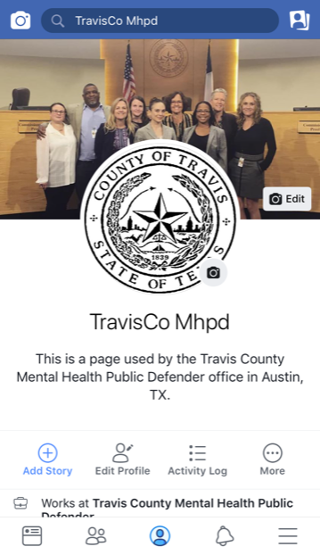
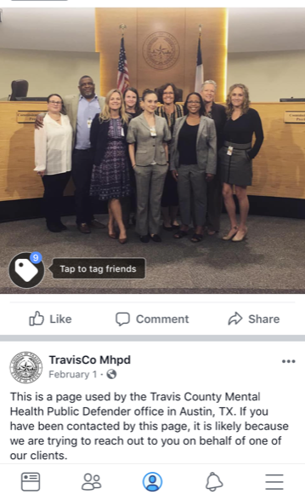

Slide 15
Assessment
Often involves a complete social history/needs assessment to determine clients needs
Provides the case manager with a clear understanding of the client, their existing resources, and perceived barriers to meeting their needs

Slide 16
Planning
Process by which the case manager and the client identify and rank problems needing resolution, establish agreed upon immediate and long-term goal, and decide upon a treatment process and the resources to be utilized

Slide 17
Facilitation/Linkage
Connecting the client with an agency/program that can provide the needed service or resource. May entail the case manager simply identifying the agency, perhaps initiating contact, or perhaps even accompanying the client to the agency and advocating for the client to obtain the needed service or resource

Slide 18
Care coordination
Involves the case manager keeping track of the client's progress through the case management plan. It may focus on the treatment continuum, ensuring that a seamless transition is made from service level to service level. It also entails evaluating the client's success in obtaining the services and resources outlined in the plan that can sustain the recovery process.

Slide 19
Creative Care coordination
Office as mailing address
Storing vital documents
Snacks, water
Clothing closet
Phone charger station in lobby
Transportation assistance

Slide 20
Advocacy
The case manager morally represents the client and assertively helps him or her obtain the services or resources they are entitled to

Slide 21
Disengagement
Ideally, can take place over time. The case manager and client can discuss what the client learned from interacting with different service providers and be encouraged to continue accessing the resources the client needs in life

Slide 22
Core components of case management
Engagement
Assessment
Planning
Facilitation/linkage
Care coordination
Advocacy
Disengagement

Slide 23
Mental healtH
Having a conversation
Connect w/ provider
Crisis services
Psychiatric Advanced Directives (PAD)

Slide 24
Psychiatric Advanced directives
Texas PADs Statutes (1997)
Chapter 137. Declaration of Mental Health Treatment
Chapter 166. Advanced Directives Act (Power of Attorney)
Texas Estate Code Section 1104.202 Designation of Guardianship for Declarant
National Resouce Center on
Psychiatric Advance Directives:
www.nrc-pad.org

Slide 25
Psychiatric Advanced directives
A PAD is a legal document to allow the person to give instructions for future mental health treatment or appoint an agent to make future decisions about your mental health treatment. It is used when the person who created the document experiences acute episodes of mental health conditions and becomes unable to make or communicate decisions about treatment.

Slide 26
Psychiatric Advanced directives
PADs are a variation of medical advance directives (ADs), legal instruments that typically offer three types of self-directed planning of one’s own health care in anticipation of a later time of decisional incapacity:
a competent individual’s informed consent to future treatment
a statement of personal values and general preferences to guide future health care decisions
the entrusting of someone to act as a proxy decision maker for future treatment
“Nothing about us without us”

Slide 27
Unique Challenges: Medication
Understanding meds
Obtaining meds
Community prescriber or community nurse
Med storage
Understanding med resistance

Slide 28
working with your clients in the criminal justice system
Court and attorney information
Contacting attorney
46B/competency
Release plan

Slide 29
46B & Competency

Slide 30
46B & Competency

Slide 31
Unique Challenges: Housing
Not wanting it
Institutionalization
Preparedness for housing
Exploitation

Slide 32
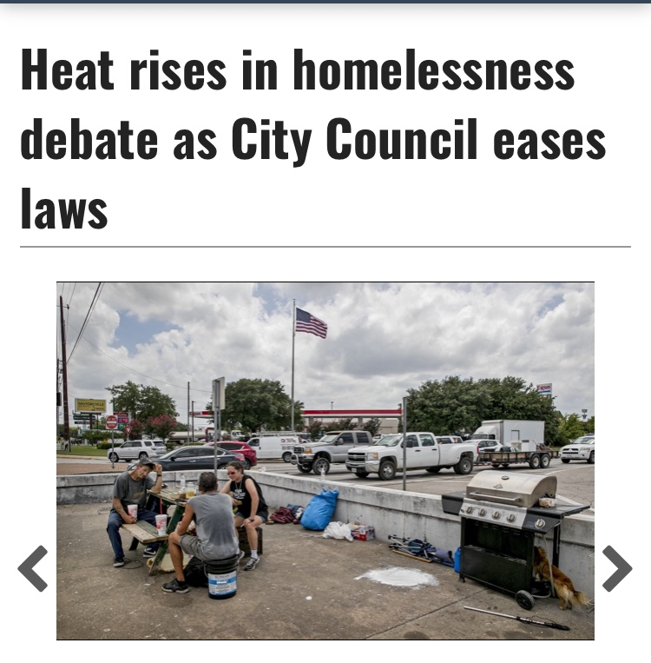
Austin’s Unique challenges: housing

Slide 33
social work code of ethics
National Association of Social Work Code of Ethics: “…the primary mission of the social work profession is to enhance human well-being and help meet the basic human needs of all people with particular attention to the needs and empowerment of people who are vulnerable, oppressed, and living in poverty.”
Charged with advocating for client’s well-being
At times this may be adverse to client’s wishes
Deck, P. (2016). Ethics—Law and Social Work: Reconciling Conflicting Ethical Obligations Between Two Seemingly Opposing Disciplines to Create a Collaborative Practice. Western New England Law Review, 38(2), 261-283.

Slide 34
Ethical Dilemmas
Medication
Housing
Guardianship
Hospitalization
What else comes to mind?

Slide 35
Ethical Dilemmas: Activity

Slide 36
Wrap-uP
Unique & complex challenges
Defining success
Case management components
Criminal justice
Ethical challenges

Slide 37
Karen Hunt, BS
512-854-3031
karen.hunt@traviscountytx.gov
Becca Hyatt, LMSW
512-854-4103
rebecca.hyatt@traviscountytx.gov
Facebook.com/TravisCountyMHPD

