Slide 1


Texas Balance of State CoC Abilene
Functional Zero for Veteran Homelessness
November 2018

Slide 2
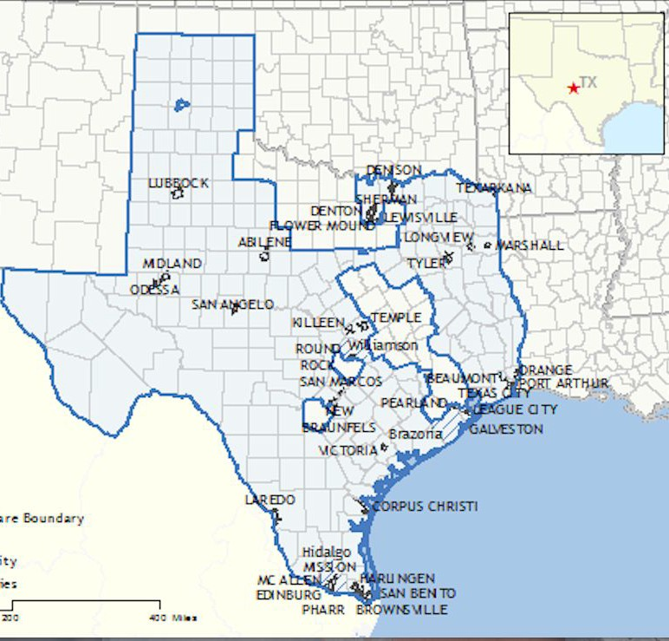
Texas Balance of State CoC - Abilene
Community Leads: John Meier and Katherine Bisson
Community Organizer: Michelle Parish, Community
Foundation of Abilene
CoC Lead: Sophia Checa
Jurisdictional Executive: Mayor Anthony Williams
VA Representative: Nicki Starkey
PHA Lead: Abilene Housing Authority
Built for Zero Coach: Dawn Moskowitz
BFZ Onsite Coach: Eddie Turner/Caitlin Bayer
Attended BFZ Learning Sessions: February, June, October 2018

Slide 3
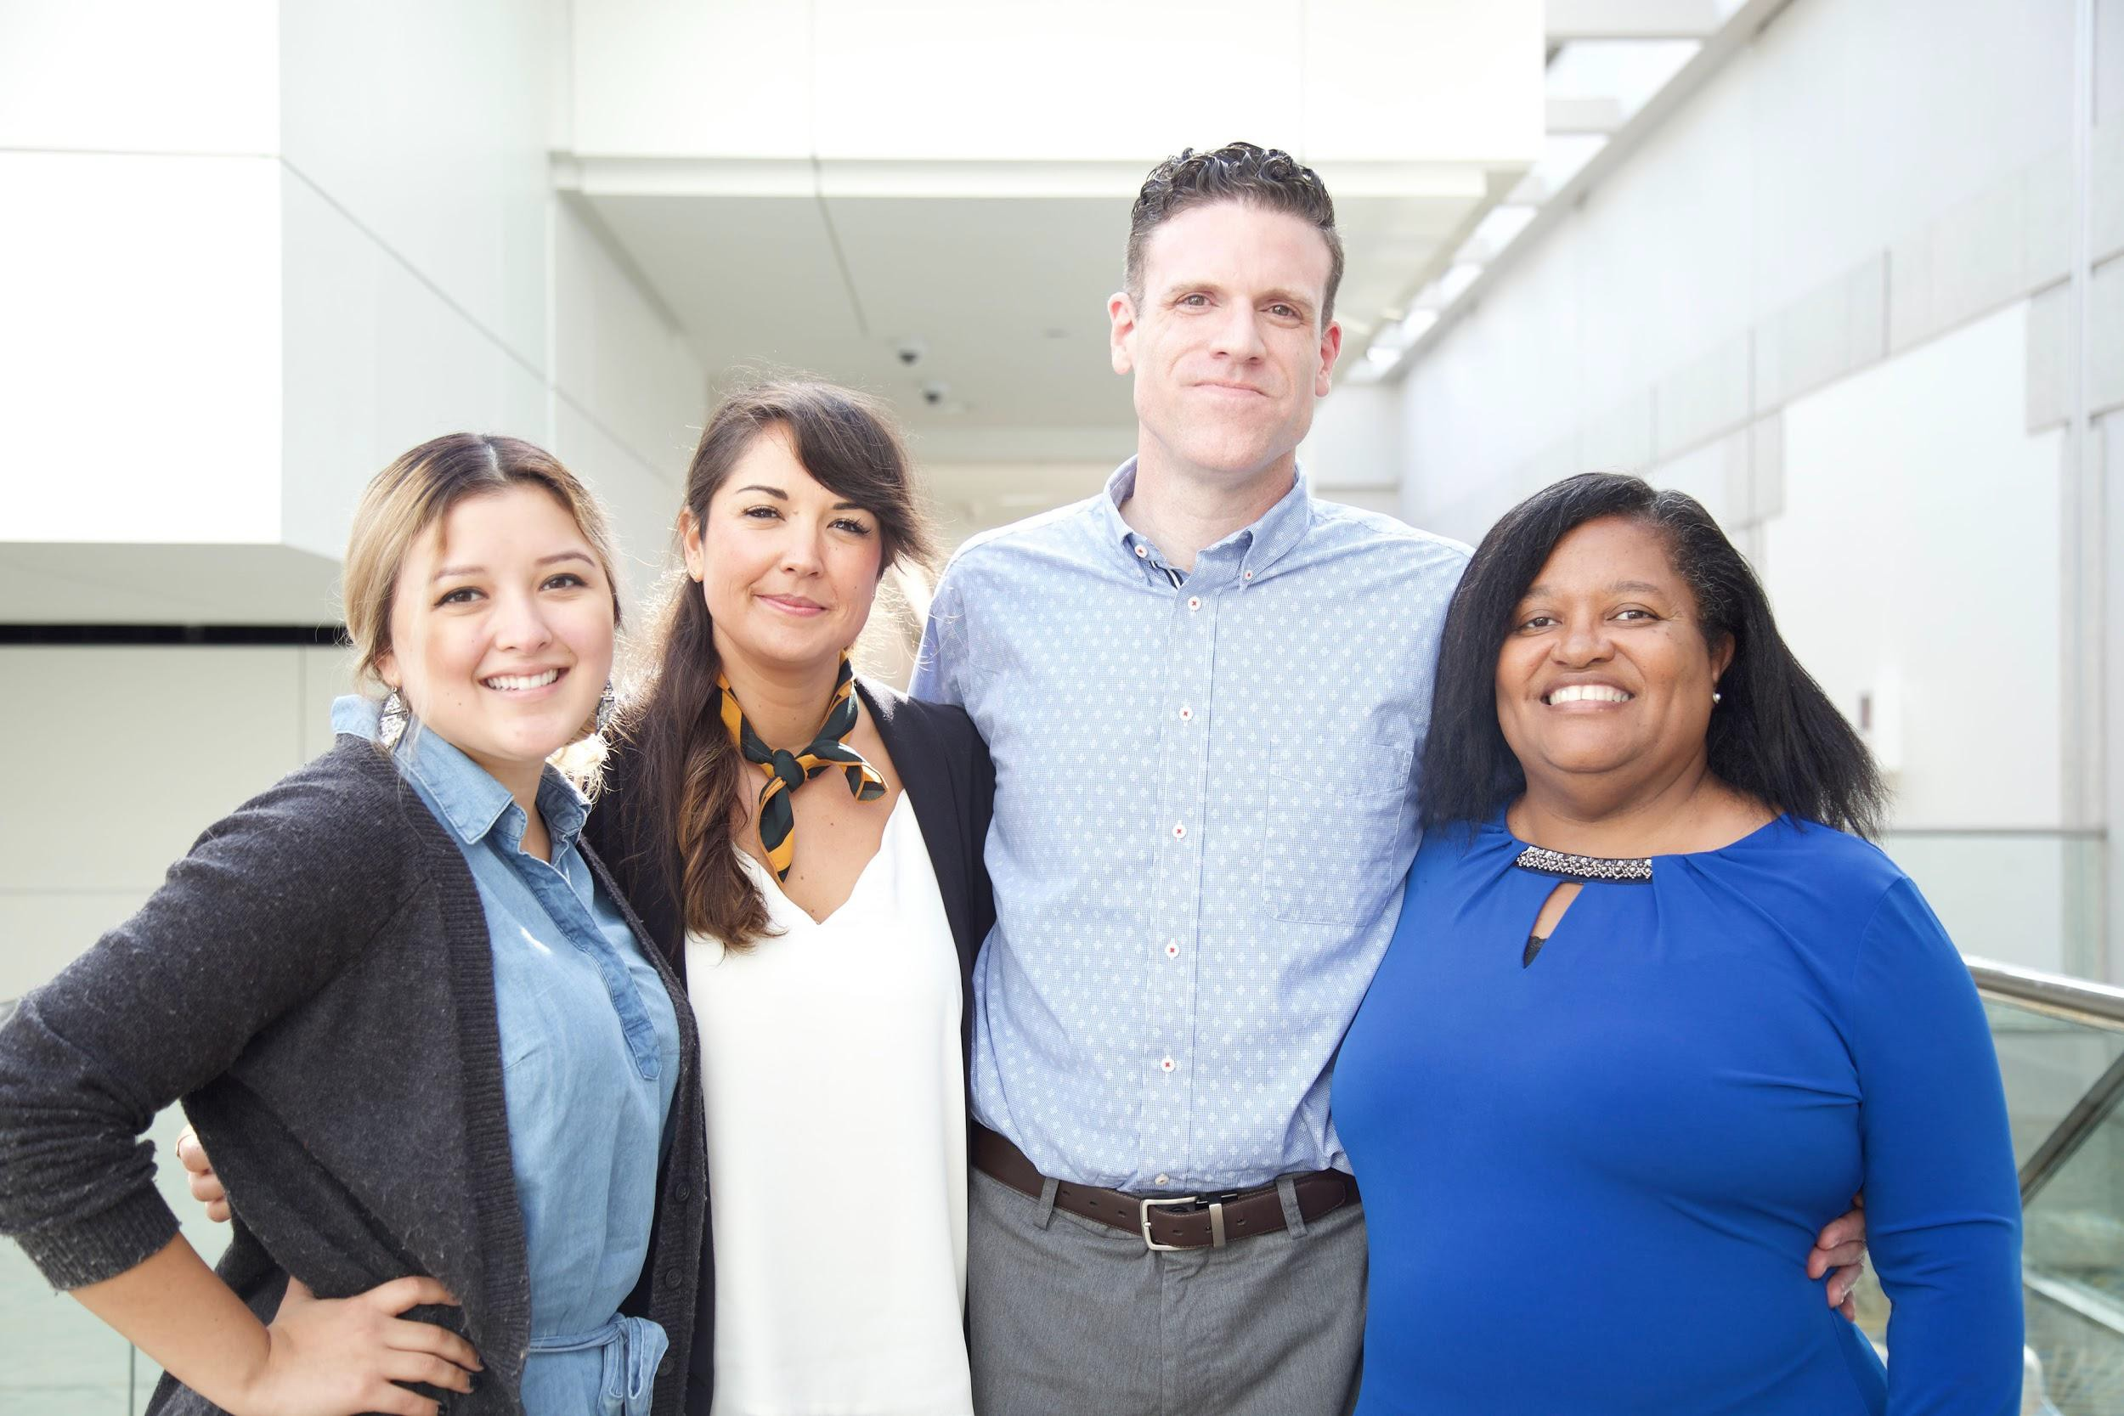
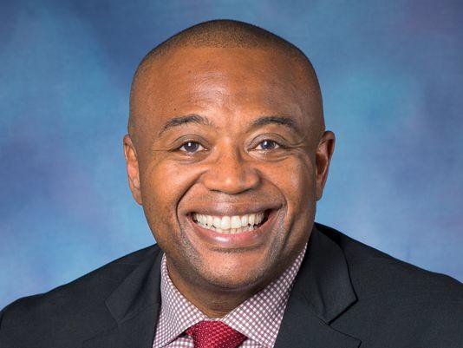
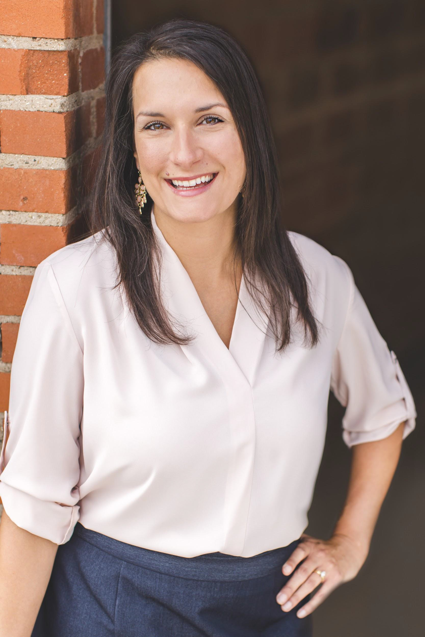
Texas Balance of State CoC - Abilene

Slide 4
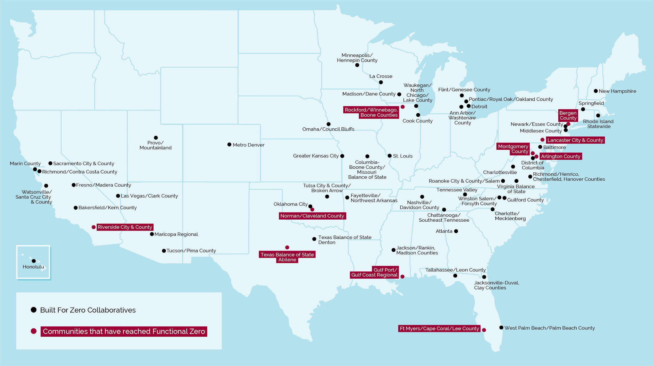
Built for Zero Communities
*Chittenden County
*Placer & Nevada Counties
*Fairfax County
*Western VA
*VA BOS - Waynesboro
*VA BOS - Petersburg
*El Paso
★ Welcome to our Newest Communities!

Slide 5
Progress to Date
Texas BoS CoC Abilene will make 9!
8 3
COMMUNITIES ENDED VETERAN HOMELESSNESS
COMMUNITIES ENDED CHRONIC HOMELESSNESS
₃₃ COMMUNITIES
HAVE ACHIEVED A
MEASURABLE REDUCTION
64 DATA ON HOMELESSNESS
COMMUNITIES
HAVE ACHIEVED QUALITY REAL-TIME
60% 98,200
FUNCTIONAL ZERO PROOF POINTS SUSTAINING GOAL
TOTAL PEOPLE HOUSED
*Built for Zero communities use the Built for Zero standard for ending veteran homelessness, a single measure that provides a higher, more measurable bar than the federal criteria and benchmarks. We eagerly support communities in meeting the criteria and benchmarks on their way to the BfZ standard.

Slide 6
Functional Zero for Veterans
Texas Balance of State - Abilene has met their functional zero threshold of less than 9!
<
# Actively Homeless Veterans
6-Mth Avg. Housing Placement Rate

Slide 7
TEXAS BOS- ABILENE
BY-NAME, REAL-TIME DATA

Slide 8
Defining a Quality By-Name List
Texas Balance of State - Abilene has met all of the quality and reliability thresholds.
All agencies and programs are represented
List includes people sleeping in shelters and on the streets
FULL COVERAGE
PERSON- LEVEL DATA
Each person has an entry that includes their name, history, health and housing needs
Each person can be followed through the system
RELIABILITY
Data balances month over month, just like your checkbook
List is updated monthly, at a minimum
As people’s housing status changes, so do their list entries
REGULAR UPDATES

Slide 9
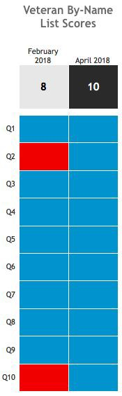
Qualitatively Assessing your list
Texas Balance of State - Abilene reached a perfect score on the veterans scorecard in April 2018 successfully meeting the framework below to produce their veterans by-name list. This ensures that Abilene has reached quality data to measure improvements over time.
COMMUNITY PARTICIPATION & COVERAGE
1. Tracking all homeless individuals
4. Outreach coverage
5. Providers reporting data
9. Including veterans experiencing chronic homelessness
POLICIES & PROCEDURES
DATA INFRASTRUCTURE
3. Tracking homeless status
6. Unique identifier
7. Tracking newly identified people
10. Tracking returns to system
2. Inactive policy
8. Tracking without full assessment

Slide 10






Key Data Points
Texas Balance of State - Abilene is consistently reporting these key data points for veterans monthly.
INFLOW
ACTIVELY HOMELESS
OUTFLOW
INFLOW: NEWLY IDENTIFIED
INFLOW: RETURNED FROM HOUSING
INFLOW: RETURNED FROM INACTIVE
OUTFLOW: OUTFLOW:
HOUSING MOVED TO PLACEMENTS INACTIVE
OUTFLOW: NO LONGER MEETS POP CRITERIA

Slide 11
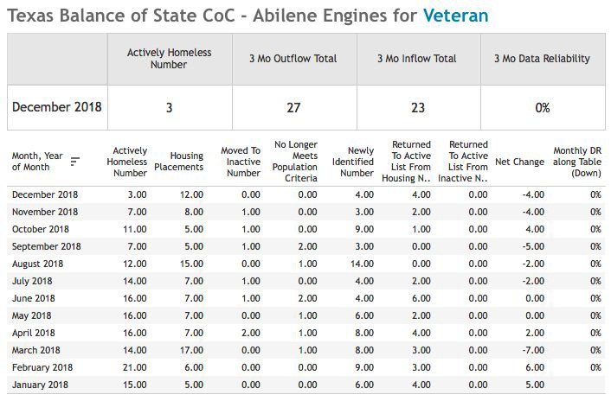
Data Reliability
Data for Texas BoS Abilene is perfectly balanced (0% data reliability) meaning that changes in actively homeless numbers are accounted for in inflow and outflow. This signals that data management practices are robust and efficient and that data is being tracked in a consistent manner.

Slide 12
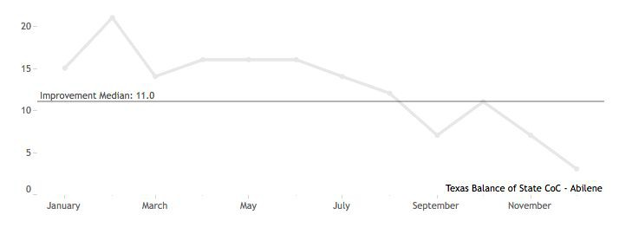
Texas BOS - Abilene: Actively Homeless - Monthly Veteran Data
June 2018: Community achieved quality data
Perfect score on veteran scorecard
0% data reliability for 3+ months
Quality improvement continues...
Piloted new diversion script
Community-wide case conferencing
Prevention
Housing Authority Landlord Outreach
September 2018: Dip to functional zero
End of the SSVF fiscal year
Increased HUD-VASH placements
BFZ Onsite - Abilene team develops “Command Center” and begins
bi-weekly collaboration calls
Nov 2018: FZ
Achieved
2018

Slide 13
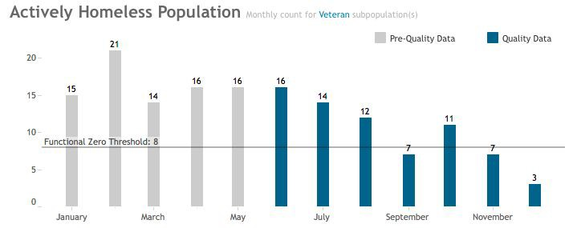
Texas BOS - Abilene: Actively Homeless - Monthly Veteran Count
Nov 2018: Achieved Functional Zero
Current Actively Homeless down to 3
2018

Slide 14
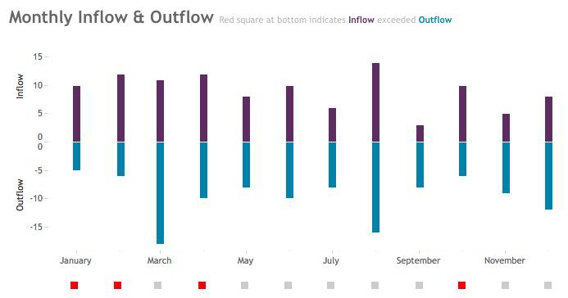
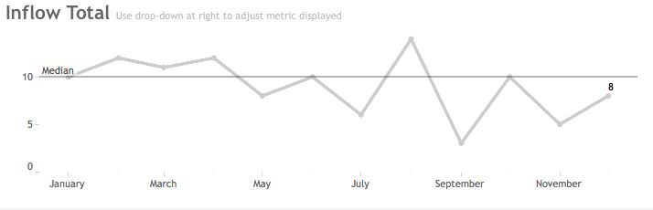
Texas BOS - Abilene: Upstream Strategies:
Implemented a new script and process for diversion
2-1-1 included as part of Coordinated Entry
Improved outreach coverage for the BNL by integrating with CE outreach efforts
Exploring prevention program
Analyzing returns from housed
2018
Texas BOS - Abilene: Downstream
Strategies:
Brought BNL to CE case conferencing meetings
Landlord outreach/unit coordination with PHA
PHA implemented a homeless preference
“Command Center” bi-weekly collaboration calls
2018

Slide 15
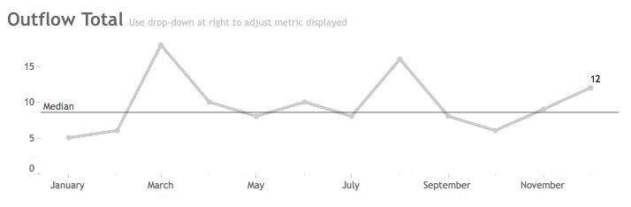
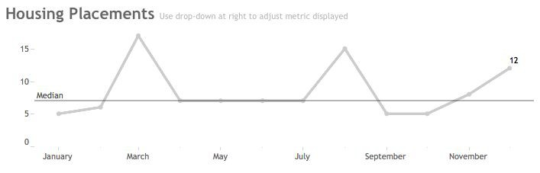
Notes on inactivity
policy/or other
outflow:
Often there is a significant lag between
HUD-VASH
issuance and lease up
2018
Notes on housing
placements:
Coordination with PHA and landlord outreach with ADRC
2018

Slide 16
Texas BOS-Abilene: Timeline in Brief
2015
Began keeping a BNL, Changed with the USICH format (1st format released).
2017
New CoC Program-funded RRH grant in operation, increased focus on housing in the community
Oct- Began planning for 100-Day Challenge to implement Coordinated Entry
2018
Jan-May- Abilene held a 100-Day challenge to house 50 of their most vulnerable neighbors
  Implemented Coordinated Entry
Feb- Texas Balance of State CoC - Abilene joined Built for Zero, Set baseline score for veteran scorecard, implemented Inactive policy
April - Reached perfect score on scorecard!
June - Reached 3-month data reliability!
July - Built for Zero - Last mile conference call - leadership team began targeting FZ
Aug- Reached functional zero threshold for the first time!
Sept- Built for Zero Onsite meeting to build will and prioritize projects.
Oct 23 - Launch 100-day Mayor’s Challenge to reach Functional Zero by 1/31/19
Nov- Confirmed as reaching functional zero, applied for USICH recognition
2019
Jan-May- Began enforced Diversion (Rapid Resolution efforts)
May- Started organized outreach Efforts
June- began coached focus towards chronic homelessness and initiated Youth Steering Committee to begin establishing efforts for youth homelessness
2020
Hire WTHN Coordinator
Funding for Youth Initiative
Funding for Diversion and Prevention

Slide 17
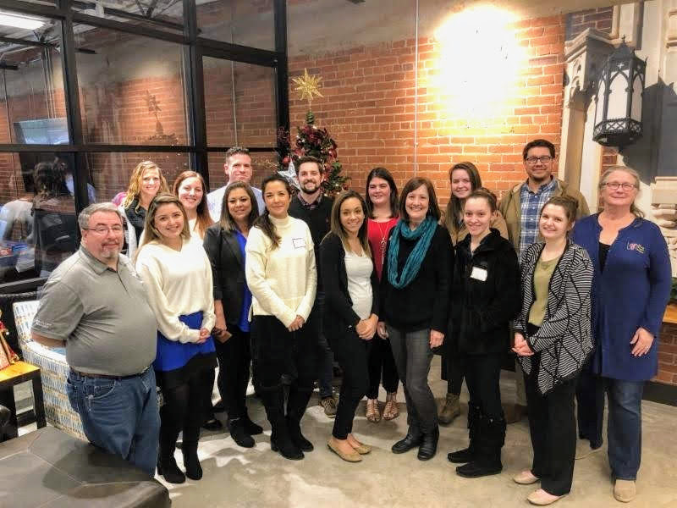
Texas BOS - Abilene: Sustaining Functional Zero

Slide 18
Texas BOS - Abilene:
Possible Barriers to Sustaining
Reliance on PHA voucher dedication and maintaining SSVF funding at level
HUD-VASH staff turnover and housing retention (preventing returns)
Interim staff and timing for filling positions (PHA + HUD-VASH)
Maintaining “Command Center” multi-agency leadership and momentum to sustain once certified for FZ + USICH
Increasing funding for prevention and continuous improvement of rapid resolution (diversion) to reduce returns from housed and monthly inflow
Need to ensure accurate and timely status updates on BNL to respond quickly to any changes in inflow or outflow.
Balancing continued focus on veterans, while increasing focus on chronic and building youth capacity

Slide 19
Texas BOS - Abilene: Community Strengths
Community persistence, focus and commitment - as reflected in the two 100-day Veteran sprint campaigns completed within the year.
Active, engaged PHA
Driven, committed leadership that were allowed time to pursue community-wide directives
Community-wide involvement and experience in pursuing common goals
Veteran-minded community
High BfZ involvement
High CoC Support
Laser-focus on data
Bias toward action
Deep understanding of community systems

Slide 20



Key milestones toward ending homelessness!
Texas Balance of State - Abilene has met the key milestones to achieve Functional Zero for Veterans, and is ready to sustain and expand to Chronic!
✅
Build the will among community leaders and develop a shared aim
✅
Achieve a real-time, by-name list of people experiencing homelessness
✅
Drive monthly reductions in your actively homeless number
✅
Achieve a measurable zero in your community
Solidify a system to sustain zero and expand to other populations

Slide 21
Texas BOS - Abilene: Media Coverage
Abilene officially ninth city in US to end veteran homelessness. 7/30/19 (Concho Valley)
After achieving functional zero for homeless veterans, efforts now moving to chronic homelessness. 7/18/19 (Big Country Homepage)
Abilene found a way to house all its homeless veterans. Other cities want to know the secret. 3/5/19 (CNN)
Abilene’s Top 10 Positive Stories of 2018 12/28/18 (Big Country)
#Abilanthropy Story: James and His New Home 11/26/18 (Community Foundation of Abilene)
More coverage on West Texas Homeless Network Facebook

