Slide 1
2021 PIT Lead Training
Notes:
Hello everyone and welcome to the Point-in-Time count or PIT lead training.

Slide 2

Introduction
Module 6
Module 2
Wrap-up
Module 1
Module 3
Module 4
Welcome
Module 5
Kyra Henderson (she/her)
Data Coordinator
Notes:
Before we get started I want to take a minute to introduce myself. My name is Kyra Henderson, my pronouns are she/her, and I am the Data Coordinator here at Texas Homeless Network. My primary role is to coordinate the annual Point-in-Time and Housing Inventory counts.

Slide 3
WINTER PIT DATE
Winter PIT Count Date:
1/28/2021
Module 6
Module 2
Wrap-up
Module 1
Module 3
Module 4
Welcome
Module 5
Notes:
This is the PIT date for this year.

Slide 4

Agenda
Point-in-Time (PIT) Basics
PIT Count Methodology
Unsheltered PIT Planning
Module 6
Sheltered PIT Planning
Module 4
Wrap-up
Module 2
Module 1
Module 5
Welcome
Module 3
Collaboration
Successful PIT Count
Next Steps
Notes:
Now lets go through the agenda for the training. We are going to start off with general overview of the PIT count, move into planning for the Unsheltered and Sheltered counts. Then we will talk about the community partners you should be engaging with as well as other tips I have for the count.

Slide 5
Point-in-Time (PIT) Basics
How many people are currently homeless in your community?
How many of them are families, youth, or veterans?
The answers to these questions and more can be answered by point-in-time counts.
A point-in-time count is an unduplicated count on a single night of the people in a community who are experiencing homelessness
Module 6
Module 1
Module 2
Wrap-up
Module 3
Module 4
Welcome
Module 5
Module 1
Notes:
So what is the PIT count? The PIT count is an unduplicated count on a single night of the people in a community who are experiencing homelessness. The less technical definition I like to use is that the PIT count is a snapshot of the minimum number of individuals in your community experiencing homelessness.

Slide 6
PIT Count Reasoning
Extent
Funding
Awareness
Raise Community Awareness
Advocate to local governments
Characteristics of those experiencing homelessness locally
Trends in Homelessness over time
Module 6
Module 4
Wrap-up
Module 1
Module 2
Module 5
Welcome
Module 3
Module 1
Advocate for private or local government funds
Eligibility for CoC, ESG, and other federal funding
Develop personal relationships with those experiencing homelessness
Create a sense of responsibility with varied stakeholders
Engagement
Notes:
The reasoning behind the PIT can be broken down into the 4 main categories:
Awareness: Which can be viewed both at a community outreach level as well as with your local governments.
Extent: which means the characteristics of those experiencing homelessness in your community as well as what trends your area might be seeing over time
Funding: For those of you who have been in any of my trainings before you have heard me talk about this one key fact: If you are requesting funding, whether it be federal, local government funding, or private funding, the first question you are going to be asked is the scope of the problem. If you don’t know how large the need is, you don’t know how much money is necessary. This is the one tool that is used nationally to illustrate the need.
and
Finally, Engagement: Not only is this an incredible opportunity to create a sense of shared responsibility with local leaders and stake holders, but it also provides the opportunity for you to meet with the folx experiencing homelessness in your community to help foster strong relationships.

Slide 7
THN Information
Texas Homeless Network (THN) is a non-profit membership-based organization helping communities strategically plan to prevent and end homelessness.
THN works to end homelessness in Texas by collaborating with all communities, large and small, across the state to build systems to achieve this goal.
We coordinate local and national advocacy efforts, data collection and research, host an annual statewide conference, and serve as the host agency for the Texas Balance of State Continuum of Care (CoC) where we assist in the coordination of programs and funding.
The Texas Balance of State CoC (TX BoS CoC) is made up of all service providers, advocates, local government officials, and citizens who work to eliminate homelessness in 215 of Texas’ 254 counties.
Module 6
Module 4
Wrap-up
Module 2
Module 5
Module 1
Module 3
Notes:
Now I wanted to talk about Texas Homeless Network and how it relates to The Texas Balance of State CoC. THN is the non-profit agency that houses the Texas Balance of State Continuum of Care. We are broken into two main teams. The Statewide Initiatives Team and the TX BoS CoC Team. The statewide initiatives team is responsible for our advocacy efforts and they are focused on projects that go beyond the Texas Balance of State geography.
The TX BoS CoC is made up of 215 counties and is comprised of the service providers, advocates, local planning entities, and citizens that are working to end homelessness in their areas. These general meetings are held by the Texas Balance of State team and are directly geared towards those 215 counties. The PIT Count is one of the activities that is required of all CoC’s and is coordinated by the CoC lead agency. Which in this circumstance is us.
I also thought this would be a good time to address some of the questions that I have heard over the last several years. I know many of you have asked why you cannot conduct the count on a different day, or why you cannot add or change questions to the count. This is because the counts need to be consistent across our full geography for when it comes time to do reporting. Rest assured that all decisions we make are carefully weighed to ensure that we are providing the most appropriate solution for the largest number of our communities.

Slide 8
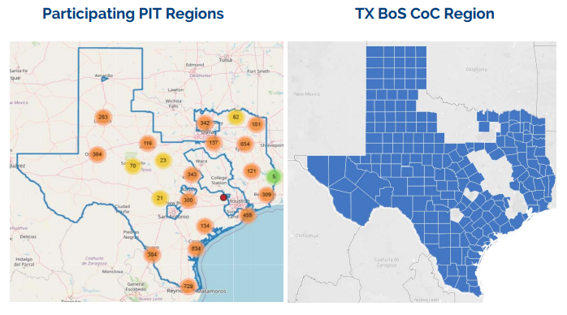
Coverage Area
Module 6
Module 4
Wrap-up
Module 2
Module 5
Module 1
Module 3
Notes:
Last year we had 51 counties collect surveys on the day of the PIT count. This made up approximately 69% of the Texas Balance of State Geography (based on population estimates). The map on the left is the 2020 PIT regions and the map on the right in the full TX BoS CoC Region.

Slide 9
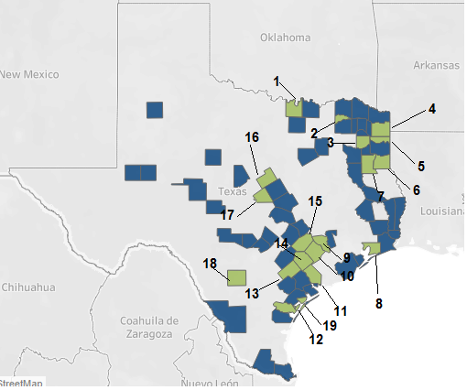
Targeted Outreach
Missing Counties:
Cooke
Delta
Upshur
Cass
Marion
Panola
Rusk
Chambers
Austin
Colorado
Jackson
San Patricio
DeWitt
Lavaca
Fayette
Hamilton
Lampasas
Frio
Aransas
Module 6
Module 4
Wrap-up
Module 2
Module 5
Module 1
Module 3
Does your agency cover any of these following areas?
Could you help us connect with a potential PIT lead in one of these areas and/or expand your count to include them?
Notes:
We went through all of the counties in the Balance of State and created a list of the ones that are covered by a Local Homeless Coalition and/or are covered by a coordinated entry region.
From there we narrowed the list down further by only including counties that are covered by at least one of the following federal funding streams: CoC, ESG, SSVF, RHY, or PATH. Our goal was to provide you all with a list of the counties that are already engaged with the Continuum of Care in multiple ways in the hopes that they would be easier to get on board to join the count.
Please note that this list includes any community that did not collect surveys in 2020. If your count included these areas and you ultimately did not find anyone, please reach out to Kyra to brainstorm additional hot spot locations.
If your agency covers these counties but you don’t have enough volunteers to send to these areas, please reach out to Kyra to brainstorm volunteer recruitment strategies.
Please take some time to consider the questions I have written on this slide and get in touch with me at your earliest convenience if you may be able to assist us in collecting data from one or more of these counties.

Slide 10
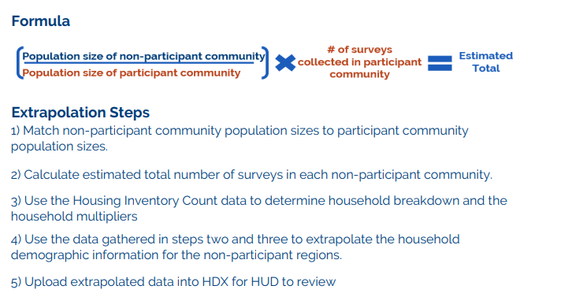
Extrapolation Basics
For reporting purposes, HUD requires that CoC's report on their full geography. Due to the size of our CoC, we are not able to achieve full coverage during the PIT count. That being said, the CoC has to employ an extrapolation method that estimates the PIT number for the entire geography.
Module 6
Module 4
Wrap-up
Module 2
Module 5
Module 1
Module 3
Notes:
Now as I spoke about earlier, we do not have full coverage of all 215 counties; however, the Department of Housing and Urban Development, or HUD, requires that each CoC report on their full coverage area. This means that we have to use an extrapolation or estimation formula to determine the survey totals for the rest of our geography.
Without going too far into the weeds, the reasons I thought it was important to inform you all of this are:
If you are from an area who historically doesn’t count, the only data we have for you is based on this estimation. While it is a HUD approved formula, there is nothing more accurate than actually conducting the count yourself.
If you are a participating community, this is why it is so important that your own counts are accurate and comprehensive to the best of your ability, because your results may have a direct affect on areas of similar population size that don’t participate.

Slide 11
Who to Contact
If you have questions about:
If you have questions about:
Community Information
Shift times
HQ location
Assigned count areas
Count Logistics
Who & where we count
Survey length/questions
Identifying hot spots
Technical issues
Count Logistics
Who & where we count
Survey length/questions
Identifying hot spots
Technical issues
Count Logistics
Who & where we count
Survey length/questions
Identifying hot spots
Technical issues
Module 6
Module 4
Wrap-up
Module 2
Module 5
Module 1
Module 3
If you can’t reach your PIT Lead:
PIT Lead
Data Coordinator
If you can’t reach the Data Coordinator
THN Administrator
Notes:
Here is a quick flowchart to describe the role of the PIT lead vs. my role. It is also part of the volunteer training to help volunteers determine who they need to reach out to based on the questions they might have.

Slide 12
Quiz
Count Logistics
Who & where we count
Survey length/questions
Identifying hot spots
Technical issues
Quiz Time!
Module 6
Module 4
Wrap-up
Module 2
Module 5
Module 1
Module 3
THN Administrator
Notes:
What is the date of the PIT Count?
January 21st, 2021
January 28th, 2021
January 30th, 2021
January 26th, 2021
2) When should volunteers contact me directly?
When they have questions about when their volunteer shift is
When they don’t remember the headquarters location
When they have a question about the count location they are assigned
When they are concerned about general count logistics
3) All counties in the balance of state can choose their own count date
True
False
4) Which information is NOT gathered on the PIT count?
The number of individuals experiencing homelessness in an area
The demographic characteristics of those experiencing homelessness
Information on veterans and survivors of domestic violence
Information on the amount of housing available for those experiencing homelessness
5) Texas Homeless Network and the Texas Balance of State Continuum of Care (TX BoS CoC) are the same thing?
True
False, the THN is the host agency for the TX BoS CoC
False, the TX BoS CoC is the host agency for THN

Slide 13
Key PIT Steps
Select PIT Lead
Establish PIT Lead and Backup
Community Awareness
Inform Community/ publicize count
Training
Recruit Volunteers
Create PIT committee
Create timeline for count planning
Engage potential members with lived experience
Engage community in identifying unsheltered locations
Set volunteers up with training
Schedule in person meetings
Register and practice with the app
Solicit Donations
Module 6
Module 4
Wrap-up
Module 5
Module 2
Module 3
Notes:
Now this is an oversimplification of all the hard work that goes into a count. But the three key things to remember and focus on are: Selecting a PIT lead and community leadership that has the capacity to take on this task. Ensuring community awareness is a focus before the count, during the count, and after the count. And having really comprehensive training.

Slide 14
Who to Count
Individuals residing in:
Unsheltered Locations
Sheltered Locations
-Street
-Outdoor Encampment
-Other places not meant for habitation
- Emergency Shelter
- Domestic Violence Shelter
- Transitional Housing
Hotel/Motel paid for by an Agency Voucher
Module 6
Module 4
Wrap-up
Module 5
Module 2
Module 3
Notes:
In essence these next two slides give you the primary requirements of the PIT count. The individuals counted are those residing in unsheltered locations, such as streets, cars, outdoor encampments, and places not meant for human habitation. And those residing in sheltered locations: which are emergency shelters, domestic violence shelters, transitional housing, and hotels paid for with an agency voucher

Slide 15
Who NOT to Count
Individuals residing in:
Permanent Housing
Temporary Situations
- PSH or RRH Programs
- HUD VASH projects
-FEMA projects
- Doubled Up with family or friends
- Substandard Housing
- Hotel/motel paid by own funds
- Shelters designed for foster care
-Sober living/ halfway houses
- Criminal Justice or Health facilities
Module 6
Module 4
Wrap-up
Module 5
Module 2
Module 3
Notes:
We do not count those residing in Permanent Housing such as PSH, RRH VASH, or FEMA projects, We also do not count those residing in temporary locations such as couch surfing with family or friends, hotels paid for by their own funds, or people in health or criminal justice facilities. As a note, these are not our guidelines, these are HUD guidelines and we are required to abide by them

Slide 16
Considerations for Youth
U.S. Department of Education (ED) Subtitle VII-B of the McKinney-Vento Homeless Assistance Act defines homeless children and youths as follows: The term "homeless children and youths"—
  Meaning individuals who lack a fixed, regular, and adequate nighttime residence (within the meaning of section 11302(a)(1) of this title); and includes—
    i. children and youths who are sharing the housing of other persons due to loss of housing, economic hardship, or a similar reason; are living in motels, hotels, trailer parks, or camping grounds due to the lack of alternative adequate accommodations; are living in emergency or transitional shelters; are abandoned in hospitals; or are awaiting foster care placement;
    ii. children and youths who have a primary nighttime residence that is a public or private place not designed for or ordinarily used as a regular sleeping accommodation for human beings (within the meaning of section 11302(a)(2)(C) of this title);
    iii. children and youths who are living in cars, parks, public spaces, abandoned buildings, substandard housing, bus or train stations, or similar settings; and iv. migratory children (as such term is defined in section 6399 of title 20) who qualify as homeless for the purposes of this subtitle because the children are living in circumstances described in clauses (i) through (iii).
Module 6
Module 4
Wrap-up
Module 5
Module 2
Module 3
Notes:
This slide is for those of you who are familiar with the school district definition of homelessness, which is used by homeless education liaisons. This is the Mckinney Vento Homeless Assistance Act definition of homeless children and youth. You will notice that on this slide I have highlighted several phrases in red font. The portions in red font are the parts of this school definition that do not fit into the PIT count definition. Those include: children and youths who are sharing the housing of other persons due to loss of housing, economic hardship, or a similar reason; are abandoned in hospitals; or are awaiting foster care placement; substandard housing. So while these students may count as homeless with their school, they do not qualify as counting for the PIT.

Slide 17
Quiz
Count Logistics
Who & where we count
Survey length/questions
Identifying hot spots
Technical issues
Quiz Time!
Module 6
Module 2
Module 4
Wrap-up
Module 5
Module 3
THN Administrator
Notes:
Quiz Questions:
1) Which one of the following sleeping locations is NOT counted on the PIT Count?
Emergency Shelter
Transitional Housing
Staying with friends/family temporarily
Hotel/motel paid for with an agency voucher
2. If someone is staying at a hotel/motel on an agency voucher, which survey would you use for them?
Sheltered
Unsheltered
They are not eligible and you would not survey them
3. If someone is staying at a hotel/motel with their own money, which survey would you use for them?
Sheltered
Unsheltered
They are not eligible and you would not survey them
4. If a youth is considered homeless with their Homeless Education Liaison's definition, they automatically are eligible for the PIT count survey.
True
False

Slide 18
Unsheltered PIT Planning
A count of people who are homeless but not in a shelter or transitional housing program is referred to as an unsheltered count.
The unsheltered count requires identification of homeless people that are living in places not meant for human habitation on January 28th.
Module 6
Module 4
Wrap-up
Module 3
Module 5
Notes:
Now we are going to talk about the Unsheltered PIT. The Unsheltered PIT, often referred to as the street count is a count of the individuals who are residing in places not mean for habitation.

Slide 19
Possible Locations
Street/sidewalk
Vehicle (car, van, RV, truck)
Park
Abandoned building
Bus, train station, airport
Under bridge/overpass
Woods/outdoor encampment
Module 6
Module 4
Wrap-up
Module 3
Module 5
Notes:
PIT Leads should create a map or list of common areas where people can be found, this can be used to help inform volunteer routes.
Prepare for the unsheltered count by creating your map zones, areas that teams of volunteers will cover during the count. Seek input from your PIT Count committee, community partners, and people with lived experience when mapping your survey locations. You may need to update your maps closer to the date of your count, as the locations frequented by people experiencing unsheltered homelessness may change.

Slide 20
Creating Hot Spot Map
Work together with your community members to start a list of locations where you see individuals experiencing homelessness living
  Visit the locations at least once a month leading up to the count
  Visit locations several times during the week leading up to the count.
This list will likely change over time and will need regular updates. Ensure that you have a process for how people can access the list of locations and how they can send you updates.
Make this a collaborative process. It will help raise awareness for everyone involved.
Module 6
Module 4
Wrap-up
Module 3
Module 5
Notes:
We recommend sorting your map zones into priority groups, based on the anticipated number of people experiencing homelessness in each zone. Should you find yourself short of volunteers on the day of the count, prioritize the higher-density zones.
To identify known locations:
Engage outreach workers, police, EMS, bylaw and parks officers, businesses and others to help you identify ‘hot spots’ for the night of the count.
Undertake walkabouts in advance of a count date to identify and confirm known locations.
Consult people experiencing homelessness to get a sense of where to canvass and how to approach potential interviewees, especially in camps.
Note that different populations experiencing homelessness may stay in different locations. For example, youth may gravitate toward more secluded areas such as forests, while single adult men may be more likely to stay in plain view on the street. Consult a range of stakeholders to ensure your mapping accurately reflects the diversity of experiences among people experiencing homelessness in your community.
Please make sure to visit hot spot locations regularly in the months leading up to the count as these areas will likely change.
Have some type of collaborative document to track locations and update each other on any significant changes.

Slide 21
Creating Hot Spot Map
Link to Google My Maps instructions
Link to YouTube tutorial on building a map
Things to Note:
You do not have to use an exact address, the map will allow you to use cross streets.
Use this map to ensure that you have full coverage of your community.
Share it with your planning team and your volunteers regularly to ask for feedback and updates.
Provide a copy to all volunteer teams on the day of the count.
There are a number of additional sites that can be used. If you Google My Maps doesn’t work for you, let me know and I can help you find a different site.
Module 6
Module 4
Wrap-up
Module 3
Module 5
Notes:
On this slide I have included a few helpful resources on where you can go to create a hot spot map as well as a video tutorial of how to create pins for each location.
You don’t need exact addresses, approximate streets should work just fine. This document can help you determine how many volunteer teams you will need in order to cover all of the locations you have identified in your area. It will also be hugely helpful to volunteers on the day of the count as they are heading out to their locations.

Slide 22
Community Partners
DFPS
Victim Service Providers*
Faith-based agencies
Housing Authority
Code Enforcement
SSVF Providers
Outreach Providers
Homeless Education Liaisons*
Module 6
Module 4
Wrap-up
Module 3
Module 5
Notes:
Here is a list of the potential community partners you should try to engage in the count process. The ones with the asterisk are community partners that we already have specific resources created to help with engagement. This is not an exhaustive list; however, it should be viewed as a starting point to drive your outreach efforts.

Slide 23
Safety Considerations
Do
Don’t
Always work in teams
Be respectful of space
Ask a person to participate if you think they are homeless
Introduce yourself and explain what you are doing
Be sincere and caring
Remain calm
Know how to de-escalate
Know emergency numbers
Honor requests to not participate
Provide shelter information if possible
Dress appropriately
Leave valuables behind
Wake up someone*
Approach if you don’t feel comfortable*
Mandate participation
Invade personal space
Cross barriers
Promise anything you can’t deliver
Be judgmental
Give money or offer rides
Share any confidential info or photos of participants
Panic
Put anyone in danger
Deviate from the survey
Module 6
Module 4
Wrap-up
Module 3
Module 5
Notes:
The safety of PIT Leads and Volunteers are our highest priority so please read over this list of considerations prior to the day of the count. This list is specifically geared towards those doing the unsheltered count; however, many of the tips still apply to the sheltered count as well.
Do not wake people up, put yourself in a situation that makes you uncomfortable, promise things you can deliver share confidential information, or deviate from the survey. The first two items on the don’t list are the scenarios in which you would do an observation survey as opposed to an unsheltered survey.
The main takeaways are that you should be respectful, calm, sincere, and prepared. While you and your volunteers are unlikely to experience dangerous situations, it is always important to have a place in case de-escalation is required.

Slide 24
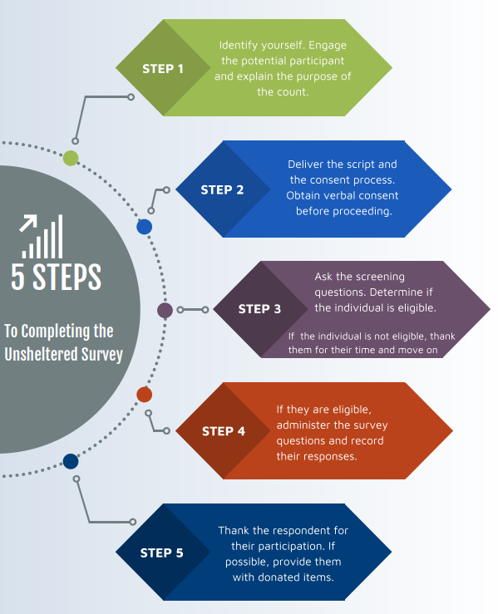
Infographic
Module 6
Module 4
Wrap-up
Module 3
Module 5
Notes:
I created this infographic to help visualize the steps involved in completing the unsheltered survey

Slide 25
Tips and Tricks
Check in with each volunteer before they go out for their shift.
Provide volunteers a checklist at least one day in advance
Forms to have prepared:
  Map of hot spots
  Interviewing guide
  Day of count cheat sheet
  Volunteer hour tracker
  Emergency phone numbers
  Instructions for registering for the app
Module 6
Module 4
Wrap-up
Module 3
Module 5
Notes:
Here is a quick list of tips and tricks when it comes to preparing information for Unsheltered PIT volunteers. My best advice is to have these materials ready to go at a minimum of one day before. Best practice would be to have these all compiled by the week before.

Slide 26
Quiz
Quiz Time!
Module 6
Module 4
Wrap-up
Module 3
Module 5
Notes:
Which of these is considered an Unsheltered Location?
Emergency Shelter
Outdoor Encampment
Hotel/Motel
Hospital
2) What is the first step when conducting an Unsheltered survey?
Ask the screening questions to determine if they are eligible for the survey
Deliver the consent process
Introduce yourself and explain the purpose of the count
Administer the survey questions
3) Which of these is considered a “Safety Don’t”
Wear appropriate clothing and shoes
Work in teams
Be respectful
Wake someone up to conduct the survey
4) You should be visiting hot spot locations in the months leading up to the count?
True
False
5) Which of these are community partners you should engage in the hot spot mapping process?
Victim Service Providers
Code Enforcement
Faith-based agencies
All of the above

Slide 27
Sheltered PIT Planning
HUD defines sheltered homeless persons as adults, children, and unaccompanied children who, on the night of the count, are living in shelters for the homeless.
Regardless of funding source, all providers of shelter, vouchers, or funds for shelters (including motel/hotel rooms), and/or transitional housing need to provide unduplicated information about the individuals and families on January 28th, 2021.
To be considered for the PIT Count:
  The primary intent of the project is to serve literally homeless persons,
  The project verifies homeless status as part of its eligibility determination, and
  The actual project clients are predominantly homeless (or, for permanent housing, were homeless at entry).
Module 6
Module 4
Wrap-up
Module 5
Notes:
Now lets talk about Sheltered PIT planning. The sheltered count is a count of the individuals residing in emergency shelter (which includes cold weather shelters, domestic violence shelters, and hotels/motels paid for with agency vouchers) and transitional housing on the night of the PIT.
In order to be considered a traditional emergency shelter or transitional housing project, they have to meet the 3 criteria on the bottom of this Power Point slide.

Slide 28
Locations
Emergency Shelters: Definition- means any facility, the primary purpose of which is to provide a temporary shelter for the homeless in general or for specific populations of the homeless and which does not require occupants to sign leases or occupancy agreements.
  Domestic violence shelters
  Hotel, motel, or apartment vouchers paid for by a public or private agency because the individual or family is homeless
*For Emergency Shelters, you should conduct the surveys in the late afternoon/evening when participants are checking in to stay the night.
Transitional Housing: Definition-Transitional housing (TH) is designed to provide homeless individuals and families with the interim stability and support to successfully move to and maintain permanent housing. Transitional housing may be used to cover the costs of up to 24 months of housing with accompanying supportive services. Program participants must have a lease (or sublease) or occupancy agreement in place when residing in transitional housing.
Module 6
Module 4
Wrap-up
Module 5
Notes:
To help give a more detailed explanation of the location definitions. Here are the HUD definitions of emergency shelter and transitional housing. Please ensure that you have read over these definitions as well as the criteria on the previous slide prior to contacting THN to have them added as a count location.
Just a quick note, for emergency shelters our recommendation is that you conduct the surveys when people are checking in for the night.

Slide 29
Locations
I will provide you a list of identified sheltered locations by November
  If you would like your list sooner please contact me.
  If you believe there is an agency that should be on this list, please go through the list of criteria with the shelter staff to see if they are eligible. Then contact me so we can discuss adding them.
To view the list of agencies that participated last year, please visit the THN website and download the Housing Inventory Count (HIC) Report
  Link to website
**If you represent an agency that provides Hotel/Motel vouchers for individuals experiencing homelessness, please contact me ASAP**
PIT Measures People
HIC Measures Housing
Who & Capacity for Crisis
Module 6
Module 4
Wrap-up
Module 5
Notes:
To help you identify the list of sheltered locations please use the Housing Inventory Count to determine which shelters have counted in the past. The visual at the bottom is meant to illustrate the connection between the PIT and HIC and how they can work together to show the comprehensive picture of your community needs and your capacity to respond to those needs. There is a link on this slide to the THN website which has the most up to date HIC information. I will also be providing you a list of sheltered locations by November for you to double check.
If you know of any agencies that will be providing hotel/motel vouchers on the night of the count, please contact me immediately so we can discuss the process for conducting those surveys.

Slide 30
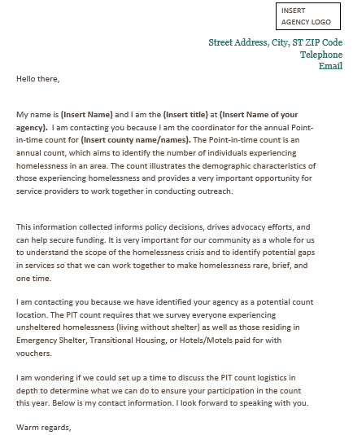
How to Contact Shelters
Module 6
Module 4
Wrap-up
Module 5
Notes:
Here is a template of the letter you can send potential shelters to solicit their participation in the PIT count. You can find a downloadable template on the THN website.

Slide 31
Domestic Violence Protocol
Notice CPD 17-08:
HUD is requiring that data reported on survivors of domestic violence should be limited to reporting on those who are currently experiencing homelessness because they are fleeing domestic violence, dating violence, sexual assault, or stalking, as opposed to reporting on survivors who have ever experienced these circumstances.
Question on the survey: Are you currently staying in this shelter because of domestic violence? (Including: dating violence, sexual violence, and/or stalking)
Module 6
Module 4
Wrap-up
Module 5
Notes:
I want to spend a little bit of time talking about the specific process for interviewing at a domestic violence shelter. To give you some context, the PIT count is only gathering information on those who are actively fleeing a domestic violence situation. The question is not asking if someone has ever experienced domestic violence.
The question on this slide is the exact language in the PIT app.

Slide 32
Surveying Survivors
Do
Don’t
Explain that the survey is confidential and all identifying information is removed for their safety.
Use their initials or a code for their name (if they don’t want to give you their initials).
Fill out their age range.
Complete the remainder of the survey with them.
Write in the notes section of the survey that they are a survivor so I can make sure their location is secure.
Provide any information on support that your PIT lead provided you
Fill in their full name
Fill in their date of birth
Fill in their exact age
Provide any identifying information in the notes section
Pressure participants into answering any questions they don’t feel comfortable answering.
Express disbelief or pity to answers on the survey by survivors.
Module 6
Module 4
Wrap-up
Module 5
Notes:
Here are some do’s and don’t around surveying survivors. Please read through this list in its entirety prior to the day of the count. I will summarize a few of the key highlights though.
Do not fill in the full name or the date of birth/age of the survivor. You will provide their age range and any demographic information they share with you though. Please also do not provide any identifying information in the notes section. You will conduct the full survey with the participants though, so once you have gotten past the name and age questions please continue filling out the remainder of the survey with them.

Slide 33
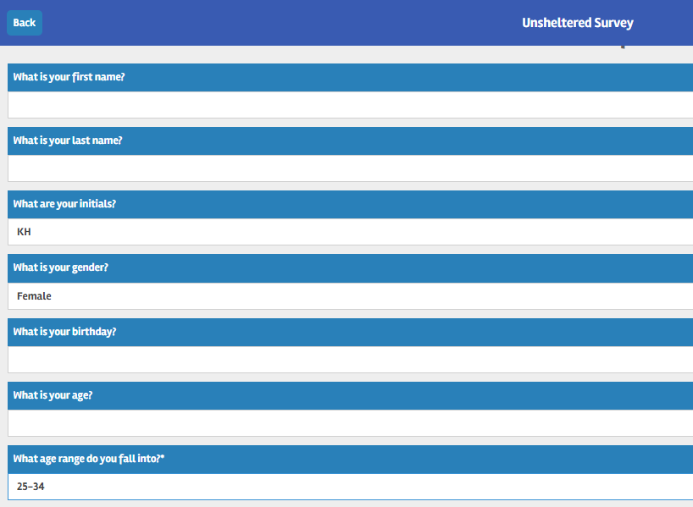
App Screenshot
Module 6
Module 4
Wrap-up
Module 5
Notes:
Here is a screenshot of the mobile app and what the beginning section of your survey should look like. Again: you will be filling out the entire survey with the participants. You are only skipping the full name, date of birth, and exact age.

Slide 34
Tips and Tricks
Prep and Forms
Verify list of agencies well in advance.
Set up either a phone call or a visit with each shelter you plan to count at
  Take note of their confidentiality protocols as well as their visitor policy.
  Be respectful and follow the direction of shelter staff at all times.
Get a list of staff at the shelter that will be conducting surveys to ensure they have been trained on the app
Maintain contact throughout the planning process
  Identify the time you will be helping survey and how long they anticipate needing your assistance.
Use Shelters.com and Aunt Bertha to identify any new shelters
Have a primary contact at each shelter for PIT and HIC purposes
Loop in THN as necessary
Module 6
Module 4
Wrap-up
Module 5
Notes:
Verify your list of sheltered location as soon as possible. Please also remain in regular contact with the staff at the shelter to ensure that you have a solid game plan if they will need any additional volunteers to help conduct surveys on the day of the count. Please be respectful of their processes and procedures when you are developing strategies for the day of the count.
It is also your role to help ensure that all staff that will be surveying have taken the appropriate trainings to prepare for the count. Loop me in if you have any questions, concerns, or if you need help reaching out the any of the shelters identified in your area.

Slide 35
Unsheltered and Sheltered Counts
Do
Don’t
If you have obtained consent
Do not complete a survey without consent
Do not continue the survey if the individual has expressed the desire to end the survey
Do not complete a survey based on an intake form unless you have specifically obtained consent to do so.
Module 6
Module 4
Wrap-up
Module 5
Notes:
A quick summary about unsheltered and sheltered counts:
You are only permitted to conduct either of these surveys if you have been given verbal consent to do so. You cannot complete the survey if you haven’t obtained consent (this includes if the participant cannot reasonably consent to the process), if you haven’t physically laid eyes on the individual on the day of the count. Please stop the survey immediately and submit it if the individual wants to leave the conversation. If they revoke their consent and express the desire for you to delete the survey responses, please do so.
If you are unable to complete the sheltered or unsheltered surveys for the above reasons, you have the option of completing the observation survey.

Slide 36
Observation Survey
Do
Don’t
Someone is sleeping
You do not feel comfortable going to a certain area
A person did not give their consent to participate in the survey or they don’t want to complete the survey in it’s entirety
Someone does not seem to understand the consent process and cannot reasonably consent to the survey.
Fill out an observation survey if you have not laid eyes on the individual that day
Module 6
Wrap-up
Module 4
Module 5
Notes:
Observation surveys can be conducted in both sheltered and unsheltered locations. You will use the observation survey if someone is sleeping, you are unable to approach the individual, they did not consent to the survey; however, you believe they are experiencing homelessness. Do not complete a survey using intake forms or based off of previous interactions. You have to see the person on the day of the count.

Slide 37
Decision Tree
If you are in a Sheltered location
Complete Sheltered Survey
Person Consented to survey
If you are at an Unsheltered location
Complete Unsheltered Survey
Person did not consent to survey
Complete Observation Survey
Safe to approach
Module 6
Module 4
Wrap-up
Module 3
Module 5
Module 2
Person could not consent to survey
-They were sleeping and/or they did not understand the consent process
Complete Observation survey
Encounter someone you believe is experiencing homelessness
Person reported that they are not experiencing homelessness
Thank them for their time.
DO NOT COMPLETE A SURVEY
Unsafe to approach
Complete Observation survey
Notes:
This is a decision tree that was created for PIT leads and volunteers this year to help them determine which survey to choose. It is color coded based on the survey type. The red/orange colors indicates decisions leading to the observation survey, the dark blue is for participants that are not eligible to be surveyed, which happens if the person reports to you they are not homeless. The purple is for unsheltered surveys. The green is for sheltered surveys.

Slide 38
Best Practices
Familiarize yourself with the survey
  Practice reading all of the questions out loud.
  Practice giving your introduction script out loud.
Communicate your intentions to prospective survey participants
Obtain consent to administer the survey
Express confidence and compassion
When surveying individuals within a group, prioritize safety and protect participant’s information
  Whenever possible, attempt to give participants as much privacy as they request.
Come up with a safety phrase for discomfort amongst your team
Know volunteer expectations
Know community resources
Module 6
Module 4
Wrap-up
Module 5
Notes:
These are the overall guidelines for how to follow best practices when it comes to conducting the PIT count. Always obtain consent, express confidence and compassion, and prepare well in advance so you feel comfortable with the questions you will encounter.

Slide 39
Service Based Count
This method focuses on conducting interviews with users of non-shelter services and locations frequented by people who are homeless.
The major difference between a night of the count approach and a service-based approach is that it cannot be assumed that everyone encountered is homeless.
  To determine homeless status, it is essential to ask detailed questions related to living situation
Data collection must not extend beyond 7 days after 1/28/21
Module 6
Module 4
Wrap-up
Module 5
Notes:
Service based counts are an optional supplemental count which can be used in conjunction with the night of count approach. You must participate in the formal count in order to also conduct a service based count.
The service based count occurs at non-shelter service locations such as day shelters, food banks, etc where those experiencing homelessness might seek out resources. In order to participate in the service based count you must notify me by November 13th, 2020. You will need to provide a list of the service locations by the end of December. Any surveys not conducted at the predefined locations will be archived immediately.
For more information on this type of count please reach out to me.

Slide 40
Paper Surveys
If you have some volunteers who will not use the mobile app or do not have access to a smart device, we will have limited paper surveys available.
You will need to contact me by November 13th, if you believe that your community will need paper surveys
  Please email me with the anticipated number of volunteers that will be using them as well as why they are unable to use the app
You will have to come up with a plan for entering the paper surveys into the app by February 1st.
Module 6
Module 4
Wrap-up
Module 5
Notes:
Quick reminder about paper surveys: We do have them and we are willing to work with your community on using them; however, we strongly urge you to have as many volunteers as possible using the app. It not only helps with data quality, but it also ensures that there is less room for error or for surveys to get lost. You are only permitted to use the paper surveys developed by THN and you are required to send all of the surveys to THN directly after inputting them. Any paper surveys created by anyone other than THN will be immediately archived.

Slide 41
Quiz
Quiz Time!
Module 6
Module 4
Wrap-up
Module 2
Module 5
Notes:
Which of these is NOT a reason to conduct the Observation Survey?
The individual was sleeping
You are running out of time on your volunteer shift and see someone as you are driving back
The individual could not reasonably consent to the survey because they didn’t understand it
You felt unsafe or uncomfortable approaching the individual
2) You are allowed to use intake paperwork to complete sheltered surveys
True
False
3) Which of these is NOT considered a sheltered survey location?
Cold weather shelter
Domestic violence shelter
Halfway House
Transitional Housing
4) When do you need to notify me of your intent to do the service based count and/or use paper surveys?
January 28th, 2021
By the end of December 2020
November 13th, 2020
You do not need to notify me in advance
5) You are only permitted to use paper surveys created by THN and sent directly from Kyra.
True
False
6) Which information are you permitted to collect on survivors?
Age range
Full Name
Date of Birth
Exact Age

Slide 42
Collaboration
Forming PIT Committee
Recruiting Volunteers
Spreading awareness
Media Engagement
Wrap-up
Module 6
Module 6
Module 7
Module 5
Notes:
As you begin planning for your count, consider how this initiative can be an effective way to engage your community in the effort to end homelessness. Recognize, too, that the success of the count depends on effective community engagement.
A PiT Count can help to inform and educate key stakeholders, including the general public, media, policy makers, the business sector, the social services sector and people experiencing homelessness. Cross-sector collaboration will encourage buy-in and provide additional resources to support the count, including money, volunteers, supplies and expert knowledge.
The count can help your community to understand and address homelessness differently. The process of planning and implementing the count can generate cross-sector coordination that may be leveraged as you implement other initiatives, including a Plan to End Homelessness, Housing First programs, systems coordination or by-name lists. Doing the count collaboratively can increase support for your efforts, facilitate new alliances, and build and strengthen partnerships. At a minimum, you should consider how you will use the information you obtain during the count to generate action on homelessness—an objective that requires community participation and coordination.

Slide 43
Engaging Sub-populations
Youth
Veterans
Families
Individuals with Lived Experience
Click here for resources
Wrap-up
Module 6
Module 6
Module 7
Module 5
Notes:
It is very important to make sure that we are engaging all of these subpopulations in the count, not only attempting to find them on the day of but also brining them to the table for planning and organizing.
Resources are on our site to help find ways to engage subpops- reach out if need help doing so

Slide 44
Engaging those with Lived Experience
Steps for Recruiting Current or Formerly Homeless Individuals for PIT
Identify desired roles needed for PIT Count.
Determine what incentives or compensation are available to current/formerly homeless individuals to participate in the PIT Count.
Early in planning process, communicate to homeless assistance agencies the roles needing to be filled.
  Request assistance from agencies in identifying good candidates.
  Persons identified should not be in the midst of crisis and in no way feel compelled to assist.
After candidates are identified, provider agencies should contact them to ask if they would be interested in participating in PIT Count.
Once participation is confirmed, staff planning the PIT should review PIT plan and training content with the individuals and make necessary adjustments.
Deploy individuals with teams on day of count.
After count is complete, consider asking any current or formerly homeless participants to serve in other CoC volunteer capacities, such as the CoC Board or consumer advisory committee.
Wrap-up
Module 6
Module 6
Module 7
Module 5
Notes:
People who have experienced homelessness are an indispensable resource to a successful point-in-time count (PIT) of unsheltered people and should be actively involved in your PIT count. Many CoCs rely on input and assistance from currently or formerly homeless people when planning, organizing, and implementing a count. When recruiting people who are homeless and staying in emergency housing, PIT leads should be sensitive to any shelter restrictions that could limit participation, such as program curfews or other requirements.
I also want to take a minute to remind everyone that if you are recruiting anyone with lived experience, especially those that are currently experiencing homelessness, you need to pay them. They are the experts and should be treated as such.

Slide 45
Quiz
Quiz Time!
Wrap-up
Module 6
Module 6
Module 5
Module 7
Module 5
Notes:
At what stage should you be attempting to involve those with lived experience?
Count Planning
Hot spot mapping
On the day of the count
All of the above
2) If you are recruiting individuals currently experiencing homelessness, you should be paying them?
True
False
3) Cross-Sector collaboration is key to conducting a successful and comprehensive count?
True
False

Slide 46
Types of Volunteers
Planning
Headquarters
Team Leads
Sheltered
Unsheltered
Service-Based
Module 6
Wrap-up
Notes:
There are many roles volunteers can play leading up to, during and after the count. Your community needs will determine the number of volunteers you require and the skills and experiences they should have.
Once you determine the number of volunteers you need, develop a process to assign them to teams. For example, assign the team leader role to volunteers who have experience working with homeless populations. And regardless of their relevant experience, assign the team leader role only to volunteers who are interested in a leadership position.

Slide 47
Debrief with Volunteers
Have a critical incident process. Prioritize the mental health and well-being of your volunteers and let them know who they can safely talk with about their experience.
Create a debrief form for volunteers to provide feedback on their experience and to identify their willingness to come back as a volunteer next year.
Share any critical incidents with THN staff immediately so we can work with you on addressing the issue and provide support to you and your volunteers
Module 6
Wrap-up
Notes:
Please have some type of debrief process with your volunteers. You should develop both a critical incident debrief protocol as well as general feedback form to help gauge how the process went as well as the likelihood that they will return for the next count. Please contact THN immediately if there are any critical incidents reported to you.

Slide 48
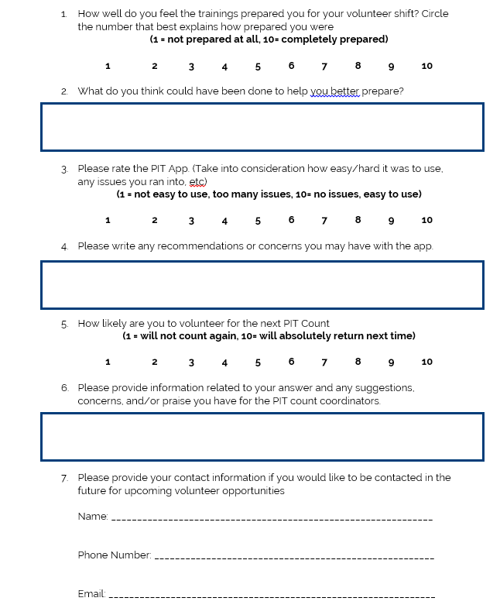
Debrief Template
Module 6
Wrap-up
Notes:
Here is a sample feedback form. It will also be available on our website for download. You can use paper surveys or use free survey software like google form.

Slide 49
Takeaways from 2020 Count
Clearer guidance needed for DV providers
Clarification needed on Paper Surveys
Issues with Hotel Observation Surveys
Wrap-up
Wrap-up
8
Notes:
Based on feedback I received from the last count these are the main issues that communities encountered. Rest assured that they have been at the forefront of my mind for the count planning this year and I will discuss our solutions in detail during the upcoming PIT trainings. Please feel free to chat in if you thing other main points should be added onto this list.

Slide 50
Updates on the 2021 Count
Trainings will now be in the form of Training Courses:
  To create consistency across the PIT regions
  To ensure data quality
  To limit need for long in-person trainings
Everyone will need to complete their associated course before registering for the count
All Training Courses will include:
  General PIT information
  Guidance on how to approach individuals experiencing homelessness
  In depth explanation of the most important PIT count questions
  Training on the mobile app and the command center
There will be a series of optional webinars for targeted technical assistance. These will be mandatory for new PIT communities.
Wrap-up
8
Notes:
As you can tell we are taking a whole new approach to training for this year for a number of reasons. I have create a series of Litmos courses that each person involved with the PIT will complete (depending on your role). The main reason is that we wanted to establish consistency amongst the information that volunteers are receiving. We also wanted to give people a safe alternative to their usual in person community trainings. You will still be permitted to do your own community trainings as you see fit; however, every volunteer will need to watch these courses before being able to register for the count.

Slide 51
Training Course Estimated Time
Estimated Time
If you are a PIT Lead: (Total: 1.5 hours)
PIT Lead Training 30 minutes
Scenario Based Training 20 minutes
Full Mobile App Training 25 minutes
Web Portal Training 15 minutes
If you are a Volunteer: (Total: 1 hour)
Volunteer Training 15 minutes
Scenario Based Training 20 minutes
Full Mobile App Training 25 minutes
*Optional- Web Portal Training 15 minutes
Wrap-up
Module 4
8
Notes:
Here is the basic template for the amount of time each role will be spending on their training portions. If you have any questions or concerns please contact me directly so we can talk through them and develop a plan.

Slide 52
Coronavirus and the PIT Count
We have not received a finalized decision from HUD regarding the 2021 PIT Count. There is no timeline for when we will receive word either.
For now, THN will be moving forward under the impression that the count will still be occurring. Any guidance we receive will be sent directly to PIT Leads.
Be patient with yourselves and with us as we navigate this coming count. The safety and well-being of our PIT leads, volunteers, and those experiencing homelessness are our number one priority. We will provide separate training materials specifically related to Coronavirus and they will be released to all PIT leads and volunteers as they are created.
Wrap-up
Wrap-up
8
Notes:
Now it is really important that I spend a few minutes talking about the current situation we find ourselves in. As many of you know, COVID 19 is very much still a legitimate threat in our communities. With this being said, we are unsure of how HUD will approach the count for this year. Especially since this year is one of the mandatory count years for all CoC’s.
There is no timeline for when they will make a decision nor do we have any idea what that decision may be. For now, THN will still be moving forward under the impression that the count will still be on track. As soon as we receive any guidance the PIT leads will be the first to know.
While we are waiting to hear from HUD I would encourage every community to be proactive. Start working together to determine your anticipated needs of Masks, gloves, hand sanitizer and other PPE. Please note that this is not to say that THN will be able to provide every community with these things. But we will work with you all to start developing plans and strategies to try and secure as much as possible.
Please also know that the safety of PIT leads, volunteers, and those experiencing homelessness is our number one priority. We will carefully consider our options and are open to making adjustments to how we approach the count depending on what feels safest at the time.

Slide 53
Next Steps
Start creating your PIT committee
Start compiling list of anticipated PPE needs
Regularly look at the THN website to gain access to the most up to date training materials and resources.
Watch the Scenario Based Training Course
Watch the Full Mobile App Training Course
Watch the Web Portal Training Course
Wrap-up
Wrap-up
8
Notes:
For now, the first step is developing your planning committee and identifying the roles each person will play.
Also please consider if you are going to be able to add any additional communities to your count and begin scheduling meetings to discuss anticipated community needs in advance of the count.

Slide 54
Quiz
Quiz Time!
Wrap-up
Wrap-up
8
Notes:
Who should you be assigning a Team Lead role to?
Someone with experience in the homelessness sector
Someone who expresses interest in a leadership role
Both B&C
The first person to sign up as a volunteer
2) What should your volunteer debrief process include?
Critical incident procedure
Questions about their likelihood of returning for the next count
Questions about how prepared they felt for the count
All of the above
3) Once you complete this quiz you are done with the training process and can register for the mobile app.
True
False

Slide 55
Thank you!
Contact Information
Kyra Henderson
Data Coordinator
Email: Kyra@thn.org
Phone: (512) 861-2192
Notes:
Here is my contact information if you have any questions or need any additional help in the mean time. Thank you so much for everything you do. This count wouldn’t be possible without you!

