Slide 2

Module 1
Module 2
Winter PIT Count Date:
1/26/2023
Module 3
Module 4
Module 5
Module 6
Wrap- Up
Notes:
This is the PIT date for this year.

Slide 3
Agenda
Module 1
Module 2
Point-in-Time (PIT) Basics
PIT Count Methodology
Module 3
Unsheltered PIT Planning
Sheltered PIT Planning
Module 4
Mobile App Logistics
Summary
Module 5
Wrap-up/ Next Steps
Module 6
Wrap- Up

Slide 4
Coronavirus and the PIT Count
Module 1
Module 2
We have not received guidance from HUD regarding the 2023 PIT Count. There is no timeline for when we will receive word either.
For now, we plan on going forward with our 2023 PIT count with both a sheltered and unsheltered count.
Be patient with yourselves and with us as we navigate this upcoming count. The safety and well-being of our PIT leads, volunteers, and those experiencing homelessness are our number one priority.
  We will provide separate training materials specifically related to Coronavirus and they will be released to all PIT leads and volunteers as they are created, and as we get more information from CDC and HUD.
Module 3
Module 4
Module 5
Module 6
Wrap- Up
Notes:
At this time we have not received word from HUD regarding Covid-19 and the 2023 PIT count. In 2022 we were able to return to conducting both a sheltered count and an unsheltered count. We plan on doing so again in 2023 as long as it is safe to do so. The COVID situation is still very fluid. We can’t predict if there will be another variant or spike in cases. As we approach the count we will have a better idea of what that is looking like. The safety of everyone involved is our number one priority here so we will be keeping an eye on the situation and update you accordingly.

Slide 5
Point-in-Time (PIT) Basics
Module 1
Module 2
How many people are currently experiencing homelessness in your community?
How many of them are families, youth, or veterans?
What do they report as their causes for homelessness?
The answers to these questions and more can be answered by point-in-time counts.
A point-in-time count is an unduplicated count on a single night of the people in a community who are experiencing homelessness
Module 3
Module 4
Module 5
Module 6
Wrap- Up
Notes:
Here are some of the questions that the PIT count aims to answer as well as the definition of the PIT count. The point-in time count is an unduplicated count on a single night of the people in a community experiencing homelessness. The other way I like to explain it is that the PIT count is the minimum number of individuals experiencing homelessness, in your community, on a single night.

Slide 6
Module 1
Extent
Funding
Awareness
Raise Community Awareness
Advocate to local governments
Module 2
Characteristics of those experiencing homelessness locally
Module 3
Trends in Homelessness over time
Module 4
Advocate for private or local government funds
Eligibility for CoC, ESG, and other federal funding
Module 5
Develop personal relationships with those experiencing homelessness
Create a sense of responsibility with varied stakeholders
Module 6
Engagement
Wrap- Up
Notes:
There are four main reasons that we conduct the PIT count represented here in this graphic. We conduct it for Awareness to advocate to local governments and raise community awareness. To understand the extent of homelessness by identifying trends in homelessness over time and the characteristics of those experiencing homelessness locally. To secure funding as the PIT can be used for eligibility for CoC and ESG federal funding as well as to advocate for private or local government funds. And finally for engagement as the PIT count allows us to develop personal relationships with those experiencing homelessness and create a sense of responsibility with various stakeholders.

Slide 7
THN Information
Module 1
Texas Homeless Network (THN) is a non-profit membership-based organization helping communities strategically plan to prevent and end homelessness.
THN works to end homelessness in Texas by collaborating with all communities, large and small, across the state to build systems to achieve this goal.
We coordinate local and national advocacy efforts, data collection and research, host an annual statewide conference, and serve as the host agency for the Texas Balance of State Continuum of Care (CoC) where we assist in the coordination of programs and funding.
The Texas Balance of State CoC (TX BoS CoC) is made up of all service providers, advocates, local government officials, and citizens who work to eliminate homelessness in 215 of Texas’ 254 counties.
Module 2
Module 3
Module 4
Module 5
Module 6
Wrap- Up
Notes:
I’m not going to go over this slide in depth, I just think that it is valuable to include a slide detailing what Texas Homeless Network does as well as clearly explaining the difference between the two divisions of our staff. The Texas Balance of State team focuses on 215 of Texas’ 254 counties, while our statewide initiatives team focuses on efforts across the state and coordinates directly with the other CoC’s.

Slide 8
Who to Contact
Module 1
Module 2
If you have questions about:
If you have questions about:
Community Information
Shift times
HQ location
Assigned count areas
Count Logistics
Who & where we count
Survey length/questions
Identifying hot spots
Technical issues
Module 3
Module 4
If you can’t reach your PIT Lead:
Data Manager
Module 5
PIT Lead
If you can’t reach the Data Manager
Module 6
Wrap- Up
THN Administrator
Notes:
Here is a flowchart that demonstrates how our roles work together. This is a simplified chart on how we communicate with each other depending on the type of information. Just to give a quick overview, for most situations involving logistics, direct your questions to me. My contact information is at the end of the presentation. If you have questions about community information, contact your PIT leads.

Slide 9
Who to Count
Module 2
Individuals residing in:
Unsheltered Locations
Sheltered Locations
-Street
-Outdoor Encampment
-Other places not meant for habitation
- Emergency Shelter
- Domestic Violence Shelter
- Transitional Housing
Hotel/Motel paid for by an Agency Voucher
Module 3
Module 4
Module 5
Module 6
Wrap- Up
Notes:
Now for a quick overview of the count itself. This slide is meant to demonstrate the types of individuals you would survey for the PIT count. The count is broken into two pieces, the sheltered count and the unsheltered count. We look for individuals residing in unsheltered locations such as the street, an outdoor encampment, and other places not meant for human habitation. We also look for individuals residing in sheltered locations such as an emergency shelter, domestic violence shelter, transitional housing, and hotels or motels paid for by an agency voucher. Again, please remember that the count involves you directly interacting with each person experiencing homelessness and conducting a survey with them.

Slide 10
Who NOT to Count
Module 2
Individuals residing in:
Permanent Housing
Temporary Situations
- PSH or RRH Programs
- HUD VASH projects
-FEMA projects
- Doubled Up with family or friends
- At-risk of homelessness
- Hotel/motel paid by own funds
- Shelters designed for foster care
-Sober living/ halfway houses
- Criminal Justice or Health facilities
Module 3
Module 4
Module 5
Module 6
Wrap- Up
Notes:
Now that we know who to count, I think it is important to highlight those that we do not count under HUDs definition of literal homelessness. We do not count individuals residing in permanent housing. This includes Permanent supportive housing and rapid rehousing programs as well as HUD VASH and FEMA Projects. We do not count those who are at risk of homelessness or in temporary living situations. This includes those at risk of eviction, doubled up with friends or family, hotels and motels paid for by their own funds, foster care, sober living, halfway houses, as well as criminal justice or health facilities such as a jail or hospital.

Slide 11
Youth Specific Considerations
Module 2
Who counts?
Who doesn’t count?
children and youths are living in motels, hotels, trailer parks, or camping grounds due to the lack of alternative adequate accommodations; are living in emergency or transitional shelters
children and youths who have a primary nighttime residence that is a public or private place not designed for or ordinarily used as a regular sleeping accommodation for human beings
children and youths who are living in cars, parks, public spaces, abandoned buildings, bus or train stations, or similar settings; and iv. migratory children
Children and youth who are sharing the housing of other persons
Children and youth who are abandoned in hospitals; or are awaiting foster care placement
Module 3
Module 4
Module 5
Module 6
Wrap- Up
Notes:
Some of you in this training may work at a school or may be familiar with the homeless definition that is used by school districts. To help with confusion I created this slide to explain the differences between who counts for the PIT count vs. the parts of the school district definition that don’t apply to the PIT. You will notice that on this slide I have highlighted several phrases in red font. The parts in red font are the aspects of this school definition that do not fit into the PIT count definition. Those include: children and youths who are sharing the housing of other persons due to loss of housing, economic hardship, or a similar reason; are abandoned in hospitals; or are awaiting foster care placement; substandard housing. So while these students may count as homeless with their school, they do not qualify as counting for the PIT.

Slide 12
Unsheltered PIT Planning
Module 3
A count of people who are unhoused but not in a shelter or transitional housing program is referred to as an unsheltered count.
The unsheltered count requires identification of persons that are living in places not meant for human habitation on January 26th.
Module 4
Module 5
Module 6
Wrap- Up
Notes:
Now we are going to talk about the Unsheltered PIT. The Unsheltered PIT, often referred to as the street count, is a count of the individuals who are residing in places not meant for habitation.

Slide 13
Possible Locations
Abandoned building
Bus, train station, airport
Park
Street/sidewalk
Tents
Under bridge/overpass
Vehicle (car, van, RV, truck)
Woods/outdoor encampment
Module 3
Module 4
Module 5
Module 6
Wrap- Up
Notes:
The locations that we can consider for the unsheltered count, include abandoned buildings, bus, train station, and airports, parks, streets, sidewalks, tents, encampments, under bridges and overpasses, and vehicles such as cars, vans and RVs. PIT Leads should create a map or list of common areas where people can be found, this can be used to help inform volunteer routes. Prepare for the unsheltered count by creating your map zones, areas that teams of volunteers will cover during the count. Seek input from your PIT Count committee, community partners, and people with lived experience when mapping your survey locations. You may need to update your maps closer to the date of your count, as the locations frequented by people experiencing unsheltered homelessness may change. We recommend looking for hotspots 1 to 2 weeks before the count.

Slide 14
Creating Known Locations Map
Work together with your PIT leads to start a list of locations where you see individuals experiencing homelessness living
  Visit the locations at least once a month leading up to the count
  Visit locations several times during the week leading up to the count.
This list will likely change over time and will need regular updates. Collaborate with your PIT leads on the best way to send your updates
PIT Leads should provide you with a map as well as a list of locations on the day of the count.
Module 3
Module 4
Module 5
Module 6
Wrap- Up
Notes:
Your PIT leads will start the process for known location mapping; however, they will require your knowledge and expertise to ensure that this list is as comprehensive as possible. Please do not hesitate to reach out to your PIT lead to brainstorm ways you can help them update their list with any locations you are aware of. You may notice that you will start seeing more locations where individuals experiencing homelessness are residing as you are driving around on your normal routine. This is the type of information your PIT leads will need and I would encourage you all to get specific insight into how they would like for this information to be documented and maintained in the months leading up to the count. Please make sure to visit hotspot locations regularly in the months leading up to the count as these areas might change. Communicate these changes with your PIT lead.

Slide 15
Safety Considerations
Do
Don’t
Module 3
Wake up someone*
Approach if you don’t feel comfortable*
Mandate participation
Invade personal space
Cross barriers
Promise anything you can’t deliver
Be judgmental
Give money or offer rides
Share any confidential info or photos of participants
Panic
Put anyone in danger
Deviate from the survey
Always work in teams
Be respectful of space
Ask a person to participate if you think they are homeless
Introduce yourself and explain what you are doing
Be sincere and caring
Remain calm
Know how to de-escalate
Know emergency numbers
Honor requests to not participate
Provide shelter information if possible
Dress appropriately
Leave valuables behind
Module 4
Module 5
Module 6
Wrap- Up
Notes:
The safety of PIT Leads and Volunteers are our highest priority so please read over this list prior to the night of the count. This list is specifically geared towards those doing the unsheltered count; however, many of the tips still apply to the sheltered count as well. It is always important to be mindful of the population that we are surveying and understand the situation they are in. Homelessness can cause a great deal of psychological and physical trauma, so always be respectful of them as you would to your own neighbors.
Do not wake people up, don’t put yourself in a situation that makes you uncomfortable, don’t promise things you can’t deliver, don’t share confidential information, or deviate from the survey. The first two items on this list are scenarios in which you would do an observation survey.
The main takeaways are that you should be respectful, calm, sincere, and prepared. While you are unlikely to experience dangerous situations, it is important to have a safe place in case de-escalation is required.

Slide 16
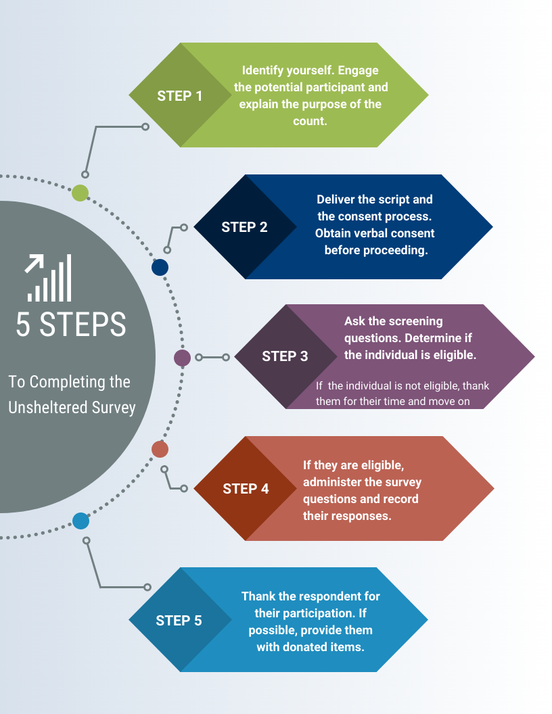
Module 3
Module 4
Module 5
Module 6
Wrap- Up
Notes:
Here are 5 steps to completing the unsheltered survey. Make sure to start by identifying yourself and stating the purpose of the count. Remember to always obtain consent to the survey. Once you have obtained verbal consent to the survey, you may now begin to ask screening questions to determine if the individual is eligible. If they are not eligible, thank them for their time and move on. If they are eligible, administer the survey questions and record their responses. Lastly, ensure that you thank the respondent for their participation, and if possible provide them with donated items, care packages, information pamphlets, and resources.

Slide 17
Tips and Tricks
Read over all of the materials provided to you at least the night before the count
  Resources will also be posted on the THN website (hyperlinked)
Come prepared wearing appropriate clothing, shoes, and with enough water and food for your volunteer shift.
Make sure your phone/smart device is charged and bring portable charger if possible.
  Have the app downloaded and be logged in prior to going to your headquarters location
Practice, Practice, Practice
  Have your introductory script ready
  Practice reading through the survey questions out loud
Reach out to PIT leads if you have any questions or concerns in advance of the count.
Module 3
Module 4
Module 5
Module 6
Wrap- Up
Notes:
Here are some tips for the Unsheltered count.
Your PIT leads will be providing you a packet of information in advance of the count. It should include the map of your locations, day of count checklist/cheat sheet, volunteer interviewing guide, and any other resources they feel like you will need. If you have not received these items, please reach out to them directly. You will also find some of these materials available on the THN website under the volunteer materials section which is hyperlinked on this slide.
Additionally you should plan on what clothing and shoes you will be wearing as well as ensuring that your cell phone or smart device is charged to collect surveys throughout the entirety of your shift.
Also, please prioritize time to practice. Practice your introductory script and also make sure that you have spent time reading through the survey questions out loud so you are familiar with the phrasing and the order of the questions. The scenario based training will provide more detailed instruction on how to approach those experiencing homelessness as well as different types of script ideas you can use. The more comfortable you are with the survey the more this interaction will feel like a conversation as opposed to a survey. The closer this interaction mirrors a conversation, the better your results will be and the more meaningful the entirety of the process will be .
Finally, if at any point through this process you have questions or concerns please reach out directly to your PIT lead. If you do not receive a timely response you are always more than welcome to reach out to me and I will do my best to assist you. ***

Slide 18
Sheltered PIT Planning
HUD defines sheltered homeless persons as adults, children, and unaccompanied children who, on the night of the count, are living in shelters for the homeless.
Regardless of funding source, all providers of shelter, vouchers, or funds for shelters (including motel/hotel rooms), and/or transitional housing need to provide unduplicated information about the individuals and families on January 26th, 2023.
To be considered for the PIT Count:
  The primary intent of the project is to serve literally homeless persons,
  The project verifies homeless status as part of its eligibility determination, and
  The actual project clients are predominantly homeless (or, for permanent housing, were homeless at entry).
Module 4
Module 5
Module 6
Wrap- Up
Notes:
Now let's talk about Sheltered PIT planning. For the sheltered count we survey people residing in emergency shelters (which includes cold weather shelters, domestic violence shelters, and hotels/motels paid for with agency vouchers) and transitional housing.
In order to be considered an emergency shelter or transitional housing project, they have to meet the following 3 criteria. 1 The primary intent of the project is to serve literally homeless persons, 2 the project verifies homeless statuses as part of its eligibility determination, and 3 the actual project clients are predominantly homeless.

Slide 19
Locations
Emergency Shelters: means any facility, the primary purpose of which is to provide a temporary shelter for the homeless in general or for specific populations of the homeless and which does not require occupants to sign leases or occupancy agreements.
  Domestic violence shelters
  Hotel, motel, or apartment vouchers paid for by a public or private agency because the individual or family is homeless
*For Emergency Shelters, you should conduct the surveys in the late afternoon/evening when participants are checking in to stay the night.
Transitional Housing: is designed to provide homeless individuals and families with the interim stability and support to successfully move to and maintain permanent housing. Transitional housing may be used to cover the costs of up to 24 months of housing with accompanying supportive services. Program participants must have a lease (or sublease) or occupancy agreement in place when residing in transitional housing.
Module 4
Module 5
Module 6
Wrap- Up
Notes:
To help give a more detailed explanation of the location definitions. Here are the HUD definitions of emergency shelter and transitional housing. Emergency shelters are any facility where the primary purpose is to provide a temporary shelter for people experiencing homelessness in general, OR for specific populations, that do not require occupants to sign a lease or occupancy agreement. Transitional housing is designed to provide homeless individuals and families with interim stability and support to successfully move to and maintain permanent housing.
Just a quick note, for emergency shelters our recommendation is that you conduct the surveys when people are checking in for the night.

Slide 20
Locations Continued
Your PIT Lead should be providing you with a list of agencies prior to the day of the count.
  If you have not received a list please contact your PIT lead.
  If you believe there is an agency that should be on this list, please contact your PIT Lead and they will reach out to me if necessary.
To view the list of agencies that participated last year, please visit the THN website and download the Housing Inventory Count (HIC) Report
  Link to website
**If you represent an agency that provides Hotel/Motel vouchers for individuals experiencing homelessness, please contact me ASAP**
Module 4
PIT Measures People
HIC Measures Housing
Who & Capacity for Crisis
Module 5
Module 6
Wrap- Up
Notes:
To help you identify the list of sheltered locations please use the Housing Inventory Count to determine which shelters have counted in the past. The visual at the bottom is meant to illustrate the connection between the PIT and HIC and how they can work together to show the comprehensive picture of your community needs and your capacity to respond to those needs.
If you know of any agencies that will be providing hotel/motel vouchers on the night of the count, please contact me immediately so we can discuss the process for conducting those surveys.

Slide 21
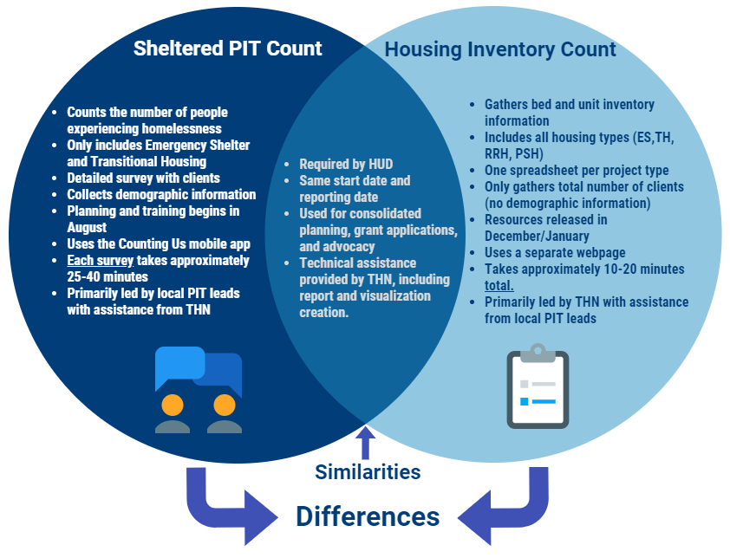
PIT Count Vs. HIC
Module 4
Module 5
Module 6
Wrap- Up
Notes:
Here is a Venn diagram to demonstrate the similarities and differences between the sheltered PIT and the HIC. I won't go through each bullet point. But if I were to give you a summary, the key differences are that the PIT requires individual surveys of each client residing in the emergency shelter or transitional housing program. Each survey takes approximately 25-40 minutes. Whereas the HIC only requires you to fill out one form for each housing project your organization has, which amounts to about 10-20 minutes total. They both are required by hud, happen at the same time, and I provide technical assistance for both. The Pit is driven by local leads with support from THN. The HIC is driven by THN with support from local leads.

Slide 22
Domestic Violence Protocol
Notice CPD 17-08:
HUD is requiring that data reported on survivors of domestic violence should be limited to reporting on those who are currently experiencing homelessness because they are fleeing domestic violence, dating violence, sexual assault, or stalking, as opposed to reporting on survivors who have ever experienced these circumstances.
Question on the survey: Are you currently staying in this shelter because of domestic violence? (Including: dating violence, sexual violence, and/or stalking)
Module 4
Module 5
Module 6
Wrap- Up
Notes:
I want to spend a little bit of time talking about the specific process for surveying at a domestic violence shelter. To give you some context, the PIT count is only gathering information on those who are actively fleeing a domestic violence situation. The question is not asking if someone has ever experienced domestic violence.
The question on this slide is the exact language in the PIT app.

Slide 23
Surveying Survivors
Do
Don’t
Explain that the survey is confidential and all identifying information is removed for their safety.
Use their initials or a code for their name (if they don’t want to give you their initials).
Fill out their age range.
Complete the remainder of the survey with them.
Write in the notes section of the survey that they are a survivor so I can make sure their location is secure.
Provide any information on support that your PIT lead provided you
Fill in their full name
Fill in their date of birth
Fill in their exact age
Provide any identifying information in the notes section
Pressure participants into answering any questions they don’t feel comfortable answering.
Express disbelief or pity to answers on the survey by survivors.
Module 4
Module 5
Module 6
Wrap- Up
Notes:
Here are some do’s and don’t around surveying DV survivors. Please make sure that your volunteers go over this list prior to the day of the count.
Do not fill in the full name or the date of birth or the age of the survivor. You will provide their age range and any demographic information they share though. Please do not provide any identifying information in the notes section. Once you have gotten past the name and age questions please continue filling out the rest of the survey with them.

Slide 24
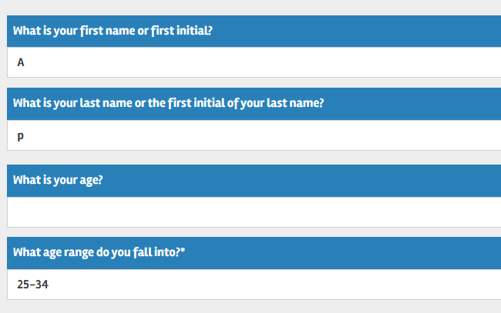
App Screenshot
Module 4
Module 5
Module 6
Wrap- Up
Notes:
Here is a screenshot of the mobile app and what the beginning section of your survey should look like when surveying domestic violence survivors. Again: you will be filling out the entire survey with the participants. You are only skipping the full name, date of birth, and exact age. We recommend putting in initials for DV survivors, and age ranges, but no other identifying information

Slide 25
Tips and Tricks
Verify list of agencies for your community prior to the PIT count.
  Contact your PIT Lead if one appears to be missing.
Work with your PIT Lead to set up either a phone call or a visit with each shelter you plan to count at.
  Take note of their confidentiality protocols as well as their visitor policy.
  Be respectful and follow the direction of shelter staff at all times.
Maintain contact with your assigned shelter leading up to the count.
  Identify the time you will be helping survey and how long they anticipate needing your assistance.
Module 4
Module 5
Module 6
Wrap- Up
Notes:
If you are a volunteer who will be helping out with the sheltered count, please work with your PIT lead on establishing regular check ins prior to the count. If you are not a staff member at the shelter where you will be surveying, please take note of any confidentiality standards they have as well as their visitor policies. Follow their instructions at all time and ensure that your PIT lead has introduced you to the staff you will be working with prior to the day of the count.

Slide 26
Unsheltered and Sheltered Counts
Do
Don’t
If you have obtained consent
Do not complete a survey without consent
Do not continue the survey if the individual has expressed the desire to end the survey
Do not complete a survey based on an intake form unless you have specifically obtained consent to do so.
Module 4
Module 5
Module 6
Wrap- Up
Notes:
Let’s have a quick conversation about the importance of obtaining consent from participants. You are only permitted to conduct a survey if you have been given verbal consent to do so. You cannot complete the survey if you haven’t obtained consent, or if you haven’t physically laid eyes on the individual on the day of the count. If the individual wants to leave the conversation stop the survey and submit it. If they revoke their consent and ask you to delete the survey responses, please do so. Absolutely do not try to convince, coerce, or persuade someone to participate in the survey. If you are unable to complete the sheltered or unsheltered surveys for the above reasons, you have the option of completing the observation survey.

Slide 27
Observation Survey
Do
Don’t
Someone is sleeping
You do not feel comfortable going to a certain area
A person did not give their consent to participate in the survey or they don’t want to complete the survey in it’s entirety
Someone does not seem to understand the consent process and cannot reasonably consent to the survey.
Fill out an observation survey if you have not laid eyes on the individual that day
Module 4
Module 5
Module 6
Wrap- Up
Notes:
Observation surveys can be conducted in both sheltered and unsheltered locations. You will use the observation survey if someone is sleeping, you are unable to approach the individual, or if they do not consent to the survey. To conduct this survey you must believe they are experiencing homelessness. Do not complete a survey using intake forms or based off of previous interactions. You must see the person on the day of the count. We do not gather any personal information, or make any assumptions about the person based on appearance, no matter the circumstances.

Slide 28
If you are in a Sheltered location
Complete Sheltered Survey
Person Consented to survey
If you are at an Unsheltered location
Complete Unsheltered Survey
Person did not consent to survey
Complete Observation Survey
Safe to approach
Module 4
Person could not consent to survey
-They were sleeping and/or they did not understand the consent process
Complete Observation survey
Encounter someone you believe is experiencing homelessness
Module 5
Person reported that they are not experiencing homelessness
Thank them for their time.
DO NOT COMPLETE A SURVEY
Module 6
Unsafe to approach
Complete Observation survey
Wrap- Up
Notes:
This is a decision tree that was created for volunteers to help you determine which survey to choose. It is color coded based on the survey type. The red and orange colors indicates decisions leading to the observation survey, the dark blue is for participants that are not eligible to be surveyed, which happens if the person reports to you they are not homeless. The purple is for unsheltered surveys. The green is for sheltered surveys.

Slide 29
Best Practices for Sheltered Count
Familiarize yourself with the survey
  Practice reading all of the questions out loud.
  Practice giving your introduction script out loud.
Communicate your intentions to prospective survey participants
Obtain consent to administer the survey
Express confidence and compassion
When surveying individuals within a group, prioritize safety and protect participant’s information
  Whenever possible, attempt to give participants as much privacy as they request.
Know volunteer expectations
Know community resources
Review this training again in the month of January to refresh your knowledge
Module 4
Module 5
Module 6
Wrap- Up
Notes:
These are the overall guidelines for how to follow best practices when it comes to conducting the PIT count. Always obtain consent, express confidence and compassion, and prepare well in advance so you feel comfortable with the questions you will encounter.

Slide 30
Registration Information
Registration Link: txbos.pointintime.info
Tutorial Video (hyperlinked)
COVID Waiver Link (hyperlinked)
Reminders:
Required for all PIT Leads and Volunteers
If this is your first time registering, you will need to follow the instructions for setting your password.
If you are a returning volunteer you can click update registration and follow the prompts to update your old password.
Ava cannot reset your password for you, they can only tell you which email you registered under.
Module 5
Module 6
8
Wrap- Up
Notes:
I am not going to spend too much time discussing the mobile app in this training, because there are a series of quick tutorial videos dedicated solely to that. I do however want to include the summaries for each of the mobile app sections for you to look back on if you need.
This year I have taken a different approach on how to do the mobile app training specifically. Now volunteers have two different options for accessing this information. You can either watch one full tutorial video on all the sections of the mobile app. Or you can watch short tutorial videos for only the specific sections which apply to you. The full video is hyperlinked on the last slide of this presentation. The short tutorials are hyperlinked on the associated slides.
Either route will give you the same information. It is just a matter of whether you would like to watch everything at once. Or space out your learning.
The first reminder I have for you is that all PIT leads and volunteers need to register through the THN registration portal. This is required regardless of whether your community has your own additional registration process. I will go through the options for how to reset your password in the tutorial video that is hyperlinked on this slide. ***

Slide 31
Mobile App Basics
Website Url: Counting.us
App Developer: Simtech Solutions Inc.
Tutorial Video (hyperlinked)
Reminders:
You will need to go through the registration process before using the mobile app
  If you haven’t already set your password, you can do it on the mobile app by selecting forgot password
Please make sure you are registered under the 2022 PIT Count.
  If you do not see 2022 PIT count anywhere, click change count and type in the setup key: TX2022
As long as there is a yellow highlight on the top of the screen, the count is in test mode and you can practice.
You will need access to internet or data to download the app
  You will also need to have access in order to submit surveys
  You can conduct surveys and save them as a draft without a connection
You are encouraged to do practice surveys up until 11:59 pm on 01/26/2023 (the night before the count)
  Any surveys submitted after that time are viewed as legitimate surveys
Module 5
Module 6
8
Wrap- Up
Notes:
Quick reminders about the app. You can download it as an app from the app store on any smart device or you can use the webpage url. My personal recommendation is to use it on a phone or a computer instead of a tablet because there was some issues on the tablet optimization.
TO register for the app you will need to go through the registration page I referenced on the last slide. If you do that, it will automatically have you registered for the correct count activity. If you forget to do that first though, you can always use the set-up key to ensure that you are counting on the correct count activity.
Remember, you have until midnight the night before the count to practice inputting surveys.

Slide 32
Hot Spot Mapping Survey
Tutorial Video (hyperlinked)
Reminders:
This survey is only available prior to the count in order to help out with planning.
  Ask your PIT leads if this is a tool they plan on using. If not, you can skip this slide
The intention of the hot spot map is to give the PIT leads an idea of where individuals are observed to be experiencing unsheltered homelessness throughout your geography leading up to the count.
  This will then be used to determine approximately how many volunteers are needed for the count as well as which locations need to be covered.
There are only two pieces of the Hot Spot Mapping Survey
  You will need to ensure that you are tagging the surveys in the correct spot. IE you either need to fill it out as soon as you see the unhoused neighbors (because your gps will drop a pin where you currently are)
    Or you will need to remember the cross streets of where they were located so you can manually move the pin
  The only other thing this survey requires is that you estimate the number of individuals residing at that location.
Module 5
Module 6
8
Wrap- Up
Notes:
This survey is new this year and is specifically for PIT count planning. The only people who need to worry about this are those that have been informed by your PIT leads that you are participating in hot spot mapping. If your community is not using this feature or you haven’t been informed by your PIT lead to submit hot spot surveys, you can skip this slide and this section of the mobile app training.
If you have been asked to complete hot spot mapping surveys. Be sure to look over this list of reminders and watch that section of the mobile app training video.

Slide 33
Sheltered Survey
Tutorial Video (hyperlinked)
Reminders:
Surveys are offered in English and Spanish
First determine if it is a household or individual survey
  You cannot have a household of 1
  Only fill out surveys on individuals and household members that have not already been surveyed.
Select project type before selecting organization and project name
  The list will pre-filter based on your project type
  If you are conducting surveys for clients staying in a hotel paid for by an agency voucher, please contact your PIT lead or myself before proceeding.
If you believe an organization or project is missing from the list, contact your PIT lead and myself
  Please do this well in advance of the count
  Do not select a different shelter that is incorrect. If you are confused about an organization name, don’t guess. Call and ask.
Fill out the survey in order and always fill out the age range before progressing into the next sections of the survey
  Different ages will have different questions asked.
Module 5
Module 6
8
Wrap- Up
Notes:
The sheltered survey has not changed much from last year other than a few questions. Quick reminders though.
You have the option of completing the survey in English or Spanish
You will need to determine the household size before you conduct the survey
Double check that the organization and project where you will be surveying is in the list. If it is not, contact your PIT lead immediately so they can help clear the issue up.
Always fill out the age range before proceeding in the survey.

Slide 34
Unsheltered Survey
Tutorial Video (hyperlinked)
Reminders:
This survey is only reserved for those that are residing in an unsheltered location such as street, car, outdoor encampment, or other places not meant for habitation.
  If someone says they are staying in a shelter later that evening, still fill out the survey with them based on where you encounter them and then ask that they provide you the name of the shelter they will be staying at.
  Type that Organization name in the notes section.
Surveys are offered in English and Spanish
First determine if it is a household or individual survey
  You cannot have a household of 1
  Only fill out surveys on individuals and household members that have not already been surveyed.
Fill out the survey in order and always fill out the age range before progressing into the next sections of the survey
  Different ages will have different questions asked.
Module 5
Module 6
8
Wrap- Up
Notes:
The unsheltered survey reminders are very similar to the sheltered survey reminders. The main difference is that these surveys are only reserved for the people that you encounter in an unsheltered location (ie not an emergency shelter or transitional housing location).
Please fill out the survey based on where you encounter the individual at the time. If they report they will be staying in a sheltered location later that evening, still fill out the unsheltered survey but then write in the notes section which sheltered location they are planning to stay at. This will allow PIT leads to double check with the shelter if that person was there so we can create a sheltered survey for them instead.

Slide 35
Observation Survey
Tutorial Video (hyperlinked)
Reminders:
Observation surveys can be completed in unsheltered locations and sheltered locations.
  You will use this in a sheltered location if a client refuses to participate in the survey. This should only be used as a last resort on sheltered clients though
The observation survey will no longer gather any demographic information
  This is a HUD recommendation and we will continue to follow their guidance. If you need more information, please contact ava@thn.org
Only conduct observation surveys on people you can physically see.
  At a minimum you need to be able to estimate their general age.
Provide as much detail as possible so we can ensure the same people aren’t counted twice.
Module 5
Module 6
8
Wrap- Up
Notes:
Observation surveys are also very similar to how they were last year. The observation surveys can be completed in both sheltered and unsheltered locations. They should only be used in the instances that people don’t or cannot consent to the survey. If you have questions about why the observation survey questions are the way that they are, please reach out to me and I would be happy to discuss it with anyone more in depth.

Slide 36
Saved Drafts
Tutorial Video (hyperlinked)
Reminders:
You will need to submit each draft individually
You have drafts saved if you see a white number in a red circle on the bottom part of your screen. All drafts need to be submitted by 11:59 pm on 1/26/23.
  Any drafts not submitted will not count in the reports
Drafts should only be used if you have no connection to submit the survey
  Submitting them in the moment will save you time in the end.
  This means you will have less to remember at the end of your shift.
You will need to have all the required questions filled out before you can successfully submit the surveys.
Module 5
Module 6
8
Wrap- Up
Notes:
The final reminder about the mobile app is related to saved drafts. Everyone has the ability to save surveys as a draft instead of immediately submitting it at the end of the interview. Because it requires that you individually submit each survey though, I recommend that you do it sparingly. This is because it often will take more time to open up the survey, scroll down, and press submit than it would be to finalize and submit the survey right after the conversation.
The times that I would use the saved drafts are if you do not want to use your wifi or mobile data to submit in the moment. Or you go so engaged in the conversation that you aren’t sure you marked down all the information that was shared. Just a reminder, the app will work in poor reception areas, you will simply just save your survey as a draft or press submit. In the tutorial video I will show you where all the saved drafts live.

Slide 37
Next Steps
Watch the mobile app training video(s)
  The mobile app training is linked here or on our website
Register for the PIT Count
  https://txbos.pointintime.info
Work with your PIT leads to start mapping hot spot locations
There are a series of additional presentations posted to the website to help you engage those with lived experience, youth, veterans, and victim service providers.
There will be additional refresher materials released in January of 2023.
  Please visit our PIT website to view these materials linked here
Wrap- Up

Slide 38
Thank you!
Contact Information
Ava Paredes
Data Coordinator
Email: Ava@thn.org
Phone: (512) 652-4714
Notes:
Here is my contact information if you have any questions or need any additional help in the mean time. Thank you so much for everything you do. This count wouldn’t be possible without you and as always I cannot express my gratitude enough for each and every one of you!

