Slide 1
Utilizing your PIT Data

Slide 2
Agenda
Module 1
Brief Overview of the PIT Count
Why Use PIT Data?
2023 PIT Data
Comparisons
Guiding Principles + Implications
Wrap-Up
Module 2
Module 3
Module 4
Module 5
Wrap- Up

Slide 3
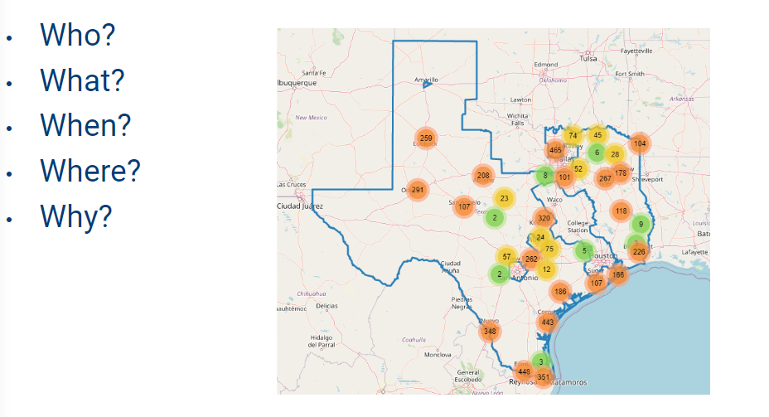
What is the PIT?
Module 1
Module 2
Module 3
Module 4
Module 5
Wrap- Up
Notes:
Who: Individuals and families residing in Unsheltered locations such as cars, parks, streets, sidewalks, and other places not meant for human habitation. As well as individuals and families residing in sheltered locations such as emergency shelters and transitional housing.
What: The PIT count aims to provide a snapshot of the individuals and families experiencing homelessness in a geographical area over the course of one night.
When: Last 10 nights in January.
Where: The Texas Balance of State CoC. The PIT count occurs across our geography in communities like yours. On this screen you’ll see a screenshot of the actual survey results from our mobile app
Why: For awareness in order to advocate to local governments, To understand the extent of homelessness by determining the number of people experiencing homelessness within our geography. To secure funding as the data can be used to secure grant funding. And for engagement as the PIT count encourages communities to get involved in ending homelessness.

Slide 4
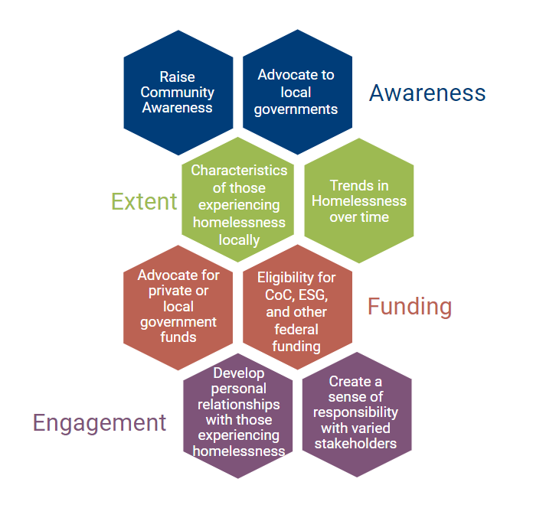
Why Do We Conduct The PIT
Module 1
Module 2
Module 3
Module 4
Module 5
Wrap- Up
Notes:
There are four main reasons that we conduct the PIT count represented here in this graphic. We conduct it for Awareness to advocate to local governments and raise community awareness. To understand the extent of homelessness by identifying trends in homelessness over time and the characteristics of those experiencing homelessness locally. To secure funding as the PIT can be used for eligibility for CoC and ESG federal funding as well as to advocate for private or local government funds. And finally for engagement as the PIT count allows us to develop personal relationships with those experiencing homelessness and create a sense of responsibility with various stakeholders.

Slide 5
Why Utilize PIT Data
Module 2
Most reliable source of data on homelessness
Occurs at the same time across the country
Comprehensive data for numerous demographics
Allows us to gauge the needs of our communities
Allows us to understand our capacity to respond to the crisis
Module 3
Module 4
Module 5
Wrap- Up
Notes:
PIT data is the most reliable source of information on homelessness. Because the PIT count occurs at the same time throughout the county, it provides us a snapshot of homelessness in our communities. Because of the unilateral participation from several communities throughout the geography of the Texas Balance of State CoC, we are able to use this concerted effort to get a comprehensive data set of numerous demographics. We can ultimately use this data to identify populations that are needing more attention, as well as gauge the need of our communities. The Point-In-Time count also happens at the same time as the Housing Inventory Count as well. We will go into more detail later in the presentation, but in short when you look at both of these data sets you can also see the extent of homelessness in your community, and your capacity to respond to it.

Slide 6
2023 PIT Data Highlights
Module 3
Module 4
Module 5
Wrap- Up

Slide 7
2023 PIT Data Highlights Continued
Module 3
Module 4
Module 5
Wrap- Up

Slide 8
Comparison Year Over Year
2022
2023
7,054 Total
9,065 Total
2,845 ES
3,067 ES
Module 4
654 TH
820 TH
Module 5
3,555 Unsheltered
5,178 Unsheltered
Wrap- Up
Notes:
This year there was an overall 46% increase in unsheltered homelessness, and 11% increase in sheltered homelessness. While these increases may seem significant, there are a few considerations to keep in mind when comparing the data. Our count in 2023 occurred on a single night as opposed to being split into two dates like in 2022. We also had increased volunteer recruitment, advanced planning, comprehensive training, and hot spot mapping in advance of the count. The weather was also much clearer, increasing the visibility of our unhoused neighbors and enabling volunteers and communities to conduct more comprehensive counts within their region. Covid also played a significantly smaller role leading to higher engagement overall. When making comparisons year over year for your data keep some of these factors in mind when applying for funding.

Slide 9
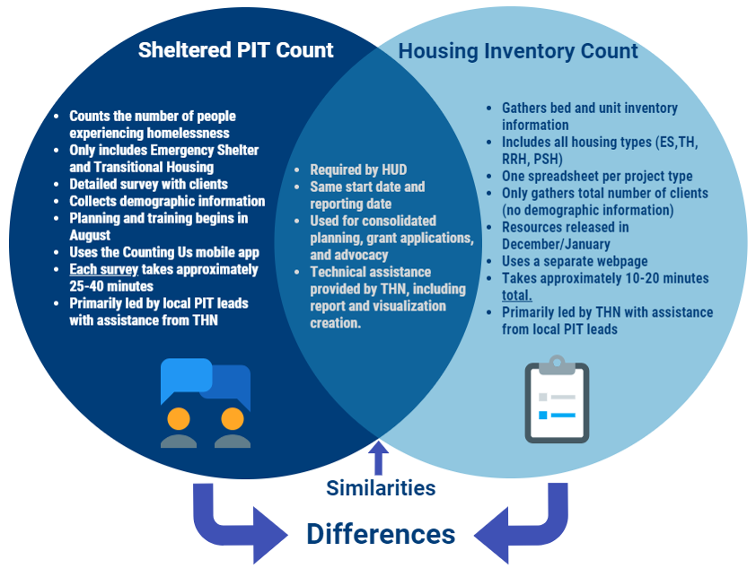
2023 Housing Inventory Count Data
Module 4
Module 5
Wrap- Up
Notes:
Now this is the point that we are going to shift into talking about the housing inventory count briefly. The reason I think it is important to have these counts in the same presentation is because they happen simultaneously and are oftentimes analyzed together. For those that aren’t familiar, the HIC is the annual count of the beds and units designated to serve those experiencing homelessness. It includes both ES and TH (which are counted for the PIT); however, it also includes RRH and PSH beds. A simple way to remember this is that the PIT measures People. The HIC measures Housing. And when you look at them both together it demonstrates the scope of homelessness in your areas as well as your capacity to respond to the crisis
Here is a Venn diagram to demonstrate the similarities and differences between the sheltered PIT and the HIC. I won't go through each bullet point. But if I were to give you a summary, the key differences are that the PIT requires individual surveys of each client residing in the emergency shelter or transitional housing program. Each survey takes approximately 25-40 minutes. Whereas the HIC only requires you to fill out one form for each housing project your organization has, which amounts to about 10-20 minutes total. They both are required by hud, happen at the same time, and I provide technical assistance for both. The Pit is driven by local leads with support from THN. The HIC is driven by THN with support from local leads.

Slide 10
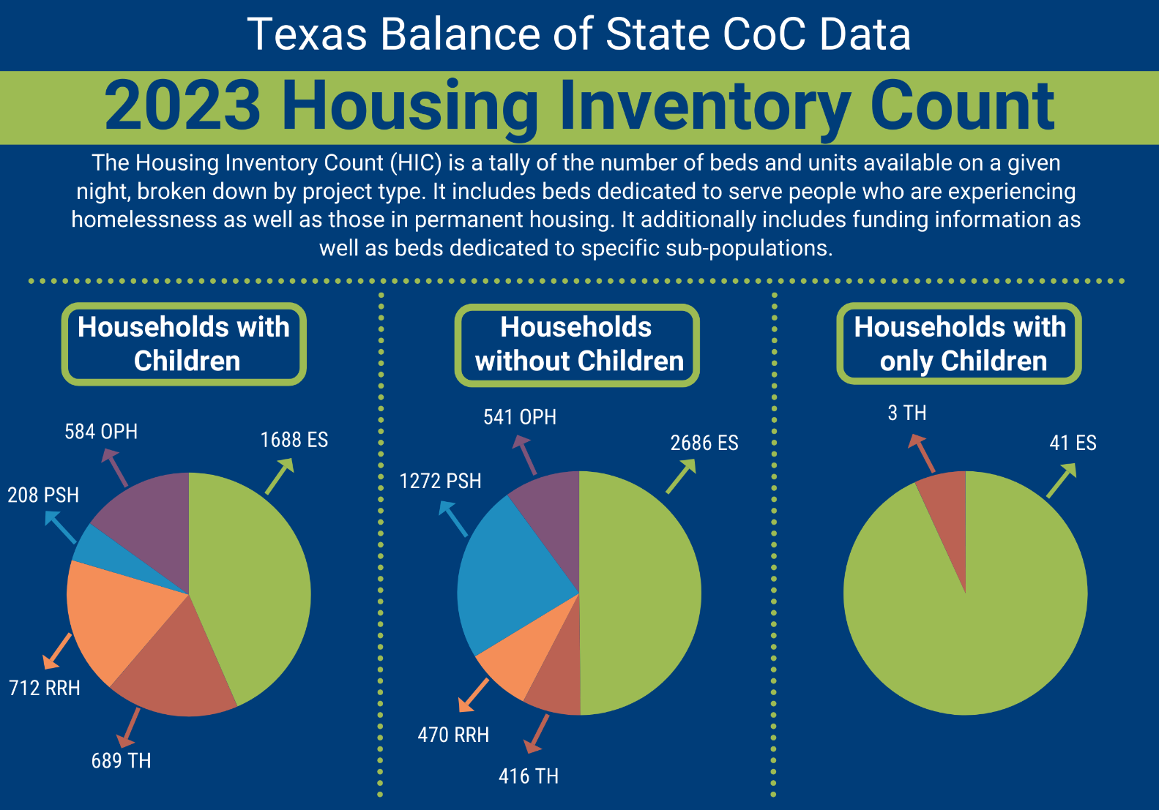
2023 Housing Inventory Count Data
Module 4
Module 5
Wrap- Up

Slide 11
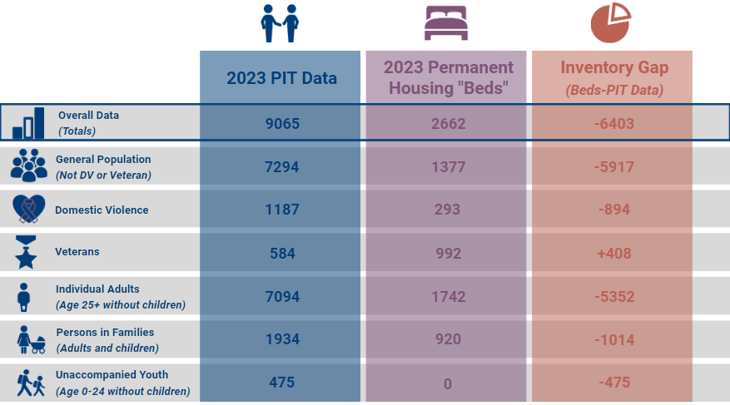
Comparison To HIC Data
Module 4
Module 5
Wrap- Up
Notes:
And here is a comparison of the 2023 PIT data to the Housing Inventory count data. These kinds of gaps analysis are an excellent way to find areas that you might be needing funding for. You can see that while we have a surplus in veteran beds, we have a significant deficit in beds for general population single adults without children. When applying for funding, doing these simple gaps analysis can be crucial when trying to determine the scope and scale of the need within your community. An important goal is to keep in mind is to have the funding needs to align with the interest and the priorities of the LHC. We want the PIT data to drive the conversation. Everyone needs to be on the same page in regards to homelessness within our communities and trying aligning our funding needs with the data. To talk a bit more about that I am going to pass it off to Jim Ward our director of planning.

Slide 12
Applying the PIT to Funding Requests
HUD expects that funding requests are based on verifiable community needs. The PIT and HIC are excellent sources of local data on the needs of your community.
For the CoC Program NOFO, PIT and HIC data fit best into the Narrative sections of your e-snaps application and a number of questions on the CoC’s local application
The CoC will also ask what data sources your Agency used when developing project design, and how those sources contributed to the request. Responses should reflect actual data that supports the funding request.
Avoid targeting specific subpopulations that are not reflected in the PIT.
Module 5
Wrap- Up
Notes:
Responses should reflect actual data that supports the funding request. IE. requesting funding for niche projects that do not align with data collected during the PIT or housing that is already available in the community on the HIC will not score as highly as projects that clearly meet an unmet need identified by the PIT or HIC.
Applicants are strongly discouraged from applying for projects that cannot be supported by data. Ie: 100 units of PSH for veterans and only 8 veterans identified during the PIT count, with a HUD VASH project that is underutilized by the local PHA.
Funders will pick up on whether an application is an opportunity to chase funds or a project is designed to meet community needs.

Slide 13
LHC Strategic Planning
Does your LHC have a strategic plan?
Is PIT growth and enhancement a part of that plan and reflected in annual action planning documents?
Do you have a year round PIT/Data workgroup or committee
Do you have a funding workgroup?
Module 5
Wrap- Up

Slide 14
Wrap- Up
Notes:
(Open Question Time 15 Minutes) Perhaps we can utilize chat for the questions as well.

Slide 15
Links + Resources
Non-Profit Strategic Planning
How to Read your PIT Data Webinar
PIT Reports
CoC Program Intro Webinar
Wrap- Up

Slide 16
Thank you!
Contact Information
Ava Paredes
Data Coordinator
Email: data@thn.org ava@thn.org
Phone: (512)-652-4714
Jim Ward
Director of Planning
Email: jim@thn.org
Phone: (512)-861-2165

