Slide 1
Best Practices for PIT Surveyors

Slide 2
Agenda
Module 1
Module 2
Combatting Myths about Homelessness
Script Options
Module 3
Tips and Tricks
Asking Demographic Questions
Module 4
Asking Subpopulation Questions
Ending the Survey
Module 5
Summary
Module 6
Wrap- Up

Slide 3
Purpose of the Presentation
Module 1
Module 2
Point-in-Time (PIT) Count Leads and volunteers alike have requested additional materials that give specific instruction on how to help those surveying feel more confident when they show up for their PIT count date.
The slides in this presentation were developed using the feedback given by PIT leads, volunteers, and homeless sector staff. Additionally, materials released by The Department of Housing and Urban Development (HUD) and the National Alliance to End Homelessness (NAEH) were referenced in the creation of this presentation.
The purpose of the training is to provide:
Tools to help surveyors assess implicit biases and concerns they may be bringing with them on the day of the PIT count.
Script options for how to introduce yourself on the day of the count and explain the purpose of the count.
Tips to help ensure your interactions go as smoothly as possible.
Insight into the phrasing of certain questions and how to overcome discomfort with asking them.
Module 3
Module 4
Module 5
Module 6
Wrap- Up

Slide 4
Myths About Homelessness
Module 1
MYTHS
People choose to be homeless.
Successfully exiting homelessness is “easy”.
Everyone experiencing homelessness has made “bad choices” to get themselves there.
People experiencing homelessness are dangerous.
If they wanted support and housing they would’ve gotten it already.
Module 2
Module 3
Module 4
Module 5
Module 6
Wrap- Up

Slide 5
The Reality of Homelessness
Module 1
REALITY
To say that homelessness is a “choice” doesn’t acknowledge that most households are a few missed paychecks away from falling into homelessness. There is a clear pattern between the rise in in-affordability and homelessness.
“Bad Choices” stems from the belief that people need to prove they are worthy of support. This perspective discredits the experience of those that have been intentionally marginalized by our systems (predominantly Black and Indigenous peoples). To simply chalk it up to bad choices ignores the very real reality that systemic racism and discriminatory barriers are the actual culprits of the homelessness crisis, not individual “choices”.
Our unhoused neighbors are far more likely to be the victim of crime instead of perpetrators. Additionally, a large portion of the individuals and families that are unhoused are fleeing domestic violence.
There is not enough affordable housing stock to adequately address the need. Additionally, many programs have long waitlists, high barriers to entry, and may not even exist in smaller and more rural communities. When combined with systemic inequities, criminalization, and stigma around homelessness, it paints a clear picture of why there is a persistent housing crisis.
Module 2
Module 3
Module 4
Module 5
Module 6
Wrap- Up

Slide 6
How Might These Myths Show Up For You?
Module 1
Module 2
You may feel really anxious or nervous when you think about talking to unhoused neighbors. Whether this is because you think you may be in danger or you feel like you don’t know how to connect.
You may be uncomfortable asking certain questions on the survey or feel uncomfortable as they recount some of their experiences with homelessness.
You may have the desire to “fix” their housing situation. Whether it be through offering money, transportation, or even somewhere to stay temporarily.
You may feel frustration with actions the unhoused neighbor has (or hasn’t taken).
You may disagree with them on their perception of services in your community.
Module 3
Module 4
Module 5
Module 6
Wrap- Up

Slide 7
Things to Remember
Module 1
Module 2
Having complex feelings, especially if it is your first time intentionally interacting with someone who is unhoused, is normal. Your job is to ensure that you assess what feelings are coming up and utilize your other teammates and the PIT leads to process as needed.
There is a difference between feeling uncomfortable because something is new and because something is unsafe or dangerous. Work with your fellow PIT count partners to help determine where your discomfort may be stemming from.
The purpose of the PIT count is not solving homelessness. The count is one of the tools to assess the characteristics of a communities homeless population. More than that though, it is an opportunity to have community partners go out in the field and start developing relationships with their unhoused neighbors.
Every person has unique perspectives and experiences that they bring with them. Your role is not to center your own perception of the situation. It is to help ensure that if they want to, your unhoused neighbors have the opportunity to share their story.
If you treat people with respect, care, and patience, you are more likely to receive it in return. The individuals are your neighbors, treat them as such.
Module 3
Module 4
Module 5
Module 6
Wrap- Up

Slide 8
Introducing Yourself
Module 2
Do
Don’t
Say your name.
Say the name of the local homeless coalition or the organization you are counting for.
Briefly explain the purpose of the survey.
Explain that participation is voluntary.
Explain that they can end the survey at any time.
State that the survey is confidential.
Speak slowly and with confidence.
Practice your script out loud (before the count) if you are nervous.
Start the conversation by asking if someone is homeless.
Promise that they will be connected with any specific service or housing if they participate.
Mandate participation.
Panic if you fumble on some of your words.
Feel like you need to remember the example script word for word.
Proceed with the survey until you’ve gotten verbal consent.
Module 3
Module 4
Module 5
Module 6
Wrap- Up

Slide 9
Reminder
Module 2
This interaction should mirror a conversation. Do not stress yourself out by trying to memorize, word for word a particular script. The only things you need to highlight when you are providing the script is:
Your name and organization.
A brief summary about the purpose of the PIT count.
Asking for verbal consent if the person is willing to participate.
If you are prone to nerves when speaking with strangers, practice your script out loud with a friend or fellow volunteer.
Try out a few different options if the first one doesn’t feel right.
You may be one of the few positive interactions this neighbor has had as of late, don’t let trying to get the introduction perfect stand in the way of having a pleasant conversation.
Module 3
Module 4
Module 5
Module 6
Wrap- Up

Slide 10
Example One
Module 2
Hello, my name is _______ I am helping conduct a short survey of our community. We would like to learn more about people experiencing homelessness, what kinds of problems they face, and what services they are in need of to move into permanent housing.
Your participation is strictly voluntary, and all of your responses are strictly confidential. Your privacy will be protected and respected. If questions make you uncomfortable, you do not have to answer them.
Would you be willing to take about 15 minutes to answer some questions?
Module 3
Module 4
Module 5
Module 6
Wrap- Up

Slide 11
Example Two
Module 2
Hello, my name is _______ and I’m a volunteer for the [Name of Local Homeless Coalition or Organization]. We are conducting a survey to count individuals experiencing homelessness to provide better programs and services to them.
Your participation is voluntary and your responses to questions will not be shared with anyone outside of our team. I need to read each question all the way through. Can I have about 15 minutes of your time?
Module 3
Module 4
Module 5
Module 6
Wrap- Up

Slide 12
Example Three
Module 2
Hi, my name is ____. I am with______ organization. We’re out here trying to talk to folks who might not have a safe place to sleep tonight. And to ask some questions to help us understand their needs.
Do you have a safe place to sleep tonight? Do you know where I might find some people around here who don’t?
*Pause for response*
Would you be willing to answer a few questions for me related to your experience? It should only take about 15 minutes and you can end the survey at any point. Nothing you tell me will be shared outside of my team.
Module 3
Module 4
Module 5
Module 6
Wrap- Up

Slide 13
General Survey Tips
Do not sneak up or startle people. If you do not believe the person sees you approaching, try announcing your presence with a non-threatening greeting.
Example: “Hello there! I’m sorry to bother you but I wanted to stop by and introduce myself…”
If you are counting when it is dark, ensure that you are doing your best not to wake people up. Also ensure that you are strategically using your flashlight in a way that won’t shine it in people’s eyes.
Maintain eye-contact with survey participants as much as possible and explain why you are looking down when you do:
Example: “Sorry I just want to make sure that I am correctly documenting what you just told me”
When possible, get on the same eye level as the participant. If they are sitting down, squat to be on their level (but maintain your balance). This will help prevent you coming off as superior and/or threatening.
Offer to position yourself in a way that allows the participant to see the survey questions themselves.
If you are a direct service worker, perhaps consider asking the participant if they would like a follow up conversation.
Module 3
Module 4
Module 5
Module 6
Wrap- Up

Slide 14
General Survey Tips Continued
Remember that you are speaking to people in difficult circumstances and asking some very sensitive questions. Always lead with respect for the person you’re speaking with and respect for their dignity.
Speak slowly and if you are asking a particularly long question, double check that the participant understands what you are asking.
Example: “I know that question was long. Please let me know if you need me to repeat or rephrase”
Everyone has the right to refuse to answer any or all of your questions. Inform respondents that it is okay to not answer questions and that they can stop the survey at any time. Do NOT force a respondent to answer a question, especially if they might belong to a marginalized identity where their safety might be compromised
Ask all questions, unless the person has already given the answer to the question over the course of your conversation. Or they have requested that you end the survey.
Always ask questions as they are written; do not ask questions in a way that shows you think you already know the answer.
Example: Ask: “What is your gender identity?” Do not ask: “You’re male, right?”
Module 3
Module 4
Module 5
Module 6
Wrap- Up

Slide 15
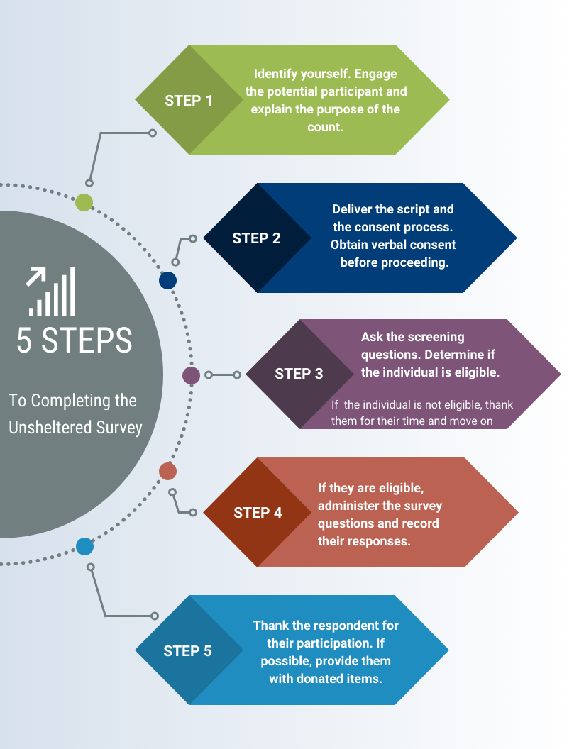
Module 3
Module 4
Module 5
Module 6
Wrap- Up

Slide 16
Safety Considerations
Do
Don’t
Module 3
Always work in teams
Be respectful of space
Introduce yourself and explain what you are doing
Be sincere and caring
Remain calm
Know how to de-escalate
Know emergency numbers
Honor requests to not participate
Provide shelter information if possible
Dress appropriately
Leave valuables behind
Wake up someone
Approach if you don’t feel comfortable
Invade personal space
Cross barriers
Promise anything you can’t deliver
Be judgmental
Give money or offer rides
Share any confidential info or photos of participants
Panic
Put anyone in danger
Deviate from the survey
Module 4
Module 5
Module 6
Wrap- Up

Slide 17
Demographic Questions
Are you Hispanic/Latin(a)(o)(x)?
What is your race?
What is your gender identity?
Are you part of the LGBTQ+ Community?
Module 4
Module 5
Module 6
Wrap- Up

Slide 18
Common Misconceptions
I can tell what someone’s (race, ethnicity, or gender) are just by looking at them.
Someone will be offended if they clearly look ____ but I still ask that question.
I disagree with the phrasing of this question and I don’t think we should be asking it.
Nobody is going to report to me if they are part of the LGBTQ+ community or are a gender other than female or male because we live in a small town.
Module 4
Module 5
Module 6
Wrap- Up

Slide 19
Combatting Misconceptions
I can tell what someone’s (race, ethnicity, or gender) are just by looking at them.
You cannot accurately assume any identities someone holds without asking them first. Assuming causes harm and disproportionately affects already marginalized communities.
Someone will be offended if they clearly look ____ but I still ask that question.
As long as you approach each question with dignity and care, it is unlikely someone will be offended.
If they do get offended you can always respond and say: I apologize, I am only reading the questions as written.
I disagree with the phrasing of this question and I don’t think we should be asking it.
The purpose of the PIT count is to hear directly from our unhoused neighbors about their personal experience.
You can bring any and all concerns related to the content of the survey to data@thn.org.
Nobody is going to report to me if they are part of the LGBTQ+ community or are a gender other than female or male because we live in a small town.
There are many people in rural America that are one or more of the identifies represented by the LGBTQ+ community.
Your only job is to approach each question with genuine care and respect. Let each person answer the questions as they see fit.
Module 4
Module 5
Module 6
Wrap- Up

Slide 20
Additional Subpopulations
In addition to determining general characteristics of those experiencing homelessness, the PIT count also gathers information on the following subpopulations:
Veterans
Survivors of domestic violence
As a note: When it comes to PIT count reporting, individuals are only identified as survivors if they are currently experiencing homelessness because of domestic violence, dating violence, sexual assault, or stalking.
In other words, domestic violence must be the current cause their housing instability.
Those that are chronically homeless*
Those that have a substance use condition*
Those that have a mental health condition*
*Part of the definition of chronic homelessness is asking questions related to substance use and mental health. These three subpopulations will be covered simultaneously in a few slides*
Module 5
Module 6
Wrap- Up

Slide 21
Notes About Surveying Veterans
Conducting a PIT count of homeless veterans is challenging because a person’s veterans status is not visibly discernible.
Some veterans might not be eligible for Veteran Affairs (VA) services and may have a complex relationship with the military. This often times means that they may not refer to themselves as veterans.
Additionally they may be slow to trust volunteers, particularly if they believe it has something to do with government assistance, which they have historically been excluded from.
Do not take this personally, continue to exude confidence and care and get as much data as you can.
Ask the question exactly as it appears in the survey: “Have you ever served in the armed forces, including in the National Guard or reserves?”
After a lot of community feedback and variations on this question, thus far this has been the most successful phrasing to not exclude those that may have left the military with a status other than “honorably discharged”.
Module 5
Module 6
Wrap- Up

Slide 22
Notes About Surveying Survivors
Survivors of violence face complex barriers to shelter and housing that are caused by the power and control dynamics of abuse, which result in: financial instability, lasting trauma, and a need for extra safety and confidentiality precautions.
Assure survivors that all identifying information on surveys is removed before it is released to the public or used for planning/reporting purposes.
As an added layer of security for survivors, we ask that those surveying survivors take the additional step of limiting the identifying information collected.
Ensure that you only use initials or some other code for the name, and only provide age range (never provide their full name or exact age)
THN staff also randomizes the location of all survivor surveys so there is not a lasting record of where they were encountered.
While we know this is a difficult question to ask and hear the answer to, gathering an accurate count of survivors enables communities to highlight the importance of developing survivor-specific housing programs
It also can be used to clearly illustrate the need for systems that are responsive to survivors’ unique housing considerations
Module 5
Module 6
Wrap- Up

Slide 23
Chronic Homelessness Definition
Many volunteers and PIT count partners are not aware of what criteria need to be met in order to classify someone as chronically homeless
The individual must have a qualifying disability or condition that affects their ability to maintain housing.
Examples: Substance use, chronic health, mental health, physical, developmental, and/or HIV/AIDS.
The individual must have resided in an emergency shelter or in an unsheltered location for:
12 consecutive months
OR
4 separate times, totaling 12 months, over the last 3 years.
Module 5
Module 6
Wrap- Up

Slide 24
Questions on the PIT to Determine Chronic Homelessness
Length of Time Homeless Criteria
Is this the first time you have been homeless?
How old were you when you first became homeless?
How many months did you stay in shelters or on the streets during the past 3 years?
How many separate times have you stayed in shelters or on the streets during the past 3 years?
How many months have you been homeless this time?
Disabling Condition Criteria:
Have you been told or do you believe you have a substance use condition that affects your ability to support yourself/family or live independently?
Have you been told or do you believe you have a chronic health condition that affects your ability to support yourself/family or live independently?
Have you been told or do you believe you have a mental health condition that affects your ability to support yourself/family or live independently
Have you been told or do you believe you have a physical disability that affects your ability to support yourself/family or live independently?
Have you been told or do you believe you have a Developmental Disability? This is a physical or mental condition that started in childhood.
Have you been told or do you believe you have HIV or AIDS?
Module 5
Module 6
Wrap- Up

Slide 25
Considerations
The chronic homeless number on the PIT count is not only cited in most media pieces about the PIT count. It is also relied heavily upon when it comes to advocating and applying for funding for additional permanent supportive housing.
It is imperative that all volunteers ask all of the questions on the previous slide in order to help each community accurately determine how many individuals fall under this definition
It may feel like you are prying or asking too sensitive of topics.
This is why we include a note at the beginning of the disabling conditions section that states: “The next set of questions asks about sensitive topics. You don’t have to answer any question that you don’t want to but your feedback will help us improve services in the community.”
Again, your job is to sincerely ask the question in a confident way. Then leave it up to the unhoused neighbor about how to respond.
Module 5
Module 6
Wrap- Up

Slide 26
Notes About All Subpopulation Questions
Do
Don’t
Explain that the survey is confidential and all identifying information is removed.
Explain that all questions are completely voluntary.
Provide any information on support that your PIT lead provided you.
Be sincere and calm.
Utilize the helpful scripts that are built into the survey.
Read the questions as written. They were phrased this way very carefully.
Pressure participants into answering any questions they don’t feel comfortable answering.
Express disbelief or pity to answers on the survey by survivors.
Pry or ask additional questions about the severity of the situation/condition.
Make visible facial that convey you are feeling uncomfortable with the question or response.
Module 5
Module 6
Wrap- Up

Slide 27
Closing the Interview
Thank the person for their time and willingness to participate in the survey
Provide them with any resource handouts or contact cards your PIT lead has given you
If your community has incentives, please ensure that you give them to the participant. If the participant leaves the survey early, still provide them with the donated item(s).
If they ask you what happens next with the survey you can state something like:
After our team looks over the data, typically we release a public report with general information related to the number of people experiencing homelessness as well as some characteristics. This data will be used to help with advocacy and community engagement. The goal is to use this data as a tool to help secure adequate services for the needs that were identified in the surveys.
Module 6
Wrap- Up

Slide 28
Notes for Law Enforcement
Law enforcement officers can often be the first point of contact for people experiencing homelessness. Police officers in places where mental health systems are inadequate might… Unhoused individuals might also have had prior negative interactions with law enforcement, institutionalization and incarceration. Because of this, unhoused individuals might not feel safe or willing to engage when approached by a police officer. We typically do not recommend uniformed officers to survey folks on the night of the count. Law enforcement can be involved in planning, and safety for the night of the count. IF police officers are going to be on the ground during the count we recommend the following best practices:
Police officers must be in plain clothes when interacting with homeless individuals experiencing homelessness
Police officers should not be armed when interacting with individuals experiencing homelessness
Police officers should not be making arrests when interacting with our unhoused neighbors
Have police officers attend trainings that focus on communication, empathy and de-escalation
Advocate for more training on how to interact with people who are in crisis in a way that does not require violence
Wrap- Up

Slide 29
Key Takeaways
View this volunteer experience as an opportunity to develop a one-on-one relationship with the unhoused individuals in your community. That is first and foremost why the PIT count came into being.
Practice your introductory script as well as all of the questions out loud. Get familiar with the survey and the order of the questions so you aren’t taken by surprise when you have to ask the next question.
Remember to center the experience of your unhoused neighbors. Your mission is to accurately report the information as they tell it to you.
Additionally, do not ask for more information about the person’s life than you need to complete the survey. Most people experiencing homelessness are asked to share their personal stories many times during assessments and intakes, which can be re-traumatizing.
Lean on your fellow PIT volunteers, PIT leads, and THN staff to help process any of the feelings that may come up before, during, or after the PIT. If you need to debrief a situation with someone outside of your community, please know that you can always reach out to ava@thn.org.
Wrap- Up

Slide 30
Thank you!
Contact Information
Ava Paredes
Data Coordinator
Email: Ava@THN.org
Phone: (512) 652-4714
Notes:
Here is my contact information if you have any questions or need any additional help in the mean time. Thank you so much for everything you do. This count wouldn’t be possible without you and as always I cannot express my gratitude enough for each and every one of you!

