Slide 1
Engaging
Domestic Violence Providers

Slide 2

Module 1
Module 2
Winter PIT Count Date:
1/23/2025
Module 3
Module 4
Module 5
Module 6
Wrap- Up
Notes:
This is the PIT date for this year.

Slide 3
Agenda
Module 1
Module 2
Intersectionality of Domestic Violence and Homelessness
Module 3
Count Logistics and Confidentiality
Preparation for the Count
Module 4
Sheltered Count
Unsheltered Count
Module 5
Next Steps
Module 6
Wrap- Up

Slide 4
Introduction
Module 2
This document compiles feedback from several communities as well as larger efforts. Listed at the end of this document are just a few resources that communities can use to analyze and improve their existing process.
  Please note that there are comments written on many of the slides to provide additional context and talking points for this presentation.
This tool is not mean to be a comprehensive guide on conducting the Point-in-Time (PIT) count. It is a supplemental resource that was developed specifically to assist with ensuring survivors are accounted for on the day of the PIT.
If you have questions, concerns, or feedback on the information in this presentation please reach out to the THN Data Coordinator.
Module 3
Module 4
Module 5
Module 6
Wrap- Up

Slide 5
Intersectionality
Module 2
Domestic violence (DV) is a leading cause of homelessness for women and children, and the need for safe and affordable housing is one of the most pressing concerns for survivors of violence and abuse.
80% of women with children experiencing homelessness have also experienced domestic violence
57% of all women experiencing homelessness report domestic violence as the immediate cause of their homelessness
Citation: Safe Housing Partnerships
Module 3
Module 4
Module 5
Module 6
Wrap- Up

Slide 6
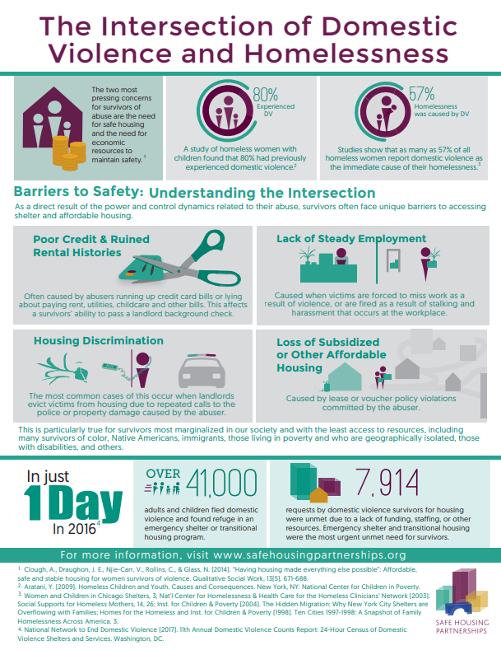
Module 2
Module 3
Module 4
Module 5
Module 6
Wrap- Up

Slide 7
Key Considerations
Module 2
Survivors of violence face complex barriers to shelter and housing that are caused by the power and control dynamics of abuse, which result in:
financial instability, lasting trauma, and a need for safety and confidentiality.
These factors are exacerbated for marginalized and vulnerable communities, such as:
Persons of color
Persons living in rural areas.
Persons with limited English Proficiency
LGBTQ+ Survivors
Survivors with Disabilities
Module 3
Module 4
Module 5
Module 6
Wrap- Up
Notes:
Housing and supportive services are critical interventions that play major roles in trauma recovery and long-term stability. CoCs and DV providers should work together to ensure survivors fleeing DV are accurately reflected in the PIT count. Additionally, effective collaboration in the PIT count will enhance ongoing partnerships between homeless and housing providers and DV providers to ensure survivors can access and maintain safe, stable, affordable housing after fleeing domestic violence.
Survivors must have meaningful access to housing programs - and this includes language access for people who speak languages other than English (including sign language), physical access to buildings and spaces that are designed for a variety of individuals and families, and access to culturally-responsive and trauma-informed services and supports. As advocates, service providers, and communities work to design and develop housing programs, we must do so with principles of equity at the center of our work. Only then will those programs be truly responsive to the unique and diverse needs of all survivors, and particularly those from historically marginalized communities.

Slide 8
Collecting Data on Survivors
While HUD has made data collection on survivors of domestic violence optional, HUD strongly encourages communities to work with their domestic violence stakeholders, especially DV providers, and homeless service providers, to determine the best way to safely and confidentially collect data on survivors of domestic violence.
Communities must evaluate whether they have the capacity to ensure adequate safety and confidentiality for those interviewed and those conducting the interview, especially when asking about domestic violence.
DV providers and other domestic violence stakeholders should be active participants in determining if and how the PIT count is conducted in a sufficiently safe and confidential manner to collect information about the domestic violence experiences of those being interviewed.
Module 3
Module 4
Module 5
Module 6
Wrap- Up

Slide 9
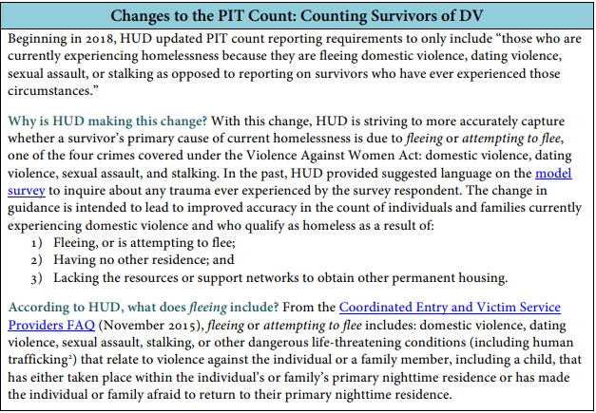
Changes to the Point-in-Time Count
Module 3
Module 4
Module 5
Module 6
Citation: HUD Exchange
Wrap- Up
Notes:
It is important that volunteers who are surveying survivors ask the question exactly as it phrased in the app. Not only will this ensure consistency across all count areas, but it is imperative that we are only gathering information on those that are currently fleeing. If different phrasing is used, than the question can no longer demonstrate the number of people experiencing homelessness as a direct result of domestic violence.

Slide 10
Confidentiality
All PIT count data is de-identified after it is submitted.
  As an added layer of security for survivors, we ask that those surveying survivors take the additional step of limiting the identifying information collected.
    Ensure that you only use initials or some other code for the name, and only provide age range (never provide their full name or exact age)
  It is important that at the agency level you have some consistent protocol to ensure that you keep track of those you have surveyed. This will prevent concerns such as double counting or survivors being missed.
    If you need help developing this protocol, contact the Data Coordinator at THN to talk through some options.
Module 3
Module 4
Module 5
Module 6
Wrap- Up
Notes:
If you are a domestic violence provider or stakeholder and you do not feel comfortable submitting the surveys under these conditions, or if you are a PIT lead in an area where your local domestic violence shelter is uncomfortable with this practice: Please reach out to the Data Coordinator at THN directly. There is a workaround to ensure that your clients are represented in the count while still adhering to your confidentiality procedures. It is imperative that we work together to get everyone counted, as safely as possible!

Slide 11
Benefits to Participating in the PIT
PIT count data is used to measure homelessness on a local and national level and is published annually on the HUD Exchange website. The PIT count data is also provided annually in a report to Congress.
The report is used by Congress, HUD, other federal departments, and the public to understand the nature and extent of homelessness. As a result, it is essential that DV programs participate in the PIT count in conjunction with local PIT Leads.
  Including survivors in the count will enable communities to:
  demonstrate the need for housing for survivors and their families,
  identify gaps in supports and services,
  enhance outreach and engagement strategies
  justify securing additional resources
  highlight the importance of developing survivor-specific housing programs
  Clearly illustrate the need for systems that are responsive to survivors’ unique housing considerations
Finally, effective collaboration will enhance ongoing partnerships between homeless and housing providers and DV providers to ensure that survivors can access and maintain safe, stable, affordable housing after fleeing domestic violence.
Module 4
Module 5
Module 6
Wrap- Up

Slide 12
Preparation Leading up to the Count
DV Providers and Local PIT Leads should Join Forces
PIT Leads should always invite DV providers and stakeholders to all planning meetings (to talk about both sheltered and unsheltered counts). DV providers can confirm and determine which DV housing programs should participate in the sheltered count. They can also be valuable assets on the planning committee to ensure survivor voices are always a center focus.
DV Providers are experts in utilizing a Trauma-Informed Approach
PIT Leads and providers should work together using a trauma-informed approach and determine a process for if and how referrals should be made if a survivor self-identifies during the count.
Educate CoC Volunteers on Domestic Violence and Safety Issues
Approaching and gathering information can be intimidating for CoC volunteers and providers who do not have direct service experience with domestic violence. It is important to ensure volunteers’ safety while also being sensitive in engaging individuals, asking questions about trauma, and providing them with appropriate resources.
Module 4
Module 5
Module 6
Wrap- Up

Slide 13
Sheltered Count Considerations
Administering PIT Count Surveys to Sheltered Clients
DV providers can administer the PIT surveys to their sheltered clients on the day of the count to get information concerning survivors’ situations.
  This is highly recommended as survivors may fall into other homeless subpopulations. Ensuring that all of their identities are represented allows for the aggregated community data set to show a comprehensive picture of the unique characteristics of those experiencing homelessness.
  It gives survivors the opportunity to share their story in a safe and confidential way, if they would like.
De-Identify Information
All survivors’ information is de-identified from the very beginning to protect client confidentiality.
Report Aggregate Information
Only aggregated information will be provided on any reports or visualizations
  i.e., the total number of persons currently experiencing homelessness because they are fleeing domestic violence, dating violence, sexual assault, or stalking
  Access to the submitted data is limited only to the Data Team at THN for the purposes of deduplication. All files are saved in a secure location.
Module 5
Module 6
Wrap- Up

Slide 14
For the Unsheltered Count
DV Providers and PIT leads can work on developing targeted trainings
DV providers can offer training to those implementing the count on how to approach individuals in a non-threatening, non-judgmental way,
  being especially sensitive to the collection of DV information from respondents and incorporating appropriate interview protocols to protect client privacy and safety
    such as: asking survey questions in a private location and not in the presence of a partner or spouse; giving respondents sufficient space and time to answer questions; not making them feel pressured to answer any questions they are not comfortable answering; and helping respondents feel respected and safe to respond to questions however they choose.
Module 6
Wrap- Up

Slide 15
Unsheltered Count Continued
Opportunity for Education on Safety Planning and Available Resources
Additionally, DV providers can offer training to PIT count volunteers on how to conduct brief safety planning and provide needed resources to individuals who indicate feeling unsafe.
  This is a unique opportunity for communities to engage with survivors that may not be aware of how to access supportive services
  Should be viewed as a community outreach opportunity in conjunction with a data gathering initiative.
Module 6
Wrap- Up

Slide 16
Things to Consider
Partnerships between DV providers and PIT Count Leads in addition to using a trauma-informed approach, is the most compassionate and efficient way to get accurate data without re-traumatizing survivors.
DV providers and local coalitions are the best resource to help determine the process for administering the survey and providing the appropriate follow up and referrals for survivors identified as fleeing or attempting to flee during the PIT count.
Successful collaboration on the count will only have a positive affect on the community and the data as a whole.
  It will demonstrate a strong partnership between domestic violence service providers and homeless service providers.
  It will be an important opportunity to educate your community on the intersections of homelessness and domestic violence
  The data can be used in advocacy, grant applications, and community engagement events to demonstrate the unique needs and experiences of survivors experiencing homelessness.
Wrap- Up

Slide 17
Next Steps
Contact your local PIT Count Lead
  If you do not know who your local lead is, please contact THN so you can be directed to them,
Begin developing strategies for how domestic violence providers and homeless service providers in your community can work together to ensure a safe and comprehensive count for survivors.
View PIT Count Information on THN’s website.
Wrap- Up

Slide 18
Resources
Safe Housing Partnerships
Engaging with Domestic Violence Survivors: What CoC’s Need to Know
Point-in-Time Count Fact Sheet on Identifying Survivors of Domestic Violence
Partnering with CoC’s on the PIT Count: What Domestic Violence Providers Need to Know
Wrap- Up

Slide 19
Thank you!
Contact Information
Ava Paredes
Data Coordinator
Email: Ava@THN.org
Phone: (512) 652-4714
Notes:
Here is my contact information if you have any questions or need any additional help in the mean time. Thank you so much for everything you do. This count wouldn’t be possible without you!

