Slide 1
2026 PIT Training

Slide 2


Introduction
Module 1
Module 2
Module 3
Module 4
Module 5
Module 6
Ava Paredes
Data and Engagement Coordinator
Wrap- Up
Notes:
Before we get started I want to take a minute to introduce myself. My name is Ava Paredes, and I am the Data Coordinator here at Texas Homeless Network. My primary role is to coordinate the annual Point-in-Time and Housing Inventory counts.

Slide 3
Module 1
Module 2
Winter PIT Count Date:
1/22/2026
Module 3
Module 4
Module 5
Module 6
Wrap- Up
Notes:
This is the PIT date for this year.

Slide 4
Agenda
Module 1
Module 2
Point-in-Time (PIT) Basics
PIT Count Methodology
Module 3
Unsheltered PIT Planning
Sheltered PIT Planning
Module 4
Volunteer Best Practices
Collaboration
Module 5
Next Steps
Module 6
Wrap- Up

Slide 5
Point-in-Time (PIT) Basics
Module 1
Module 2
How many people are currently experiencing homelessness in your community?
How many of them are families, youth, or veterans?
What do they report as their causes for homelessness?
The answers to these questions and more can be answered by point-in-time counts.
A point-in-time count is an unduplicated count on a single night of the people in a community who are experiencing homelessness
Module 3
Module 4
Module 5
Module 6
Wrap- Up
Notes:
Here are some of the questions that the PIT count aims to answer as well as the definition of the PIT count. The point-in time count is an unduplicated count on a single night of the people in a community experiencing homelessness. The other way I like to explain it is that the PIT count is the minimum number of individuals experiencing homelessness, in your community, on a single night.

Slide 6
Module 1
Extent
Funding
Awareness
Raise Community Awareness
Advocate to local governments
Module 2
Characteristics of those experiencing homelessness locally
Module 3
Trends in Homelessness over time
Module 4
Advocate for private or local government funds
Eligibility for CoC, ESG, and other federal funding
Module 5
Develop personal relationships with those experiencing homelessness
Create a sense of responsibility with varied stakeholders
Module 6
Engagement
Wrap- Up
Notes:
There are four main reasons that we conduct the PIT count represented here in this graphic. We conduct it for Awareness to advocate to local governments and raise community awareness. To understand the extent of homelessness by identifying trends in homelessness over time and the characteristics of those experiencing homelessness locally. To secure funding as the PIT can be used for eligibility for CoC and ESG federal funding as well as to advocate for private or local government funds. And finally for engagement as the PIT count allows us to develop personal relationships with those experiencing homelessness and create a sense of responsibility with various stakeholders.

Slide 7
THN Information
Module 1
Texas Homeless Network (THN) is a non-profit membership-based organization helping communities strategically plan to prevent and end homelessness.
THN works to end homelessness in Texas by collaborating with all communities, large and small, across the state to build systems to achieve this goal.
We coordinate local and national advocacy efforts, data collection and research, host an annual statewide conference, and serve as the host agency for the Texas Balance of State Continuum of Care (CoC) where we assist in the coordination of programs and funding.
The Texas Balance of State CoC (TX BoS CoC) is made up of all service providers, advocates, local government officials, and citizens who work to eliminate homelessness in 214 of Texas’ 254 counties.
Module 2
Module 3
Module 4
Module 5
Module 6
Wrap- Up
Notes:
I’m not going to go over this slide in depth, I just think that it is valuable to include a slide detailing what Texas Homeless Network does as well as clearly explaining the difference between the two divisions of our staff. The Texas Balance of State team focuses on 215 of Texas’ 254 counties, while our statewide initiatives team focuses on efforts across the state and coordinates directly with the other CoC’s.

Slide 8
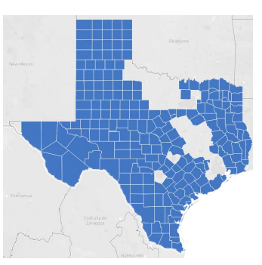
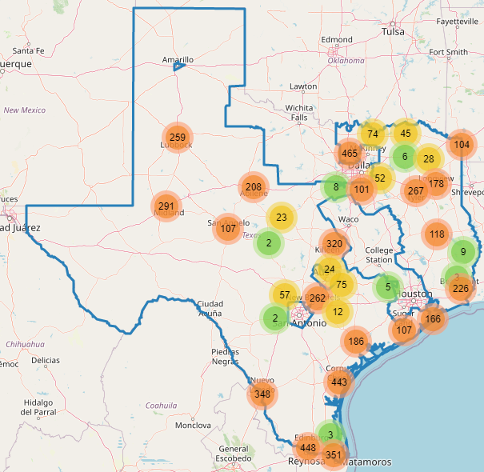
Coverage Area
Module 1
Module 2
Texas Balance of State Region
2025 PIT Regions
Module 3
Module 4
Module 5
Module 6
Wrap- Up
Notes:
To help visualize the area we covered on the last full PIT count in 2023 vs. our region, here are two maps. On the right is the Texas Balance of State map with our counties highlighted in blue, and on the left is our 2023 PIT coverage highlighted by dots on the map. As you can see from looking at these maps, we are still lacking coverage in numerous counties across our CoC. In 2023 we were able to cover about 74% of our CoC’s population. So about 26% of our CoC did not have any PIT coverage in 2023. ***

Slide 9
Extrapolation Basics
Module 1
Module 2
For reporting purposes, HUD requires that CoCs report on their full geography. Due to the size of our CoC, we are not able to achieve full coverage during the PIT count. Our CoC has to employ an extrapolation method that estimates the PIT number for the entire geography.
Module 3
Module 4
Ensure data quality
Ensure that we ask all questions to participants
Work to reduce duplicate responses
Expand PIT coverage to new areas
Module 5
Module 6
Wrap- Up
Notes:
So normally I stray away from this discussion about extrapolation, but I feel like it is important for you to know how your data affects our overall numbers that we report to HUD. HUD requires us to submit data on the entirety of our geography. We are not able to cover our whole geography due to how large it is. In order to account for the counties within our CoC that do not have any PIT coverage, we use extrapolation to determine the number of unhoused individuals within non-participating counties. We use data from participating counties like yours in order to estimate the number of homeless individuals within non-participating counties, that is how your data comes into play within this process. I am mentioning this because it is important to note that the data that we collect on the night of the count has a major effect on the results outside of your designated regions. Because of this we must do our best to ensure a high standard of data quality so that the final data submission to HUD is accurate. This can include making sure we ask all of the questions to survey participants, work to reduce duplicates and expanding our PIT coverage to new areas within our counties.

Slide 10
Who to Contact
Module 1
If you have questions about:
If you have questions about:
Module 2
Community Information
Shift times
HQ location
Assigned count areas
Count Logistics
Who & where we count
Survey length/questions
Identifying hot spots
Technical issues
Count Logistics
Who & where we count
Survey length/questions
Identifying hot spots
Technical issues
Count Logistics
Who & where we count
Survey length/questions
Identifying hot spots
Technical issues
Module 3
Module 4
If you can’t reach your PIT Lead:
Data and Engagement Coordinator
PIT Lead
Module 5
If you can’t reach the Data Coordinator
Module 6
THN Administrator
Wrap- Up
Notes:
Here is a flowchart that demonstrates how our roles work together. This is a simplified chart on how we communicate with each other depending on the type of information. Just to give a quick overview, for most situations involving logistics, direct your questions to me. Please do not hesitate to reach out to me if you have any questions or concerns as we get into PIT season. I am here to help and support you. My contact information is at the end of the presentation. If volunteers have questions about community information, they contact you, the PIT leads, but if you do not have an answer, you can always forward questions to me.

Slide 11
Key PIT Steps
Module 2
Select PIT Lead
Establish PIT Lead and Backup
Community Awareness
Inform Community/ publicize count
Training
Recruit Volunteers
Create PIT committee
Create timeline for count planning
Engage potential members with lived experience
Engage community in identifying unsheltered locations
Set volunteers up with training
Schedule in person meetings
Register and practice with the app
Solicit Donations
Module 3
Module 4
Module 5
Module 6
Wrap- Up
Notes:
This graphic is a simplified list of the primary tasks required for a successful PIT count. As you all start planning and training your volunteers, you will receive more specific and detailed guidance. I would also like to stress that community engagement should be occurring throughout the entirety of the process. You will need to decide as a community what structure best suits your needs.

Slide 12
Who to Count
Module 2
Individuals residing in:
Unsheltered Locations
Sheltered Locations
-Street
-Outdoor Encampment
-Other places not meant for habitation
- Emergency Shelter
- Domestic Violence Shelter
- Transitional Housing
Hotel/Motel paid for by an Agency Voucher
Module 3
Module 4
Module 5
Module 6
Wrap- Up
Notes:
Now for a quick overview of the count itself. This slide is meant to demonstrate the types of individuals you would survey for the PIT count. The count is broken into two pieces, the sheltered count and the unsheltered count. We look for individuals residing in unsheltered locations such as the street, an outdoor encampment, and other places not meant for human habitation. We also look for individuals residing in sheltered locations such as an emergency shelter, domestic violence shelter, transitional housing, and hotels or motels paid for by an agency voucher. Again, please remember that the count involves you directly interacting with each person experiencing homelessness and conducting a survey with them.

Slide 13
Who NOT to Count
Module 2
Individuals residing in:
Permanent Housing
Temporary Situations
- PSH or RRH Programs
- HUD VASH projects
-FEMA projects
- Doubled Up with family or friends
- At-risk of homelessness
- Hotel/motel paid by own funds
- Shelters designed for foster care
-Sober living/ halfway houses
- Criminal Justice or Health facilities
Module 3
Module 4
Module 5
Module 6
Wrap- Up
Notes:
Now that we know who to count, I think it is important to highlight those that we do not count under HUDs definition of literal homelessness. We do not count individuals residing in permanent housing. This includes Permanent supportive housing and rapid rehousing programs as well as HUD VASH and FEMA Projects. We do not count those who are at risk of homelessness or in temporary living situations. This includes those at risk of eviction, doubled up with friends or family, hotels and motels paid for by their own funds, foster care, sober living, halfway houses, as well as criminal justice or health facilities such as a jail or hospital.

Slide 14
Considerations for Youth
Module 2
U.S. Department of Education (ED) Subtitle VII-B of the McKinney-Vento Homeless Assistance Act defines homeless children and youths as follows: The term "homeless children and youths"—
  Meaning individuals who lack a fixed, regular, and adequate nighttime residence (within the meaning of section 11302(a)(1) of this title); and includes—
    i. children and youths who are sharing the housing of other persons due to loss of housing, economic hardship, or a similar reason; are living in motels, hotels, trailer parks, or camping grounds due to the lack of alternative adequate accommodations; are living in emergency or transitional shelters; are abandoned in hospitals; or are awaiting foster care placement;
    ii. children and youths who have a primary nighttime residence that is a public or private place not designed for or ordinarily used as a regular sleeping accommodation for human beings (within the meaning of section 11302(a)(2)(C) of this title);
    iii. children and youths who are living in cars, parks, public spaces, abandoned buildings, substandard housing, bus or train stations, or similar settings; and iv. migratory children (as such term is defined in section 6399 of title 20) who qualify as homeless for the purposes of this subtitle because the children are living in circumstances described in clauses (i) through (iii).
Module 3
Module 4
Module 5
Module 6
Wrap- Up
Notes:
This is the Mckinney Vento Homeless Assistance Act definition of homeless children and youth. You will notice that on this slide I have highlighted several phrases in red font. The parts in red font are the aspects of this school definition that do not fit into the PIT count definition. Those include: children and youths who are sharing the housing of other persons due to loss of housing, economic hardship, or a similar reason; are abandoned in hospitals; or are awaiting foster care placement; substandard housing. So while these students may count as homeless with their school, they do not qualify as counting for the PIT.

Slide 15
Unsheltered PIT Planning
Module 3
A count of people who are unhoused but not in a shelter or transitional housing program is referred to as an unsheltered count.
The unsheltered count requires identification of persons that are living in places not meant for human habitation on January 22nd.
Module 4
Module 5
Module 6
Wrap- Up
Notes:
Now we are going to talk about the Unsheltered PIT. The Unsheltered PIT, often referred to as the street count, is a count of the individuals who are residing in places not meant for habitation.

Slide 16
Possible Locations
Abandoned building
Bus, train station, airport
Park
Street/sidewalk
Tents
Under bridge/overpass
Vehicle (car, van, RV, truck)
Woods/outdoor encampment
Module 3
Module 4
Module 5
Module 6
Wrap- Up
Notes:
The locations that we can consider for the unsheltered count, include abandoned buildings, bus, train station, and airports, parks, streets, sidewalks, tents, encampments, under bridges and overpasses, and vehicles such as cars, vans and RVs. PIT Leads should create a map or list of common areas where people can be found, this can be used to help inform volunteer routes. Prepare for the unsheltered count by creating your map zones, areas that teams of volunteers will cover during the count. Seek input from your PIT Count committee, community partners, and people with lived experience when mapping your survey locations. You may need to update your maps closer to the date of your count, as the locations frequented by people experiencing unsheltered homelessness may change. We recommend looking for hotspots 1 to 2 weeks before the count.

Slide 17
Creating Hot Spot Map
Work together with your community members to start a list of locations where you see individuals experiencing homelessness living.
  Visit the locations at least once a month leading up to the count
  Visit locations several times during the week leading up to the count.
This list will likely change over time and will need regular updates. Ensure that you have a process for how people can access the list of locations and how they can send you updates.
Make this a collaborative process. It will help raise awareness for everyone involved.
Module 3
Module 4
Module 5
Module 6
Wrap- Up
Notes:
We recommend sorting your map zones into priority groups, based on the anticipated number of people in each zone. If you are short of volunteers on the night of the count, prioritize the higher-density zones.
To identify known locations, we recommend:
-Engaging outreach workers, police, EMS, bylaw and parks officers, businesses and others to help you identify ‘hot spots’ for the night of the count.
-Undertaking walkabouts in advance of a count date to identify and confirm known locations.
-Consulting people experiencing homelessness to get a sense of where to canvas and how to approach potential interviewees, especially in camps.
Note that different populations experiencing homelessness stay in different locations. For example, youth may gravitate toward more secluded areas such as forests, while single adult men may be more likely to stay in plain view on the street. Consult a range of stakeholders to ensure your mapping accurately reflects the diversity of experiences among people experiencing homelessness within your community.
Please make sure to visit hotspot locations regularly in the months leading up to the count as these areas might change.
I also recommend developing some type of collaborative document to track locations and to update each other on any significant changes.

Slide 18
Creating Hot Spot Map
Link to Google My Maps instructions
Link to YouTube tutorial on building a map
Things to Note:
You do not have to use an exact address, the map will allow you to use cross streets.
Use this map to ensure that you have full coverage of your community.
Share it with your planning team and your volunteers regularly to ask for feedback and updates.
Provide a copy to all volunteer teams on the day of the count.
There are a number of additional sites that can be used. If you Google My Maps doesn’t work for you, let me know and I can help you find a different site.
Module 3
Module 4
Module 5
Module 6
Wrap- Up
Notes:
On this slide I have included a few helpful resources on where you can create a hotspot map as well as a video tutorial on how to create pins for each location.
You don’t need exact addresses, approximate streets should work just fine. This document can help you determine how many volunteer teams you need in order to cover all of the locations you have identified. This will be helpful to volunteers on the day of the count as they head out to conduct surveys.

Slide 19
Community Partners
DFPS
Victim Service Providers*
Faith-based agencies
Housing Authority
Code Enforcement
SSVF Providers
Outreach Providers
Homeless Education Liaisons*
Module 3
Module 4
Module 5
Module 6
Wrap- Up
Notes:
Here is a list of the potential community partners you should try to engage in the PIT. The ones with asterisks are community partners that already have specific resources created to help with engagement. This is not an exhaustive list; however, it should be viewed as a starting point to drive your outreach efforts. These parts of your community can help you engage those with lived experience, help with volunteer recruitment, and also help with hot spot mapping.

Slide 20
Safety Considerations
Do
Don’t
Module 3
Wake up someone*
Approach if you don’t feel comfortable*
Mandate participation
Invade personal space
Cross barriers
Promise anything you can’t deliver
Be judgmental
Give money or offer rides
Share any confidential info or photos of participants
Panic
Put anyone in danger
Deviate from the survey
Always work in teams
Be respectful of space
Ask a person to participate if you think they are homeless
Introduce yourself and explain what you are doing
Be sincere and caring
Remain calm
Know how to de-escalate
Know emergency numbers
Honor requests to not participate
Provide shelter information if possible
Dress appropriately
Leave valuables behind
Module 4
Module 5
Module 6
Wrap- Up
Notes:
The safety of PIT Leads and Volunteers are our highest priority so please read over this list prior to the night of the count. This list is specifically geared towards those doing the unsheltered count; however, many of the tips still apply to the sheltered count as well. It is always important to be mindful of the population that we are surveying and understand the situation they are in. Homelessness can cause a great deal of psychological and physical trauma, so always be respectful of them as you would to your own neighbors.
Do not wake people up, don’t put yourself in a situation that makes you uncomfortable, don’t promise things you can’t deliver, don’t share confidential information, or deviate from the survey. The first two items on this list are scenarios in which you would do an observation survey.
The main takeaways are that you should be respectful, calm, sincere, and prepared. While you are unlikely to experience dangerous situations, it is important to have a safe place in case de-escalation is required.

Slide 21
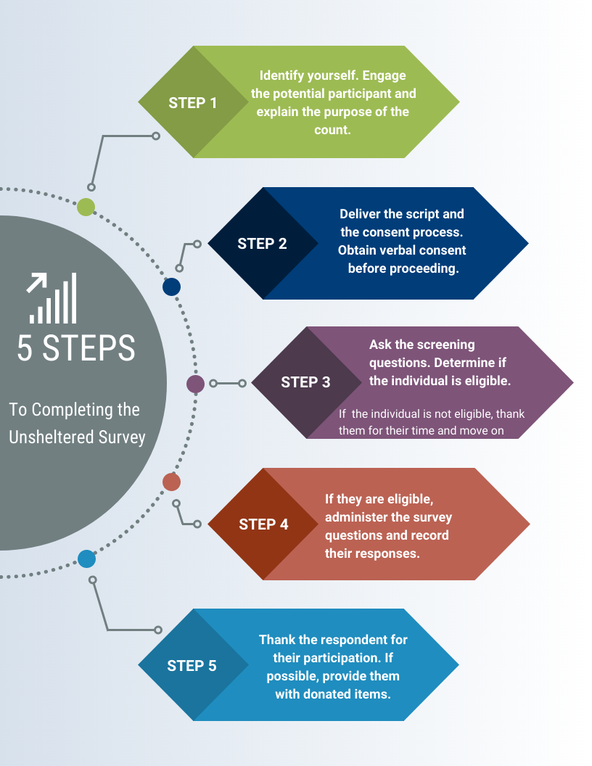
Module 3
Module 4
Module 5
Module 6
Wrap- Up
Notes:
Here are 5 steps to completing the unsheltered survey. Make sure to start by identifying yourself and stating the purpose of the count. Remember to always obtain consent to the survey. Once you have obtained verbal consent to the survey, you may now begin to ask screening questions to determine if the individual is eligible. If they are not eligible, thank them for their time and move on. If they are eligible, administer the survey questions and record their responses. Lastly, ensure that you thank the respondent for their participation, and if possible provide them with donated items, care packages, information pamphlets, and resources.

Slide 22
Coordination Tips
Module 3
Check in with each volunteer before they go out for their shift.
Provide volunteers a checklist at least one day in advance
Forms to have prepared:
  Map of hot spots
  Interviewing guide
  Day of count cheat sheet
  Volunteer hour tracker
  Emergency phone numbers
  Instructions for registering for the app
Module 4
Module 5
Module 6
Wrap- Up
Notes:
Here is a quick list of tips for preparing information for Unsheltered PIT volunteers. My best advice is to have these materials ready to go one day before the count. Best practice would be to have the information compiled by the week before. Perhaps create a checklist for volunteers and check in with them when they go in and out for their surveying shifts. We recommend preparing and providing a map of hotspots, an interviewing guide or script, day of the count cheat sheet, volunteer hour tracker, emergency phone numbers, safety information and contingencies, and instructions for registering for the app.

Slide 23
Sheltered PIT Planning
HUD defines sheltered homeless persons as adults, children, and unaccompanied children who, on the night of the count, are living in shelters for the homeless.
Regardless of funding source, all providers of shelter, vouchers, or funds for shelters (including motel/hotel rooms), and/or transitional housing need to provide unduplicated information about the individuals and families on January 22nd, 2026.
To be considered for the PIT Count:
  The primary intent of the project is to serve literally homeless persons,
  The project verifies homeless status as part of its eligibility determination, and
  The actual project clients are predominantly homeless (or, for permanent housing, were homeless at entry).
Module 4
Module 5
Module 6
Wrap- Up
Notes:
Now let's talk about Sheltered PIT planning. For the sheltered count we survey people residing in emergency shelters (which includes cold weather shelters, domestic violence shelters, and hotels/motels paid for with agency vouchers) and transitional housing.
In order to be considered an emergency shelter or transitional housing project, they have to meet the following 3 criteria. 1 The primary intent of the project is to serve literally homeless persons, 2 the project verifies homeless statuses as part of its eligibility determination, and 3 the actual project clients are predominantly homeless.

Slide 24
Locations
Emergency Shelters: means any facility, the primary purpose of which is to provide a temporary shelter for the homeless in general or for specific populations of the homeless and which does not require occupants to sign leases or occupancy agreements.
  Domestic violence shelters
  Hotel, motel, or apartment vouchers paid for by a public or private agency because the individual or family is homeless
*For Emergency Shelters, you should conduct the surveys in the late afternoon/evening when participants are checking in to stay the night.
Transitional Housing: is designed to provide homeless individuals and families with the interim stability and support to successfully move to and maintain permanent housing. Transitional housing may be used to cover the costs of up to 24 months of housing with accompanying supportive services. Program participants must have a lease (or sublease) or occupancy agreement in place when residing in transitional housing.
Module 4
Module 5
Module 6
Wrap- Up
Notes:
To help give a more detailed explanation of the location definitions. Here are the HUD definitions of emergency shelter and transitional housing. Emergency shelters are any facility where the primary purpose is to provide a temporary shelter for people experiencing homelessness in general, OR for specific populations, that do not require occupants to sign a lease or occupancy agreement. Transitional housing is designed to provide homeless individuals and families with interim stability and support to successfully move to and maintain permanent housing.
Just a quick note, for emergency shelters our recommendation is that you conduct the surveys when people are checking in for the night.

Slide 25
Locations Continued
I will provide PIT Leads a list of identified sheltered locations by December
  If you would like your list sooner please contact me.
  If you believe there is an agency that should be on this list, please go through the list of criteria with the shelter staff to see if they are eligible. Then contact me so we can discuss adding them.
To view the list of agencies that participated last year, please visit the THN website and download the Housing Inventory Count (HIC) Report
  Link to website
**If you represent an agency that provides Hotel/Motel vouchers for individuals experiencing homelessness, please contact me ASAP**
Module 4
PIT Measures People
HIC Measures Housing
Scope of Crisis & Your Capacity to respond
Module 5
Module 6
Wrap- Up
Notes:
Now this is the point that we are going to shift into talking about the housing inventory count briefly. The reason I think it is important to have these counts in the same presentation is because they happen simultaneously and are oftentimes analyzed together. For those that aren’t familiar, the HIC is the annual count of the beds and units designated to serve those experiencing homelessness. It includes both ES and TH (which are counted for the PIT); however, it also includes RRH and PSH beds. A simple way to remember this is that the PIT measures People. The HIC measures Housing. And when you look at them both together it demonstrates the scope of homelessness in your areas as well as your capacity to respond to the crisis.

Slide 26
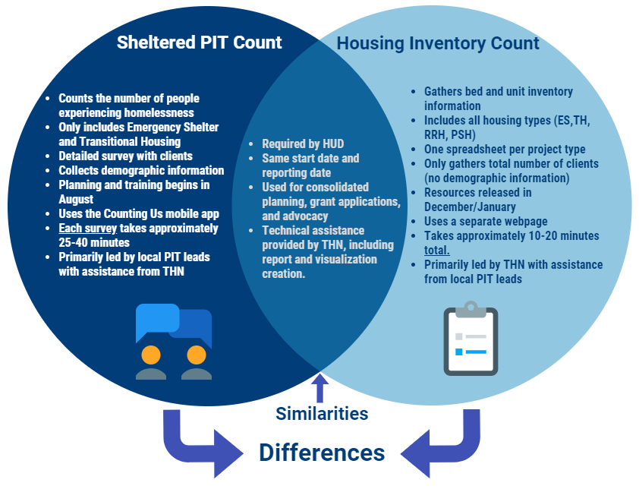
PIT Count Vs. HIC
Module 4
Module 5
Module 6
Wrap- Up
Notes:
Here is a Venn diagram to demonstrate the similarities and differences between the sheltered PIT and the HIC. I won't go through each bullet point. But if I were to give you a summary, the key differences are that the PIT requires individual surveys of each client residing in the emergency shelter or transitional housing program. Each survey takes approximately 25-40 minutes. Whereas the HIC only requires you to fill out one form for each housing project your organization has, which amounts to about 10-20 minutes total. They both are required by hud, happen at the same time, and I provide technical assistance for both. The Pit is driven by local leads with support from THN. The HIC is driven by THN with support from local leads.

Slide 27
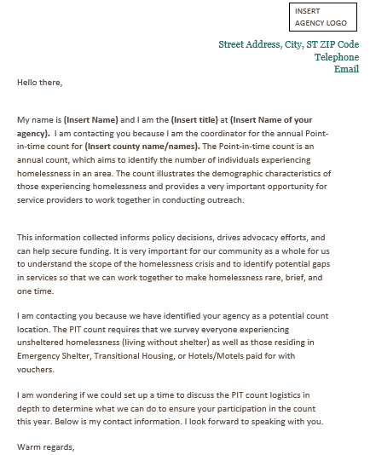
How to Contact Shelters
Module 4
Module 5
Module 6
Wrap- Up
Notes:
Here is a template of the letter you can send potential shelters to solicit their participation in the PIT count. You can find a downloadable template on the THN website.

Slide 28
Domestic Violence Protocol
Notice CPD 17-08:
HUD is requiring that data reported on survivors of domestic violence should be limited to reporting on those who are currently experiencing homelessness because they are fleeing domestic violence, dating violence, sexual assault, or stalking, as opposed to reporting on survivors who have ever experienced these circumstances.
Question on the survey: Are you currently staying in this shelter because of domestic violence? (Including: dating violence, sexual violence, and/or stalking)
Module 4
Module 5
Module 6
Wrap- Up
Notes:
I want to spend a little bit of time talking about the specific process for surveying at a domestic violence shelter. To give you some context, the PIT count is only gathering information on those who are actively fleeing a domestic violence situation. The question is not asking if someone has ever experienced domestic violence.
The question on this slide is the exact language in the PIT app.

Slide 29
Surveying Survivors
Do
Don’t
Explain that the survey is confidential and all identifying information is removed for their safety.
Use their initials or a code for their name (if they don’t want to give you their initials).
Fill out their age range.
Complete the remainder of the survey with them.
Write in the notes section of the survey that they are a survivor so I can make sure their location is secure.
Provide any information on support that your PIT lead provided you
Fill in their full name
Fill in their date of birth
Fill in their exact age
Provide any identifying information in the notes section
Pressure participants into answering any questions they don’t feel comfortable answering.
Express disbelief or pity to answers on the survey by survivors.
Module 4
Module 5
Module 6
Wrap- Up
Notes:
Here are some do’s and don’t around surveying DV survivors. Please make sure that your volunteers go over this list prior to the day of the count.
Do not fill in the full name or the date of birth or the age of the survivor. You will provide their age range and any demographic information they share though. Please do not provide any identifying information in the notes section. Once you have gotten past the name and age questions please continue filling out the rest of the survey with them.

Slide 30
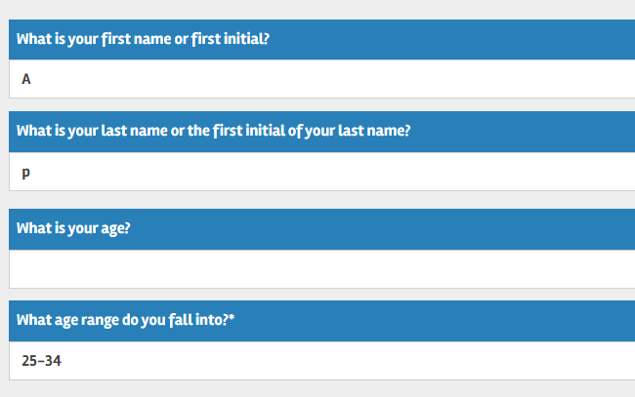
App Screenshot
Module 4
Module 5
Module 6
Wrap- Up
Notes:
Here is a screenshot of the mobile app and what the beginning section of your survey should look like when surveying domestic violence survivors. Again: you will be filling out the entire survey with the participants. You are only skipping the full name, date of birth, and exact age. We recommend putting in initials for DV survivors, and age ranges, but no other identifying information

Slide 31
Coordination Tips
Prep and Forms
Verify list of agencies well in advance.
Set up either a phone call or a visit with each shelter you plan to count at
  Take note of their confidentiality protocols as well as their visitor policy.
  Be respectful and follow the direction of shelter staff at all times.
Get a list of staff at the shelter that will be conducting surveys to ensure they have been trained on the app
Maintain contact throughout the planning process
  Identify the time you will be helping survey and how long they anticipate needing your assistance.
Use Shelters.com and FindHelp.org to identify any new shelters
Have a primary contact at each shelter for PIT and HIC purposes
Loop in THN as necessary
Module 4
Module 5
Module 6
Wrap- Up
Notes:
Here is a quick list of coordination tips for your sheltered count. We recommend verifying your list of shelters as soon as possible. I will be sending out a list of emergency shelters and transitional housing projects in the coming weeks for this. Please also remain in regular contact with the staff at the shelter to ensure that you have a solid game plan if they will need any additional volunteers to help conduct surveys on the day of the count. Please be respectful of their processes and procedures when you are developing strategies for the day of the count.
It is also your role to help ensure that all staff that will be surveying have taken the appropriate trainings to prepare for the count. Loop me in if you have any questions, concerns, or if you need help reaching out to any of the shelters in your area.

Slide 32
Consent to Survey
Do
Don’t
If you have obtained consent
Do not complete a survey without consent
Do not continue the survey if the individual has expressed the desire to end the survey
Do not complete a survey based on an intake form unless you have specifically obtained consent to do so.
Module 4
Module 5
Module 6
Wrap- Up
Notes:
Let’s have a quick conversation about the importance of obtaining consent from participants. You are only permitted to conduct a survey if you have been given verbal consent to do so. You cannot complete the survey if you haven’t obtained consent, or if you haven’t physically laid eyes on the individual on the day of the count. If the individual wants to leave the conversation stop the survey and submit it. If they revoke their consent and ask you to delete the survey responses, please do so. Absolutely do not try to convince, coerce, or persuade someone to participate in the survey. If you are unable to complete the sheltered or unsheltered surveys for the above reasons, you have the option of completing the observation survey.

Slide 33
Observation Survey
Do
Don’t
Someone is sleeping
You do not feel comfortable going to a certain area
A person did not give their consent to participate in the survey or they don’t want to complete the survey in it’s entirety
Someone does not seem to understand the consent process and cannot reasonably consent to the survey.
Fill out an observation survey if you have not laid eyes on the individual that day
Module 4
Module 5
Module 6
Wrap- Up
Notes:
Observation surveys can be conducted in both sheltered and unsheltered locations. You will use the observation survey if someone is sleeping, you are unable to approach the individual, or if they do not consent to the survey. To conduct this survey you must believe they are experiencing homelessness. Do not complete a survey using intake forms or based off of previous interactions. You must see the person on the day of the count. We do not gather any personal information, or make any assumptions about the person based on appearance, no matter the circumstances.

Slide 34
Observation Surveys Continued
Observation surveys ARE NOT the first tool in your tool belt when it comes to surveying individuals. Our goal is to complete as many interview surveys as possible. You SHOULD NOT be using observation surveys as the first survey you choose to use when going on the night of the PIT. You should first be asking for consent for the interview survey. The observation survey is ONLY for situations where you can’t physically interview someone.
Module 4
DO NOT:
Go around gathering observation surveys of people you have not talked to.
Gather observation surveys of people who are not homeless or unhoused.
Use observation surveys as your primary tool on the night of the count.
Module 5
Module 6
Wrap- Up

Slide 35
If you are in a Sheltered location
Complete Sheltered Survey
Person Consented to survey
If you are at an Unsheltered location
Complete Unsheltered Survey
Person did not consent to survey
Complete Observation Survey
Safe to approach
Module 4
Person could not consent to survey
-They were sleeping and/or they did not understand the consent process
Complete Observation survey
Encounter someone you believe is experiencing homelessness
Module 5
Person reported that they are not experiencing homelessness
Thank them for their time.
DO NOT COMPLETE A SURVEY
Module 6
Unsafe to approach
Complete Observation survey
Wrap- Up
Notes:
This is a decision tree that was created for PIT leads and volunteers to help them determine which survey to choose. It is color coded based on the survey type. The red and orange colors indicates decisions leading to the observation survey, the dark blue is for participants that are not eligible to be surveyed, which happens if the person reports to you they are not homeless. The purple is for unsheltered surveys. The green is for sheltered surveys.

Slide 36
Best Practices
Familiarize yourself with the survey
  Practice reading all of the questions out loud.
  Practice giving your introduction script out loud.
Communicate your intentions to prospective survey participants
Obtain consent to administer the survey
Express confidence and compassion
When surveying individuals within a group, prioritize safety and protect participant’s information
  Whenever possible, attempt to give participants as much privacy as they request.
Come up with a safety phrase for discomfort amongst your team
Know volunteer expectations
Know community resources
Module 4
Module 5
Module 6
Wrap- Up
Notes:
These are the overall guidelines for how to follow best practices when it comes to conducting the PIT count. Always obtain consent, express confidence and compassion, and prepare well in advance so you feel comfortable with the questions you will encounter.

Slide 37
Service Based Count
This method focuses on conducting interviews with users of non-shelter services and locations frequented by people who are homeless.
The major difference between a night of the count approach and a service-based approach is that it cannot be assumed that everyone encountered is homeless.
  To determine homeless status, it is essential to ask detailed questions related to living situation
Data collection must not extend beyond 7 days after 1/22/26
Module 4
Module 5
Module 6
Wrap- Up
Notes:
Service based counts are an optional supplemental count which can be used in conjunction with the night of the count approach. You must participate in the formal count in order to also conduct a service based count. The service based count occurs at non-shelter service locations such as day shelters, food banks, etc. Where those experiencing homelessness might seek out resources. In order to participate in the service based count, you must notify me by November 9th 2024. You will need to provide a list of the service locations by the end of December. Any surveys not conducted at the predefined locations will be achieved immediately. For more information on this type of count please reach out to me.

Slide 38
Paper Surveys
If you have some volunteers who will not use the mobile app or do not have access to a smart device, we will have limited paper surveys available.
You will need to contact me by December 1st, if you believe that your community will need paper surveys
  Please email me with the anticipated number of volunteers that will be using them as well as why they are unable to use the app
You will have to come up with a plan for entering the paper surveys into the app by February 2nd.
Module 4
Module 5
Module 6
Wrap- Up
Notes:
Quick reminder about paper surveys: We do have them and we are willing to work with your community on using them; however, we strongly urge you to have volunteers use the app. It not only helps with data quality, but it also ensures that there is less room for error or in case your surveys get lost. You are only permitted to use the paper surveys developed by THN. You are required to send all of the surveys to THN directly after inputting them. Any paper surveys created by anyone other than THN will be immediately archived.

Slide 39
Volunteer Responsibilities
Planning
Headquarters
Team Leads
Sheltered
Unsheltered
Service-Based
Module 5
Module 6
Wrap- Up
Notes:
There are many roles volunteers can play leading up to, during and after the count. Your community needs will determine the number of volunteers you require and the skills and experiences they should have.
Once you determine the number of volunteers you need, develop a process to assign them to teams. For example, assign the team leader role to volunteers who have experience working with homeless populations. And regardless of their relevant experience, assign the team leader role only to volunteers who are interested in a leadership position.

Slide 40
Debrief with Volunteers
Have a critical incident process. Prioritize the mental health and well-being of your volunteers and let them know who they can safely talk with about their experience.
Create a debrief form for volunteers to provide feedback on their experience and to identify their willingness to come back as a volunteer next year.
Share any critical incidents with THN staff immediately so we can work with you on addressing the issue and provide support to you and your volunteers
Module 5
Module 6
Wrap- Up
Notes:
Please have some type of debrief process with your volunteers. You should develop both a critical incident debrief protocol as well as general feedback form to help gauge how the process went as well as the likelihood that they will return for the next count. Please contact THN immediately if there are any critical incidents reported to you.

Slide 41
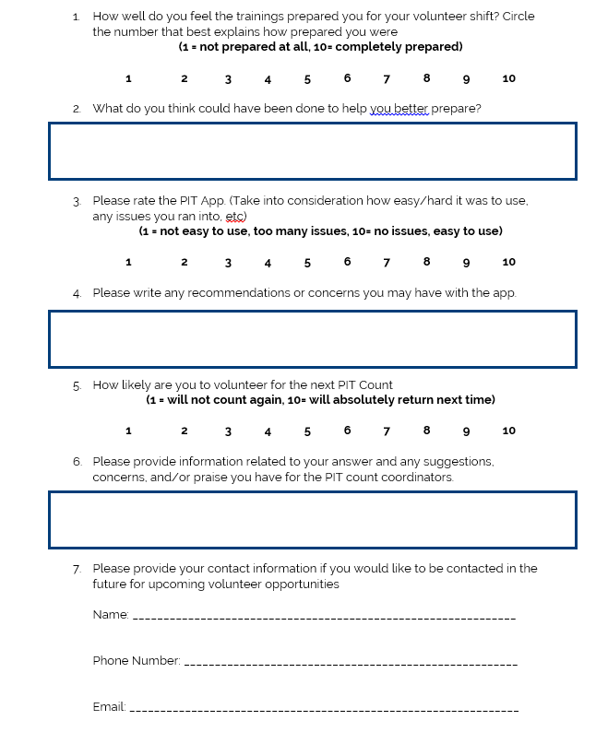
Module 5
Module 6
Wrap- Up
Notes:
Here is a sample feedback form. It will also be available on our website for download. You can use paper surveys or use free survey software like google forms.

Slide 42
Collaboration
Forming PIT Committee
Recruiting Volunteers
Spreading awareness
Media Engagement
Module 6
Wrap- Up
Notes:
As you begin planning for your count, consider how this initiative can be an effective way to engage your community in the effort to end homelessness. Also recognize that the success of the count depends on effective community engagement.
A PIT count can help to inform and educate key stakeholders within your community. This can include the general public, media, policy makers, the business sector, the social services sector, and people experiencing homelessness. Cross-sector collaboration will encourage participation and provide additional resources to support the count, including money, volunteers, supplies, and expert knowledge.
The count can help your community understand and address homelessness differently. The process of planning and implementing the count can generate cross-sector coordination that may be leveraged as you implement other initiatives. This can include a plan to end homelessness, housing first programs, system coordination or by-name lists. Doing the count collaboratively can increase support for your efforts, facilitate new alliances, and build and strengthen partnerships. At a minimum, you should consider how you will use the information you obtain during the count to generate action on homelessness-an objective that requires community participation and coordination.

Slide 43
Conversation About Engaging Law Enforcement
Questions to consider:
  Does your local law enforcement have a homeless outreach team?
  Have they ever expressed interest in participating in your LHC or PIT count?
  Have you noticed any changes in their response to the statewide camping ban?
  What role have they played in the past? How did that go?
Module 6
Wrap- Up
Notes:
Let’s have a quick conversation about engaging law enforcement. There are a few things to consider when engaging law enforcement in your Point-In-Time counts. Does your local law enforcement do homeless outreach? Have they expressed interest in participating in your LHC or PIT count? Have you noticed any changes in their response to the statewide camping ban? And finally, what role have they played in the past? Did it go well, and did it prioritize the safety and wellbeing of those surveyed? All of these questions should be considered before choosing to engage law enforcement in the upcoming PIT count.

Slide 44
Logistics of Engaging Law Enforcement
Best practices to consider:
  Uniformed law enforcement should NOT be surveying unhoused neighbors
  They should be in plain clothes and unmarked cars
  Their primary roles in the PIT count should be limited to:
    Helping your committee identify hot spots before the count, keeping you apprised of any significant changes.
    Available to respond to potential volunteer safety concerns on the day of the count.
    They should NOT be ticketing or arresting on the day of the count.
      Consider if there is a way you could develop a Memorandum of Understanding (MOU) with them.
  If you have concerns about law enforcement impeding your count:
    Try to minimize public facing messaging around the PIT count date.
    See if they would be willing to attend trainings or meetings focused on combatting myths around homelessness.
    Reach out to other regional partners or THN to see if we can provide additional support and assistance.
Module 6
Wrap- Up
Notes:
Here are some best practices to consider for engaging law enforcement. They should not be surveying people, and if they are they should be in plain clothes and in unmarked cars. Limit their roles to helping identifying hot spots prior to the count, and to address any safety concerns. They should not be ticketing or arresting people on the day of the count. If you have concerns about law enforcement impeding your count, try minimizing public facing messaging around the PIT count date, see if they would be willing to attend trainings or meetings focused on combatting myths around homelessness, and reach out to us if you need any further support or assistance.

Slide 45
Engaging Sub-populations
Survivors of Domestic Violence
Youth/ Families
Veterans
Click here for resources
Module 6
Wrap- Up
Notes:
It is very important to make sure that we are engaging all of these subpopulations in the count, not only attempting to find them on the day of but also brining them to the table for planning and organizing.
There are resources on our website regarding engaging these subpopulations, again please reach out to me if you have any questions or need any help.

Slide 46
Conversation About Engaging
Sub-Populations
Questions to consider:
  Which population(s) do you feel like are the most prevalent in your community?
  Which population(s) does your community do a good job of engaging?
  Which population(s) does your community not do a good job of engaging?
  Which community partners are missing from your committee in order to better engage those population(s) ?
  Do you need to add a planning coordinator specifically focused on that group?
  What logistical support do you need from THN or other stakeholders to better engage these groups?
Module 6
Wrap- Up
Notes:
Here are some things to consider when engaging subpopulations. Think about what populations in your community are the most prevalent, what populations is your community already engaging, what populations you are not engaging, what community partners are missing from your committees in order to better engage those populations, and if you need to add people to those groups.

Slide 47
Engaging those with Lived Experience
Steps for Recruiting Current or Formerly Homeless Individuals for PIT
Identify desired roles needed for PIT Count.
Determine what incentives or compensation are available to current/formerly homeless individuals to participate in the PIT Count.
Early in planning process, communicate to homeless assistance agencies the roles needing to be filled.
  Request assistance from agencies in identifying good candidates.
  Persons identified should not be in the midst of crisis and in no way feel compelled to assist.
After candidates are identified, provider agencies should contact them to ask if they would be interested in participating in PIT Count.
Once participation is confirmed, staff planning the PIT should review PIT plan and training content with the individuals and make necessary adjustments.
Deploy individuals with teams on day of count.
After count is complete, consider asking any current or formerly homeless participants to serve in other CoC volunteer capacities, such as the CoC Board or consumer advisory committee.
Module 6
Wrap- Up
Notes:
People who have experienced homelessness are an indispensable resource to a successful point-in-time count (PIT) of unsheltered people and should be actively involved in your PIT count. Many CoCs rely on input and assistance from currently or formerly homeless people when planning, organizing, and implementing a count. When recruiting people who are homeless and staying in emergency housing, PIT leads should be sensitive to any shelter restrictions that could limit participation, such as program curfews or other requirements.
I also want to take a minute to remind everyone that if you are recruiting anyone with lived experience, especially those that are currently experiencing homelessness, you must pay them for their time. They are the experts and should be treated as such.

Slide 48
Updates on the 2026 PIT
Upcoming Trainings will be Webinars.
  Pre Count- PIT Lead Webinar
  Pre Count- Counting Us App/Regional Command Center Webinar
  Post Count- How to read your Data Webinar
There will be a pre-recorded volunteer training released in December
  You can request Ava to conduct virtual volunteer trainings from October-January. Please give at least a few weeks notice
  Supplemental materials will be released such as pre recorded volunteer training videos and Counting Us app training.
  Possible In person Trainings available, please contact me for details, on a first come first serve basis.
There will be opportunities for one on one support, and “office hours” style support calls towards the end of the year, November through January
There are a series of additional presentations posted to the website to help you engage those with lived experience, youth, veterans, and victim service providers.
Wrap- Up
Notes:
So the next training for PIT leads after we complete this one is a Pre-count Webinar on how to use our data gathering app and regional command center. And a post-count webinar on how to read your data. There will be a pre-recorded volunteer training released in December that can be accessed at any time. In addition, if you can give me a few weeks notice, I can also conduct virtual volunteer training if needed. Please reach out to me and let me know if this is something you might be interested in for your community. We will also be providing training for our sheltered counts as well. And there are a series of additional presentations posted to the THN website to help you engage providers in the PIT count. I would also like to mention that we will be having a sign up form at some point in December for individual community check ins if you are interested. We will also be holding “office hour” conference calls so you can come in and ask questions and receive guidance.

Slide 49
Tentative Timeline
-Mandatory PIT Lead Training webinar
-Finalize Shelter List
-Begin Mapping Unsheltered Location list
-Begin Volunteer Recruitment and community engagement
-Mobile app training
-Deadline to sign up for service based count and/or paper surveys
-”Office Hours” support call opportunities begin
-Continue volunteer recruitment
-PIT leads and communities can sign up for One on One support calls
-Refresher materials to be released by THN
-Volunteer training materials released
-Start holding volunteer trainings
-Finalize shelter engagement plan
-Look over training materials and presentations
-Conduct PIT Count
October
November
December
January
Wrap- Up
Notes:
Here is a quick timeline of the most important events to note for our upcoming PIT count.

Slide 50
Next Steps
Schedule Mobile App Training
Start creating your PIT committee
Be on the lookout for Sheltered location list from Ava
Start developing volunteer recruitment plan
Request volunteer training if needed
Be on the look-out for support call opportunities
Wrap- Up
Notes:
Here are the next steps as we progress towards our PIT count. We will be scheduling our mobile app training that will be going over the Counting Us app that we use to gather data and the Regional Command Center that we use to view our data. If you have not done so already, begin forming your PIT committees. Be on the lookout for the Sheltered location list from myself coming soon. Start developing a volunteer recruitment plan and begin recruiting volunteers if you have the capacity to do so. You can request volunteer training if that is something you might be interested in. And finally be on the look-out for our opportunities for support calls as well as any other email updates that might come your way.

Slide 51

Wrap- Up

Slide 52
Thank you!
Contact Information
Ava Paredes
Data and Engagement Coordinator
Email: Ava@THN.org
Phone: (512)-652-4714

