Slide 1
How to Read and Analyze your PIT Data

Slide 2

Agenda
Module 1
Overview of the PIT Count
Review Report Types
First Page Overview
Data Quality Section
Household Breakdown
What to do with your PIT Data
Wrap-Up/ Q&A
Module 2
Module 3
Module 4
Module 5
Module 6
Wrap- Up

Slide 3
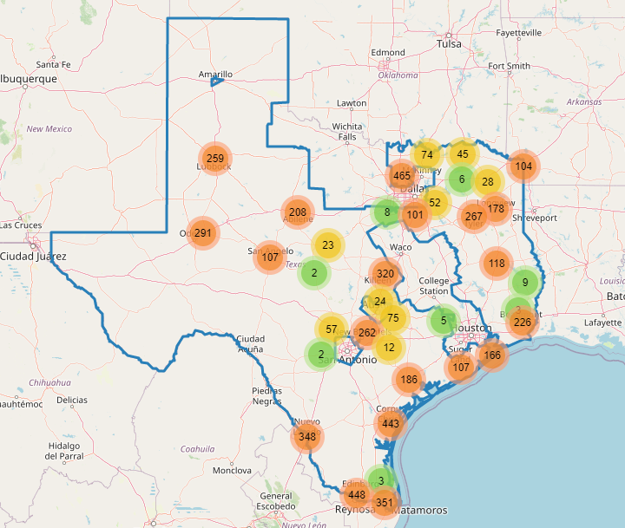
Brief Overview of the PIT Count
Module 1
Who?
What?
When?
Where?
Why?
Module 2
Module 3
Module 4
Module 5
Module 6
Wrap- Up
Notes:
Who: Individuals and families residing in Unsheltered locations such as cars, parks, streets, sidewalks, and other places not meant for human habitation. As well as individuals and families residing in sheltered locations such as emergency shelters and transitional housing.
What: The PIT count aims to provide a snapshot of the individuals and families experiencing homelessness in a geographical area over the course of one night.
When: Last 10 nights in January.
Where: The Texas Balance of State CoC. The PIT count occurs across our geography in communities like yours. On this screen you’ll see a screenshot of the actual survey results from our mobile app
Why: For awareness in order to advocate to local governments, To understand the extent of homelessness by determining the number of people experiencing homelessness within our geography. To secure funding as the data can be used to secure grant funding. And for engagement as the PIT count encourages communities to get involved in ending homelessness.

Slide 4
3 Report Types
Module 2
Sheltered | Unsheltered | Combined
Folks in Emergency Shelters or Transitional Housing | Folks who are living in a place not meant for human habitation | A report with both sheltered and unsheltered folks
Module 3
Module 4
Module 5
Module 6
Wrap- Up
Notes:
There are three types of reports that you should have received:
Sheltered- Sheltered reports contain the data for all of the folks that are sheltered on the night of the count. This includes people in emergency shelters and transitional housing.
Unsheltered- Unsheltered reports contain the data for all of the folks that are living in a place not meant for human habitation on the night of the count. This can include living on the streets, living in a homeless encampment, living in an abandoned building, and other places not meant for human habitation.
Combined- The combined report contains the data for both sheltered and unsheltered folks in your region or geographic area. If you want to find total demographic data for particular population in your region, perhaps you want to find the total number of people of a particular sex, or a particular race, the combined report is where you should start.
This might be a good place to stop for questions.

Slide 5
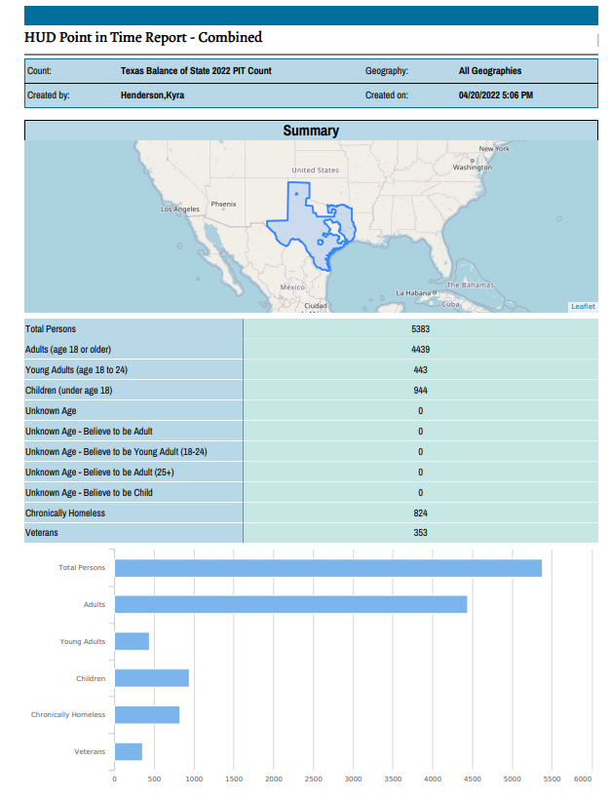
Overview of the First Page
Total Persons
Age Breakdown
Chronically Homeless
Veterans
Module 3
Module 4
Module 5
Module 6
Page 1
Wrap- Up
Notes:
On our first page of the report you will see the geography for this report in the middle of the page, as well as the type of report you are viewing at the top. The first page also gives you a basic breakdown of the population of your geographic region based on age, and a few subpopulations such as chronically homeless people and homeless veterans. If you want to know the specifics about how chronically homeless is defined, in the chat we are going to link a HUD document that explains the definition. I have received some questions about the 3 age categories (adults, youth, children) not adding up to the total population number at the top of the report, this is because homeless youth, due to their age range of 18-24, are already included in the adults category.This means that in order to find your total, all you have to do is add the adults and children.
Below this population table we can also see a bar chart of the population breakdown. Including the subpopulations that we just mentioned.

Slide 6
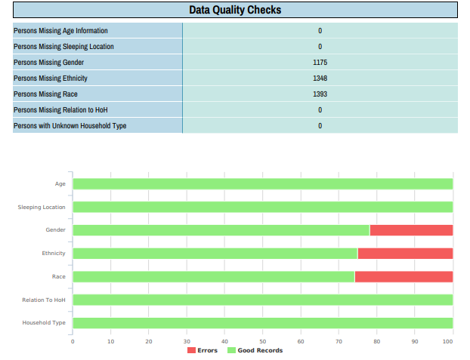
Data Quality Checks Section
Sex
Module 4
Sex
Module 5
Module 6
Page 2
Wrap- Up
Notes:
When looking at the data quality section it is important to note how the reports count errors. Errors are counted when a response is left blank. There are certain instances where a respondent might answer “don’t know” or “refused”. This is not represented within the data quality checks section, it will only count an error when the response for a particular question is left blank. I’d also like to note that the “don't know” and “refused” responses are also not represented anywhere else in the report, so sometimes your totals for certain demographics might not add up because of the complexity related to how the report counts blanks and don’t know/refused responses.
Some of these data quality issues can be mitigated by working towards comprehensiveness when gathering data. Our goal is to have as few missing data elements as possible. Even though we can’t get people to answer every single question, we want to at least give them the opportunity to answer all of the questions. Some volunteers might skip these questions in order to swiftly move through the survey and gather as much data and respondents as possible. It is important that we encourage our volunteers to ask all the questions if possible. By training our volunteers to be comprehensive when gathering data we can ensure that there are less data quality issues in the future.
I’d like to stress that even though we want to give respondents an opportunity to answer every question in the survey, some people might not want to answer questions about their sex or race. This is perfectly okay and to be expected. Some people might not know off the top of their head the answers to these questions, and others might simply not want to answer them, and that is perfectly fine as well.

Slide 7



Household Types
Households with Children | Households without Children | Households with only Children
At least one person is 18 or older and at least one person is under 18. | Only adults 18 and older. | Only children under 18.
Module 5
Module 6
Wrap- Up
Notes:
Before we go into the household types I’d first like to point out the difference between a household and a person. Households are families, persons are the individuals that make up those families. The reason the report is broken down this way is because this is how the data is reported to HUD.
Households with Children:
These households have at least one person over the age of 18 and one person under the age of 18
Households without Children:
The members of this household are all adults over the age of 18.
Households with only Children:
The members of this household are all children under the age of 18

Slide 8
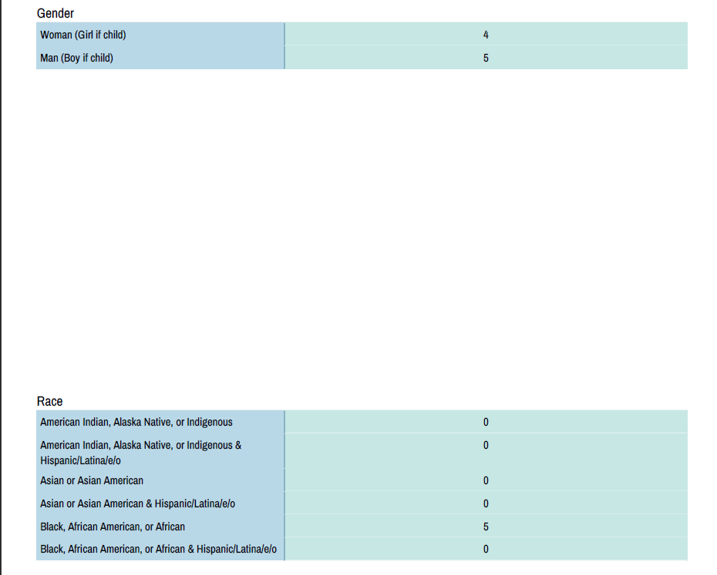
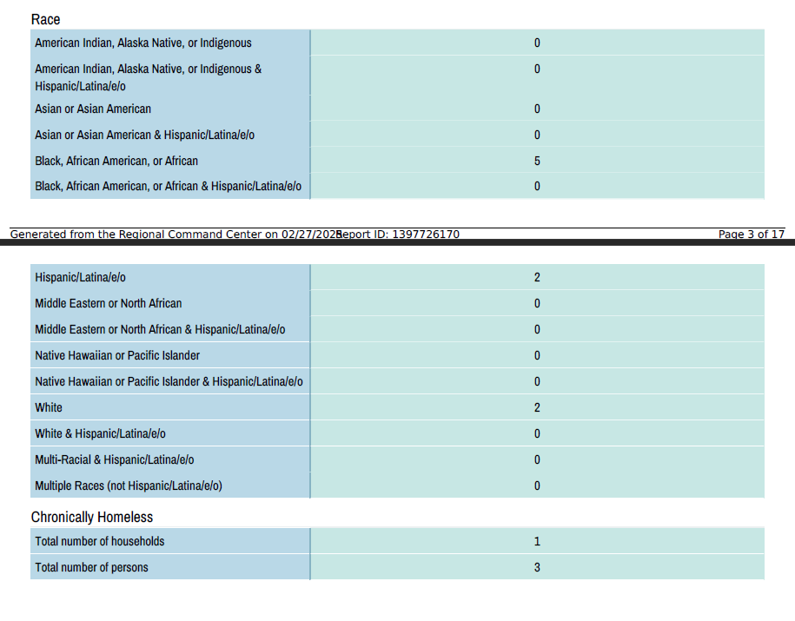
Demographics
Sex
Sex
Race
Chronic Homelessness
Module 5
Module 6
Page 3-6
Wrap- Up
Notes:
Each household report page will have its own demographic breakdown for sex, race and chronic homelessness. If you want to know the totals for any of these demographics, you will add them up across the three main household categories that we talked about on the previous slide. The reports do not give us a page for total demographic data for all households such as total race, age, sex and chronic homelessness. In order to find total demographic data for all households we need to manually add up the three broad household types for each demographic. We plan on putting in a request with our vendor SIMTECH to make a total households page a feature on future reports, but there are no guarantees that this will be integrated into future PIT reports.
It is important to note for these demographics that sometimes a respondent might answer a question with more than one choice. Say for example, someone might identify as multiple races. The report does not classify people under multiple categories in these kind of situations. If someone selects more than one race, they are automatically categorized as having “Multiple” races. If you want to see each individual response for those demographics, knowing that it will be greater than your total number of people, let us know and we can send over an excel spreadsheet with that information.

Slide 9
Veteran and Youths
Households with At least One Child and One Adult
Households without Children
Households with only Children
-Veteran Households with at least one child and one adult
-Parenting Youth (parents are 18 years and older)
-Veteran Households without Children
-Unaccompanied Youth 18 years and older
-Unaccompanied Youth Under the Age of 18
-Parenting Youth (parents are under the age of 18)
Module 5
Module 6
Page 7-11
Wrap- Up
Notes:
There are several different subpopulations accounted for within the PIT reports. The PIT reports also give you a breakdown of veteran households, with and without children. There are also two youth pages as well. One for unaccompanied youths, and one for parenting youths. Unaccompanied youth are people between the ages of 0-24 who are unaccompanied on the night of the count, meaning they are without their parents or guardians. And there are parenting youth, who are people between the ages of 18-24 with at least one child under 18.
It is important to note which subpopulations overlap with the three main household types that we talked about earlier, this is where some of these subpopulation households are also counted under the three broad household types. Veteran households with at least one child and one adult, and parenting youth where the parents are 18 years and older will overlap with the Households with at least One Child and One Adult category. Veteran households without children and Unaccompanied youth age 18 and older will overlap with the Households without Children category. Finally, unaccompanied youth under the age of 18, and parenting youth where the parents are under the age of 18 will overlap with the Households with only Children category.

Slide 10
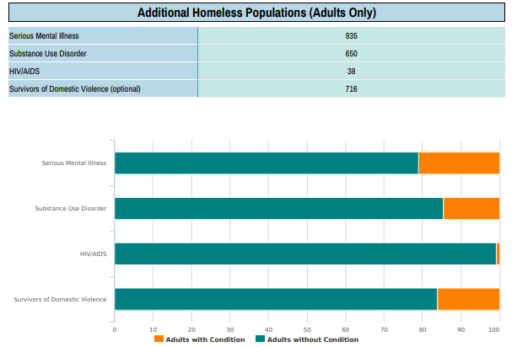
Additional Homeless Populations
Serious Mental Illness
Substance Abuse Disorder
HIV/AIDS
Domestic Violence Survivors
Module 5
Module 6
Page 12
Wrap- Up
Notes:
At the very end of the PIT reports is a section called “additional homeless populations”. These include people with serious mental illness, substance abuse disorder, HIV/AIDS, and DV survivors. You will also see another bar chart below the table that has the individuals living with a chronic condition and DV survivors highlighted in orange. The orange stands for people who responded yes to the particular question regarding their status with particular chronic conditions or if they are a survivor of domestic violence.

Slide 11
2025 Variables to Consider
Unsheltered Count
Sheltered Count
Severe winter weather on our PIT date in the gulf coast area
Lubbock left our CoC and was left out of our final numbers
Closure of projects,
Opening of new projects,
Increase in the number of hotel/motel “voucher” projects,
Increase in bed capacity due to removal of social distancing protocol
Increase in staff turnover
Module 6
Wrap- Up

Slide 12
Analyzing Trends Over Time
Module 6
Wrap- Up
Notes:
Now that we have taken the time to acknowledge some of the variables that may have affected your count, let’s move into discussing the ways you can strategically analyze your data. This first slide goes through the most commonly requested analysis we get, which is a comparison of PIT data year to year.
On this slide there is a percent change formula. This is the most common way you can analyze your PIT data as you do it year over year. You can plug in numbers from past years and the most reacent year into this formula and understand the percentage in change. Always take these numbers with a grain of salt though, and make sure to always understand the context in which the data was gathered, as we discussed with some of those variables that effected the most recent PIT count. The really cool thing about the type of analysis that I cover in this presentation is that it doesn’t require complex analysis. Many of the data points you may be hoping to find can come from simple formulas like this one, which can also be easily googled if you forget.

Slide 13


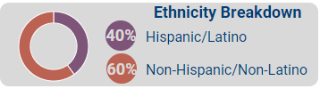
Talking Points from PIT Report ONLY
What is the percent of adults who are first time homeless?
What is the percent of people that are unsheltered?
What is the percent of women that are veterans?
Module 6
Wrap- Up
Notes:
Now that we have talked about how to compare previous PIT data to current PIT data, let’s talk about how you can find talking points using nothing more than the reports you have already received. The second most common talking point I am asked to go over is what the percentage is of a particular group in relation to the full population. Examples of this are listed on the slide, including what percentage of adults are experiencing homelessness for the first time. Or even going a step deeper to find out what the percentage is of a subpopulation in relation to another subpopulation, the example being the percent of women that are veterans experiencing homelessness.
Now while the formula on this slide is also fairly simple, it is important to remember that you need to ensure you are dividing by the correct number.
Example: for veterans you would only divide by the number of adult women, because children cannot be veterans.
Below are two examples of data points that were derived from this type of analysis. One example demonstrates a way to use written text in conjunction with icons. The other demonstrates a simple pie chart that can be used to clearly demonstrate the comparison of two data points.

Slide 14
Why Utilize PIT Data
Most reliable source of data on homelessness
Occurs at the same time across the country
Comprehensive data for numerous demographics
Allows us to gauge the needs of our communities
Allows us to understand our capacity to respond to the crisis
Notes:
PIT data is the most reliable source of information on homelessness. Because the PIT count occurs at the same time throughout the county, it provides us a snapshot of homelessness in our communities. Because of the unilateral participation from several communities throughout the geography of the Texas Balance of State CoC, we are able to use this concerted effort to get a comprehensive data set of numerous demographics. We can ultimately use this data to identify populations that are needing more attention, as well as gauge the need of our communities. The Point-In-Time count also happens at the same time as the Housing Inventory Count as well. We will go into more detail later in the presentation, but in short when you look at both of these data sets you can also see the extent of homelessness in your community, and your capacity to respond to it.

Slide 15
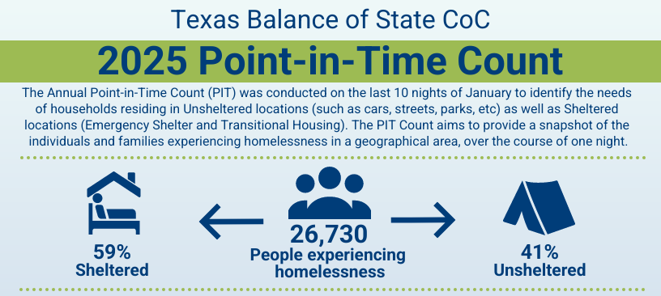
2025 PIT Data

Slide 16
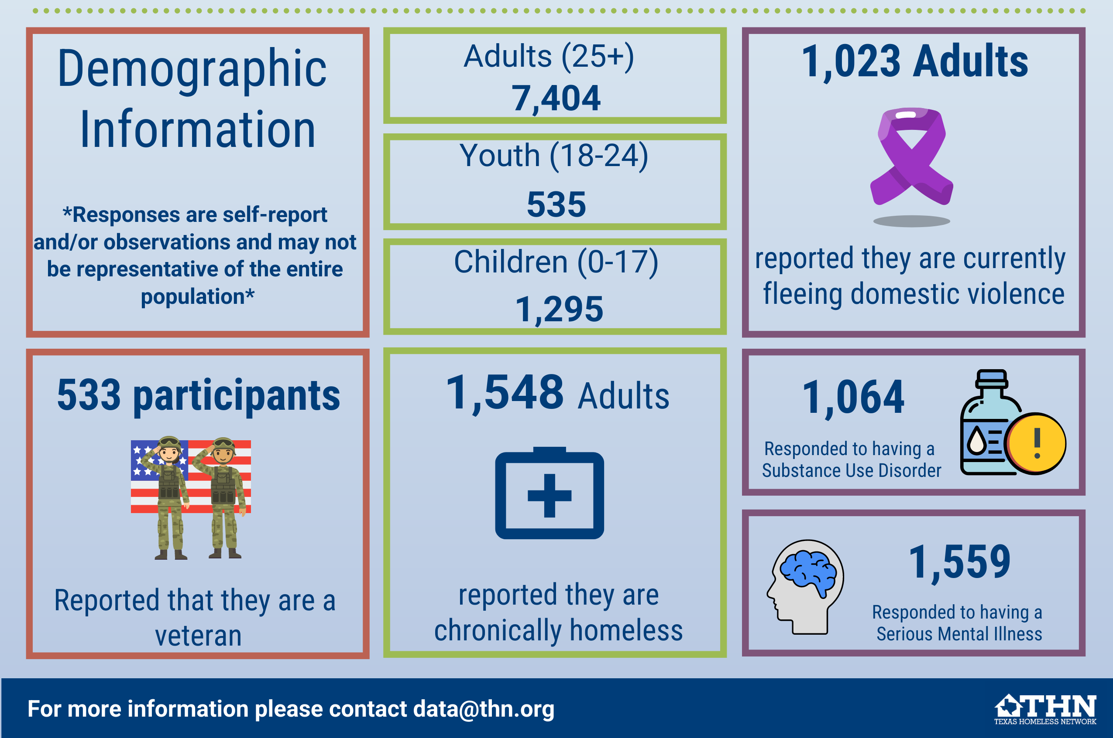
2025 PIT Data

Slide 17
Comparison Year Over Year
2024
2025
10,081 Total
9,234 Total
2,990 ES
3,069 ES
723 TH
814 TH
6,368 Unsheltered
5,351 Unsheltered

Slide 18
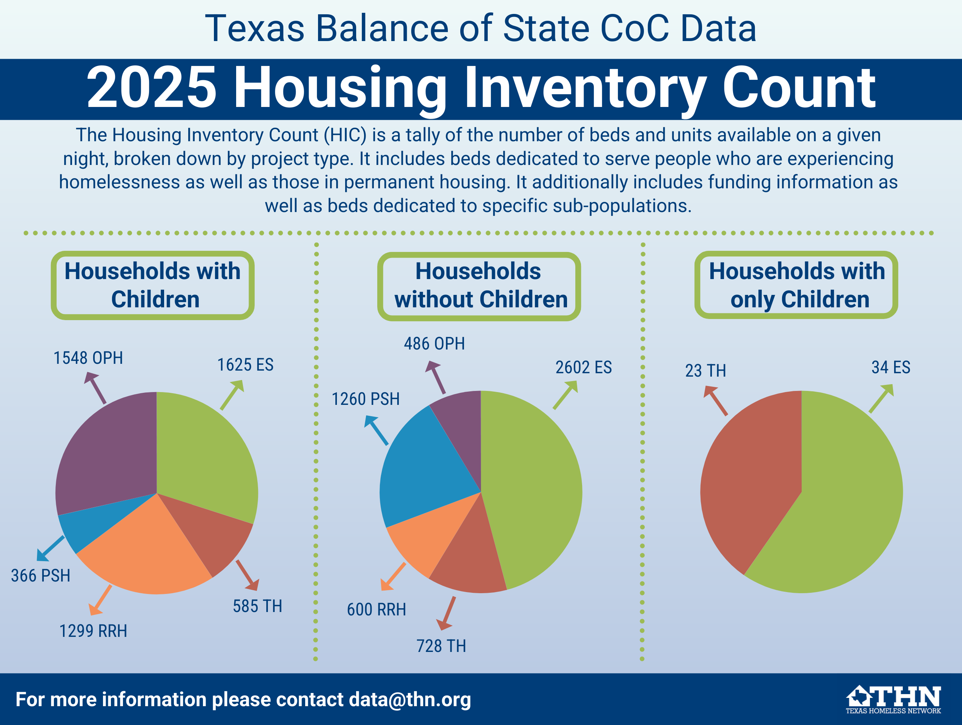
2025 HIC Data

Slide 19
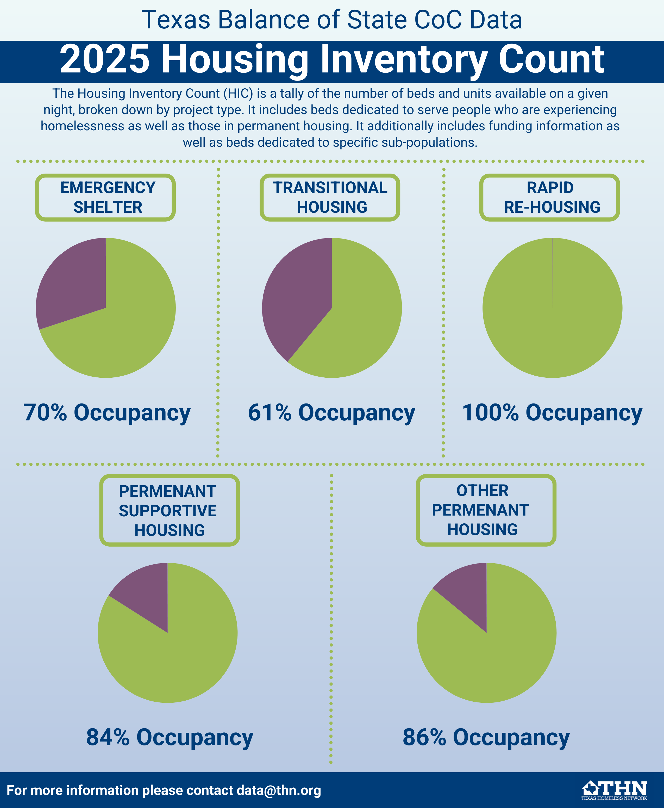
2025 HIC Data

Slide 20
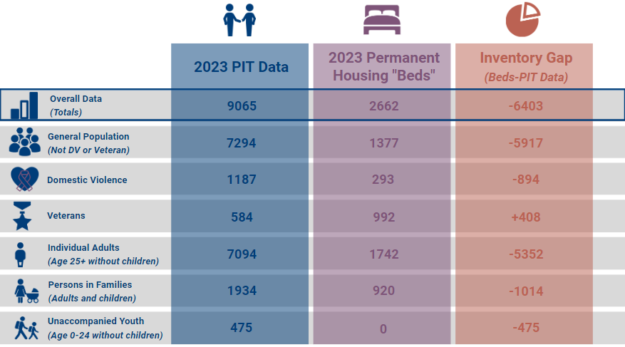
Comparison to HIC Data
Notes:
And here is a comparison of the 2023 PIT data to the Housing Inventory count data. These kinds of gaps analysis are an excellent way to find areas that you might be needing funding for. You can see that while we have a surplus in veteran beds, we have a significant deficit in beds for general population single adults without children. When applying for funding, doing these simple gaps analysis can be crucial when trying to determine the scope and scale of the need within your community. An important goal is to keep in mind is to have the funding needs to align with the interest and the priorities of the LHC. We want the PIT data to drive the conversation. Everyone needs to be on the same page in regards to homelessness within our communities and trying aligning our funding needs with the data. To talk a bit more about that I am going to pass it off to Jim Ward our director of planning.

Slide 21
Presentation Suggestions
Write out your particular talking points in advance.
Take time to explain particular variables in your community to help provide context to the data.
Try to appeal to different learning styles
Use easily recognizable charts when you are comparing data points (like bar graphs and pie charts).
Break up the data into separate slides/ pages.
Practice your presentation and anticipate the questions you may be asked. Ask for assistance/ guidance from THN staff if needed.
Infographics are helpful but not necessary.
Module 6
Wrap- Up
Notes:
For those of you who are not familiar with presenting data or would like to brainstorm some ways to get more confident with it, here are some of the tips and tricks I have learned over the years.
Talking points are the main highlights you want people to take away from your presentation, which can be very helpful to keep your audience engaged.
Much like I did earlier in the presentation, it is important to talk about variables in your community that may have impacted the data. Variables can include number of volunteers, amount of time hot spot mapping, day of count logistics, and any specific obstacles you encountered (bad weather, COVID spike before count, etc)
As we know, people have different learning styles and as much as you can, I recommend trying to find ways to play into all of them. Just like what I did in this presentation, a mixture of visual elements such as text, pictures, and charts as well as audio can help ensure that your audience is interacting with the data in the way that makes sense to them.
Very similarly to what I say about the importance of practicing your PIT surveys outloud, its important to practice your presentation aloud. This will help you develop confidence as well as help you anticipate questions you may be asked.
If you realize you are not feeling confident about presenting the data, you can also feel free to reach out to data@thn.org so staff can work with you on either developing talking points or attending the meeting with you to assist.
One caveat to this, THN staff will assess our capacity and will attempt to accommodate all requests. Please allow us a minimum of 1 month notice if your request involves any specialized materials to be created.
And finally a quick note about infographics. If you feel confident making graphics, these are a wonderful tool because you can use them both in a presentation or send them out on their own (via email or social media).
If you are not confident though, you can have just as much impact by writing blog posts with visuals, creating specialized powerpoints such as this one, or releasing “data snapshots” over important data elements (like those small images I had on the last couple slides.
There is not one correct way to present data.

Slide 22
Prompting Questions
Making your presentation interactive by asking questions can help engage your audience:
Examples:
What is this data telling you?
What about this data surprises you
What about this data confuses you?
What other data would you like to see?
Module 6
Wrap- Up
Notes:
Another way to spice up your presentation and also give yourself a break from talking and summarizing for folks is to utilize some interactive polling/ prompting questions
Not only does this help you ensure that your audience is understanding what you are presenting, but it also gives them a level of autonomy over what they take from the presentation. The more connected they feel with the data, the more likely they are to find the presentation impactful. I put some example questions on this slide to give you some ideas of questions I have used in the past.

Slide 23
Important Reminder
You don’t have to know everything
“I don’t know about that, let me get back to you once our team has a chance to look this over.”
“Off the top of my head I don’t know the answer to that question, but I would be happy to check in with my team and we will send you the information we find.”
“This is just our preliminary findings and we haven’t had much time to do in depth analysis, please send me a follow up email with your questions and we will get back to you when we have the capacity to do a deeper dive into the data.”
“I’m not sure that question is possible to answer with this data set, maybe we can take this conversation offline and we can talk about this more.”
Module 6
Wrap- Up
Notes:
Now if you take nothing else from this presentation, please remember that you are not expected to know everything. There may be times that a question is asked that you don’t know the answer to or you become flustered when someone makes a statement you weren’t prepared for. Here are some of the many phrases I have said when I run into this situation. Just remember, be honest, speak with confidence, and know that it is okay not to be perfect.

Slide 24

Wrap- Up

Slide 25
Summary/ Wrap-up
For general PIT count questions for 2025 or for this upcoming PIT year, please email ava@thn.org
For specialized reports, presentation requests, or other data requests, please email data@thn.org
Reports were emailed to all PIT leads and Can be requested from Ava
You can also find the infographics in this presentation on the PIT and HIC page on THN.org
Wrap- Up

Slide 26
Thank you!
Contact Information
Ava Paredes
Data and Engagement Coordinator
Email: ava@thn.org
Phone: (512)-652-4714

