Slide 1
TX BoS CoC
General Membership Meeting
9/23/2026

Slide 2

Tell us about yourself!
Tell us your county, if you’ve experienced homelessness, and groups you belong to or represent
https://thn.wufoo.com/forms/wqabpg20h7ak3u/
Notes:
Before meeting

Slide 3
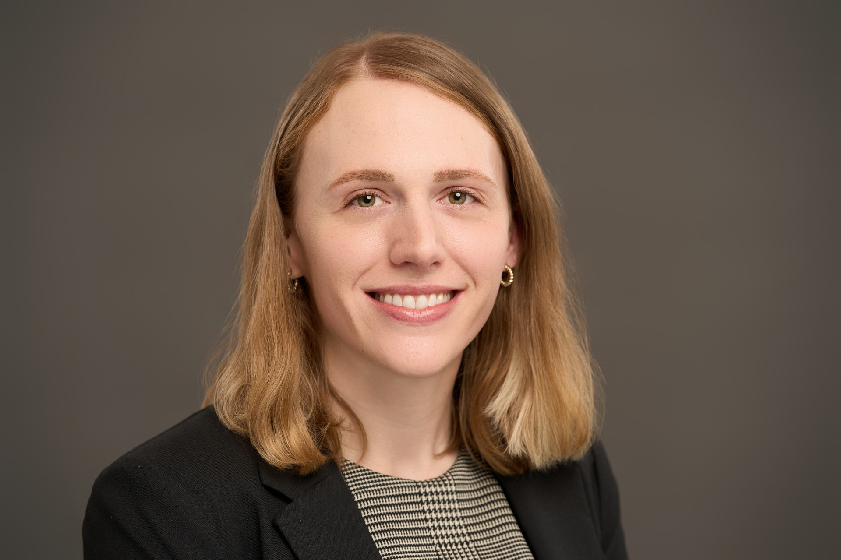
Welcome
Hope Nordon, Senior Director of CoC Programs

Slide 4
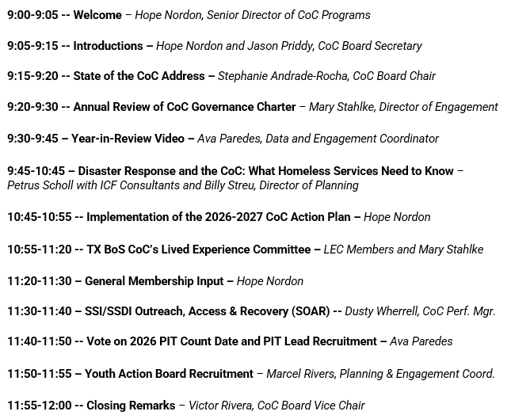
Notes:
Mary point to agenda on screen, agenda at each chair

Slide 5

Introductions
Jason Priddy,
CoC Board Secretary

Slide 6

Texas Homeless Network
Mission Statement
We lead Texas communities to
make homelessness rare, brief,
and non-recurring.
Organizational Activities:
Statewide Advocacy and Education
TX BoS CoC Collaborative Applicant
TX BoS CoC HMIS Lead Agency and Coordinated Entry Lead Agency
Notes:
THN staff provide staff support to the TX BoS CoC

Slide 7
What is a CoC?
A CoC, as defined by the U.S. Department of Housing and Urban Development (HUD) in the CoC Program Interim Rule at 24 CFR Part 578.3, is the group organized to carry out the responsibilities required under the CoC Program for a defined geographic area.
A community-based planning network for homelessness assistance.
The geographic area covered by the community-based planning network.
A program operated by the U.S. Dept. of Housing & Urban Development
(HUD)

Slide 8
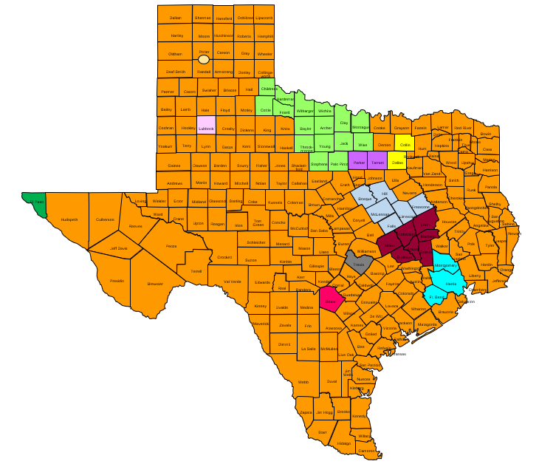
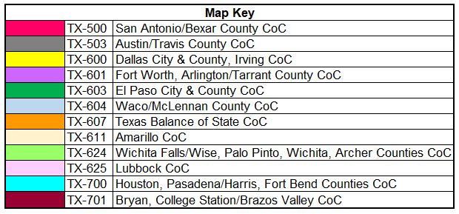
Texas Balance of State Continuum of Care

Slide 9

Texas Balance of State Continuum of Care
Mission Statement
The TX BoS CoC develops system-level responses and coordinates local community strategies that prevent and end homelessness and increase housing stability.

Slide 10

HUD’s definition of “Homeless”
Residing in a place not meant for human habitation
Residing in temporary shelter
  Congregate/emergency shelter
  Transitional housing
  Hotel/motel paid by charity or federal/state/local government
Fleeing domestic violence
Notes:
https://files.hudexchange.info/resources/documents/HomelessDefinition_RecordkeepingRequirementsandCriteria.pdf

Slide 11
Ending Homelessness
Every community has a systemic response in place that ensures homelessness is prevented whenever possible or is otherwise a rare, brief, and non-recurring experience.
Notes:
When we think about ending homelessness, we do not mean that we won’t see people experiencing homelessness ever again. Changing economic realities, the unpredictability of life, and unsafe or unwelcoming family environments may create situations where individuals, families, or youth could experience or be at risk of homelessness. It would take major structural changes such as addressing inequality to truly end homelessness for all individuals.
The United States Interagency Council on Homelessness (USICH) states that ending homelessness means that every community has a systematic response in place that ensures homelessness is prevented whenever possible or if it does occur, it is a rare, brief, and non-recurring experience.

Slide 12
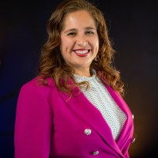
State of the CoC Address
Stephanie Andrade-Rocha, CoC Board Chair

Slide 13

CoC Governance Charter—Annual Review
Mary Stahlke, Director of Engagement

Slide 14
CoC Governance Charter—Annual Review
To find the CoC Governance Charter online:
Go to www.thn.org
Hover over “Texas BoS Continuum of Care”
Hover over “About TX BoS CoC”
Click on “Our Governance”
See “TX BoS CoC Governance Documents”

Slide 15
Governance Charter Overview
Charter identifies the CoC’s governance structure, roles, responsibilities, and authority
Outlines key operational components of the CoC
Links to CoC policies and procedures
General members, CoC Board members, and THN staff may suggest changes throughout the year
Staff will give public notice about the suggested changes and make them available for public comment
CoC Board approves changes on behalf of the CoC

Slide 16
Governance Charter—Proposed Changes
Living document
Worked with HUD-provided technical assistance from April-June 2026
Proposed changes this year:
  Adding references to the Coordinated Entry (CE) Lead Agency
  Changing the number of CoC Board seats
  Adding the CoC Board selection process
  Updating links to several documents and websites
  Making minor grammatical changes

Slide 17
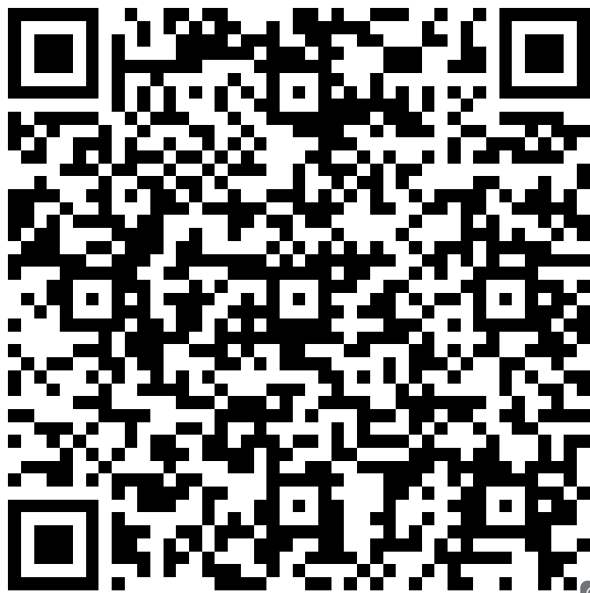
Comment on CoC Governance Charter
Give comments on the proposed changes to the CoC Governance Charter
Late September through late October

Slide 18

Year-in-Review Video
Ava Paredes,
Data and Engagement Coordinator

Slide 19


Slide 20
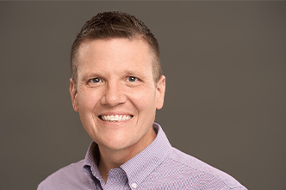
Disaster Response and the CoC: What Homeless Services Need to Know
Billy Streu,
Director of Planning

Slide 21
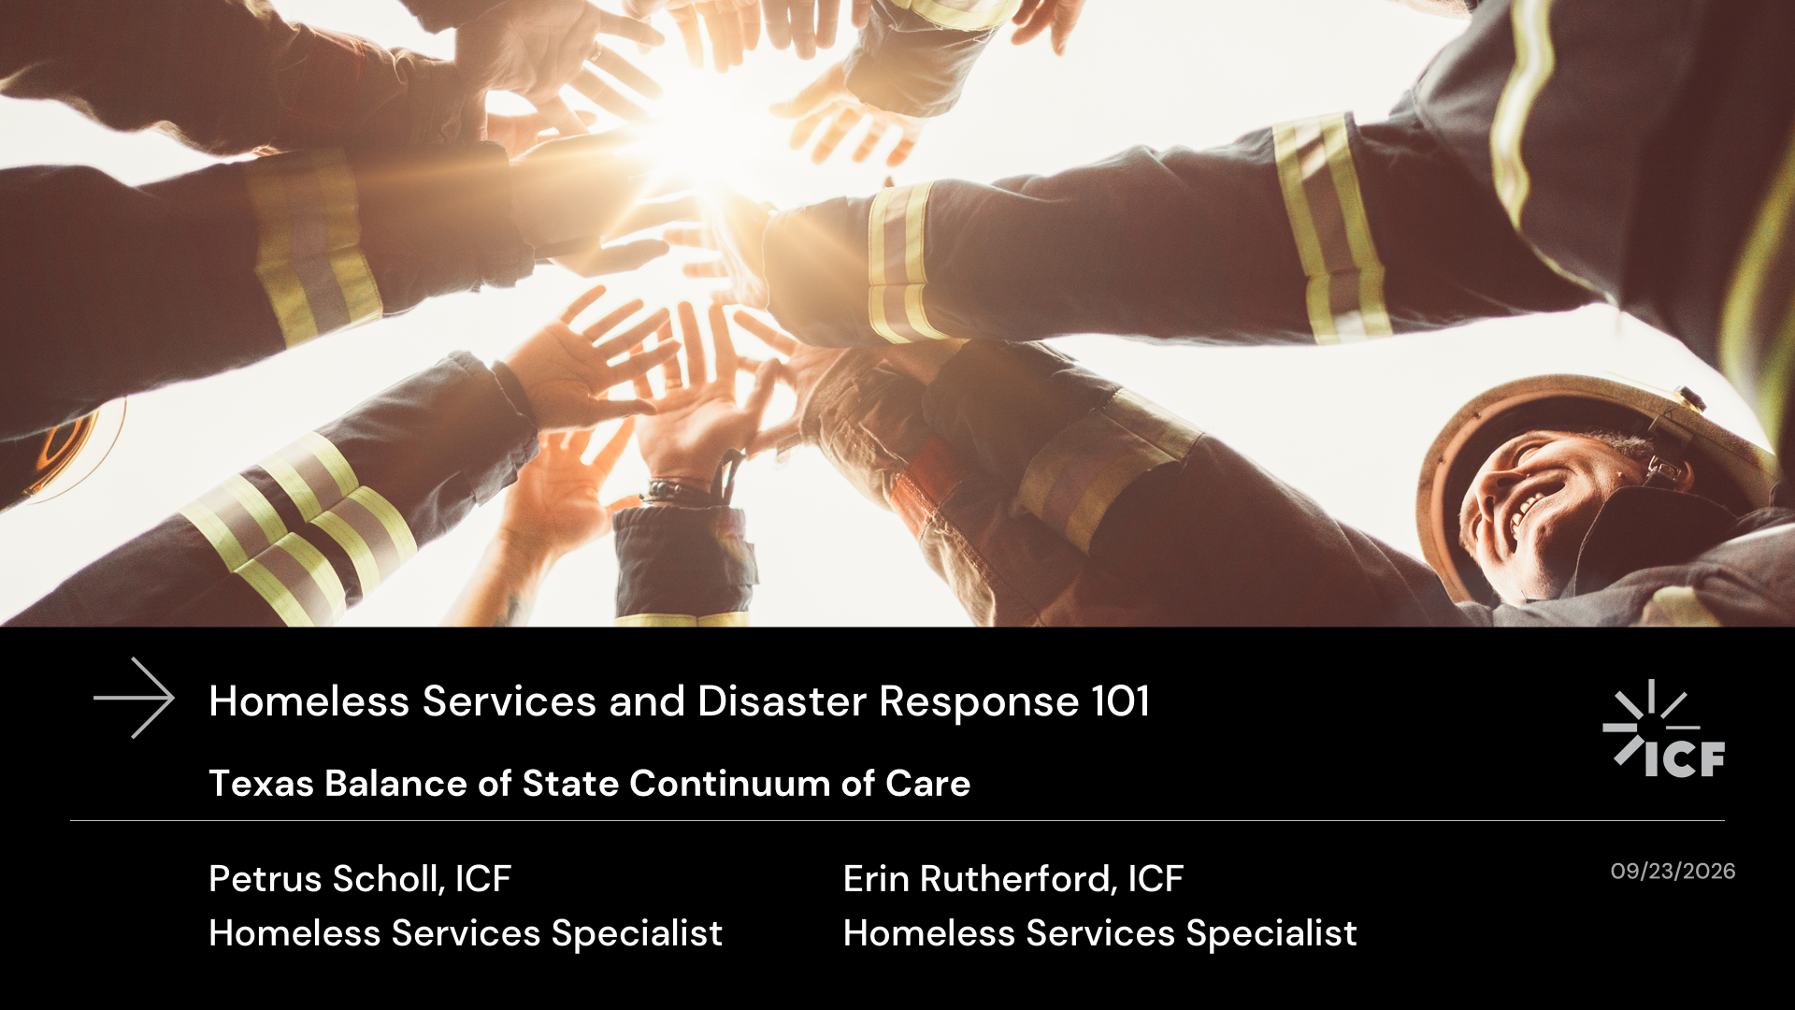

Slide 22
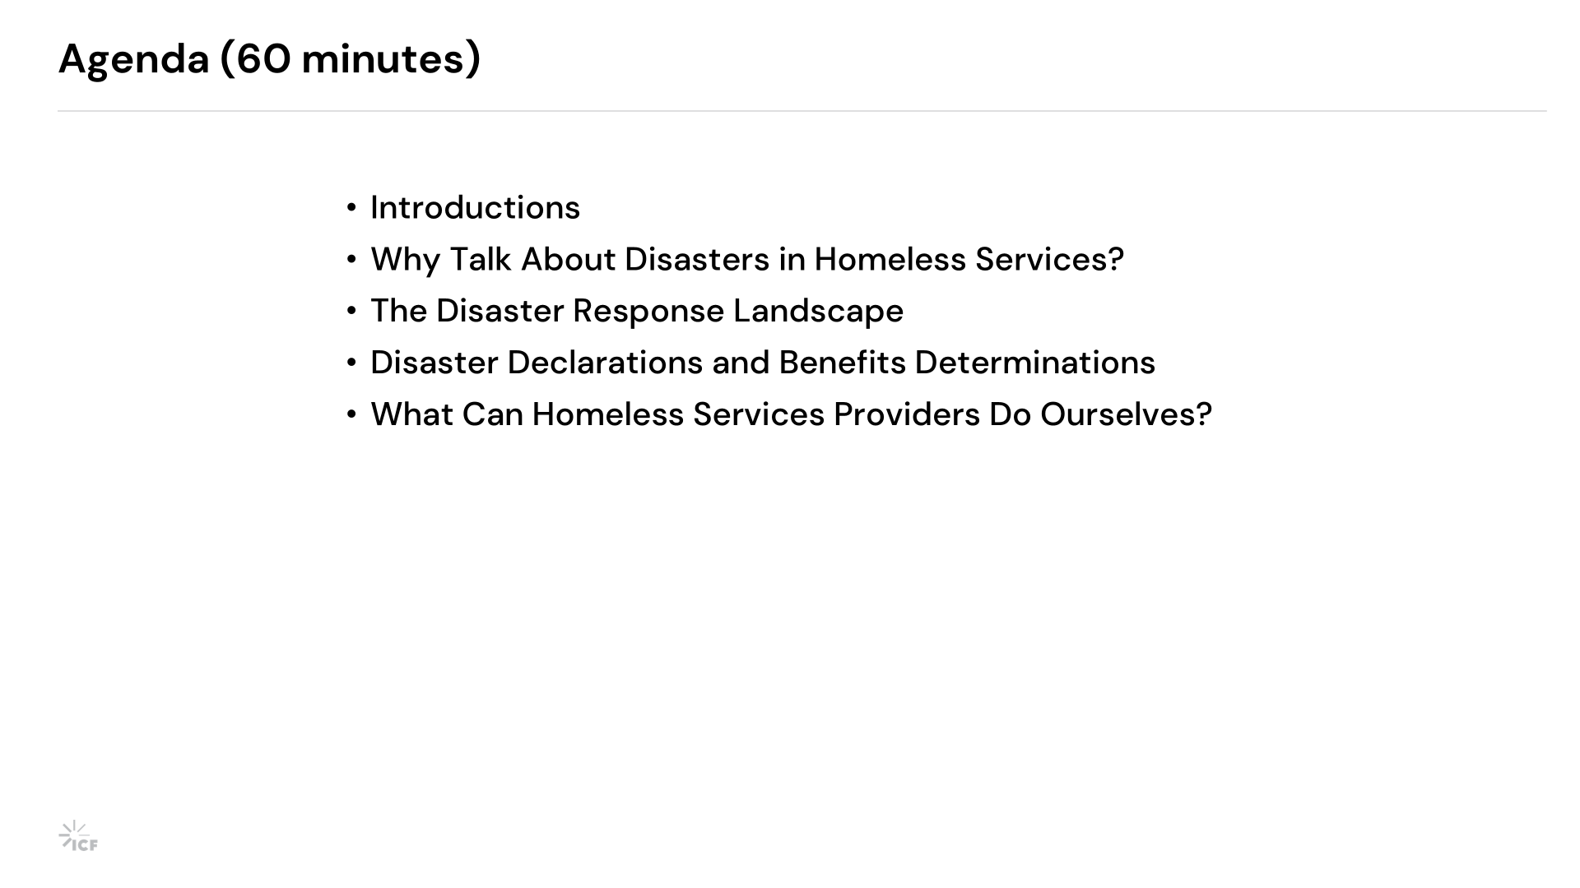
Agenda (60 minutes)
Introductions
Why Talk About Disasters in Homeless Services?
The Disaster Response Landscape
Disaster Declarations and Benefits Determinations
What Can Homeless Services Providers Do Ourselves?
Notes:
PETRUS

Slide 23


Slide 24
Why Talk About Disasters in Homeless Services?
Notes:
PETRUS → ERIN

Slide 25


Slide 26

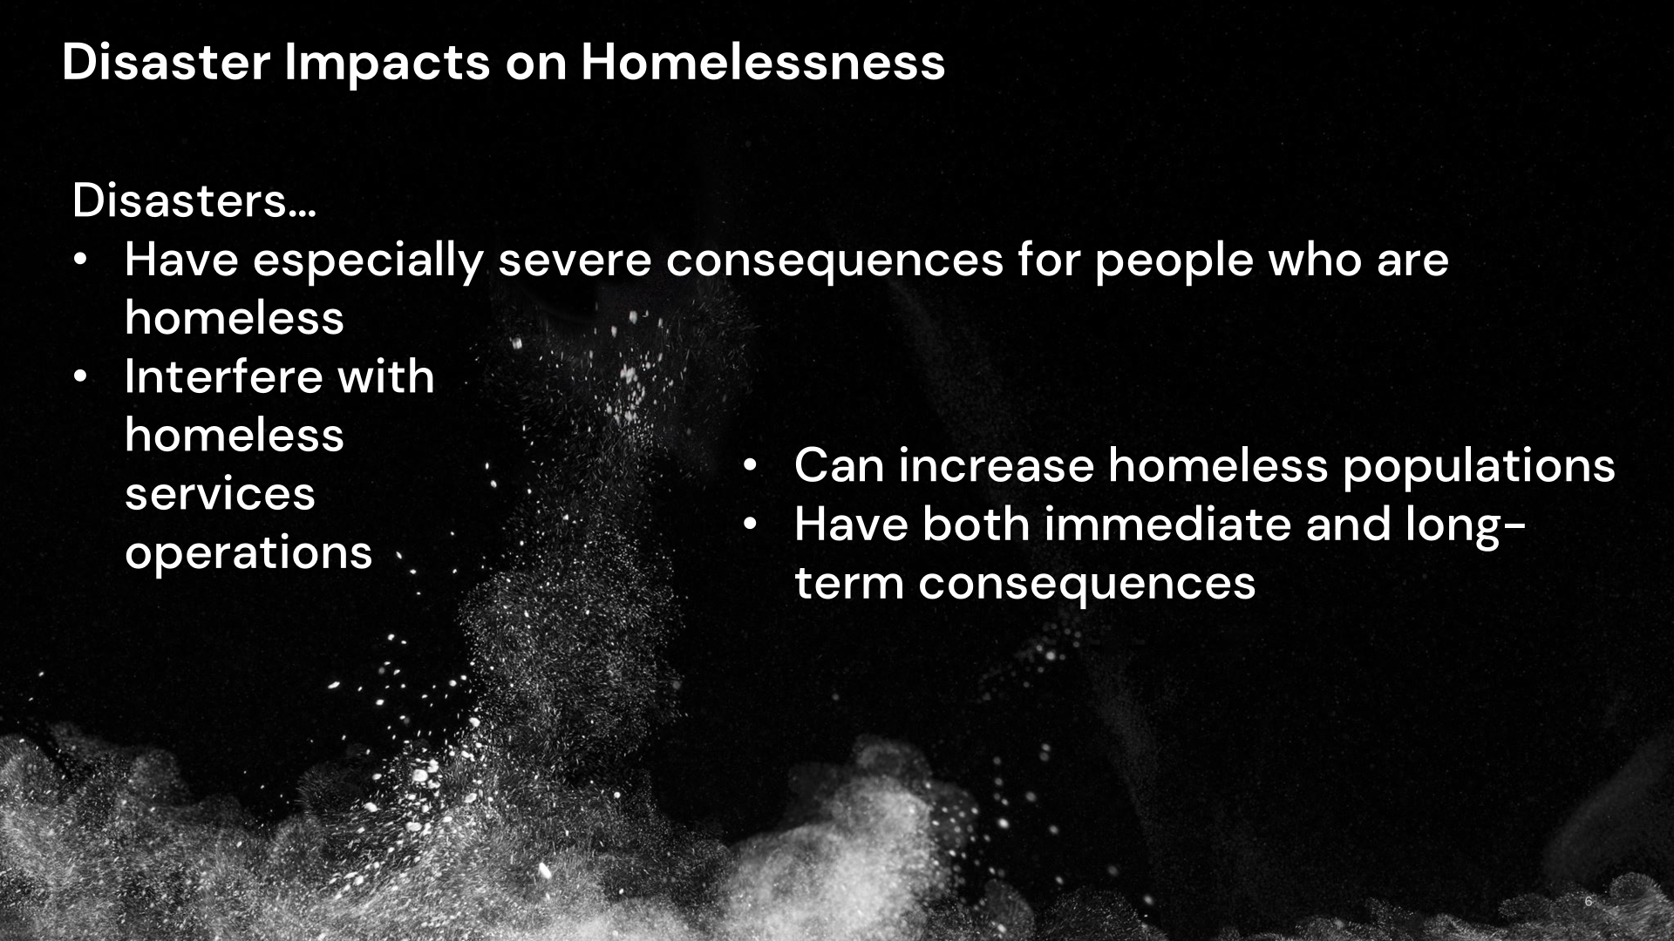
Why talk about disasters?
Homeless services has a critical role in disaster response
Our role is to support disaster response, not replace it
Notes:
ERIN
[read slide, then:]
People who are homeless are one of the most significantly disaster impacted populations in any community—and they’re among the least likely to benefit from disaster preparedness, response, and recovery, both because:
People who are homeless often don’t know how to access (or don’t feel safe accessing) DR responses; and
Disaster response often doesn’t know how to effectively work with people who are homeless, either as individuals or as a population.
We emphasize that the role of homeless services is to support but not replace because we as homeless services providers are so used to doing it ourselves. When it comes to disaster response, we need to be advocates, not builders.

Slide 27
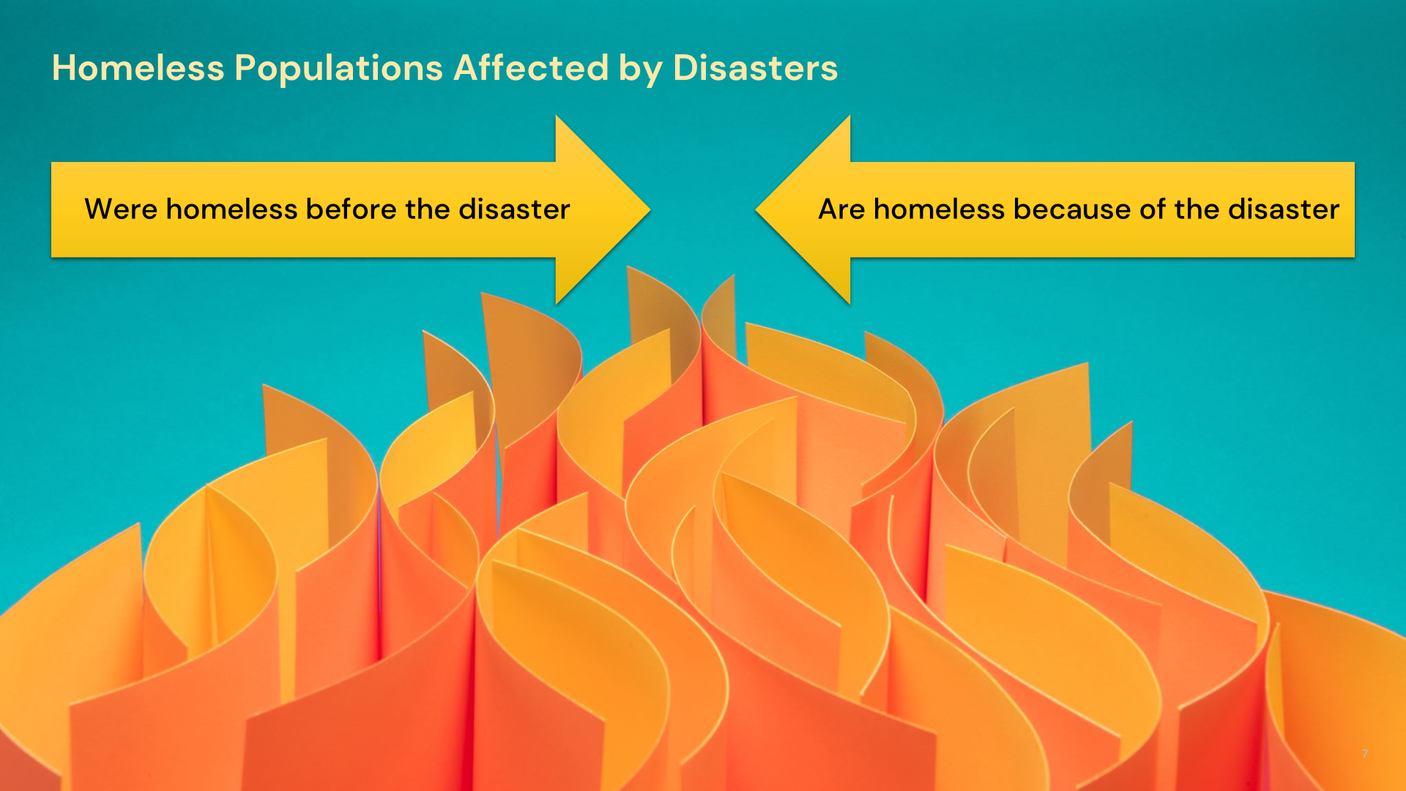

Slide 28
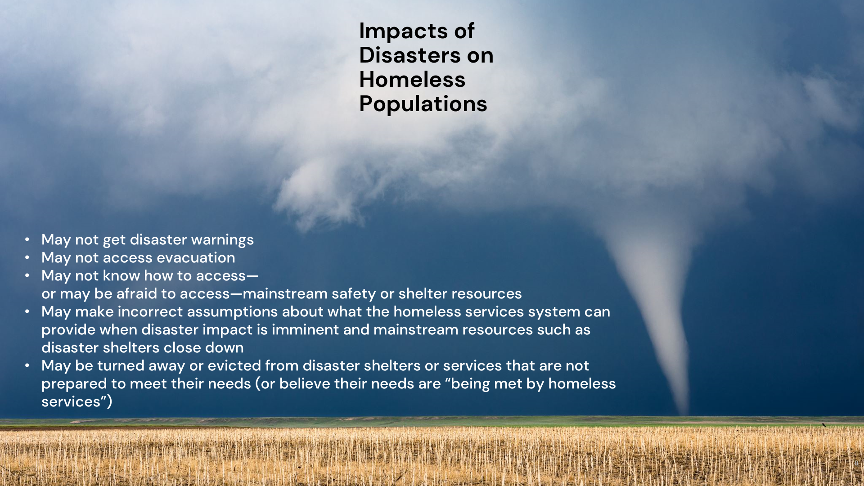

Slide 29
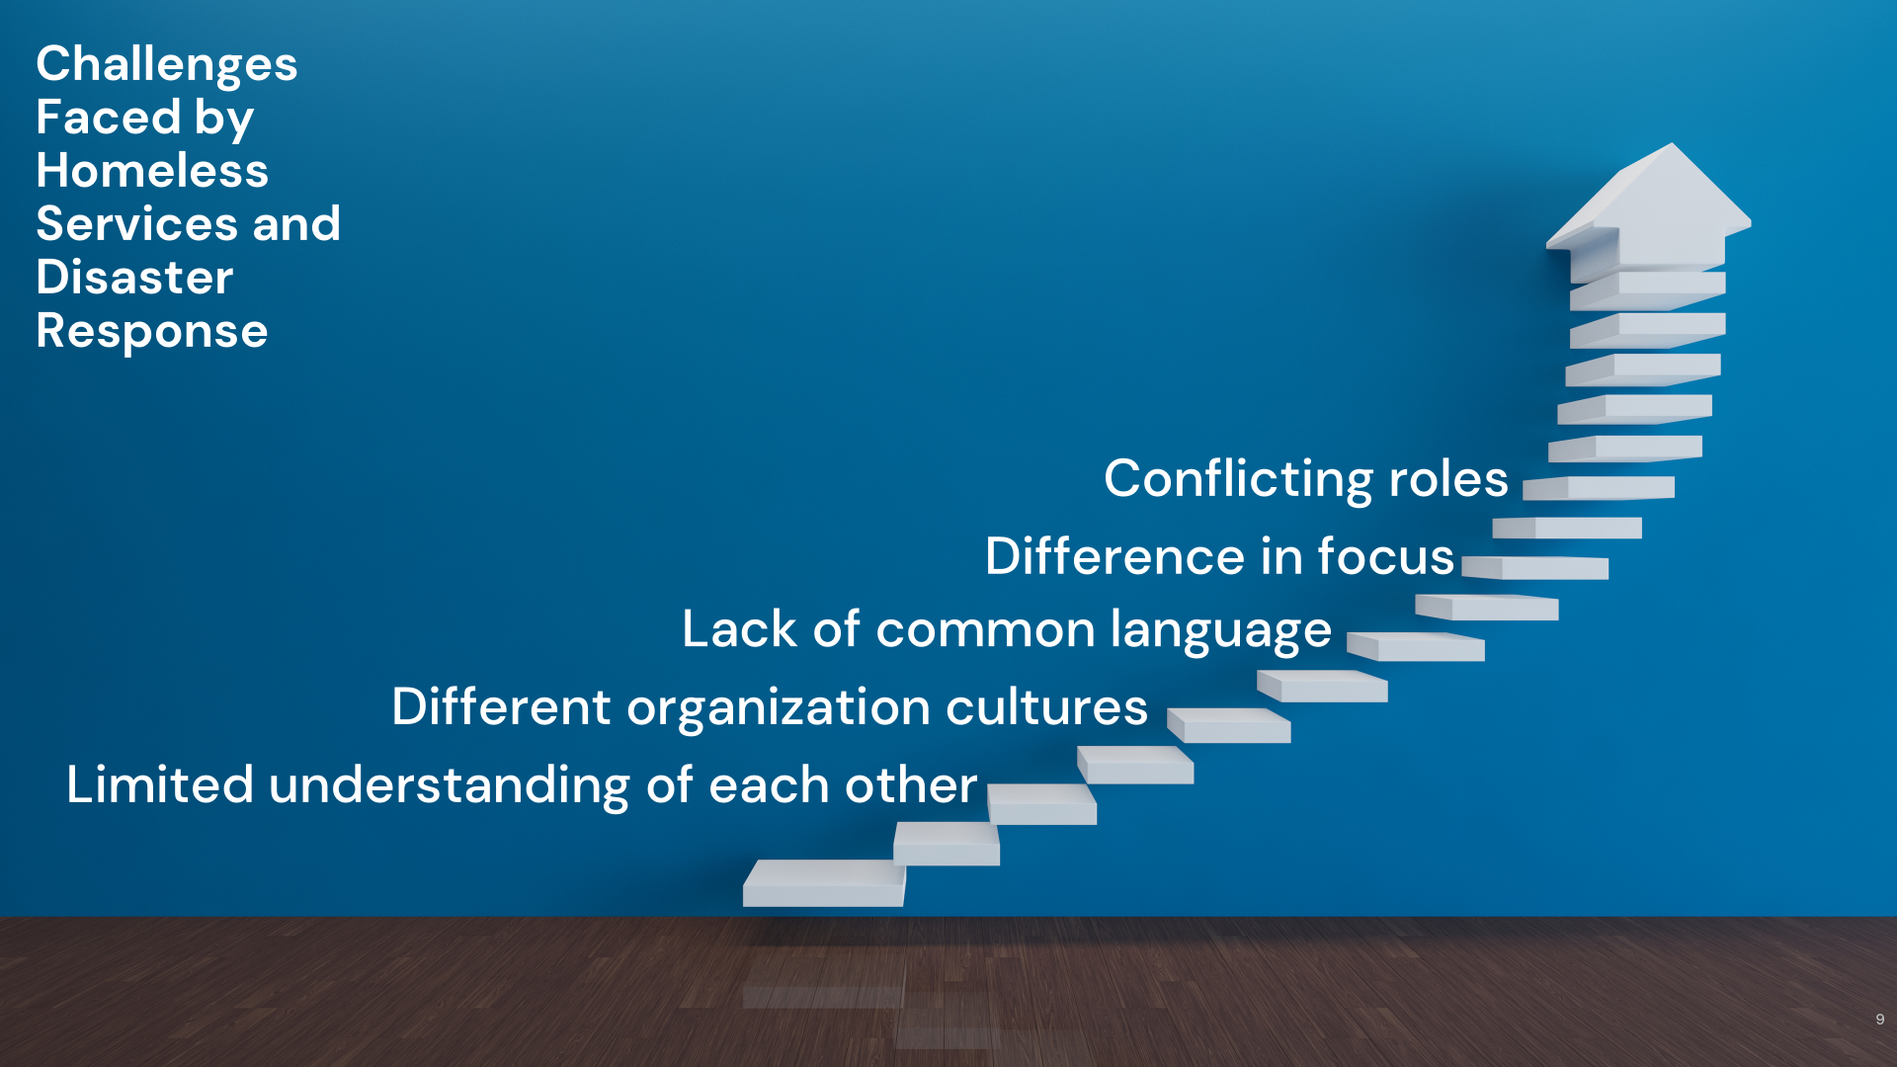

Slide 30


Slide 31


Slide 32
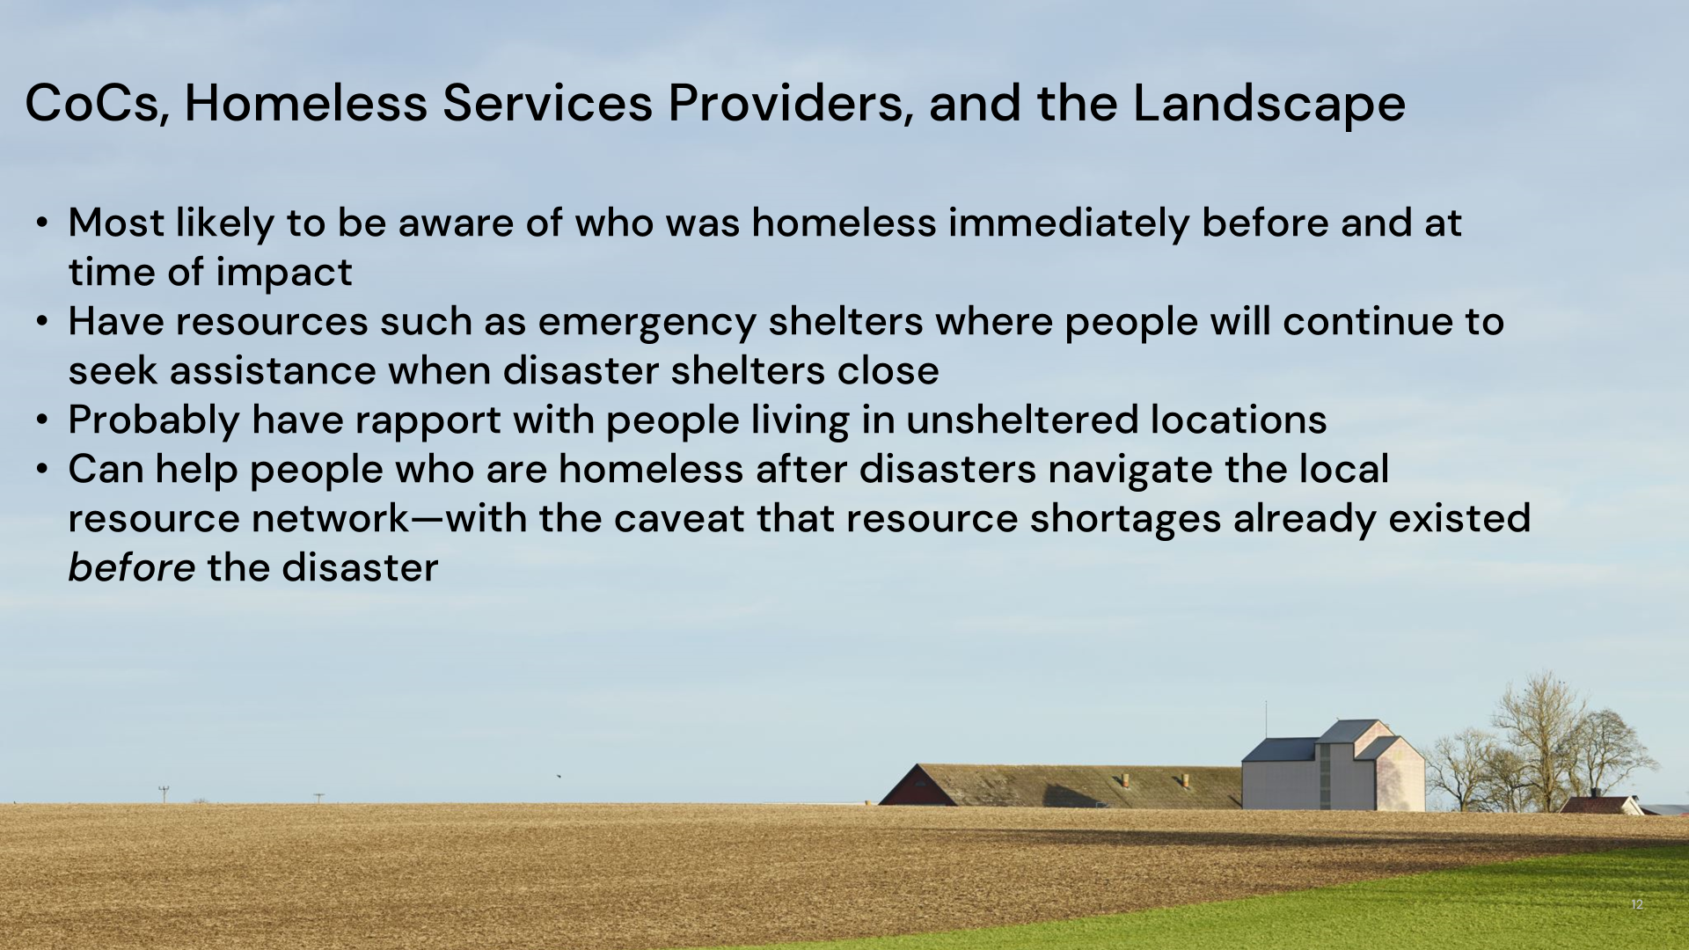

Slide 33
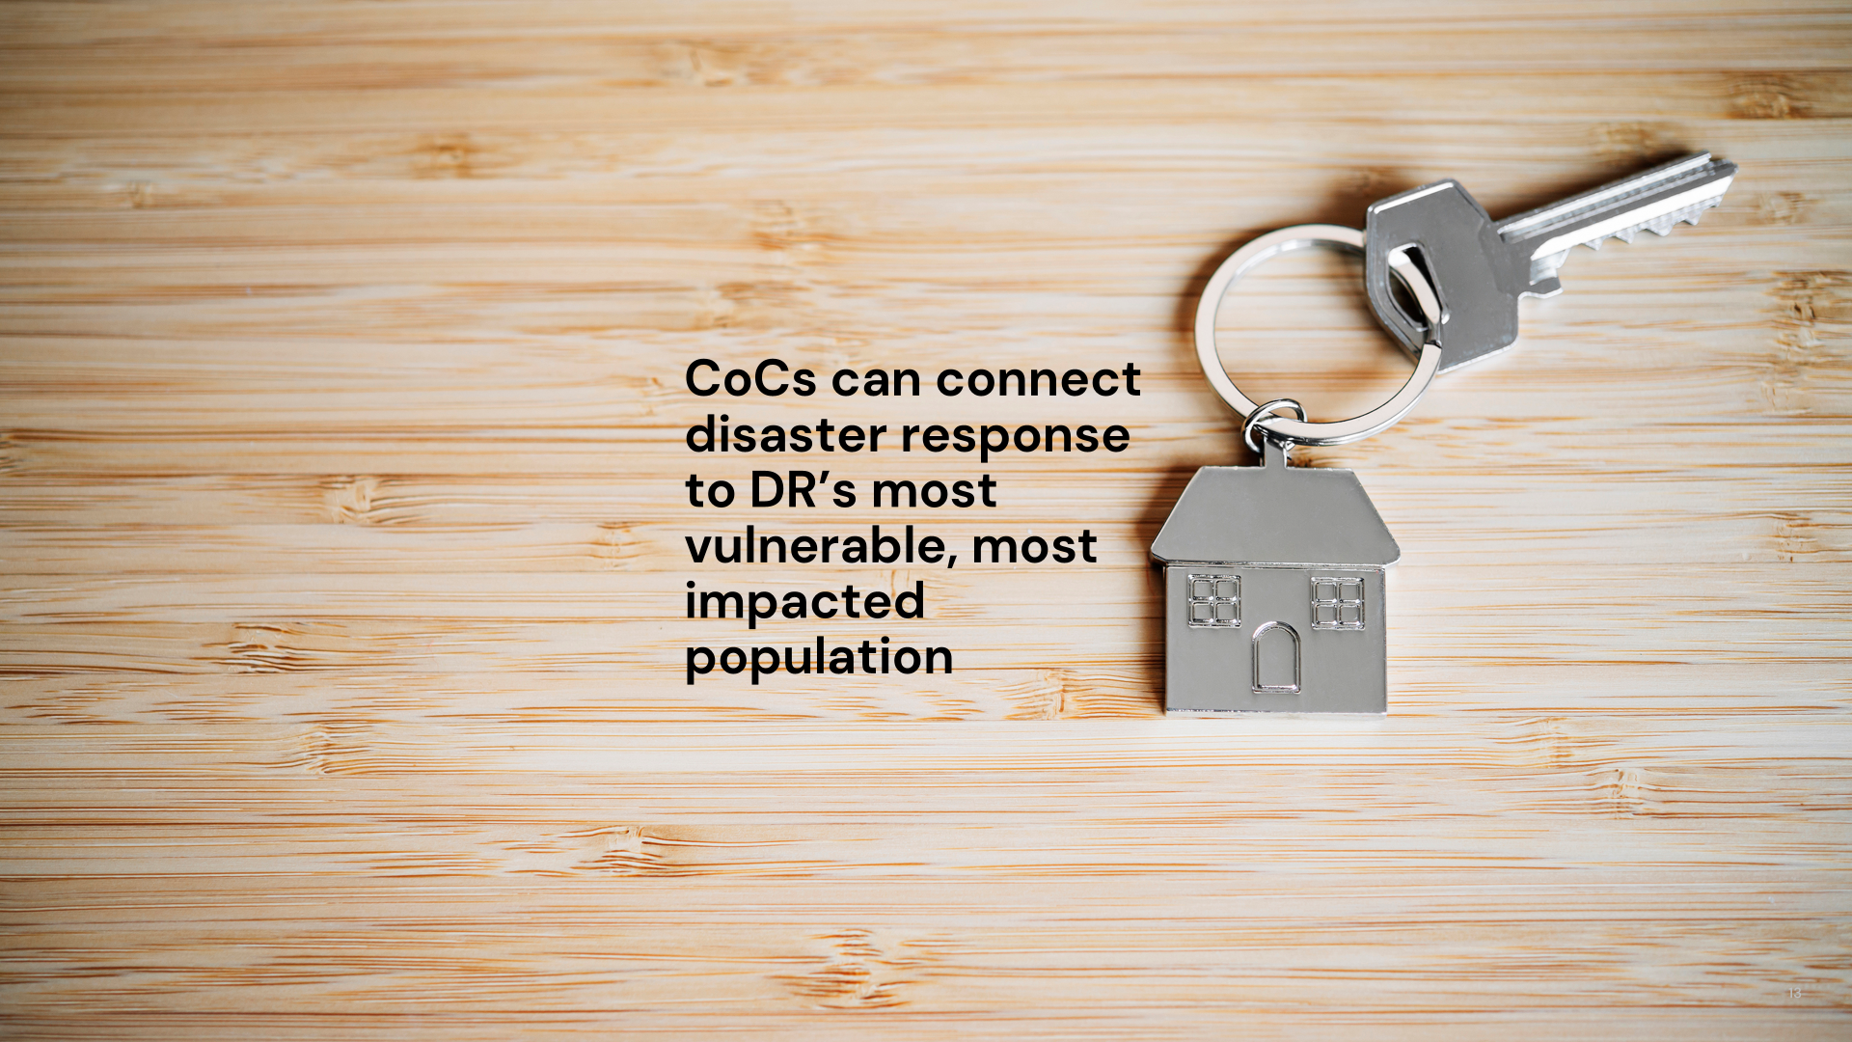

Slide 34
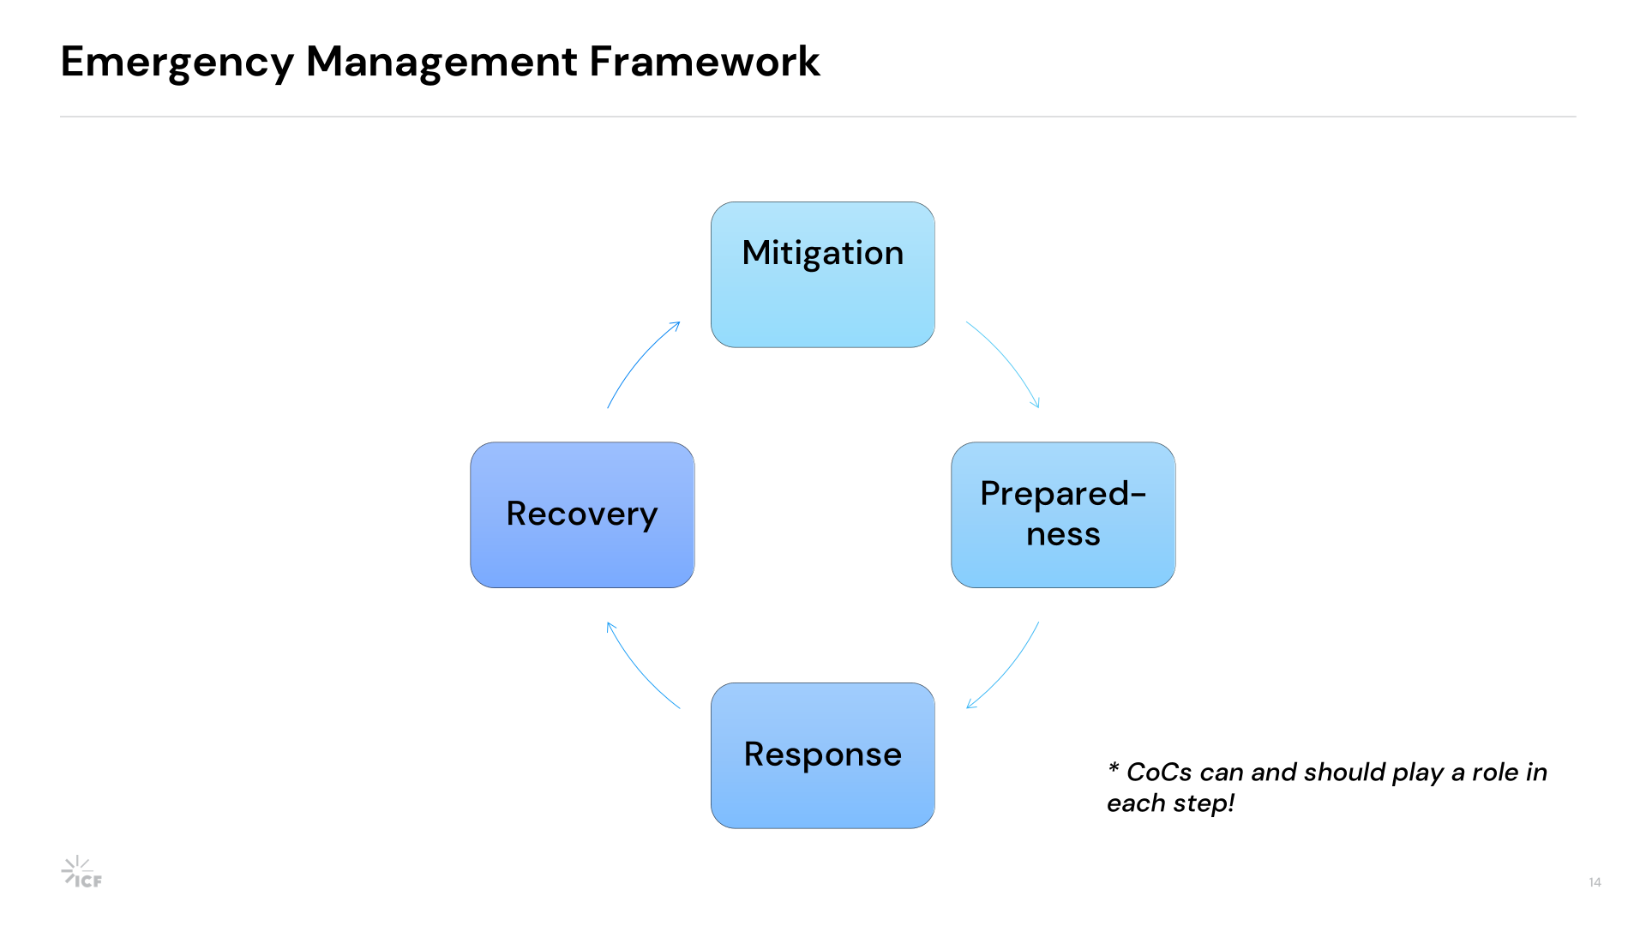

Slide 35
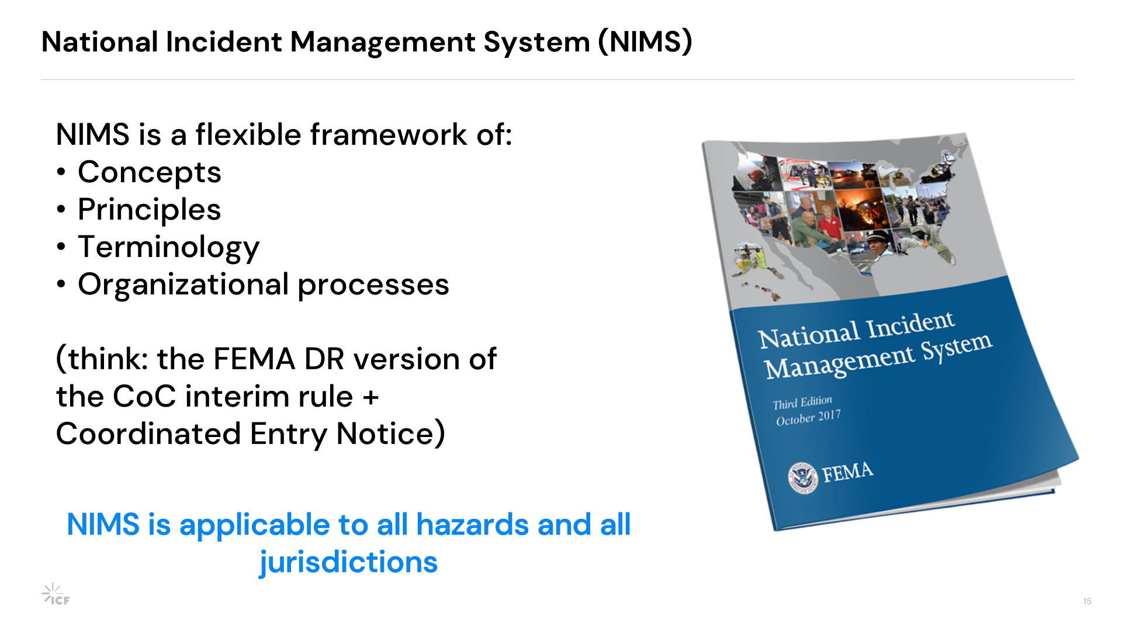

Slide 36
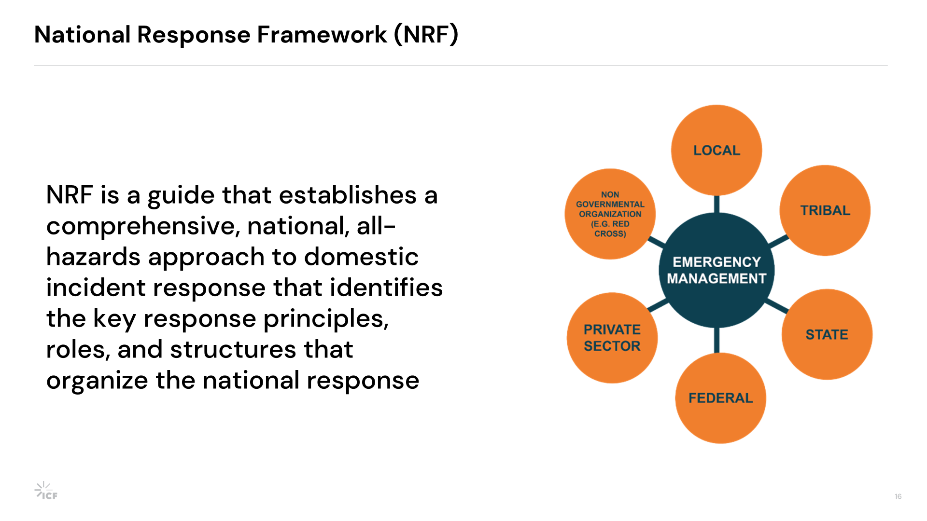

Slide 37
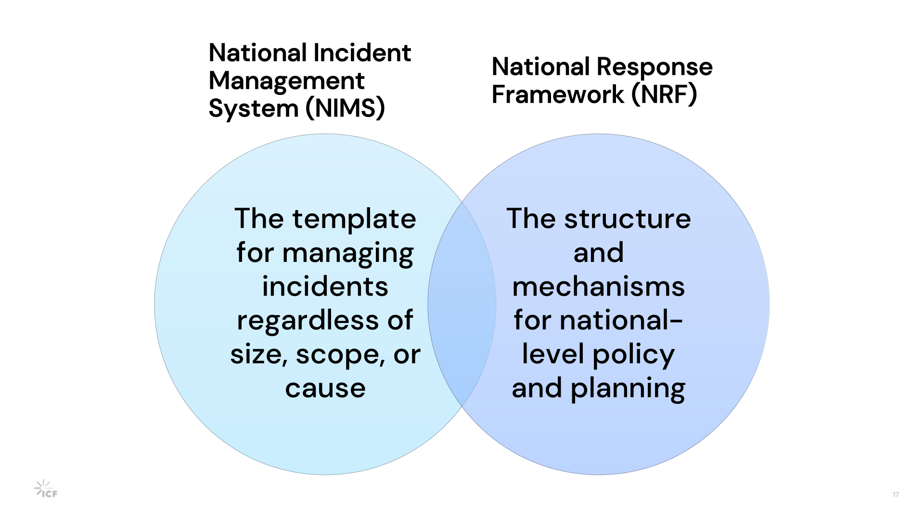

Slide 38
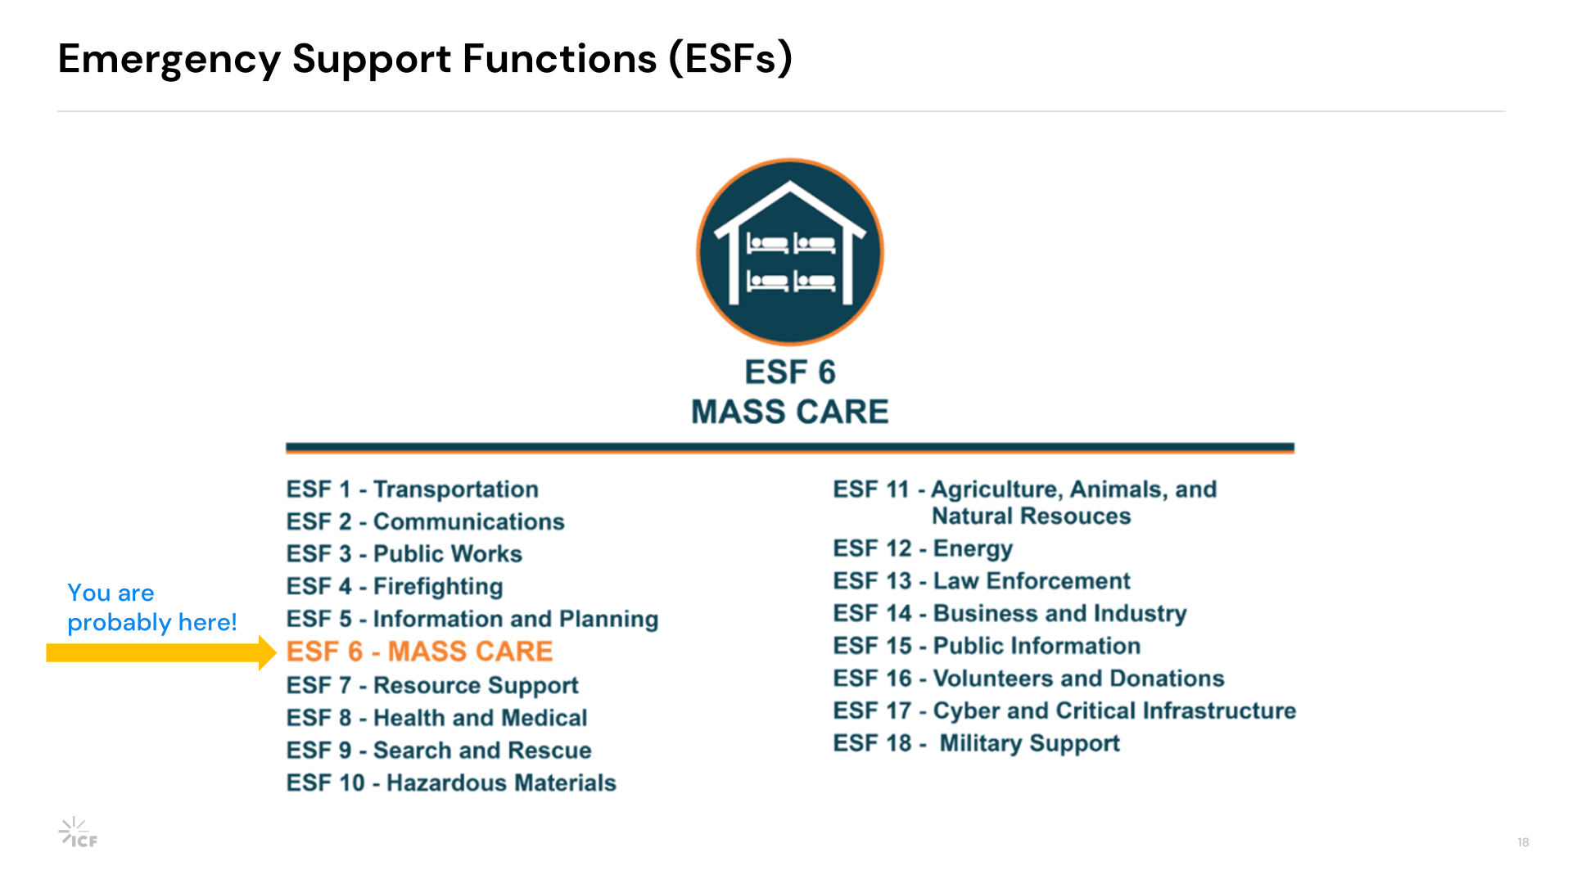

Slide 39
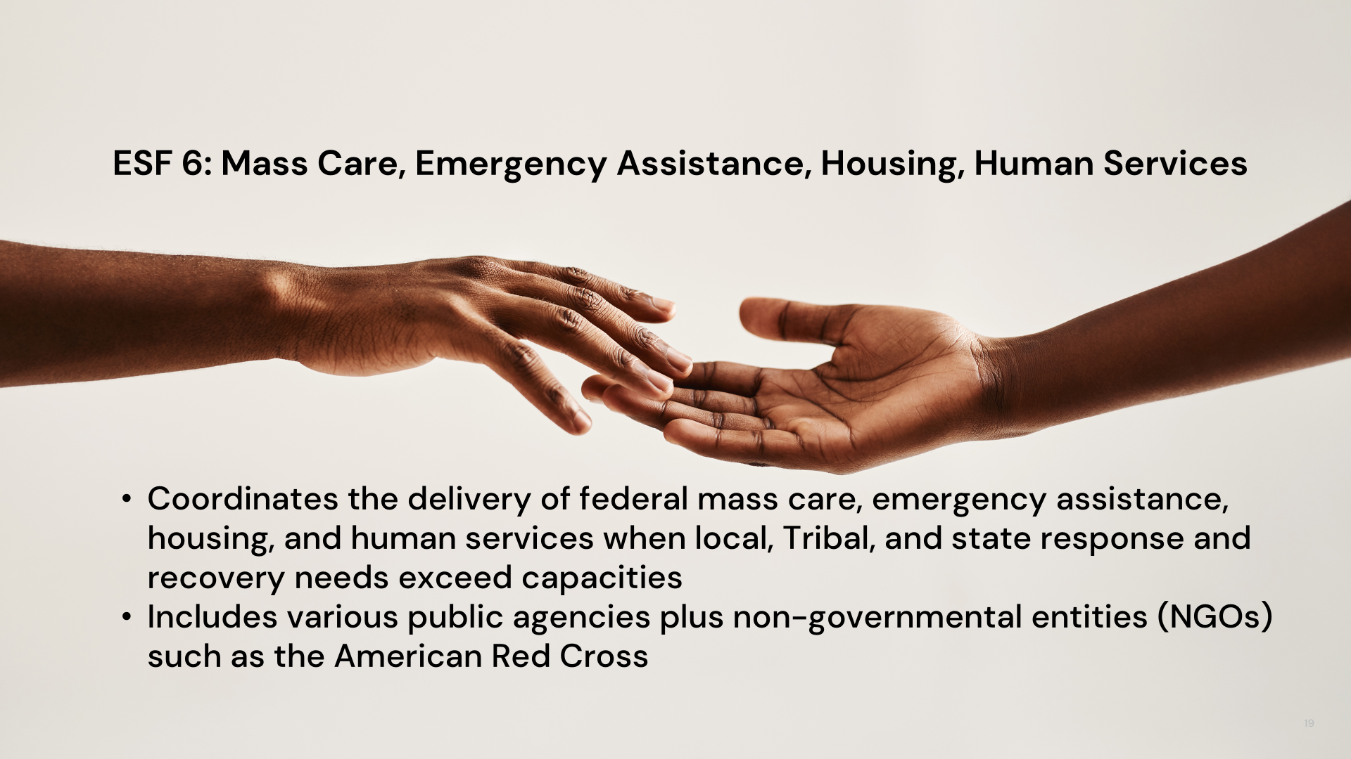

Slide 40


Slide 41
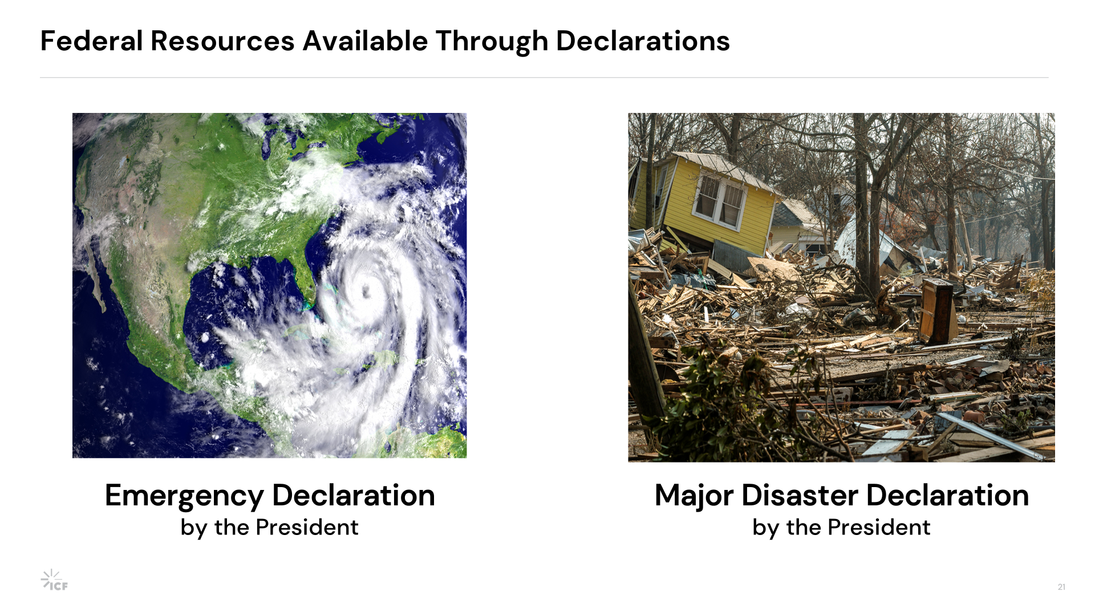

Slide 42
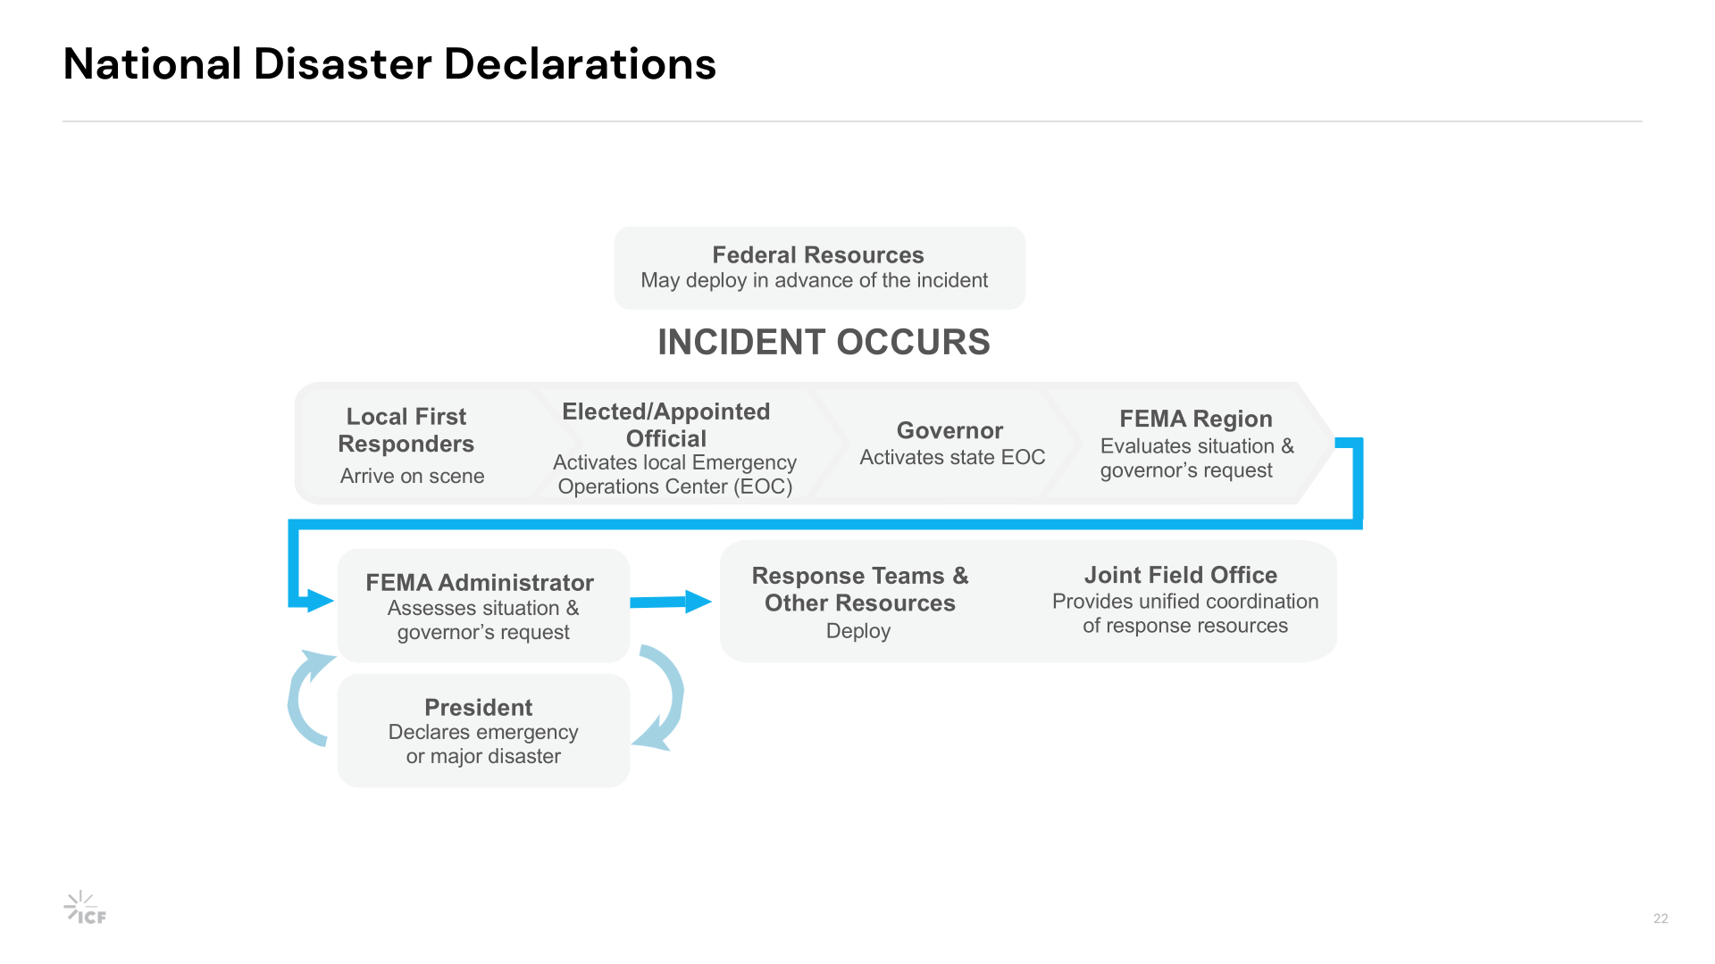

Slide 43
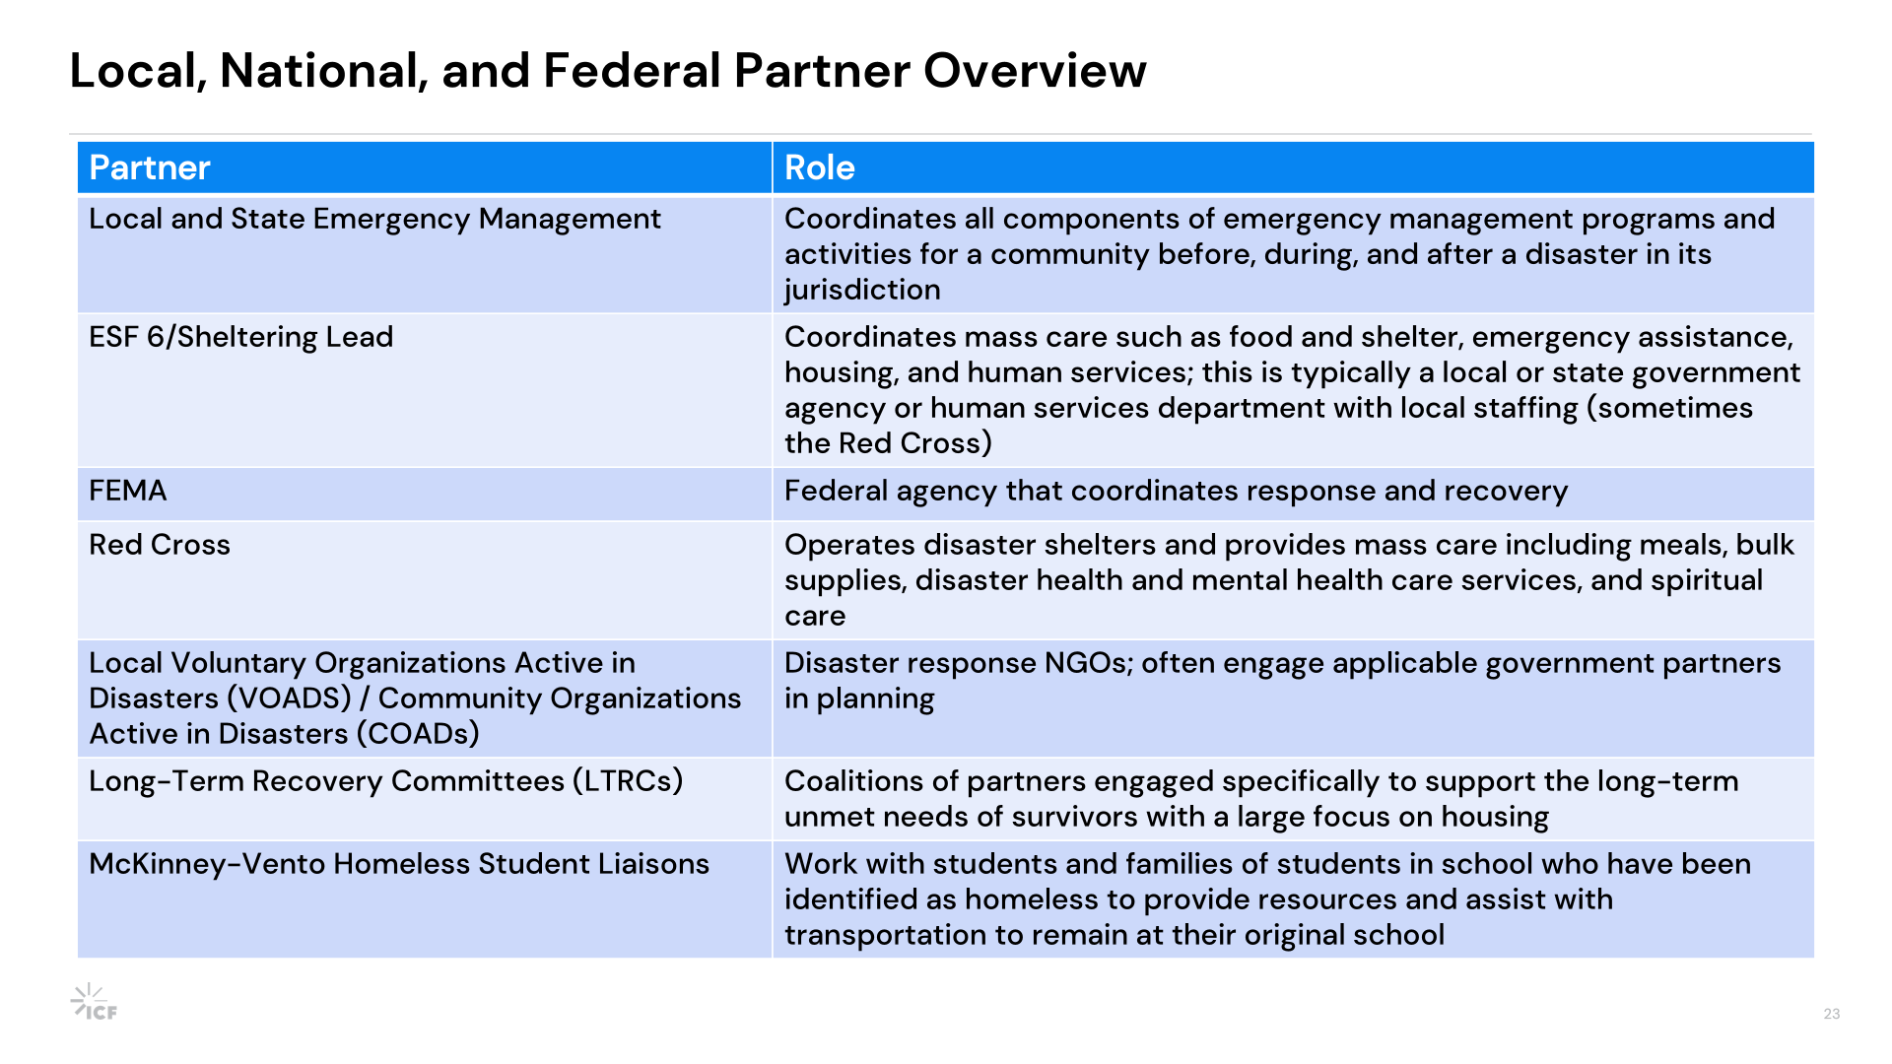

Slide 44
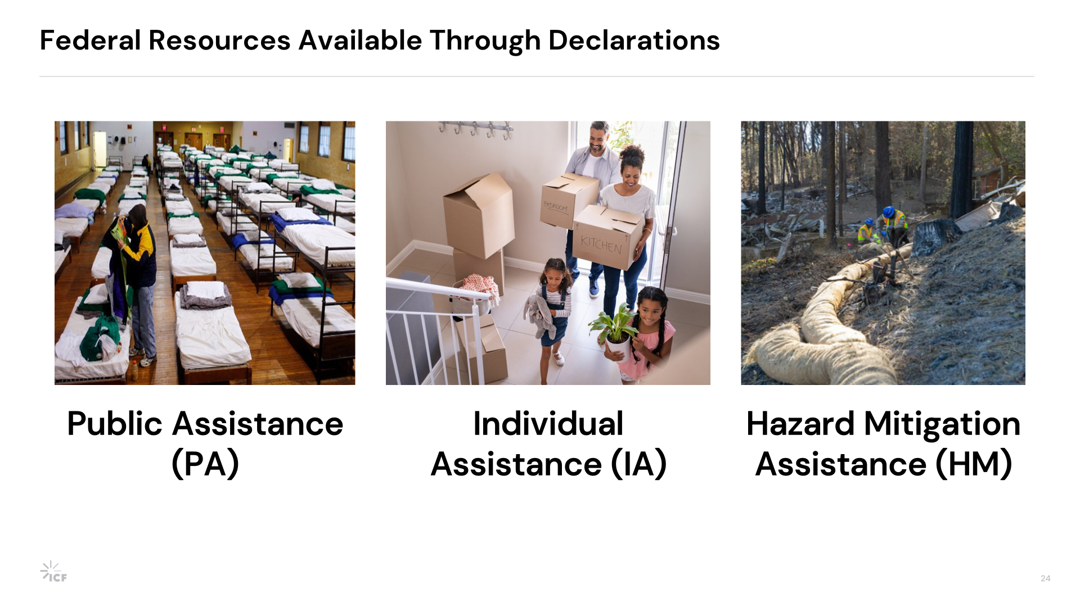

Slide 45
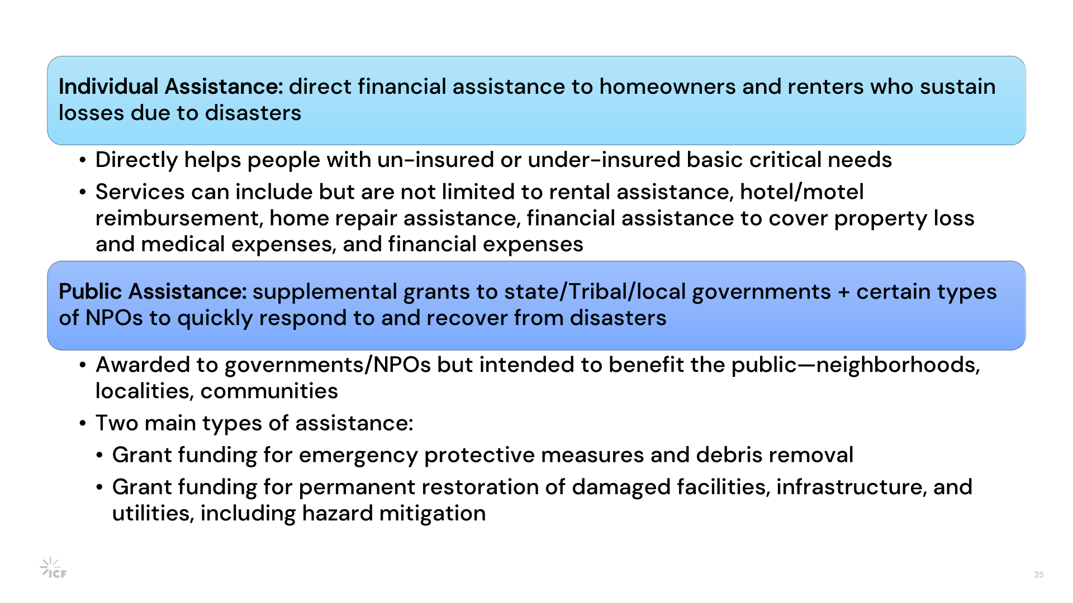

Slide 46
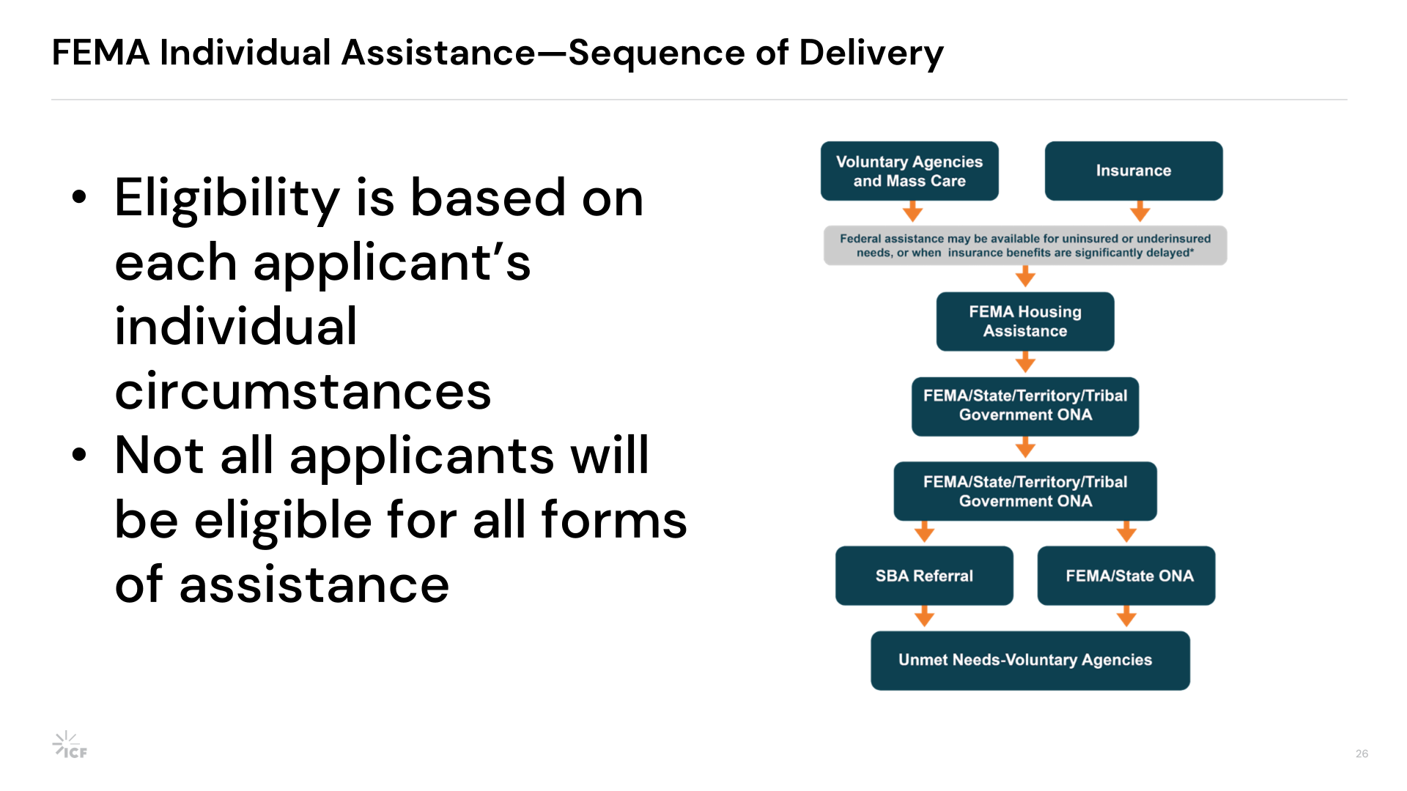

Slide 47


Slide 48
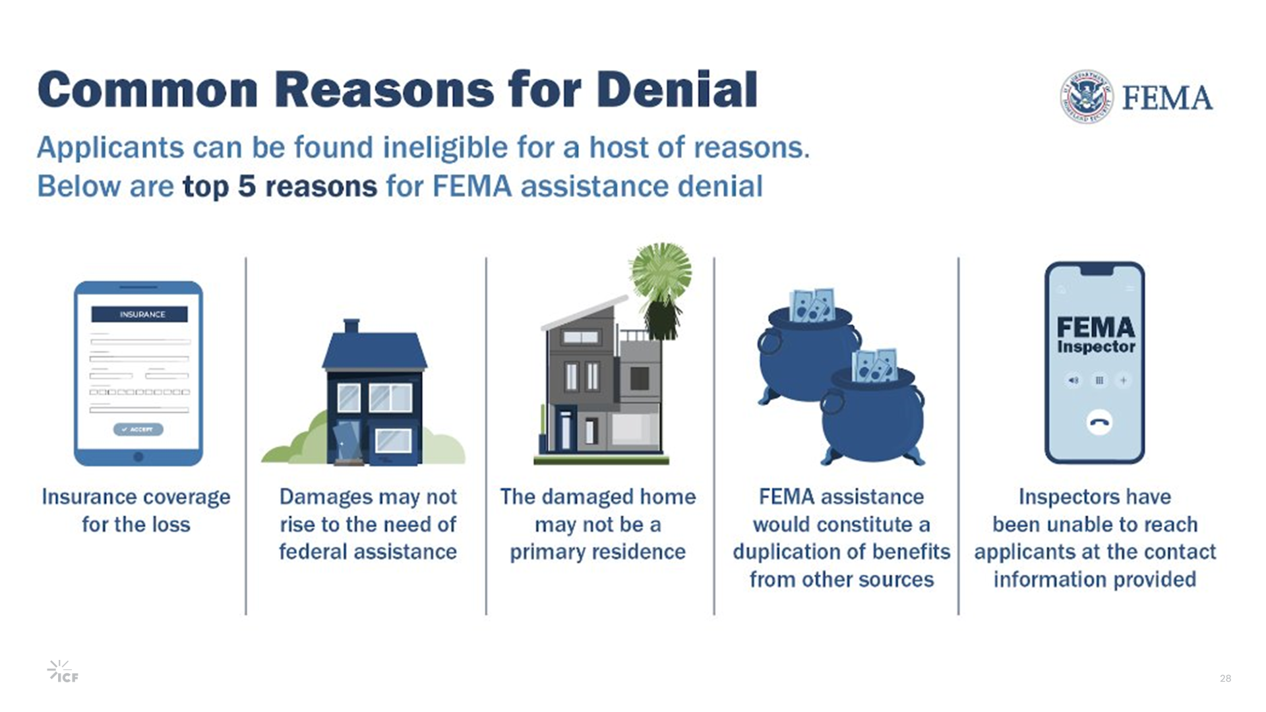

Slide 49


Slide 50
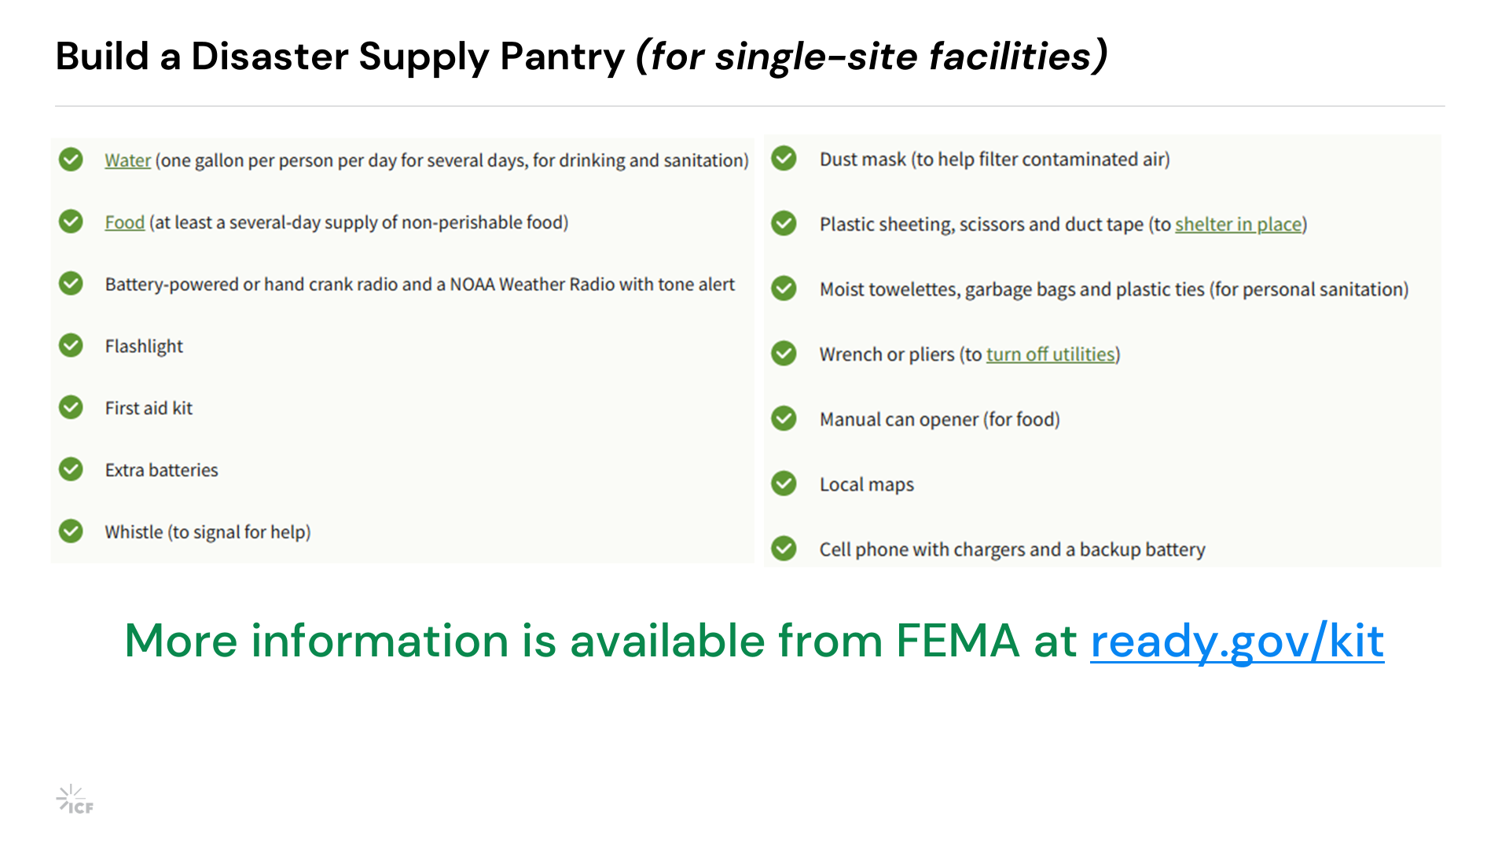

Slide 51
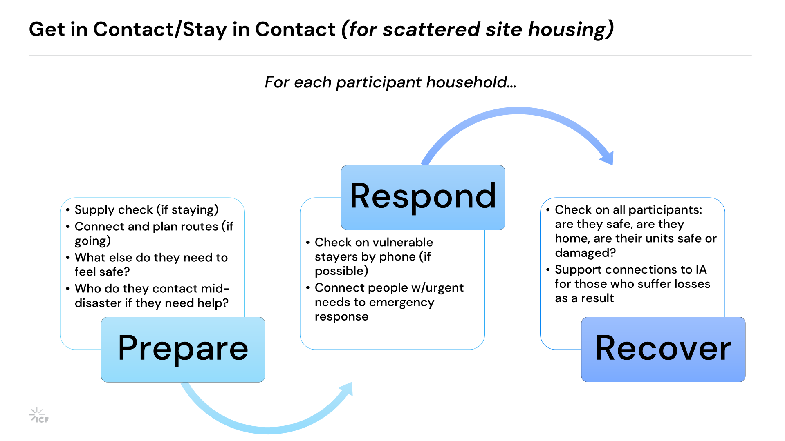

Slide 52
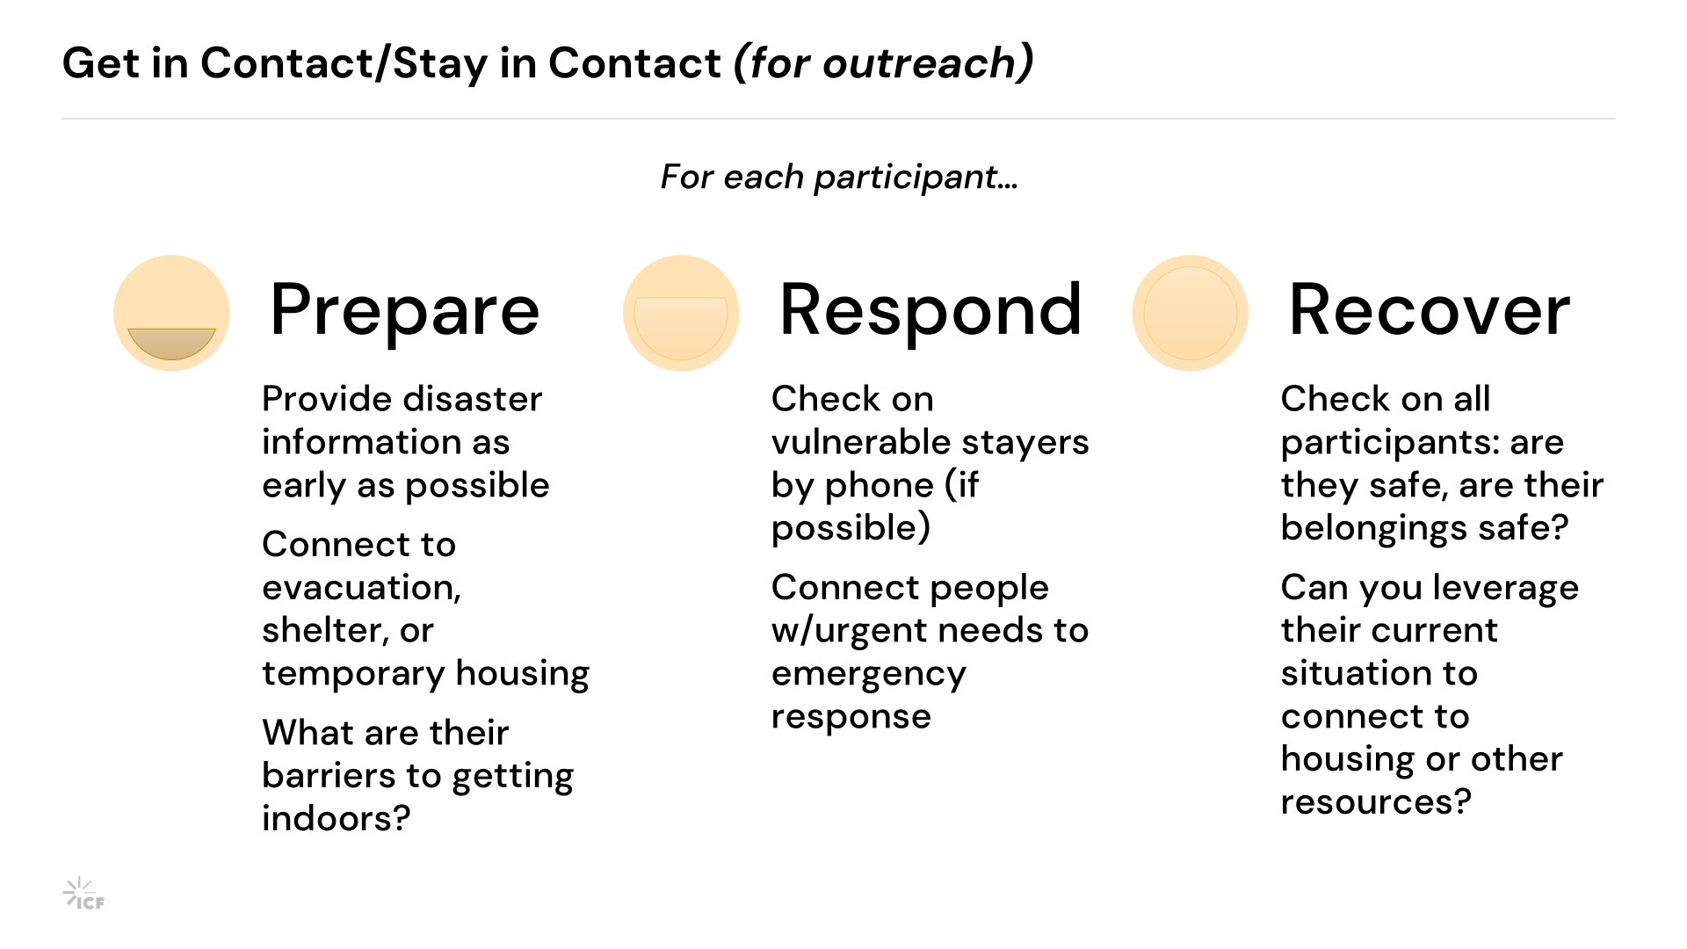

Slide 53
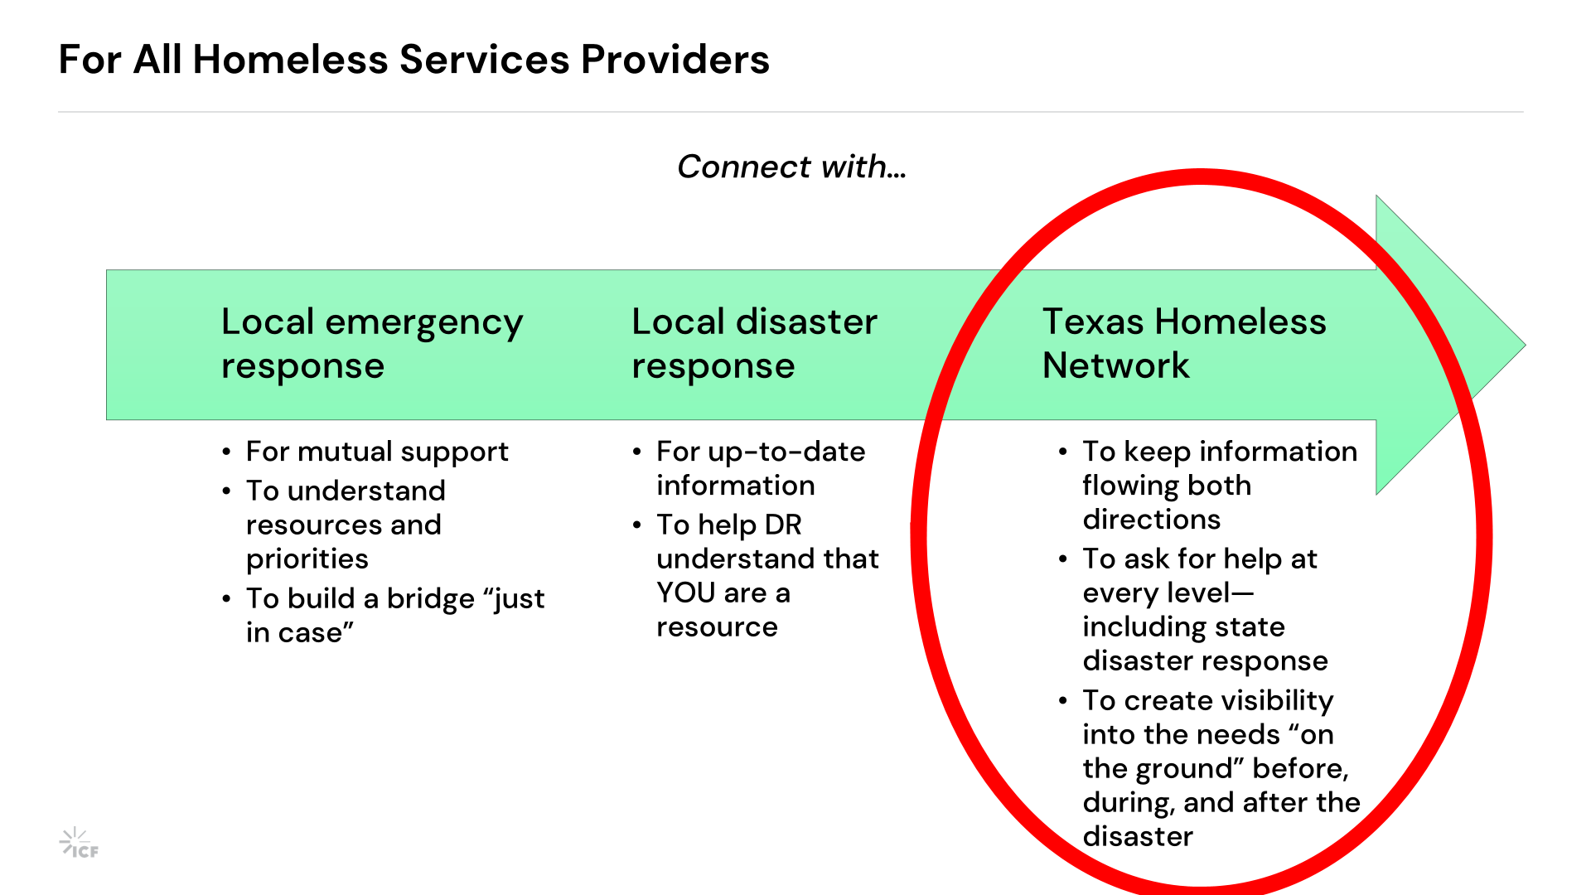

Slide 54


Slide 55
Disaster Coordination in the TX BoS CoC
Notes:
This is not an emergency management program. This is not a disaster response system. This is a coordination framework that helps THN understand housing and homelessness impacts related to disasters across a whopping 214 county geography.

Slide 56

TX BoS CoC Disaster Coordination Initiative
The Challenge
The Question
The TX BoS CoC spans 214 counties with diverse communities.
How do we maintain visibility into housing and homelessness-related concerns across 214 counties when disasters occur?
Disaster can create impacts for people experiencing homelessness and housing instability.
Situational awareness can be difficult to obtain from county to county, especially in rural and frontier communities.

Slide 57
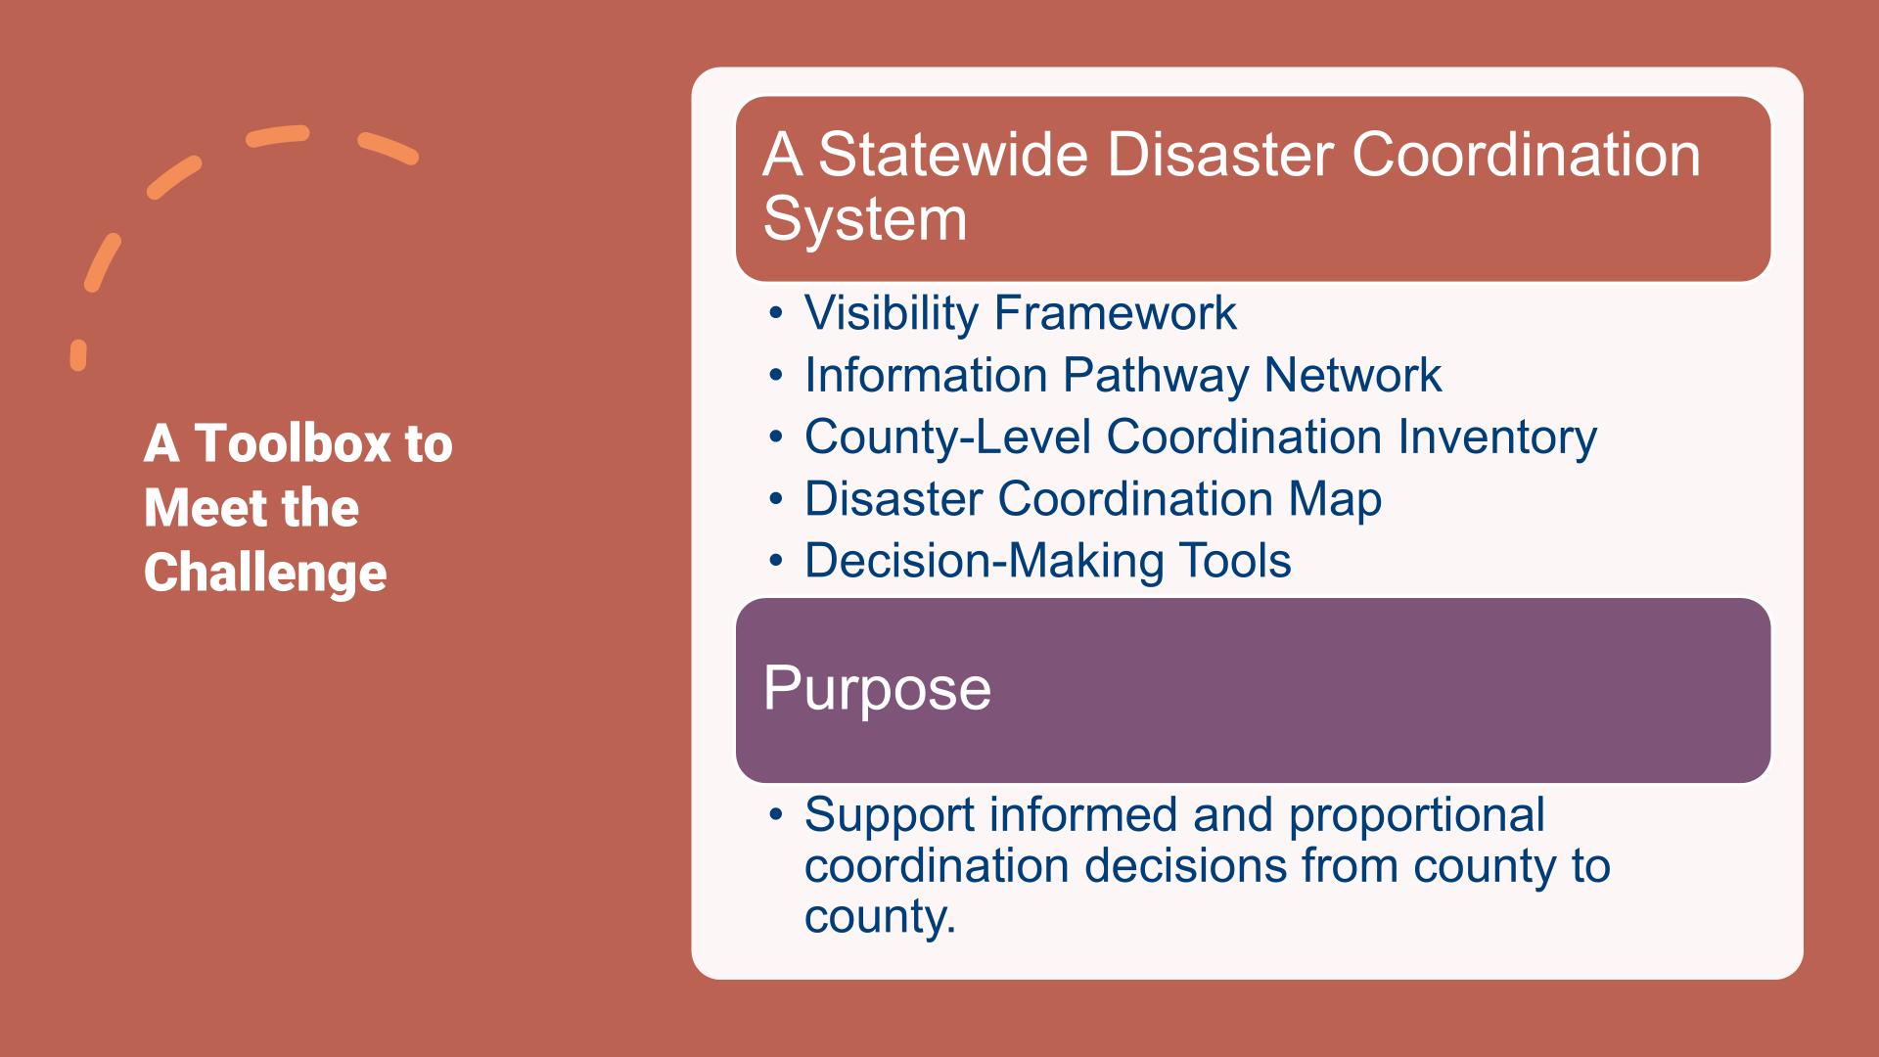

Slide 58
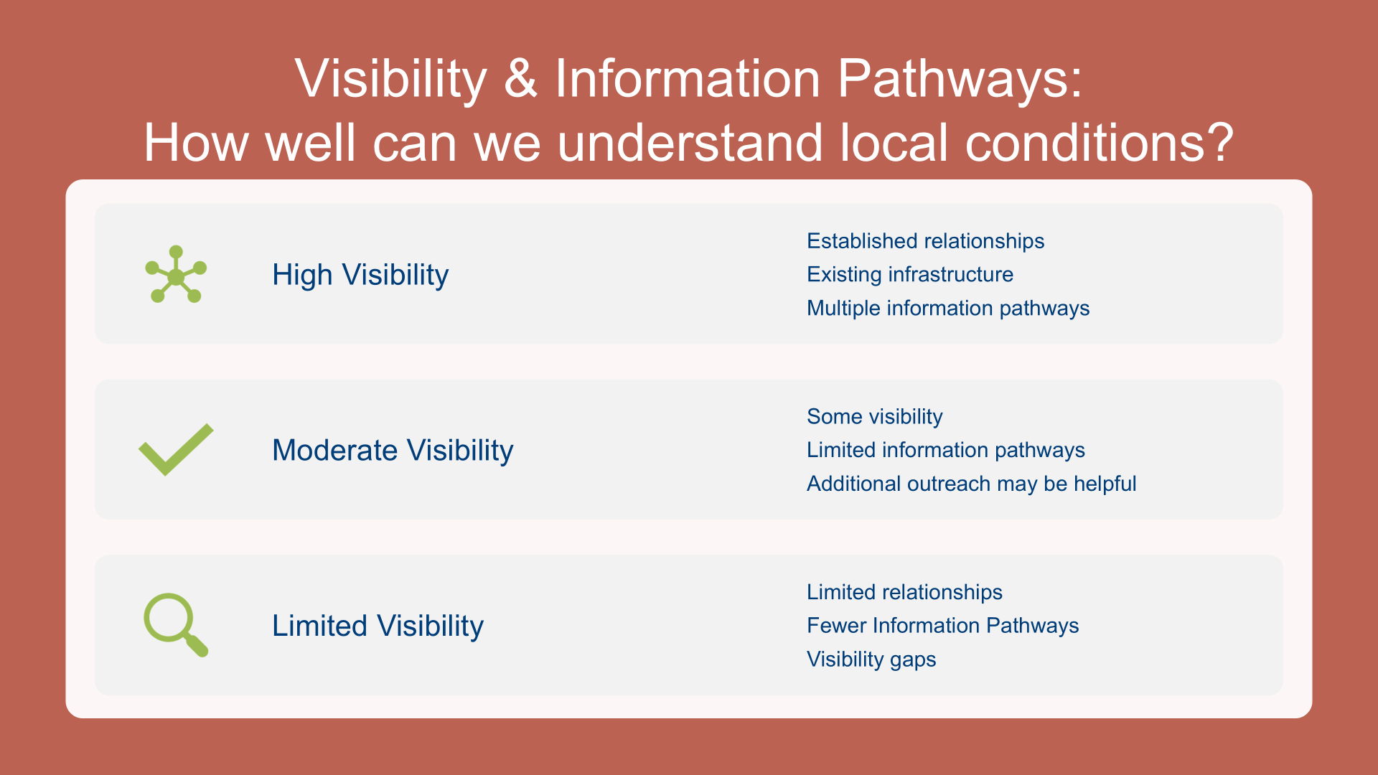

Slide 59
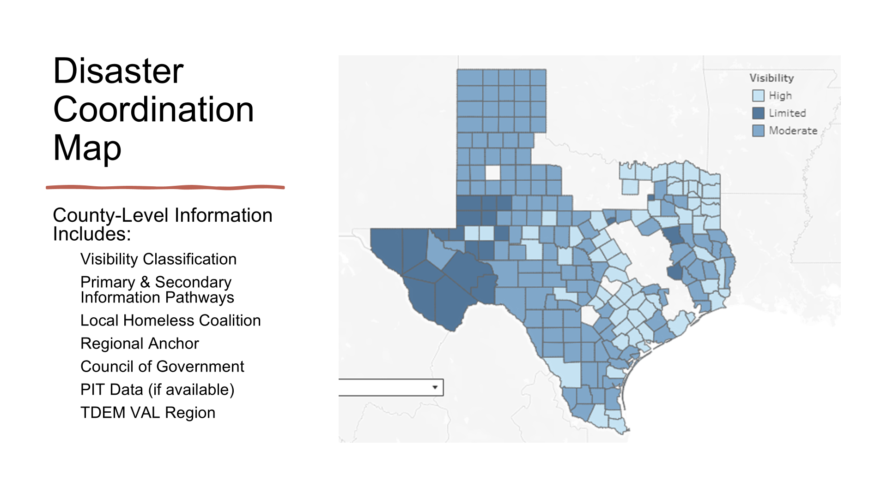

Slide 60
Map and Worksheet
TX BoS CoC Disaster Coordination Map | Tableau Public
TX BoS CoC Disaster Coordination Inventory.xlsx

Slide 61
What's Next?
Continue strengthening Information Pathways across the TX BoS CoC
Expand regional and community partnerships
Test and refine the approach over time
Launch disastercoord@thn.org as a dedicated disaster coordination contact for sharing local updates, housing and homelessness impacts, and other information.

Slide 62
2026-2027 CoC Action Plan Implementation
Hope Nordon, Senior Director of CoC Programs

Slide 63
Priority 1: Local Focus & Modernization
Quarter 1 Progress
Expanded partnerships with disaster-response, regional, and nontraditional partners.
Integrated feedback from the CoC Modernization Workgroup into the Outcomes Analysis data visualization tool.
Began planning how General Members can continue to inform CoC Modernization.
Quarter 2 Progress
Developed LHC prioritization considerations and ranked them by importance and ability to measure.
Developed LHC-facing strategies tailored to three development stages: Foundational; Developing & Building; Sustaining & Enhancing.
Began development of a shorter and more detailed versions of the Outcomes Analysis Report.
Continued outreach to new partners and identified representation as a potential factor in LHC prioritization.
How this connects to General Members
Local communities will have clearer pathways for engaging with the CoC and advancing shared priorities.
The CoC is working toward making local data easier to understand and use for community decisions.
General Member feedback remains part of how Modernization and Action Plan work is shaped.
New partnerships can bring additional resources, perspectives, and connections into local homelessness response.
What’s Next
Begin developing the LHC Action Plan Template and move toward selecting/prioritizing LHCs for tailored support.
Continue refining local data tools and determine how they can be shared and used with communities.
Continue General Member opportunities to review progress and provide feedback.
Use local context and partnership gaps to guide future support.

Slide 64
Priority 2: Service & Housing Outcomes
Quarter 1 Progress
Published an annual CoC training calendar.
Expanded learning through short recorded trainings, live webinars, RRH Boot Camps, and development of a person-centered case management series.
Completed 31 quarterly performance reviews.
Conducted Quality Review Plan meetings and regular spending reviews.
Quarter 2 Progress
Started the 8-part Person-Centered Case Management series; five sessions were delivered during Q2.
Held a two-part CoC New Project Training Clinic with 46 attendees.
Continued quarterly performance reviews, completing 26 through the FY26 CoC Competition scorecard.
Worked directly with 6 Coordinated Entry (CE) Regions on data quality improvement.
How this connects to General Members
Training topics are being shaped by needs identified across the CoC.
General Members can help identify system barriers that the CoC should address.
Performance review and monitoring activities are intended to identify barriers and connect providers with needed support.
Better data visualization can help communities and providers explain outcomes, needs, and opportunities for improvement.
What’s Next
Develop guidance for training on data visualization tools and expand opportunities for community feedback.
Continue performance and data-quality improvement work with providers and CE Regions.
Use what the CoC learns from providers and communities to refine support and technical assistance strategies.

Slide 65
Priority 3: Person-Centered Implementation
Quarter 1 Progress
The Lived Experience Committee (LEC) provided feedback on draft CE assessment questions.
An initial Gaps Analysis findings report was developed from 82 stakeholder responses.
Initial planning began for continued LEC involvement in CoC activities.
Continued development of new CE processes through coordination with Workgroup and HUD Technical Assistance.
Quarter 2 Progress
CE assessment questions were refined and prioritized for Focus Group review.
Planning began for the 2027 CE pilot, including training, HMIS workflows, and prioritization mapping.
Sought out and integrated LEC input on CE assessment scripts and the Outcomes Analysis data visualization.
Gaps Analysis findings were reframed in the context of CoC Priorities to inform decision-making with the Community Investment Committee
How this connects to General Members
People with lived experience are increasingly involved in shaping CoC tools and processes.
The CoC is using community data to better understand housing gaps and local needs.
General Members have opportunities to influence priorities through meetings, feedback, and discussion.
Person-centered implementation means considering how policies and processes work for people experiencing homelessness and for the providers serving them.
What’s Next
Conduct Focus Groups on the updated CE assessment in coordination with HUD Technical Assistance.
Continue developing ways to use PIT/HIC and other data for community education about housing gaps and homelessness.
Advance strategies for LHCs to meaningfully include people with lived experience.
Continue working with the LEC to define areas of influence and gather General Member input.

Slide 66
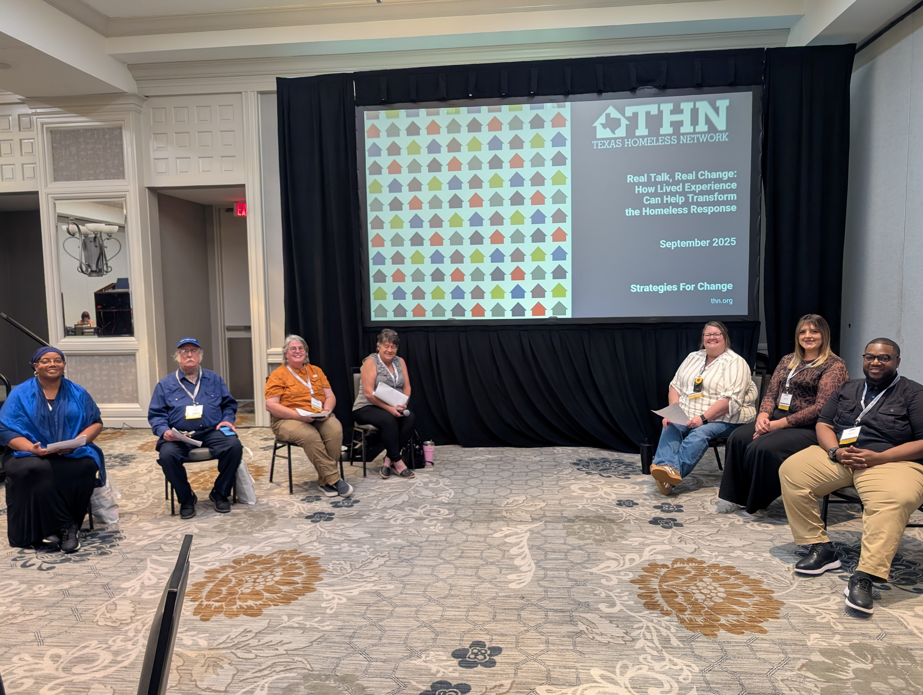
Lived Experience Committee

Slide 67


TX BoS CoC
Lived Experience Committee (LEC)
Four Years and Counting

Slide 68


Agenda
Introductions
LEC Accomplishments
Goals for 2026-2027

Slide 69
LEC Purpose
The Lived Experience Committee (LEC) provides Texas Homeless Network staff and the TX BoS CoC Board with valuable input on homeless services within the CoC.
Members provide feedback on proposed policy and funding decisions based on their personal experience, including interacting with homeless services within the CoC.

Slide 70
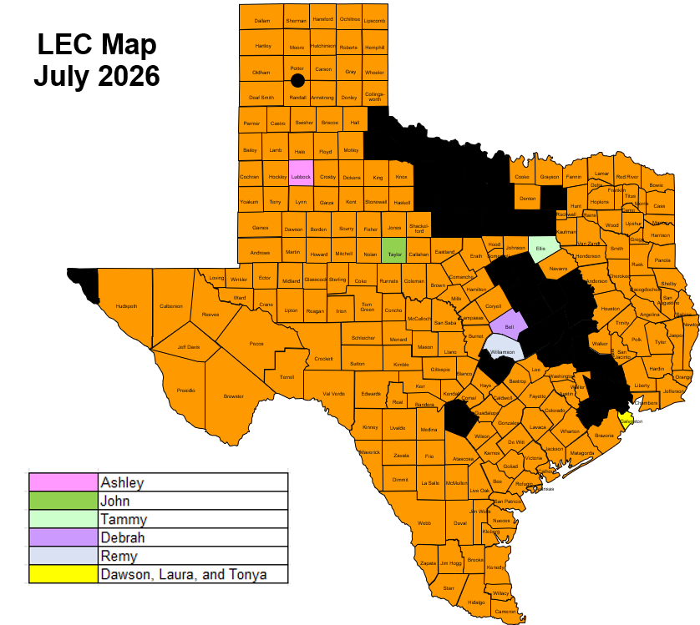
Notes:
We will be recruiting new members in a few months

Slide 71
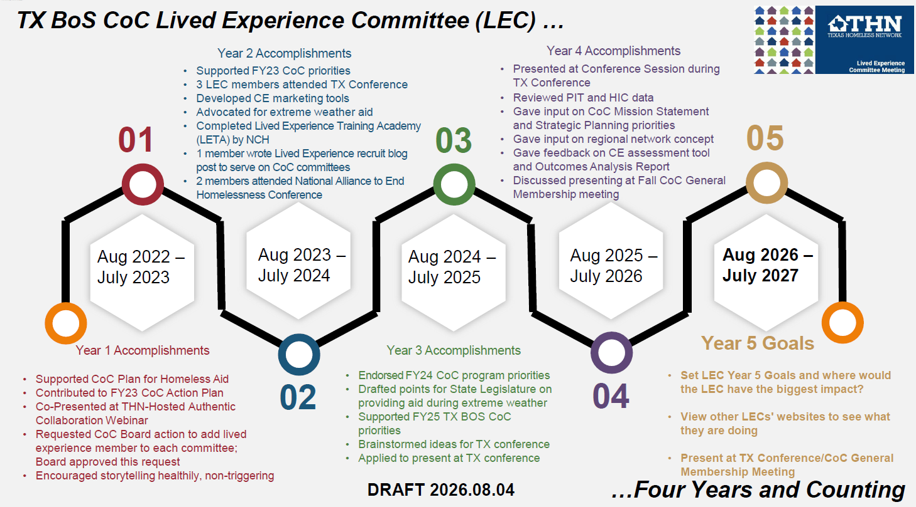

Slide 72
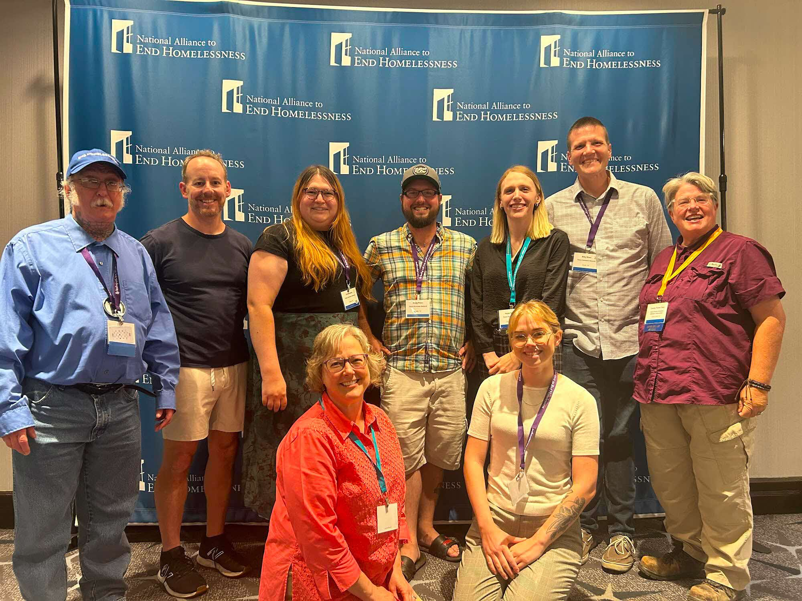
LEC Members and THN STAFF
At the 2024 National Alliance to End Homelessness (NAEH) Conference

Slide 73
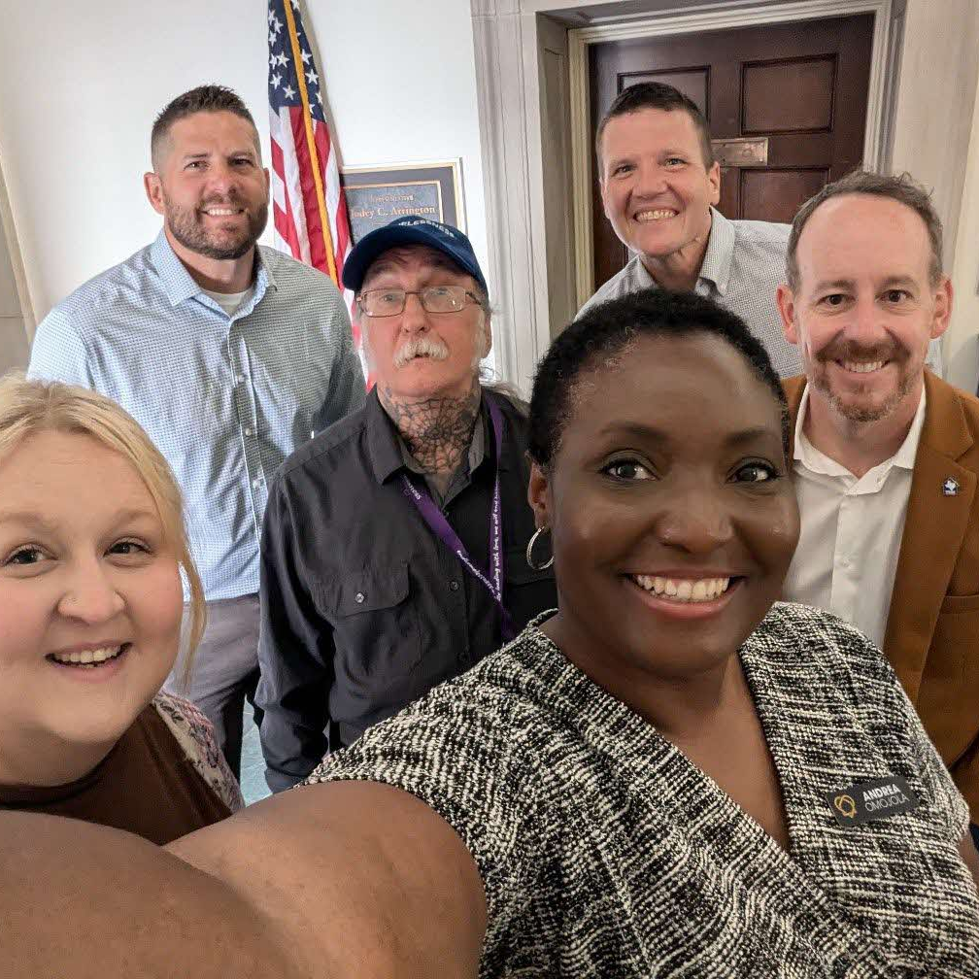
LEC Member and CoC Members
At the 2024 National Alliance to End Homelessness (NAEH) Conference’s
Capitol Hill Day

Slide 74
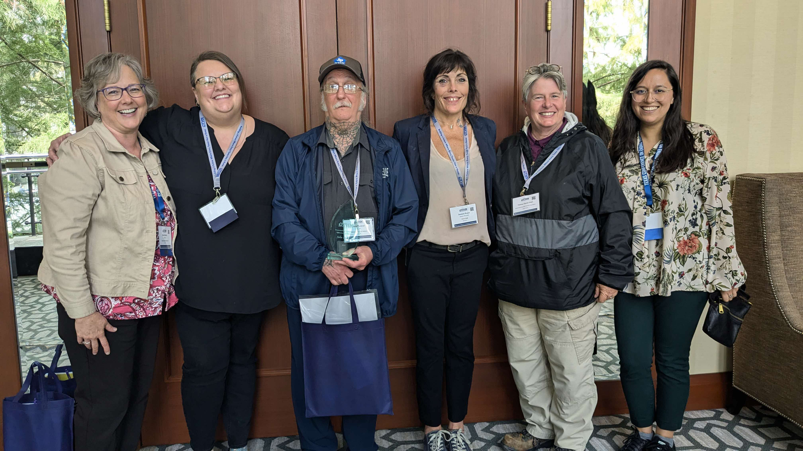
LEC Members and THN Staff
At the 2024 Texas Conference on Ending Homelessness

Slide 75
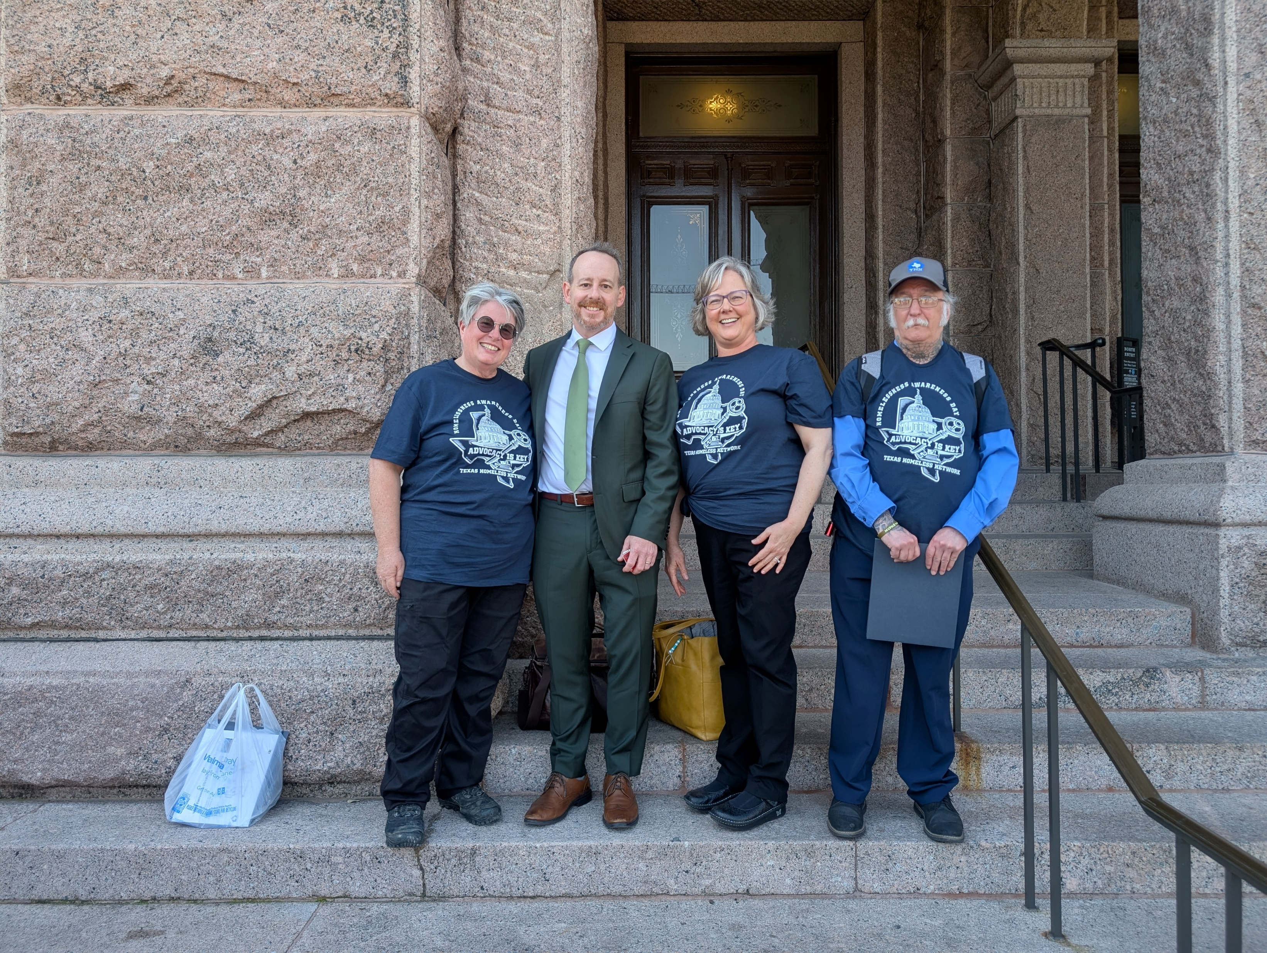
LEC Members and THN Staff
At the 2025 Homelessness Awareness Day (HAD)
at the Texas Capitol

Slide 76

LEC Members
At the 2025 Texas Conference on Ending Homelessness

Slide 77
2026-2027 Goals
Aug. 2022-July 2023
Aug. 2023-July 2024
Aug. 2024-July 2025
Aug. 2025-July 2026
Aug. 2026-July 2027
How can the LEC be most impactful for the CoC?

Slide 78
Thank you…
…for participating in the presentation

Slide 79
General Membership Input:
Open Feedback & Suggestions to the CoC
Hope Nordon, Senior Director of CoC Programs

Slide 80

SOAR: SSI/SSDI Outreach, Access, and Recovery
Dusty Wherrell, CoC Performance Manager

Slide 81
SOAR Updates
The National TA Center has been closed for over a year resulting in the free standardized training being lost
State Leads have been providing training for free, typically once a quarter
  Trained 133 individuals, 41 from the Tx BoS CoC
  IF you have been trained in the last year by someone other than the State Leads, please reach out so I can add you to the list of approved caseworkers for the state you will need to provide proof of the training
SSA offices have indicated that SOAR is deprioritized
  Texas Department of Disability Services is still prioritizing SOAR applications!!!
    If not on their list, applications will not be expedited and will be treated like non-SOAR assisted applications
There is an official outcome tracker that should be used
  https://forms.cloud.microsoft/r/DYmWbN1MNX

Slide 82
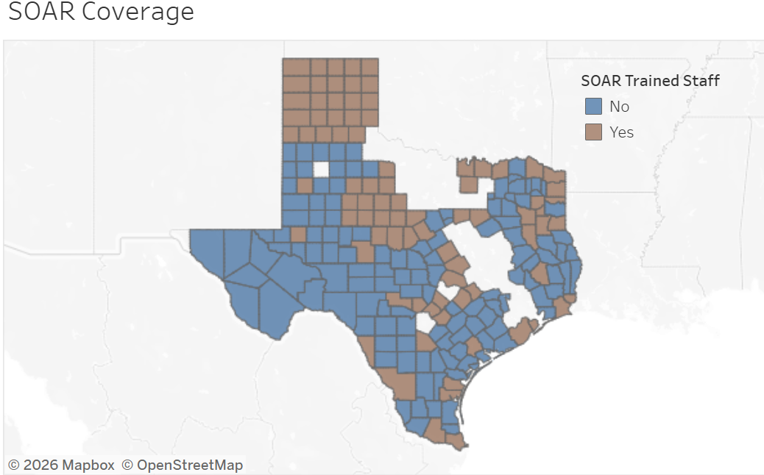

Slide 83
The Ask
Please reach out if
  you were SOAR trained in 2020 or later please reach out to me so I can add you to my list for DDS
  you are trained and are no longer providing SOAR
  Your contact information has changed since you have completed SOAR training
The hope is to create a functional system for providers to make soft referrals for SOAR services (will only provide agency level information)

Slide 84
Points of Contact
TX BoS Local Lead
  Dusty Wherrell – dusty@thn.org
State Leads
  La Shandraia Dwyer - lashandraiadwyer@austinecho.org
  Lyla Ordoñez - soaradvocacy@gmail.com
  Dusty Wherrell – dusty@thn.org

Slide 85
2027 Point-in-Time (PIT) Count
Ava Paredes,
Data and Engagement Coordinator

Slide 86
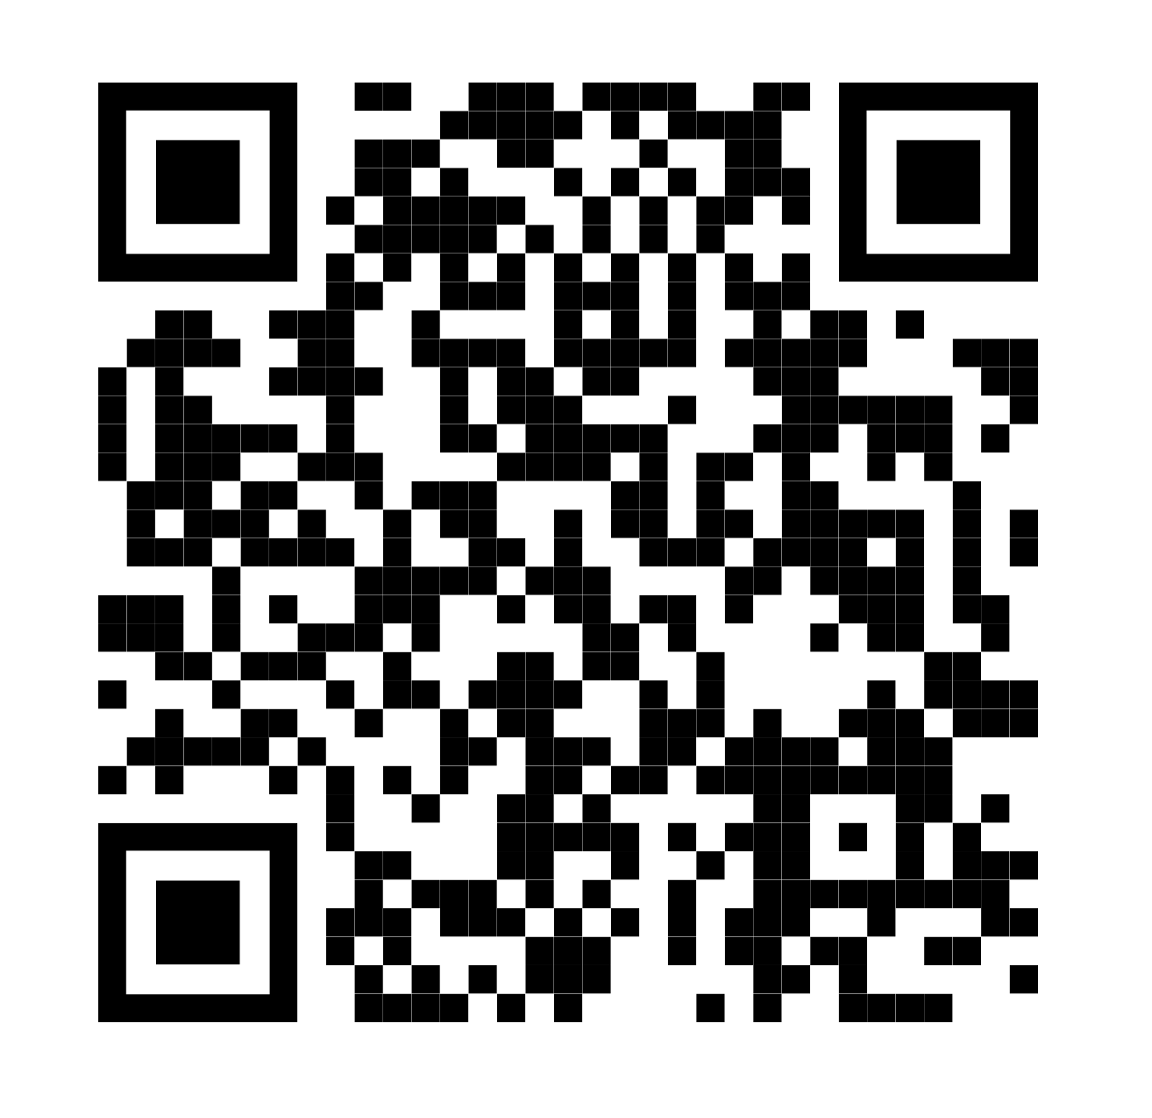
2027 Point-in-Time (PIT) Count
PIT Lead recruitment has begun
Contact Ava@thn.org if you want
to be a PIT Lead for your community
Vote on the PIT Count date for 2027
using the QR code

Slide 87

Youth Action Board (YAB) Recruitment
Marcel Rivers,
Planning and Engagement Coordinator

Slide 88
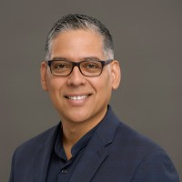
Closing Remarks
Victor Rivera,
CoC Board Vice Chair

Slide 89

Thank You!
Subscribe to the TX BoS CoC
newsletter at thn.org/stay-informed/
or use the QR code.

Slide 90
Tell us about yourself
Tell us your county, if you’ve experienced homelessness, and groups you belong to or represent
https://thn.wufoo.com/forms/wqabpg20h7ak3u/
Notes:
Before meeting

